Slide 1

Recurrent Neural Networks (RNN) for Modeling of Nonlinear Systems
Sebastian Hirt | 12.01.2023
Lehrstuhl für Regelungstechnik

Slide 2
Motivation
Just plot of timeseries
Image of systems, gears, pendulum?

Slide 3
Introduction

Slide 4
Introduction
ODEs describe nonlinear systems over time
Recurrent neural networks capable of nonlinearities and time series
Generation of training data
Hyperparameter search

Slide 5
Methods

Slide 6
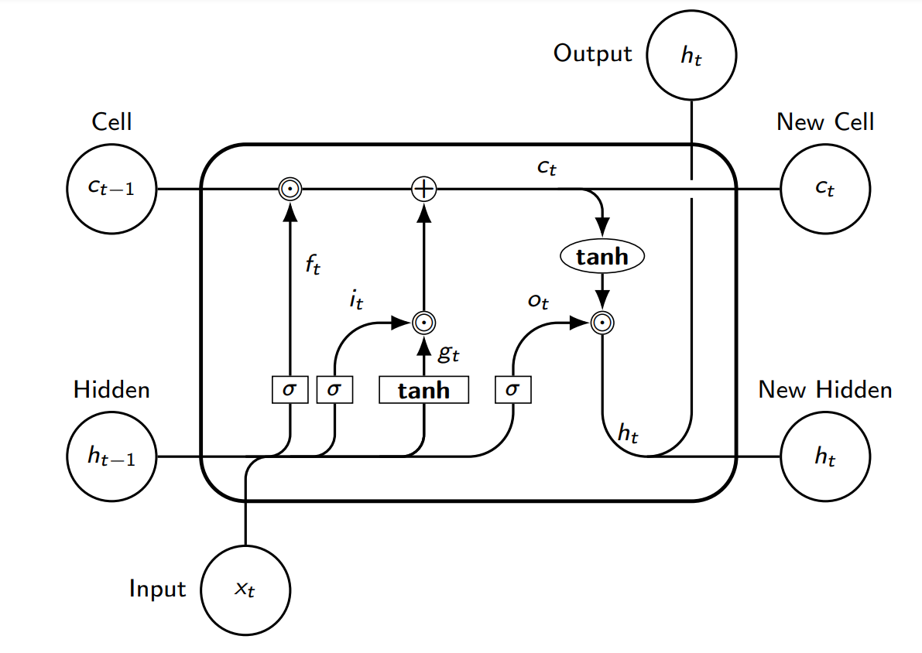
LSTM-Cell
Long-term dependency through cell state
Passing of new initial value to next timestep internally
Gates with trainable weights
Adapted from (Yu, Y., Si, X., Hu, C., & Zhang, J., 2019)

Slide 7
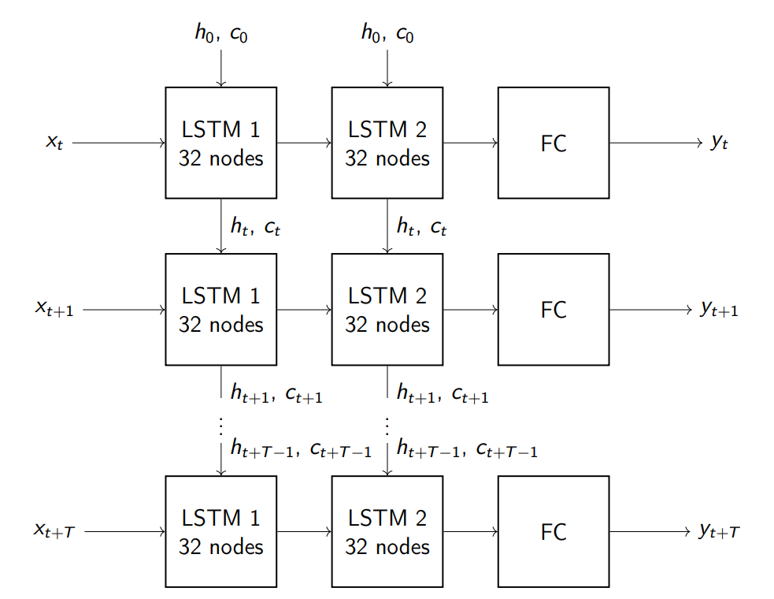
Model
Example of model with 32 nodes and 2 hidden layers
Transfer of states to next time steps
Same weights at all time steps of individual Cells
Ability to predict indefinite future states
Fixed number of timesteps for training

Slide 8
Optimization
Forward pass
MSE loss function
Backpropagation through time (Werbos, P., 1990)
Adam optimizer

Slide 9
Dataset creation

Slide 10
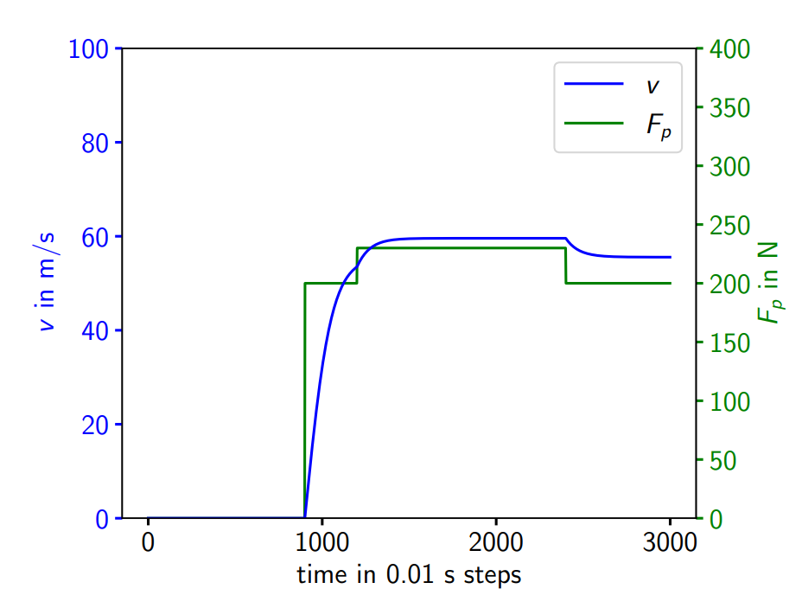
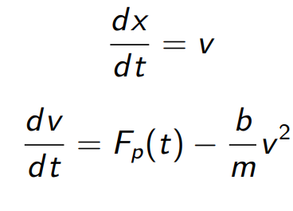
Drag-Complex Dataset
Pushing force on object
Drag on object

Slide 11
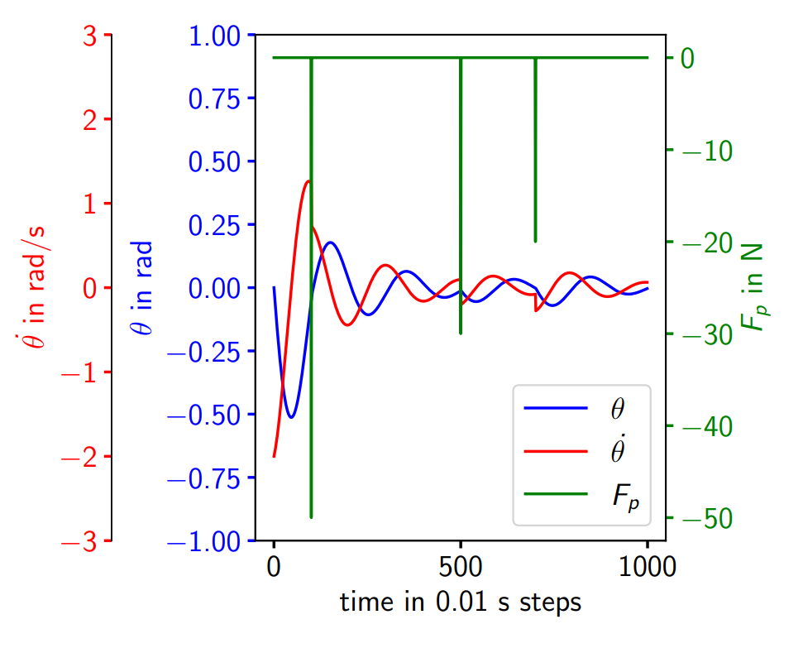
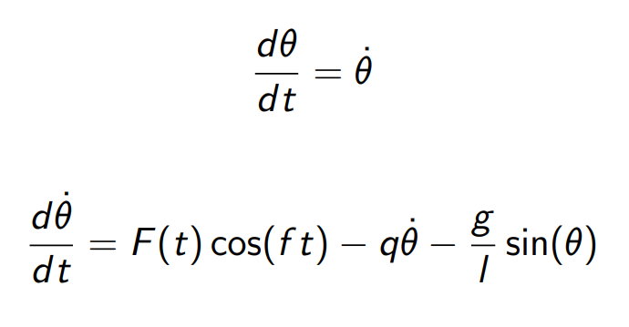
Pendulum-Complex Dataset
Pushing a pendulum
Friction due to air

Slide 12
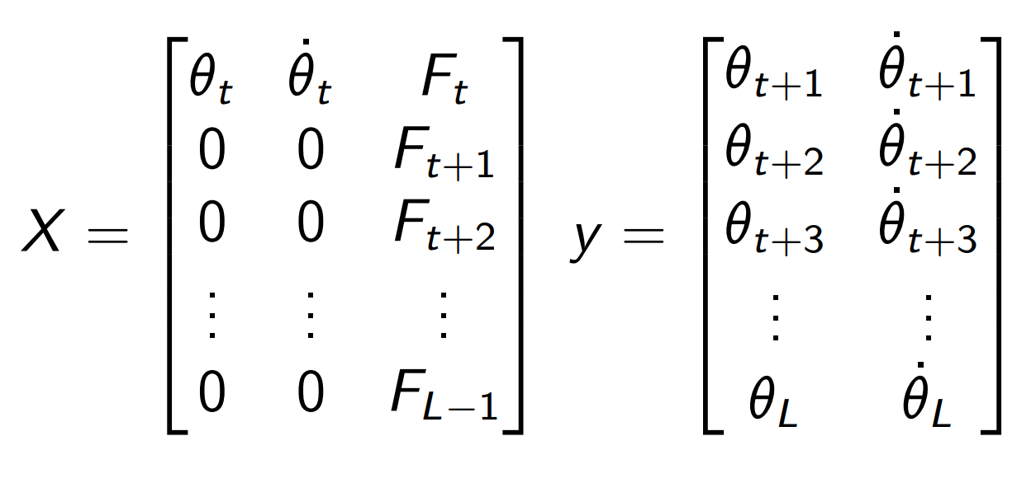
Preparation for Training
Split into training, validation and test set
Scaling with MinMaxScaler to [-1,1] to match LSTM output
Initial condition given at first timestep, after zero
Force input given at every time step

Slide 13
Hyperparameter search

Slide 14
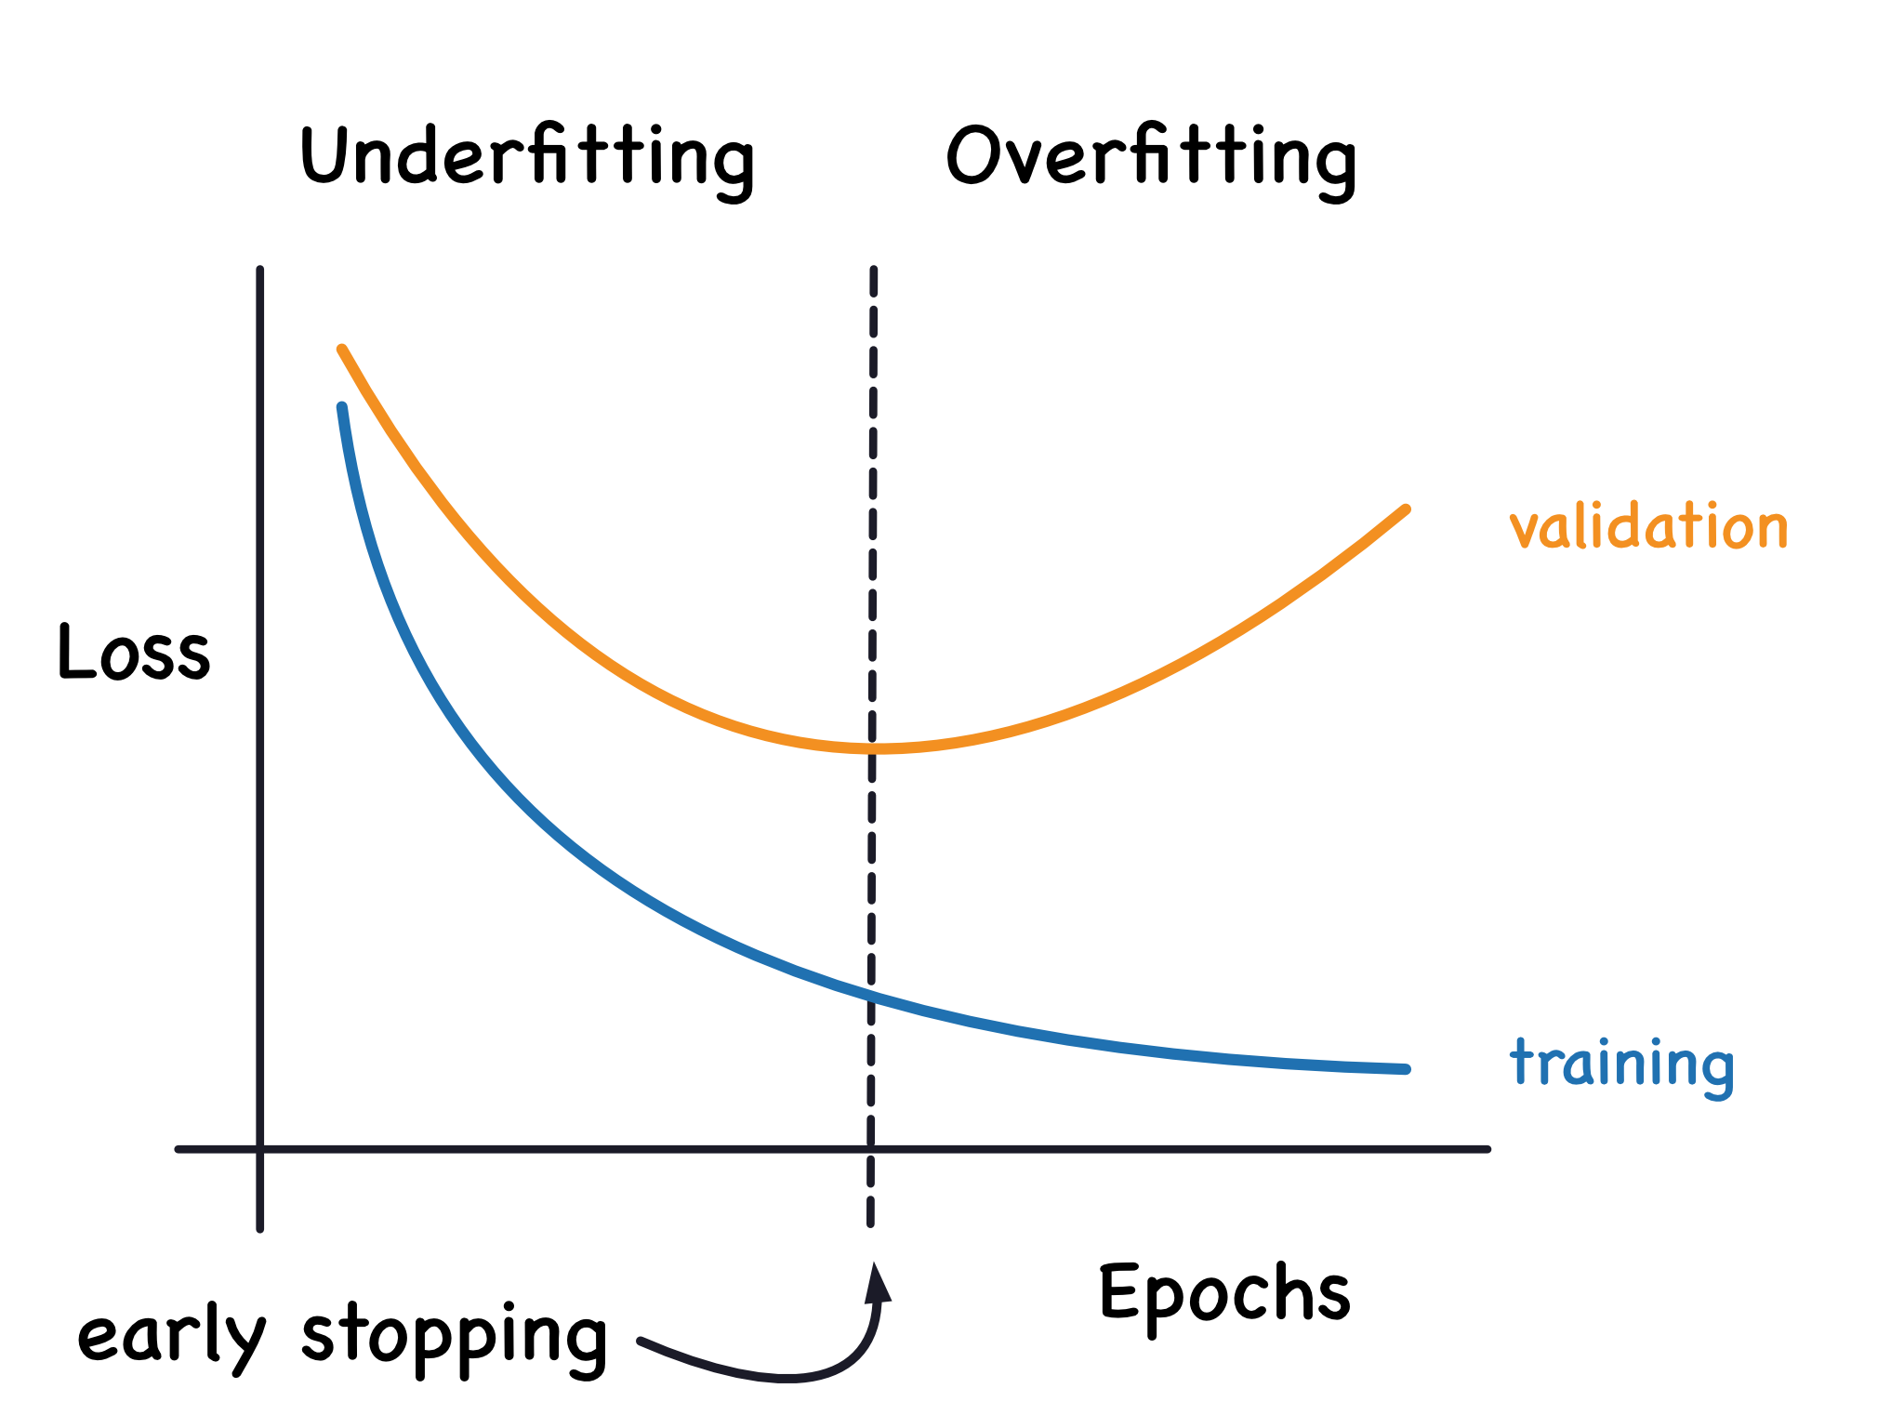
Manual search
Monitoring validation loss for early stopping
Check hyperparameters one by one
Take best parameter for next step
Order of searching:
Learning rate
Number of layers
Number of nodes in each layer
Training for 500 epochs, then 5000 with best model

Slide 15
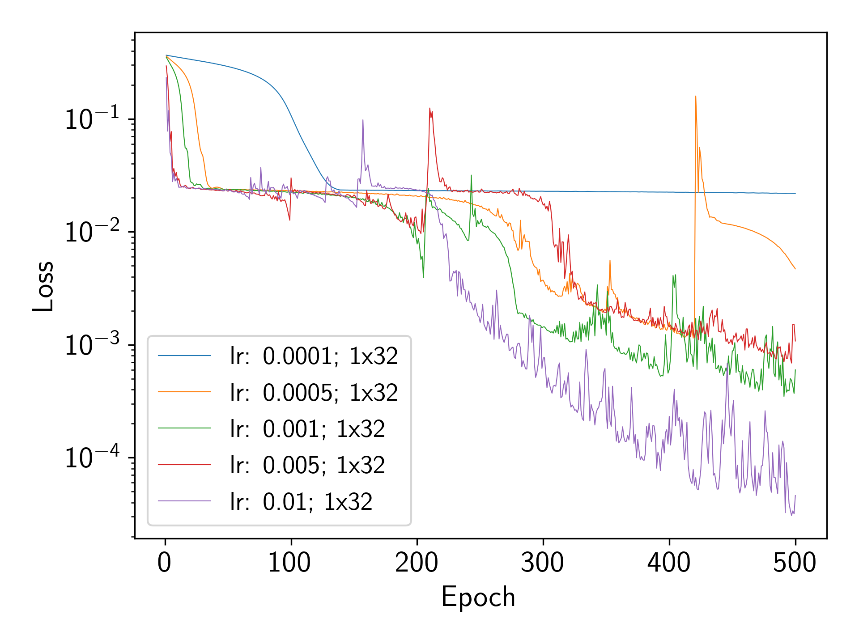
Hyperparameter search - Learning rate
Better performance with higher learning rate

Slide 16
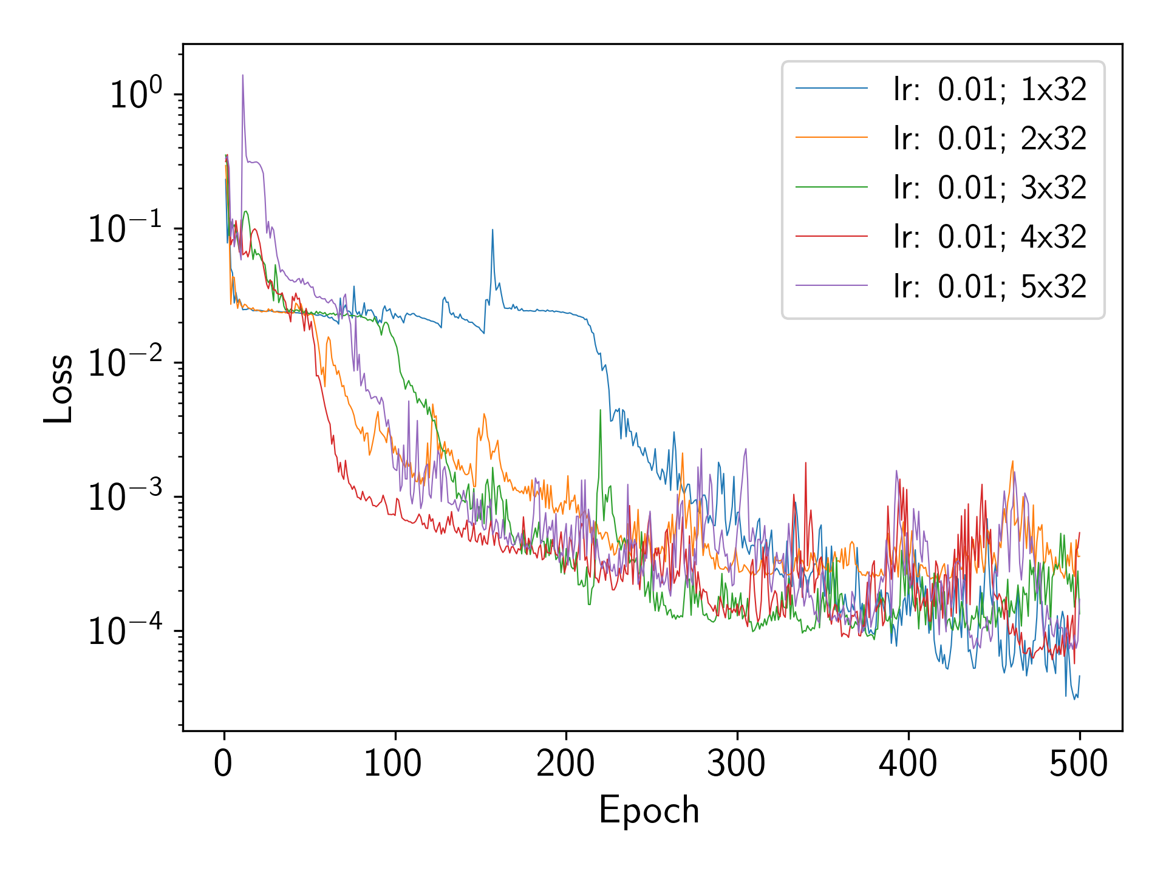
Hyperparameter search - Layers
Better performance with less layers
No clear winner

Slide 17
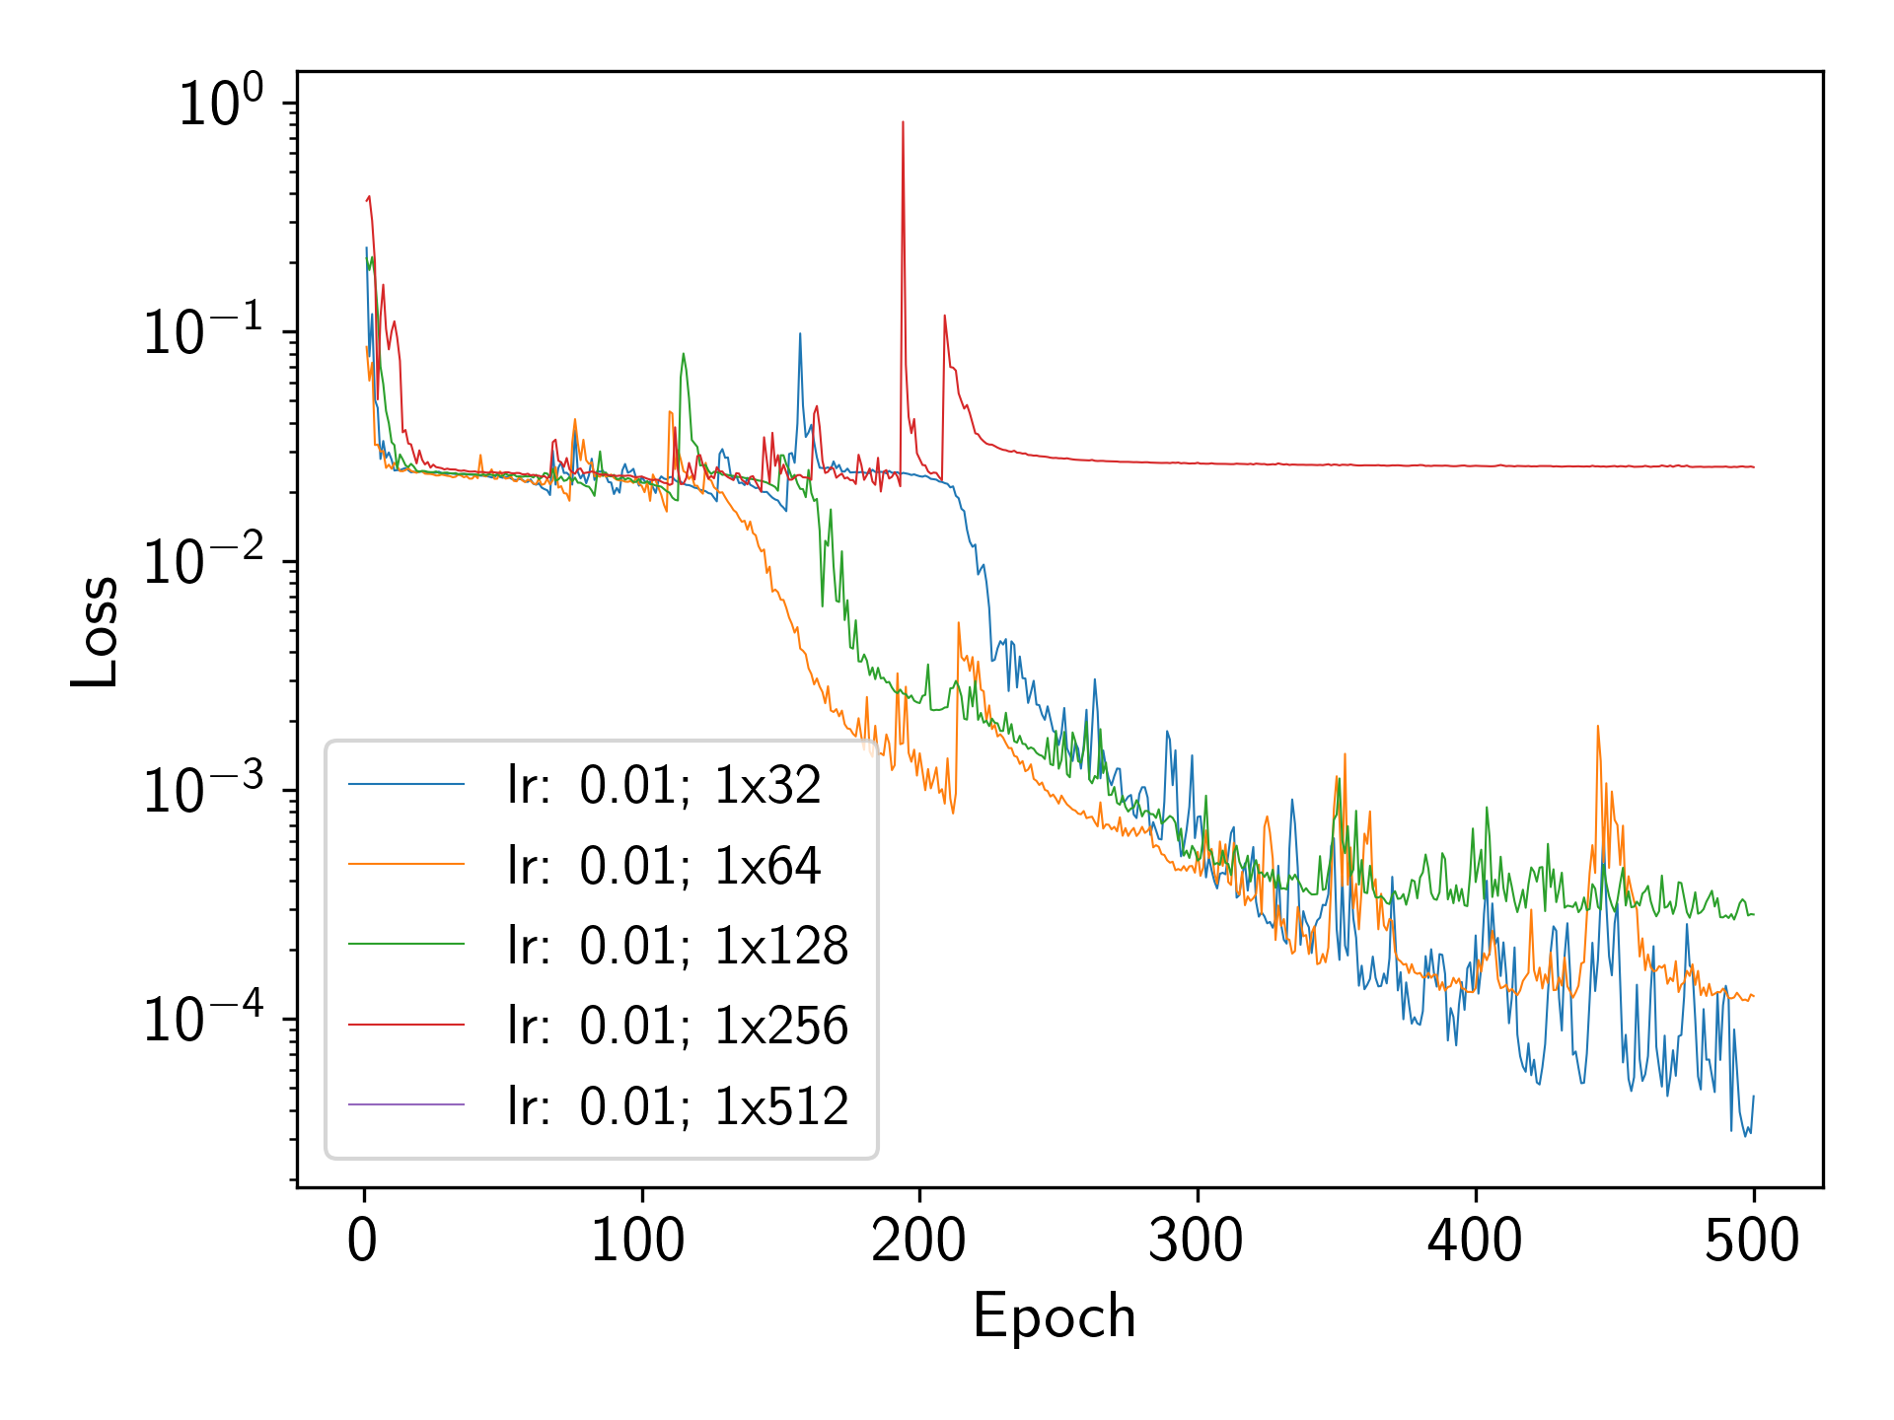
Hyperparameter search - Nodes
Better performance with less nodes
Smaller models train more stable

Slide 18
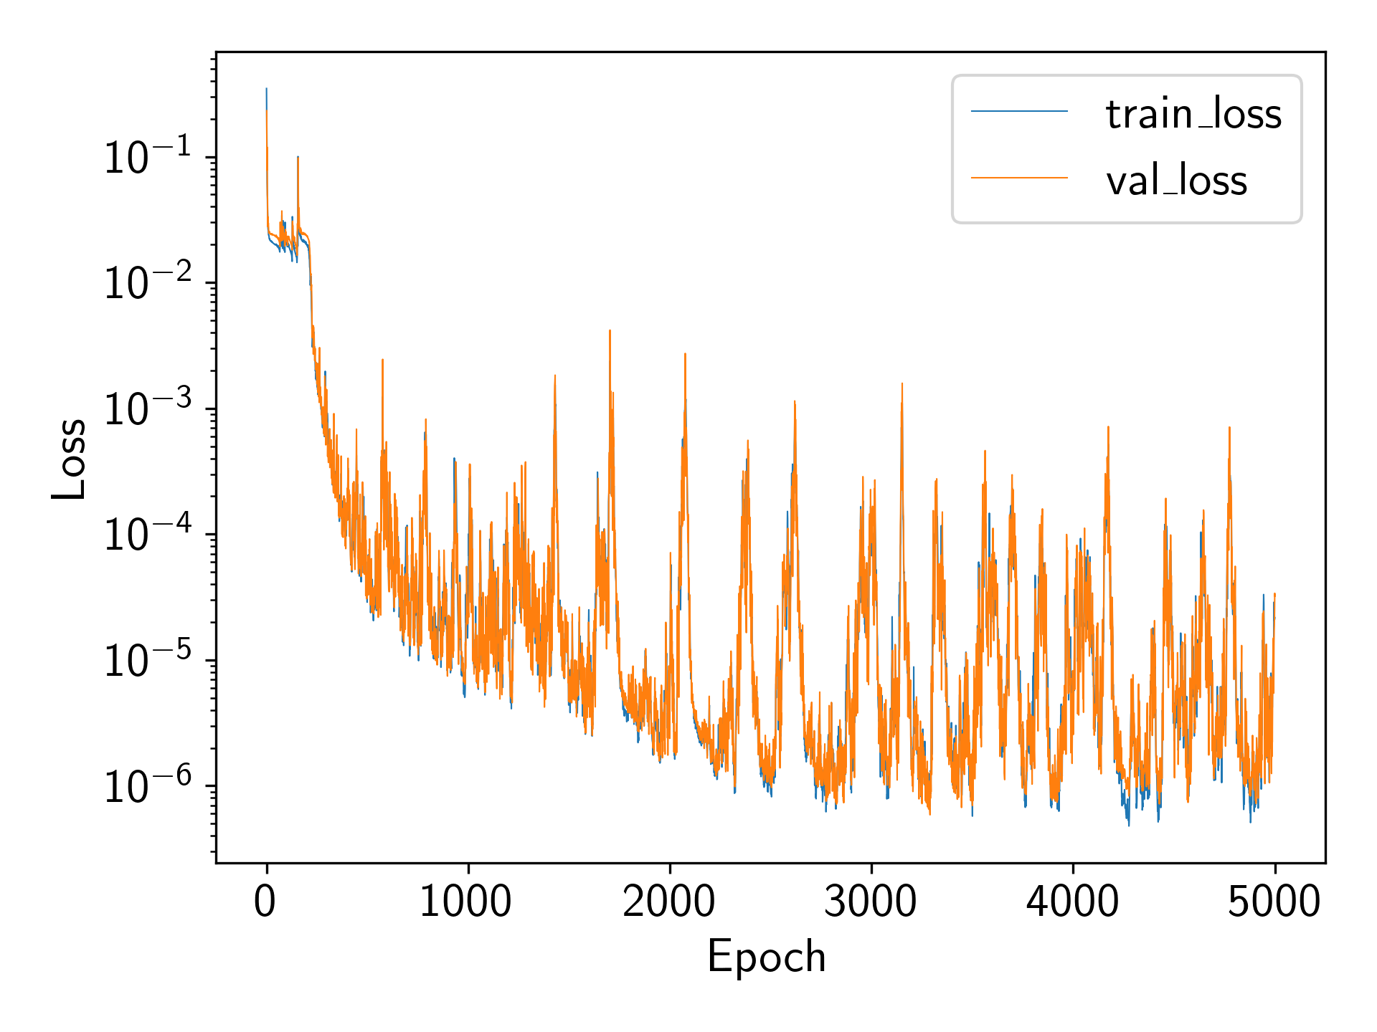
Early Stopping
Early stopping to save best model

Slide 19
Evaluation and Conclusion

Slide 20
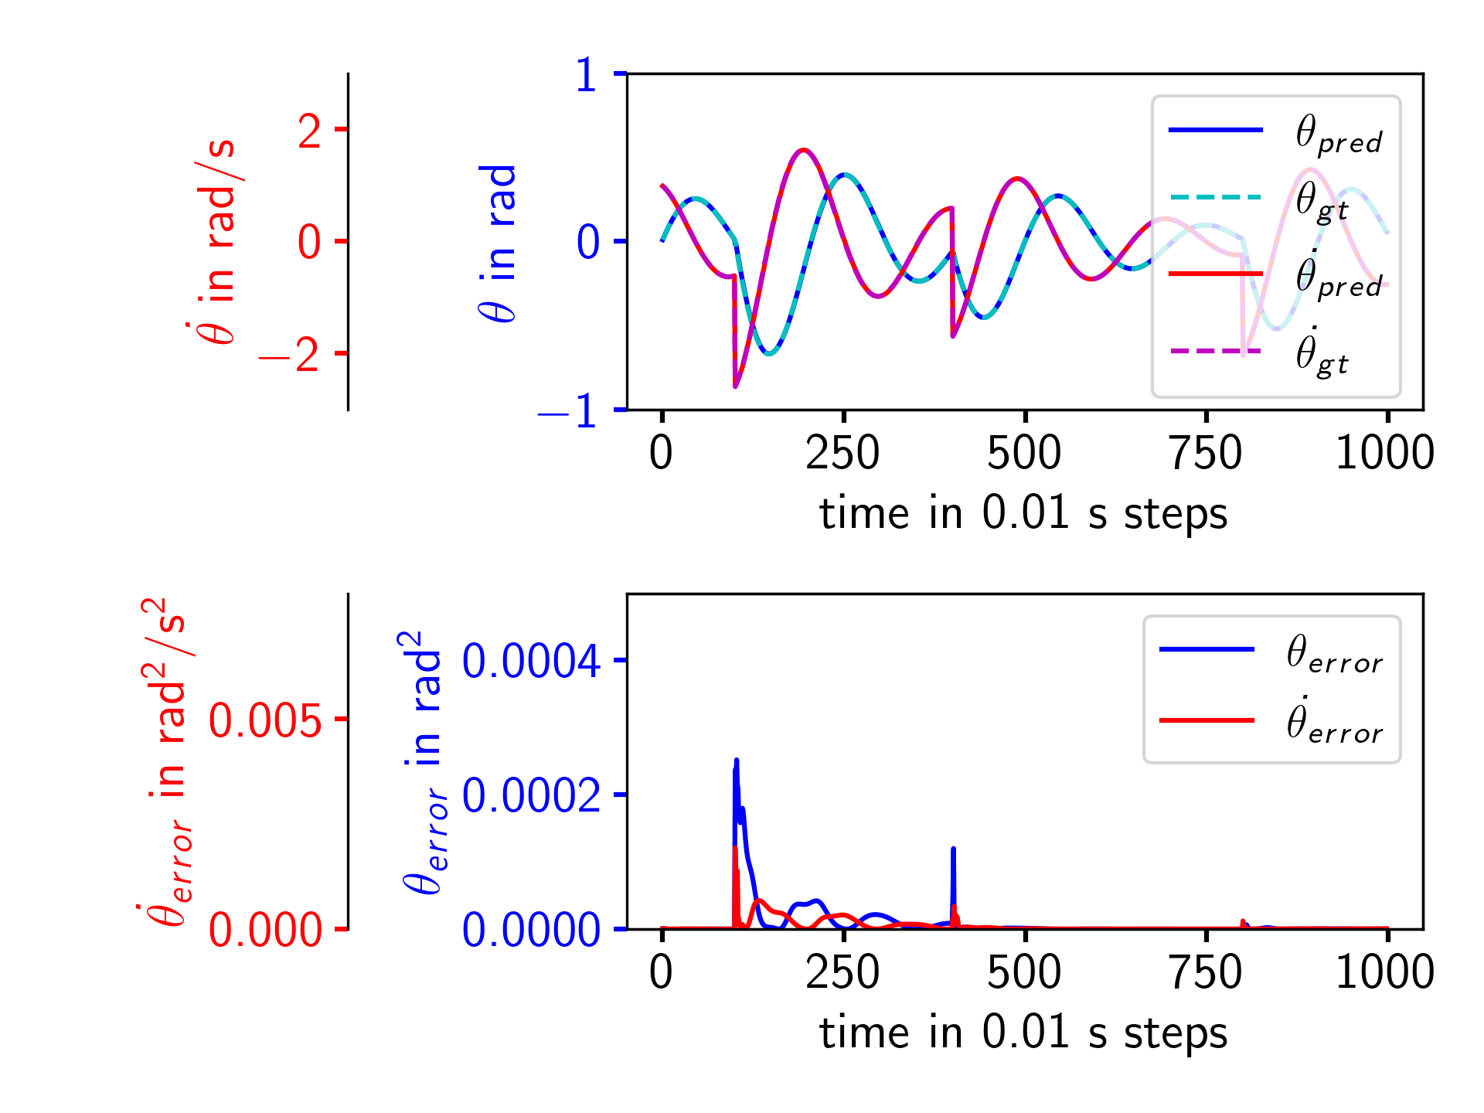
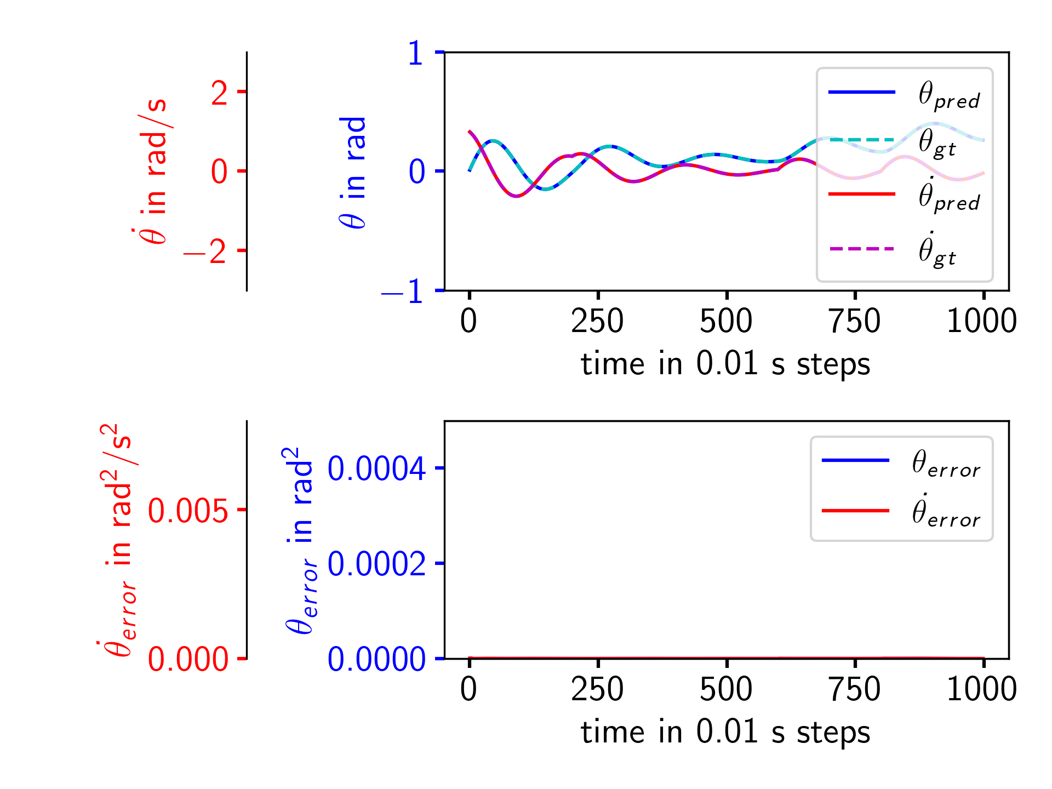
Pendulum Evaluation
Overall low error
Small error spikes on input change

Slide 21
Conclusion and Future Work
Difficulties in training for larger model
Clear ability to predict nonlinear system
Error spikes on input change
Recommendation:
Use 2 LSTM layers with 32/64 nodes and learning rate of 0.01 for similar systems
New hyperparameter search for different systems
Analysis on what and how much training data is necessary to achieve good results
Testing for more complex ODEs
Deeper look into training instabilities necessary for larger models
Notes:
Create better dataset to test specific situations

Slide 22
Thank You!

Slide 23
References
Yu, Y., Si, X., Hu, C., & Zhang, J. (2019). A review of recurrent neural networks: LSTM cells and network architectures. Neural Computation, 31(7), 1235–1270.
Werbos, P. (1990). Backpropagation through time: what it does and how to do it. Proceedings of the IEEE, 78(10), 1550–1560.

Slide 24

Problem description
Pushing force:
$F_{p}= ma$
Air resistance (Drag):
$F_{d}=\frac{1}{2}ρv^{2}C_{D}A$
Simplification:
$b=\frac{1}{2}ρC_{D}A$
Resulting force:
$F=F_{p}−F_{d}$

Slide 25

Problem description
Resulting force:
$F=F_{p}−F_{d}$
Express as second order differential equation:
$m\frac{d^{2}x}{dt^{2}}=F_{p}−b\frac{dx}{dt}$
Transform into system of two first order equations:
$\frac{dx}{dt}=v$
$\frac{dv}{dt}=\frac{F_{p}−bv^{2}}{m}$
→ use in odeint python function to get values of velocity and/or position

