Slide 1

Modeling of nonlinear systems with LSTMs
Sebastian Hirt | 20.10.2022
Lehrstuhl für Regelungstechnik

Slide 2
Problem description

Slide 3

Problem description
Pushing force:
$F_{p}= ma$
Air resistance (Drag):
$F_{d}=\frac{1}{2}ρv^{2}C_{D}A$
Simplification:
$b=\frac{1}{2}ρC_{D}A$
Resulting force:
$F=F_{p}−F_{d}$

Slide 4

Problem description
Resulting force:
$F=F_{p}−F_{d}$
Express as second order differential equation:
$m\frac{d^{2}x}{dt^{2}}=F_{p}−b\frac{dx}{dt}$
Transform into system of two first order equations:
$\frac{dx}{dt}=v$
$\frac{dv}{dt}=\frac{F_{p}−bv^{2}}{m}$
→ use in odeint python function to get values of velocity and/or position

Slide 5
Visualization

Slide 6
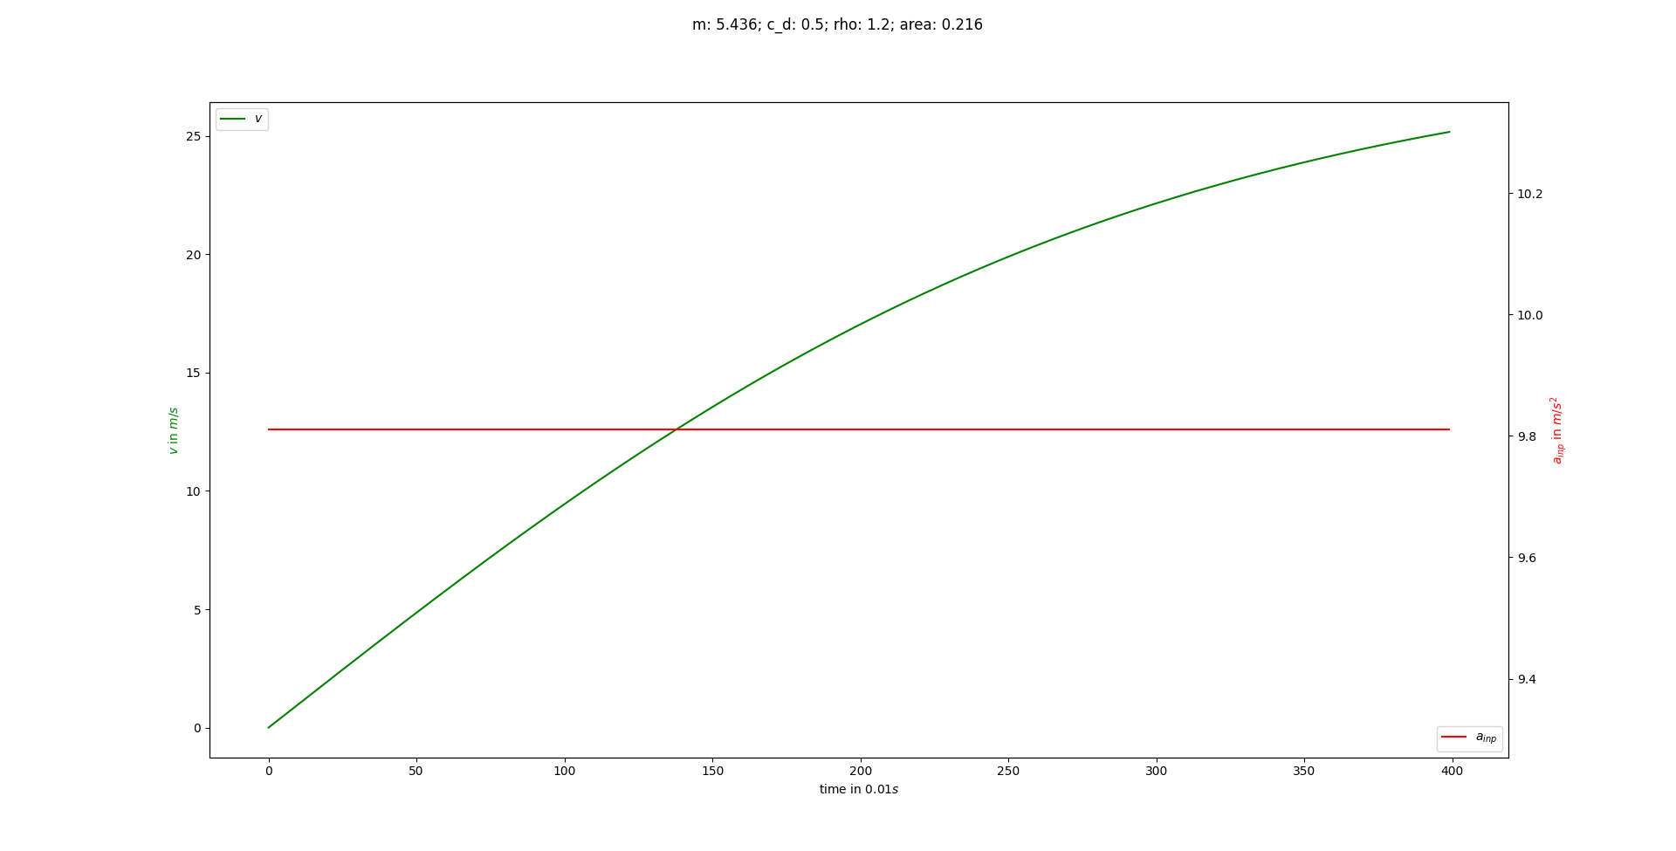
Visualization

Slide 7
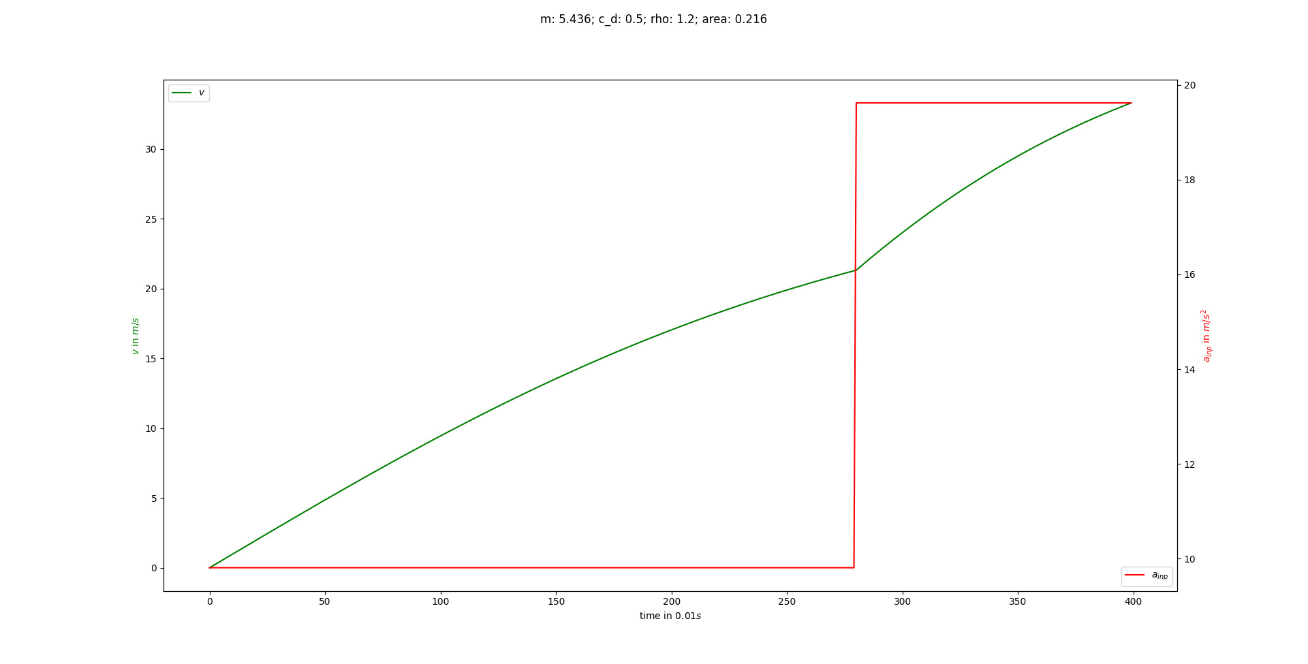
Visualization

Slide 8
Prediction on Trainingset

Slide 9
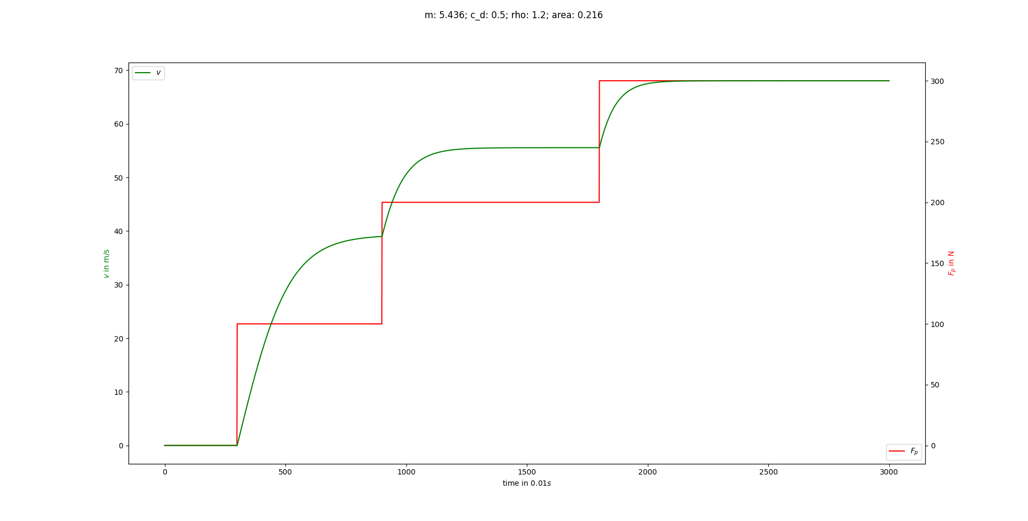
Prediction on Trainingset
Setup:
1 Sample with 3 “Force steps”; So, Training, Validation and Test sets are the same in this case.
Try to make sure that is at least capable of learning the nonlinearities.
No normalization, yet.

Slide 10
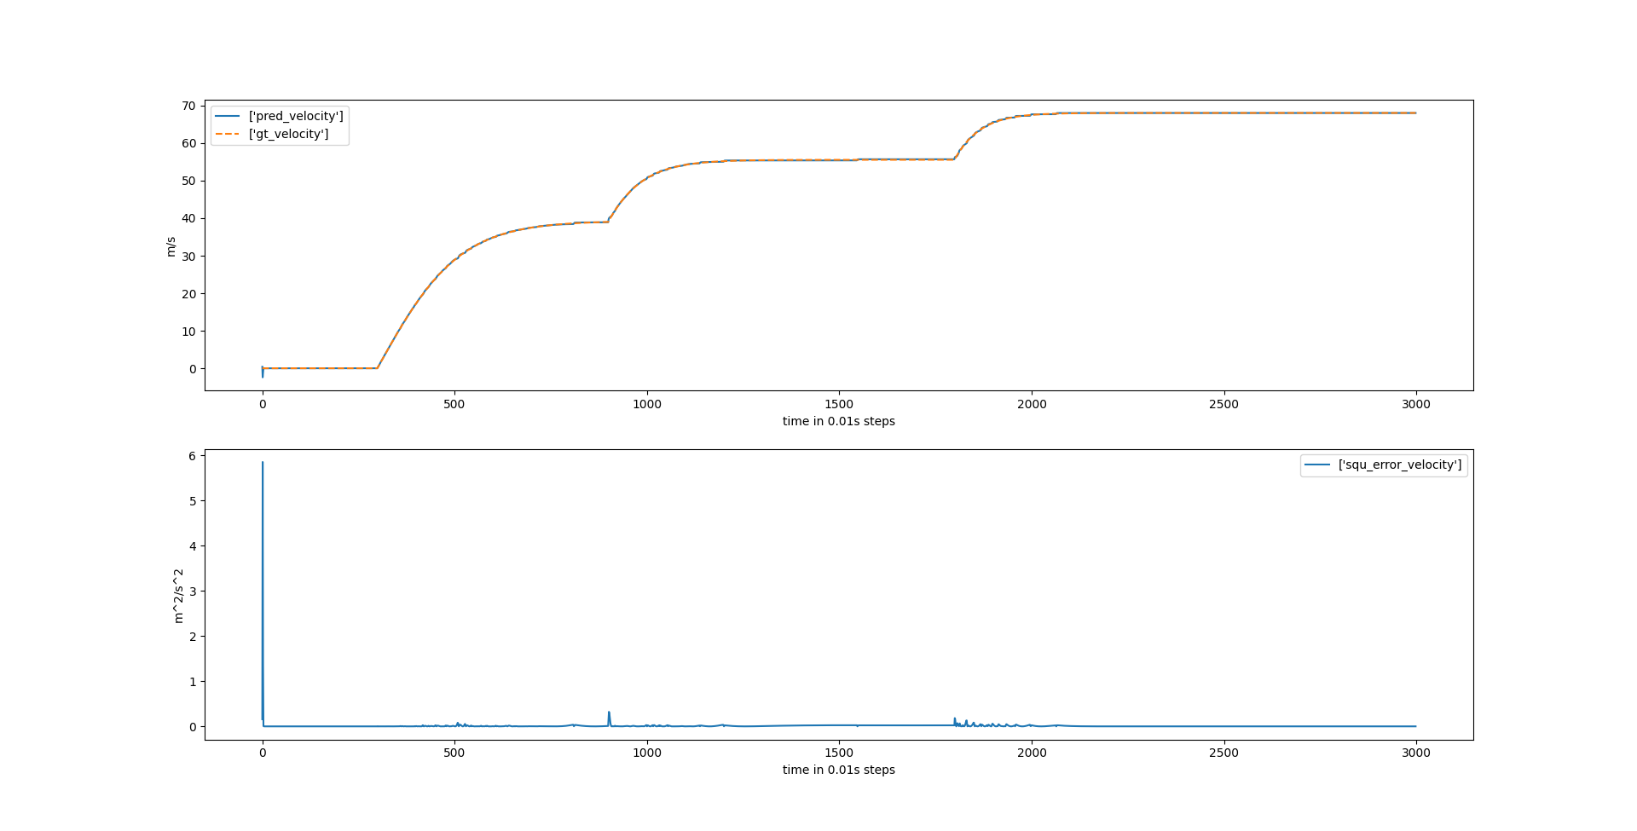
Prediction on Trainingset
It learns. The prediction (pred) lies on the ground truth (gt) almost the entire time

Slide 11
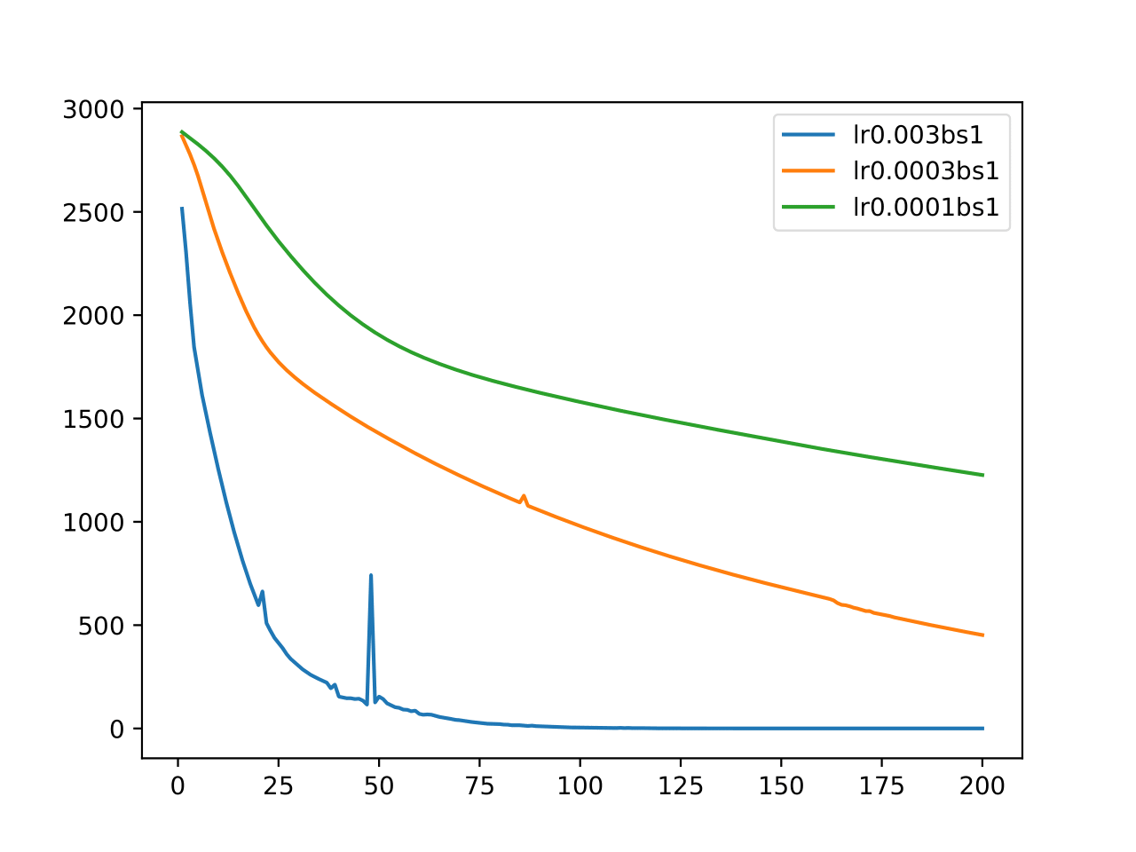
Error?
Why is there still a large error around the start of the sequence?
Maybe because it is difficult to learn that the starting condition is given at the first timestep, but not at the later ones. Shouldn’t be the issue in this case, as that input is 0 for the first 300 timesteps, so not different for the first.
Or longer training necessary; lower learning rates have not converged yet and might find lower minimum (could try reducing learning rate after certain number of epochs as well)

Slide 12
ToDo

Slide 13
ToDo
Normalize! Probably doesn’t hurt.
Evaluate on new data!
Need more similar data samples, variety of steps.
Train again on now multiple different training samples
Evaluate on the training data again, to make sure it can learn one sample of the multiple training samples well.
Then evaluate on new data!

Slide 14
Pendulum
First Pendulum
Evaluate on new data!
Need more similar data samples, variety of steps. → Different starting conditions between -2 and 2, 100 different series
Normalization not necessary, variables have similar ranges
Train again on now multiple different training samples
Evaluate on the training data again, to make sure it can learn one sample of the multiple training samples well.
Then evaluate on new data!

Slide 15
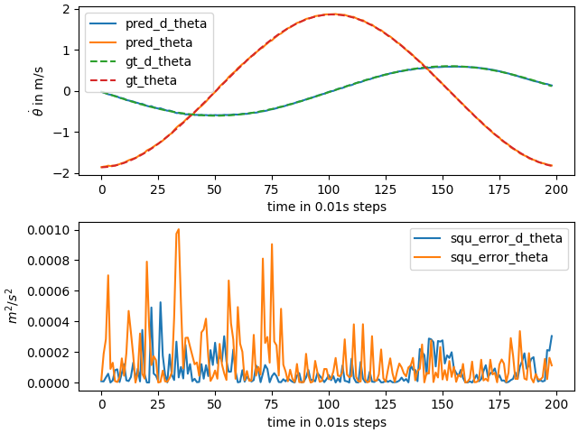
Pendulum – Multiple Samples
Prediction on Trainingset

Slide 16
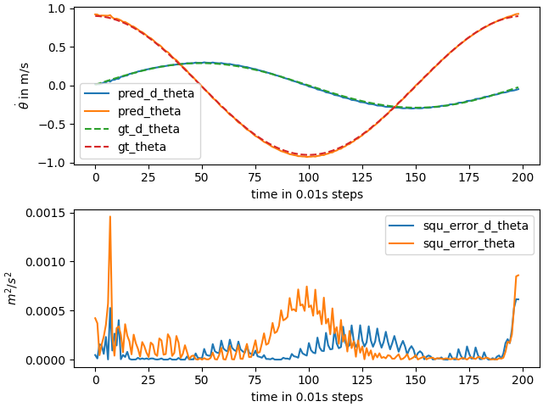
Pendulum – Multiple Samples
Prediction on Validation Set

Slide 17
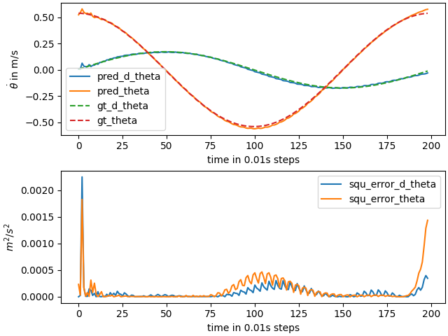
Pendulum – Multiple Samples
Prediction on Test Set

Slide 18
ToDo - Drag

Slide 19
Drag
Drag
Evaluate on new data!
Need more similar data samples, variety of steps. → Different step heights, 20 variations (12 train, 4 val, 4 test)
Normalization to values between 0 and 1 (Min-Max)
Train again on now multiple different training samples
Evaluate on the training data again, to make sure it can learn one sample of the multiple training samples well.
Then evaluate on new data!

Slide 20
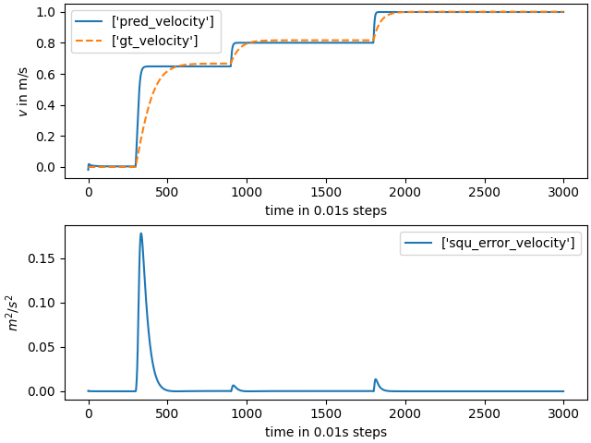
Drag norm – Multiple Samples
Prediction on Trainingset

Slide 21
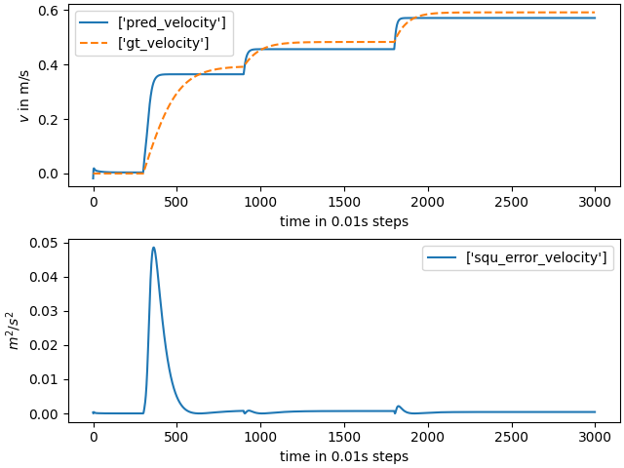
Drag norm – Multiple Samples
Prediction on Validation Set

Slide 22
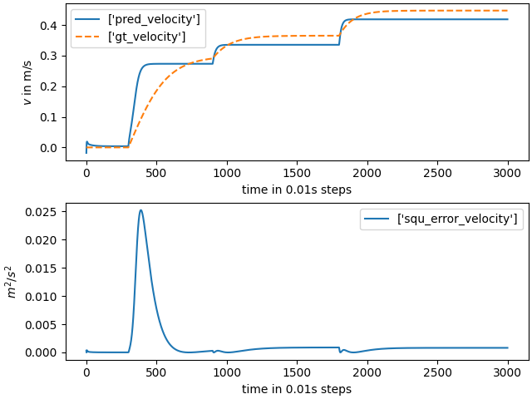
Drag norm – Multiple Samples
Prediction on Test Set

Slide 23
Drag without Normalization

Slide 24
Drag
Drag
Evaluate on new data!
Need more similar data samples, variety of steps. → Different step heights, 20 variations (12 train, 4 val, 4 test)
No Normalization to values between 0 and 1 (Min-Max)
Train again on now multiple different training samples
Evaluate on the training data again, to make sure it can learn one sample of the multiple training samples well.
Then evaluate on new data!

Slide 25
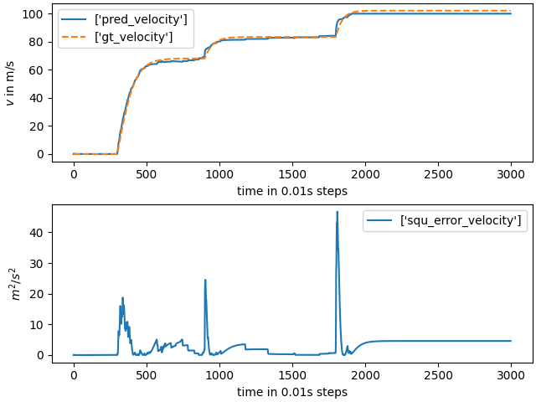
Drag no norm – Multiple Samples
Prediction on Trainingset

Slide 26
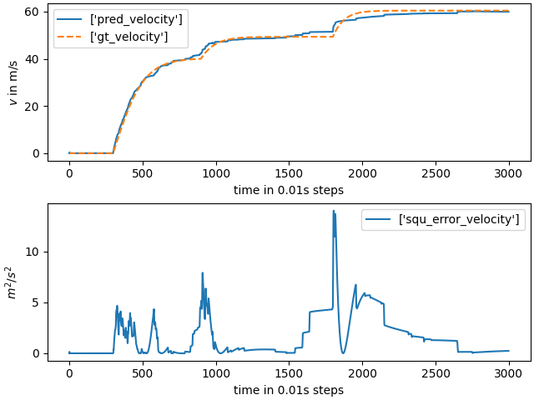
Drag no norm – Multiple Samples
Prediction on Validation Set

Slide 27
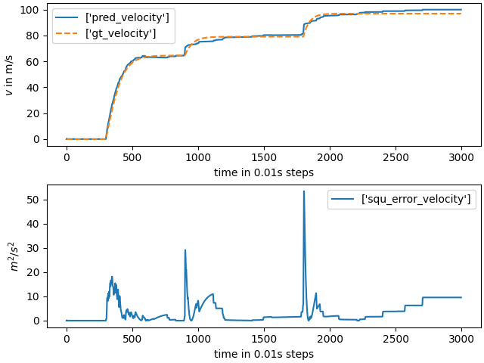
Drag no norm – Multiple Samples
Prediction on Test Set

Slide 28
Eval
Seems like normalization doesn’t really help
Normalization might only help if there are multiple outputs with different ranges of values
The loss is then just larger for the variables with a higher value
Leads to prioritization of what output to improve
Not the case here, only one output
But need to unnormalize results and compare then with objective metric (mean squared error)

Slide 29
ToDo
ToDo
Finalize plot labels
Unnormalize normalized results, calculate loss on sets then, compare to unnormalized training
Test model sizes (more/less layers, more/less LSTM cells in each layer) and make table comparison
Issues
Need to decide what I want to test
Many Hyperparameters, can’t test everything
Define few configurations
Make hypotheses how they will perform
Compare them in table

Slide 30
Vielen Dank
für Ihre Aufmerksamkeit!

