Slide 1

Recurrent Neural Networks (RNN) for Modeling of Nonlinear Systems
Sebastian Hirt | 12.01.2023
Lehrstuhl für Regelungstechnik

Slide 2
Motivation
Just plot of timeseries
Image of systems, gears, pendulum?

Slide 3
Introduction

Slide 4
Introduction
ODEs describe nonlinear systems over time
Recurrent neural networks capable of nonlinearities and time series
Generation of training data
Hyperparameter search

Slide 5
Methods

Slide 6
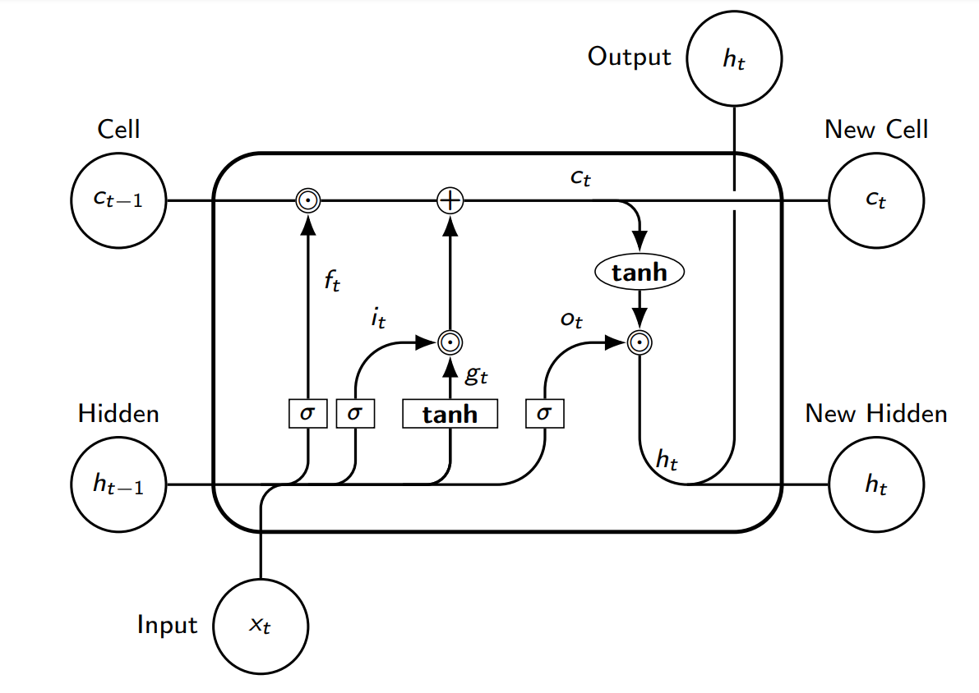
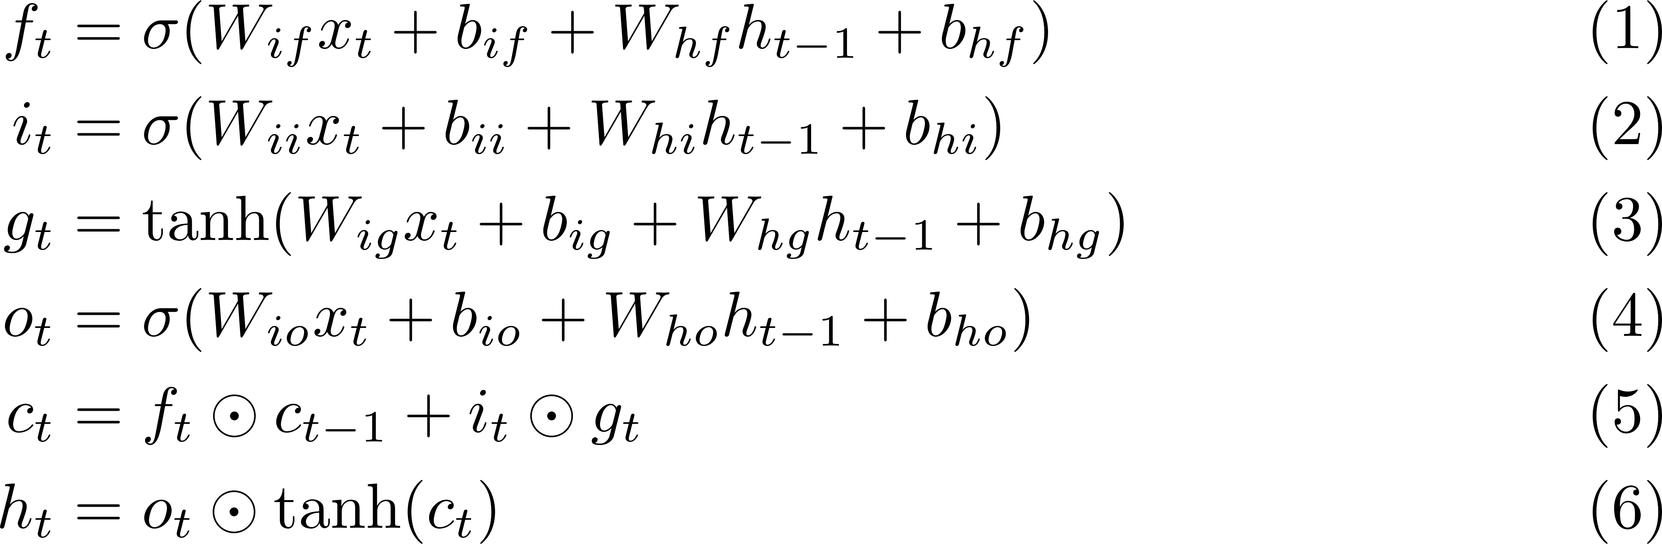
LSTM
Adapted from (Yu, Y., Si, X., Hu, C., & Zhang, J., 2019)

Slide 7
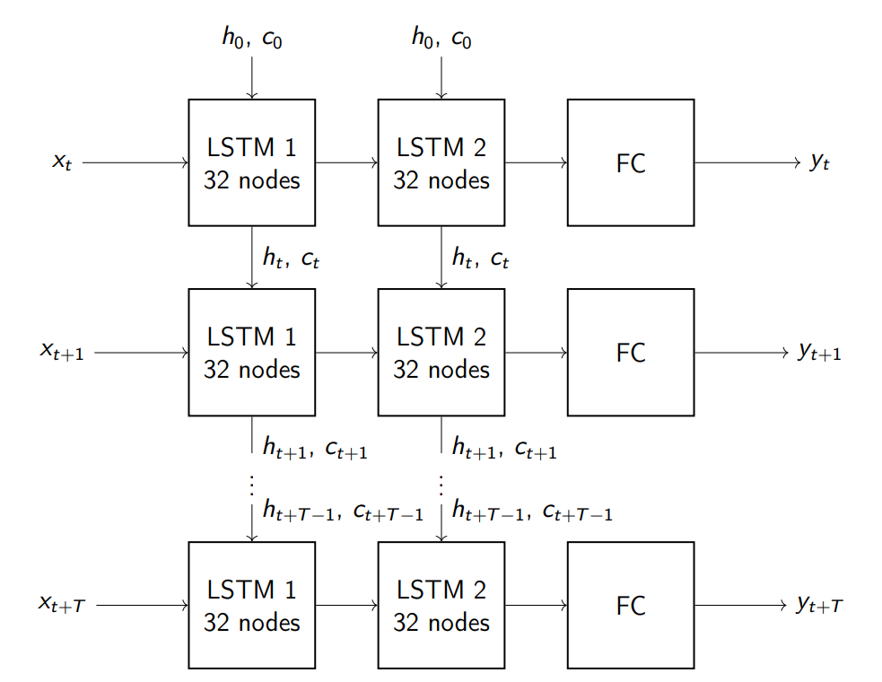
Architecture
Example of model with 32 nodes and 2 hidden layers
States are carried to next time steps
Weights are the same at all time steps
Ability to predict indefinite future states
Fixed number of timesteps for training

Slide 8
Optimization
Forward pass
MSE loss function
Backpropagation through time (Werbos, P., 1990)
Adam optimizer

Slide 9
Dataset creation

Slide 10
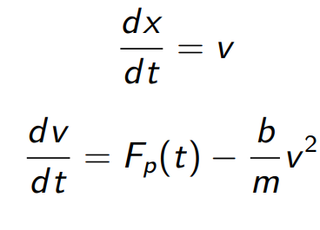
Problem description
Pushing force on object
Drag on object

Slide 11
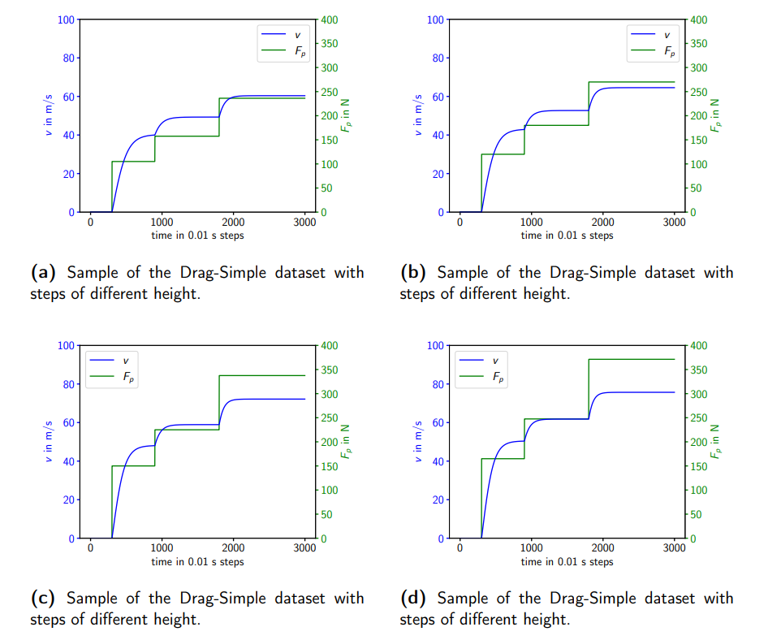
Drag simple

Slide 12
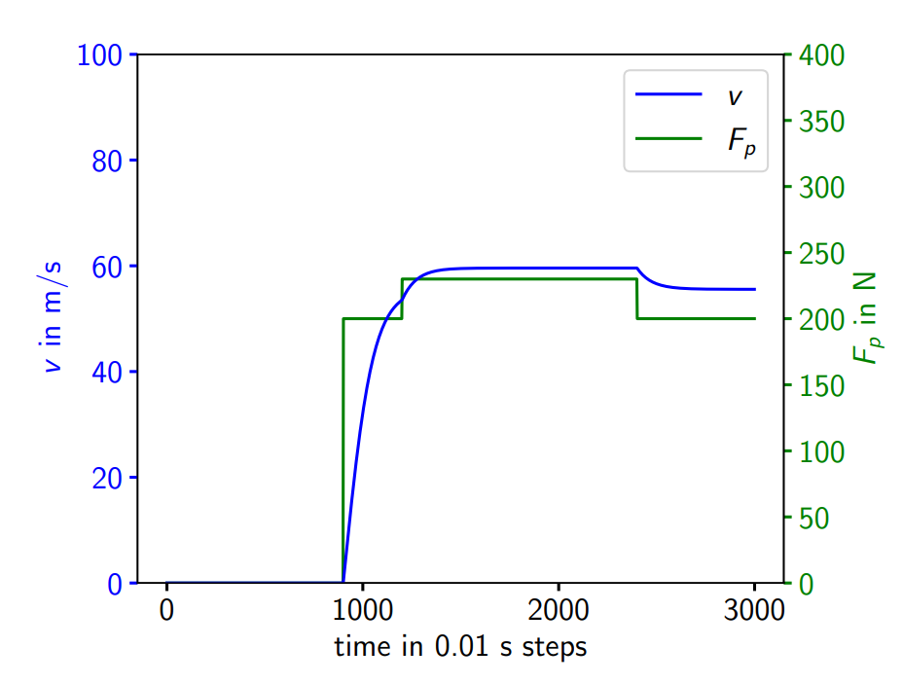
Drag complex

Slide 13
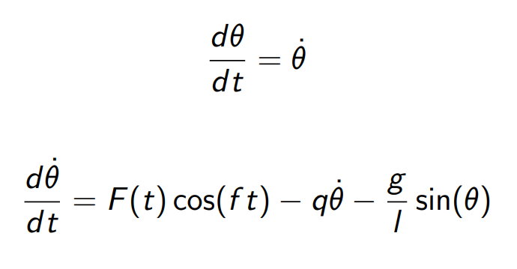
Problem description
Pushing a pendulum
Friction due to air

Slide 14
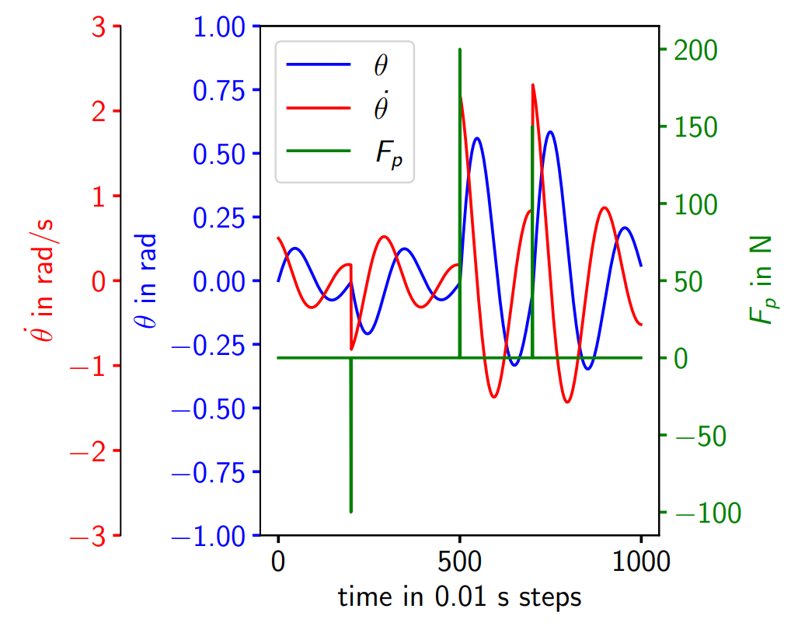
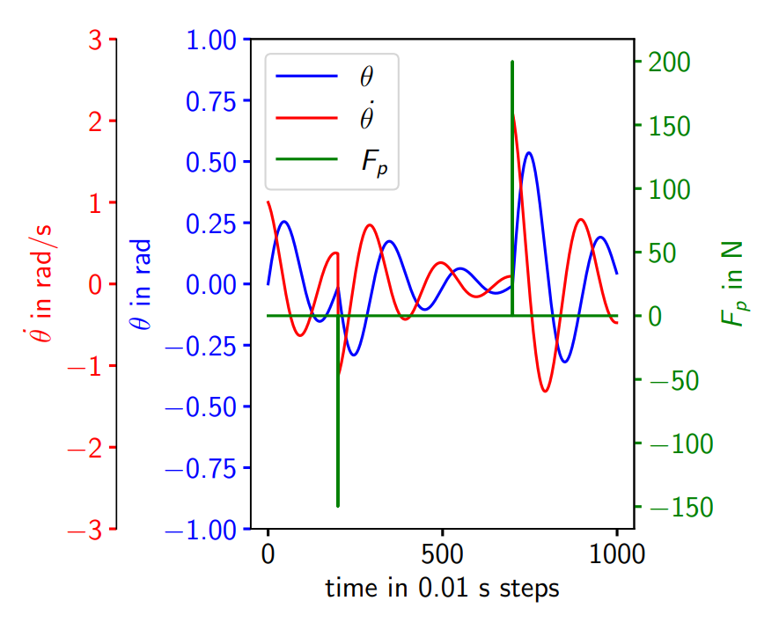
Pendulum simple

Slide 15
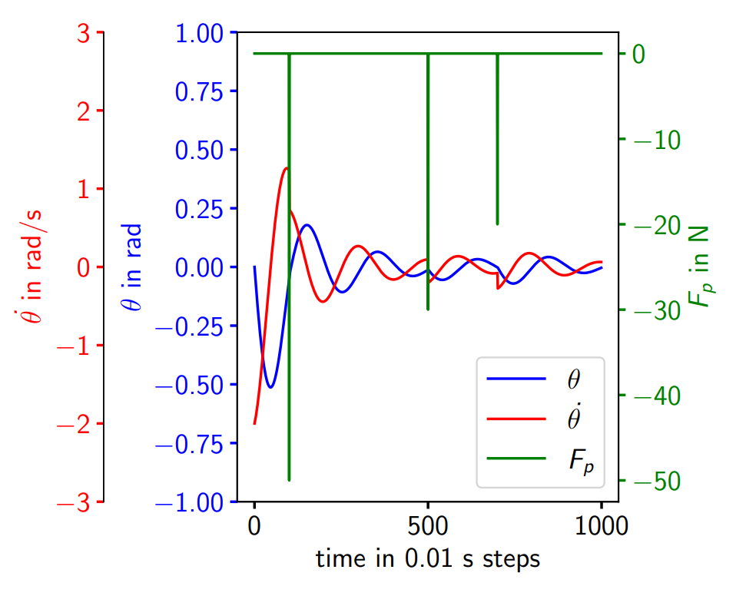
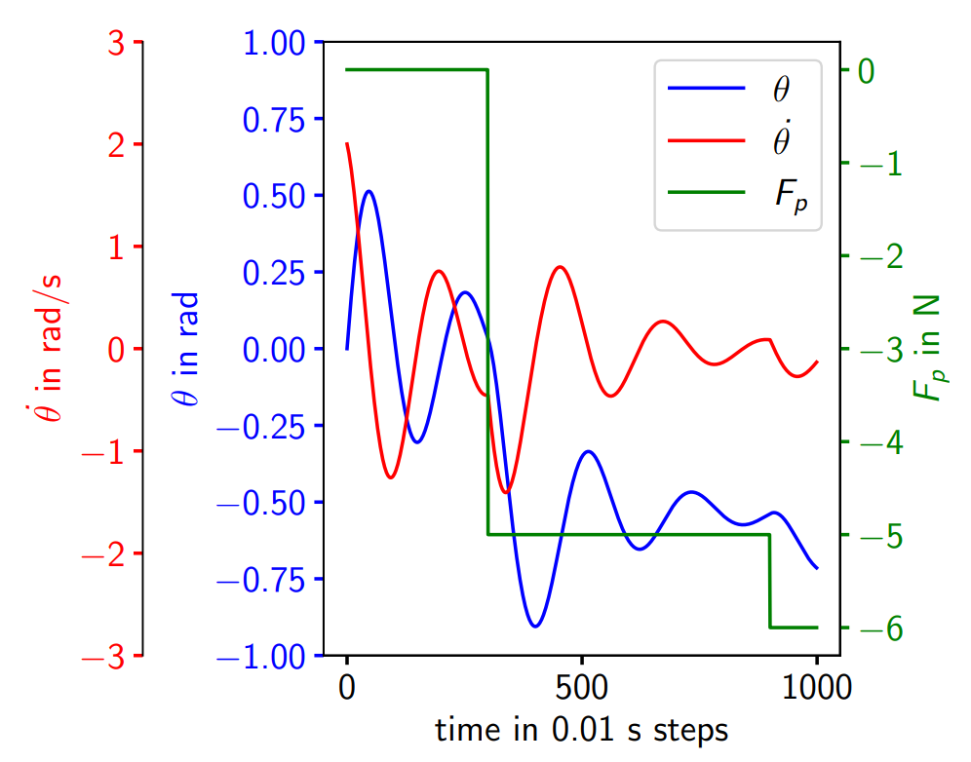
Pendulum complex

Slide 16
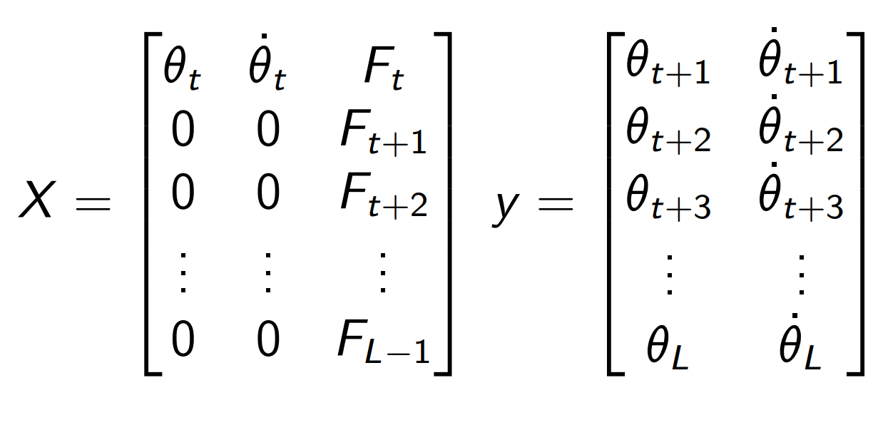
Preparation for Training
Split into training, validation and test set
Scaling with MinMaxScaler to [-1,1] to match LSTM output
Initial condition given at first timestep, after zero
Force input given at every time step

Slide 17
Hyperparameter search

Slide 18
Manual search
Monitoring validation loss for early stopping
Check hyperparameters one by one
Take best parameter for next step
Order of searching:
Learning rate
Number of layers
Number of nodes in each layer
Training for 500 epochs, then 5000 with best model

Slide 19
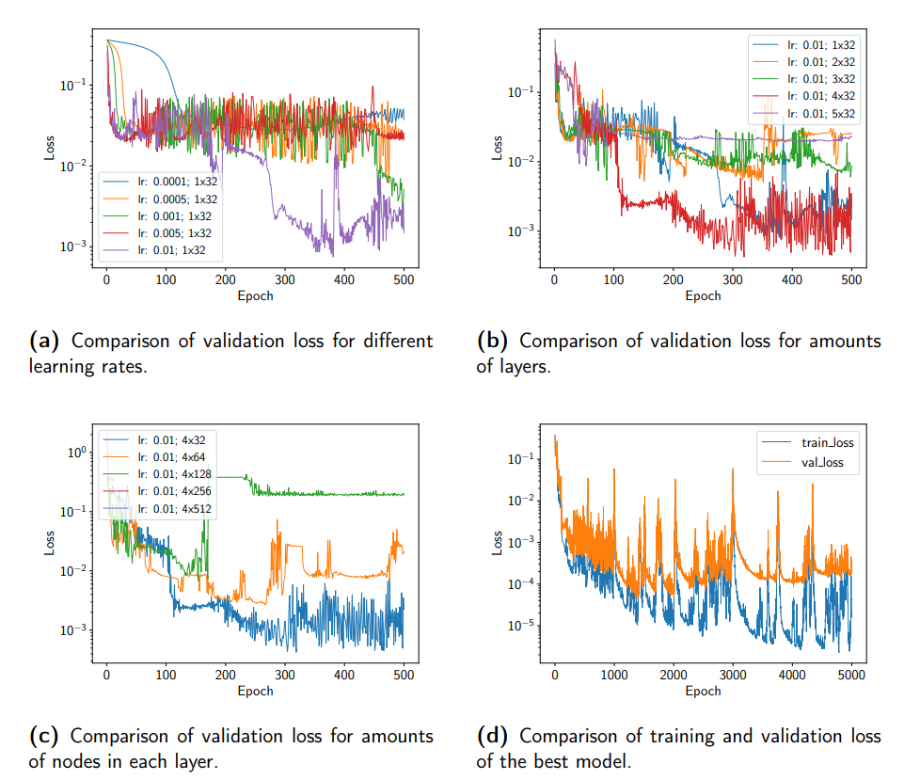
Drag simple

Slide 20
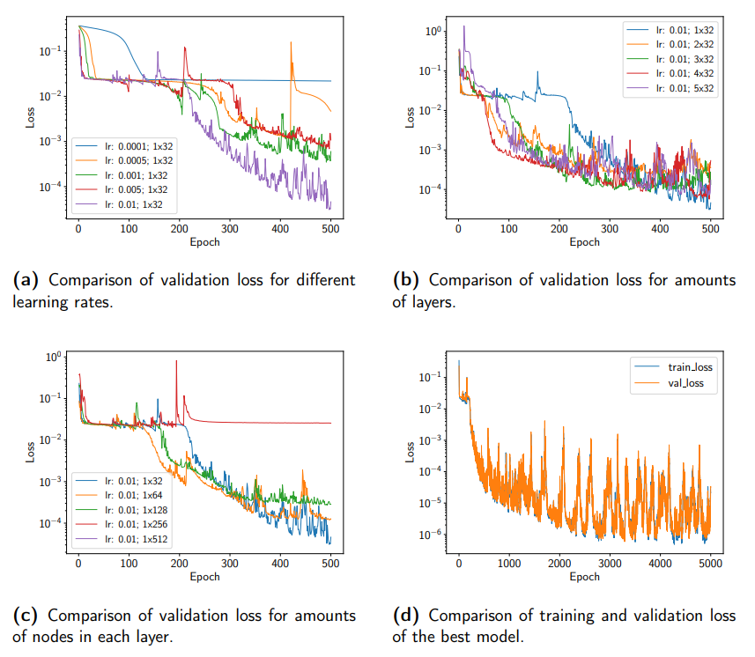
Drag complex

Slide 21
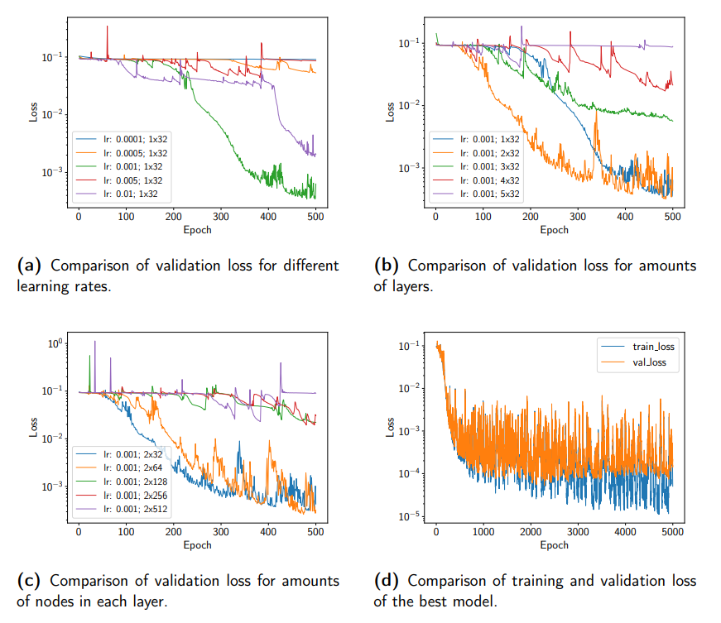
Pendulum simple

Slide 22
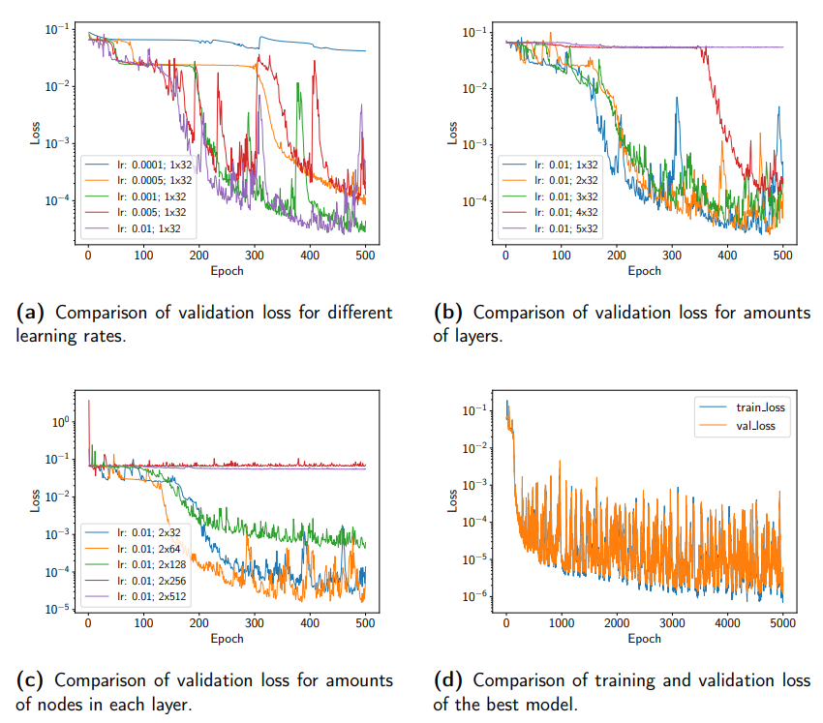
Pendulum complex

Slide 23
Evaluation

Slide 24
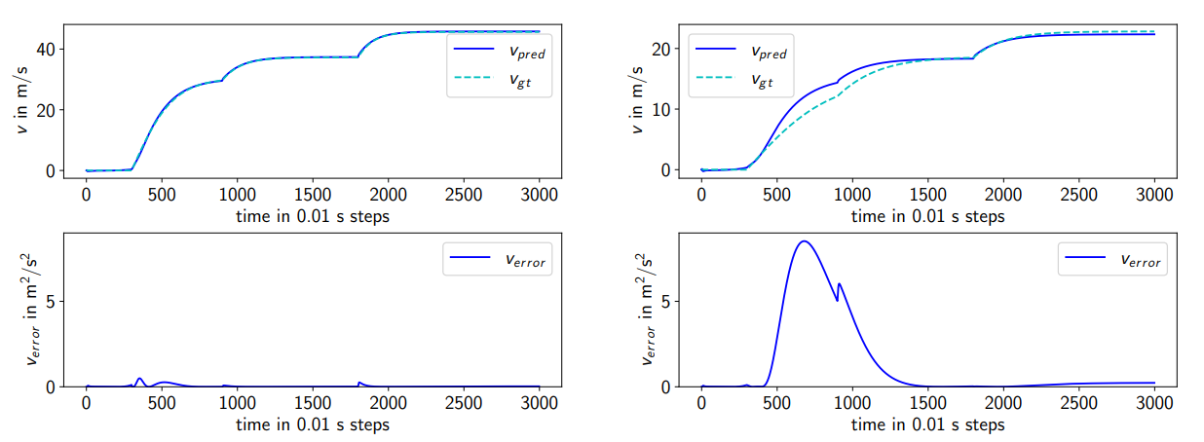
Evaluation – Drag simple

Slide 25
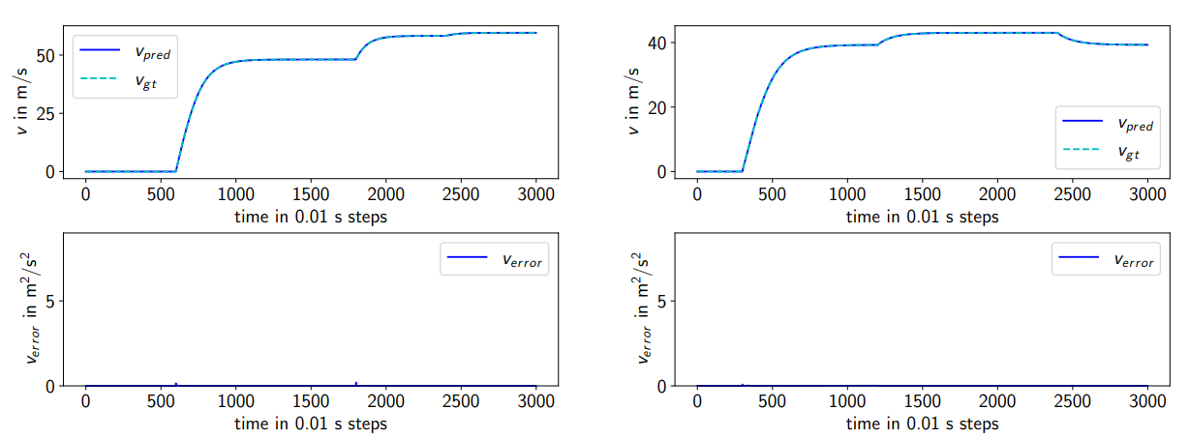
Evaluation – Drag complex

Slide 26
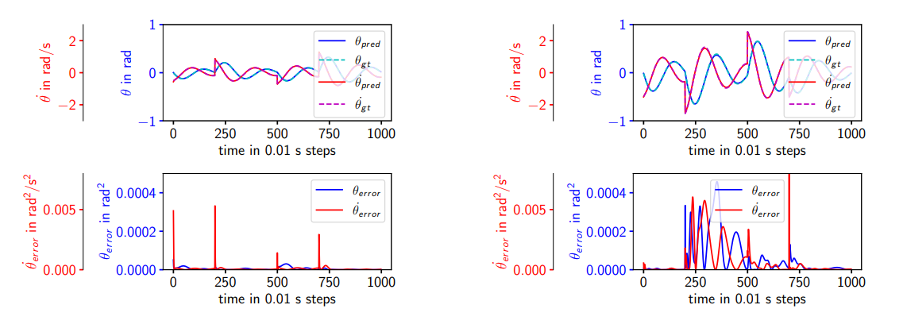
Evaluation – Pendulum simple

Slide 27
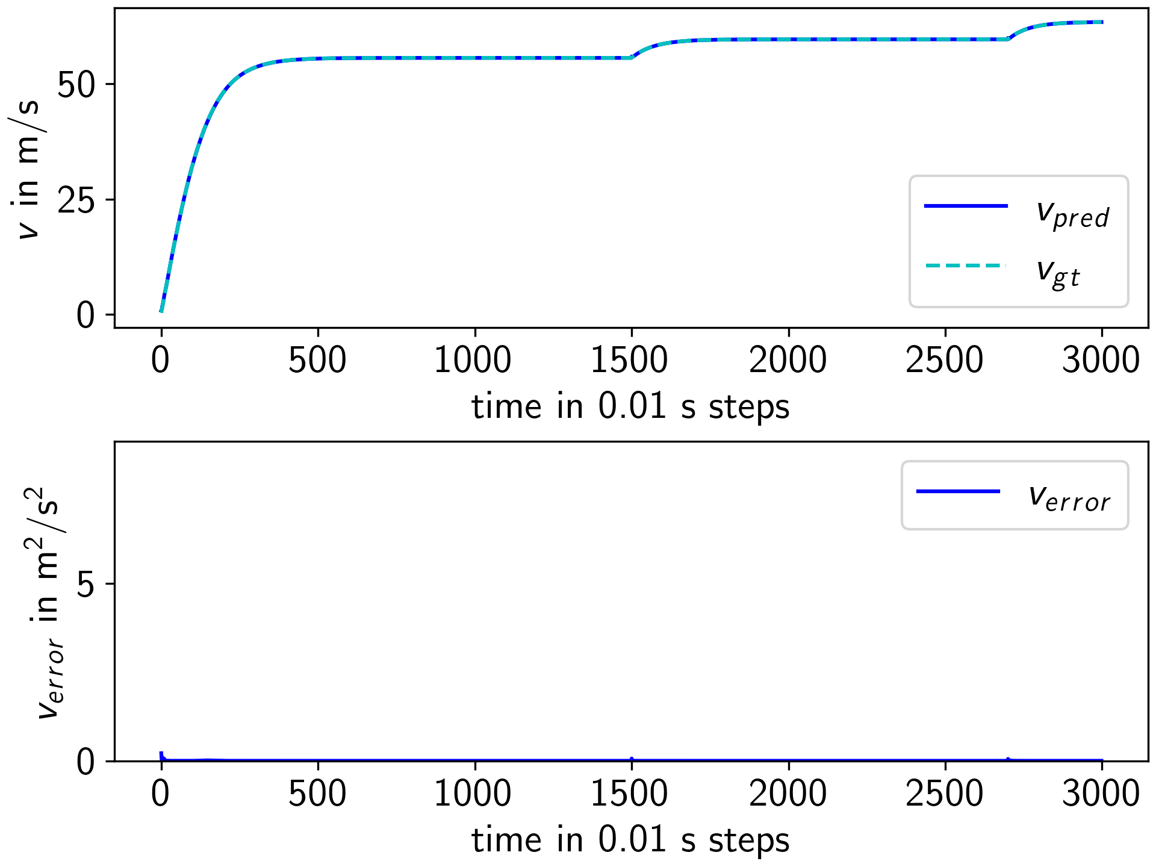
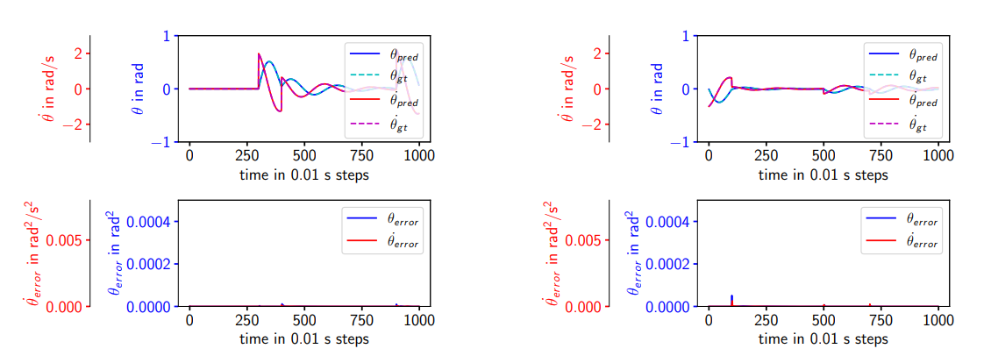
Evaluation – Pendulum complex

Slide 28
Conclusion and Future Work
Difficulties in training for larger model
Clear ability to predict nonlinear system
Error spikes on input change
Recommendation:
Use 2 LSTM layers with 32/64 nodes and learning rate of 0.01 for similar systems
New hyperparameter search for different systems
Analysis on what and how much training data is necessary to achieve good results
Testing for more complex ODEs
Deeper look into training instabilities necessary for larger models
Notes:
Create better dataset to test specific situations

Slide 29
Thank You!

Slide 30
References
Yu, Y., Si, X., Hu, C., & Zhang, J. (2019). A review of recurrent neural networks: LSTM cells and network architectures. Neural Computation, 31(7), 1235–1270.
Werbos, P. (1990). Backpropagation through time: what it does and how to do it. Proceedings of the IEEE, 78(10), 1550–1560.

Slide 31

Problem description
Pushing force:
$F_{p}= ma$
Air resistance (Drag):
$F_{d}=\frac{1}{2}ρv^{2}C_{D}A$
Simplification:
$b=\frac{1}{2}ρC_{D}A$
Resulting force:
$F=F_{p}−F_{d}$

Slide 32

Problem description
Resulting force:
$F=F_{p}−F_{d}$
Express as second order differential equation:
$m\frac{d^{2}x}{dt^{2}}=F_{p}−b\frac{dx}{dt}$
Transform into system of two first order equations:
$\frac{dx}{dt}=v$
$\frac{dv}{dt}=\frac{F_{p}−bv^{2}}{m}$
→ use in odeint python function to get values of velocity and/or position

