Slide 1
Presentation of Project
Group 1

Slide 2
Group Members and Distributions
Erbol: Implementation of Unibot, Context Task, presentation
Sixuan: Implementation of Unibot, Context Task, slides
Eszter: Functions of Unibot, Flowchart, Pseudocode (Sport, Social)
Maximilian: Functions of Unibot, Flowchart, Pseudocode (Study)

Slide 3
Main Problem to solve
Our aim is to create a program named Unibot, which works as a chatbot to help first-year students access information in terms of study, sport, and social.
The main problem to solve is how can we design a algorithm that navigates topics and provides relevant answers to implement this chatbot.

Slide 4
Algorithms
The main strategy we used to solve the problem is Check all possibilities.
We manually create all possible branches of conversation by using conditional statements.
To implement its implication in Discord, we used data structure Tree. It stores every possible branches in which conversation can go as nodes, edges are labeled based on user reply.

Slide 5
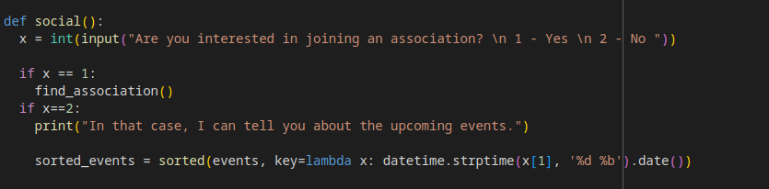
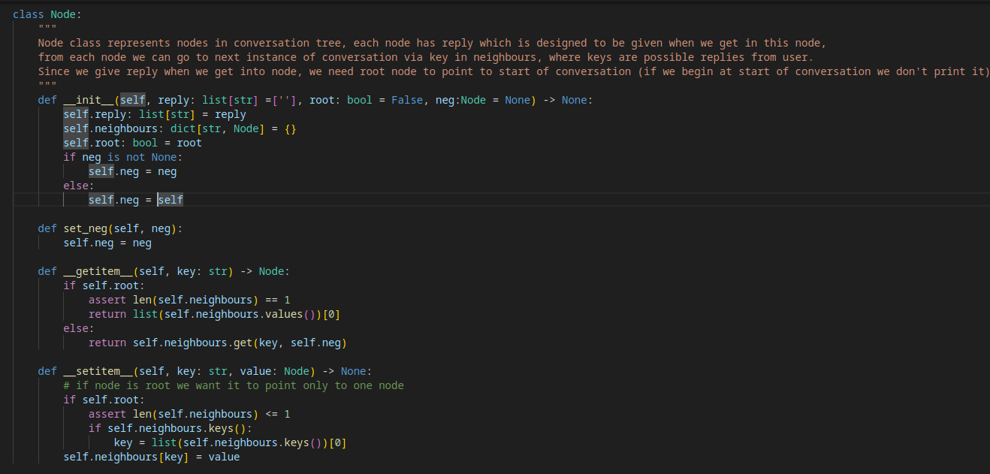

Slide 6
Problem 1
During integration of python functions in discord we encountered a lot of problems, due to different workflow of python and discord. Python allows us to run one line after another and easily use user input when it is needed.
Discord on the other hand allows only to set listener for some actions, the most useful of which was “on_message” - it allows to do some actions when we get message and afterwards sets everything back to initial state.
It makes us to use global functions, which decreases efficiency and readability of the code drastically.

Slide 7
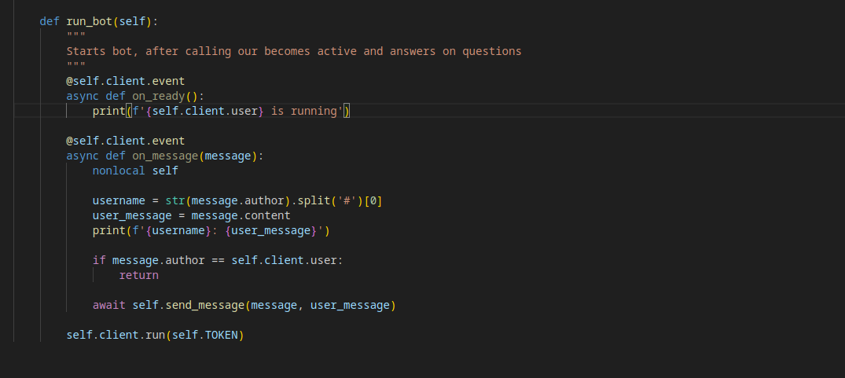
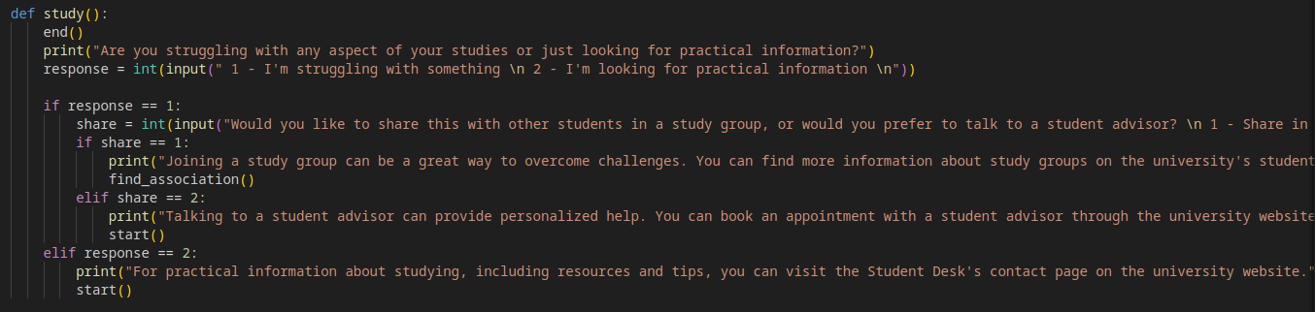
Notes:
study in some cases takes different amount of inputs by using if statement. In discord api we can only make action for each input separately, afterwards everything is back to 0

Slide 8
Solution
Our solution was to change design of our approach: instead of running discord bot separately, we can create class that contains current position in conversation and all necessities for the bot.
To keep track of conversation we implemented one more class - conversation tree. Each node of this tree contains reply based on functions implemented before, it connects with nodes that represent possible outcome based on reply of the user.
Using this we can travel between nodes and keep track of our conversation without making code messy and unreadable.

Slide 9
Problem 2
It was also troublesome do figure out how to use data that user provides in answers, for example when we greet user we need to use his username, or when they ask for event we need to consider what day it’s today to give only not concluded events.

Slide 10
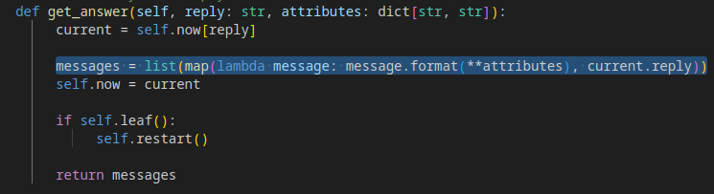
Solution
To solve this we use string templates as replies stored inside node, when we try to print it bot checks dictionary attributes inside it and tries to put them inside reply when it’s possible

Slide 11
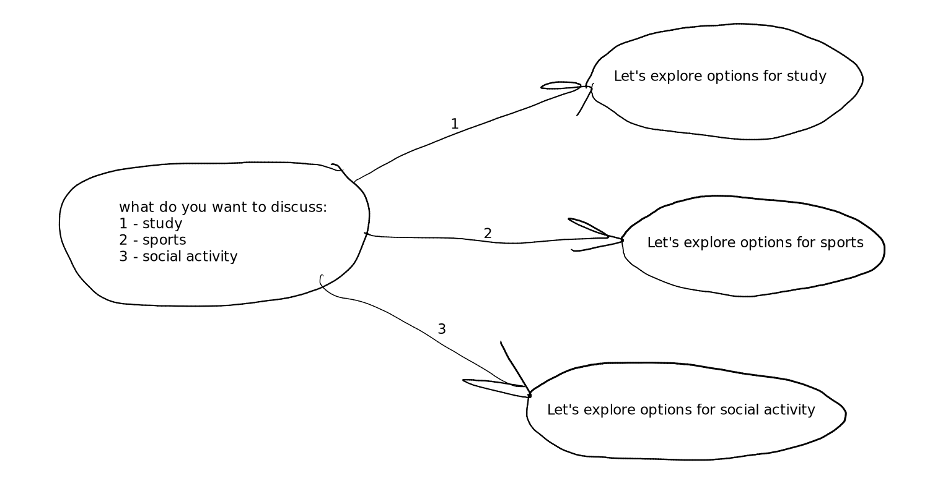

Slide 12
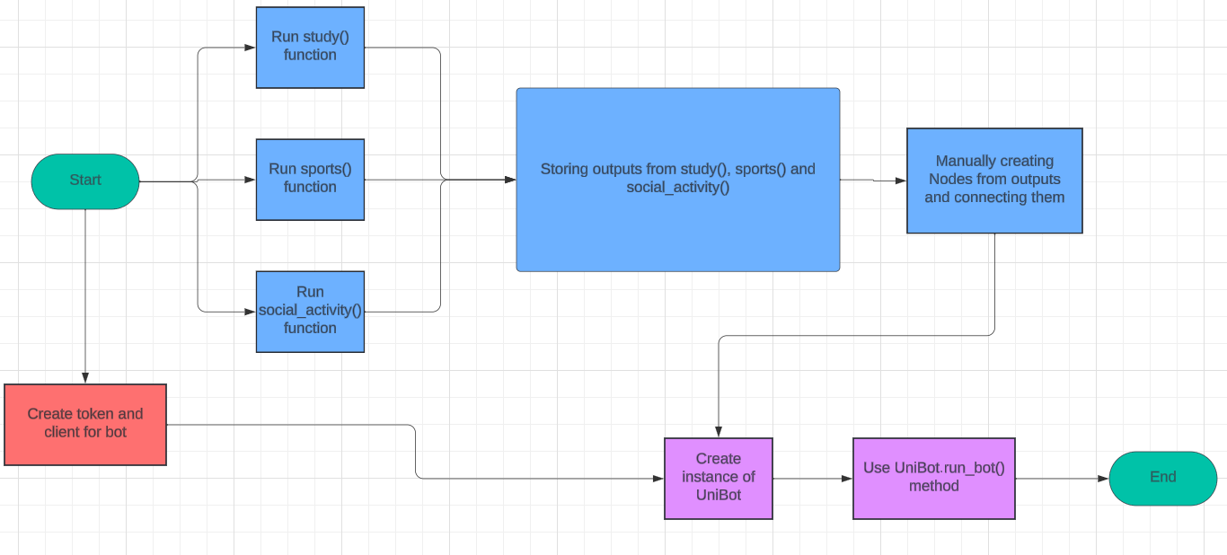
Flowchart: Overall

Slide 13
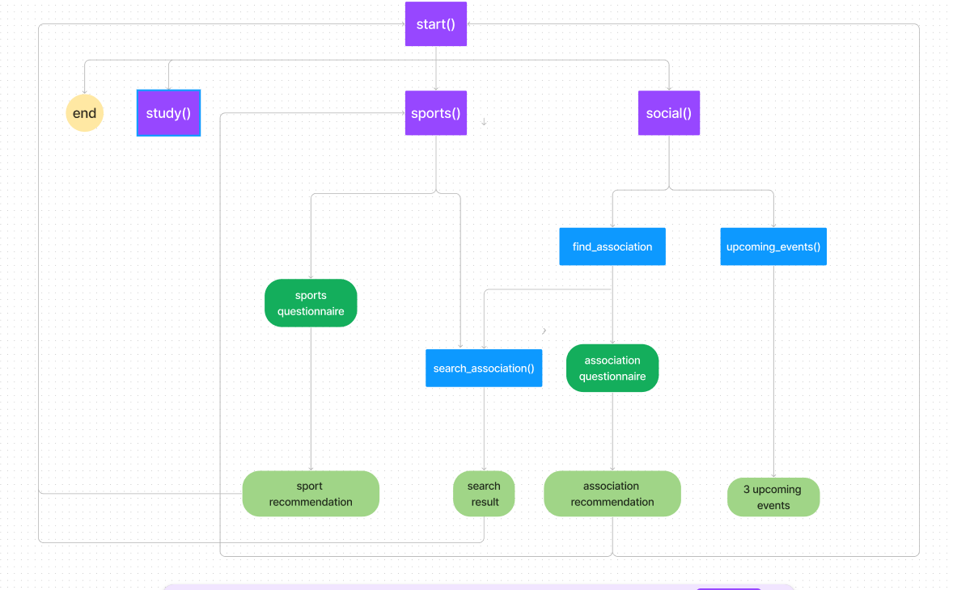
Flowchart: study, sport, social_activity

Slide 14
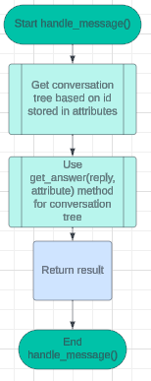
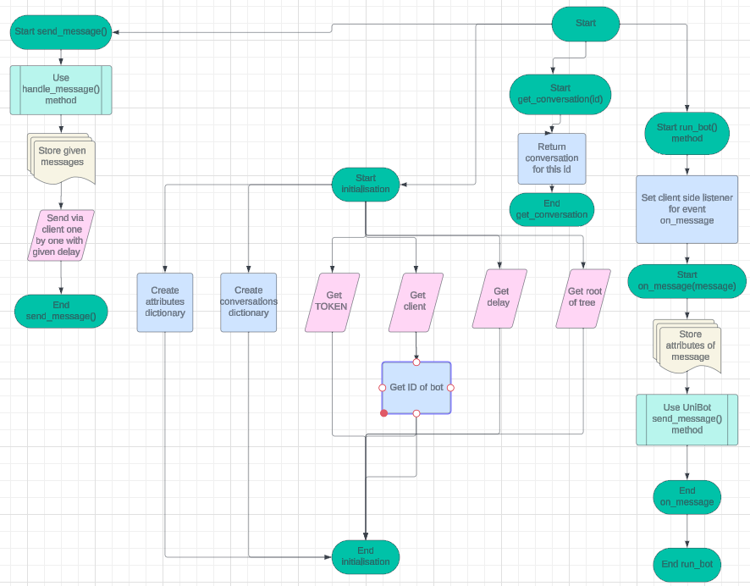
Flowchart: UniBot

Slide 15
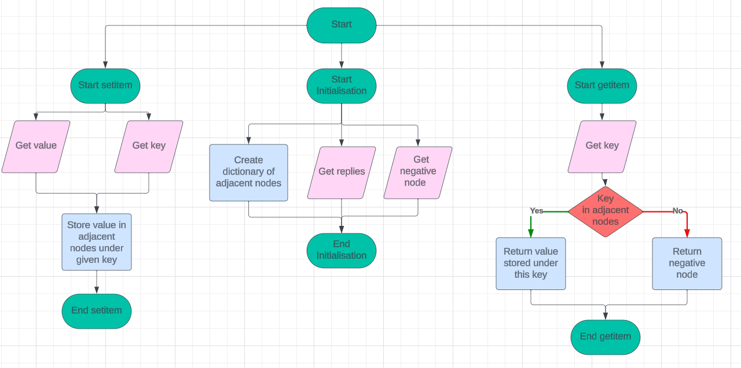
Flowchart: Node

Slide 16
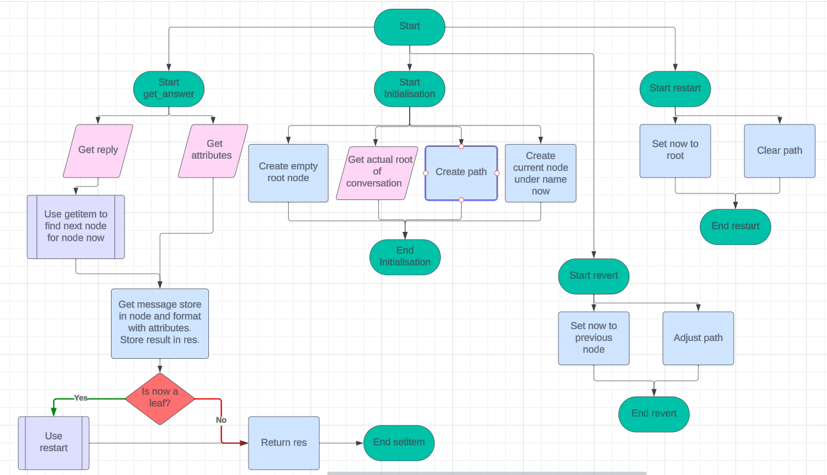
Flowchart: UniBot

Slide 17
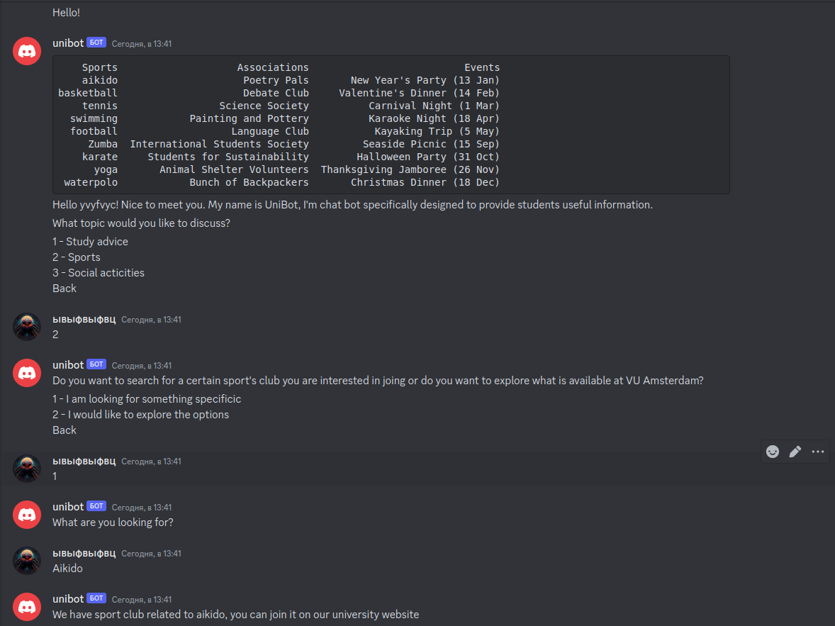
Demonstration
Here is example of dialog with a bot:

Slide 18
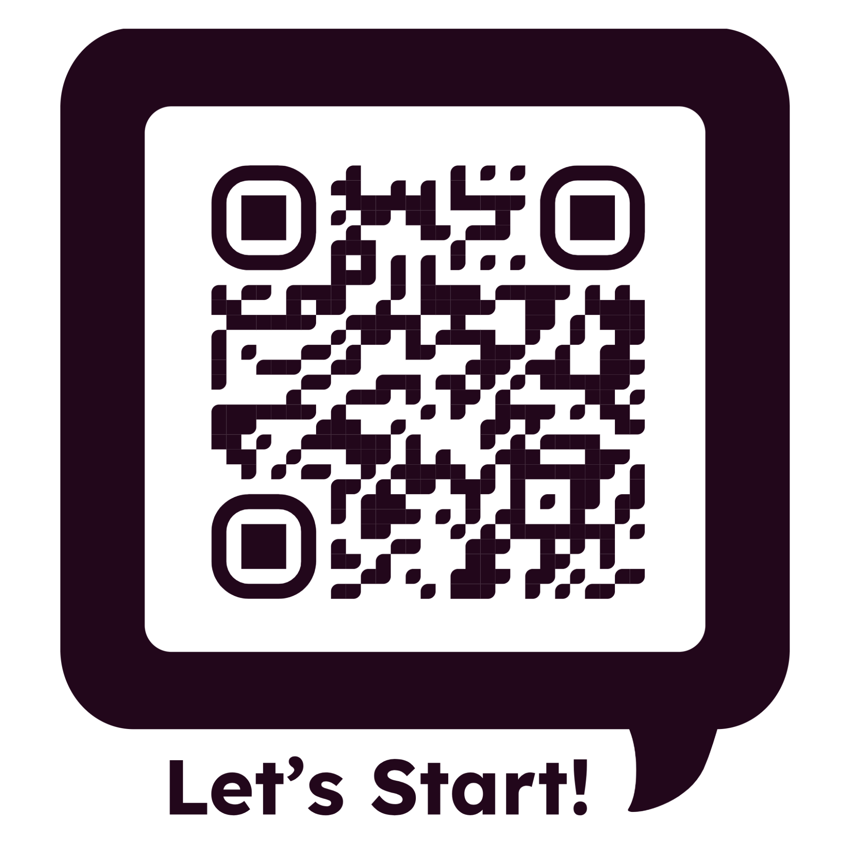

Slide 19
Thanks for Watching!

