Slide 1
EdgeFogSim
Where should a task run: Edge, Fog or Cloud? A rule-based placement simulator with VMs, tenant security and QoS results.
ARM 305 – Cloud, Dev, Edge and Fog Computing · Mini Project
Moksh 06719051624 · Bhavya Bisht 05019051624 · Dhruv Sharma 05719051624 · Bhuwan Chugh 04219051624
Notes:
Introduce the problem: urgent jobs need nearby, small edge nodes; heavy jobs can wait for the big, distant cloud. EdgeFogSim simulates choosing where each task runs and measures the result.

Slide 2
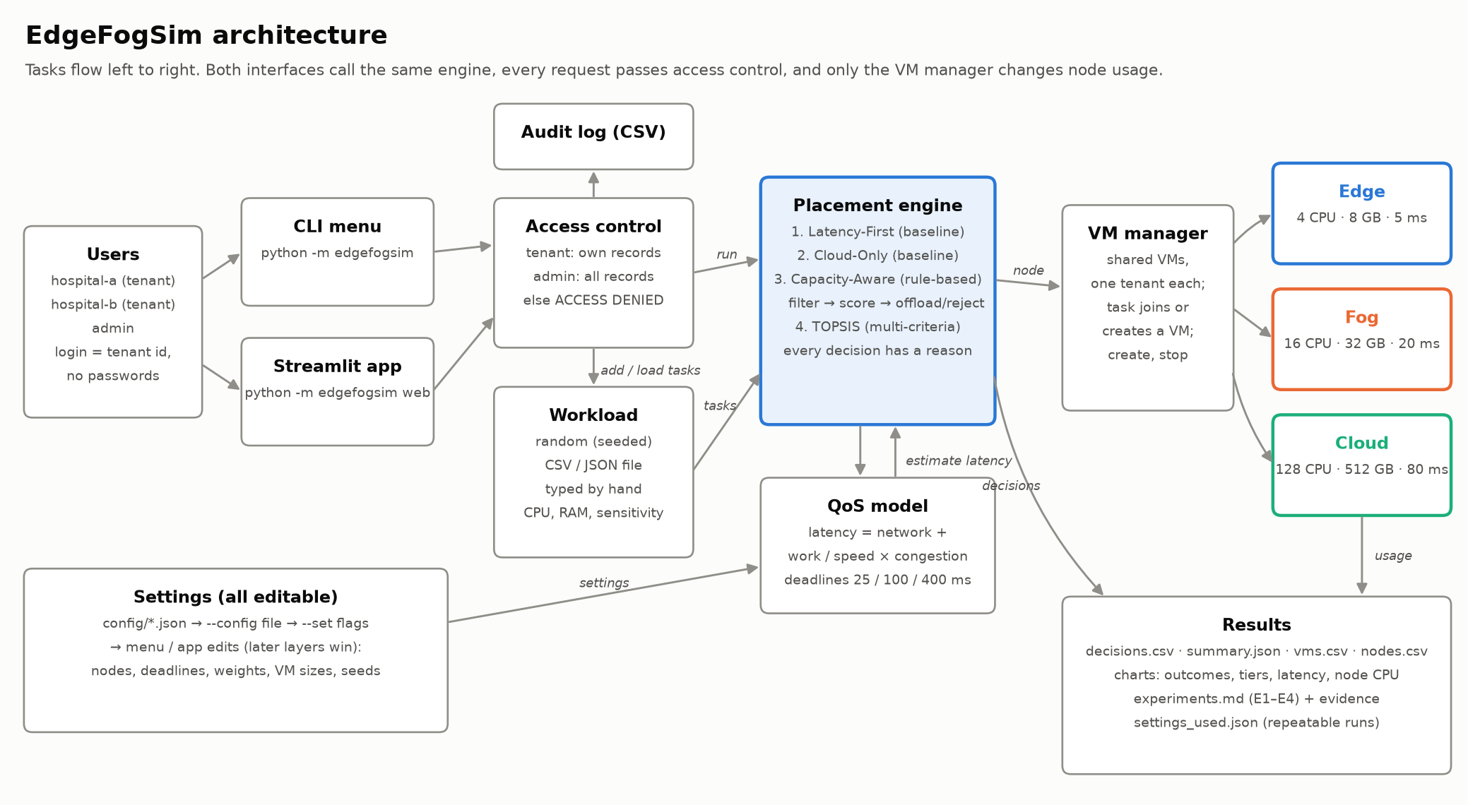
Every task passes access control, a policy and a shared VM
Notes:
Walk left to right: tenants log in through the CLI menu or the Streamlit app; access control refuses other tenants' records; the placement engine picks a node using the QoS model; the VM manager runs the task inside one of that tenant's VMs; results are exported as CSV, JSON and charts.

Slide 3
How latency and the placement score are calculated
Latency of a task on a node
Worked example: T01 on edge-1
L = d + (W ÷ s) × C C = 1 ÷ (1 − u)
2 CPU · W = 4 · high → D = 25 ms
L
latency: time until the answer comes back (ms)
u = (0 + 2) ÷ 4 = 0.5
C = 1 ÷ (1 − 0.5) = 2
L = 5 + (4 ÷ 0.6) × 2
= 5 + 6.67 × 2 = 18.3 ms
18.3 ≤ 25 → on time
S = 0.5·1 + 0.3·0.27 + 0.2·0.5
= 0.68
d
network delay to the node: edge 5, fog 20, cloud 80 ms
W
work units: how much processing the task needs
s
node speed: edge 0.6, fog 1, cloud 2 (W ÷ s = ms of work)
C
congestion: 1 when idle, 2 at half load, 10 at 90% load
u
node CPU load after adding the task, 0 to 1 (capped at 95%)
Placement score (Capacity-Aware)
S = 0.5·T + 0.3·(D − L) ÷ D + 0.2·(1 − u)
T
tier preference: 1st choice 1, 2nd 0.5, 3rd 0
Other nodes: fog-1 0.43. Highest score wins, so T01 goes to edge-1.
D
deadline by sensitivity: high 25, medium 100, low 400 ms
(D−L)÷D
share of the deadline left over; success means L ≤ D
1 − u
share of the node's CPU still free after adding the task
Notes:
Latency L is network delay d plus processing time W divided by speed s, stretched by congestion C. C comes from the node's CPU load u after adding the task: an idle node has C = 1, a half-loaded node doubles processing time, and a 90% loaded node makes it ten times slower, like a queue. A task succeeds if L is within its deadline D. Capacity-Aware then scores each node that passes its filters: tier preference, the share of the deadline left over, and the CPU left free, with weights 0.5, 0.3 and 0.2. Walk through the worked example on the right: T01 on the empty Edge node has u = 0.5, so C = 2 and L = 18.3 ms, inside its 25 ms deadline, and Edge scores highest.

Slide 4
Capacity-Aware: filter, score, then offload or reject
1
Prefer tiers by urgency
Sample tasks on empty nodes
high → Edge, Fog, Cloud · medium → Fog first · low → Cloud first
Task | Needs | Result
T01 (high) | 2 CPU, W 4 | edge-1, 18 ms
T02 (high) | 2 CPU, W 4 | fog-1 (offload), 25 ms
T03 (low) | 8 CPU, W 40 | cloud-1, 101 ms
T04 (high) | 20 CPU, W 4 | rejected
2
Filter out nodes
no room for the task's VM, CPU load over 85%, or L > D (the deadline would be missed)
3
Score the rest
S = 0.5·T + 0.3·(D − L) ÷ D + 0.2·(1 − u); highest wins
Compared against
Latency-First: nearest node with room, ignores deadlines
Cloud-Only: every task to the cloud
TOPSIS: ranks nodes on latency, free CPU and free memory together
4
Offload or reject
not first-choice tier = offload, with the reason; nothing passes (even at 100% load) = reject, naming the failed check on each node
Notes:
Capacity-Aware is the rule-based algorithm the brief asks for. It prefers a tier by urgency, rules out nodes that have no room, are over 85% loaded or would miss the deadline, scores the rest with the formula from the previous slide, and offloads or rejects with a reason. In the sample: T01 fits on Edge; T02 is offloaded to Fog because Edge would be 100% loaded; T03 is low urgency so it goes to Cloud; T04 needs 20 CPUs, more than Edge or Fog have, and Cloud's 80 ms network delay already exceeds its 25 ms deadline, so it is rejected.

Slide 5
Smart policies run 0 late; baselines run 10 and 12 of 20 late
0
late with Capacity-Aware
10
late with Latency-First
20 generated tasks, seed 42 (11 high, 5 medium, 4 low sensitivity).
Notes:
E1: 20 generated tasks, seed 42 (11 high, 5 medium, 4 low sensitivity). Each policy starts from empty nodes. Capacity-Aware and TOPSIS check the deadline before placing, so they reject what they cannot finish in time instead of running it late.

Slide 6
Overload, security and node changes behave as expected
E2 · Overload
E3 · Unauthorised access
E4 · Node changes
Edge already 90% busy, then 10 urgent tasks
hospital-b tries another tenant's task and VM
Same 20 tasks, one node changed at a time
4
6
0
DENIED
read task T01
edge-1 cpu_cores 4 → 8
on time 11 → 12
rejected 9 → 8
tasks on edge 1 → 2
offloaded
rejected
late
DENIED
read VM vm-0001
Offloaded tasks went to Fog in time; every rejection names the check that failed.
Latency-First on the same burst: 1 on time, 9 late.
No node is ever allocated beyond its capacity.
DENIED
stop VM vm-0001
cloud-1 base_latency_ms 80 → 150
Each refusal is one line in the CSV audit log. The VM keeps running; the admin can still read both records.
on time 11 → 9
rejected 9 → 11
avg latency 70.9 → 96.6 ms
Notes:
E2 is the overload scenario: with Edge already 90% busy, Capacity-Aware moves tasks to Fog when Fog can still meet the deadline and rejects, with a reason, those no node can finish in time; Latency-First keeps using Edge and runs almost all of them late. E3 is the unauthorised access attempt: every read or stop of another tenant's records is refused and logged. E4 changes one node at a time: doubling Edge CPU lets more urgent tasks run on Edge, while making Cloud 150 ms away pushes medium tasks, whose deadline is 100 ms, off the Cloud.

Slide 7
What we learned
Limitations
All 4 experiments matched their expected outcome (19/19 checks)
Checking the deadline before placing beats placing on the nearest node
Shared tenant VMs and one access rule keep tenants apart
Every number is a setting; runs are repeatable from settings_used.json
No task duration or arrival time; tasks run until their VM stops
Latency is a formula, not a measurement
Greedy, one task at a time; GA/PSO or Q-learning could do better
No VM migration; login is a tenant id by design
Try it: python -m edgefogsim · python -m edgefogsim web · python run_experiments.py
Notes:
Close with the takeaways, then the limitations; offer a live demo of the menu or the Streamlit app.

