Slide 1


SMART INDIA HACKATHON 2024
TITLE PAGE
Problem Statement ID – SIH1607
Problem Statement Title- AI-Powered Smart Traffic Management System for Real-Time Adaptive Traffic Signal Control
Theme- Smart Automation
PS Category- Software
Team ID- 35
Team Name- eventHandlers404

Slide 2
TRAFFIC विकल्प
eventHandlers404
AI-powered traffic light control system
This AI powered traffic control light utilizes real-time video analysis to manage traffic at intersections. It detects, counts and estimates traffic density.
This dynamic system adjusts signal timings based on live data to reduce congestion, wait times and factors contributing to accidents.
Uses AI for intelligent decision-making, unlike traditional fixed-timer systems.
Continuously adjusts traffic signals based on live traffic conditions for improved adaptability.
Future-ready with the ability to integrate additional features such as emergency vehicle prioritization and IoT sensors.
Can be implemented across multiple intersections and integrated into broader city-wide traffic management systems.

Slide 3
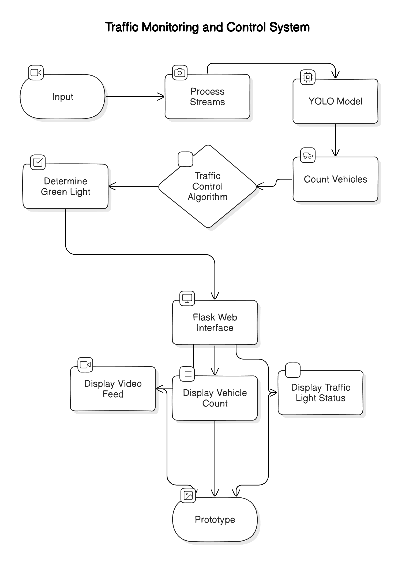
TECHNICAL APPROACH
eventHandlers404
Programming Languages:
> Python: For developing the AI model, traffic control algorithms, and backend functionalities.
> JavaScript: For creating interactive elements and dynamic updates on the web interface.
Frameworks and Libraries:
> YOLOv8: For real-time object detection and vehicle counting.
> OpenCV: For video processing, image analysis and integrating with YOLO.
> Flask: For building the web application to serve live video feeds and display traffic data.
> Bootstrap: For creating a responsive and visually appealing web interface.
> NumPy/Pandas: For data manipulation and analysis

Slide 4
FEASIBILITY AND VIABILITY
eventHandlers404
Feasibility
>Technological Readiness: The use of YOLOv8 and OpenCV for real- time vehicle detection and video processing is well-established and proven, ensuring reliable performance.
>Cost-Effectiveness: Standard cameras and servers are affordable and sufficient for the project’s needs, making the solution economically viable.
>Scalability: The system can be easily scaled to multiple intersections and integrated into broader city traffic management networks, allowing for future expansion.
Challenges
>Model Accuracy: Ensuring the YOLO model performs well under varying lighting and weather conditions.
>Edge Cases: Handling unexpected situations such as stalled vehicles and violation of traffic rules.
>System Reliability: Maintaining consistent performance and avoiding failures, especially in critical scenarios.
Strategies
>Redundancy: Adds backups to switch to timed signals if the AI or video feed fails.
>Model Tuning: Manually fine-tune the AI model at regular intervals to adapt to different conditions.
>Robust Testing: Conduct thorough testing at Bhaijipura crossroad at peak hours to ensure reliable system performance.
>Image Preprocessing: Adoption of image resizing and feature enhancement techniques to improve the quality of images under bad weather conditions.

Slide 5
IMPACT AND BENEFITS
eventHandlers404
Improved Traffic Flow: Dynamic signal adjustments reduce congestion and wait times, enhancing overall traffic efficiency.
Enhanced Safety: Real-time monitoring and adaptive signals minimize the risk of accidents by managing traffic more effectively.
Environmental Benefits: Reducing idling time lowers vehicle emissions, contributing to a cleaner environment.
Emergency Vehicle Prioritization: Future integration of emergency vehicle detection ensures quicker response times and improved public safety.
Scalability: The system can be expanded to multiple intersections, optimizing traffic management on a larger scale.

Slide 6
RESEARCH AND REFERENCES
eventHandlers404
Real time Traffic monitoring System based on Deep Learning and YOLOv8
Deep Learning-Based Object Detection and Classification for Autonomous Vehicles in Different Weather Scenarios
FUTURE SCOPE
Emergency Vehicle Prioritization: Integrating systems to prioritize ambulances, fire trucks, and police vehicles, ensuring faster response times during emergencies.
Cloud-Based Traffic Monitoring: Implementing cloud computing for real-time traffic data storage, analysis, and decision-making across cities.
AI-Driven Predictions: Leveraging AI to predict traffic patterns and optimize signal timings for better long-term traffic management.

