Slide 1


SMART INDIA HACKATHON 2024
TITLE PAGE
Problem Statement ID – SIH1607
Problem Statement Title- AI-Powered Smart Traffic Management System for Real-Time Adaptive Signal Control
Theme- Smart Automation
PS Category- Software
Team ID-
Team Name- eventHandlers404

Slide 2
IDEA TITLE
eventHandlers404
AI-powered traffic light control system
This AI powered traffic control light utilizes real-time video analysis to manage traffic at intersections. It detects, counts and estimates traffic density.
This dynamic system adjusts signal timings based on live data to reduce congestion, wait times and factors contributing to accidents.
Uses AI for intelligent decision-making, unlike traditional fixed-timer systems.
Continuously adjusts traffic signals based on live traffic conditions for improved adaptability.
Future-ready with the ability to integrate additional features such as emergency vehicle prioritization and IoT sensors.
Can be implemented across multiple intersections and integrated into broader city-wide traffic management systems.

Slide 3
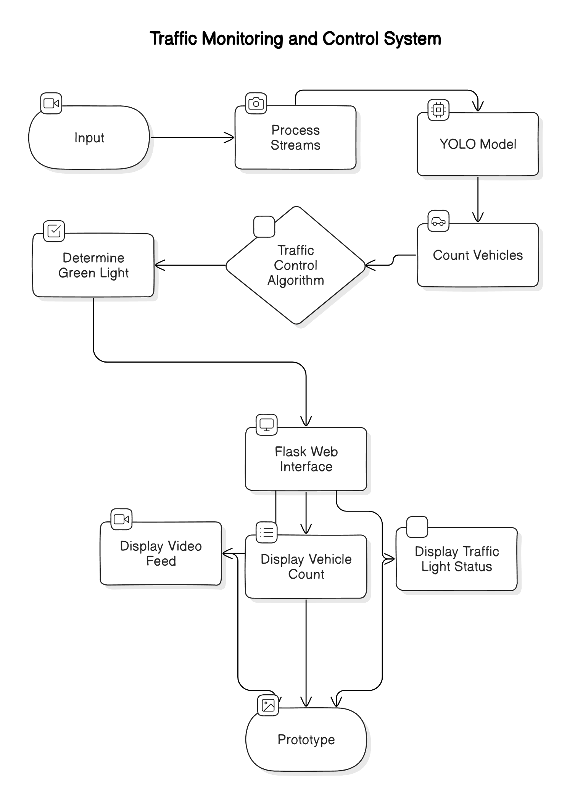
TECHNICAL APPROACH
eventHandlers404
Programming Languages:
> Python: For developing the AI model, traffic control algorithms, and backend functionalities.
> JavaScript: For creating interactive elements and dynamic updates on the web interface.
Frameworks and Libraries:
> YOLO: For real-time object detection and vehicle counting.
> OpenCV: For video processing, image analysis and integrating with YOLO.
> Flask: For building the web application to serve live video feeds and display traffic data.
> Bootstrap: For creating a responsive and visually appealing web interface.
> NumPy/Pandas: For data manipulation and analysis

Slide 4
FEASIBILITY AND VIABILITY
eventHandlers404
Feasibility:
>Technological Readiness: The use of YOLO and OpenCV for real- time vehicle detection and video processing is well-established and proven, ensuring reliable performance.
>Cost-Effectiveness: Standard cameras and servers are affordable and sufficient for the project’s needs, making the solution economically viable.
>Scalability: The system can be easily scaled to multiple intersections and integrated into broader city traffic management networks, allowing for future expansion.
Challenges:
>Model Accuracy: Ensuring the YOLO model performs well under varying lighting and weather conditions.
>Edge Cases: Handling unexpected situations such as stalled vehicles or sudden traffic surges.
>System Reliability: Maintaining consistent performance and avoiding failures, especially in critical scenarios.
Strategies:
>Redundancy: Implement fail-safes to revert to time-based control if the AI model or video feed fails.
>Model Tuning: Regularly update and fine-tune the AI model to adapt to different condition.
>Robust Testing: Conduct thorough testing under various scenarios to address edge cases and ensure reliable system performance.
>Image Preprocessing: Utilize advanced image preprocessing techniques to enhance visibility and improve vehicle detection in adverse weather conditions.

Slide 5
IMPACT AND BENEFITS
eventHandlers404
Improved Traffic Flow: Dynamic signal adjustments reduce congestion and wait times, enhancing overall traffic efficiency.
Enhanced Safety: Real-time monitoring and adaptive signals minimize the risk of accidents by managing traffic more effectively.
Environmental Benefits: Reducing idling time lowers vehicle emissions, contributing to a cleaner environment.
Emergency Vehicle Prioritization: Future integration of emergency vehicle detection ensures quicker response times and improved public safety.
Scalability: The system can be expanded to multiple intersections, optimizing traffic management on a larger scale.

Slide 6
RESEARCH AND REFERENCES
eventHandlers404
Details / Links of the reference and research work

Slide 7
IMPORTANT INSTRUCTIONS
Please ensure below pointers are met while submitting the Idea PPT:
Kindly keep the maximum slides limit up to six (6). ( Including the title slide)
Try to avoid paragraphs and post your idea in points /diagrams / Infographics /pictures
Keep your explanation precise and easy to understand
Idea should be unique and novel.
You can only use provided template for making the PPT without changing the idea details pointers (mentioned in previous slides).
You need to save the file in PDF and upload the same on portal. No PPT, Word Doc or any other format will be supported.
Note - You can delete this slide (Important Pointers) when you upload the details of your idea on SIH portal.

