Slide 1

FINAL-YEAR ENGINEERING PROJECT · PROJECT DEFENSE
PackSci AI
AI-Based Intelligent Food Packaging Material Recommendation System
"From Food Properties to Intelligent Packaging Decisions."
STUDENTS
DEPARTMENT
Likith T M, Mokshith H C
Artificial Intelligence and Machine Learning
INSTITUTION
DATE
Alva's Institute of Engineering and Technology
[Presentation Date]
AI/ML
RAG
FoodTech
Packaging Science
Food Commodity
AI Engine
Packaging Film
Longer Shelf Life
Notes:
Introduce PackSci AI as a decision-support system that recommends food packaging materials from food properties. It supports experts; it does not replace lab validation.

Slide 2
02 · PROBLEM & INDUSTRIAL NEED
Why Intelligent Packaging Selection?
The packaging decision is a multi-parameter engineering problem.
Moisture
ENGINEERING CHALLENGE
Food Properties
Storage Environment
Barrier Properties
Shelf-Life Requirement
Mechanical Damage
Oxidation (O₂)
Food Product
Packaging requirements differ significantly across food commodities.
Incorrect oxygen or moisture transmission can accelerate quality deterioration.
Fresh produce needs controlled gas exchange due to respiration.
Manual selection relies on domain expertise and iterative testing.
Respiration
Microbial Spoilage
Objective: provide AI-assisted decision support before physical packaging trials — not replace packaging experts.
Temperature
PackSci AI
Notes:
Packaging selection is a multi-parameter problem: moisture, oxidation, microbes, temperature, respiration and mechanical damage all matter differently per food.

Slide 3
03 · PROPOSED SYSTEM
PackSci AI — Hybrid Intelligent Architecture
Deterministic Engineering Intelligence + Retrieval-Grounded Generative AI
Decision Engine
Rules + weighted scoring + ML
User
Commodity + conditions
React + TS UI
Analysis dashboard
FastAPI Backend
Validation & security
Groq LLM
Explanation layer
Packaging Report
Ranked materials + rationale
RAG Knowledge Pipeline
Qdrant + embeddings + sources
PERSISTENCE
Users · Commodities · Packaging materials · Material properties · Recommendations · Analysis history · Knowledge metadata
PostgreSQL
FRONTEND
BACKEND
DATABASE
VECTOR DB
AI
EMBEDDING
React, TypeScript, Tailwind
FastAPI, Python
PostgreSQL
Qdrant Cloud
Groq LLM
FastEmbed / ONNX
PackSci AI
Notes:
Hybrid architecture: a deterministic decision engine chooses and scores materials; the RAG pipeline plus Groq LLM only explains the choice using retrieved evidence.

Slide 4
04 · DECISION ENGINE
From Food Properties to Packaging Score
A multi-criteria engineering decision model
Food Properties
How the overall packaging score is built
Each candidate material is rated on the criteria below. Criteria that matter more for the specific food are given more importance, and the ratings are combined into one overall score used to rank the materials.
Engineering Constraints
Barrier Suitability · Moisture Protection · Oxygen Protection · Shelf-Life Suitability · Mechanical Strength · Cost · Sustainability · MAP Compatibility
Candidate Filtering
OXYGEN BARRIER
MOISTURE BARRIER
FRESH PRODUCE
Weighted Scoring
Oxygen Transmission
Water Vapour Transmission
Respiration & Gas Exchange
Measures how easily oxygen passes through the film. Lower values protect fatty and oxidation-sensitive foods from rancidity.
Measures how much moisture crosses the film. Dry snacks need tight barriers to stay crisp; moist foods need them to avoid drying out.
Fruits and vegetables keep breathing after harvest, faster when warm. Films must let gases exchange so produce does not suffocate.
Material Ranking
Recommended Structure
High respiration → avoid excessive gas restriction
High-fat food → stronger oxygen barrier required
High moisture → stronger moisture barrier required
PackSci AI
Notes:
Food properties become engineering constraints, unsuitable materials are filtered, and the rest are rated on several criteria. More important criteria for that food count more, and ratings combine into one overall score.

Slide 5
05 · RAG KNOWLEDGE ENGINE
Grounded AI with RAG
From generic LLM answers to evidence-aware packaging explanations
Scientific Documents
Processing & Chunking
384-D Embeddings
FastEmbed / ONNX
Qdrant Cloud
Vector search
Relevant Evidence
Groq LLM
Grounded Explanation
+ source references
KNOWLEDGE SOURCES
KEY ADVANTAGES
Packaging standards
Semantic retrieval
Context-aware explanation
Source-grounded responses
Reduced hallucination risk
Traceable knowledge
SECURITY NOTE
Food packaging literature
Groq API Key → Backend only
Postharvest research
Keys live in server environment variables. The React client never receives or stores provider credentials.
Material technical information
Approved internal knowledge base
PackSci AI
Notes:
Scientific documents are chunked, embedded and stored in Qdrant. Relevant evidence is retrieved and passed to the LLM to produce a grounded, source-referenced explanation.

Slide 6
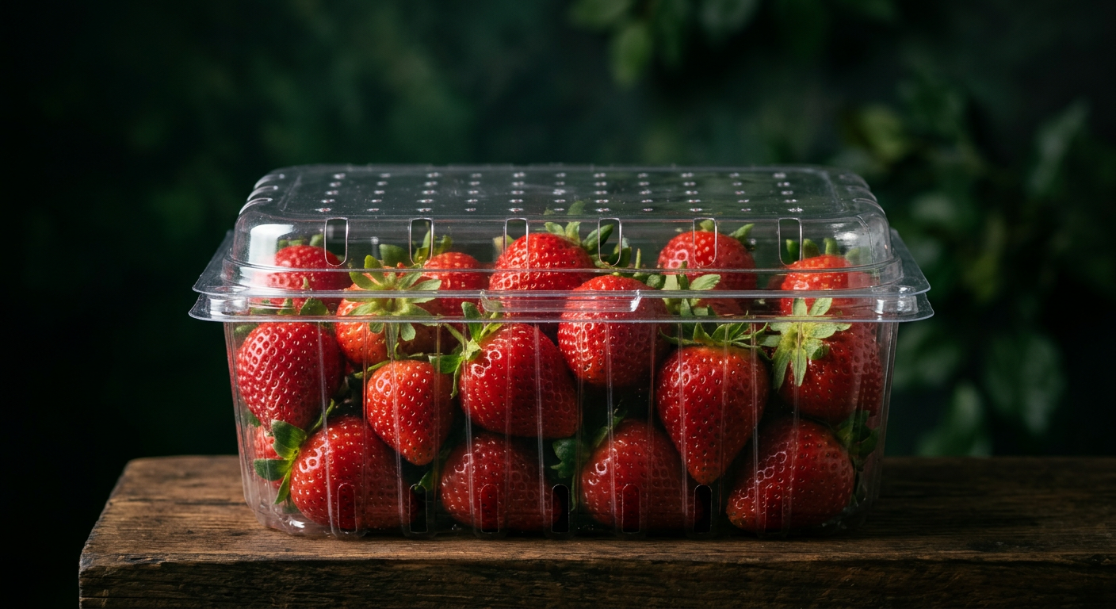
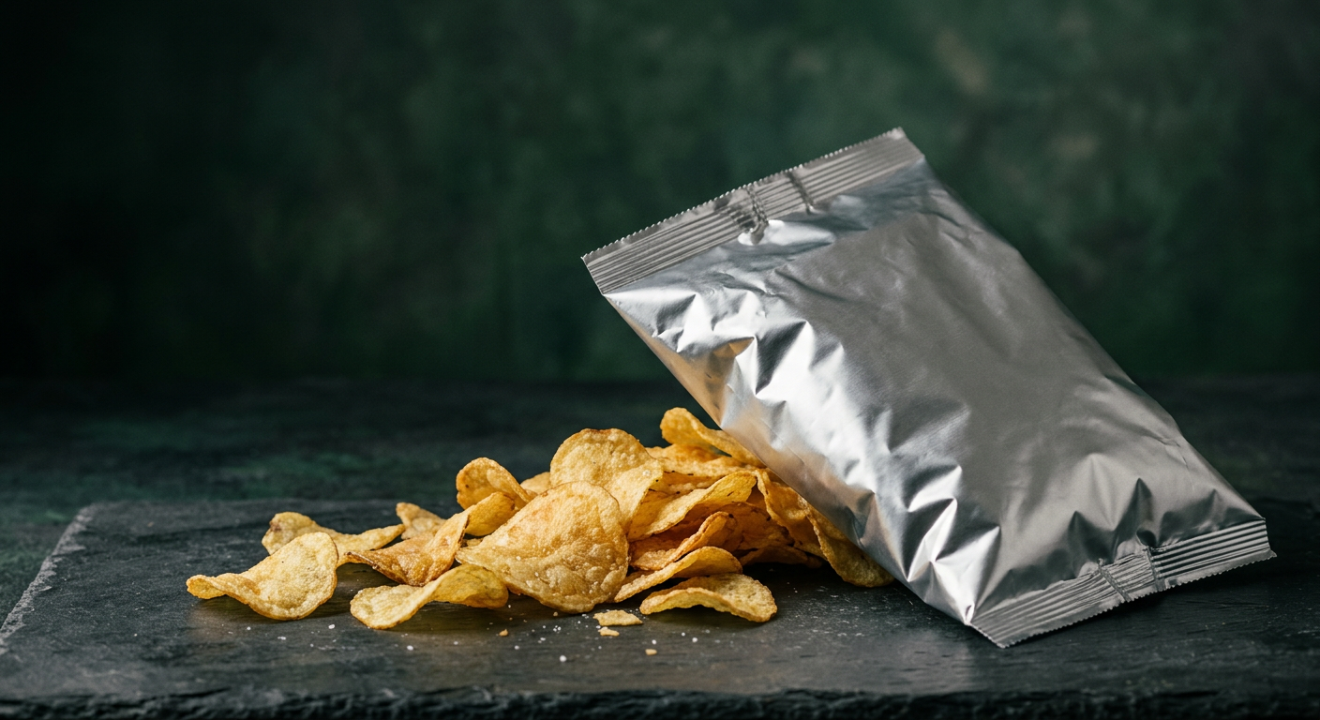
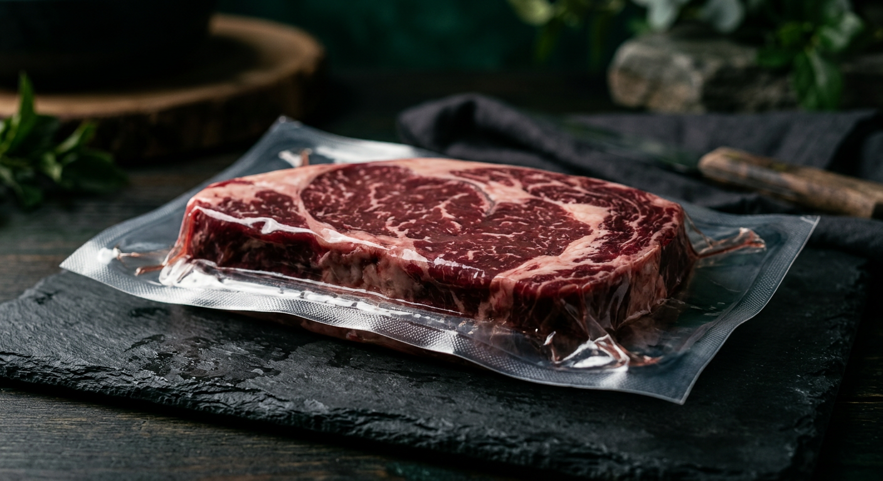
06 · CASE STUDIES
Case Studies: Commodity → Packaging Decision
Illustrative prototype scenarios demonstrating the recommendation workflow
CASE 01
CASE 02
CASE 03
Strawberry
Potato Chips
Fresh Meat
High moisture · High respiration · Fresh produce
Low moisture target · Oxidation-sensitive
High perishability
RECOMMENDATION
RECOMMENDATION
RECOMMENDATION
Micro-perforated BOPP / PLA
Metallized BOPP / CPP
EVOH/PA barrier · Vacuum Skin Pack
Controlled gas exchange
Moisture management
Reduced oxygen-depletion risk
High oxygen barrier
High moisture barrier
Good sealability
Oxygen barrier
Puncture resistance
Vacuum compatibility
Prototype / Literature-informed
Prototype / Literature-informed
Prototype / Literature-informed
PackSci AI
Notes:
Three illustrative, literature-informed scenarios: strawberry, potato chips and fresh meat. These are prototype examples, not validated experiments.

Slide 7
07 · PLATFORM
Secure, Traceable & User-Centric Platform
SECURITY
DATABASE · POSTGRESQL
USER EXPERIENCE · PROTOTYPE UI
bcrypt password hashing
Users
Commodity
Strawberry
Temperature
4 °C
JWT Bearer authentication
Analysis History
Humidity
85 %
Recommendations
Shelf Life
7 days
Protected API routes
Commodity
ANALYZE
Backend-only API keys
Packaging Material
Recommended
User data isolation
Micro-perforated Film
Qdrant Cloud — Scientific knowledge retrieval
91%*
*Illustrative compatibility score
PackSci AI
Notes:
Security: bcrypt, JWT, protected routes, backend-only keys, per-user data isolation. PostgreSQL stores traceable history; Qdrant stores knowledge.

Slide 8
08 · IMPACT & ROADMAP
Impact, Contribution & Future Roadmap
Building a scalable bridge between food science and AI
CONTRIBUTION
SUSTAINABILITY LOOP
ROADMAP
AI-assisted material selection
Food → Packaging → Longer Shelf Life → Less Food Waste → Recyclable / Bio-based
1
Phase 1 · Validated datasets
Engineering-based scoring
2
Phase 2 · Laboratory validation
3
Phase 3 · IoT packaging sensors
RAG-grounded scientific explanation
Monomaterial & recyclable structures · bio-based alternatives · food-waste reduction potential (not yet measured)
4
Phase 4 · Real-time shelf-life monitoring
Centralized packaging knowledge
5
Phase 5 · Mobile / Edge AI deployment
THANK YOU
"Smarter Packaging. Safer Food. Sustainable Future."
Questions & Discussion
PackSci AI
Notes:
Contribution, sustainability potential and roadmap: validated datasets, lab validation, IoT sensors, real-time monitoring, and edge deployment. Thank you.

