Slide 1
Project Presentation
Catching Anomalous Providers in Medicare Claims:
An Unsupervised Screen for Payment Integrity
Mokshit Anjani Sreekar Palleboina
M.S. Data Science, University of Colorado Boulder
Cotiviti Intern Screening — Topic 2

Slide 2
Agenda
The problem
The approach
What I built
The review console
Results
Limitations
Options for Cotiviti
Conclusion
2
Cotiviti Intern Screening

Slide 3
The Problem
Medicare paid out about $28.8 billion in improper payments in 2025.
There are far too many providers for reviewers to check them all.
The real problem is deciding who to look at first.
3
Cotiviti Intern Screening

Slide 4
The Approach
A supervised model learns from confirmed-fraud labels, so it only catches schemes that were already caught and labeled.
This screen is unsupervised. It scores every provider by how far its billing behavior sits from its peers.
Because it does not need labels, it can flag new schemes before anyone has labeled them.
4
Cotiviti Intern Screening

Slide 5
What I Built
Each provider is rolled into one row, described with behavioral ratios instead of raw size.
Two detectors, HDBSCAN and Isolation Forest, score each provider and are combined by rank.
The output is a ranked review queue of the riskiest providers.
An LLM then explains each flag in plain language for the reviewer.
5
Cotiviti Intern Screening

Slide 6
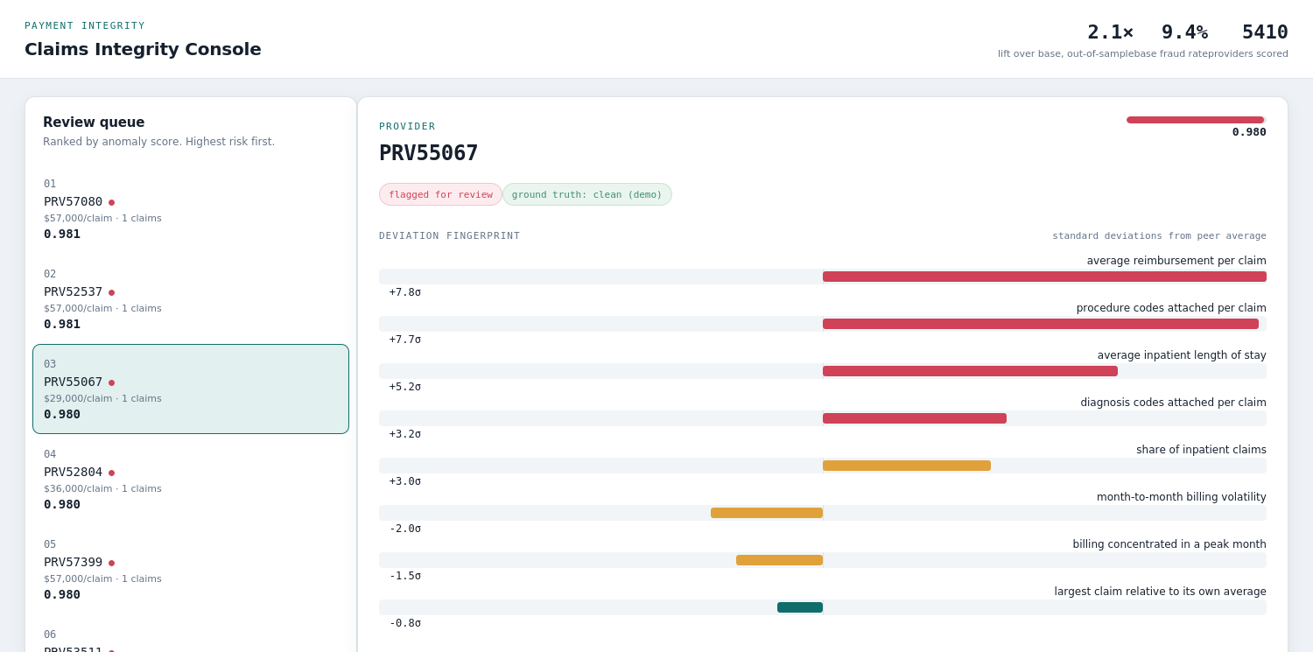
The Review Console
Open a flagged provider, read why it was flagged, and generate a briefing.
6
Cotiviti Intern Screening

Slide 7
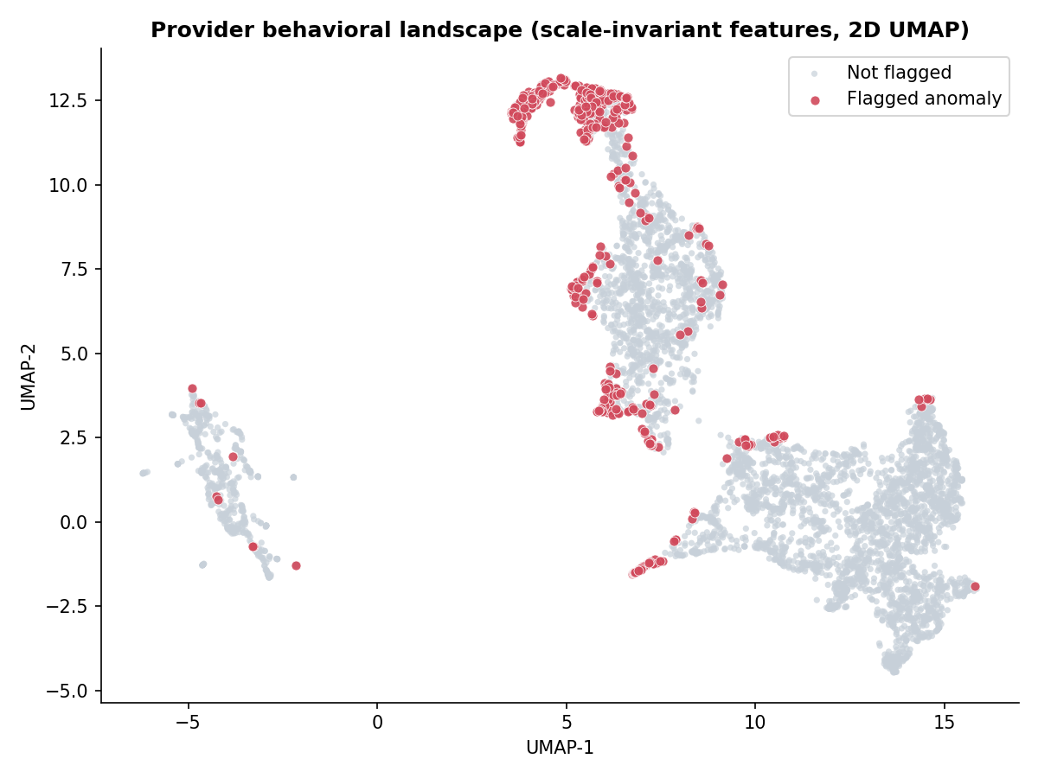
Results
2.1x lift over the base rate, measured out of sample.
43% of the fraud caught in the top 10% of the queue.
A supervised baseline reaches 6.3x. It has labels; this screen does not.
Honest note: my first version showed 4.3x. It was a size confound. The real number is 2.1x.
7
Cotiviti Intern Screening

Slide 8
Limitations
An anomaly is not the same as fraud. The top flag in my run was a legitimate high-intensity specialist.
There is no specialty grouping yet, so genuinely high-cost providers get flagged.
A fraudster who bills close to the average slips right past an outlier screen.
8
Cotiviti Intern Screening

Slide 9
Options for Cotiviti
A. Use it as a triage layer on top of the existing review queue.
B. Add the explanation step to speed up and document reviews.
C. Cut false positives by grouping providers on specialty and region.
Start with A and B on a single claim type, measure the lift, then invest in C.
9
Cotiviti Intern Screening

Slide 10
Conclusion
An unsupervised screen that works from behavior alone, and explains itself.
Near term, it is a screen-and-explain layer on top of existing review.
Longer term, the same approach can move earlier, before a payment goes out.
10
Cotiviti Intern Screening

