Slide 1
Unit-3
Memory Organization
Cache Memory Organization
Main Memory & Interleaving
I/O Organization
Modern Processors, Parallel Processing

Slide 2
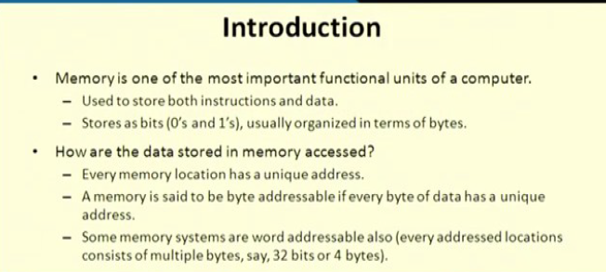

Slide 3
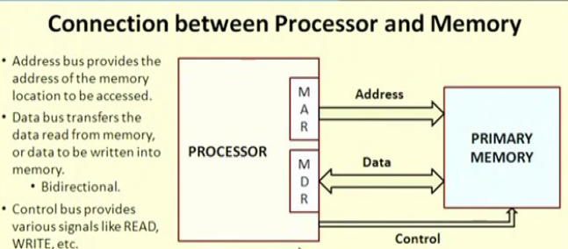

Slide 4
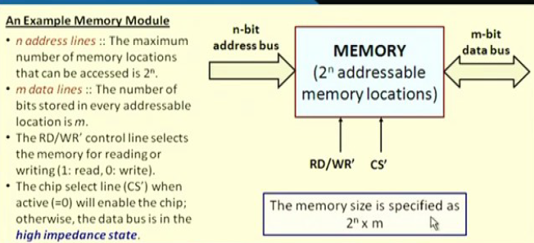

Slide 5
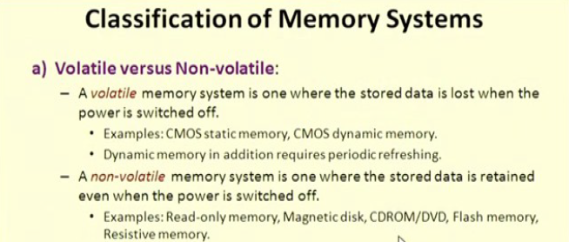

Slide 6
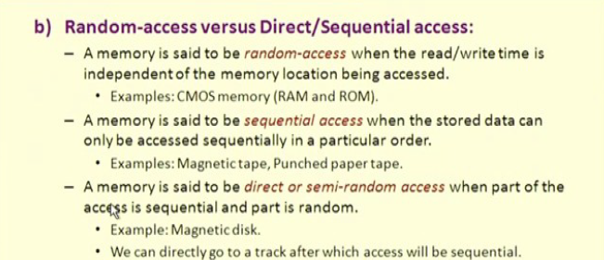

Slide 7
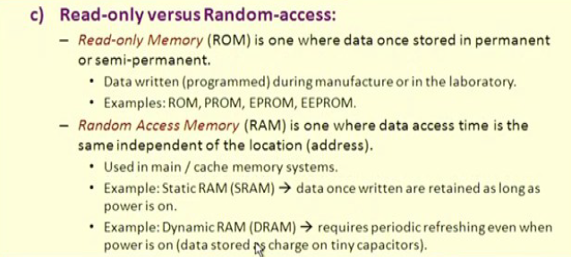

Slide 8
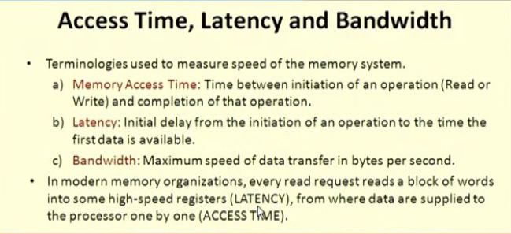

Slide 9
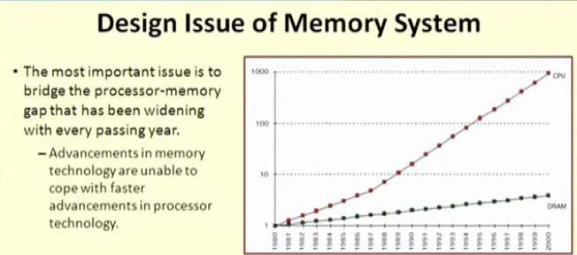

Slide 10
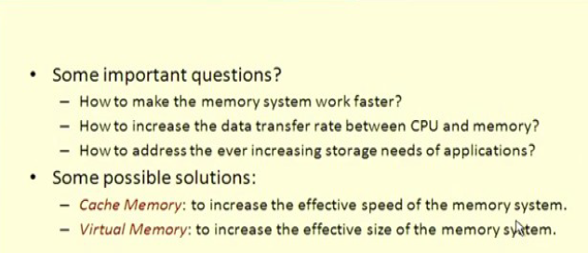

Slide 11
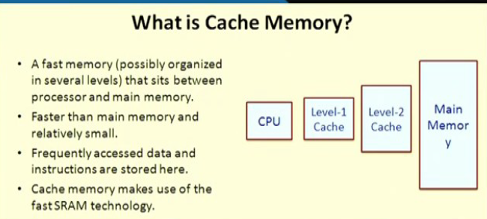

Slide 12
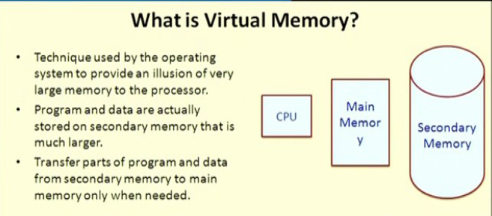

Slide 13
Memory Hierarchy Design
organize the memory so that it can actually minimize the access time.
The development of the Memory Hierarchy occurred on a behavior of a program known as locality of references.

Slide 14
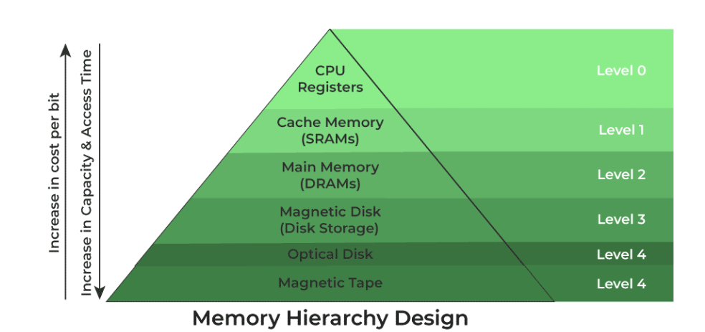

Slide 15
Types of Memory Hierarchy
External Memory or Secondary Memory: Comprising of Magnetic Disk, Optical Disk, and Magnetic Tape i.e. peripheral storage devices which are accessible by the processor via an I/O Module.
Internal Memory or Primary Memory: Comprising of Main Memory, Cache Memory & CPU registers. This is directly accessible by the processor.

Slide 16
1. Registers
Registers are small, high-speed memory units located in the CPU.
They are used to store the most frequently used data and instructions.
Registers have the fastest access time and the smallest storage capacity, typically ranging from 16 to 64 bits.

Slide 17
2. Cache Memory
Cache memory is a small, fast memory unit located close to the CPU.
It stores frequently used data and instructions that have been recently accessed from the main memory.
Cache memory is designed to minimize the time it takes to access data by providing the CPU with quick access to frequently used data.

Slide 18
Main Memory
also known as RAM (Random Access Memory), is the primary memory of a computer system.
It has a larger storage capacity than cache memory, but it is slower.
Main memory is used to store data and instructions that are currently in use by the CPU.

Slide 19
Types of Main Memory
Static RAM: stores the binary information in flip flops and information remains valid until power is supplied. It has a faster access time and is used in implementing cache memory.
Dynamic RAM: It stores the binary information as a charge on the capacitor. It requires refreshing circuitry to maintain the charge on the capacitors after a few milliseconds. It contains more memory cells per unit area as compared to SRAM.

Slide 20
4. Secondary Storage
It is non-volatile memory unit that has a larger storage capacity than main memory.
It is used to store data and instructions that are not currently in use by the CPU.
Secondary storage has the slowest access time and is typically the least expensive type of memory in the memory hierarchy.

Slide 21
Magnetic disks
are simply circular plates that are fabricated with either a metal or a plastic or a magnetized material.
The Magnetic disks work at a high speed inside the computer and these are frequently used.

Slide 22
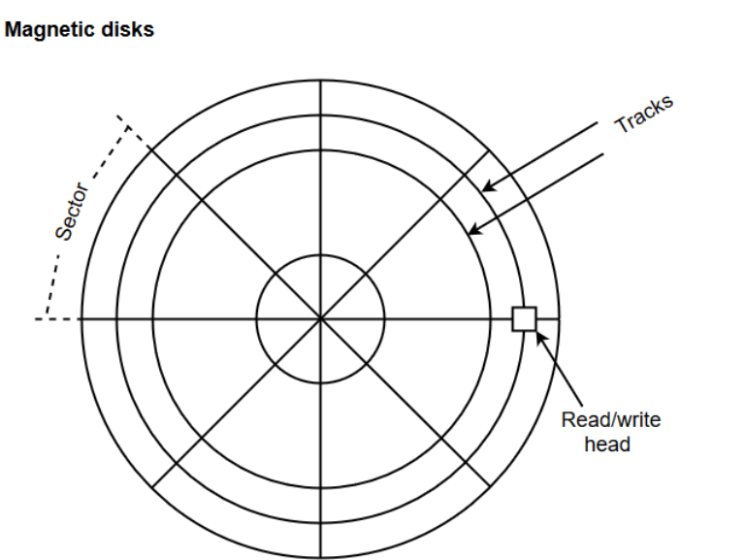
The memory bits are stored in the magnetized surface in spots along the concentric circles called tracks
The concentric circles (tracks) are commonly divided into sections called sectors

Slide 23
Magnetic tape
simply a magnetic recording device that is covered with a plastic film.
It is generally used for the backup of data.
In the case of a magnetic tape, the access time for a computer is a little slower and therefore, it requires some amount of time for accessing the strip.

Slide 24
Characteristics of Memory Hierarchy
Capacity: It is the global volume of information the memory can store. As we move from top to bottom in the Hierarchy, the capacity increases.
Access Time: As we move from top to bottom in the Hierarchy, the access time increases.
Performance: It will be increased with the use of this memory hierarchy.
Cost Per Bit: As we move from bottom to top in the Hierarchy, the cost per bit increases i.e. Internal Memory is costlier than External Memory.

Slide 25
Advantages of Memory Hierarchy
It helps in removing some destruction, and managing the memory in a better way.
It helps in spreading the data all over the computer system.
It saves the consumer’s price and time.

Slide 26
Cache memory
Cache memory is a special type of high-speed memory located close to the CPU in a computer.
It stores frequently used data and instructions, So that the CPU can access them quickly, improving the overall speed and efficiency of the computer.
It is a faster and smaller segment of memory whose access time is as close as registers.
In a hierarchy of memory, cache memory has access time lesser than primary memory. Generally, cache memory is used as a buffer.

Slide 27
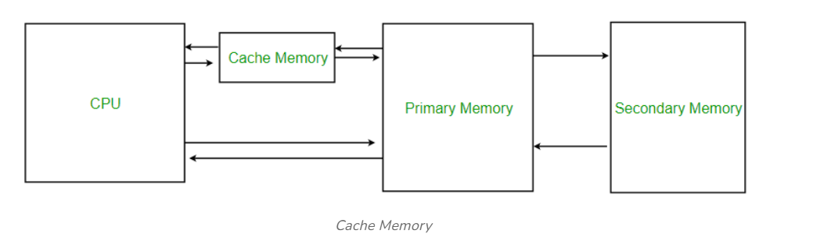

Slide 28
Characteristics of Cache Memory
Cache memory is an extremely fast memory type that acts as a buffer between RAM and the CPU.
Cache Memory holds frequently requested data and instructions so that they are immediately available to the CPU when needed.
Cache memory is costlier than main memory or disk memory but more economical than CPU registers.
Cache Memory is used to speed up and synchronize with a high-speed CPU.

Slide 29
Working of Cache Memory
In order to understand the working of cache we must understand few points:
Cache memory is faster, they can be accessed very fast.
Cache memory is smaller, a large amount of data cannot be stored.
Whenever CPU needs any data it searches for corresponding data in the cache (fast process) if data is found, it processes the data according to instructions, however, if data is not found in the cache CPU search for that data in primary memory(slower process) and loads it into the cache. This ensures frequently accessed data are always found in the cache and hence minimizes the time required to access the data.

Slide 30
Benefits of Cache Memory
Faster access: Faster than main memory. It resides closer to CPU , typically on same chip or in close proximity. Cache stores subset of data and instruction.
Reducing memory latency: Memory access latency refers to time taken for processes to retrieve data from memory. Caches are designed to exploit principle of locality.

Slide 31
Lowering bus traffic: Accessing data from main memory involves transferring it over system bus By utilizing cache memory , processor can reduce frequency of accessing main memory resulting in less bus traffic and improves system efficiency.
Increasing effective CPU utilization: Cache memory allows CPU to operate at a higher effective speed. CPU can spend more time executing instruction rather than waiting for memory access. This leads to better utilization of CPU’s processing capabilities and higher overall system performance.

Slide 32
Scalability: Cache memory helps improve system scalability by reducing impact of memory latency on overall system performance.

Slide 33
Cache Hit and Cache Miss
Cache Hit: When the CPU finds the required data in the cache memory, allowing for quick access. On searching in the cache if data is found, a cache hit has occurred.
Cache Miss: When the required data is not found in the cache, forcing the CPU to retrieve it from the slower main memory. On searching in the cache if data is not found, a cache miss has occurred.
The performance of cache memory is frequently measured in terms of a quantity called Hit ratio.

Slide 34
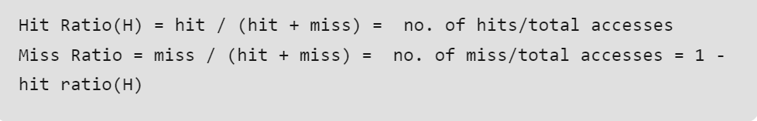
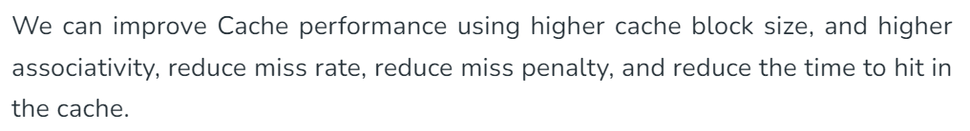

Slide 35
Types of Cache Memory
L1 or Level 1 Cache:
It is the first level of cache memory that is present inside the processor.
It is present in a small amount inside every core of the processor separately.
The size of this memory ranges from 2KB to 64 KB

Slide 36
L2 or Level 2 Cache:
It is the second level of cache memory that may present inside or outside the CPU.
If not present inside the core, It can be shared between two cores depending upon the architecture and is connected to a processor with the high-speed bus.
The size of memory ranges from 256 KB to 512 KB.

Slide 37
L3 or Level 3 Cache:
It is the third level of cache memory that is present outside the CPU and is shared by all the cores of the CPU.
Some high processors may have this cache
. This cache is used to increase the performance of the L2 and L1 cache.
The size of this memory ranges from 1 MB to 8MB.

Slide 38
Locality Of Reference
It is a phenomenon in which a computer program tends to access same set of memory locations for a particular time period.
In other words, Locality of Reference refers to the tendency of the computer program to access instructions whose addresses are near one another.
The property of locality of reference is mainly shown by loops and subroutine calls in a program.

Slide 39
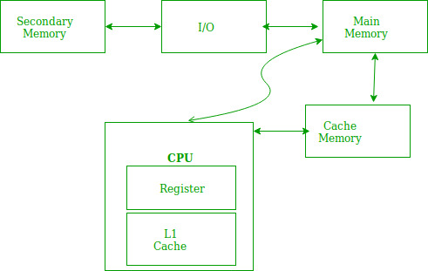

Slide 40
It is based on the principle of locality of reference.
There are two ways with which data or instruction is fetched from main memory and get stored in cache memory. These two ways are the following:
1. Temporal locality
2. Spatial locality

Slide 41
Temporal locality
Temporal locality means current data or instruction that is being fetched may be needed soon.
It refers to reuse of specific data/ resources within a short period of time.
So we should store that data or instruction in the cache memory so that we can avoid again searching in main memory for the same data.
Ex: Loop.

Slide 42
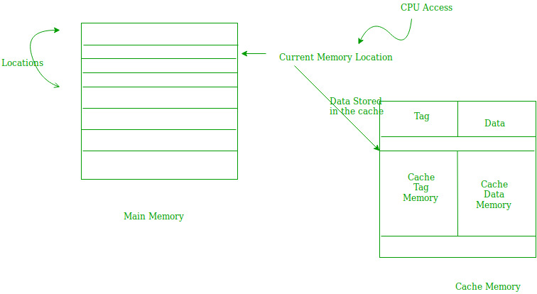

Slide 43
Spatial locality
Spatial locality means instruction or data near to the current memory location that is being fetched, may be needed soon in the near future.
It refers to the use of data elements within relatively close storage location.
This is slightly different from the temporal locality. Here we are talking about nearly located memory locations while in temporal locality we were talking about the actual memory location that was being fetched.

Slide 44
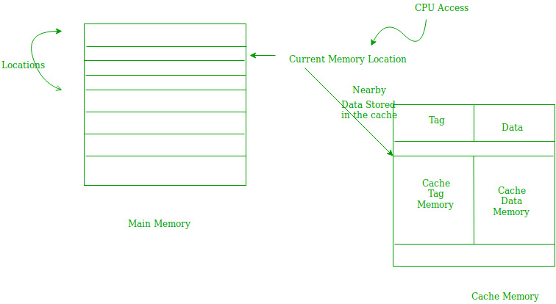

Slide 45
Cache performance measurement
Hit time—the time it takes to access a memory location in the cache.
Miss penalty— A cache miss penalty refers to the delay caused by a cache miss.
It indicates the extra time a cache spends to fetch data from its memory.

Slide 46
Methods to reduce Hit Time
1. Small and simple caches: If lesser hardware is required for the implementation of caches, then it decreases the Hit time because of the shorter critical path through the Hardware.
2. Avoid Address translation during indexing: Caches that use physical addresses for indexing are known as a physical cache. Caches that use the virtual addresses for indexing are known as virtual cache. Address translation can be avoided by using virtual caches. Hence, they help in reducing the hit time.

Slide 47
Methods to reduce Miss Rate:
Larger block size: If the block size is increased, spatial locality can be exploited in an efficient way which results in a reduction of miss rates.
Larger cache size: Increasing the cache size results in a decrease of capacity misses, thereby decreasing the miss rate. But, they increase the hit time and power consumption.
These are the basic methods through which the performance of cache can be optimized

Slide 48
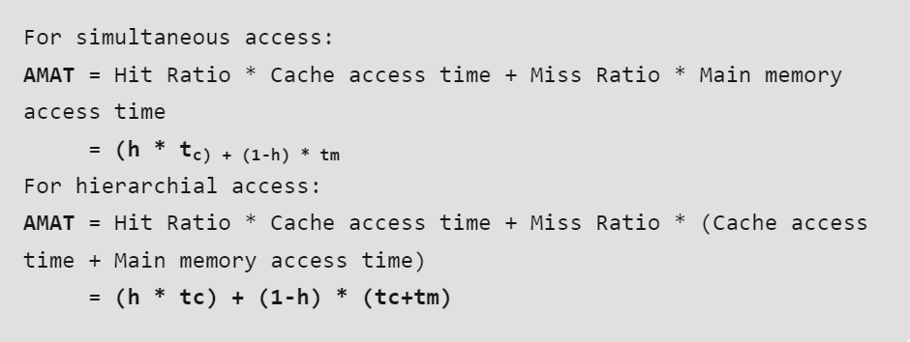
Average Memory Access Time(AMAT)
AMAT helps in analyzing the cache memory and its performance.
The lesser the AMAT, the better the performance is.
AMAT can be calculated as:

Slide 49
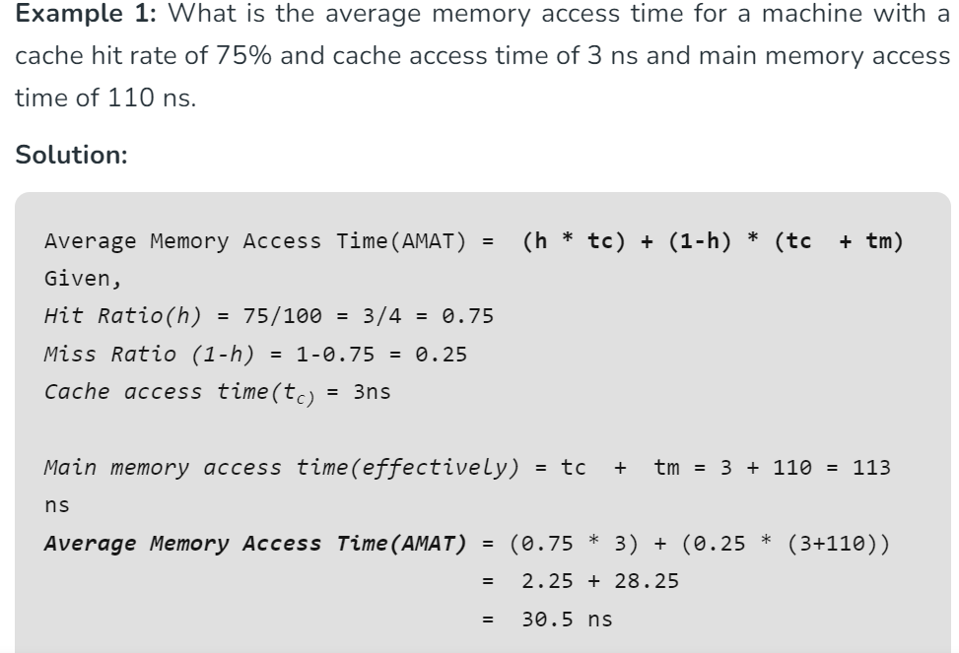

Slide 50
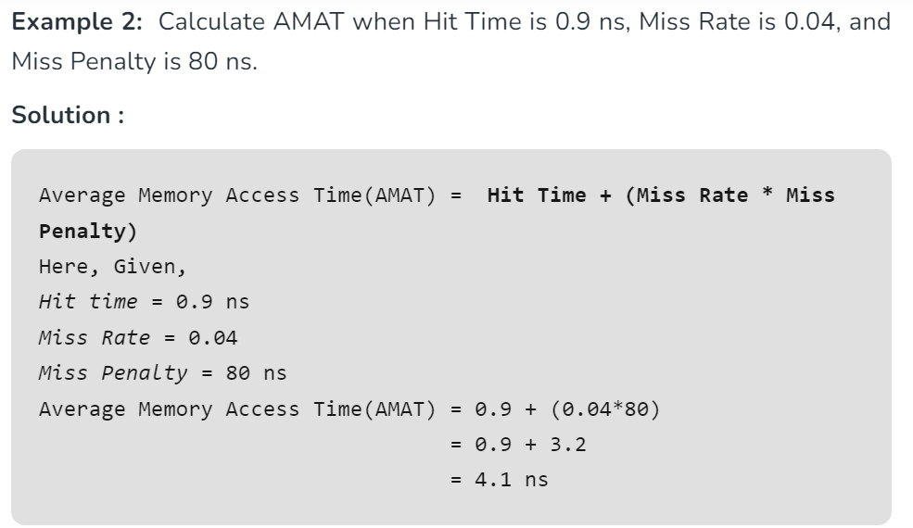

Slide 51
Cache Mapping
It is a technique that is used to bring the main memory content to the cache or to identify the cache block in which the required content is present.
The process of extracting the cache memory location and other related information in which the required content is present from the main memory address is called as cache mapping.
The cache mapping is done on the collection of bytes called blocks. In the mapping, the block of main memory is moved to the line of the cache memory.

Slide 52
Primary Terminologies
Some primary terminologies related to cache mapping are listed below:
Main Memory Blocks: The main memory is divided into equal-sized partitions called the main memory blocks.
Cache Line: The cache is divided into equal partitions called the cache lines.
Tag Bits: Tag bits are the identification bits that are used to identify which block of main memory is present in the cache line.

Slide 53
Need for Cache Mapping
Cache mapping is needed to identify where the cache memory is present in cache memory.
Mapping provides the cache line number where the content is present in the case of cache hit
or where to bring the content from the main memory in the case of cache miss.

Slide 54
Cache Mapping Techniques
There are three types of cache mappings namely:
Direct Mapping
Fully Associative Mapping
Set Associative Mapping

Slide 55
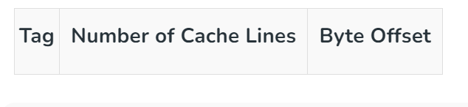
Direct Mapping
In direct mapping physical address is divided into three parts i.e., Tag bits, Cache Line Number and Byte offset.
The bits in the cache line number represents the cache line in which the content is present whereas the bits in tag are the identification bits that represents which block of main memory is present in cache.
The bits in the byte offset decides in which byte of the identified block the required content is present.

Slide 56
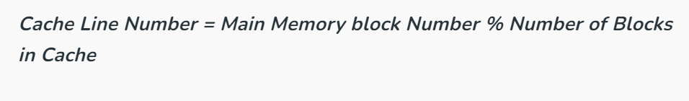
The simplest technique is direct mapping
If a line is previously taken up by a memory block when a new block needs to be loaded, the old block is trashed.
Direct mapping’s performance is directly proportional to the hit ratio.

Slide 57
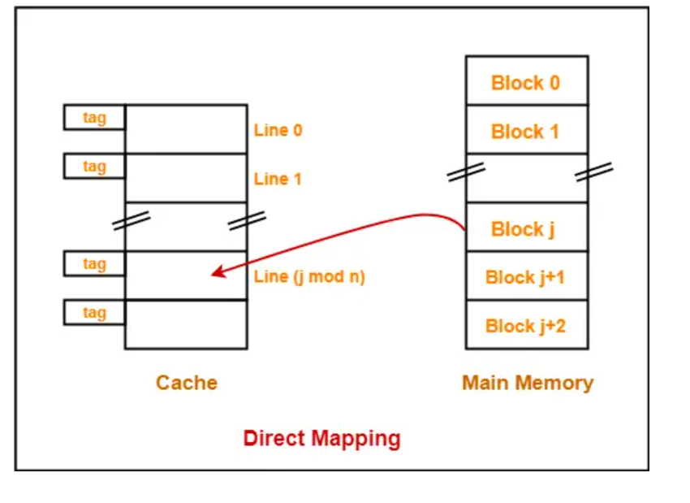

Slide 58
Drawbacks
Compulsory miss occurs
Conflict miss occurs
Cache memory could not be used effectively

Slide 59
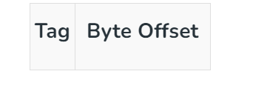
Fully Associative Mapping
In fully associative mapping address is divided into two parts i.e., Tag bits and Byte offset.
The tag bits identify that which memory block is present and
bits in the byte offset field decides in which byte of the block the required content is present.

Slide 60
In this type of mapping, associative memory is used to store the content and addresses of the memory word.
A block of main memory can map to any line of the cache that is freely available at that moment.
This enables the placement of any word at any place in the cache memory.
It is considered to be the fastest and most flexible mapping form.

Slide 61
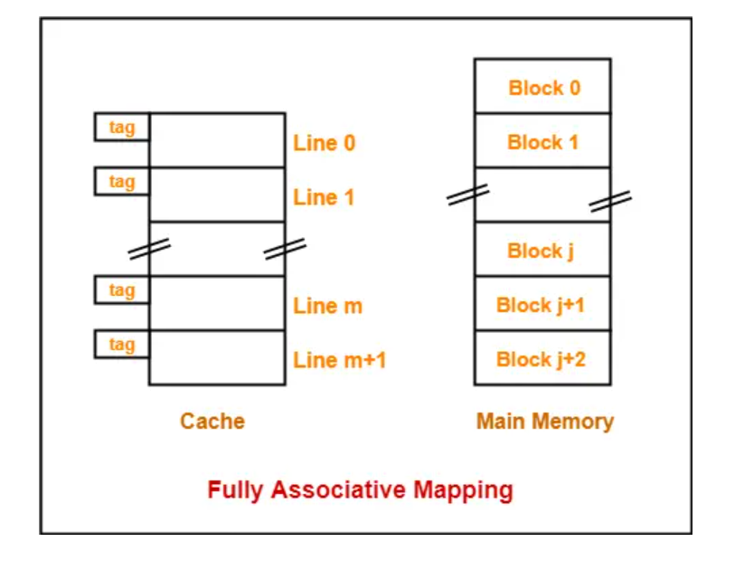

Slide 62

Set Associative Mapping
In set associative mapping the cache blocks are divided in sets.
It divides address into three parts i.e., Tag bits, set number and byte offset.
The bits in set number decides that in which set of the cache the required block is present and
tag bits identify which block of the main memory is present.
The bits in the byte offset field gives us the byte of the block in which the content is present.

Slide 63
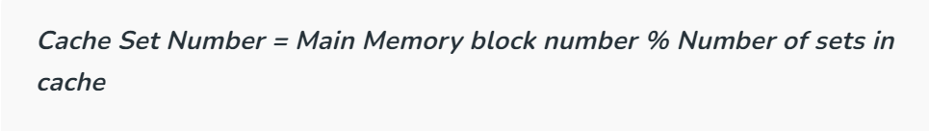
This form of mapping is an enhanced form of direct mapping where the drawbacks of direct mapping are removed.
Set associative cache mapping combines the best of direct and associative cache mapping techniques

Slide 64
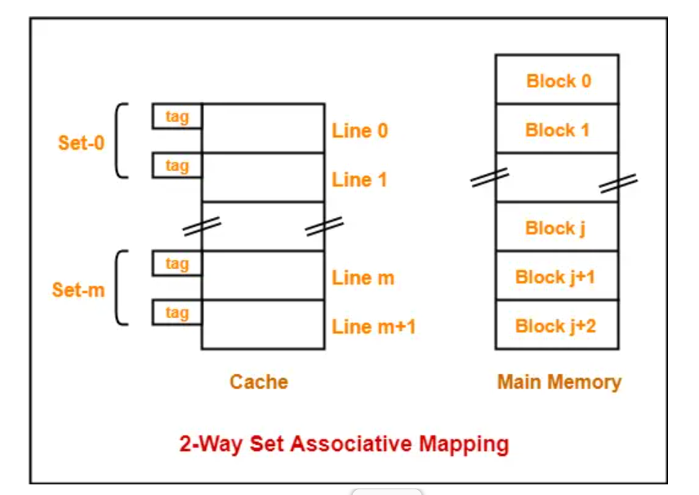

Slide 65
Virtual memory
Virtual Memory is a storage scheme that provides user an illusion of having a very big main memory.
This is done by treating a part of secondary memory as the main memory.
Virtual memory provides benefits in terms of costs, physical space, multitasking capabilities, and data security.

Slide 66
Types of virtual memory
There are two techniques to manage virtual memory,
paging
segmentation.
Paging: RAM is segregated into blocks. These blocks are referred to as pages. Computing processes are then allocated to these pages based on their memory needs.

Slide 67
Segmentation
Another approach to efficient memory management is that of segmentation.
Instead of allocating fixed-size pages to processes, memory segments of varied lengths are assigned to computing operations based on their memory needs.
In contrast to paging, segmentation does not waste memory segments.

Slide 68
Benefits Of Virtual memory
Balance the shortage of physical space:
Paging and segmentation methods ensure that main memory is freed up for necessary and critical operations.
Inexpensive virtual memory:
It settles within the system’s hardware limit and boosts the device performance, especially in mobile phones, without causing a financial burden.

Slide 69
Supports multitasking and collaboration
virtual memory enables multiprogramming wherein multiple users or processes can access shared memory, enhancing CPU and RAM utilization.
Enhance data security:
It minimizes the chances of data manipulation and spying

Slide 70
Disadvantages of Virtual Memory
It can slow down the system performance, as data needs to be constantly transferred between the physical memory and the hard disk.
It takes more time in switching between applications.
It can increase the risk of data loss or corruption, as data can be lost if the hard disk fails or if there is a power outage while data is being transferred to or from the hard disk.
It can increase the complexity of the memory management system, as the operating system needs to manage both physical and virtual memory.

Slide 71
Memory Interleaving
It is an abstraction technique which divides physical memory into a number of modules or equal size chunks such that consecutive words in the address space are placed in distinct modules.
It spreads memory addresses uniformly across memory banks to compensate for the relatively poor speed of dynamic random-access memory (DRAM)

Slide 72
Example:
Suppose we have 4 memory banks, each containing 256 bytes, and then the Block Oriented scheme (no interleaving) will assign virtual addresses 0 to 255 to the first bank and 256 to 511 to the second bank.
But in Interleaved memory, virtual address 0 will be with the first bank, 1 with the second memory bank, 2 with the third bank and 3 with the fourth, and then 4 with the first memory bank again

Slide 73
Need of memory interleaving
When the processor requests data from the main memory, a block (chunk) of data is transferred to the cache and then to processor.
So whenever a cache miss occurs, the data is to be fetched from the main memory.
But main memory is relatively slower than the cache.
So to improve the access time of the main memory, interleaving is used.

Slide 74
Why is interleaved memory used?
Overcoming Single Module Limitations:
Traditional memory systems rely on a single memory module to store and retrieve data, which can create a bottleneck due to limited data access speed.
It divides memory into multiple banks, allowing simultaneous access to increase memory bandwidth and enhance data transfer rates.

Slide 75
Reducing Memory Latency:
In non-interleaved memory systems, the CPU often waits for a memory module to complete its ongoing operation before accessing data.
It mitigates this latency issue by enabling the CPU to access data from different memory modules simultaneously, reducing waiting times and improving overall system performance.

Slide 76
Classification of Memory Interleaving:
High Order Interleaving
Low Order Interleaving

Slide 77
High Order Interleaving
the most significant bits decides memory banks where a particular location resides.
The least significant bits are sent as addresses to each chip.
One problem is that consecutive addresses tend to be in the same chip.
The maximum rate of data transfer is limited by the memory cycle time.
It is also known as Memory Banking.

Slide 78
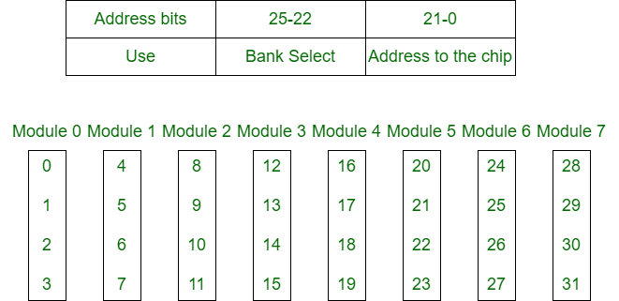

Slide 79
Low Order Interleaving
The least significant bits select the memory bank (module) in low-order interleaving.
In this, consecutive memory addresses are in different memory modules, allowing memory access faster than the cycle time.

Slide 80
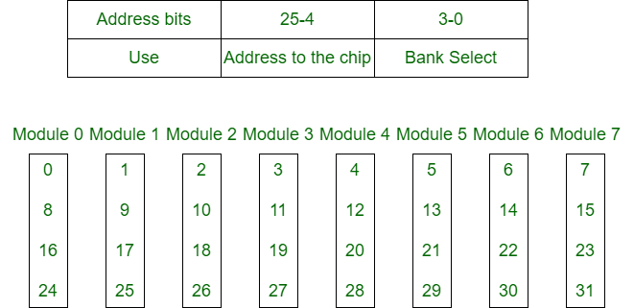

Slide 81
Benefits of Interleaved Memory
It allows simultaneous access to different modules of memory.
interleave memory makes a system more responsive and faster than non-interleaving.
with simultaneous memory access, the CPU processing time also decreases and increasing throughput.
Interleave memory is useful in the system with pipelining and vector processing.
An n-way interleaved memory in which main memory is divided into n-banks and the system can access n operands/instructions from n separate memory banks at the same time. This type of memory access can minimize memory access time

