Slide 1

Automata Formal Languages & Logic
Prof. Divyaprabha K N
Department of Computer Science & Engineering
ACK: Prof. Kavitha K N

Slide 2
Automata Formal Languages & Logic
Unit 1- Minimization of DFA
Divyaprabha K N
Department of Computer Science & Engineering

Slide 3

Automata Formal Languages and Logic
Unit 1 - Deterministic Finite Acceptor/Automata
What is minimization of DFA?
In automata theory (a branch of theoretical computer science ), DFA minimization is the task of transforming a given deterministic finite automaton (DFA) into an equivalent DFA that has a minimum number of states. Here, two DFAs are called equivalent if they recognize the same regular language .(definition from wikipedia)

Slide 4
Automata Formal Languages and Logic
Unit 1 - Deterministic Finite Acceptor/Automata
Why one must reduce the number of states in DFA?
When constructing NFA from regular expression and converting the resultant NFA to DFA using subset construction method, the resulting DFA may not always be the smallest one with less number of states accepting the smme class of languages. It is always desirable to minimize the automata where the implementation of the minimized DFA will be more efficient the in terms of space and speed of execution
Note: The minimal equivalent DFA is unique up to naming of the states

Slide 5
Automata Formal Languages and Logic
Unit 1 - Deterministic Finite Acceptor/Automata
Algorithm to Minimize/reduce the number of states in DFA
Table filling Algorithm:
Let the DFA be D=(Q, ∑, δ, q₀ F),
The table filling algorithm for minimizing the given DFA is as follows:
Construct a table(triangular matrix table) of pairs (x,y) where x and y are the states in DFA, x,y ∈ Q, initially all the entries in the table are unmarked
Mark the pair(x,y) if x ∉ F and y ∈ F and the other way around . this marked pairs are called distinguishable pairs.
Repeat the following step up till you make an entire pass of the table and no new pair gets marked:
If (x,y) is unmarked and there exists a symbol ‘a ∈ Σ’ such that a pair {δ(x,a),
δ(y,a)} is marked then mark the pair (x,y)
After completion, x=y, if and only if the pair (x,y) is not marked and that pair can be merged as considered as a single state. And this pair is called indistinguishable pair

Slide 6
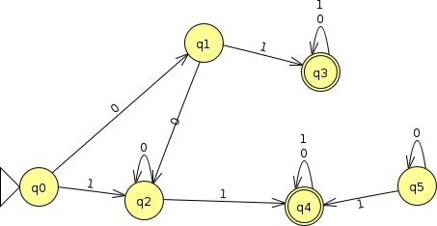
Automata Formal Languages and Logic
Unit 1 - Deterministic Finite Acceptor/Automata
Example 1: Minimize the following DFA:
Transition table:
 | 0 | 1
q0 | q1 | q2
q1 | q2 | q3
q2 | q2 | q4
q3 | q3 | q3
q4 | q4 | q4
To minimize the above DFA,
Identify the state which is not reachable from the start state and remove that state. In the above DFA state q5 is not reachable fro start state and should be removed. Then apply table filling algorithm for the DFA resultant DFA(DFA after removing the state not reachable form the start state.
Construct a table of pairs as shown below:

Slide 7
Automata Formal Languages and Logic
Unit 1 - Deterministic Finite Acceptor/Automata
Example 1: Minimize the following DFA:
While constructing the table , start the horizontal cells from state 0 to last but one state , in this example you can start form state q0 and end with state q3, Start the vertical cells from second state and end with last state , in this example start with state q1 and end with state q5. you can follow any order but it is advisable to go in increasing order for easier understanding.
Step 1:
q1
q2
*q3
*q4
 | q0 | q1 | q2 | * q3

Slide 8
Automata Formal Languages and Logic
Unit 1 - Deterministic Finite Acceptor/Automata
Example 1: Minimize the following DFA:
Table after 1st iteration:
Mark all distinguishable pairs: i.e, Mark all final and non final states(step 2:) since q0,q1,q2 are non final states and q3 and q4 are final states we can quickly enter ‘X’ in 6 cells.
q1
q2
*q3 | X | X | X
*q4 | X | X | X
 | q0 | q1 | q2 | * q3

Slide 9
Automata Formal Languages and Logic
Unit 1 - Deterministic Finite Acceptor/Automata
Example 1: Minimize the following DFA:
Next apply 3rd rule and try and see whether the remaining cells can be marked,
{q0,q1}:
{δ(q0,0), δ(q1,0)}= {q1, q2}
The resulting pair is not marked.
{δ(q0,1), δ(q1,1)}={q2,q3}
The resulting pair{q2,q3} is marked , so we can mark the pair {q1.q2} as a distinguished pair.
{q0,q2}:
{δ(q0,0), δ(q2,0)}= {q1,q2}
The resulting pair is not marked
{δ(q0,1), δ(q2,1)}= {q2,q4}
The resulting pair {q2,q4} is marked , so we can mark the pair {q0,q2} as a distinguished pair.
{q1,q2}:
{δ(q1,0), δ(q2,0)}={q2} can't mark
{δ(q1,1), δ(q2,1)}={q3,q4} cant mark as the resulting pair is both final state.
{q3,q3} can't be marked as distinguishable pair as both the states are final states

Slide 10
Automata Formal Languages and Logic
Unit 1 - Deterministic Finite Acceptor/Automata
Example 1: Minimize the following DFA:
Final Table
q1 | X
q2 | X
*q3 | X | X | X
*q4 | X | X | X
 | q0 | q1 | q2 | * q3

Slide 11
Automata Formal Languages and Logic
Unit 1 - Deterministic Finite Acceptor/Automata
Example 1: Minimize the following DFA:
The cell corresponding to the pairs which are not marked are indistinguishable pairs of final state
and non-final states and can be merged as a single final state and single non-final state. Pair {q1,q2} can be merged as a single non-final state and pair {q3,q4} can be merged as single final state
The resulting DFA will have 3 states after merging they are {q1,q2} , {q3q4}, q0 The transition table of the minimized DFA :
δ(q0,0)= q1
δ(q0,1)=q2
={q1,q2}
δ({q1q2},0)= q2 (q1q2)
δ({q1q2},1)= {q3q4}
δ({q3q4},0)= {q3q4}
δ({q3q4},0)= {q3q4}

Slide 12
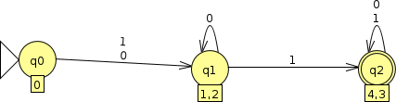
Automata Formal Languages and Logic
Unit 1 - Deterministic Finite Acceptor/Automata
Example 1: Minimize the following DFA:
The final minimized DFA state diagram:
 | 0 | 1
q0 | {q1,q2} | {q1,q2}
{q1,q2} | {q1,q2} | {q3q4}
{q3,q4} | {q3q4} | {q3q4}

Slide 13
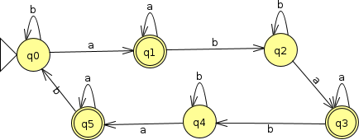
Automata Formal Languages and Logic
Unit 1 - Deterministic Finite Acceptor/Automata
Example 2: Minimize the following DFA:
TRANSITION TABLE:
 | a | b
q0 | q1 | q0
q1 | q1 | q2
q2 | q3 | q2
12 q3 | q3 | q4
q4 | q5 | q4
q5 | q5 | q0

Slide 14
Automata Formal Languages and Logic
Unit 1 - Deterministic Finite Acceptor/Automata
Example 2: Minimize the following DFA:
Final table:
All the states are reachable from the start state. Construct the table using table filling algorithm
Table after filling the final and non final pairs is given below:
*q1 | X
q2 |  | X
*q3 | X |  | X
q4 |  | X |  | X
*q5 | X |  | X |  | X
 | q0 | *q1 | q2 | *q3 | q4

Slide 15
Automata Formal Languages and Logic
Unit 1 - Deterministic Finite Acceptor/Automata
Example 2: Minimize the following DFA:
Next apply 3rd rule and try and see whether the remaining cells can be marked,
{q0,q2}:
{δ(q0,a), δ(q2,a)}= {q1,q3}
The resultant pair is not marked
{δ(q0,b), δ(q2,b)}= {q0q2}
The resultant pair is not marked
So the pair {q0,q2} can't be marked as distinguishable pair
{q0,q4}:
{δ(q0,a), δ(q4,a)}={q1,q5} Resultant pair is not marked
{δ(q0,b), δ(q4,b)}={q0,q4}
Resultant pair is not marked
So the pair {q0,q4} can't be marked as distinguishable pair

Slide 16
Automata Formal Languages and Logic
Unit 1 - Deterministic Finite Acceptor/Automata
Example 2: Minimize the following DFA:
{q1,q5}:
{δ(q1,a), δ(q5,a)}={q1,q5} Resultant pair is not marked
{δ(q1,b), δ(q5,b)}={q2,q0} Resultant pair is not marked
So the pair {q1,q5} can't be marked as distinguishable pair
{q1,q3}:
{δ(q1,a), δ(q3,a)}={q1,q3} Resultant pair is not marked
{δ(q1,b), δ(q3,b)}={q2,q4} Resultant pair is not marked
So the pair {q1,q3} can't be marked as distinguishable pair
So the states, {q0,q4,q2} can be merged into single state and {q1,q3,q5) can be merged as another state.

Slide 17
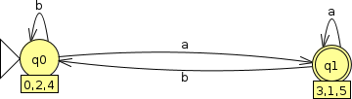
Automata Formal Languages and Logic
Unit 1 - Deterministic Finite Acceptor/Automata
Example 2: Minimize the following DFA:
The transition table for the minimized DFA:
 | a | b
{q0q2q4} | {q1q3q5} | {q0q2q4}
{q1q3q5} | {q1q3q5} | {q0q2q4}
Minimized DFA state diagram:

Slide 18
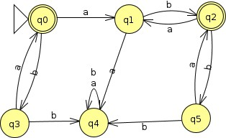
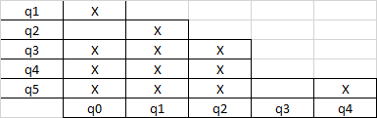

Automata Formal Languages and Logic
Unit 1 - Deterministic Finite Acceptor/Automata
Example 3 : Minimize the following DFA
Transition table:
 | a | b
->*q0 | q1 | q3
q1 | q4 | q2
*q2 | q1 | q5
q3 | q0 | q4
q4 | q4 | q4
q5 | q2 | q4
The table after applying table filling algorithm

Slide 19
Automata Formal Languages and Logic
Unit 1 - Deterministic Finite Acceptor/Automata
Example 3 : Minimize the following DFA
The 4 states after applying table filling algorithm are: {q0q2}, { q3,q5}, q1,q4 The minimized DFA transition table:
The states are renamed as:
{q0q2}=q3
{q3q5}= q1 Q1 = q1
q0=q4
 | a | b
->*q3 | q2 | q1
q2 | q0 | q3
q1 | q3 | q0
q0 | q0 | q0

Slide 20
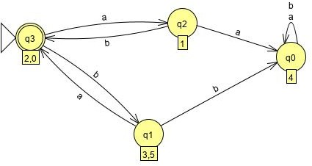
Automata Formal Languages and Logic
Unit 1 - Deterministic Finite Acceptor/Automata
Example 3 : Minimize the following DFA
The minimized DFA transition diagram::

Slide 21
THANK YOU
Divyaprabha K N
Department of Computer Science & Engineering
divyaprabha@pes.edu

