Slide 1

DIGITAL DESIGN AND COMPUTER ORGANIZATION
Multiplexers
Team DDCO Department of Computer Science and Engineering

Slide 2
DIGITAL DESIGN AND COMPUTER ORGANIZATION
Multiplexers
Department of Computer Science and Engineering

Slide 3
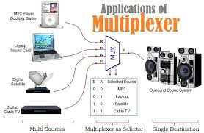
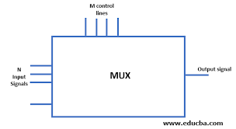
Combinational logic Multiplexers
A multiplexer (also called a mux) multiplexes many inputs onto a single output
Data selector
Many to one
N:1 MUX
2^{N} inputs n select lines , one output
M. Morris Mano, Michael D. Ciletti, Digital Design: With an Introduction to the Verilog HDL, 5th ed., Prentice Hall, 2012, Section 4.11

Slide 4
Combinational logic Multiplexers
A multiplexer is a combinational circuit that selects binary information from one of many input lines and directs it to a single output line. The selection of a particular input line is controlled by a set of selection lines. Normally, there are 2^{n} input lines and n selection lines whose bit combinations determine which input is selected.
M. Morris Mano, Michael D. Ciletti, Digital Design: With an Introduction to the Verilog HDL, 5th ed., Prentice Hall, 2012, Section 4.11

Slide 5
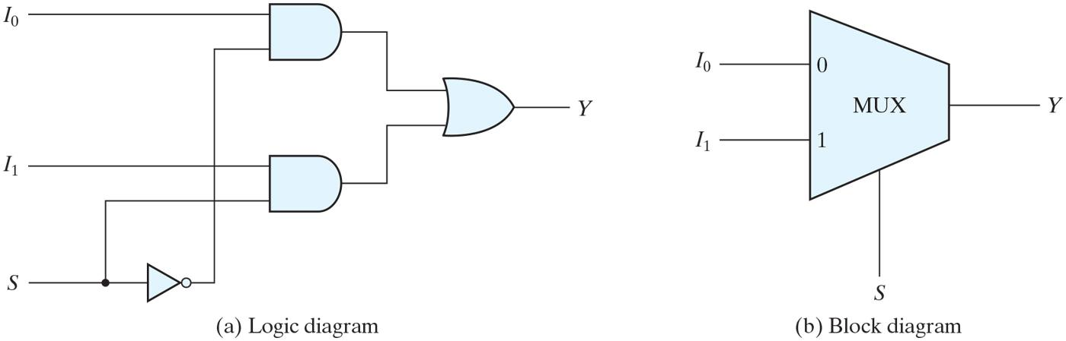
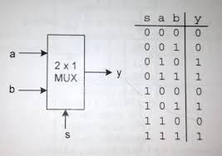
Combinational logic Multiplexers
Two to One Line Multiplexer

Slide 6
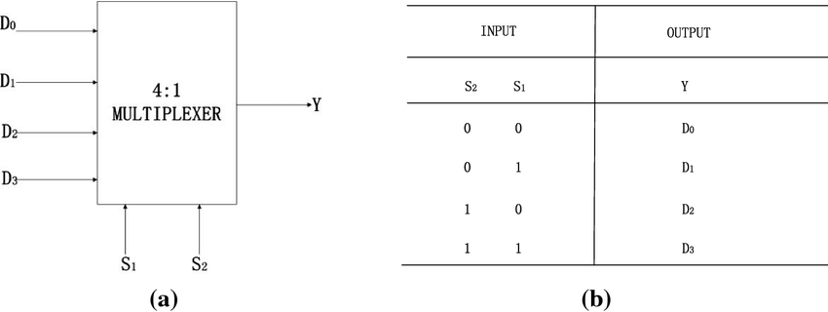
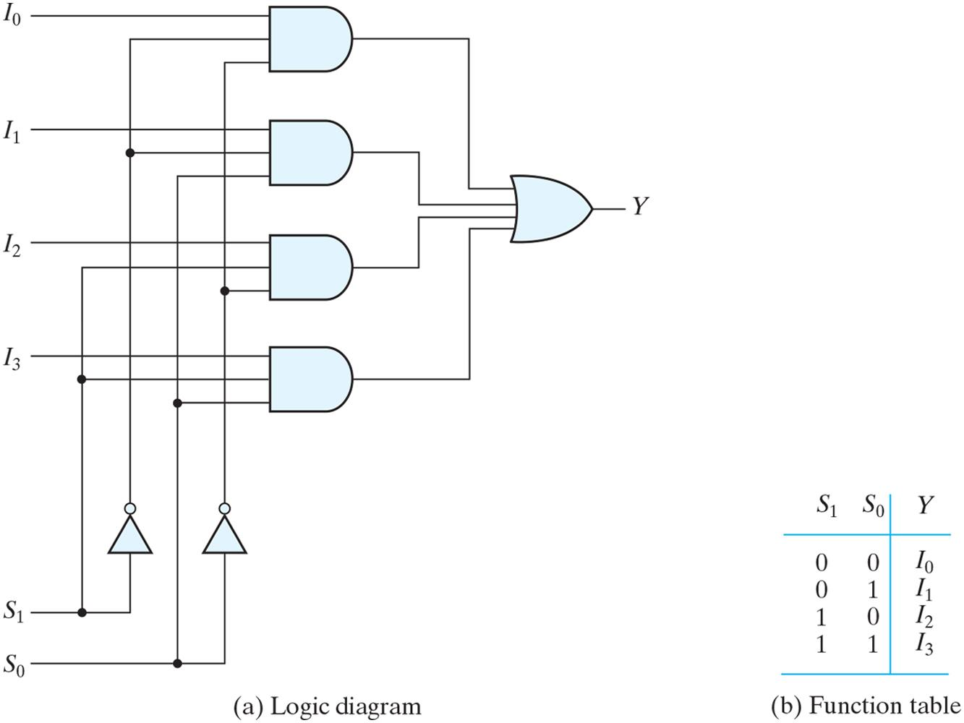
Combinational logic Multiplexers
Four to One Line Multiplexer

Slide 7
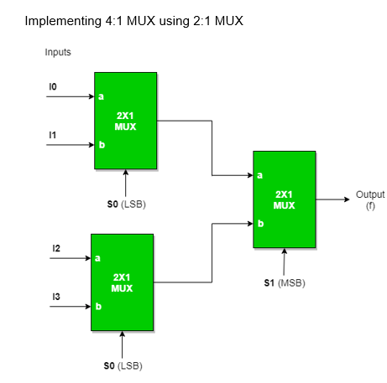
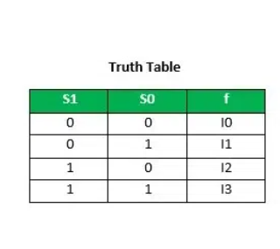
Combinational logic Multiplexers
Implementing 4:1 MUX using 2:1 MUX

Slide 8
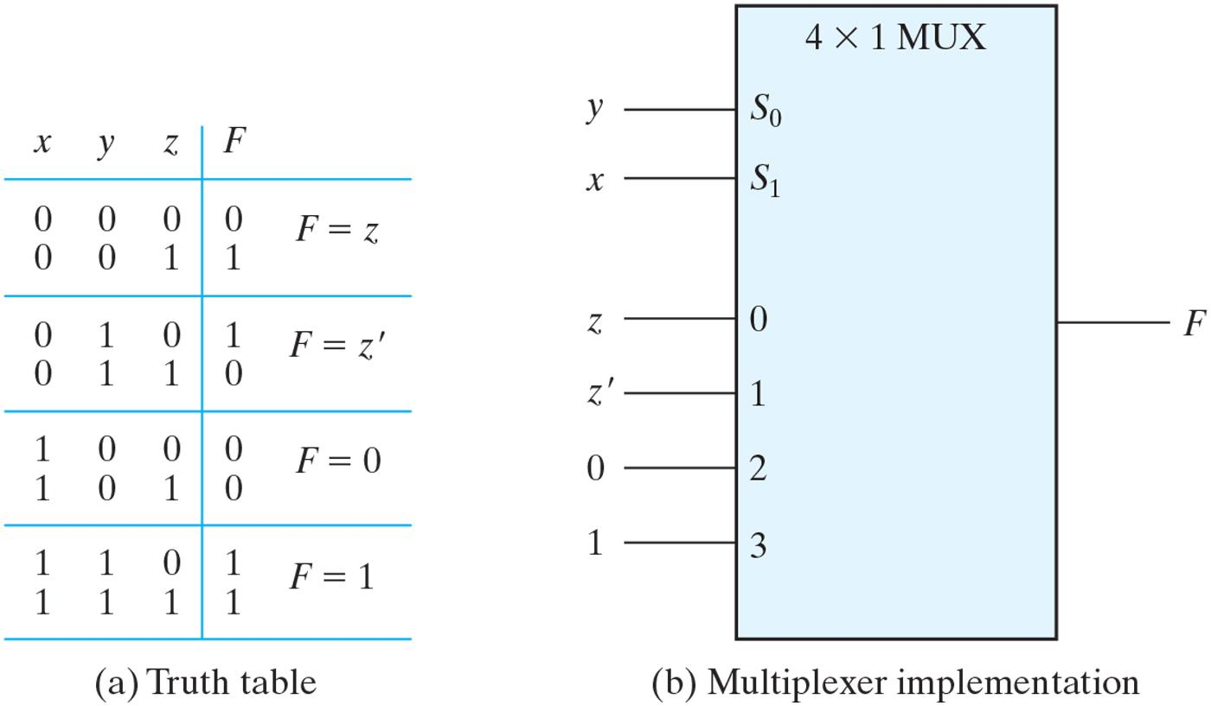
Combinational logic Multiplexers-Boolean Function Implementation
Implementing a Boolean Function with a Multiplexer
F (x, y, z) = (1, 2, 6, 7)
Connect input variables to select inputs of multiplexer (n-1 for n variables)
Set data inputs to multiplexer equal to values of function for corresponding assignment of select variables
Using a variable at data inputs reduces size of the multiplexer

Slide 9
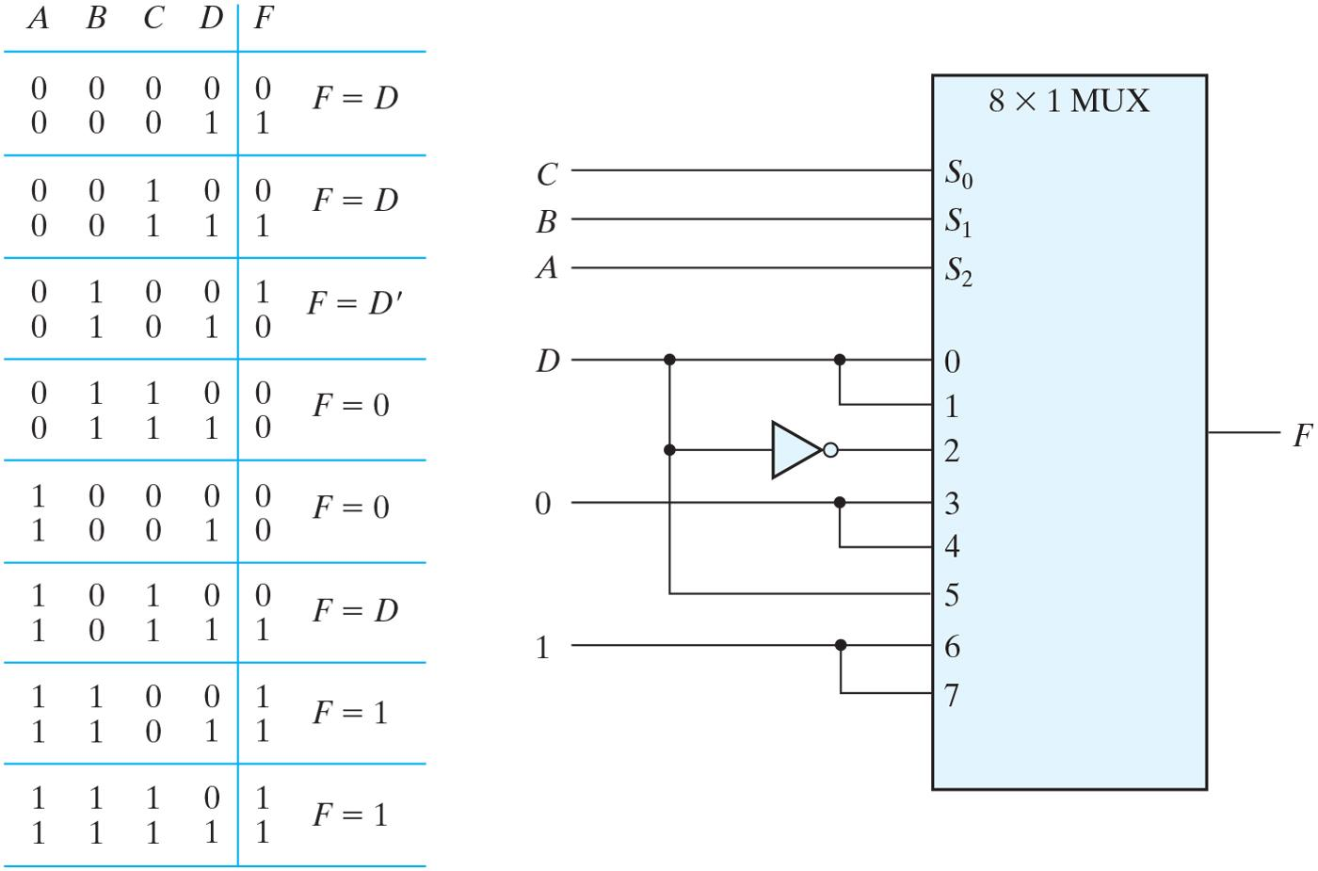
Combinational logic Multiplexers
Implementing a four input Function with a 8X1 Multiplexer
F (A, B, C, D) = (1, 3, 4, 11, 12, 13, 14, 15)

Slide 10
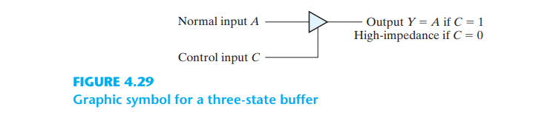
Combinational logic Multiplexers- Three State Gates
Two of the states are signals equivalent to logic 1 and logic 0 as in a conventional gate. The third state is a high-impedance state in which (1) the logic behaves like an open circuit, which means that the output appears to be disconnected, (2) the circuit has no logic significance, and (3) the circuit connected to the output of the three-state gate is not affected by the inputs to the gate.

Slide 11
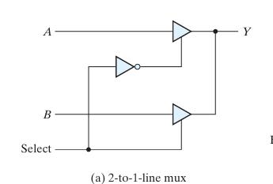

Combinational logic Multiplexers- Three State Gates
When the select input is 0, the upper buffer is enabled by its control input and the lower buffer is disabled. Output Y is then equal to input A . When the select input is 1, the lower buffer is enabled and Y is equal to B
The construction of multiplexers with three-state buffers is demonstrated in Fig. 4.30 . Figure 4.30(a) shows the construction of a two-to-one-line multiplexer with 2 three-state buffers and an inverter. The two outputs are connected together to form a single output line.

Slide 12
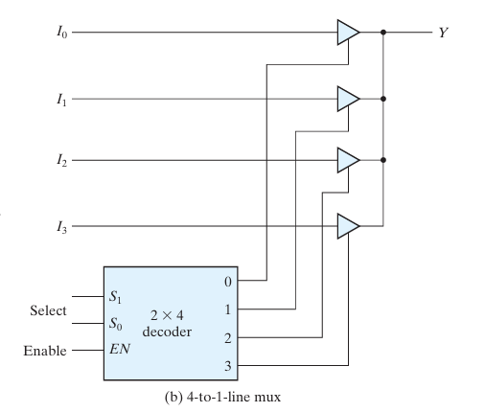
Combinational logic Multiplexers- Three State Gates
No more than one buffer may be in the active state at any given time.
One way to ensure that no more than one control input is active at any given time is to use a decoder, as shown in the diagram
When the enable input of the decoder is 0, all of its four outputs are 0 and the bus line is in a high-impedance state because all four buffers are disabled. When the enable input is active, one of the three state buffers will be active, depending on the binary value in the select inputs of the decoder.

Slide 13
Combinational logic Multiplexers- Think about it
5:1 Mux
A combinational logic circuit having n data inputs, [log₂ n| control inputs and one output, that connects the data input indicated by the control inputs to the output
What is the Boolean formula for a 3:1 mux? Construct a 3:1 mux using 2:1 muxes
AND, OR and NOT gates

Slide 14
Combinational logic Multiplexers- Think about it
Using 2 X 1 MUX design y=AB
Using 4 X 1 MUX design y=AB`+ B`C`+A`BC

Slide 15
Combinational logic Multiplexers-
A 4-to-1 multiplexer is used to implement the Boolean function F(A,B,C)=∑m(1,3,5,7) Which variables should be connected to the select lines of the MUX? A) A and B B) B and C C) A and C D) Any two variables
How many select lines are required for a 5:1 multiplexer?
A) 2 B) 3 C) 4 D) 5

Slide 16
Combinational logic Multiplexers-
A 4-to-1 multiplexer is used to implement the Boolean function F(A,B,C)=∑m(1,3,5,7) Which variables should be connected to the select lines of the MUX? A) A and B B) B and C C) A and C D) Any two variables
Answer: D
. How many select lines are required for a 5:1 multiplexer?
A) 2 B) 3 C) 4 D) 5
Answer: B) 3

Slide 17
Combinational logic Multiplexers-
The Boolean function F(x,y,z)=∑m(1,2,6,7) is implemented using an 8:1 multiplexer. What should be the values of data inputs D₀ to D₇?
D = {1,1,1,0,0,0,1,1} B) D = {0,1,0,1,0,1,0,1} C) D = {1,0,0,1,1,1,0,0} D) D = {0,1,1,0,0,0,1,1}

Slide 18
Combinational logic Multiplexers-
The Boolean function F(x,y,z)=∑m(1,2,6,7) is implemented using an 8:1 multiplexer. What should be the values of data inputs D₀ to D₇?
A) D = {1,1,1,0,0,0,1,1} B) D = {0,1,0,1,0,1,0,1} C) D = {1,0,0,1,1,1,0,0} D) D = {0,1,1,0,0,0,1,1}
Answer: D) D = {0,1,1,0,0,0,1,1} Explanation:
The minterms correspond to the positions where F = 1.
So, D₁ = D₂ = D₆ = D₇ = 1, rest are 0.

Slide 19
THANK YOU
Team DDCO
Department of Computer Science

