Slide 1

DIGITAL DESIGN AND COMPUTER ORGANIZATION
Other counters
Team DDCO Department of Computer Science and Engineering

Slide 2
Other Counters(T1 section 6.5)
Counters can be designed to generate any desired sequence of states. A divide‐by‐ N counter (also known as a modulo‐ N counter) is a counter that goes through a repeated sequence of N states.
A circuit with n flip‐flops has 2^{n} binary states. There are occasions when a sequential circuit uses fewer than this maximum possible number of states. States that are not used in specifying the sequential circuit are not listed in the state table. In simplifying the input equations, the unused states may be treated as don’t‐care conditions or may be assigned specific next states.
it is necessary to ensure that the circuit eventually goes into one of the valid states so that it can resume normal operation. Otherwise, if the sequential circuit circulates among unused states, there will be no way to bring it back to its intended sequence of state transitions
M. Morris Mano, Michael D. Ciletti, Digital Design: With an Introduction to the Verilog HDL, 5th ed., Prentice Hall, 2012, Section 6.5.

Slide 3
Counter with Unused States
A circuit with n flip‐flops has 2n binary states. There are occasions when a sequential circuit uses fewer than this maximum possible number of states. States that are not used
In sequential circuit.
The count has a repeated sequence of six states, with flip‐flops B and C repeating the binary count 00, 01, 10, and flip‐flop A alternating between 0 and 1 every three counts.
M. Morris Mano, Michael D. Ciletti, Digital Design: With an Introduction to the Verilog HDL, 5th ed., Prentice Hall, 2012, Section 6.5.

Slide 4
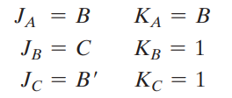
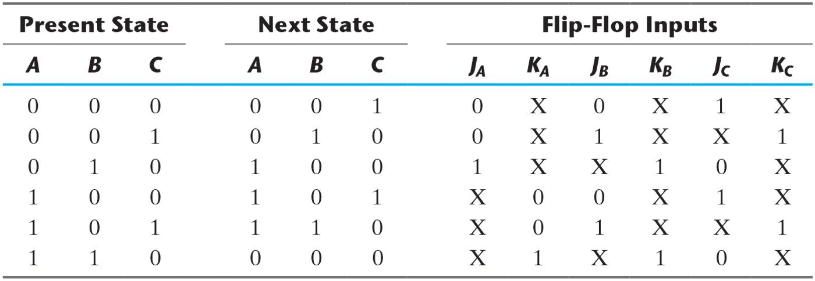
Table 6.7 State Table for Counter.
Other Counters with Unused States
Unused states= 011 and 111
M. Morris Mano, Michael D. Ciletti, Digital Design: With an Introduction to the Verilog HDL, 5th ed., Prentice Hall, 2012, Section 6.5.

Slide 5
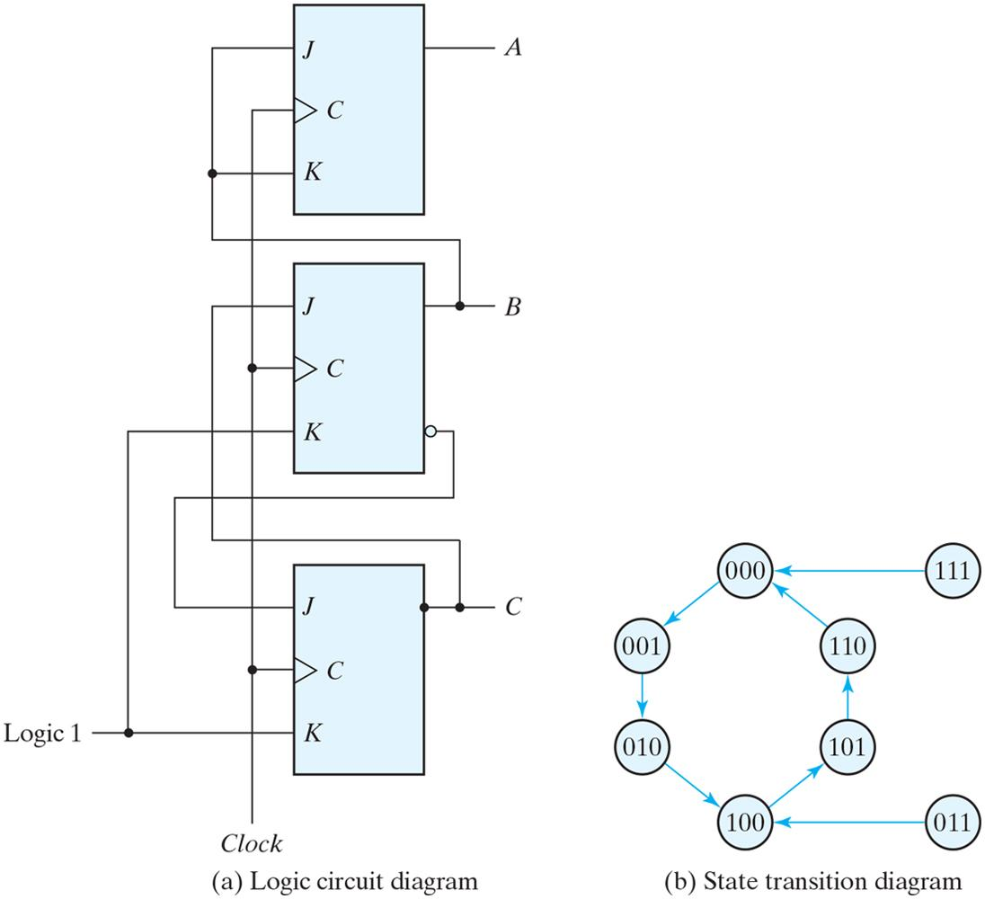
Figure 6.16 Counter with unused states.
Other Counters with Unused States
Thus, the counter is self‐correcting. In a self‐correcting counter, if the counter happens to be in one of the unused states, it eventually reaches the normal count sequence after one or more clock pulses
M. Morris Mano, Michael D. Ciletti, Digital Design: With an Introduction to the Verilog HDL, 5th ed., Prentice Hall, 2012, Section 6.5.

Slide 6
Ring Counters
A Ring Counter is a circular shift register with only one flip‐flop being set at any particular time; all others are cleared. The single bit is shifted from one flip‐flop to the next to produce the sequence of timing signals
The initial value of the register is 1000 and requires Preset/Clear flip‐flops.
Each flip‐flop is in the 1 state once every four clock cycles and produces one of the four timing signals
Each output becomes a 1 after the negative‐edge transition of a clock pulse and remains 1 during the next clock cycle.
M. Morris Mano, Michael D. Ciletti, Digital Design: With an Introduction to the Verilog HDL, 5th ed., Prentice Hall, 2012, Section 6.5.

Slide 7
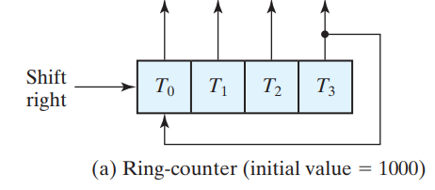
Ring Counters
Single bit shifted right with every clock pulse and circulates back from T3 to T0. Each flip‐flop is in the 1 state once every four clock cycles
It is negative edge triggered flipflop state changes on negative edge
Initial value is always 1000
M. Morris Mano, Michael D. Ciletti, Digital Design: With an Introduction to the Verilog HDL, 5th ed., Prentice Hall, 2012, Section 6.5.

Slide 8
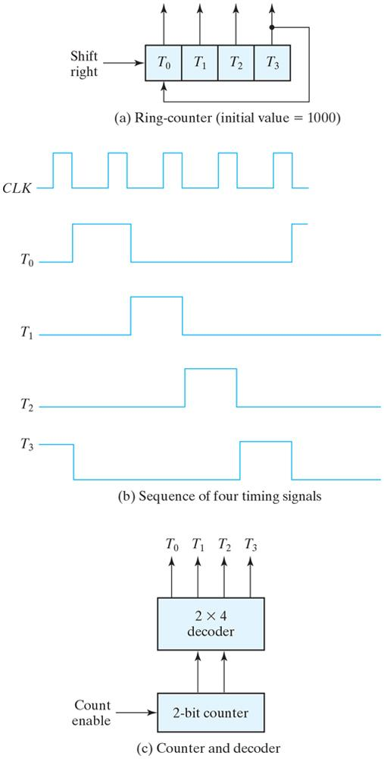
Figure 6.17 Generation of timing signals.
Ring Counters
M. Morris Mano, Michael D. Ciletti, Digital Design: With an Introduction to the Verilog HDL, 5th ed., Prentice Hall, 2012, Section 6.5.

Slide 9
Ring Counters
To generate 2^{n} timing signals, we need either a shift register with 2^{n} flip‐flops or an n ‐bit binary counter together with an n ‐to‐2 ^{n} ‐line decoder.
For example, 16 timing signals can be generated with a 16‐bit shift register connected as a ring counter or with a 4‐bit binary counter and a 4‐to‐16‐line decoder. In the first case, we need 16 flip‐flops. In the second, we need 4 flip‐flops and 16 four‐input AND gates for the decoder. It is also possible to generate the timing signals with a combination of a shift register and a decoder. That way, the number of flip‐flops is less than that in a ring counter, and the decoder requires only two‐input gates. This combination is called a Johnson counter .
M. Morris Mano, Michael D. Ciletti, Digital Design: With an Introduction to the Verilog HDL, 5th ed., Prentice Hall, 2012, Section 6.5.

Slide 10
Ring Counters –Summary
Counters constructed by connecting together flip-flops in closed loop, typically with a single 1 bit circulating among them, are called ring counters
Modulus of an n-bit ring counter is n
3-bit Ring Counter
d
q reset
d
q reset
d
q set
Reset
clk
Also called “one-hot” counters (as in one-hot encoding)
Number of states= number of flipflop, mod-8 ring counter requires eight flip-flops and a mod-16 ring counter would require sixteen flip-flops.(number of states=number of flipflops) but Other flipflop number of states is =2^{n}
M. Morris Mano, Michael D. Ciletti, Digital Design: With an Introduction to the Verilog HDL, 5th ed., Prentice Hall, 2012, Section 6.5.

Slide 11
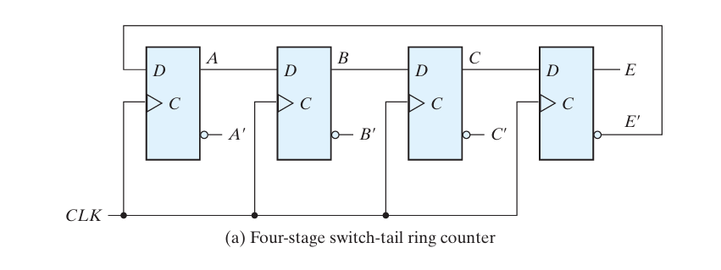
Johnson Counter
A k ‐bit ring counter circulates a single bit among the flip‐flops to provide k distinguish able states. The number of states can be doubled if the shift register is connected as a switch‐tail ring counter.
A switch‐tail ring counter is a circular shift register with the complemented output of the last flip‐flop connected to the input of the first flip‐flop.
M. Morris Mano, Michael D. Ciletti, Digital Design: With an Introduction to the Verilog HDL, 5th ed., Prentice Hall, 2012, Section 6.5.

Slide 12
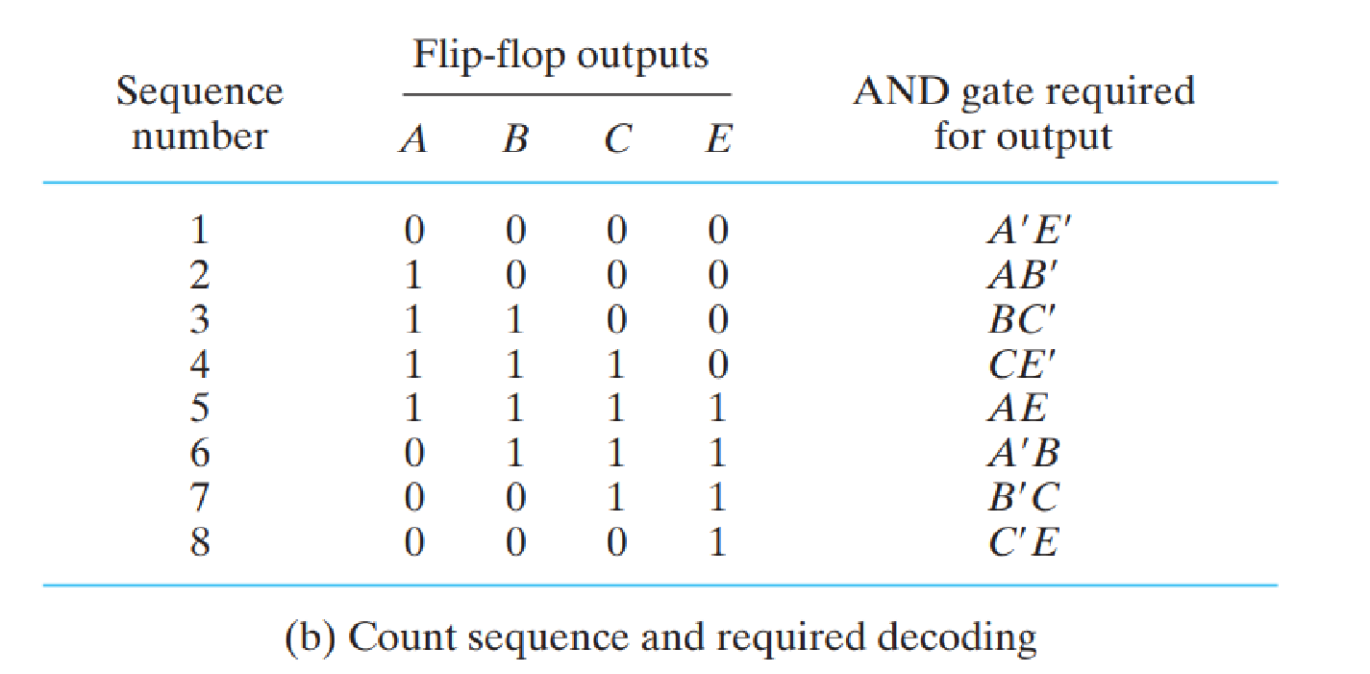
Johnson counter
M. Morris Mano, Michael D. Ciletti, Digital Design: With an Introduction to the Verilog HDL, 5th ed., Prentice Hall, 2012, Section 6.5.
Notes:
Identify first change in 0 /1 for all entries except for condition 0000 and 1111 write first and last element
Decoding for timing signals
Johnson counters can be constructed for any number of timing sequences. The number of flip-flops needed is one-half the number of timing signals.
The number of decoding gates is equal to the number of timing signals and only two-input gates are needed.

Slide 13
Johnson counter
The circular connection is made from the complemented output of the rightmost flip‐flop to the input of the leftmost flip‐flop.
The register shifts its contents once to the right with every clock pulse, and at the same time, the complemented value of the E flip‐flop is transferred into the A flip‐flop.
In general, a k ‐bit switch‐tail ring counter will go through a sequence of 2 k states. Starting from all 0’s, each shift operation inserts 1’s from the left until the register is filled with all 1’s. In the next sequences, 0’s are inserted from the left until the register is again filled with all 0’s.
A Johnson counter is a k ‐bit switch‐tail ring counter with 2 k decoding gates to pro vide outputs for 2 k timing signals.
The eight AND gates listed in the table, when connected to the circuit, will complete the construction of the Johnson counter.
M. Morris Mano, Michael D. Ciletti, Digital Design: With an Introduction to the Verilog HDL, 5th ed., Prentice Hall, 2012, Section 6.5.

Slide 14
Johnson Counter
One disadvantage of the circuit in Fig. 6.18 (a) is that if it finds itself in an unused state, it will persist in moving from one invalid state to another and never find its way to a valid state. The difficulty can be corrected by modifying the circuit to avoid this undesirable condition
One correcting procedure is to disconnect the output from flip‐flop B that goes to the D input of flip‐flop C and instead enable the input of flip‐flop C by the function
D_{C} = (A + C)B where D_{C} is the flip‐flop input equation for the D input of flip‐flop C. Johnson counters can be constructed for any number of timing sequences. The number of flip‐flops needed is one‐half the number of timing signals.
The number of decoding gates is equal to the number of timing signals, and only two‐input gates are needed.
M. Morris Mano, Michael D. Ciletti, Digital Design: With an Introduction to the Verilog HDL, 5th ed., Prentice Hall, 2012, Section 6.5.

Slide 15

COUNTERS - 2
Johnson counter using D flipflop(negative edge triggered)-summary
3-bit Johnson (Twisted Ring) Counter (switch tail counter)
d
q reset
d
q reset
d
q set
reset
clk
What is the modulus of an n-bit Johnson counter?
The MOD of the Johnson counter is 2n if n flip-flops are used. The main advantage of the Johnson counter is that it only needs half the number of flip-flops compared to the standard ring counter for the same MOD. ( 4ff=8 states(2n))
M. Morris Mano, Michael D. Ciletti, Digital Design: With an Introduction to the Verilog HDL, 5th ed., Prentice Hall, 2012, Section 6.5.
Notes:
Number of states = 2* number of flipflops
Applications of Ring & Johnson Counters
Frequency counters.
As object counters.
Parallel to serial data conversion logic circuits.
Analog to digital convertors.
Digital clocks.
Digital triangular wave generator.
Generating staircase voltage.
Frequency divider circuits of the clock signal

Slide 16
Ring Counter applications
Application: Instruction Pipeline Controller in Microprocessors
In certain simple microcontrollers and DSP cores, a ring counter is used as the control unit for the pipeline stages (Fetch → Decode → Execute → Memory → Write-back).
Why? A ring counter naturally cycles one “hot” bit through its outputs, so each stage gets activated in perfect round-robin order.
This avoids the need for complex decoders and guarantees non-overlapping control signals, which is critical for synchronous CPU timing.
Practical use: Intel’s early pipeline controllers and some ARM/DSP cores have used ring counters in control sequencing because they are simple, reliable, and glitch-free.
M. Morris Mano, Michael D. Ciletti, Digital Design: With an Introduction to the Verilog HDL, 5th ed., Prentice Hall, 2012, Section 6.5.

Slide 17
Johnson Counter applications
Johnson Counter in LED Chaser / Marquee Display
A Johnson counter (e.g., CD4017 IC) generates 10 sequential outputs (Q0–Q9).
Each clock pulse activates one output at a time
Connect 10 LEDs to Q0–Q9.On each clock tick:
Q0 HIGH → LED1
ONNext tick → Q1 HIGH → LED2 ON… continues until Q9, then loops back to Q0.
LEDs light up one after another in a running sequence → “chaser” or “marquee” effect.
Applications:
Advertising signboards
Why Johnson Counter?
Only 5 flip-flops → 10 outputs
No extra decoder needed
M. Morris Mano, Michael D. Ciletti, Digital Design: With an Introduction to the Verilog HDL, 5th ed., Prentice Hall, 2012, Section 6.5.

Slide 18
MCQ
A 4-bit synchronous counter with unused states is designed to count only 6 states. If the counter accidentally enters an unused state, it eventually returns to the valid sequence. Such a counter is called:
(A) Non-deterministic counter (B) Self-correcting counter (C) Johnson counter (D) Binary coded decimal counter
A 4-bit switch-tail ring counter (Johnson counter) starts from all 0’s. Which of the following will be the fifth state?
(A) 1110 (B) 1111 (C) 0111 (D) 1000
M. Morris Mano, Michael D. Ciletti, Digital Design: With an Introduction to the Verilog HDL, 5th ed., Prentice Hall, 2012, Section 6.5.

Slide 19
MCQ
A 4-bit synchronous counter with unused states is designed to count only 6 states. If the counter accidentally enters an unused state, it eventually returns to the valid sequence. Such a counter is called:
(A) Non-deterministic counter (B) Self-correcting counter (C) Johnson counter (D) Binary coded decimal counter
Answer: (B) Self-correcting counter Explanation: Self-correcting counters ensure that invalid states eventually lead back into the normal cycle.
A 4-bit switch-tail ring counter (Johnson counter) starts from all 0’s. Which of the following will be the fifth state?
(A) 1110 (B) 1111 (C) 0111 (D) 1000
Answer: (B) 1111 Explanation: Sequence: 0000 → 1000 → 1100 → 1110 → 1111 → … The 5th state = 1111.
M. Morris Mano, Michael D. Ciletti, Digital Design: With an Introduction to the Verilog HDL, 5th ed., Prentice Hall, 2012, Section 6.5.

Slide 20
MCQ
A 3‑bit synchronous counter is implemented using T‑flip-flops and its present state is 101. What will be the next state?
A) 110 B) 011 C) 010 D) 001
M. Morris Mano, Michael D. Ciletti, Digital Design: With an Introduction to the Verilog HDL, 5th ed., Prentice Hall, 2012, Section 6.5.

Slide 21
MCQ
A 3‑bit synchronous counter is implemented using T‑flip-flops and its present state is 101. What will be the next state?
A) 110 B) 011 C) 010 D) 001
Answer: (A) 110 Explanation: In a synchronous up counter using T-FFs, each output toggles if its T input is 1. For a typical design, all T inputs = 1, so the next state from 101 (5) is 110 (6).
T0 = 1 (LSB toggles on every clock).
T1 = Q0 (next bit toggles when Q0 = 1).
T2 = Q0·Q1 (next bit toggles when Q0 and Q1 = 1).
In general, Tk=Q0⋅Q1⋅…⋅Qk−1T_k = Q_0 · Q_1 · … · Q_{k-1}
M. Morris Mano, Michael D. Ciletti, Digital Design: With an Introduction to the Verilog HDL, 5th ed., Prentice Hall, 2012, Section 6.5.

Slide 22
THANK YOU
Team DDCO Department of Computer Science and Engineering

