Slide 1

Traffic Sign Recognition
 |  | Mohan D – 1BM19IS092 Moksh Jayanth GR – 1BM19IS094 N Prabhu – 1BM19IS096
Under the guidance of:
Prof. Shubha V Rao
Dept of Information Science and Engineering
B.M.S. College of Engineering

Slide 2
OUTLINE
Problem Statement
Proposed Methodology
Tools used for implementation
Implementation
Testing
Results and Discussion
References

Slide 3
Problem Statement
To analyze a given image of a traffic sign and predict what class it belongs to. Employ different image recognition deep learning architecture for our test case/scenario and train traffic signs categorized into 40 different classes and compare the accuracy of these models.

Slide 4
Proposed Methodology
Divide initial dataset into Test and Train datasets(Completely Different) with 80% size to Train and remaining 20% to test.
Develop own model which classifies images in our dataset with best possible accuracy on the given dataset.
Alert the users about the traffic sign boards via SMS Functionality provided by the App.
Deploy the program as a Web Application for the end users.

Slide 5
Tools used for Implementation
TensorFlow - For Training and loading the model.
PIL - To handle the images.
Matplotlib - For plotting the graphs
NumPy - To store image pixel data in array format
Sklearn - To split Dataset into Test and Train

Slide 6
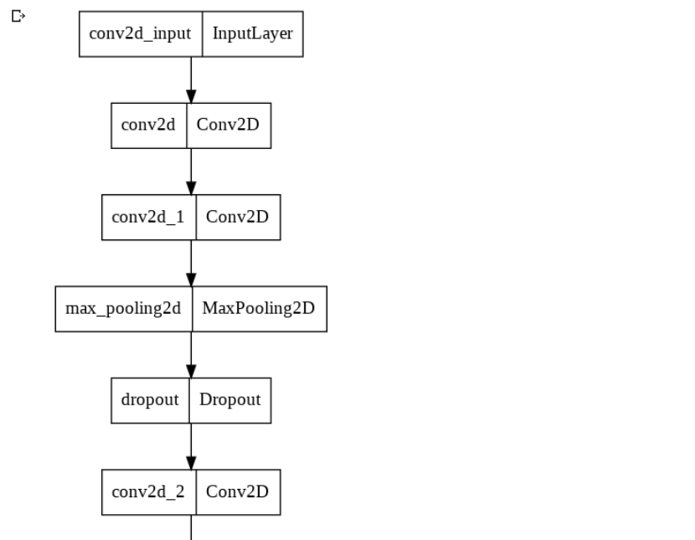
Implementation

Slide 7
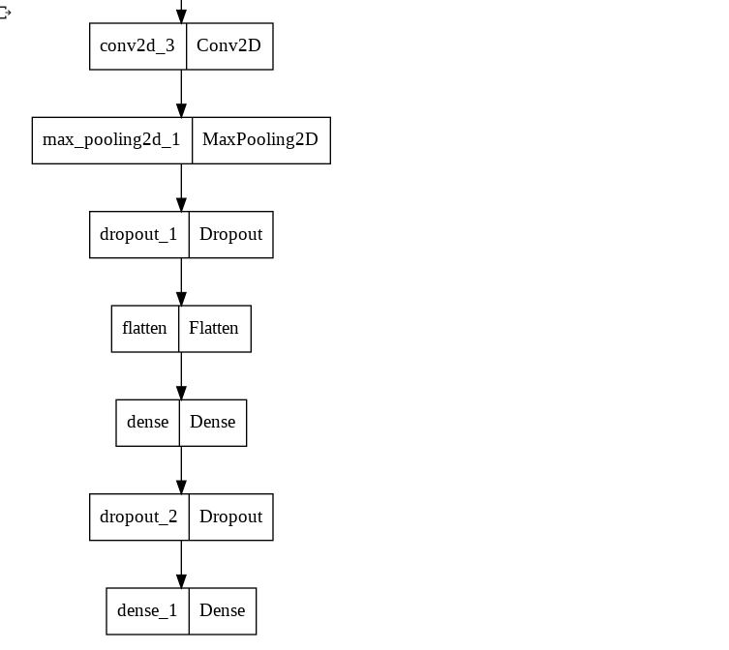

Slide 8
Testing
The model was tested on testing set containing about 20 images in each class of testing set.
Libraries like TensorFlow, pillow, NumPy were used to preprocess and test the data.
Images in testing dataset were completely different from Training data which make sures that our model can classify on new images.

Slide 9
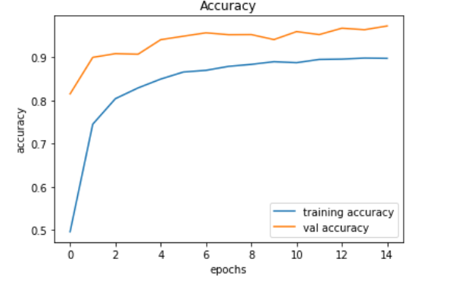
Model’s First Run Performance

Slide 10
Applications or Relevance of the Project
Traffic sign detection and recognition plays an important role in expert systems, such as traffic assistance driving systems and automatic driving systems.
It instantly assists drivers or automatic driving systems in detecting and recognizing traffic signs effectively.
This is great technology to be incorporated in Self-driving cars to recognize traffic sign boards.

Slide 11
Research Paper And Other References
Research Papers –
● Research and Application of Traffic Sign Detection and Recognition Based on Deep Learning (2018) - https://ieeexplore.ieee.org/document/8410256
● A traffic sign detection algorithm based on deep convolutional neural network (2016) - https://ieeexplore.ieee.org/document/7888348
Other References –
● Kaggle For Sign Board Dataset - Kaggle: Your Machine Learning and Data Science Community
● TensorFlow - https://www.tensorflow.org
● Twilio - https://www.twilio.com
● Gradio As Deployment Library - Gradio

Slide 12
THANK YOU
Notes:
ap

