Slide 1
VisionDocPhi-3.5
Adaptive OCR-Infused Prompting for Document Visual Question Answering
Mokshita Kochhar | IIT Kharagpur Research Intern
Model: Phi-3.5-Vision (4.2B) | Dataset: SP-DocVQA | Metric: ANLS
Headline Result
Vision-only ANLS 0.506 → OCR-adaptive ANLS 0.658 (+0.152) on 200 paired samples, with no fine-tuning.
1/11

Slide 2
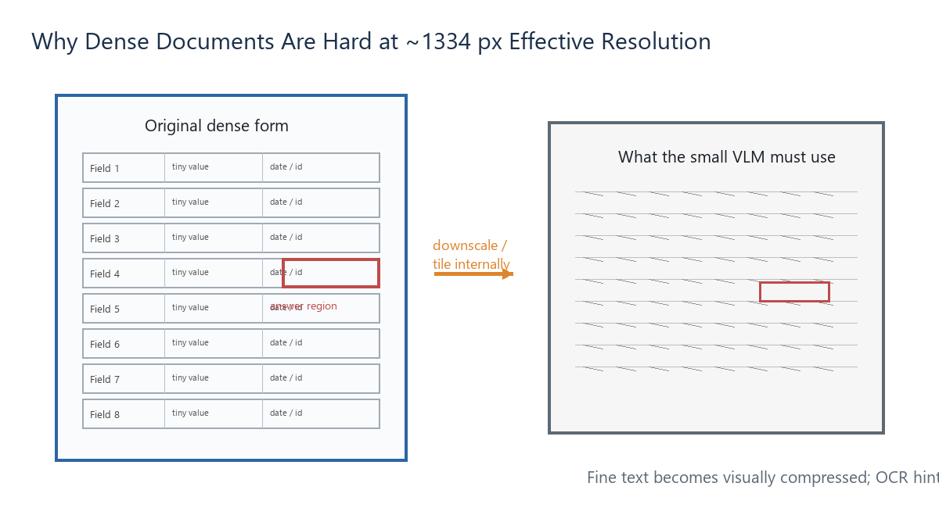
Phi-3.5-Vision & Its Limitations
A small VLM is practical, but dense documents stress its visual input budget.
What is Phi-3.5-Vision?
4.2B-parameter multimodal model that takes image + text and generates a short answer. It can run on a single GPU, making it attractive for low-cost, private deployment.
Resolution Bottleneck
The processor uses 336×336 HD crops. With num_crops=4, the effective processed size is roughly 4×336, often summarized as ~1334×1334 px.
Fine print and handwritten digits lose detail.
Full-page attention is diluted across many visual tokens.
The 4B model must jointly read, localize, and reason.
It is a general VLM, not a document-layout specialist.
2/11

Slide 3
The Problem
DocVQA requires exact answers from crowded scanned pages.
Task
Baseline
Document image + natural-language question → short exact answer.
Image + question → Phi-3.5-Vision → answer. Mean ANLS: 0.506 on 200 SP-DocVQA samples.
Where the baseline fails on structured documents
Wrong field selected when many labels look similar.
Fine print, table cells, and handwritten digits are misread.
Boilerplate text is copied instead of the answer value.
Table/list questions are especially hard: baseline ANLS is only 0.376.
Core Insight
The bottleneck is not only reading text; it is finding the right text region inside a resolution-limited VLM.
3/11

Slide 4
Our Solution
OCR guides vision; it does not replace it.
Hypothesis
V1 → V2 Design Shift
Targeted OCR hints can reduce field-selection errors on structured documents while preserving visual grounding.
V1 always injected OCR and could hurt visual questions. V2 uses adaptive routing plus a quality gate, so OCR appears only when likely helpful.
Always pass the document image to Phi-3.5-Vision.
Selectively append a small OCR snippet with bounding boxes.
Never return OCR text directly; the VLM generates the answer.
Fallback to vision-only if OCR is weak or unavailable.
Principle | Why it matters
Selective OCR | Avoids noise
Safe fallback | Protects accuracy
Image primary | Keeps visual grounding
Bounded prompt | Limits distraction
One-line Summary
Instead of scaling model size, we structure the input so a small VLM has a smaller, cleaner search space.
4/11

Slide 5
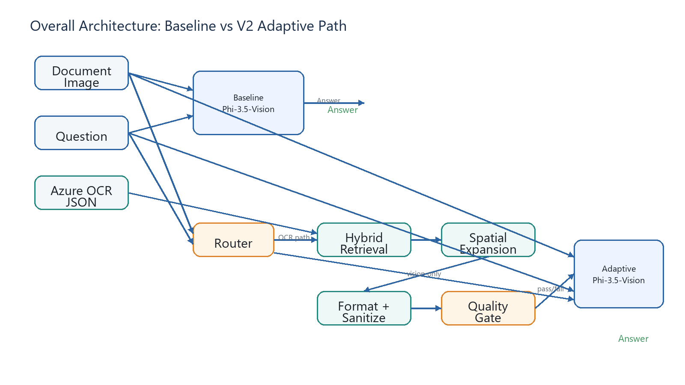
Overall Architecture
The same VLM is used in both modes; the adaptive path may add OCR hints.
How to read this diagram: Baseline sends only image + question. V2 first asks the Router whether OCR is worth trying. If yes, Retrieval selects relevant lines, Spatial Expansion adds nearby label-values, Formatter cleans and orders them with coordinates, and the Quality Gate accepts or rejects the snippet. If any stage rejects, the model receives the same vision-only input as baseline. OCR is assistive context, not direct answer lookup.
Data Flow
OCR source: Azure Computer Vision line-level text + bounding boxes | Orchestration: src/agents/pipeline.py | Inference: src/models/inference.py
5/11

Slide 6
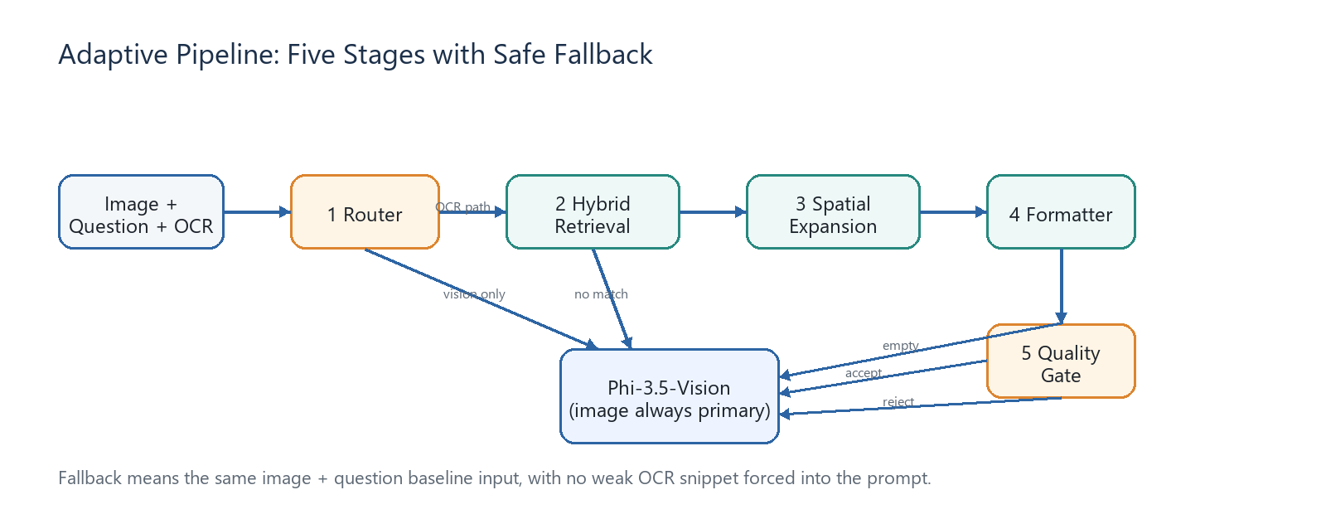
The Adaptive Pipeline: 5 Stages
Every failure condition routes back to vision-only input.
Stage | What it does | Fallback trigger
Router | OCR path vs vision-only | No OCR file
Hybrid Retrieval | 70% semantic + 30% keyword scoring | No line ≥ 0.20
Spatial Expansion | Adds value lines below/right of labels | Anchors kept
Formatter | Drops boilerplate and adds coordinates | All lines removed
Quality Gate | Confidence ≥ 0.45 plus info gain | Reject weak snippet
Routing Stats
Why fallback matters
96 vision-only at router | 84 received OCR hints | 20 fell back after retrieval or gate.
Adaptive wins 46 samples while baseline wins 6 because the pipeline rarely forces weak OCR into the prompt.
6/11

Slide 7
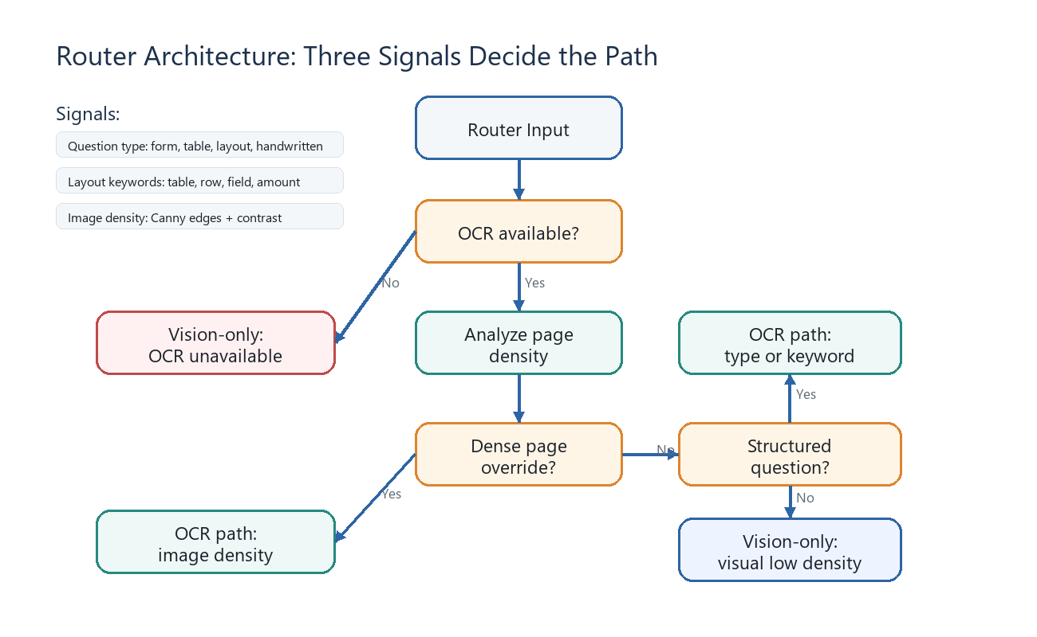
Router Architecture
Three runtime signals decide OCR-assisted vs vision-only.
Runtime Signals
Question type metadata, layout keywords, and pixel-level image density (Canny edges + contrast).
Edge density > 18% → OCR path.
Edges > 12% and low contrast → OCR path.
Low contrast and edges > 8% → OCR path.
Outcome | Count | Mean ANLS
Question type/keyword | 84 | 0.756
Visual low density | 96 | 0.568
Gate rejected | 11 | 0.701
No lines matched | 6 | 0.647
Image density fallback | 3 | 0.667
Important
Evaluation labels like layout-heavy vs visual-heavy are for analysis. The Router uses runtime evidence, not those cohort labels.
7/11

Slide 8
Evaluation Setup & ANLS Metric
A paired comparison on the same 200 questions.
Mode | Input to Phi-3.5-Vision
Vision-only baseline | Image + question only
OCR-adaptive V2 | Image + question + optional OCR snippet
ANLS Formula
similarity = 1 - edit_distance / max(len(pred), len(gt)) If similarity < 0.5, ANLS = 0; otherwise ANLS = (similarity - 0.5) / 0.5.
200 stratified samples, seed 42.
100 layout-heavy + 100 visual-heavy.
Same model, greedy decoding, max 20 tokens.
Azure OCR pre-extracted; Kaggle T4 float16.
Prediction | Ground Truth | ANLS
10 rat sera | 10 rat sera | 1.0
8/25/86 | 8/25/88 | 0.72
8/25/15 | 8/25/88 | 0.43
xyz | abc | 0.0
Why ANLS?
Exact match is too brittle for documents. ANLS gives partial credit for near-matches and handles multiple acceptable ground-truth answers.
8/11

Slide 9
Results
OCR-adaptive V2 improves accuracy, especially on structured documents.
Metric | Vision-only | OCR-adaptive | Δ
Mean ANLS | 0.506 | 0.658 | +0.152
Exact match | 0.420 | 0.595 | +0.175
Samples | 200 | 200 | —
Type | Baseline | V2 | Δ
Table/list | 0.376 | 0.771 | +0.395
Layout | 0.571 | 0.800 | +0.229
Form | 0.603 | 0.790 | +0.187
Handwritten | 0.521 | 0.683 | +0.162
Figure/diagram | 0.435 | 0.584 | +0.149
Free text | 0.457 | 0.554 | +0.097
Cohort | Baseline | Adaptive | Δ
Layout-heavy | 0.568 | 0.770 | +0.202
Visual-heavy | 0.444 | 0.546 | +0.102
Adaptive Wins
Baseline Wins
Ties
46
6
148
Interpretation: improvement is real but concentrated where OCR helps — layout-heavy documents and especially tables.
9/11

Slide 10
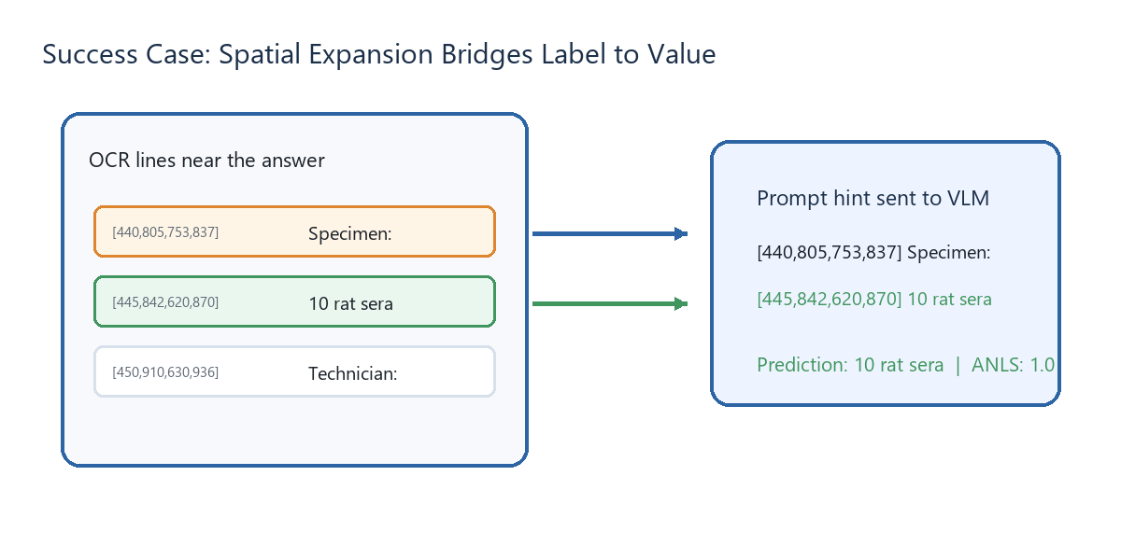
Case Studies: Success vs Failure
Use examples to show both the value and limits of the pipeline.
Success: Specimen
Retrieval matched the label “Specimen:” and spatial expansion added the value line below: “10 rat sera.” Prediction: 10 rat sera, ANLS 1.0.
Success via fallback: Eastern Airlines
Retrieval confidence was only ~0.303 (<0.45), so the gate rejected OCR. Vision-only answered “Eastern Airlines,” ANLS 1.0.
Failure: Date OCR trust
Ground truth: 8/25/88. Baseline predicted 8/25/86 (ANLS 0.72). OCR-adaptive predicted 8/25/15 (ANLS 0.43) after copying bad OCR.
Lesson: spatial expansion fixes label-value gaps, the gate avoids weak snippets, but OCR errors can still propagate when confidence looks high.
10/11

Slide 11
Conclusion & Takeaways
Inference-time architecture can unlock small VLM capability.
What we built
What we proved
A V2 adaptive OCR-infused pipeline for Phi-3.5-Vision DocVQA: five stages plus a quality gate, with safe fallback at every step.
+0.152 mean ANLS (0.506 → 0.658), layout-heavy +0.202, table/list +0.395, and 46 vs 6 head-to-head wins.
Key Takeaway
Routing, retrieval, spatial expansion, and gating can make a 4B vision-language model much more reliable on dense documents without fine-tuning or scaling to GPT-4V.
The image stays primary. OCR is a targeted hint, not a replacement.
Thank you / Questions
11/11

