Slide 2
SQL vs NoSql
Optimized for storage
Normalized (usually)
Ad hoc queries
Scale vertically
Good for OLAP
Optimized for computation
Denormalized (usually)
Instantiated views
Scale vertically
Built for OLTP

Slide 4
Why DynamoDB
Cloud DB (no administration)
AutoScale
Auto sharding
Performance by default
AWS infrastructure

Slide 6
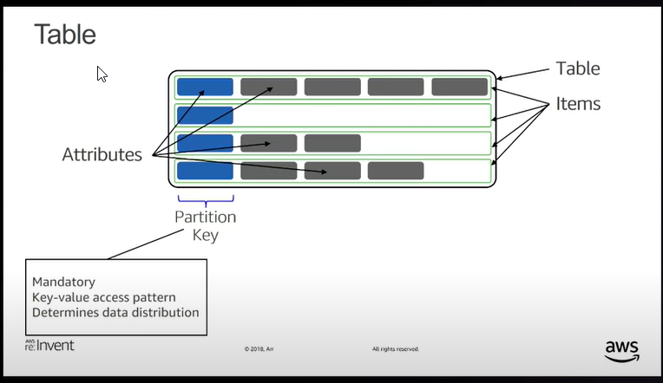
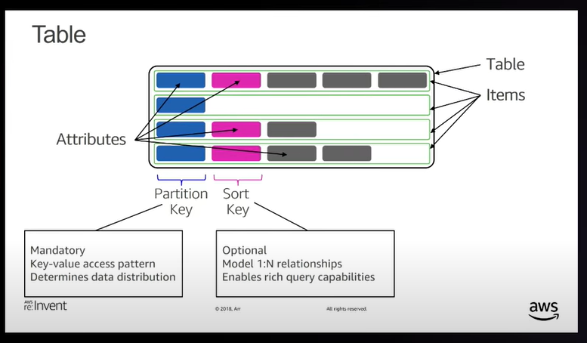

Slide 7
Indices
Local secondary index (LSI):
Indexes inside one partition.
Synchronous.
Up to 5 indices.
Defined on table creation.
Additional indices limit partitioning.
Global secondary index (GSI)
Copy of a table with different partition/sort keys.
Keeps projection of your data.
Asynchronous (eventually consistent).
Up to 20 indices.
Add/remove any time.

Slide 8
