Slide 1
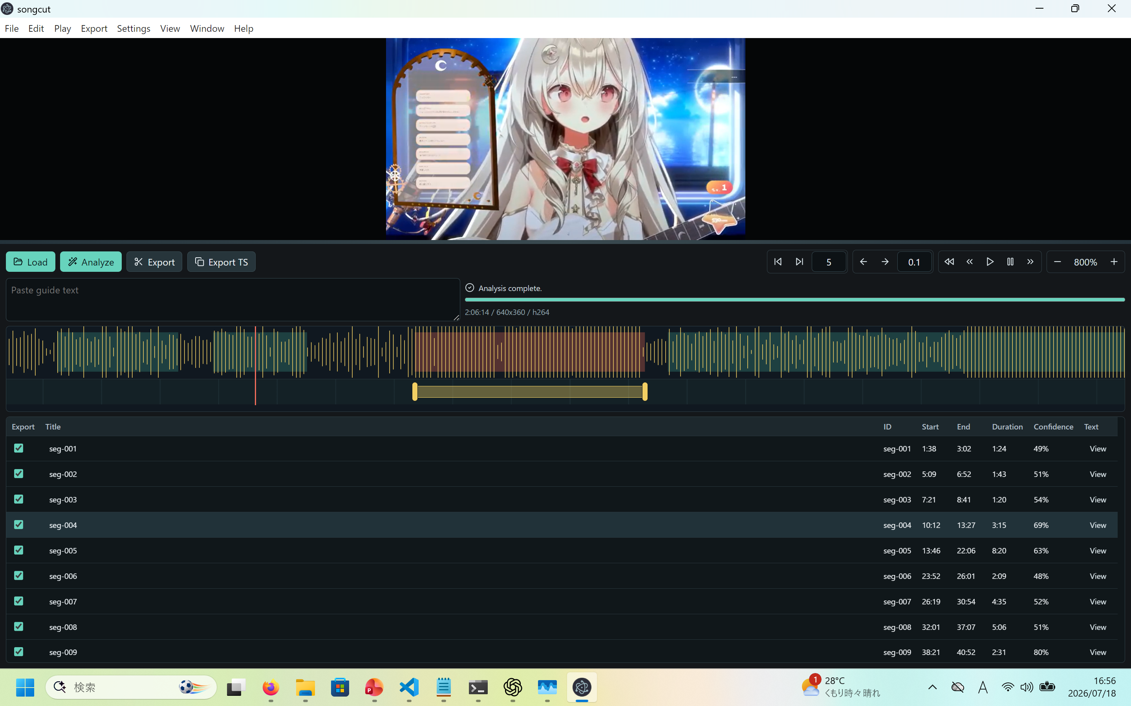
1. Select “Load” to load movie
3. Select “Analysis”
2. Paste TS Comment if you have

Slide 2
3. Edit start-end position of segment by mouse drag
2. Edit title by click
1. Select segment to edit
4. Select for export

Slide 3
Segment boundary preview tool
Segment boundary micro adjustment tool
Playback tool
Timeline zoom tool

