Slide 1
Customer Segmentation & Anomaly Detection in Online Retail
Using Deep Features & Unsupervised Learning on the Online Retail II Dataset
Team 24: Matthew Nguyen & Kevin Su

Slide 2
Why segment customers and find anomalies?
Retail revenue is highly skewed (Pareto effect)
We want to know:
Who drives most of the spend?
How do they differ from everyone else?
Unusual behavior can mean:
Fraud or data errors
Rare but important customers or events

Slide 3
Dataset Overview & Context
Online Retail II – UK-based gift retailer
Transaction-level CSV:
InvoiceNo, InvoiceDate
StockCode, Description
Quantity, UnitPrice
CustomerID, Country
We aggregate to the customer level for segmentation.

Slide 4
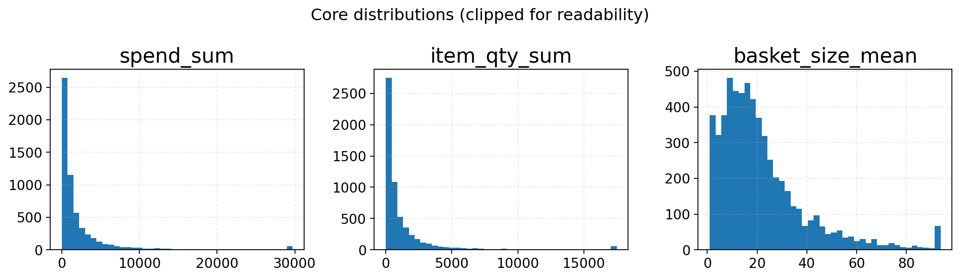
Core Customer Distributions
Skewed distributions in:
Total spend
Number of transactions
Basket sizes & quantities
Most customers are small buyers, a few are very large buyers

Slide 5
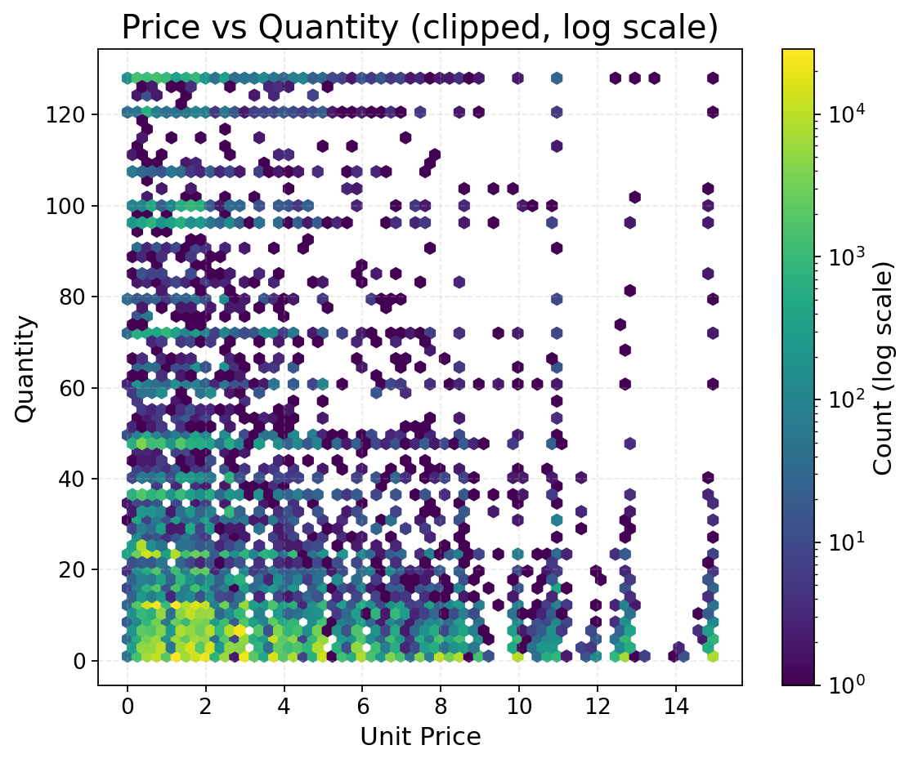
Price vs Quantity: Transaction-Level View
2-D hexbin of UnitPrice vs Quantity
Dense mass at:
Low to medium prices
Low to moderate quantities
Rare regions:
Very high quantities
Very high prices

Slide 6
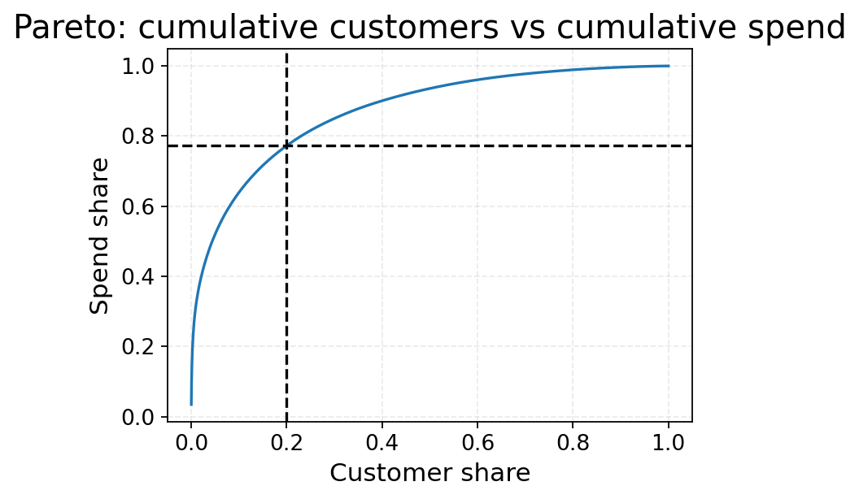
Pareto: Cumulative Customers vs Cumulative Spend
~20% of customers ≈ 75–80% of revenue
Strong Pareto effect → highly concentrated spend
Justifies segmenting and prioritizing customers

Slide 7
Customer-Level Features
Recency: days since last purchase
Frequency: number of transactions (tx_count)
Monetary: total spend, average basket size
Basket behavior: item_qty_sum, basket_size_mean
RFM score: quantile-based R, F, M + total RFM

Slide 8
Modeling Strategy
Goal 1: Segment customers
K-Means clustering on:
Standardized RFM/basket features
Autoencoder embeddings
Sequence embeddings (LSTM over product sequences)
Goal 2: Detect Anomalies
Isolation Forest on features
Autoencoder reconstruction error (MSE)

Slide 9
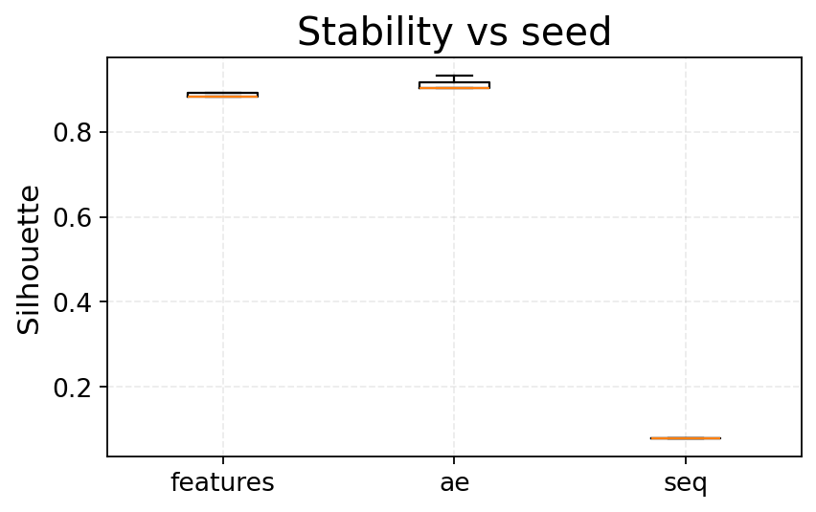
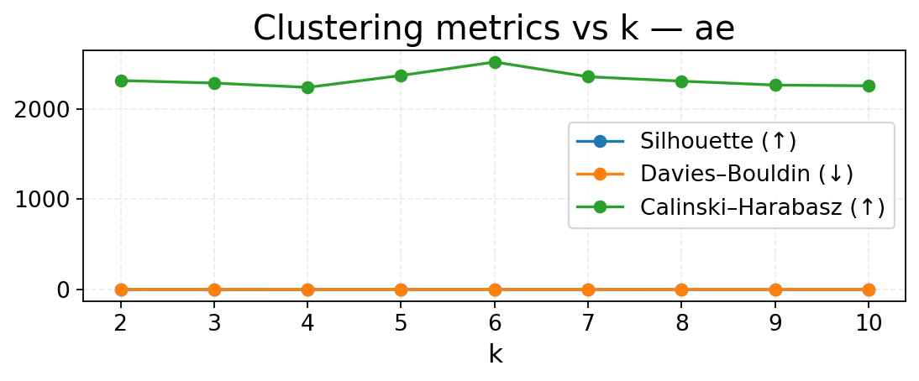
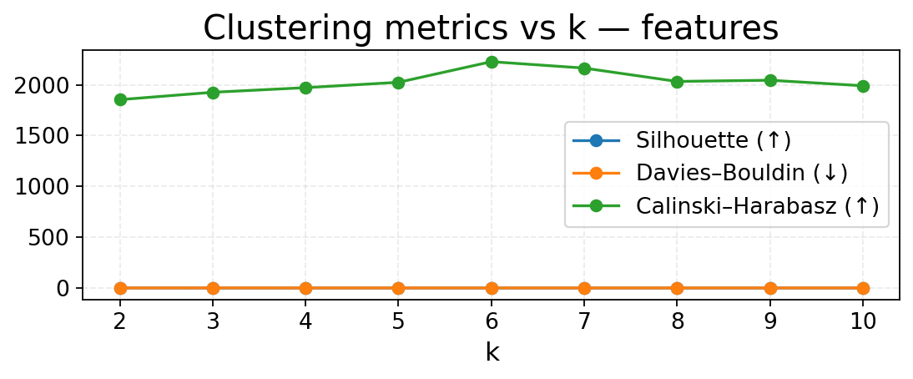
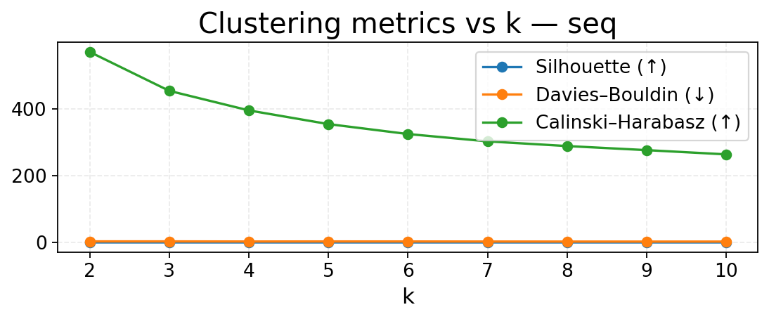
Cluster Quality & Stability
Swept k = 2 … 10 for each representation
Evaluated:
Silhouette (↑ better)
Davies–Bouldin (↓ better)
Calinski–Harabasz (↑ better)
AE embeddings achieved:
Highest silhouette
More stable scores across seeds

Slide 10
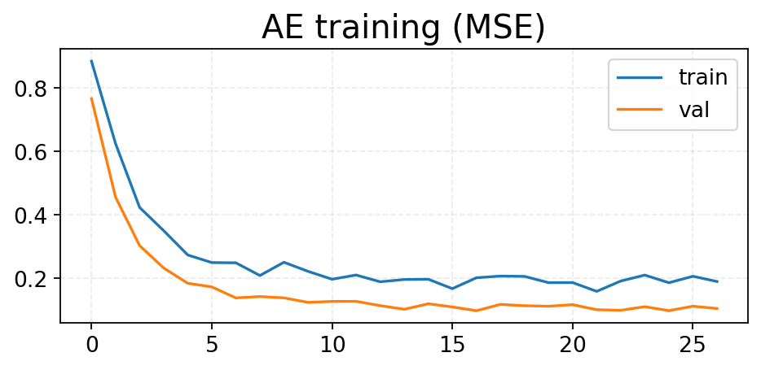
Autoencoder Training Loss
Shallow dense AE on standardized features
Reconstruction MSE decreases smoothly
Indicates good fit without overfitting spikes

Slide 11
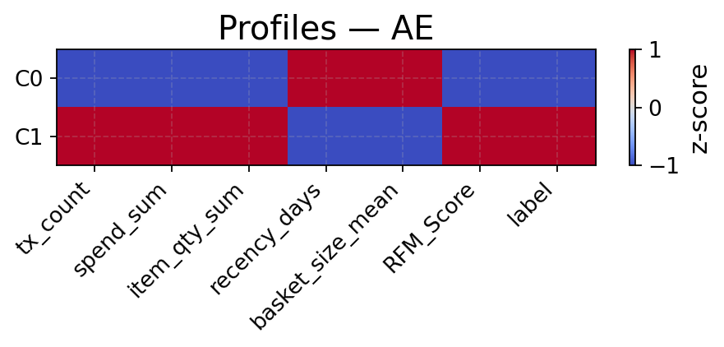
Segment Profiles — Autoencoder Clusters
Heatmap of z-scored means per segment:
tx_count, spend_sum, item_qty_sum
recency_days, basket_size_mean, RFM_score
Clear contrast:
C1: high spend, high frequency, high RFM, more recent
C0: lower activity, more stale

Slide 12
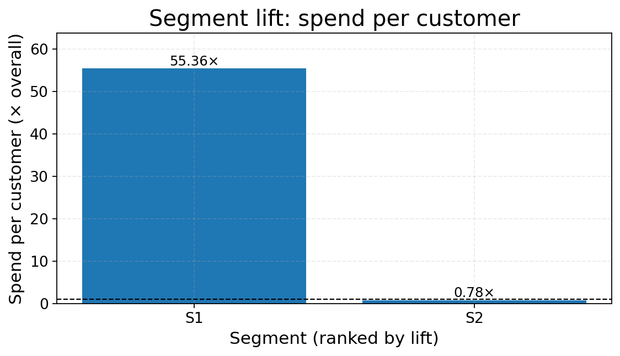
Segment Lift: Spend Per Customer
Bars show mean spend per customer vs overall average
S1 (VIP segment):
~55× higher spend per customer than overall average
S2 (non-VIP):
Slightly below average

Slide 13
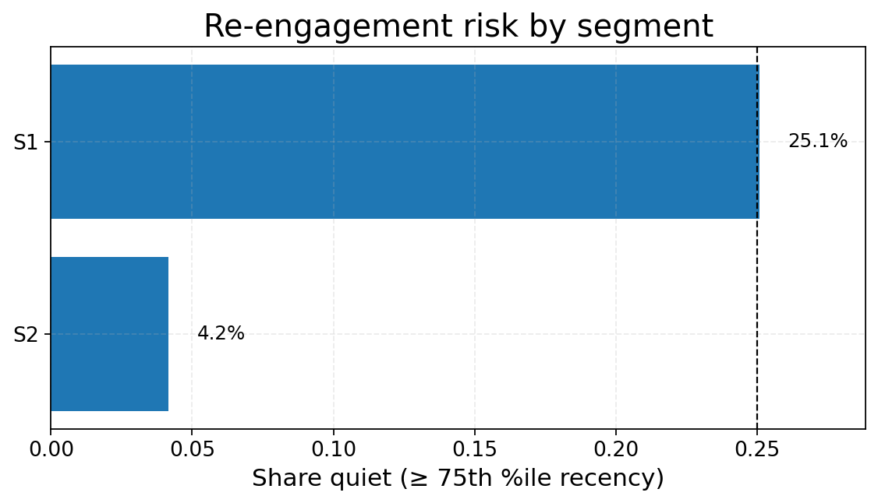
Re-Engagement Risk by Segment
Define “quiet” customers: recency ≥ 75th percentile
Bars show share of quiet customers per segment
S1 vs S2:
Compare risk of going inactive vs baseline

Slide 14
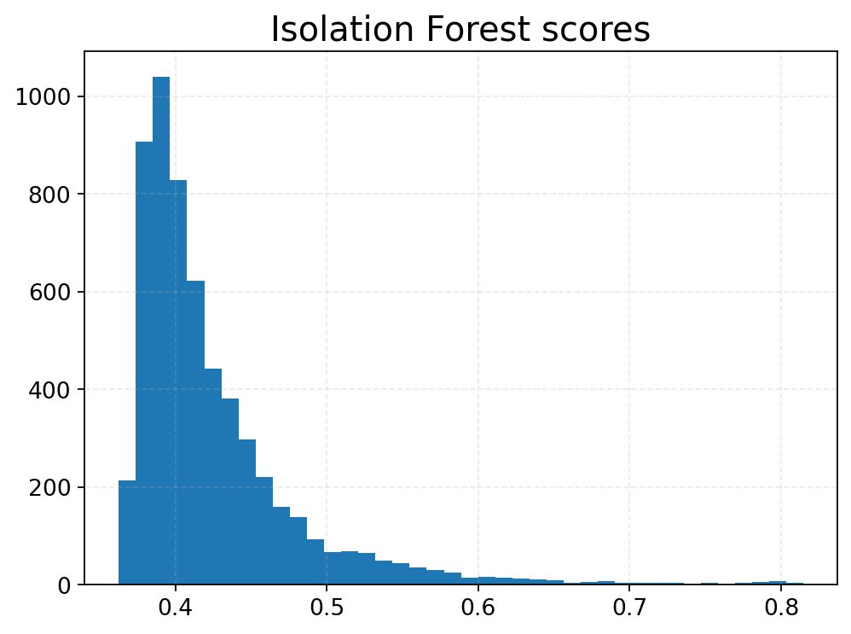
Isolation Forest Anomaly Scores
Histogram of IF anomaly scores
Long right tail → few highly anomalous customers
We focus on top few percent as candidates

Slide 15
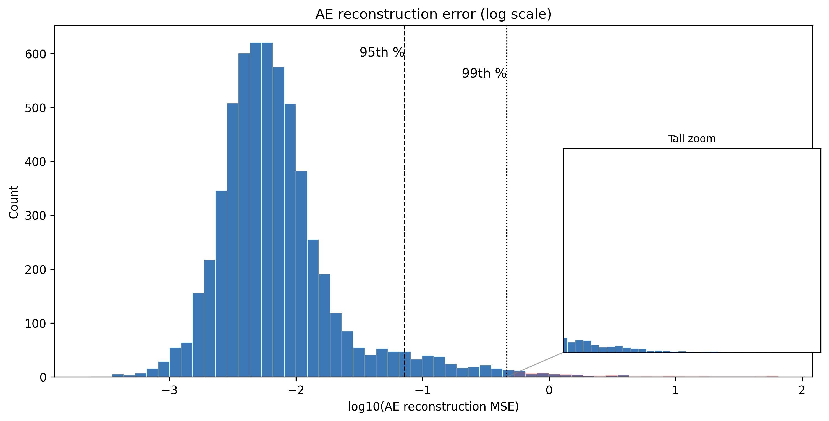
AE Reconstruction Error (log scale)
Histogram of log10(AE reconstruction MSE)
Vertical lines: 95th and 99th percentiles
Customers above the 99th percentile are very poorly reconstructed

Slide 16
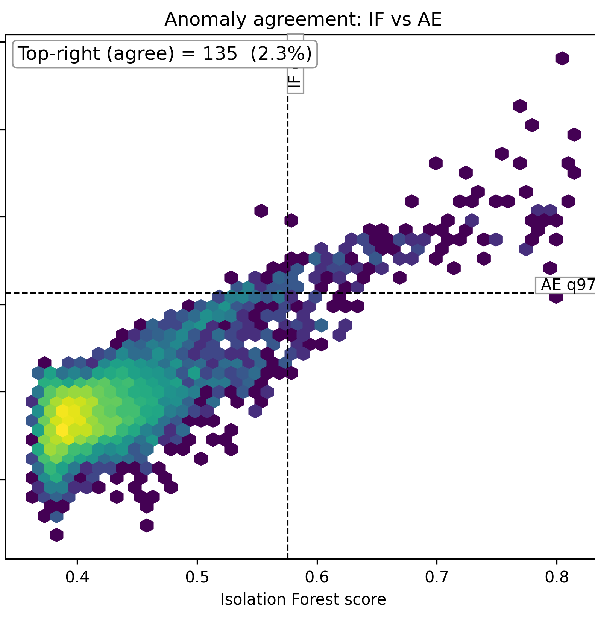
Anomaly Agreement: Isolation Forest vs AE
2-D hexbin:
X = IF score
Y = log10(AE MSE)
Dashed lines = high-risk quantiles for each score
Top-right quadrant:
~135 customers (~2–3%)
Both methods agree they are unusual

Slide 17
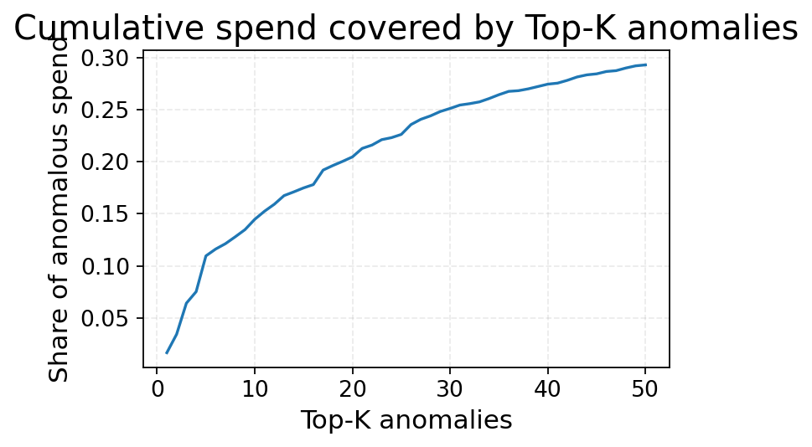
Cumulative Spend Covered by Top-k Anomalies
X-axis: Top-k anomalies (sorted by risk)
Y-axis: Fraction of anomalous spend covered
Top ~50 anomalies cover ~30% of anomalous spend

Slide 18
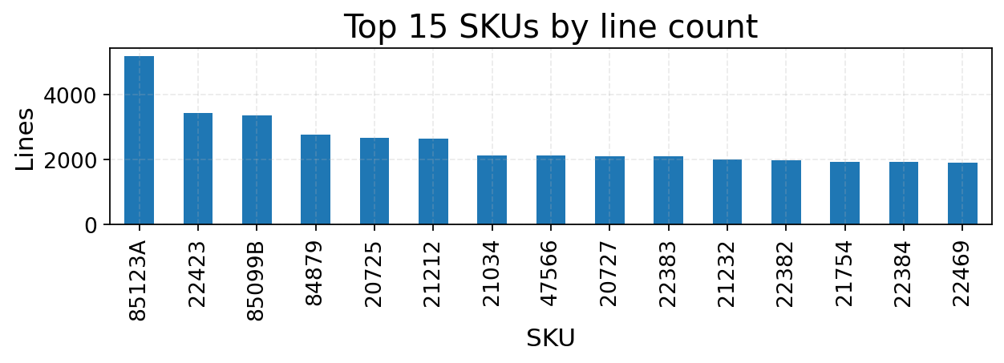
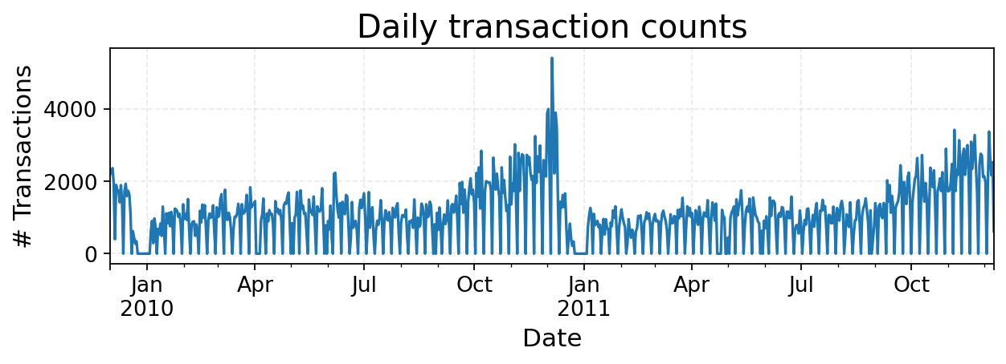
Daily Activity & Top SKUs
There is clear seasonality and spikes around certain dates.
Certain products dominate volume, which can influence customer behavior patterns.
daily_tx.png – daily transaction counts (seasonality, spikes)
top_skus.png – bar chart of top-selling products

Slide 19
Conclusions
Strong Pareto effect: small fraction of customers drive most revenue
AE-based segmentation:
Higher silhouette & more stable than feature-only approaches
Clear high-value vs lower-value segments with distinct profiles
Dual-signal anomalies (IF + AE):
~2–3% of customers flagged as consistently unusual
Top ~50 anomalies cover a large share of anomalous spend
Approach is model-agnostic and reusable for similar retail datasets

Slide 20
Limitations & Next Steps
Dataset is single retailer, historical only
No ground-truth fraud labels → anomalies require manual validation
Future ideas: Incorporate margin or return behavior, use sequence models more heavily for next-purchase prediction, and test on other retailers to check robustness

