Slide 1

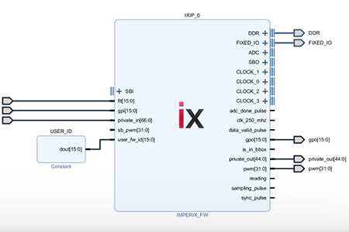
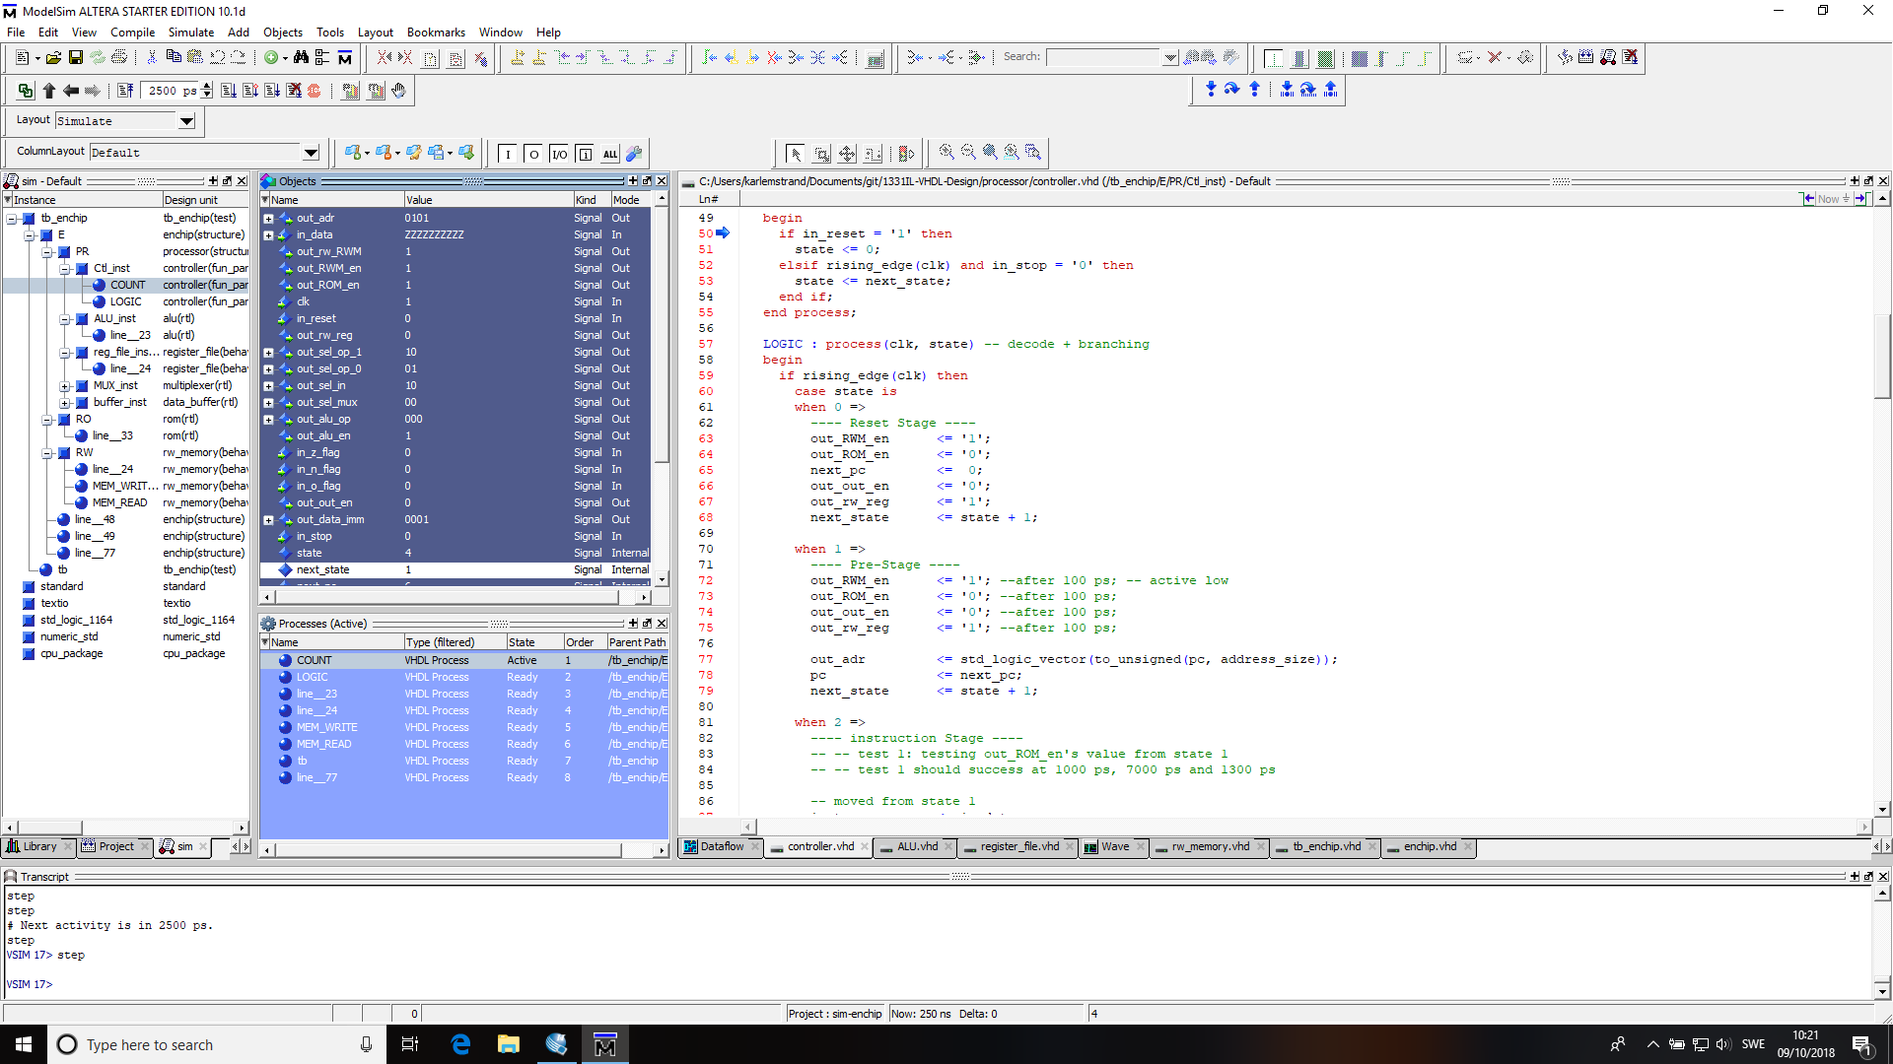

Slide 2
UNIT 6
FINITE STATE MACHINES(FSMs)
Moore Machines
Mealy Machines
Algorithmic State Machine (ASM) charts

Slide 3
VHDL For FPGA
Finite State Machines
VHDL Coding : There exist many different styles . The style explained here considers two processes : one for the state transitions , and another for the outputs.
First Step: Have your FSM diagram (ASM preferably ) ready . The coding then just simply follows the state diagram
We need to define a custom user data type e.g. g., state ”) to represent the states
Two processes must be considered (see figure on next slide)
Transitions : It is where the state transitions that occur on the clock edge ) are described
Outputs : This is a combinational circuit where outputs are defined based on the current state and input signals
Classification:
Moore FSM: Outputs depend only on the current state of the circuit.
Mealy FSM: Outputs depend on the current state of the circuit as well as the inputs of the circuit.

Slide 4
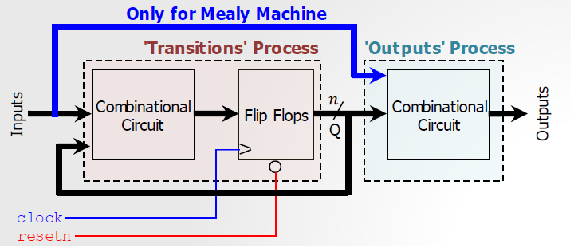
VHDL For FPGA
Finite State Machines
There should be a ‘resetn’ signal so that the FSM always start from an initial state.
The figure depicts a generic state machine with the VHDL processes that describe it.

Slide 5
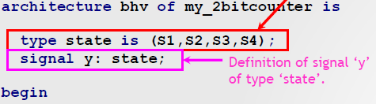
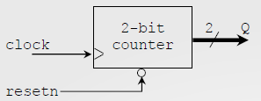
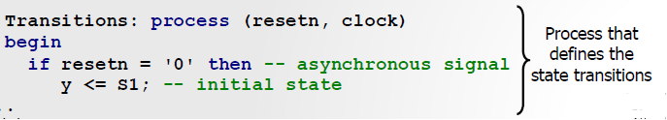

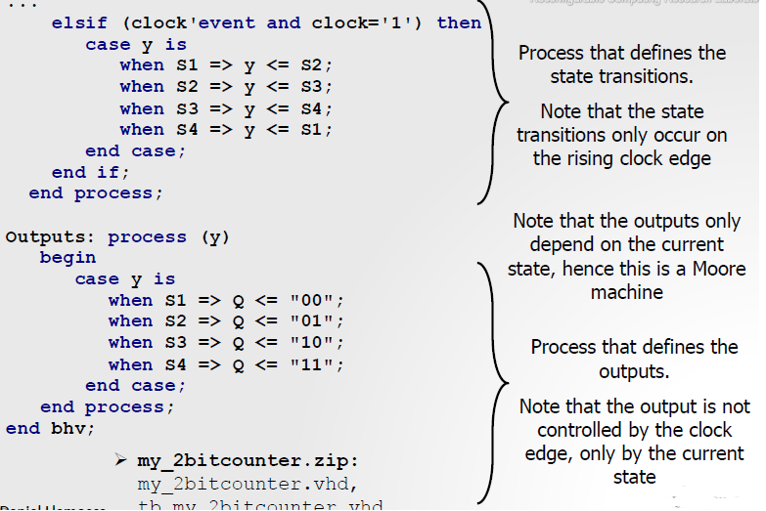
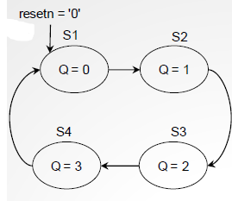
VHDL For FPGA
2-bit counter (Moore Type)
Count: 00 → 01 → 10 → 10 → 00

Slide 6
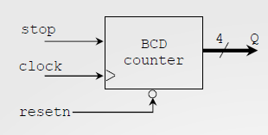
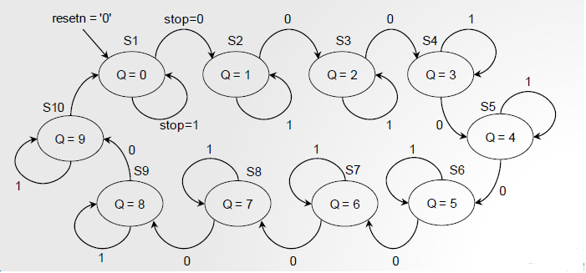
VHDL For FPGA
BCD counter with stop signal
Moore-type FSM
If the ‘stop’ signal is asserted, the count stops. If ‘stop’ is not asserted, the count continues.

Slide 7

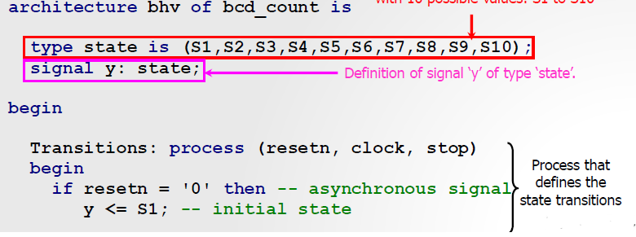
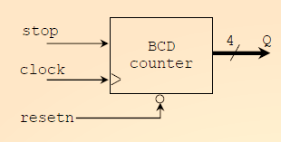
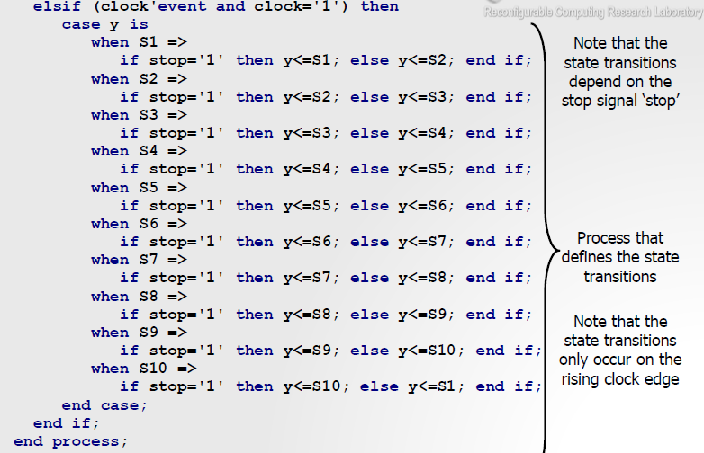

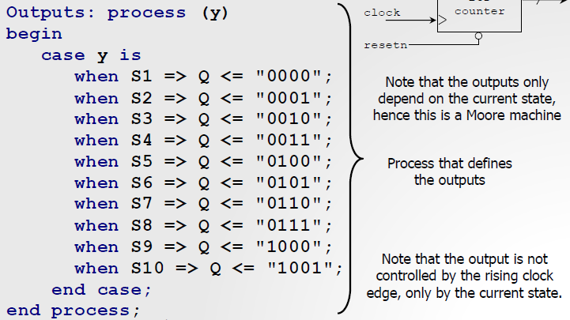
VHDL For FPGA
BCD counter with stop signal

Slide 8
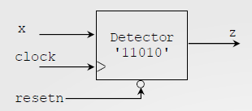
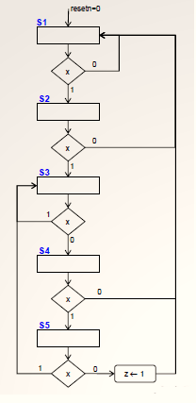
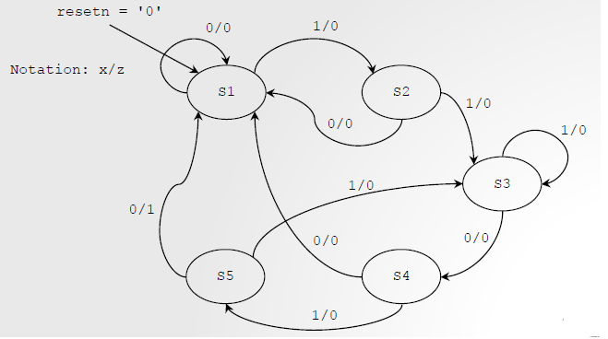
VHDL For FPGA
Sequence detector with overlap
ALGORITHMIC STATE MACHINE (ASMs) charts
Mealy-type FSM
It detects the sequence 11010
State Diagram: 5 states
This is an efficient way to represent Finite State Machines.
We use the 11010 detector as an example here.

Slide 9
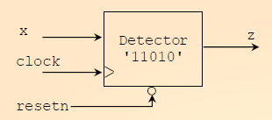

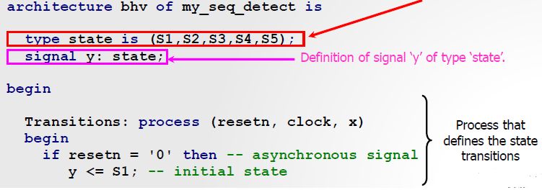
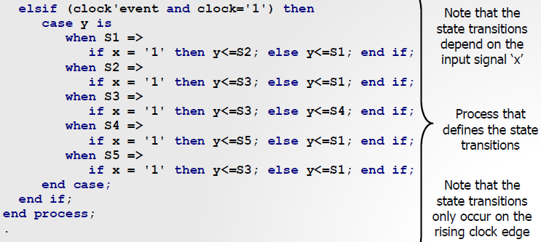
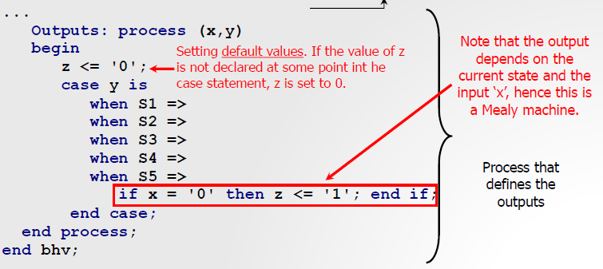
VHDL For FPGA
Sequence detector with overlap
Mealy-type FSM

Slide 10

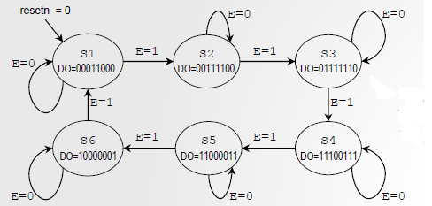
VHDL For FPGA
LED sequence
Moore-type FSM
Sequence: 0001100, 00111100, 01111110, 11100111, 11000011, 10000001.
The FSM includes an enable that allows for state transitions.
This FSM requires 6 states, i.e. 3 flip flops. The 6-bit output is generated by a combinational circuit (decoder).

Slide 11
Thank You

