Slide 1
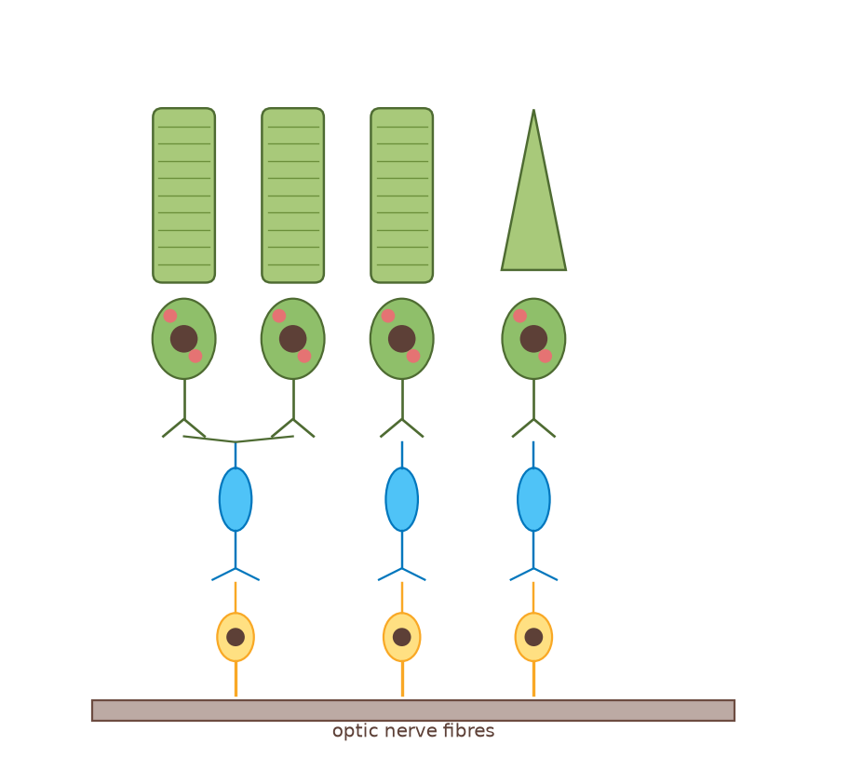
A2 Biology · JD Science
The Nervous System – complete interactive course
Choose a module. Home on every later slide returns here. Start the slide show (F5) before clicking buttons.
Part 1 · Organisation of the nervous system
Part 2 · The nerve impulse
Part 3 · Sensory receptors
Part 4 · The synapse
Teaching sequence is unchanged: explanations, diagrams, activities and questions stay in order inside each module. Hidden answer slides are skipped if you only press Space.
◀
▶
Original course © Boardworks Ltd 2009. Reconstructed interactive resource.
Notes:
Course home. Four module buttons jump to each part title. Sequential Next opens Part 1. Home buttons on later slides return here.

Slide 2
A2 Biology
Home
The Nervous System
Part 1: Organisation
◀
▶
Interactive reconstruction · Flash-free · Original course © Boardworks Ltd 2009
Original course © Boardworks Ltd 2009. Reconstructed interactive resource.
Notes:
Title slide. Click the green arrow on later slides, or press the on-slide buttons. Original Boardworks Flash activities could not be executed; this file rebuilds them with hyperlinks.

Slide 3
How to use this presentation
Home
A2 Biology
This is a reconstructed classroom presentation. Original 2009 Boardworks activities used Adobe Flash, which no longer runs. Every activity below uses native PowerPoint hyperlinks (no macros, no Flash).
Next / Back arrows
Move through the teaching sequence.
Green buttons
Reveal answers, open an activity, or jump to a labelled structure.
Reset
Returns an activity to its starting slide so you can reuse it in the same lesson.
Check / Show answers
Teacher-controlled reveal. Hidden slides are skipped if you just press Space.
Slide Show mode
Start the slide show (F5). Buttons only jump while the show is running.
◀
▶
3 of 79
Original course © Boardworks Ltd 2009. Reconstructed interactive resource.
Notes:
Demonstrate Slide Show mode. Buttons do not jump in Normal (edit) view.

Slide 4
Learning outcomes
Home
A2 Biology
By the end of this lesson you should be able to:
1
Describe the organisation of the human nervous system (CNS and PNS, including somatic and autonomic divisions).
2
Label the main parts of a neurone and state the function of each part.
3
Compare sensory, relay and motor neurones in terms of structure and direction of impulse.
4
Explain how myelination and nodes of Ranvier relate to neurone function.
5
Link organisation of the nervous system to clinical work in neurology.
◀
▶
4 of 79
Original course © Boardworks Ltd 2009. Reconstructed interactive resource.

Slide 5
Contents
Home
A2 Biology
1. the human nervous system
2. organisation explorer (click to reveal)
3. neurone structure – click the labels
4. types of neurone
5. matching activity
6. knowledge check
7. scientist case study
8. plenary
◀
▶
5 of 79
Original course © Boardworks Ltd 2009. Reconstructed interactive resource.
Notes:
Menu for jumping around the lesson. Useful when reusing activities.

Slide 6
The human nervous system
Home
A2 Biology
The nervous system is a highly organized system of nervous tissue that detects, relays and co-ordinates information about an organism’s internal and external environment.
All nervous systems contain nerve cells, called neurones, which convey information in the form of nerve impulses. They can produce a rapid, localized response.
◀
▶
6 of 79
Original course © Boardworks Ltd 2009. Reconstructed interactive resource.
Notes:
Original static teaching slide – scientific wording retained. Diagram is a new 2D reconstruction of retinal circuitry (rods, cones, bipolar and ganglion cells), which appears throughout the series.

Slide 7
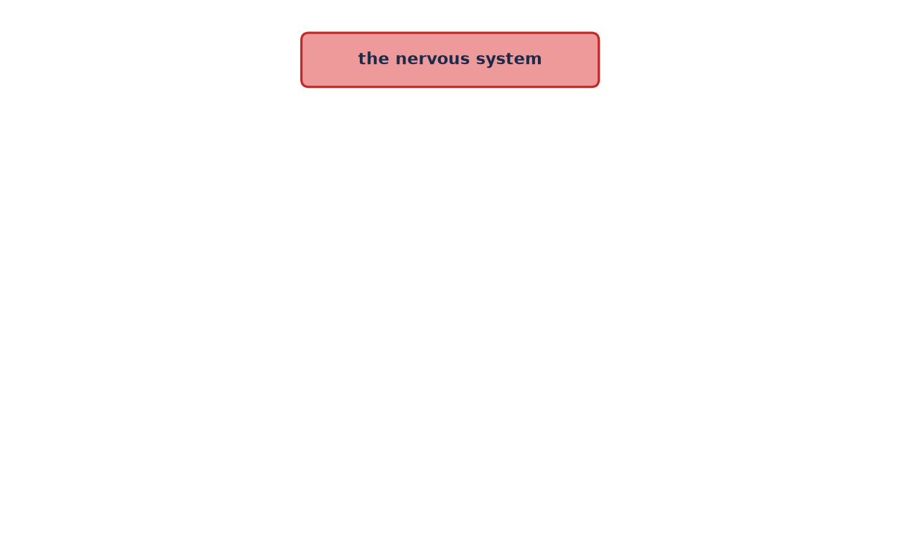
How is the nervous system organized?
Home
A2 Biology
Organization of the nervous system
Each part of the nervous system performs a different function.
Press the red button, then each new button, to reveal how the nervous system is organized.
Reveal CNS and PNS
◀
▶
Reset
Show all
Functions
7 of 79
Original course © Boardworks Ltd 2009. Reconstructed interactive resource.
Notes:
Rebuilt Flash click-to-reveal tree. Each button jumps to the next reveal level. Reset returns to the start.

Slide 8
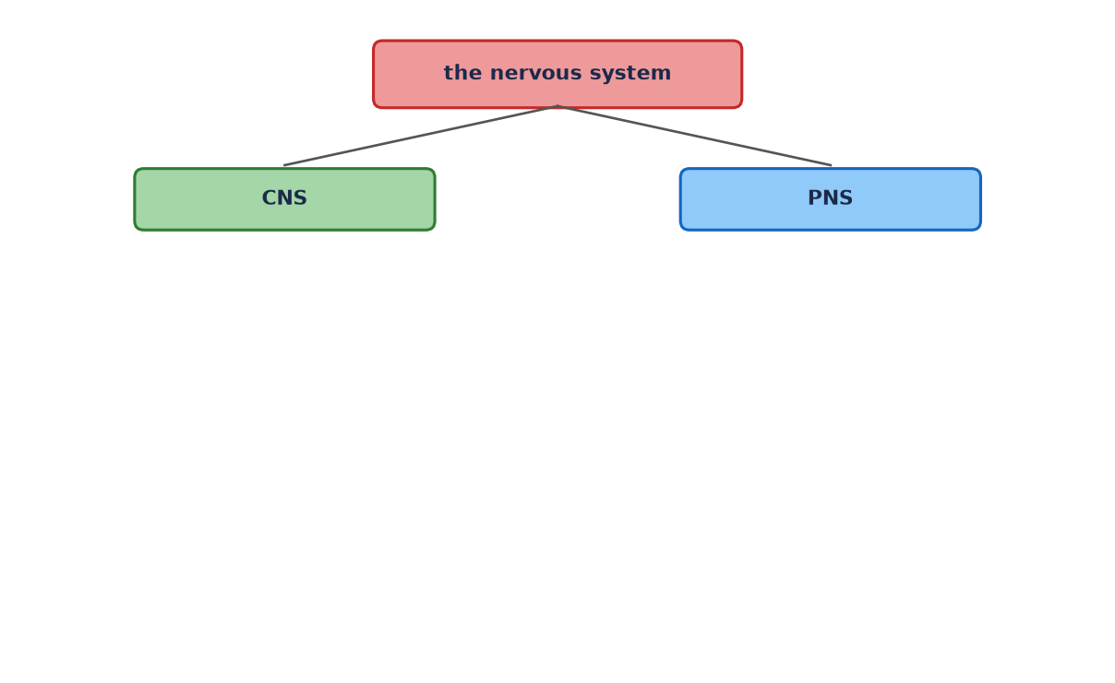
How is the nervous system organized?
Home
A2 Biology
Organization of the nervous system
The nervous system is divided into the CNS and the PNS.
Press CNS and PNS to see what each contains.
Reveal CNS parts
Reveal PNS parts
◀
▶
Reset
Show all
Functions
8 of 79
Original course © Boardworks Ltd 2009. Reconstructed interactive resource.
Notes:
Rebuilt Flash click-to-reveal tree. Each button jumps to the next reveal level. Reset returns to the start.

Slide 9
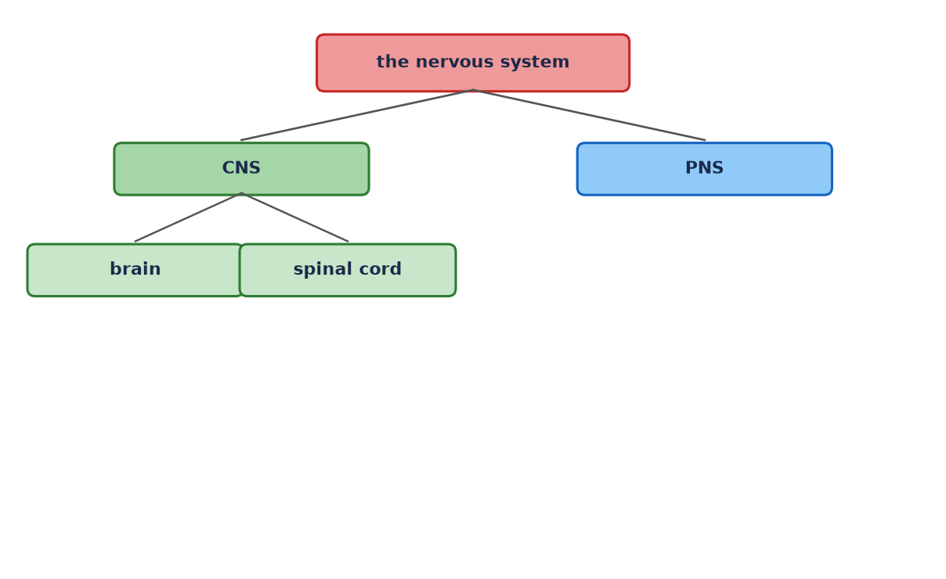
How is the nervous system organized?
Home
A2 Biology
Organization of the nervous system
The CNS is the brain and spinal cord.
Press PNS to see its divisions.
Reveal PNS parts
◀
▶
Reset
Show all
Functions
9 of 79
Original course © Boardworks Ltd 2009. Reconstructed interactive resource.
Notes:
Rebuilt Flash click-to-reveal tree. Each button jumps to the next reveal level. Reset returns to the start.

Slide 10
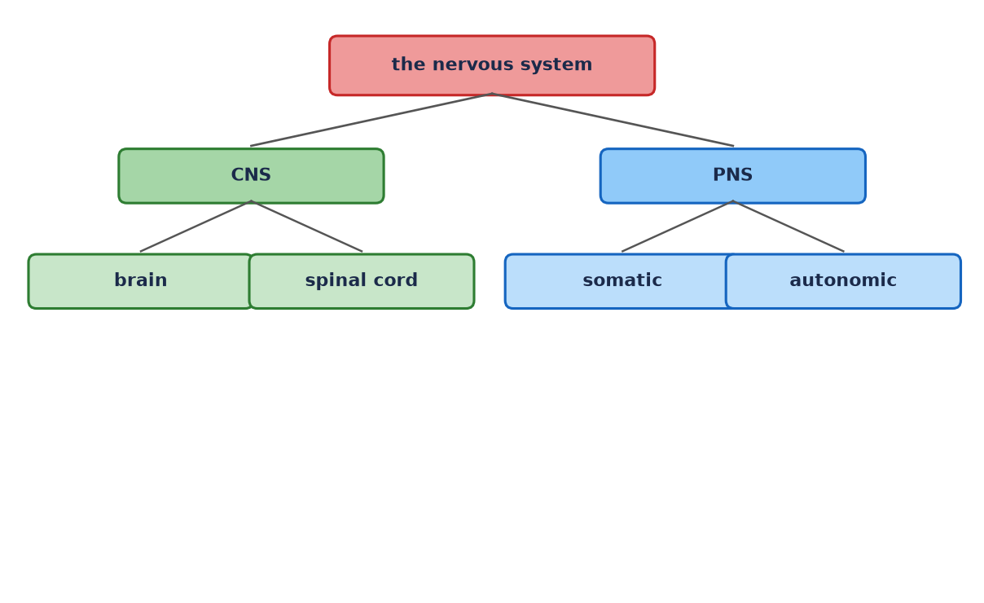
How is the nervous system organized?
Home
A2 Biology
Organization of the nervous system
The PNS is every nerve outside the CNS. It has somatic and autonomic divisions.
Press autonomic to split it further.
Reveal autonomic branches
◀
▶
Reset
Show all
Functions
10 of 79
Original course © Boardworks Ltd 2009. Reconstructed interactive resource.
Notes:
Rebuilt Flash click-to-reveal tree. Each button jumps to the next reveal level. Reset returns to the start.

Slide 11
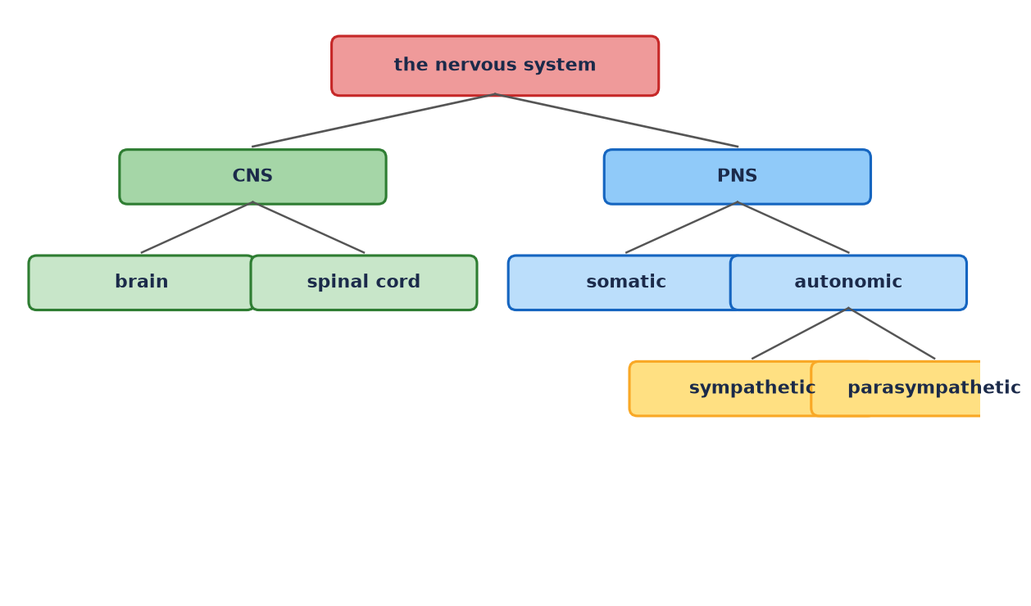
How is the nervous system organized?
Home
A2 Biology
Organization of the nervous system
The autonomic nervous system has sympathetic (‘fight or flight’) and parasympathetic (‘rest and digest’) branches.
◀
▶
Reset
Show all
Functions
11 of 79
Original course © Boardworks Ltd 2009. Reconstructed interactive resource.
Notes:
Rebuilt Flash click-to-reveal tree. Each button jumps to the next reveal level. Reset returns to the start.

Slide 12
Functions of each division
Home
A2 Biology
CNS – brain
Processes sensory information, initiates motor output, higher functions (memory, language, coordination).
CNS – spinal cord
Carries impulses between brain and PNS; is the integrating centre for many reflex arcs.
Somatic PNS
Sensory neurones from skin, muscles and joints; motor neurones to skeletal muscle (mostly voluntary).
Autonomic PNS
Controls glands, smooth muscle and cardiac muscle (involuntary).
Sympathetic
Increases heart rate, dilates bronchioles, diverts blood to muscle – ‘fight or flight’.
Parasympathetic
Slows heart rate, stimulates digestion – ‘rest and digest’. Antagonistic to sympathetic.
Back to explorer
activity
Original course © Boardworks Ltd 2009. Reconstructed interactive resource.

Slide 13
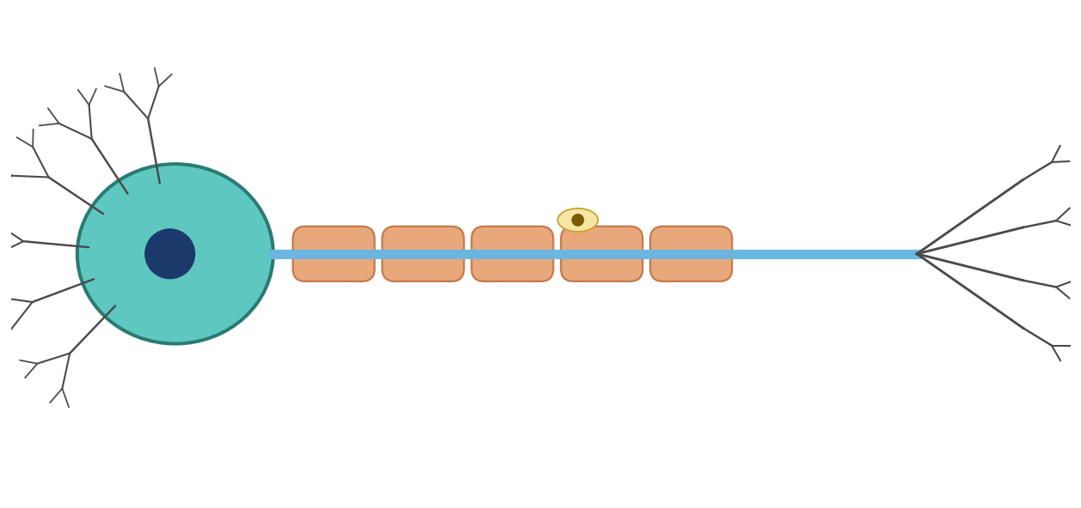
General structure of a neurone
Home
A2 Biology
What is the structure of a neurone?
cell body ▶
axon ▶
node of Ranvier ▶
dendrites ▶
myelin sheath ▶
nucleus of Schwann cell ▶
Neurones are specialized cells that convey information in the form of nerve impulses. Press on the labels to find out more about each part of the neurone.
◀
▶
Reset
12 of 79
Original course © Boardworks Ltd 2009. Reconstructed interactive resource.
Notes:
Rebuilt Flash labelling activity. Each label opens a hidden explanation slide, then Back returns here.

Slide 14
General structure of a neurone
Home
A2 Biology
Cell body
Cell body
The cell body (soma) contains the nucleus and organelles. It is the metabolic centre of the neurone and manufactures proteins and neurotransmitters. In motor neurones it lies in the CNS; in sensory neurones it lies in a ganglion just outside the CNS.
Back to diagram
activity
Original course © Boardworks Ltd 2009. Reconstructed interactive resource.

Slide 15
General structure of a neurone
Home
A2 Biology
Dendrites
Dendrites
Dendrites are highly branched cytoplasmic extensions. They receive impulses from other neurones (or from a receptor) and carry them towards the cell body. More branches mean a larger surface area for synapses.
Back to diagram
activity
Original course © Boardworks Ltd 2009. Reconstructed interactive resource.

Slide 16
General structure of a neurone
Home
A2 Biology
Axon
Axon
The axon is a long, single fibre that carries the nerve impulse away from the cell body towards the synaptic terminals. Motor axons may be more than a metre long. The axoplasm is surrounded by the axon membrane, where the action potential is generated.
Back to diagram
activity
Original course © Boardworks Ltd 2009. Reconstructed interactive resource.

Slide 17
General structure of a neurone
Home
A2 Biology
Myelin sheath
Myelin sheath
A thick insulating layer of fatty material (myelin) wrapped around the axon by Schwann cells in the PNS (oligodendrocytes in the CNS). It prevents ion leakage and greatly increases conduction speed.
Back to diagram
activity
Original course © Boardworks Ltd 2009. Reconstructed interactive resource.

Slide 18
General structure of a neurone
Home
A2 Biology
Node of Ranvier
Node of Ranvier
A gap in the myelin sheath where the axon membrane is exposed. Voltage-gated ion channels are concentrated here. The action potential ‘jumps’ from node to node – saltatory conduction.
Back to diagram
activity
Original course © Boardworks Ltd 2009. Reconstructed interactive resource.

Slide 19
General structure of a neurone
Home
A2 Biology
Schwann cell
Schwann cell
A glial cell that wraps around a PNS axon, forming the myelin sheath. The nucleus of the Schwann cell sits in the outermost layer of the wrap. One Schwann cell myelinates one internodal segment of one axon.
Back to diagram
activity
Original course © Boardworks Ltd 2009. Reconstructed interactive resource.

Slide 20
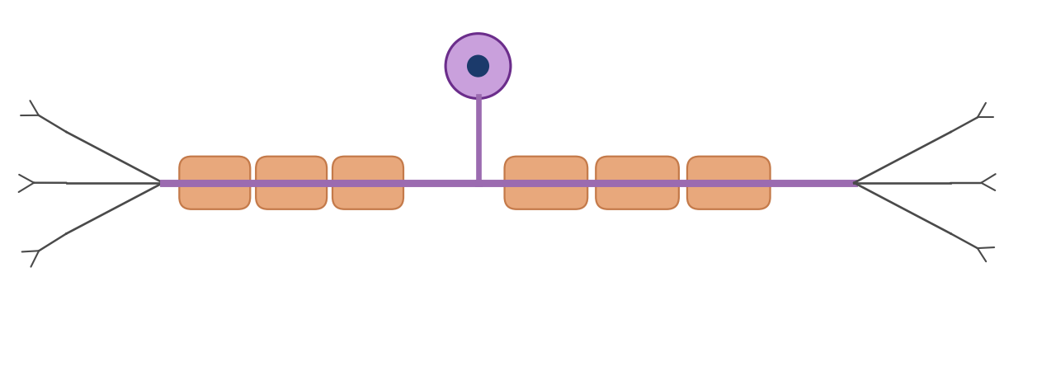
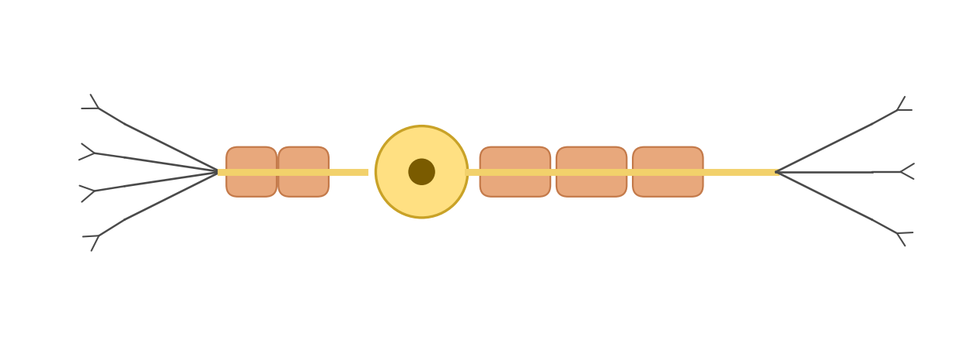
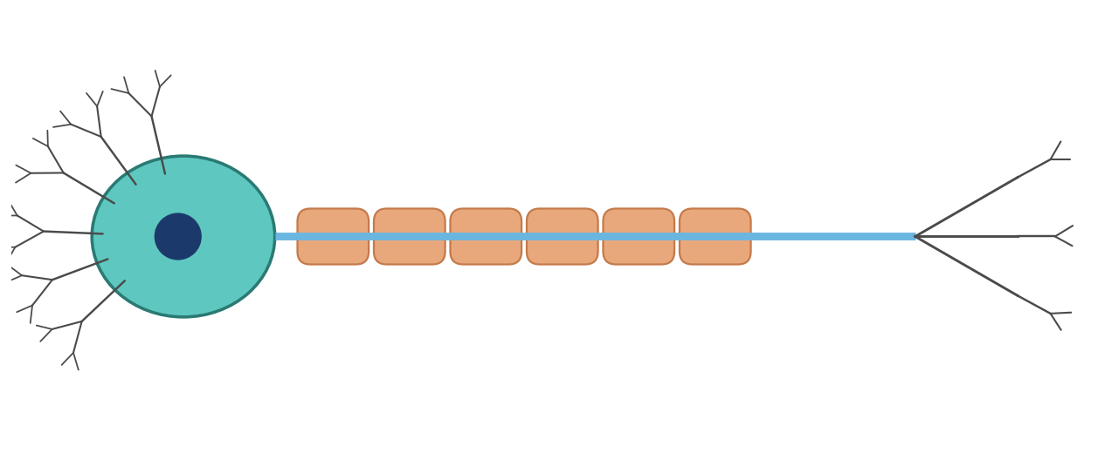
Types of neurone
Home
A2 Biology
There are several different types of neurone:
sensory
neurones:
receptor organs
CNS
info
relay
neurones:
sensory neurones
motor neurones
info
motor
neurones:
CNS
effectors
info
◀
▶
13 of 79
Original course © Boardworks Ltd 2009. Reconstructed interactive resource.
Notes:
Original comparison diagrams rebuilt. Info buttons open function cards.

Slide 21
Types of neurone
Home
A2 Biology
Sensory neurone
Carries impulses from a receptor towards the CNS. The cell body is in a dorsal root ganglion, off to the side of the axon. There is a long dendron and a shorter axon. Many sensory neurones are myelinated.
Back
activity
Original course © Boardworks Ltd 2009. Reconstructed interactive resource.

Slide 22
Types of neurone
Home
A2 Biology
Relay (intermediate) neurone
Found entirely within the CNS. Connects sensory neurones to motor neurones and to other relay neurones, allowing integration and coordination. Typically short, with many synapses. Also called an interneurone.
Back
activity
Original course © Boardworks Ltd 2009. Reconstructed interactive resource.

Slide 23
Types of neurone
Home
A2 Biology
Motor neurone
Carries impulses from the CNS to an effector (muscle or gland). The cell body is in the CNS (grey matter of spinal cord or brain) with many dendrites. A long myelinated axon runs out through the PNS to the effector.
Back
activity
Original course © Boardworks Ltd 2009. Reconstructed interactive resource.

Slide 24
Comparing neurone types
Home
A2 Biology
Click a heading to reveal the comparison. Use Show all before moving on.
Feature
Sensory
Relay
Motor
Show comparison table
◀
▶
14 of 79
Original course © Boardworks Ltd 2009. Reconstructed interactive resource.
Notes:
Reveal table is a hidden slide so Space will skip it during a straight run-through.

Slide 25
Comparing neurone types
Home
A2 Biology
Feature
Sensory
Relay
Motor
Direction of impulse
Receptor → CNS
CNS → CNS
CNS → effector
Cell body position
Dorsal root ganglion
Entirely in CNS
In CNS (grey matter)
Relative axon length
Short axon, long dendron
Short
Long axon
Myelin
Usually myelinated
Often unmyelinated
Usually myelinated
Back
activity
Original course © Boardworks Ltd 2009. Reconstructed interactive resource.

Slide 26
Neurone structure
Home
A2 Biology
Match the parts of the neurone to the definitions
node of Ranvier
a long single fibre that carries nerve impulses
axon
a thick insulating layer around the axon
myelin sheath
gap in the myelin sheath where the axon is exposed
Schwann cell
highly branched fibres that conduct impulses
dendrites
a cell wrapped around the axon, forming the myelin sheath
◀
▶
Check
Reset
15 of 79
Original course © Boardworks Ltd 2009. Reconstructed interactive resource.
Notes:
Rebuilt Flash matching activity. Definitions are shuffled (original order). Click a term to highlight its match, or Check to show the full key. Correct pairs: node of Ranvier = gap in myelin; axon = long single fibre; myelin sheath = insulating layer; Schwann cell = cell wrapped around axon; dendrites = highly branched fibres.

Slide 27
Neurone structure
Home
A2 Biology
Matched pair
node of Ranvier
gap in the myelin sheath where the axon is exposed
Back to matching
activity
Original course © Boardworks Ltd 2009. Reconstructed interactive resource.

Slide 28
Neurone structure
Home
A2 Biology
Matched pair
axon
a long single fibre that carries nerve impulses
Back to matching
activity
Original course © Boardworks Ltd 2009. Reconstructed interactive resource.

Slide 29
Neurone structure
Home
A2 Biology
Matched pair
myelin sheath
a thick insulating layer around the axon
Back to matching
activity
Original course © Boardworks Ltd 2009. Reconstructed interactive resource.

Slide 30
Neurone structure
Home
A2 Biology
Matched pair
Schwann cell
a cell wrapped around the axon, forming the myelin sheath
Back to matching
activity
Original course © Boardworks Ltd 2009. Reconstructed interactive resource.

Slide 31
Neurone structure
Home
A2 Biology
Matched pair
dendrites
highly branched fibres that conduct impulses
Back to matching
activity
Original course © Boardworks Ltd 2009. Reconstructed interactive resource.

Slide 32
Neurone structure – answers
Home
A2 Biology
Answer key
node of Ranvier
gap in the myelin sheath where the axon is exposed
axon
a long single fibre that carries nerve impulses
myelin sheath
a thick insulating layer around the axon
Schwann cell
a cell wrapped around the axon, forming the myelin sheath
dendrites
highly branched fibres that conduct impulses
Back to matching
activity
Original course © Boardworks Ltd 2009. Reconstructed interactive resource.

Slide 33
Knowledge check 1
Home
A2 Biology
Which statement about relay neurones is correct?
A They carry impulses from receptors directly to effectors.
B They are found entirely in the CNS and connect other neurones.
C Their cell bodies always lie in a dorsal root ganglion.
D They are the only myelinated neurones in the nervous system.
◀
▶
16 of 79
Original course © Boardworks Ltd 2009. Reconstructed interactive resource.
Notes:
Correct = B.

Slide 34
Knowledge check 1
Home
A2 Biology
Correct.
Relay (intermediate) neurones lie entirely in the CNS and synapse with sensory and motor neurones, allowing integration.
Continue
activity
Original course © Boardworks Ltd 2009. Reconstructed interactive resource.

Slide 35
Knowledge check 1
Home
A2 Biology
Not quite.
Think about where a relay neurone is found, and what it connects. Try again.
Try again
activity
Original course © Boardworks Ltd 2009. Reconstructed interactive resource.

Slide 36
Knowledge check 1
Home
A2 Biology
Not quite.
Think about where a relay neurone is found, and what it connects. Try again.
Try again
activity
Original course © Boardworks Ltd 2009. Reconstructed interactive resource.

Slide 37
Knowledge check 1
Home
A2 Biology
Not quite.
Think about where a relay neurone is found, and what it connects. Try again.
Try again
activity
Original course © Boardworks Ltd 2009. Reconstructed interactive resource.

Slide 38
Knowledge check 2
Home
A2 Biology
The nodes of Ranvier are:
A the nuclei of Schwann cells
B synapses between sensory and motor neurones
C gaps in the myelin sheath where the axon is exposed
D the cell bodies of sensory neurones
◀
▶
17 of 79
Original course © Boardworks Ltd 2009. Reconstructed interactive resource.

Slide 39
Knowledge check 2
Home
A2 Biology
Correct.
Nodes of Ranvier are unmyelinated gaps. They allow saltatory conduction.
Continue
activity
Original course © Boardworks Ltd 2009. Reconstructed interactive resource.

Slide 40
Knowledge check 2
Home
A2 Biology
Not quite.
Look back at the labelled neurone. Try again.
Try again
activity
Original course © Boardworks Ltd 2009. Reconstructed interactive resource.

Slide 41
Knowledge check 2
Home
A2 Biology
Not quite.
Look back at the labelled neurone. Try again.
Try again
activity
Original course © Boardworks Ltd 2009. Reconstructed interactive resource.

Slide 42
Knowledge check 2
Home
A2 Biology
Not quite.
Look back at the labelled neurone. Try again.
Try again
activity
Original course © Boardworks Ltd 2009. Reconstructed interactive resource.

Slide 43
Scientist case study
Home
A2 Biology
Scientists in the real world: the neurologist
The original Boardworks activity was a Flash interview with Dr Kevin Talbot, then Reader in Clinical Neurology at Oxford University, with a drop-down question menu. The interview recording cannot be recovered from the flattened export. The questions below keep the same classroom purpose: linking organisation of the nervous system to clinical neurology.
What does a neurologist do?
How does motor neurone disease relate to this topic?
Why does organisation of the nervous system matter in diagnosis?
What skills do clinical neurologists use?
◀
▶
18 of 79
Original course © Boardworks Ltd 2009. Reconstructed interactive resource.
Notes:
Original Flash dropdown and photograph were not recoverable and are not copied. Reconstructed Q&A for classroom use.

Slide 44
Scientist case study
Home
A2 Biology
A neurologist is a doctor who diagnoses and treats disorders of the brain, spinal cord and peripheral nerves. They use knowledge of how the nervous system is organised to work out where a lesion is – CNS or PNS, sensory or motor, somatic or autonomic.
Back to questions
activity
Original course © Boardworks Ltd 2009. Reconstructed interactive resource.

Slide 45
Scientist case study
Home
A2 Biology
Motor neurone disease (MND / ALS) destroys motor neurones in the CNS. Signals no longer reach skeletal muscle, so muscles weaken and waste. Sensory neurones are typically spared, which is why the organisation into sensory, relay and motor pathways is clinically important.
Back to questions
activity
Original course © Boardworks Ltd 2009. Reconstructed interactive resource.

Slide 46
Scientist case study
Home
A2 Biology
Symptoms follow the wiring. A problem in a spinal motor neurone affects effectors supplied by that segment. A brain lesion may affect many pathways. Distinguishing upper from lower motor neurone signs, and CNS from PNS, depends on this map of organisation.
Back to questions
activity
Original course © Boardworks Ltd 2009. Reconstructed interactive resource.

Slide 47
Scientist case study
Home
A2 Biology
History taking, neurological examination (tone, power, reflexes, sensation, coordination), and linking signs to named pathways. Research neurologists also study how neurones live, die and might be protected – building on the cell biology of the neurone you have just labelled.
Back to questions
activity
Original course © Boardworks Ltd 2009. Reconstructed interactive resource.

Slide 48
Plenary
Home
A2 Biology
True or false? Click a statement, then decide.
Sensory neurones carry impulses from the CNS to effectors.
The sympathetic and parasympathetic systems are both autonomic.
Myelin is produced by Schwann cells in the PNS.
Relay neurones have their cell bodies in the dorsal root ganglion.
Show all answers
◀
▶
19 of 79
Original course © Boardworks Ltd 2009. Reconstructed interactive resource.

Slide 49
Plenary
Home
A2 Biology
False
Sensory neurones carry impulses from receptors to the CNS. Motor neurones run from the CNS to effectors.
Back
activity
Original course © Boardworks Ltd 2009. Reconstructed interactive resource.

Slide 50
Plenary
Home
A2 Biology
True
Both are divisions of the autonomic (involuntary) nervous system and usually act antagonistically.
Back
activity
Original course © Boardworks Ltd 2009. Reconstructed interactive resource.

Slide 51
Plenary
Home
A2 Biology
True
In the PNS, Schwann cells wrap the axon. In the CNS the equivalent cells are oligodendrocytes.
Back
activity
Original course © Boardworks Ltd 2009. Reconstructed interactive resource.

Slide 52
Plenary
Home
A2 Biology
False
Dorsal root ganglia contain sensory neurone cell bodies. Relay neurone cell bodies are in the CNS.
Back
activity
Original course © Boardworks Ltd 2009. Reconstructed interactive resource.

Slide 53
Plenary – answers
Home
A2 Biology
False. Sensory neurones carry impulses from the CNS to effectors. Sensory neurones carry impulses from receptors to the CNS. Motor neurones run from the CNS to effectors.
True. The sympathetic and parasympathetic systems are both autonomic. Both are divisions of the autonomic (involuntary) nervous system and usually act antagonistically.
True. Myelin is produced by Schwann cells in the PNS. In the PNS, Schwann cells wrap the axon. In the CNS the equivalent cells are oligodendrocytes.
False. Relay neurones have their cell bodies in the dorsal root ganglion. Dorsal root ganglia contain sensory neurone cell bodies. Relay neurone cell bodies are in the CNS.
Back
activity
Original course © Boardworks Ltd 2009. Reconstructed interactive resource.

Slide 54
End of Part 1
Home
A2 Biology
Next: Part 2 – The nerve impulse
You can replay any activity from the Contents slide. Reset always returns an activity to its first screen so it can be used again with another group or a second pass.
Back to contents
Next: The nerve impulse
◀
▶
20 of 79
Original course © Boardworks Ltd 2009. Reconstructed interactive resource.

Slide 55
A2 Biology
Home
The Nervous System
Part 2: The nerve impulse
◀
▶
Interactive reconstruction · Flash-free · Original course © Boardworks Ltd 2009
Original course © Boardworks Ltd 2009. Reconstructed interactive resource.

Slide 56
Contents
Home
A2 Biology
1. what is a nerve impulse?
2. resting potential animation
3. resting potential questions
4. action potential animation
5. ion channels table
6. action potential graph
7. all-or-nothing and stimulus strength
8. refractory period
9. saltatory conduction
10. true or false plenary
◀
▶
22 of 79
Original course © Boardworks Ltd 2009. Reconstructed interactive resource.

Slide 57
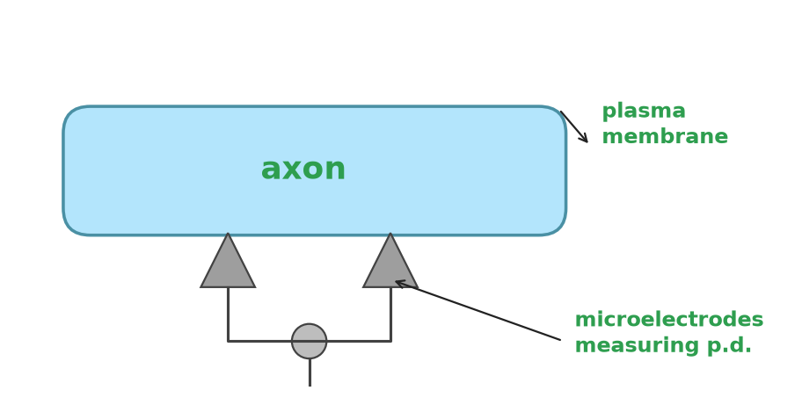
What is a nerve impulse?
Home
A2 Biology
All cells have a difference in electrical charge across the plasma membrane. This is called the potential difference (p.d.). It is measured in millivolts (mV).
The normal, resting state of an axon is called the resting potential. In this state the p.d. across the axon is –70 mV. The membrane is said to be polarized.
A nerve impulse, or action potential, occurs when the p.d. across an axon is temporarily reversed. The p.d. changes to around +35 mV. The membrane is said to be depolarized.
◀
▶
23 of 79
Original course © Boardworks Ltd 2009. Reconstructed interactive resource.
Notes:
Original static teaching slide. Wording retained. Diagram rebuilt.

Slide 58
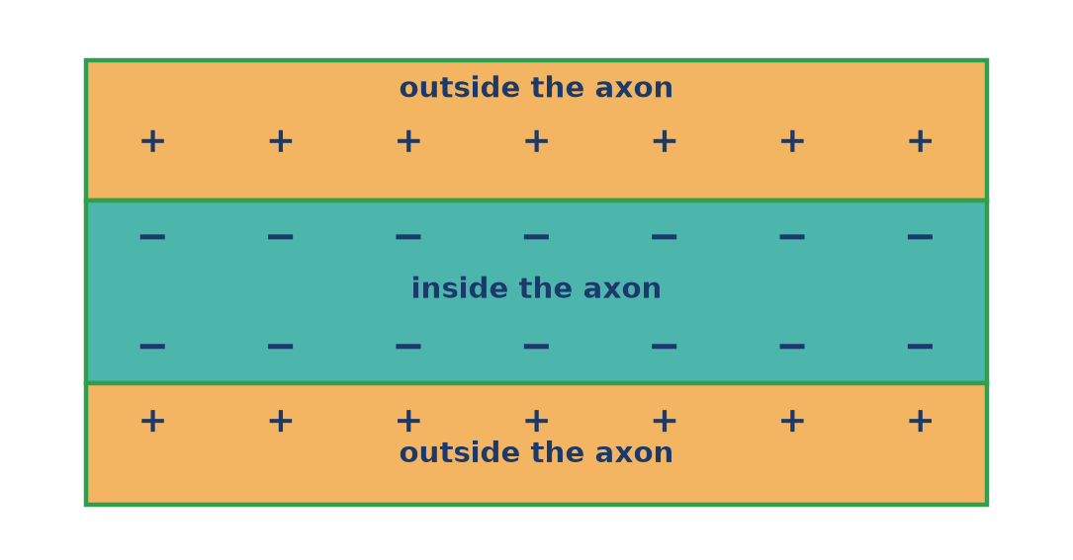
What happens during the resting state?
Home
A2 Biology
Step 1 of 4: Charge difference
An axon is at resting potential when no impulse is present. The inside is negative compared with the outside (about –70 mV). Click Next step to see how this state is maintained.
◀
▶
Reset
Next step
24 of 79
Original course © Boardworks Ltd 2009. Reconstructed interactive resource.
Notes:
Rebuilt Flash play-bar animation as a teacher-paced step sequence with Reset.

Slide 59
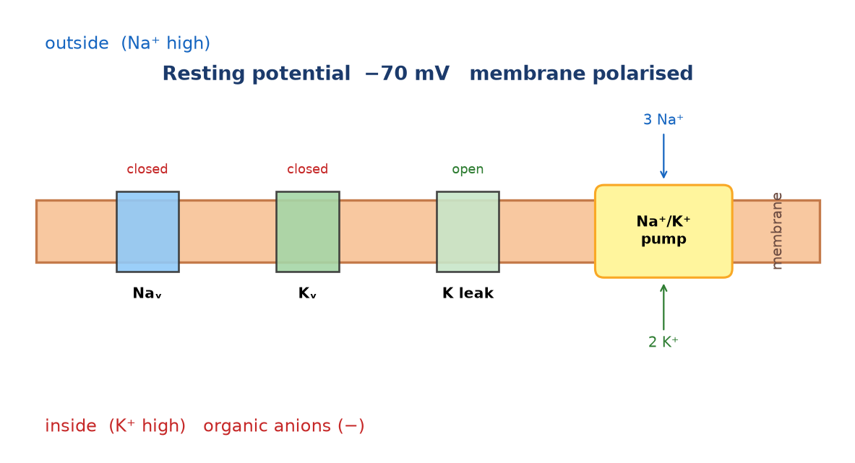
What happens during the resting state?
Home
A2 Biology
Step 2 of 4: Sodium–potassium pump
The Na⁺/K⁺ pump uses ATP to move 3 Na⁺ out for every 2 K⁺ in. This is active transport. The unequal exchange makes the inside more negative.
◀
▶
Previous
Reset
Next step
25 of 79
Original course © Boardworks Ltd 2009. Reconstructed interactive resource.
Notes:
Rebuilt Flash play-bar animation as a teacher-paced step sequence with Reset.

Slide 60
What happens during the resting state?
Home
A2 Biology
Step 3 of 4: Membrane permeability
The resting membrane is much more permeable to K⁺ than to Na⁺ because of open potassium leak channels. K⁺ diffuses out, leaving behind negatively charged organic ions (proteins) that cannot leave.
◀
▶
Previous
Reset
Next step
26 of 79
Original course © Boardworks Ltd 2009. Reconstructed interactive resource.
Notes:
Rebuilt Flash play-bar animation as a teacher-paced step sequence with Reset.

Slide 61
What happens during the resting state?
Home
A2 Biology
Step 4 of 4: Putting it together
Pump (3 Na⁺ out, 2 K⁺ in) + K⁺ leak + trapped organic anions = polarised membrane at about –70 mV. Voltage-gated Na⁺ and K⁺ channels are closed.
◀
▶
Previous
Reset
Continue
27 of 79
Original course © Boardworks Ltd 2009. Reconstructed interactive resource.
Notes:
Rebuilt Flash play-bar animation as a teacher-paced step sequence with Reset.

Slide 62
Understanding resting potential
Home
A2 Biology
What happens during resting potential? Choose the correct ending for each sentence.
The potential difference across the axon is …
During this state the axon is …
The inside of the axon is …
The sodium–potassium pump moves …
The axon membrane is more permeable to …
Show all answers
◀
▶
28 of 79
Original course © Boardworks Ltd 2009. Reconstructed interactive resource.
Notes:
Rebuilt Flash drop-down cloze. Original S/C (show/check) buttons become Show all answers.

Slide 63
Understanding resting potential
Home
A2 Biology
The potential difference across the axon is …
-70 mV
0 mV
+35 mV
activity
Original course © Boardworks Ltd 2009. Reconstructed interactive resource.

Slide 64
Understanding resting potential
Home
A2 Biology
During this state the axon is …
polarised
depolarised
at threshold
activity
Original course © Boardworks Ltd 2009. Reconstructed interactive resource.

Slide 65
Understanding resting potential
Home
A2 Biology
The inside of the axon is …
negative compared with the outside
positive compared with the outside
at the same charge as the outside
activity
Original course © Boardworks Ltd 2009. Reconstructed interactive resource.

Slide 66
Understanding resting potential
Home
A2 Biology
The sodium–potassium pump moves …
an unequal number of ions (3 Na⁺ out, 2 K⁺ in)
equal numbers of Na⁺ and K⁺
only sodium ions
activity
Original course © Boardworks Ltd 2009. Reconstructed interactive resource.

Slide 67
Understanding resting potential
Home
A2 Biology
The axon membrane is more permeable to …
potassium ions than sodium ions
sodium ions than potassium ions
calcium ions than potassium ions
activity
Original course © Boardworks Ltd 2009. Reconstructed interactive resource.

Slide 68
Understanding resting potential
Home
A2 Biology
Correct.
Resting potential is about –70 mV (some texts use –65 to –70 mV).
Back
activity
Original course © Boardworks Ltd 2009. Reconstructed interactive resource.

Slide 69
Understanding resting potential
Home
A2 Biology
Not quite.
Look back at the resting-potential animation and try again.
Try again
activity
Original course © Boardworks Ltd 2009. Reconstructed interactive resource.

Slide 70
Understanding resting potential
Home
A2 Biology
Not quite.
Look back at the resting-potential animation and try again.
Try again
activity
Original course © Boardworks Ltd 2009. Reconstructed interactive resource.

Slide 71
Understanding resting potential
Home
A2 Biology
Correct.
The membrane has a charge difference, so it is polarised.
Back
activity
Original course © Boardworks Ltd 2009. Reconstructed interactive resource.

Slide 72
Understanding resting potential
Home
A2 Biology
Not quite.
Look back at the resting-potential animation and try again.
Try again
activity
Original course © Boardworks Ltd 2009. Reconstructed interactive resource.

Slide 73
Understanding resting potential
Home
A2 Biology
Not quite.
Look back at the resting-potential animation and try again.
Try again
activity
Original course © Boardworks Ltd 2009. Reconstructed interactive resource.

Slide 74
Understanding resting potential
Home
A2 Biology
Correct.
Organic anions and net ion movement keep the inside negative.
Back
activity
Original course © Boardworks Ltd 2009. Reconstructed interactive resource.

Slide 75
Understanding resting potential
Home
A2 Biology
Not quite.
Look back at the resting-potential animation and try again.
Try again
activity
Original course © Boardworks Ltd 2009. Reconstructed interactive resource.

Slide 76
Understanding resting potential
Home
A2 Biology
Not quite.
Look back at the resting-potential animation and try again.
Try again
activity
Original course © Boardworks Ltd 2009. Reconstructed interactive resource.

Slide 77
Understanding resting potential
Home
A2 Biology
Correct.
The 3:2 ratio helps generate the resting potential.
Back
activity
Original course © Boardworks Ltd 2009. Reconstructed interactive resource.

Slide 78
Understanding resting potential
Home
A2 Biology
Not quite.
Look back at the resting-potential animation and try again.
Try again
activity
Original course © Boardworks Ltd 2009. Reconstructed interactive resource.

Slide 79
Understanding resting potential
Home
A2 Biology
Not quite.
Look back at the resting-potential animation and try again.
Try again
activity
Original course © Boardworks Ltd 2009. Reconstructed interactive resource.

Slide 80
Understanding resting potential
Home
A2 Biology
Correct.
K⁺ leak channels are open at rest; voltage-gated Na⁺ channels are closed.
Back
activity
Original course © Boardworks Ltd 2009. Reconstructed interactive resource.

Slide 81
Understanding resting potential
Home
A2 Biology
Not quite.
Look back at the resting-potential animation and try again.
Try again
activity
Original course © Boardworks Ltd 2009. Reconstructed interactive resource.

Slide 82
Understanding resting potential
Home
A2 Biology
Not quite.
Look back at the resting-potential animation and try again.
Try again
activity
Original course © Boardworks Ltd 2009. Reconstructed interactive resource.

Slide 83
Resting potential – answers
Home
A2 Biology
Answer key
• p.d. = –70 mV
• the axon is polarised
• inside is negative compared with the outside
• the pump moves 3 Na⁺ out and 2 K⁺ in (unequal numbers)
• the membrane is more permeable to K⁺ than to Na⁺
Back
activity
Original course © Boardworks Ltd 2009. Reconstructed interactive resource.

Slide 84
Action potential
Home
A2 Biology
A temporary reversal of the potential difference in the axon is caused by a change in the distribution of ions.
Press play on the next screens to see how this change propagates a nerve impulse.
Play sequence
◀
▶
29 of 79
Original course © Boardworks Ltd 2009. Reconstructed interactive resource.

Slide 85
What happens during an action potential?
Home
A2 Biology
Step 1 of 4: Resting – channels closed
Voltage-gated Na⁺ and K⁺ channels are closed. The membrane is polarised at about –70 mV.
◀
▶
Reset
Next step
30 of 79
Original course © Boardworks Ltd 2009. Reconstructed interactive resource.
Notes:
Rebuilt Flash play animation of ion movement during an action potential.

Slide 86
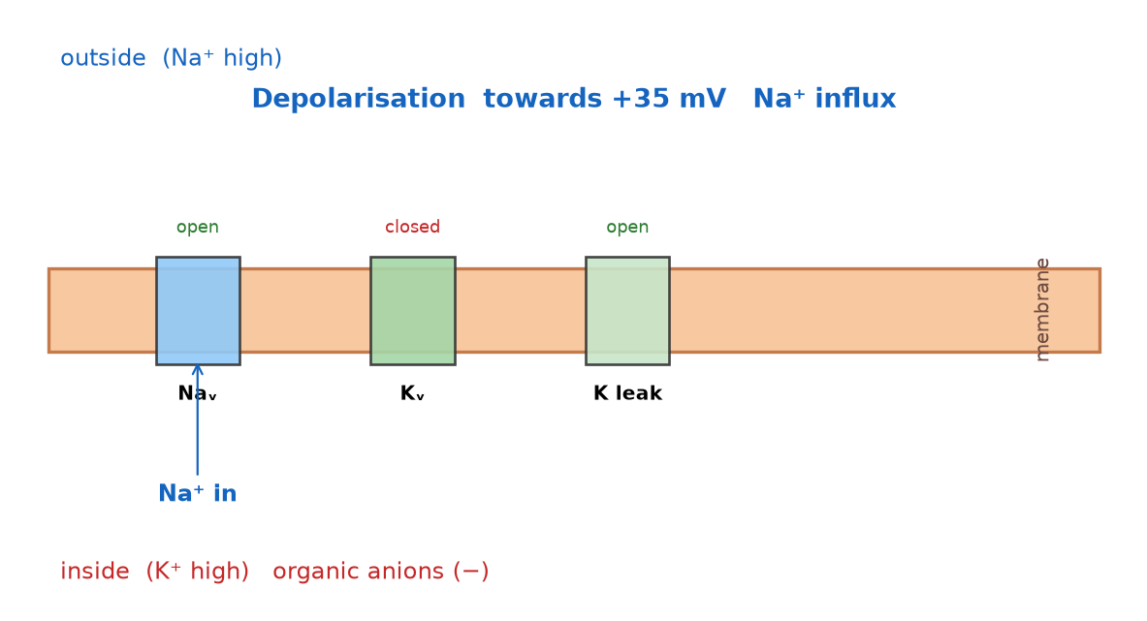
What happens during an action potential?
Home
A2 Biology
Step 2 of 4: Depolarisation – Na⁺ in
A stimulus opens voltage-gated sodium channels. Na⁺ rushes in down its electrochemical gradient. The inside becomes positive (about +35 mV). This is depolarisation.
◀
▶
Previous
Reset
Next step
31 of 79
Original course © Boardworks Ltd 2009. Reconstructed interactive resource.
Notes:
Rebuilt Flash play animation of ion movement during an action potential.

Slide 87
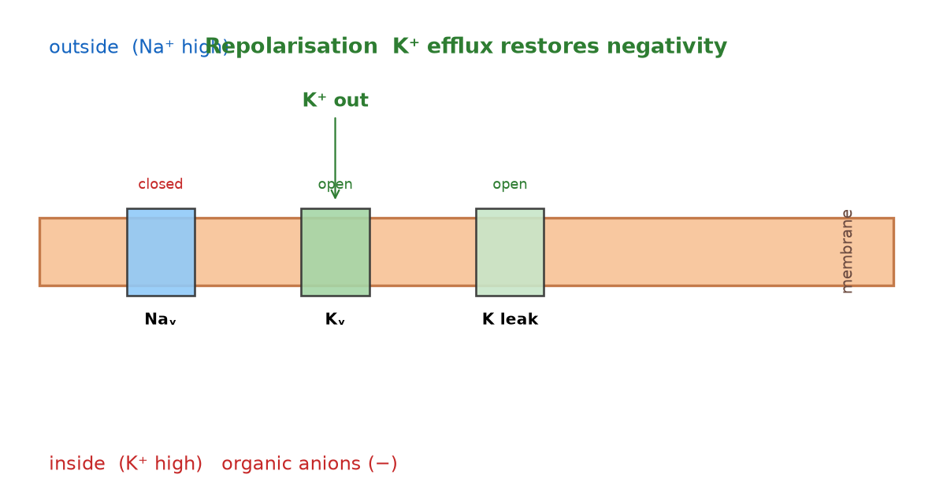
What happens during an action potential?
Home
A2 Biology
Step 3 of 4: Repolarisation – K⁺ out
Na⁺ channels inactivate. Voltage-gated K⁺ channels open. K⁺ leaves the axon and the inside becomes negative again. This is repolarisation.
◀
▶
Previous
Reset
Next step
32 of 79
Original course © Boardworks Ltd 2009. Reconstructed interactive resource.
Notes:
Rebuilt Flash play animation of ion movement during an action potential.

Slide 88
What happens during an action potential?
Home
A2 Biology
Step 4 of 4: Return to rest
There is a brief hyperpolarisation (more negative than rest). The Na⁺/K⁺ pump and leak channels restore the resting ion distribution. Local currents then depolarise the next patch of membrane.
◀
▶
Previous
Reset
Continue
33 of 79
Original course © Boardworks Ltd 2009. Reconstructed interactive resource.
Notes:
Rebuilt Flash play animation of ion movement during an action potential.

Slide 89
What happens during an action potential?
Home
A2 Biology
Which voltage-gated ion channels are open during each stage?
voltage-gated potassium
voltage-gated sodium
resting potential
click to reveal
click to reveal
depolarisation
click to reveal
click to reveal
repolarisation
click to reveal
click to reveal
◀
▶
Check
Reset
34 of 79
Original course © Boardworks Ltd 2009. Reconstructed interactive resource.
Notes:
Rebuilt Flash open/closed drag table. Click Check for the key.

Slide 90
Ion channels – answers
Home
A2 Biology
Answer key
K⁺ voltage-gated
Na⁺ voltage-gated
resting potential
closed
closed
depolarisation
closed
open
repolarisation
open
closed
Note: potassium leak channels stay open at rest. This table is about voltage-gated channels only, matching the original Boardworks activity.
Back
activity
Original course © Boardworks Ltd 2009. Reconstructed interactive resource.

Slide 91
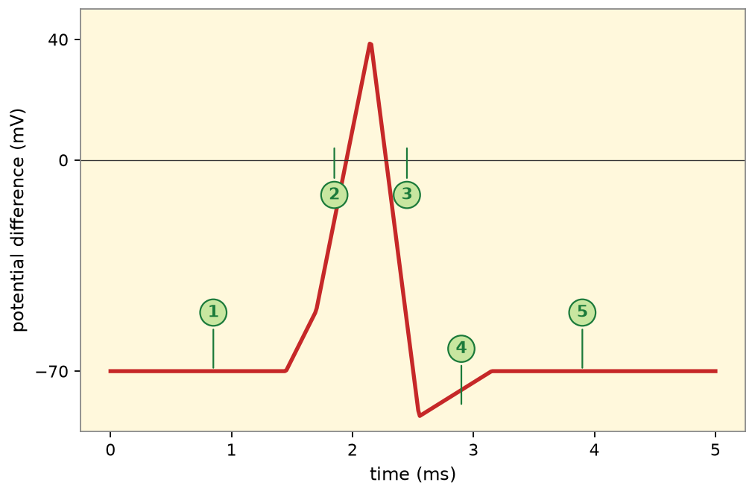
Changes during an action potential
Home
A2 Biology
How does the potential difference change?
Press on the numbered graph labels to view a summary of the events during each stage of an action potential.
1 rest
2 depolarisation
3 repolarisation
4 hyperpolarisation
5 return to rest
◀
▶
35 of 79
Original course © Boardworks Ltd 2009. Reconstructed interactive resource.
Notes:
Rebuilt Flash click-on-graph. Stages 1–5 match the original numbered labels.

Slide 92
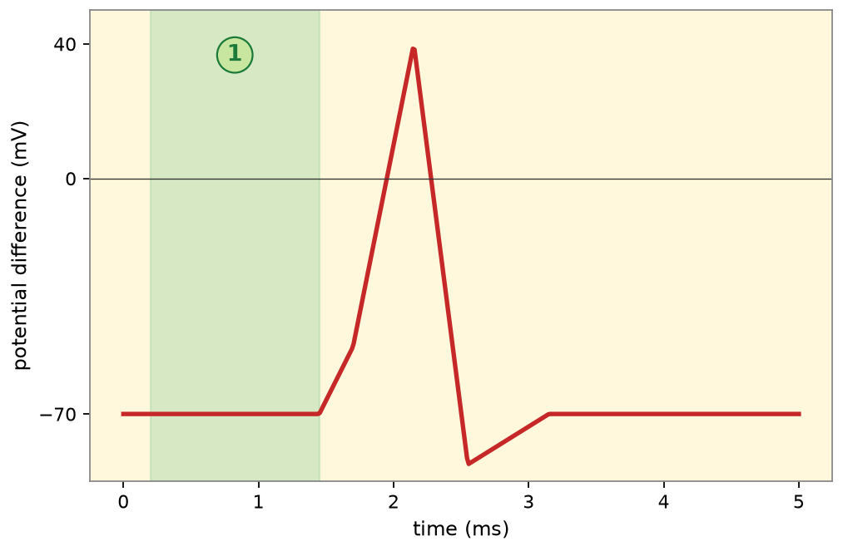
Changes during an action potential
Home
A2 Biology
1 Resting potential
Voltage-gated channels closed. p.d. ≈ –70 mV. Membrane polarised. Na⁺/K⁺ pump and K⁺ leak maintain the gradient.
Back to graph
activity
Original course © Boardworks Ltd 2009. Reconstructed interactive resource.

Slide 93
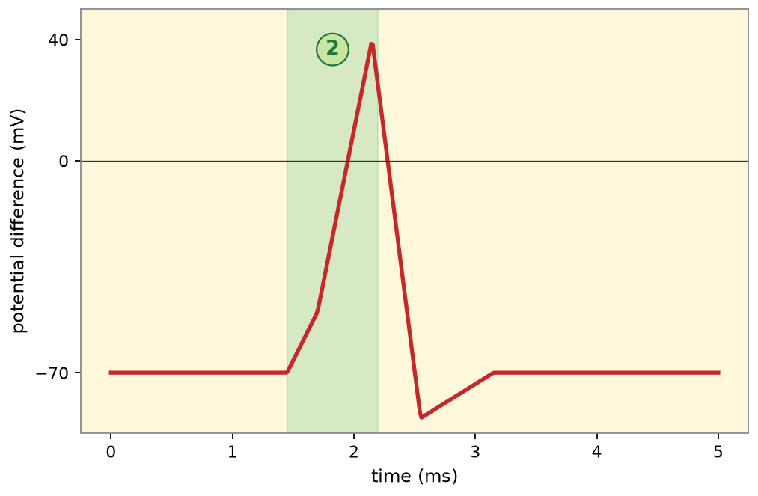
Changes during an action potential
Home
A2 Biology
2 Depolarisation
Threshold reached. Voltage-gated Na⁺ channels open. Na⁺ influx reverses the p.d. towards +35 mV. The membrane is depolarised.
Back to graph
activity
Original course © Boardworks Ltd 2009. Reconstructed interactive resource.

Slide 94
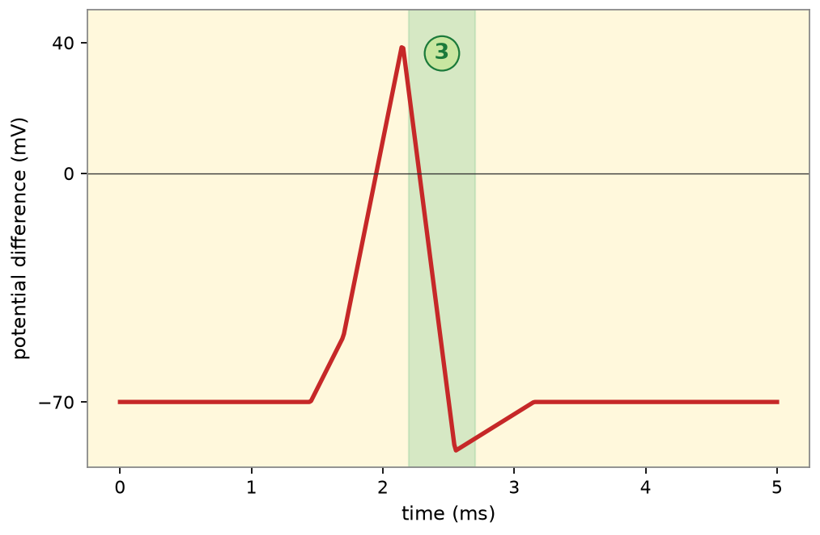
Changes during an action potential
Home
A2 Biology
3 Repolarisation
Na⁺ channels inactivate. Voltage-gated K⁺ channels open. K⁺ efflux restores negativity inside the axon.
Back to graph
activity
Original course © Boardworks Ltd 2009. Reconstructed interactive resource.

Slide 95
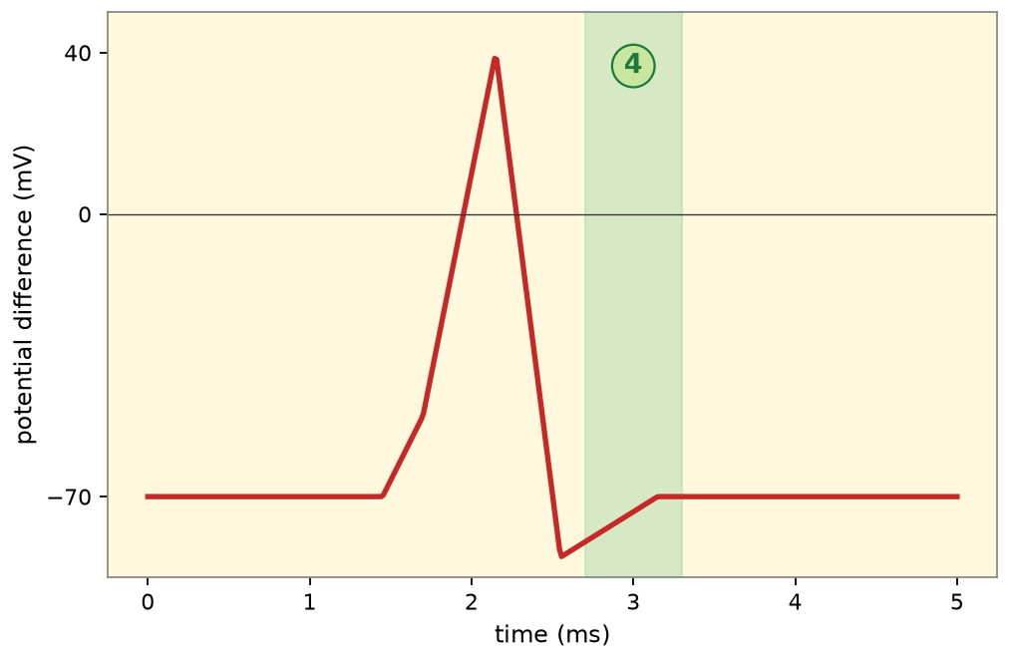
Changes during an action potential
Home
A2 Biology
4 Hyperpolarisation
K⁺ channels are slow to close, so the p.d. briefly becomes more negative than rest (undershoot).
Back to graph
activity
Original course © Boardworks Ltd 2009. Reconstructed interactive resource.

Slide 96
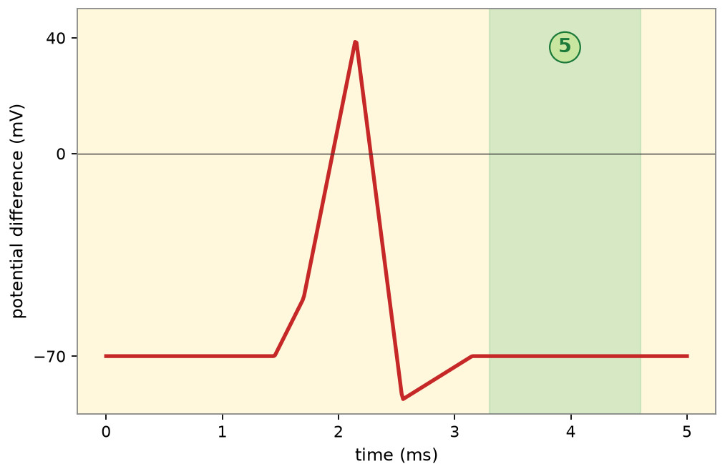
Changes during an action potential
Home
A2 Biology
5 Return to resting potential
Ion channels reset. The pump restores Na⁺ and K⁺ concentrations. The axon is ready for another impulse once the refractory period ends.
Back to graph
activity
Original course © Boardworks Ltd 2009. Reconstructed interactive resource.

Slide 97
How does the axon change?
Home
A2 Biology
Changes within the axon are essential for the propagation of an action potential.
Answer these questions about the properties of depolarisation, repolarisation and resting potential.
Press start to begin.
start
◀
▶
36 of 79
Original course © Boardworks Ltd 2009. Reconstructed interactive resource.
Notes:
Rebuilt Flash start-quiz. Three MCQs follow.

Slide 98
How does the axon change?
Home
A2 Biology
During depolarisation, which ions move where?
A Na⁺ ions move into the axon
B K⁺ ions move into the axon
C Na⁺ ions move out of the axon
D Organic anions leave the axon
◀
▶
37 of 79
Original course © Boardworks Ltd 2009. Reconstructed interactive resource.
Notes:
Correct = A. Voltage-gated sodium channels open and Na⁺ floods in, making the inside positive.

Slide 99
How does the axon change?
Home
A2 Biology
Correct.
Voltage-gated sodium channels open and Na⁺ floods in, making the inside positive.
Continue
activity
Original course © Boardworks Ltd 2009. Reconstructed interactive resource.

Slide 100
How does the axon change?
Home
A2 Biology
Not quite.
Think about which channels open first when threshold is reached.
Try again
activity
Original course © Boardworks Ltd 2009. Reconstructed interactive resource.

Slide 101
How does the axon change?
Home
A2 Biology
Not quite.
Think about which channels open first when threshold is reached.
Try again
activity
Original course © Boardworks Ltd 2009. Reconstructed interactive resource.

Slide 102
How does the axon change?
Home
A2 Biology
Not quite.
Think about which channels open first when threshold is reached.
Try again
activity
Original course © Boardworks Ltd 2009. Reconstructed interactive resource.

Slide 103
How does the axon change?
Home
A2 Biology
During repolarisation, the inside of the axon becomes negative again because:
A Na⁺ continues to enter
B K⁺ ions leave the axon
C The membrane becomes impermeable to all ions
D Chloride ions enter in large amounts
◀
▶
38 of 79
Original course © Boardworks Ltd 2009. Reconstructed interactive resource.
Notes:
Correct = B. Voltage-gated potassium channels open and K⁺ efflux restores the negative inside.

Slide 104
How does the axon change?
Home
A2 Biology
Correct.
Voltage-gated potassium channels open and K⁺ efflux restores the negative inside.
Continue
activity
Original course © Boardworks Ltd 2009. Reconstructed interactive resource.

Slide 105
How does the axon change?
Home
A2 Biology
Not quite.
Repolarisation is caused by potassium leaving, not by sodium still entering.
Try again
activity
Original course © Boardworks Ltd 2009. Reconstructed interactive resource.

Slide 106
How does the axon change?
Home
A2 Biology
Not quite.
Repolarisation is caused by potassium leaving, not by sodium still entering.
Try again
activity
Original course © Boardworks Ltd 2009. Reconstructed interactive resource.

Slide 107
How does the axon change?
Home
A2 Biology
Not quite.
Repolarisation is caused by potassium leaving, not by sodium still entering.
Try again
activity
Original course © Boardworks Ltd 2009. Reconstructed interactive resource.

Slide 108
How does the axon change?
Home
A2 Biology
Why does a local circuit cause the next region of membrane to depolarise?
A The pump reverses direction
B Positive charge inside spreads to the adjacent region, opening Na⁺ channels there
C Myelin pumps sodium
D The synapse releases calcium along the axon
◀
▶
39 of 79
Original course © Boardworks Ltd 2009. Reconstructed interactive resource.
Notes:
Correct = B. Inward Na⁺ makes that patch positive. Nearby resting membrane is depolarised to threshold and a new action potential is generated – the impulse propagates.

Slide 109
How does the axon change?
Home
A2 Biology
Correct.
Inward Na⁺ makes that patch positive. Nearby resting membrane is depolarised to threshold and a new action potential is generated – the impulse propagates.
Continue
activity
Original course © Boardworks Ltd 2009. Reconstructed interactive resource.

Slide 110
How does the axon change?
Home
A2 Biology
Not quite.
Local currents (local circuits) are the link between one depolarised patch and the next.
Try again
activity
Original course © Boardworks Ltd 2009. Reconstructed interactive resource.

Slide 111
How does the axon change?
Home
A2 Biology
Not quite.
Local currents (local circuits) are the link between one depolarised patch and the next.
Try again
activity
Original course © Boardworks Ltd 2009. Reconstructed interactive resource.

Slide 112
How does the axon change?
Home
A2 Biology
Not quite.
Local currents (local circuits) are the link between one depolarised patch and the next.
Try again
activity
Original course © Boardworks Ltd 2009. Reconstructed interactive resource.

Slide 113
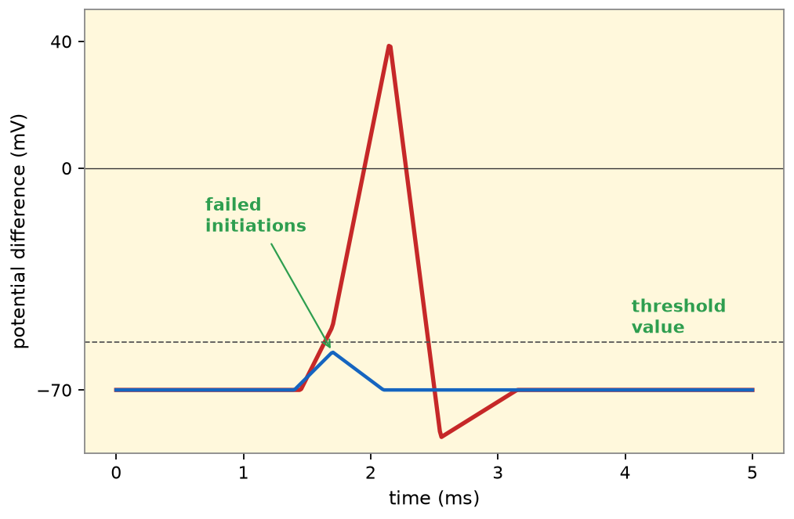
The all or nothing principle
Home
A2 Biology
For an action potential to be generated, the stimulus must be greater than the threshold value.
A stimulus will be below the threshold value if insufficient numbers of sodium channels open, preventing full depolarization of the axon.
Once the threshold value is reached, the action potential generated is always the same size regardless of the strength of the stimulus. It is an ‘all or nothing’ response.
◀
▶
40 of 79
Original course © Boardworks Ltd 2009. Reconstructed interactive resource.
Notes:
Original static teaching slide. Graph rebuilt.

Slide 114
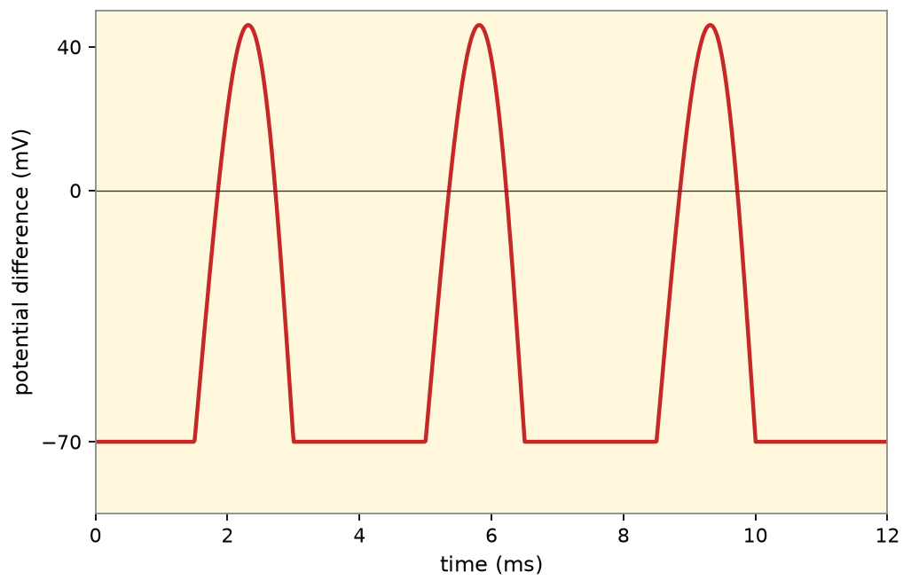
Different strengths of stimuli
Home
A2 Biology
Changing the strength of the stimulus
Adjust the strength of the stimulus to see how this affects the frequency of an action potential.
weak
medium
strong
A stronger stimulus does not make a bigger action potential. It increases the frequency of action potentials.
◀
▶
41 of 79
Original course © Boardworks Ltd 2009. Reconstructed interactive resource.
Notes:
Rebuilt Flash slider. Weak/medium/strong buttons show different AP frequencies.

Slide 115
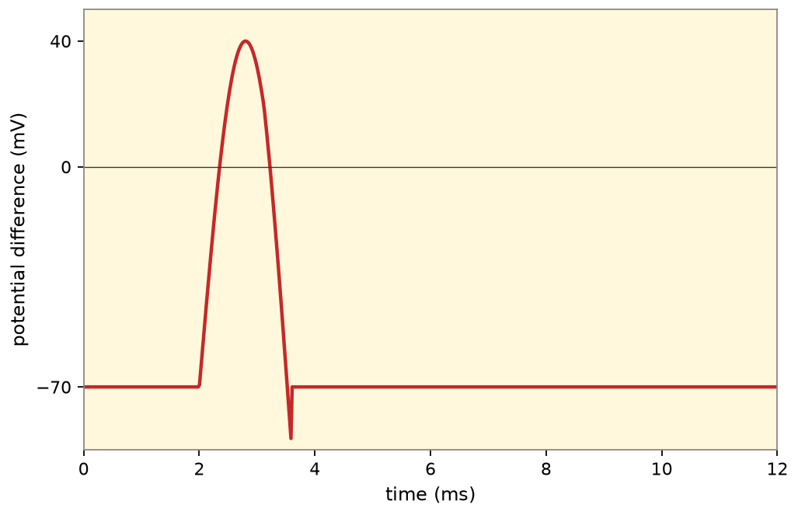
Different strengths of stimuli
Home
A2 Biology
Weak (just above threshold): low frequency of action potentials.
Back
activity
Original course © Boardworks Ltd 2009. Reconstructed interactive resource.

Slide 116
Different strengths of stimuli
Home
A2 Biology
Medium: higher frequency. Amplitude of each action potential is unchanged.
Back
activity
Original course © Boardworks Ltd 2009. Reconstructed interactive resource.

Slide 117
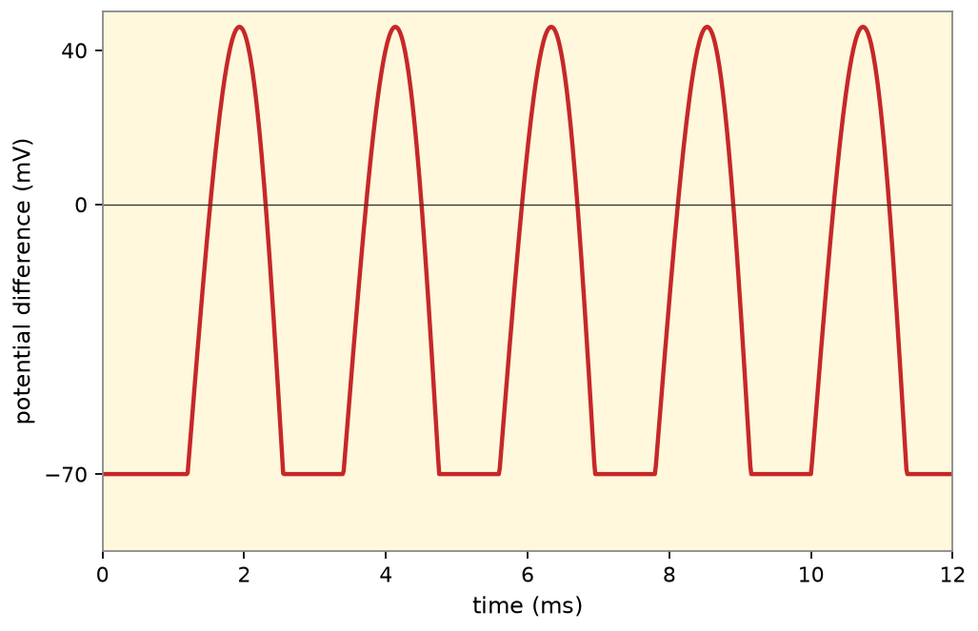
Different strengths of stimuli
Home
A2 Biology
Strong: highest frequency. Still the same amplitude – all or nothing.
Back
activity
Original course © Boardworks Ltd 2009. Reconstructed interactive resource.

Slide 118
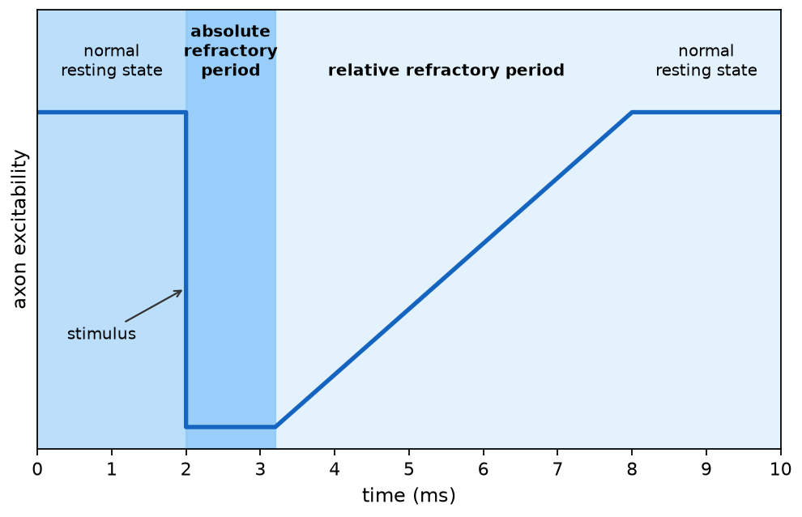
The axon after an action potential
Home
A2 Biology
What is the refractory period?
Once an action potential has passed, the axon becomes inexcitable for a short period of time. Press on each area of the graph to learn more about how the axon excitability changes.
absolute refractory
relative refractory
◀
▶
42 of 79
Original course © Boardworks Ltd 2009. Reconstructed interactive resource.
Notes:
Rebuilt Flash click-on-graph for refractory periods.

Slide 119
The axon after an action potential
Home
A2 Biology
Absolute refractory period
No new action potential can be generated, however strong the stimulus. Voltage-gated Na⁺ channels are inactivated and must reset. This also forces unidirectional propagation – the region behind the impulse cannot fire again yet.
Back
activity
Original course © Boardworks Ltd 2009. Reconstructed interactive resource.

Slide 120
The axon after an action potential
Home
A2 Biology
Relative refractory period
A larger-than-normal stimulus can generate an action potential because some Na⁺ channels have recovered but the membrane is still hyperpolarised. Excitability rises back to normal as the resting potential is restored.
Back
activity
Original course © Boardworks Ltd 2009. Reconstructed interactive resource.

Slide 121
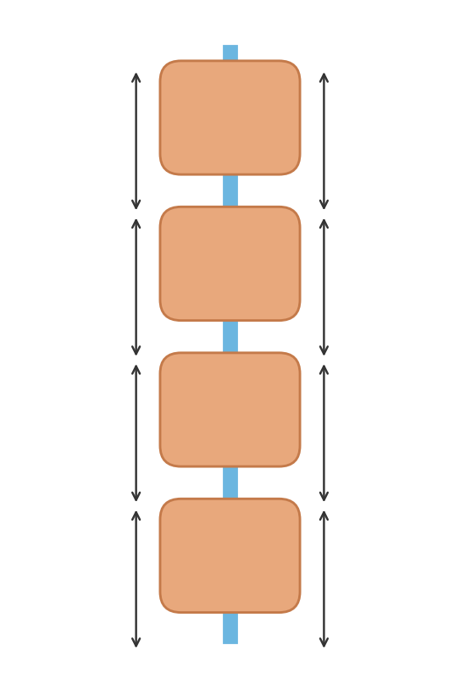
What affects the speed of an impulse?
Home
A2 Biology
Step 1 of 4: Myelin and nodes
An action potential moves faster along myelinated neurones than those without a myelin sheath.
Ion channels at the nodes of Ranvier allow Na⁺ and K⁺ to cross. It is only at these points that an action potential is generated in a myelinated neurone.
◀
▶
Reset
Next step
43 of 79
Original course © Boardworks Ltd 2009. Reconstructed interactive resource.
Notes:
Rebuilt saltatory conduction animation plus the original speed-factor teaching points.

Slide 122
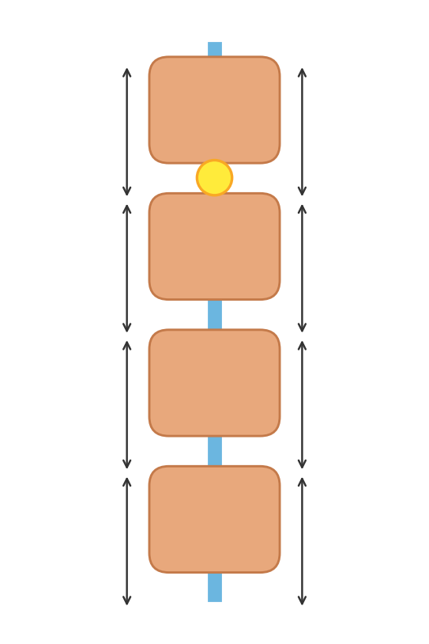
What affects the speed of an impulse?
Home
A2 Biology
Step 2 of 4: Jumping from node to node
The action potential appears at a node. Local currents depolarise the next node. This jumping is saltatory conduction and is much quicker than step-by-step conduction in a non-myelinated axon.
◀
▶
Previous
Reset
Next step
44 of 79
Original course © Boardworks Ltd 2009. Reconstructed interactive resource.
Notes:
Rebuilt saltatory conduction animation plus the original speed-factor teaching points.

Slide 123
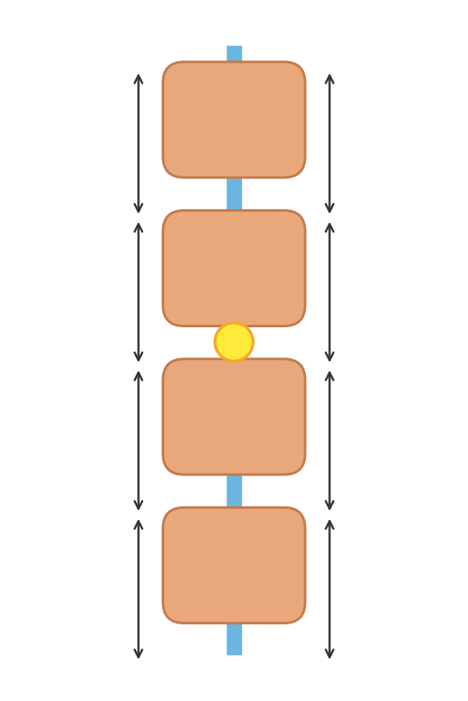
What affects the speed of an impulse?
Home
A2 Biology
Step 3 of 4: Next node fires
The impulse ‘jumps’ to the next exposed node. Myelin prevents ion leakage in the internodes, so the local current remains strong enough to bring the distant node to threshold.
◀
▶
Previous
Reset
Next step
45 of 79
Original course © Boardworks Ltd 2009. Reconstructed interactive resource.
Notes:
Rebuilt saltatory conduction animation plus the original speed-factor teaching points.

Slide 124
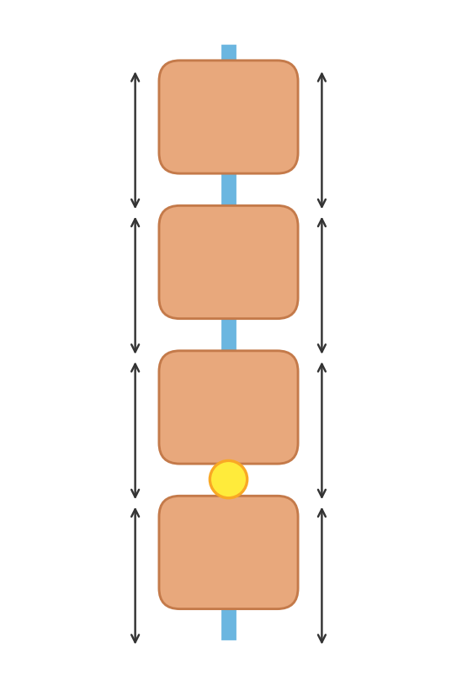
What affects the speed of an impulse?
Home
A2 Biology
Step 4 of 4: Axon diameter and temperature
Greater axon diameter → faster impulse (smaller surface area to volume ratio, less ion leak).
Higher temperature → faster impulse (faster ion diffusion), until proteins denature. This is why local cooling slows nerves.
◀
▶
Previous
Reset
Continue
46 of 79
Original course © Boardworks Ltd 2009. Reconstructed interactive resource.
Notes:
Rebuilt saltatory conduction animation plus the original speed-factor teaching points.

Slide 125
What affects the speed of an impulse?
Home
A2 Biology
The speed of a nerve impulse is also affected by:
Axon diameter – The greater the diameter of the axon the faster the impulse travels.
Axons with a small diameter have a larger surface area to volume ratio than axons with a large diameter. This causes a larger amount of ions to leak out of the axon, making it more difficult for an action potential to propagate.
Temperature – The higher the temperature, the faster the speed of the impulse. Temperature affects the rate of diffusion of ions across the axon.
◀
▶
47 of 79
Original course © Boardworks Ltd 2009. Reconstructed interactive resource.
Notes:
Original wording retained.

Slide 126
True or false?
Home
A2 Biology
Are these statements about action potentials true or false?
1. Every stimulus detected by the sensory receptors causes an action potential to be generated.
true
false
2. An action potential is always the same size regardless of the strength of stimuli.
true
false
3. The amplitude of the action potential increases when the stimulus is stronger.
true
false
4. In an unmyelinated neurone an action potential will travel by saltatory conduction.
true
false
5. It is impossible for an action potential to be generated during the absolute refractory period.
true
false
◀
▶
Show all
Reset
48 of 79
Original course © Boardworks Ltd 2009. Reconstructed interactive resource.
Notes:
Click true or false for each statement. Show all reveals the key.

Slide 127
True or false?
Home
A2 Biology
Incorrect. The statement is FALSE.
Every stimulus detected by the sensory receptors causes an action potential to be generated.
The generator potential must reach threshold. Subthreshold stimuli fail to trigger an action potential.
Back to quiz
activity
Original course © Boardworks Ltd 2009. Reconstructed interactive resource.

Slide 128
True or false?
Home
A2 Biology
Correct. The statement is FALSE.
Every stimulus detected by the sensory receptors causes an action potential to be generated.
The generator potential must reach threshold. Subthreshold stimuli fail to trigger an action potential.
Back to quiz
activity
Original course © Boardworks Ltd 2009. Reconstructed interactive resource.

Slide 129
True or false?
Home
A2 Biology
Correct. The statement is TRUE.
An action potential is always the same size regardless of the strength of stimuli.
All-or-nothing: once threshold is reached, amplitude is constant. Strength is coded by frequency.
Back to quiz
activity
Original course © Boardworks Ltd 2009. Reconstructed interactive resource.

Slide 130
True or false?
Home
A2 Biology
Incorrect. The statement is TRUE.
An action potential is always the same size regardless of the strength of stimuli.
All-or-nothing: once threshold is reached, amplitude is constant. Strength is coded by frequency.
Back to quiz
activity
Original course © Boardworks Ltd 2009. Reconstructed interactive resource.

Slide 131
True or false?
Home
A2 Biology
Incorrect. The statement is FALSE.
The amplitude of the action potential increases when the stimulus is stronger.
Amplitude stays the same. Frequency increases.
Back to quiz
activity
Original course © Boardworks Ltd 2009. Reconstructed interactive resource.

Slide 132
True or false?
Home
A2 Biology
Correct. The statement is FALSE.
The amplitude of the action potential increases when the stimulus is stronger.
Amplitude stays the same. Frequency increases.
Back to quiz
activity
Original course © Boardworks Ltd 2009. Reconstructed interactive resource.

Slide 133
True or false?
Home
A2 Biology
Incorrect. The statement is FALSE.
In an unmyelinated neurone an action potential will travel by saltatory conduction.
Saltatory conduction requires myelin and nodes of Ranvier. Unmyelinated axons use continuous conduction.
Back to quiz
activity
Original course © Boardworks Ltd 2009. Reconstructed interactive resource.

Slide 134
True or false?
Home
A2 Biology
Correct. The statement is FALSE.
In an unmyelinated neurone an action potential will travel by saltatory conduction.
Saltatory conduction requires myelin and nodes of Ranvier. Unmyelinated axons use continuous conduction.
Back to quiz
activity
Original course © Boardworks Ltd 2009. Reconstructed interactive resource.

Slide 135
True or false?
Home
A2 Biology
Correct. The statement is TRUE.
It is impossible for an action potential to be generated during the absolute refractory period.
Na⁺ channels are inactivated. No stimulus, however strong, can open enough of them.
Back to quiz
activity
Original course © Boardworks Ltd 2009. Reconstructed interactive resource.

Slide 136
True or false?
Home
A2 Biology
Incorrect. The statement is TRUE.
It is impossible for an action potential to be generated during the absolute refractory period.
Na⁺ channels are inactivated. No stimulus, however strong, can open enough of them.
Back to quiz
activity
Original course © Boardworks Ltd 2009. Reconstructed interactive resource.

Slide 137
True or false? – answers
Home
A2 Biology
1. FALSE. Every stimulus detected by the sensory receptors causes an action potential to be generated. The generator potential must reach threshold. Subthreshold stimuli fail to trigger an action potential.
2. TRUE. An action potential is always the same size regardless of the strength of stimuli. All-or-nothing: once threshold is reached, amplitude is constant. Strength is coded by frequency.
3. FALSE. The amplitude of the action potential increases when the stimulus is stronger. Amplitude stays the same. Frequency increases.
4. FALSE. In an unmyelinated neurone an action potential will travel by saltatory conduction. Saltatory conduction requires myelin and nodes of Ranvier. Unmyelinated axons use continuous conduction.
5. TRUE. It is impossible for an action potential to be generated during the absolute refractory period. Na⁺ channels are inactivated. No stimulus, however strong, can open enough of them.
Back to quiz
Continue
activity
Original course © Boardworks Ltd 2009. Reconstructed interactive resource.

Slide 138
End of Part 2
Home
A2 Biology
Next: Part 3 – Sensory receptors
Back to contents
Next: Sensory receptors
◀
▶
49 of 79
Original course © Boardworks Ltd 2009. Reconstructed interactive resource.

Slide 139
A2 Biology
Home
The Nervous System
Part 3: Sensory receptors
◀
▶
Interactive reconstruction · Flash-free · Original course © Boardworks Ltd 2009
Original course © Boardworks Ltd 2009. Reconstructed interactive resource.

Slide 140
Contents
Home
A2 Biology
1. the sensory nervous system
2. Pacinian corpuscle animation
3. photoreceptors in the retina
4. rod cells and rhodopsin
5. cone cells and iodopsin
6. rods vs cones sorting
7. knowledge check
◀
▶
51 of 79
Original course © Boardworks Ltd 2009. Reconstructed interactive resource.

Slide 141
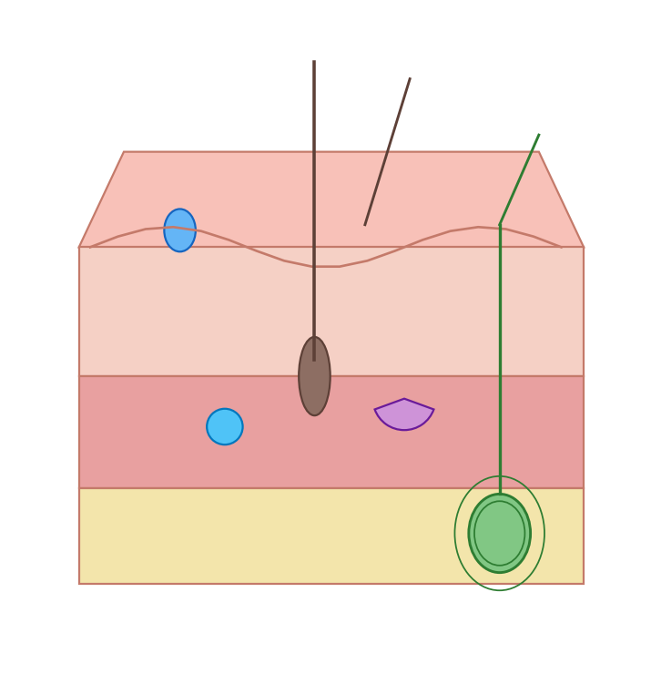
The sensory nervous system
Home
A2 Biology
Receptors are specialized cells that can detect changes in the body’s internal and external environment. Most receptor cells are only sensitive to one type of stimulus.
Receptors convert the energy of the stimulus into the start of a nerve impulse known as a generator potential.
For example, mechanoreceptors detect changes in mechanical energy, such as pressure.
◀
mechanoreceptor in the skin
▶
52 of 79
Original course © Boardworks Ltd 2009. Reconstructed interactive resource.
Notes:
Original wording retained. Skin-block diagram rebuilt (Pacinian corpuscle highlighted in later slides).

Slide 142
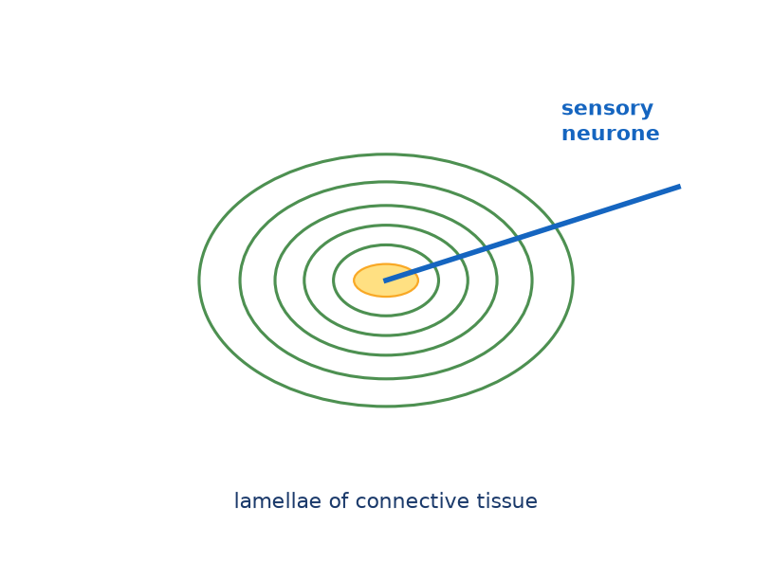
Mechanoreceptors in the skin
Home
A2 Biology
Step 1 of 4: Pacinian corpuscle at rest
Mechanoreceptors within the skin can detect pressure. The Pacinian corpuscle is a pressure receptor in the dermis/hypodermis. It has concentric lamellae of connective tissue around a sensory neurone ending.
◀
▶
Reset
Next step
53 of 79
Original course © Boardworks Ltd 2009. Reconstructed interactive resource.
Notes:
Rebuilt Flash play animation of pressure transduction in a Pacinian corpuscle.

Slide 143
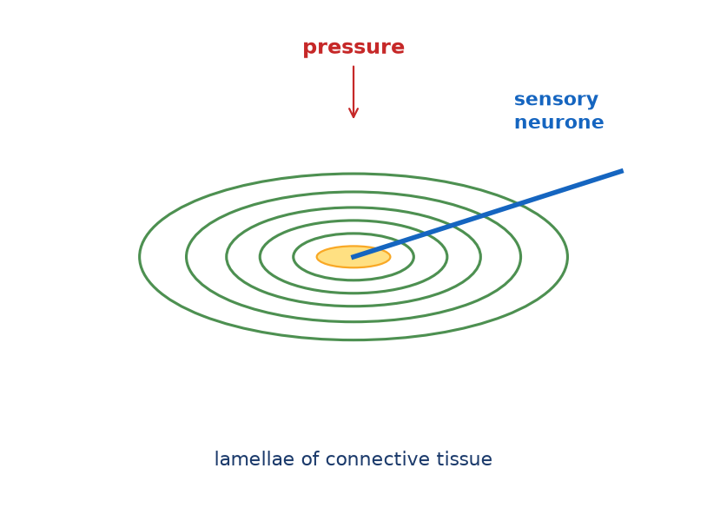
Mechanoreceptors in the skin
Home
A2 Biology
Step 2 of 4: Pressure deforms the lamellae
Pressure deforms the lamellae and stretches the neurone ending in the centre. Stretch-mediated sodium channels in the membrane open.
◀
▶
Previous
Reset
Next step
54 of 79
Original course © Boardworks Ltd 2009. Reconstructed interactive resource.
Notes:
Rebuilt Flash play animation of pressure transduction in a Pacinian corpuscle.

Slide 144
Mechanoreceptors in the skin
Home
A2 Biology
Step 3 of 4: Generator potential
Na⁺ enters and the membrane depolarises – a generator potential. The greater the pressure, the greater the deformation and the larger the generator potential (it is graded).
◀
▶
Previous
Reset
Next step
55 of 79
Original course © Boardworks Ltd 2009. Reconstructed interactive resource.
Notes:
Rebuilt Flash play animation of pressure transduction in a Pacinian corpuscle.

Slide 145
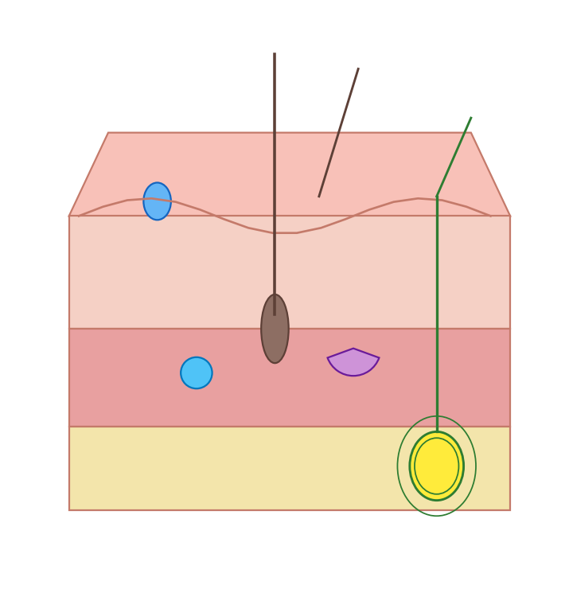
Mechanoreceptors in the skin
Home
A2 Biology
Step 4 of 4: If threshold is reached
If the generator potential reaches threshold, voltage-gated Na⁺ channels open and an action potential fires along the sensory neurone towards the CNS. This is how mechanical energy is transduced into electrical energy.
◀
▶
Previous
Reset
Continue
56 of 79
Original course © Boardworks Ltd 2009. Reconstructed interactive resource.
Notes:
Rebuilt Flash play animation of pressure transduction in a Pacinian corpuscle.

Slide 146
Photoreceptors in the retina
Home
A2 Biology
What cells are found in the retina?
The retina is a photosensitive layer at the back of the eye. It contains two types of photoreceptors called rods and cones, which respond to different light intensities.
Press on each label to find out more about the cells of the retina.
cone cell ▶
rod cell ▶
bipolar cell ▶
ganglion cell ▶
optic nerve ▶
◀
▶
Reset
57 of 79
Original course © Boardworks Ltd 2009. Reconstructed interactive resource.
Notes:
Rebuilt Flash click-label retina activity.

Slide 147
Photoreceptors in the retina
Home
A2 Biology
Cone cell
Photoreceptor for high light intensity and colour. Outer segment is conical. Concentrated in the fovea. Contains iodopsin. Usually a 1:1 link to a bipolar cell – high visual acuity.
Back
activity
Original course © Boardworks Ltd 2009. Reconstructed interactive resource.

Slide 148
Photoreceptors in the retina
Home
A2 Biology
Rod cell
Photoreceptor for dim light (scotopic vision). Outer segment is rod-shaped with many rhodopsin discs. Many rods synapse with one bipolar cell (retinal convergence) – high sensitivity, lower acuity. Absent from the fovea.
Back
activity
Original course © Boardworks Ltd 2009. Reconstructed interactive resource.

Slide 149
Photoreceptors in the retina
Home
A2 Biology
Bipolar cell
Connects photoreceptors to ganglion cells. In rod pathways, several rods share a bipolar cell (summation of generator potentials). In cone pathways at the fovea, the link is often one-to-one.
Back
activity
Original course © Boardworks Ltd 2009. Reconstructed interactive resource.

Slide 150
Photoreceptors in the retina
Home
A2 Biology
Ganglion cell
Its axon forms part of the optic nerve. An action potential is generated in the ganglion cell, not in the rod or cone themselves. The optic disc (blind spot) is where these axons leave the eye.
Back
activity
Original course © Boardworks Ltd 2009. Reconstructed interactive resource.

Slide 151
Photoreceptors in the retina
Home
A2 Biology
Optic nerve
Bundle of ganglion-cell axons leaving at the blind spot. There are no photoreceptors here, so an image falling on the optic disc is not seen.
Back
activity
Original course © Boardworks Ltd 2009. Reconstructed interactive resource.

Slide 152
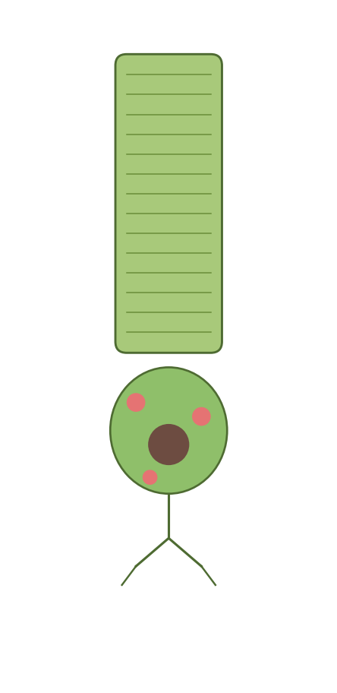
How do rod cells produce impulses?
Home
A2 Biology
Rod cells allow vision in dim light due to the presence of a pigment called rhodopsin, which is found in membrane-bound vesicles.
When rhodopsin absorbs light it splits into its constituent parts, opsin and retinal. This is called bleaching. Low intensity light is sufficient to cause this breakdown.
The presence of opsin causes a change in the permeability of the rod cell to sodium, which initiates a generator potential. Rhodopsin can reform in the absence of further light stimulation.
vesicles containing rhodopsin
◀
▶
58 of 79
Original course © Boardworks Ltd 2009. Reconstructed interactive resource.
Notes:
Original wording retained. At A-level, bleaching of rhodopsin → opsin + retinal → generator potential is the required sequence. (More advanced courses note that light actually closes Na⁺ channels in rods; the Boardworks 2009 wording is kept here as in the source course.)

Slide 153
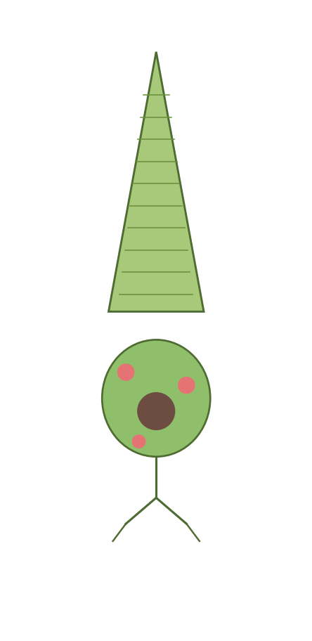
How do cone cells produce impulses?
Home
A2 Biology
Cone cells are sensitive to high light intensities due to the presence of the pigment iodopsin.
In bright light, iodopsin is broken down into its constituent parts, generating an action potential in the ganglion cell.
There are three different types of cone cell, each containing a different form of iodopsin. Each form of iodopsin absorbs a different wavelength of light – green, blue or red.
The colour seen depends on the relative degree of stimulation of the three different types of cone cell.
vesicles containing iodopsin
◀
▶
59 of 79
Original course © Boardworks Ltd 2009. Reconstructed interactive resource.
Notes:
Original wording retained. Trichromatic theory: three iodopsin forms, colour from relative stimulation.

Slide 154
Photoreceptors
Home
A2 Biology
Do these statements apply to rods or cones?
Click a statement, then place it.
mostly used for night vision
contain rhodopsin
contain iodopsin
concentrated in the fovea
high sensitivity, lower acuity
three types detect colour
many share one bipolar cell
work in bright light
◀
▶
Check
Reset
60 of 79
Original course © Boardworks Ltd 2009. Reconstructed interactive resource.
Notes:
Rebuilt Flash rods/cones sort. Original first card was ‘mostly used for night vision’ (rods).

Slide 155
Photoreceptors
Home
A2 Biology
mostly used for night vision
Does this describe rods or cones?
rods
cones
activity
Original course © Boardworks Ltd 2009. Reconstructed interactive resource.

Slide 156
Photoreceptors
Home
A2 Biology
Correct – rods.
mostly used for night vision
Back to sort
activity
Original course © Boardworks Ltd 2009. Reconstructed interactive resource.

Slide 157
Photoreceptors
Home
A2 Biology
Not quite.
‘mostly used for night vision’ describes rods, not cones.
Back to sort
activity
Original course © Boardworks Ltd 2009. Reconstructed interactive resource.

Slide 158
Photoreceptors
Home
A2 Biology
contain rhodopsin
Does this describe rods or cones?
rods
cones
activity
Original course © Boardworks Ltd 2009. Reconstructed interactive resource.

Slide 159
Photoreceptors
Home
A2 Biology
Correct – rods.
contain rhodopsin
Back to sort
activity
Original course © Boardworks Ltd 2009. Reconstructed interactive resource.

Slide 160
Photoreceptors
Home
A2 Biology
Not quite.
‘contain rhodopsin’ describes rods, not cones.
Back to sort
activity
Original course © Boardworks Ltd 2009. Reconstructed interactive resource.

Slide 161
Photoreceptors
Home
A2 Biology
contain iodopsin
Does this describe rods or cones?
rods
cones
activity
Original course © Boardworks Ltd 2009. Reconstructed interactive resource.

Slide 162
Photoreceptors
Home
A2 Biology
Not quite.
‘contain iodopsin’ describes cones, not rods.
Back to sort
activity
Original course © Boardworks Ltd 2009. Reconstructed interactive resource.

Slide 163
Photoreceptors
Home
A2 Biology
Correct – cones.
contain iodopsin
Back to sort
activity
Original course © Boardworks Ltd 2009. Reconstructed interactive resource.

Slide 164
Photoreceptors
Home
A2 Biology
concentrated in the fovea
Does this describe rods or cones?
rods
cones
activity
Original course © Boardworks Ltd 2009. Reconstructed interactive resource.

Slide 165
Photoreceptors
Home
A2 Biology
Not quite.
‘concentrated in the fovea’ describes cones, not rods.
Back to sort
activity
Original course © Boardworks Ltd 2009. Reconstructed interactive resource.

Slide 166
Photoreceptors
Home
A2 Biology
Correct – cones.
concentrated in the fovea
Back to sort
activity
Original course © Boardworks Ltd 2009. Reconstructed interactive resource.

Slide 167
Photoreceptors
Home
A2 Biology
high sensitivity, lower acuity
Does this describe rods or cones?
rods
cones
activity
Original course © Boardworks Ltd 2009. Reconstructed interactive resource.

Slide 168
Photoreceptors
Home
A2 Biology
Correct – rods.
high sensitivity, lower acuity
Back to sort
activity
Original course © Boardworks Ltd 2009. Reconstructed interactive resource.

Slide 169
Photoreceptors
Home
A2 Biology
Not quite.
‘high sensitivity, lower acuity’ describes rods, not cones.
Back to sort
activity
Original course © Boardworks Ltd 2009. Reconstructed interactive resource.

Slide 170
Photoreceptors
Home
A2 Biology
three types detect colour
Does this describe rods or cones?
rods
cones
activity
Original course © Boardworks Ltd 2009. Reconstructed interactive resource.

Slide 171
Photoreceptors
Home
A2 Biology
Not quite.
‘three types detect colour’ describes cones, not rods.
Back to sort
activity
Original course © Boardworks Ltd 2009. Reconstructed interactive resource.

Slide 172
Photoreceptors
Home
A2 Biology
Correct – cones.
three types detect colour
Back to sort
activity
Original course © Boardworks Ltd 2009. Reconstructed interactive resource.

Slide 173
Photoreceptors
Home
A2 Biology
many share one bipolar cell
Does this describe rods or cones?
rods
cones
activity
Original course © Boardworks Ltd 2009. Reconstructed interactive resource.

Slide 174
Photoreceptors
Home
A2 Biology
Correct – rods.
many share one bipolar cell
Back to sort
activity
Original course © Boardworks Ltd 2009. Reconstructed interactive resource.

Slide 175
Photoreceptors
Home
A2 Biology
Not quite.
‘many share one bipolar cell’ describes rods, not cones.
Back to sort
activity
Original course © Boardworks Ltd 2009. Reconstructed interactive resource.

Slide 176
Photoreceptors
Home
A2 Biology
work in bright light
Does this describe rods or cones?
rods
cones
activity
Original course © Boardworks Ltd 2009. Reconstructed interactive resource.

Slide 177
Photoreceptors
Home
A2 Biology
Not quite.
‘work in bright light’ describes cones, not rods.
Back to sort
activity
Original course © Boardworks Ltd 2009. Reconstructed interactive resource.

Slide 178
Photoreceptors
Home
A2 Biology
Correct – cones.
work in bright light
Back to sort
activity
Original course © Boardworks Ltd 2009. Reconstructed interactive resource.

Slide 179
Photoreceptors – answers
Home
A2 Biology
RODS
• mostly used for night vision
• contain rhodopsin
• high sensitivity, lower acuity
• many share one bipolar cell
CONES
• contain iodopsin
• concentrated in the fovea
• three types detect colour
• work in bright light
Back
activity
Original course © Boardworks Ltd 2009. Reconstructed interactive resource.

Slide 180
Knowledge check
Home
A2 Biology
A Pacinian corpuscle produces a generator potential when:
A stretch-mediated sodium channels open and Na⁺ enters
B iodopsin is bleached by dim light
C voltage-gated potassium channels close permanently
D acetylcholine is released from the lamellae
◀
▶
61 of 79
Original course © Boardworks Ltd 2009. Reconstructed interactive resource.
Notes:
Correct = A. Pressure deforms the ending, stretch-mediated Na⁺ channels open, Na⁺ influx creates a graded generator potential.

Slide 181
Knowledge check
Home
A2 Biology
Correct.
Pressure deforms the ending, stretch-mediated Na⁺ channels open, Na⁺ influx creates a graded generator potential.
Continue
activity
Original course © Boardworks Ltd 2009. Reconstructed interactive resource.

Slide 182
Knowledge check
Home
A2 Biology
Not quite.
Think about transduction of mechanical energy in the Pacinian corpuscle.
Try again
activity
Original course © Boardworks Ltd 2009. Reconstructed interactive resource.

Slide 183
Knowledge check
Home
A2 Biology
Not quite.
Think about transduction of mechanical energy in the Pacinian corpuscle.
Try again
activity
Original course © Boardworks Ltd 2009. Reconstructed interactive resource.

Slide 184
Knowledge check
Home
A2 Biology
Not quite.
Think about transduction of mechanical energy in the Pacinian corpuscle.
Try again
activity
Original course © Boardworks Ltd 2009. Reconstructed interactive resource.

Slide 185
Knowledge check
Home
A2 Biology
Which statement about rods is correct?
A They contain iodopsin and give high visual acuity
B They contain rhodopsin and are used in dim light
C They are concentrated in the fovea
D Each rod has a 1:1 connection to a ganglion cell at the fovea
◀
▶
62 of 79
Original course © Boardworks Ltd 2009. Reconstructed interactive resource.
Notes:
Correct = B. Rods use rhodopsin, operate in dim light, show convergence, and are absent from the fovea.

Slide 186
Knowledge check
Home
A2 Biology
Correct.
Rods use rhodopsin, operate in dim light, show convergence, and are absent from the fovea.
Continue
activity
Original course © Boardworks Ltd 2009. Reconstructed interactive resource.

Slide 187
Knowledge check
Home
A2 Biology
Not quite.
Compare pigment, location and connectivity of rods and cones.
Try again
activity
Original course © Boardworks Ltd 2009. Reconstructed interactive resource.

Slide 188
Knowledge check
Home
A2 Biology
Not quite.
Compare pigment, location and connectivity of rods and cones.
Try again
activity
Original course © Boardworks Ltd 2009. Reconstructed interactive resource.

Slide 189
Knowledge check
Home
A2 Biology
Not quite.
Compare pigment, location and connectivity of rods and cones.
Try again
activity
Original course © Boardworks Ltd 2009. Reconstructed interactive resource.

Slide 190
End of Part 3
Home
A2 Biology
Next: Part 4 – The synapse
Back to contents
Next: The synapse
◀
▶
63 of 79
Original course © Boardworks Ltd 2009. Reconstructed interactive resource.

Slide 191
A2 Biology
Home
The Nervous System
Part 4: The synapse
◀
▶
Interactive reconstruction · Flash-free · Original course © Boardworks Ltd 2009
Original course © Boardworks Ltd 2009. Reconstructed interactive resource.

Slide 192
Contents
Home
A2 Biology
1. what happens at a synapse? (animation)
2. features of a synapse
3. transmission sequence
4. structure – labelling
5. knowledge check
◀
▶
65 of 79
Original course © Boardworks Ltd 2009. Reconstructed interactive resource.

Slide 193
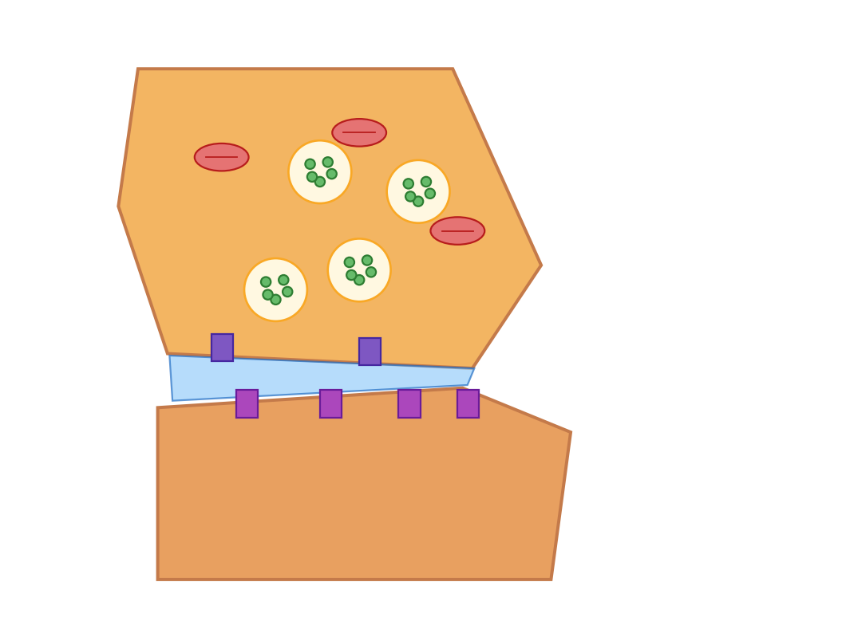
What happens at a synapse?
Home
A2 Biology
Step 1 of 8: The junction
Nervous impulses can be transmitted from one neurone to another. This transfer occurs at a junction called the synapse. Press Next step to watch neurotransmitter release, diffusion, binding and the postsynaptic response.
◀
▶
Reset
Next step
66 of 79
Original course © Boardworks Ltd 2009. Reconstructed interactive resource.
Notes:
Rebuilt Flash synapse animation as an 8-step sequence covering AP arrival, Ca²⁺ entry, vesicle fusion, ACh diffusion, receptor binding and postsynaptic depolarisation.

Slide 194
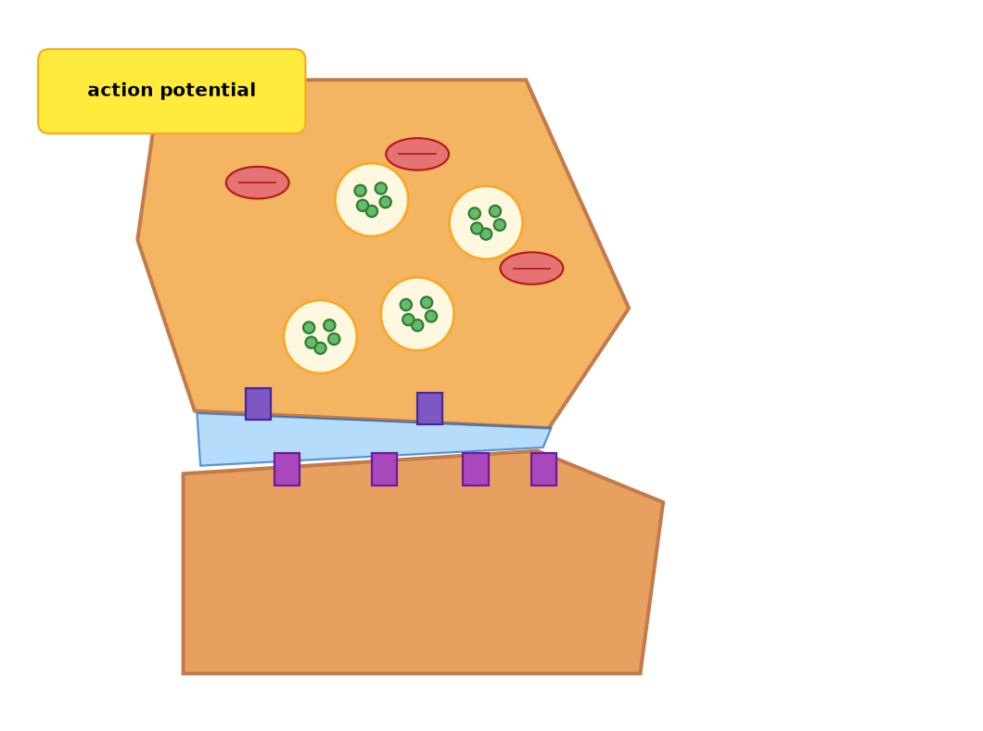
What happens at a synapse?
Home
A2 Biology
Step 2 of 8: Action potential arrives
An action potential reaches the synaptic knob of the presynaptic neurone. The membrane depolarises.
◀
▶
Previous
Reset
Next step
67 of 79
Original course © Boardworks Ltd 2009. Reconstructed interactive resource.
Notes:
Rebuilt Flash synapse animation as an 8-step sequence covering AP arrival, Ca²⁺ entry, vesicle fusion, ACh diffusion, receptor binding and postsynaptic depolarisation.

Slide 195

What happens at a synapse?
Home
A2 Biology
Step 3 of 8: Calcium ions enter
Voltage-gated calcium channels open. Ca²⁺ diffuses into the synaptic knob down its concentration gradient.
◀
▶
Previous
Reset
Next step
68 of 79
Original course © Boardworks Ltd 2009. Reconstructed interactive resource.
Notes:
Rebuilt Flash synapse animation as an 8-step sequence covering AP arrival, Ca²⁺ entry, vesicle fusion, ACh diffusion, receptor binding and postsynaptic depolarisation.

Slide 196
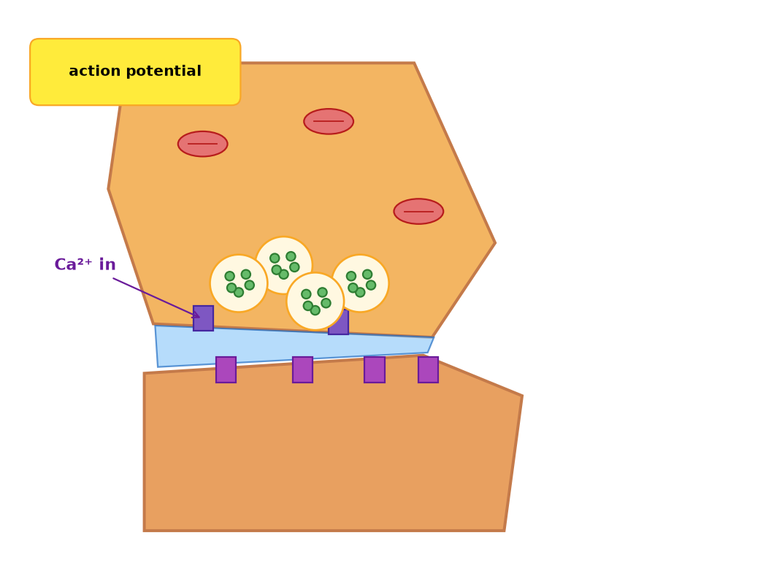
What happens at a synapse?
Home
A2 Biology
Step 4 of 8: Vesicles move
Ca²⁺ causes synaptic vesicles to move to and fuse with the presynaptic membrane.
◀
▶
Previous
Reset
Next step
69 of 79
Original course © Boardworks Ltd 2009. Reconstructed interactive resource.
Notes:
Rebuilt Flash synapse animation as an 8-step sequence covering AP arrival, Ca²⁺ entry, vesicle fusion, ACh diffusion, receptor binding and postsynaptic depolarisation.

Slide 197
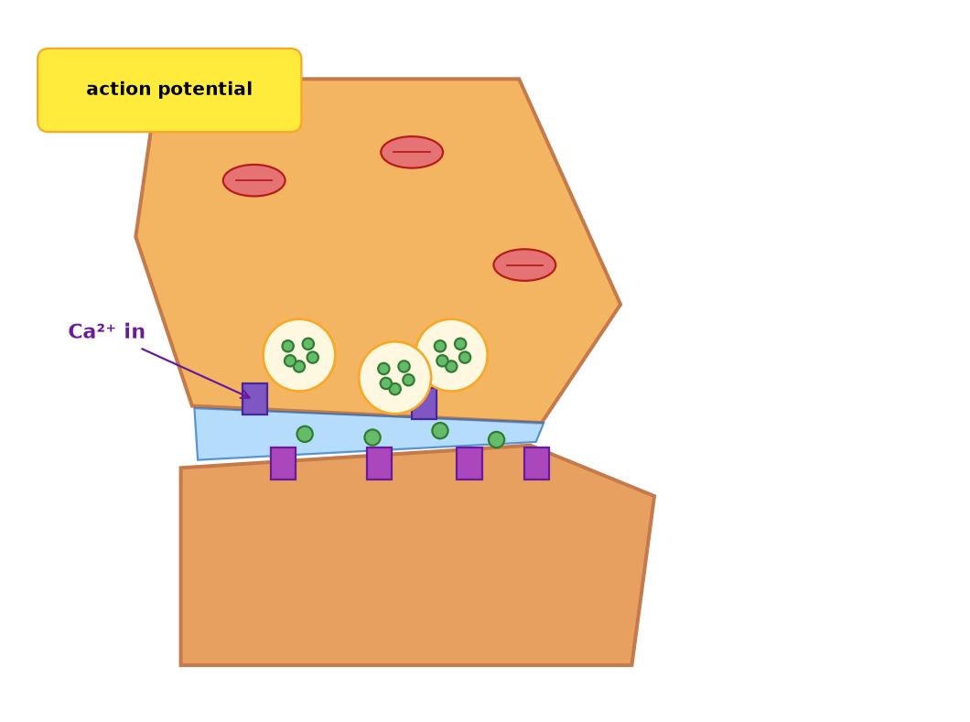
What happens at a synapse?
Home
A2 Biology
Step 5 of 8: Acetylcholine released
Vesicles release acetylcholine (ACh) into the synaptic cleft by exocytosis.
◀
▶
Previous
Reset
Next step
70 of 79
Original course © Boardworks Ltd 2009. Reconstructed interactive resource.
Notes:
Rebuilt Flash synapse animation as an 8-step sequence covering AP arrival, Ca²⁺ entry, vesicle fusion, ACh diffusion, receptor binding and postsynaptic depolarisation.

Slide 198
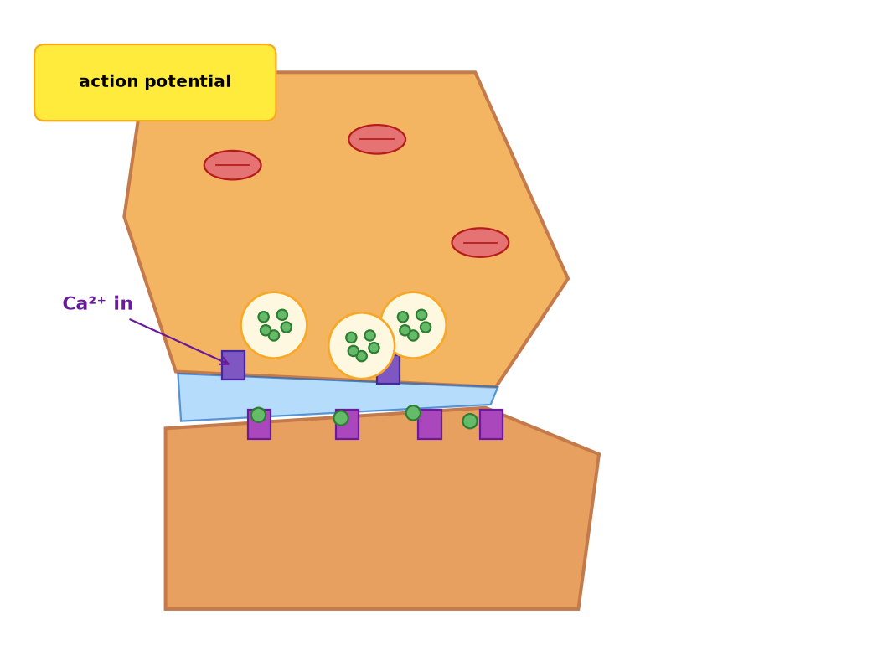
What happens at a synapse?
Home
A2 Biology
Step 6 of 8: Diffusion across the cleft
ACh diffuses across the synaptic cleft (about 20–30 nm). This is the reason synaptic transmission is slower than electrical conduction along an axon.
◀
▶
Previous
Reset
Next step
71 of 79
Original course © Boardworks Ltd 2009. Reconstructed interactive resource.
Notes:
Rebuilt Flash synapse animation as an 8-step sequence covering AP arrival, Ca²⁺ entry, vesicle fusion, ACh diffusion, receptor binding and postsynaptic depolarisation.

Slide 199
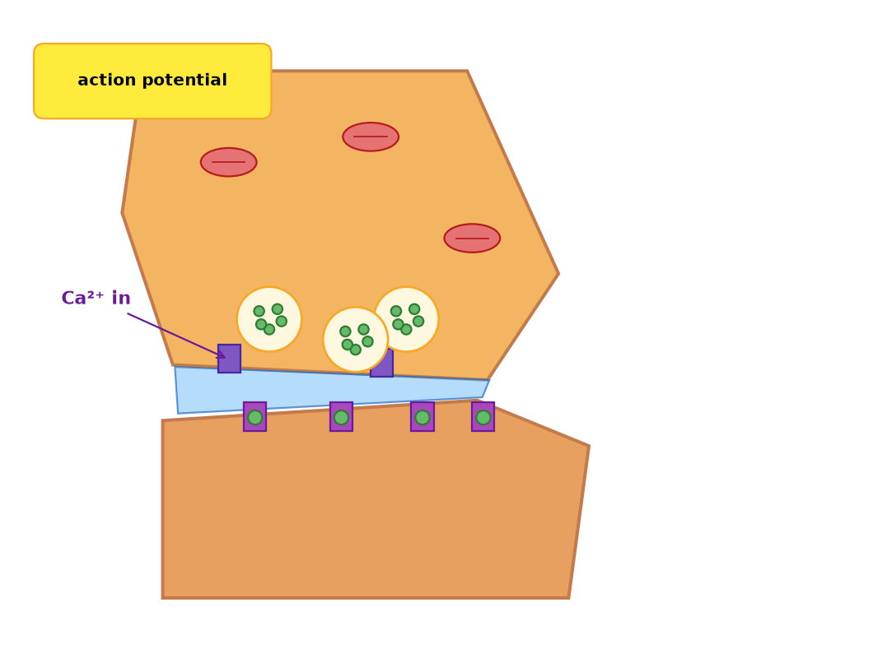
What happens at a synapse?
Home
A2 Biology
Step 7 of 8: Receptor binding
ACh binds to complementary receptors on the postsynaptic membrane. This opens ligand-gated sodium channels.
◀
▶
Previous
Reset
Next step
72 of 79
Original course © Boardworks Ltd 2009. Reconstructed interactive resource.
Notes:
Rebuilt Flash synapse animation as an 8-step sequence covering AP arrival, Ca²⁺ entry, vesicle fusion, ACh diffusion, receptor binding and postsynaptic depolarisation.

Slide 200
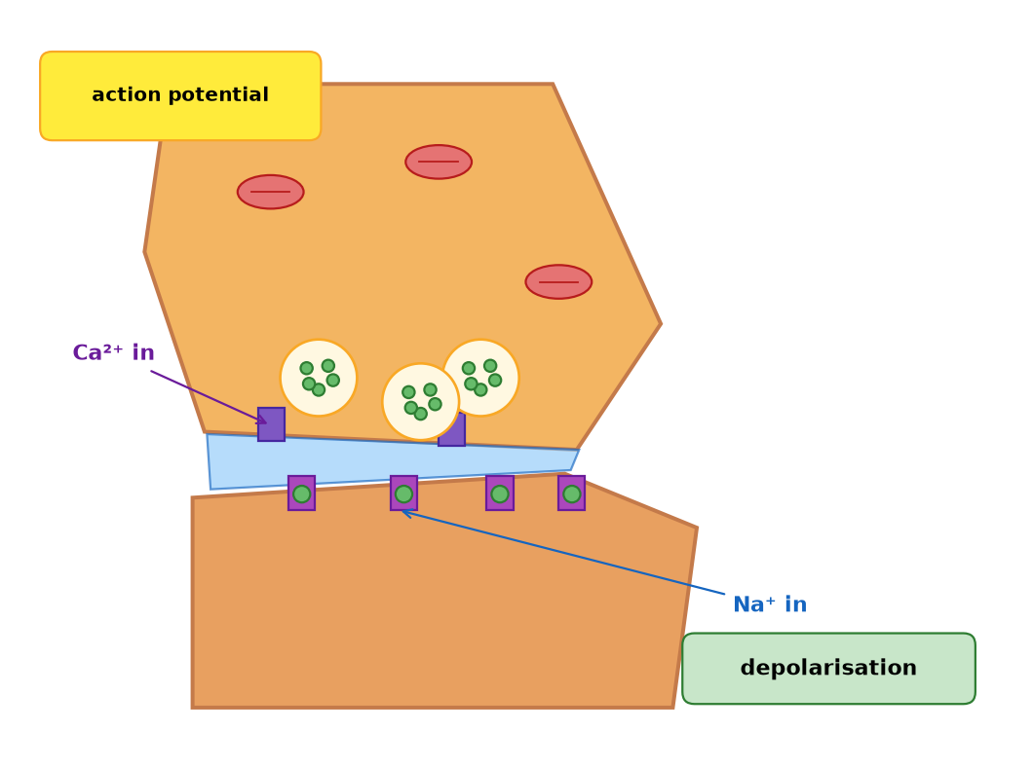
What happens at a synapse?
Home
A2 Biology
Step 8 of 8: Postsynaptic response
Na⁺ enters the postsynaptic neurone. If the excitatory postsynaptic potential reaches threshold, an action potential is generated. ACh is then hydrolysed by acetylcholinesterase so the membrane can repolarise.
◀
▶
Previous
Reset
Continue
73 of 79
Original course © Boardworks Ltd 2009. Reconstructed interactive resource.
Notes:
Rebuilt Flash synapse animation as an 8-step sequence covering AP arrival, Ca²⁺ entry, vesicle fusion, ACh diffusion, receptor binding and postsynaptic depolarisation.

Slide 201
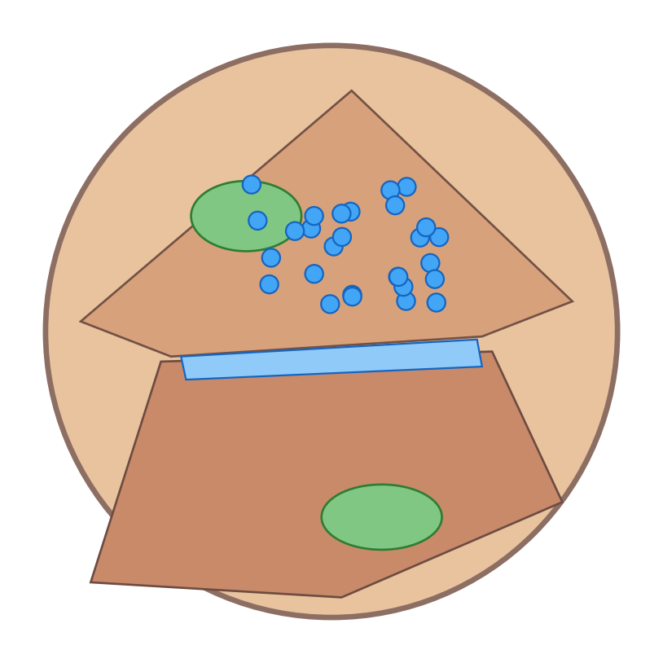
What are the main features?
Home
A2 Biology
The features of a synapse
Which structures can you identify?
Which cell is the presynaptic neurone?
show diagram
identify structures
which is presynaptic?
◀
▶
74 of 79
Original course © Boardworks Ltd 2009. Reconstructed interactive resource.
Notes:
Original Flash toggle (micrograph / diagram) rebuilt. The electron-micrograph lookalike is an original illustration, not the copyrighted TEM image.

Slide 202
What are the main features?
Home
A2 Biology
2D diagram of a cholinergic synapse.
Orange: presynaptic knob (vesicles, mitochondria, Ca²⁺ channels).
Blue band: synaptic cleft.
Lower cell: postsynaptic membrane with receptors.
Back
activity
Original course © Boardworks Ltd 2009. Reconstructed interactive resource.

Slide 203
What are the main features?
Home
A2 Biology
Synaptic vesicles (contain neurotransmitter)
Mitochondria (ATP for exocytosis and pumps)
Presynaptic membrane with voltage-gated Ca²⁺ channels
Synaptic cleft (diffusion pathway)
Postsynaptic receptors / ligand-gated Na⁺ channels
Postsynaptic neurone
Back
activity
Original course © Boardworks Ltd 2009. Reconstructed interactive resource.

Slide 204
What are the main features?
Home
A2 Biology
The presynaptic neurone is the one that contains the synaptic vesicles (the upper cell in the diagram).
It is the cell that arrives with the action potential and releases neurotransmitter. The postsynaptic cell has the receptors and, if threshold is reached, fires the next action potential.
Synapses are unidirectional because vesicles are only in the presynaptic knob and receptors only on the postsynaptic membrane.
Back
activity
Original course © Boardworks Ltd 2009. Reconstructed interactive resource.

Slide 205
Transmission across a synapse
Home
A2 Biology
What is the sequence in events across a synapse?
The statements are jumbled (as in the original). Click Check to see the correct order.
1
Calcium channels in the membrane open and ions move in.
2
An action potential is generated in the postsynaptic neurone.
3
Synaptic vesicles move towards the presynaptic membrane.
4
An action potential arrives at the presynaptic neurone.
5
Vesicles fuse with the membrane, releasing acetylcholine.
6
Acetylcholine binds to receptors on the postsynaptic cell.
7
Sodium channels on the postsynaptic membrane open.
8
Sodium ions move into the cell, causing it to depolarize.
◀
▶
Check
Reset
75 of 79
Original course © Boardworks Ltd 2009. Reconstructed interactive resource.
Notes:
Original Flash sequencing activity. Shuffled order retained from the source slide. Correct order: 4, 1, 3, 5, 6, 7, 8, 2 of the numbered source list (AP arrives → Ca²⁺ in → vesicles move → ACh released → bind → Na⁺ channels open → Na⁺ in / depolarise → postsynaptic AP).

Slide 206
Transmission – correct order
Home
A2 Biology
Correct sequence
1
An action potential arrives at the presynaptic neurone.
2
Calcium channels in the membrane open and ions move in.
3
Synaptic vesicles move towards the presynaptic membrane.
4
Vesicles fuse with the membrane, releasing acetylcholine.
5
Acetylcholine binds to receptors on the postsynaptic cell.
6
Sodium channels on the postsynaptic membrane open.
7
Sodium ions move into the cell, causing it to depolarize.
8
An action potential is generated in the postsynaptic neurone.
Back
activity
Original course © Boardworks Ltd 2009. Reconstructed interactive resource.

Slide 207
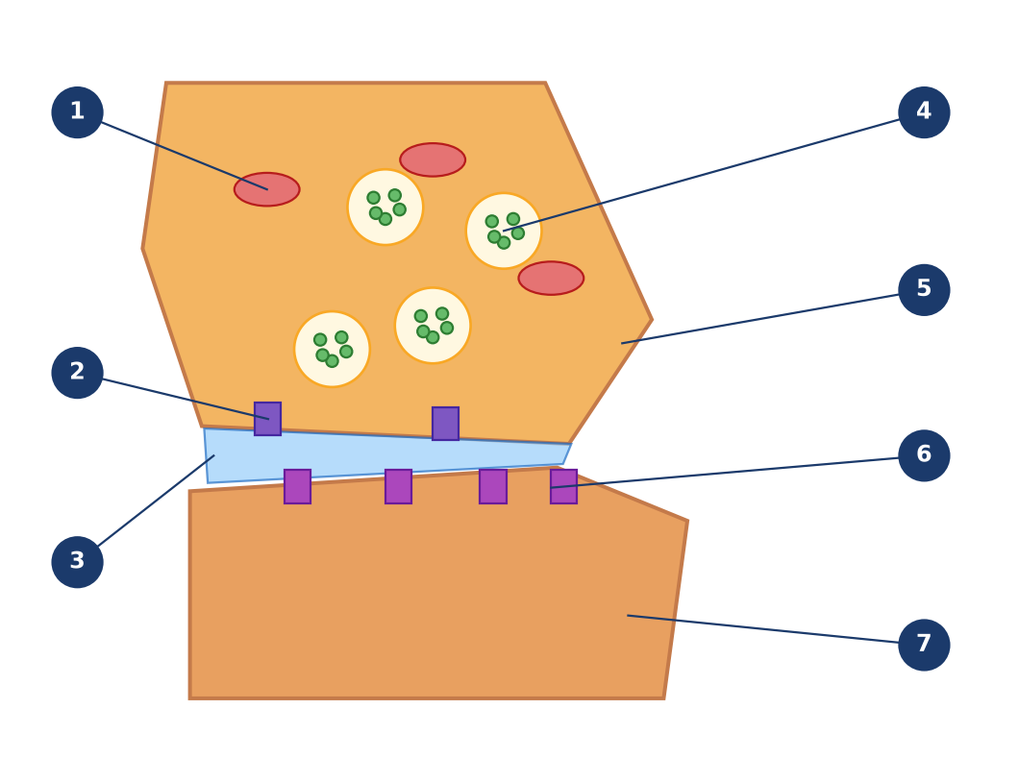
The structure of the synapse
Home
A2 Biology
What are the main features of a synapse?
1
4
5
2
6
3
7
Click a numbered hotspot, then choose the correct label from the list.
◀
▶
Check
Reset
76 of 79
Original course © Boardworks Ltd 2009. Reconstructed interactive resource.
Notes:
Rebuilt Flash drop-down labelling. Seven structures around the synaptic knob and cleft.

Slide 208
The structure of the synapse
Home
A2 Biology
Choose the correct label
mitochondrion
voltage-gated Ca²⁺ channel
synaptic cleft
synaptic vesicle
presynaptic membrane
receptor (ligand-gated Na⁺ channel)
postsynaptic membrane
activity
Original course © Boardworks Ltd 2009. Reconstructed interactive resource.

Slide 209
The structure of the synapse
Home
A2 Biology
Correct – 1 Mitochondrion
Provides ATP for active transport (Na⁺/K⁺ pump, Ca²⁺ removal) and for vesicle recycling / exocytosis.
Back to diagram
activity
Original course © Boardworks Ltd 2009. Reconstructed interactive resource.

Slide 210
The structure of the synapse
Home
A2 Biology
Not that one.
Look at the position of the leader line and try again.
Try again
activity
Original course © Boardworks Ltd 2009. Reconstructed interactive resource.

Slide 211
The structure of the synapse
Home
A2 Biology
Choose the correct label
mitochondrion
voltage-gated Ca²⁺ channel
synaptic cleft
synaptic vesicle
presynaptic membrane
receptor (ligand-gated Na⁺ channel)
postsynaptic membrane
activity
Original course © Boardworks Ltd 2009. Reconstructed interactive resource.

Slide 212
The structure of the synapse
Home
A2 Biology
Correct – 2 Voltage-gated Ca²⁺ channel
Opens when the action potential depolarises the presynaptic membrane, allowing Ca²⁺ in.
Back to diagram
activity
Original course © Boardworks Ltd 2009. Reconstructed interactive resource.

Slide 213
The structure of the synapse
Home
A2 Biology
Not that one.
Look at the position of the leader line and try again.
Try again
activity
Original course © Boardworks Ltd 2009. Reconstructed interactive resource.

Slide 214
The structure of the synapse
Home
A2 Biology
Choose the correct label
mitochondrion
voltage-gated Ca²⁺ channel
synaptic cleft
synaptic vesicle
presynaptic membrane
receptor (ligand-gated Na⁺ channel)
postsynaptic membrane
activity
Original course © Boardworks Ltd 2009. Reconstructed interactive resource.

Slide 215
The structure of the synapse
Home
A2 Biology
Correct – 3 Synaptic cleft
Narrow gap between the two neurones. Neurotransmitter diffuses across it. It also ensures the impulse cannot jump electrically, keeping the synapse unidirectional and integrable.
Back to diagram
activity
Original course © Boardworks Ltd 2009. Reconstructed interactive resource.

Slide 216
The structure of the synapse
Home
A2 Biology
Not that one.
Look at the position of the leader line and try again.
Try again
activity
Original course © Boardworks Ltd 2009. Reconstructed interactive resource.

Slide 217
The structure of the synapse
Home
A2 Biology
Choose the correct label
mitochondrion
voltage-gated Ca²⁺ channel
synaptic cleft
synaptic vesicle
presynaptic membrane
receptor (ligand-gated Na⁺ channel)
postsynaptic membrane
activity
Original course © Boardworks Ltd 2009. Reconstructed interactive resource.

Slide 218
The structure of the synapse
Home
A2 Biology
Correct – 4 Synaptic vesicle
Contains acetylcholine (in this cholinergic example). Fuses with the presynaptic membrane during exocytosis.
Back to diagram
activity
Original course © Boardworks Ltd 2009. Reconstructed interactive resource.

Slide 219
The structure of the synapse
Home
A2 Biology
Not that one.
Look at the position of the leader line and try again.
Try again
activity
Original course © Boardworks Ltd 2009. Reconstructed interactive resource.

Slide 220
The structure of the synapse
Home
A2 Biology
Choose the correct label
mitochondrion
voltage-gated Ca²⁺ channel
synaptic cleft
synaptic vesicle
presynaptic membrane
receptor (ligand-gated Na⁺ channel)
postsynaptic membrane
activity
Original course © Boardworks Ltd 2009. Reconstructed interactive resource.

Slide 221
The structure of the synapse
Home
A2 Biology
Correct – 5 Presynaptic membrane
Membrane of the synaptic knob. Site of vesicle fusion and Ca²⁺ channels.
Back to diagram
activity
Original course © Boardworks Ltd 2009. Reconstructed interactive resource.

Slide 222
The structure of the synapse
Home
A2 Biology
Not that one.
Look at the position of the leader line and try again.
Try again
activity
Original course © Boardworks Ltd 2009. Reconstructed interactive resource.

Slide 223
The structure of the synapse
Home
A2 Biology
Choose the correct label
mitochondrion
voltage-gated Ca²⁺ channel
synaptic cleft
synaptic vesicle
presynaptic membrane
receptor (ligand-gated Na⁺ channel)
postsynaptic membrane
activity
Original course © Boardworks Ltd 2009. Reconstructed interactive resource.

Slide 224
The structure of the synapse
Home
A2 Biology
Correct – 6 Receptor / ligand-gated Na⁺ channel
On the postsynaptic membrane. ACh binding opens the channel so Na⁺ can enter.
Back to diagram
activity
Original course © Boardworks Ltd 2009. Reconstructed interactive resource.

Slide 225
The structure of the synapse
Home
A2 Biology
Not that one.
Look at the position of the leader line and try again.
Try again
activity
Original course © Boardworks Ltd 2009. Reconstructed interactive resource.

Slide 226
The structure of the synapse
Home
A2 Biology
Choose the correct label
mitochondrion
voltage-gated Ca²⁺ channel
synaptic cleft
synaptic vesicle
presynaptic membrane
receptor (ligand-gated Na⁺ channel)
postsynaptic membrane
activity
Original course © Boardworks Ltd 2009. Reconstructed interactive resource.

Slide 227
The structure of the synapse
Home
A2 Biology
Correct – 7 Postsynaptic membrane
Membrane of the next neurone (or effector). Generates an excitatory (or inhibitory) postsynaptic potential.
Back to diagram
activity
Original course © Boardworks Ltd 2009. Reconstructed interactive resource.

Slide 228
The structure of the synapse
Home
A2 Biology
Not that one.
Look at the position of the leader line and try again.
Try again
activity
Original course © Boardworks Ltd 2009. Reconstructed interactive resource.

Slide 229
Synapse structure – answers
Home
A2 Biology
1 Mitochondrion – Provides ATP for active transport (Na⁺/K⁺ pump, Ca²⁺ removal) and for vesicle recycling / exocytosis.
2 Voltage-gated Ca²⁺ channel – Opens when the action potential depolarises the presynaptic membrane, allowing Ca²⁺ in.
3 Synaptic cleft – Narrow gap between the two neurones. Neurotransmitter diffuses across it. It also ensures the impulse cannot jump electrically, keeping the synapse unidirectional and integrable.
4 Synaptic vesicle – Contains acetylcholine (in this cholinergic example). Fuses with the presynaptic membrane during exocytosis.
5 Presynaptic membrane – Membrane of the synaptic knob. Site of vesicle fusion and Ca²⁺ channels.
6 Receptor / ligand-gated Na⁺ channel – On the postsynaptic membrane. ACh binding opens the channel so Na⁺ can enter.
7 Postsynaptic membrane – Membrane of the next neurone (or effector). Generates an excitatory (or inhibitory) postsynaptic potential.
Back
activity
Original course © Boardworks Ltd 2009. Reconstructed interactive resource.

Slide 230
Knowledge check
Home
A2 Biology
What is the immediate effect of Ca²⁺ entering the synaptic knob?
A Acetylcholinesterase is activated
B Synaptic vesicles move to and fuse with the presynaptic membrane
C Sodium ions leave the postsynaptic neurone
D The synaptic cleft becomes wider
◀
▶
77 of 79
Original course © Boardworks Ltd 2009. Reconstructed interactive resource.
Notes:
Correct = B. Ca²⁺ is the trigger for vesicle exocytosis of acetylcholine.

Slide 231
Knowledge check
Home
A2 Biology
Correct.
Ca²⁺ is the trigger for vesicle exocytosis of acetylcholine.
Continue
activity
Original course © Boardworks Ltd 2009. Reconstructed interactive resource.

Slide 232
Knowledge check
Home
A2 Biology
Not quite.
Calcium entry is the step that links the action potential to neurotransmitter release.
Try again
activity
Original course © Boardworks Ltd 2009. Reconstructed interactive resource.

Slide 233
Knowledge check
Home
A2 Biology
Not quite.
Calcium entry is the step that links the action potential to neurotransmitter release.
Try again
activity
Original course © Boardworks Ltd 2009. Reconstructed interactive resource.

Slide 234
Knowledge check
Home
A2 Biology
Not quite.
Calcium entry is the step that links the action potential to neurotransmitter release.
Try again
activity
Original course © Boardworks Ltd 2009. Reconstructed interactive resource.

Slide 235
Knowledge check
Home
A2 Biology
Why is transmission at a cholinergic synapse unidirectional?
A Myelin is only on the postsynaptic side
B Vesicles are only presynaptic and receptors are only postsynaptic
C Sodium ions can only diffuse one way
D The cleft contains mitochondria that pump ACh backwards
◀
▶
78 of 79
Original course © Boardworks Ltd 2009. Reconstructed interactive resource.
Notes:
Correct = B. Neurotransmitter is released from one side only; receptors sit only on the other. The impulse cannot reverse.

Slide 236
Knowledge check
Home
A2 Biology
Correct.
Neurotransmitter is released from one side only; receptors sit only on the other. The impulse cannot reverse.
Continue
activity
Original course © Boardworks Ltd 2009. Reconstructed interactive resource.

Slide 237
Knowledge check
Home
A2 Biology
Not quite.
Think about where the vesicles are, and where the receptors are.
Try again
activity
Original course © Boardworks Ltd 2009. Reconstructed interactive resource.

Slide 238
Knowledge check
Home
A2 Biology
Not quite.
Think about where the vesicles are, and where the receptors are.
Try again
activity
Original course © Boardworks Ltd 2009. Reconstructed interactive resource.

Slide 239
Knowledge check
Home
A2 Biology
Not quite.
Think about where the vesicles are, and where the receptors are.
Try again
activity
Original course © Boardworks Ltd 2009. Reconstructed interactive resource.

Slide 240
End of Part 4
Home
A2 Biology
End of the nervous system series
Replay any activity from Contents. Reset returns each activity to its first screen so you can use it again in the same lesson.
Back to contents
Course menu
◀
▶
79 of 79
Original course © Boardworks Ltd 2009. Reconstructed interactive resource.

