Slide 1
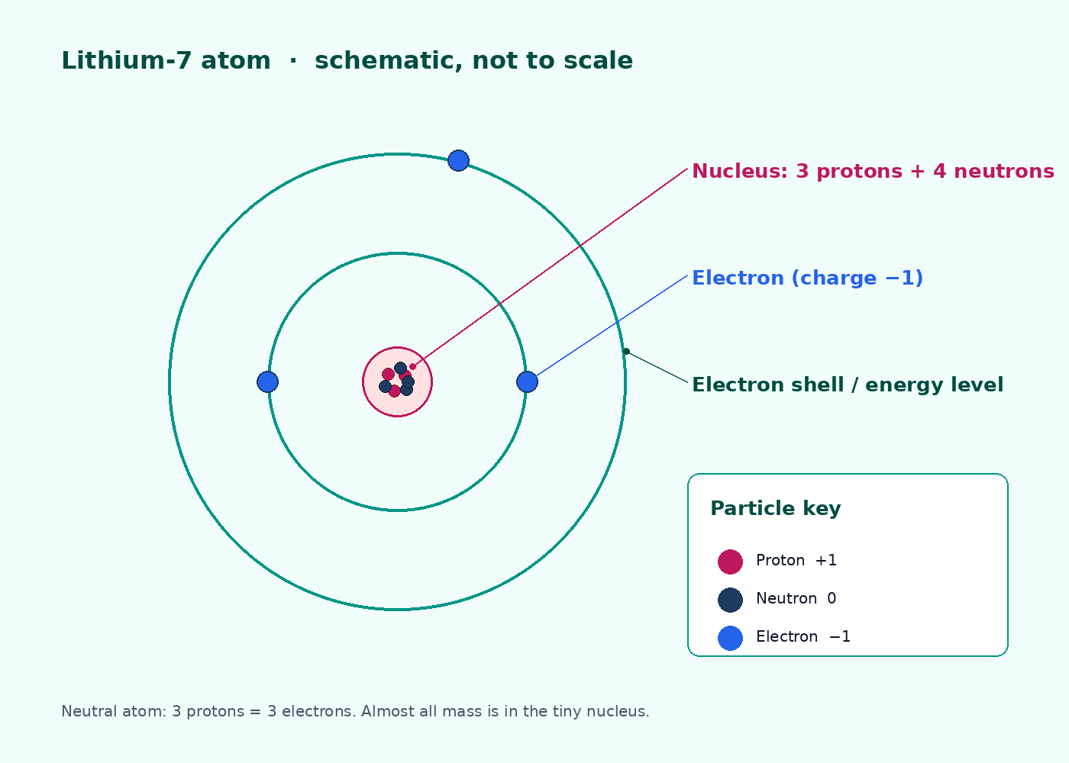

BTEC Level 3 · Applied Science · Unit 1 · Chemistry
BTEC Unit 1 Chemistry: Atomic Structure
Subatomic particles, nuclide notation, isotopes, A_{r} and ion formation — taught as a BTEC Level 3 Unit 1 lesson.
PowerPoint teaching resource
jdscience.co.uk
Atomic structure
1 / 35

Slide 2
Learning objectives
By the end of this lesson you should be able to:
1
State relative charge, relative mass and location of protons, neutrons and electrons.
2
Use A and Z to calculate protons, neutrons and electrons, including ions.
3
Explain isotopes and why chemical properties stay the same.
4
Calculate A_{r} from percentage abundances and interpret a simple mass spectrum.
5
Describe ion formation as a change in electrons, not protons.
jdscience.co.uk
Atomic structure
2 / 35

Slide 3
LEVEL 3 DEPTH CHECK
Beyond GCSE recall
This lesson must progress past simple recall. Use these Level 3 moves in explanations and answers.
GCSE starting point
Unit 1 progression
Particles are +1, 0, −1
Use charge arithmetic: charge = protons − electrons
Isotopes have different mass
Same Z, different neutrons; chemical properties match because electrons match
A_{r} is on the periodic table
A_{r} is a weighted mean versus 1/12 of ¹²C; no unit
Ions are charged atoms
Nucleus unchanged; link to later bonding and electrostatic attraction
jdscience.co.uk
Atomic structure
3 / 35

Slide 4
DO NOW
Prior-knowledge retrieval
1.
Name the three subatomic particles found in an atom. [1]
2.
Which particle determines which element an atom is? [1]
3.
What is the difference between an atom and a molecule? [2]
4.
Is the nucleus positive, negative or neutral — and why? [2]
Think first — answers are on the next slide.
jdscience.co.uk
Atomic structure
4 / 35

Slide 5
ANSWERS
Retrieval answers
1
Proton, neutron and electron.
2
The proton number (atomic number, Z).
3
An atom is a single particle of an element. A molecule contains two or more atoms chemically bonded.
4
Positive — the nucleus contains protons (and uncharged neutrons).
jdscience.co.uk
Atomic structure
5 / 35

Slide 6
The nuclear model
A tiny dense nucleus; electrons in shells
1 Look for
2 Say in full
3 Level 3 move
A labelled atom with a nucleus, shells, protons, neutrons and electrons.
Almost all the mass is in a tiny nucleus. Electrons occupy shells around it.
Chemical behaviour depends on the outer electrons, not on the neutrons.
jdscience.co.uk
Atomic structure
6 / 35

Slide 7
A labelled lithium-7 atom
Almost all of the mass is in the nucleus.
The nucleus occupies a tiny fraction of the volume.
Electrons occupy shells (energy levels).
A neutral atom has equal numbers of protons and electrons.
Chemical behaviour depends on the outer electrons.
Original schematic of ⁷Li — 3 protons, 4 neutrons, 3 electrons. Not to scale.
jdscience.co.uk
Atomic structure
7 / 35

Slide 8
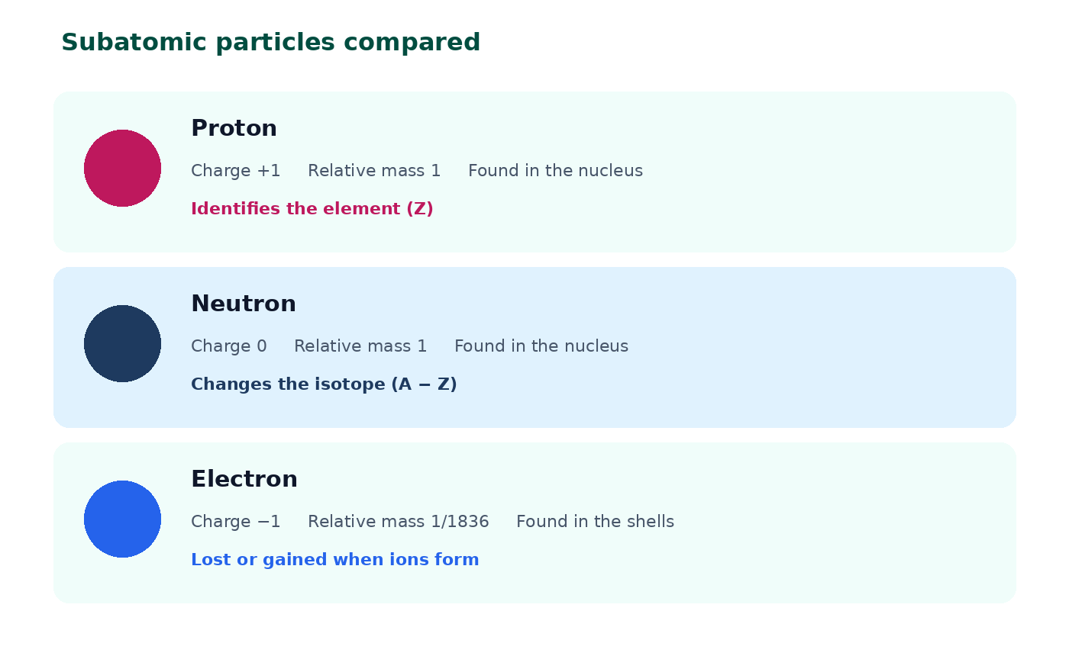
Comparing the three particles
Protons identify the element.
Neutrons change the isotope without changing Z.
Electrons are lost or gained when ions form.
Relative electron mass is about 1/1836 — treat as negligible in mass number.
jdscience.co.uk
Atomic structure
8 / 35

Slide 9
Subatomic particles
Particle
Relative charge
Relative mass
Where found
Proton
+1
1
Nucleus
Neutron
0
1
Nucleus
Electron
−1
≈ 1/1836
Shells
Learn this table exactly. Examiners expect charge and mass, not just names.
jdscience.co.uk
Atomic structure
9 / 35

Slide 10
Reading a nuclide symbol
Mass number top left, atomic number bottom left
1 Look for
2 Say in full
3 Level 3 move
A as a superscript, Z as a subscript — written ²³₁₁Na, never 23Na.
Neutrons = A − Z. In a neutral atom, electrons = Z.
For an ion, change electrons only. The nucleus — and the element — stay the same.
jdscience.co.uk
Atomic structure
10 / 35

Slide 11
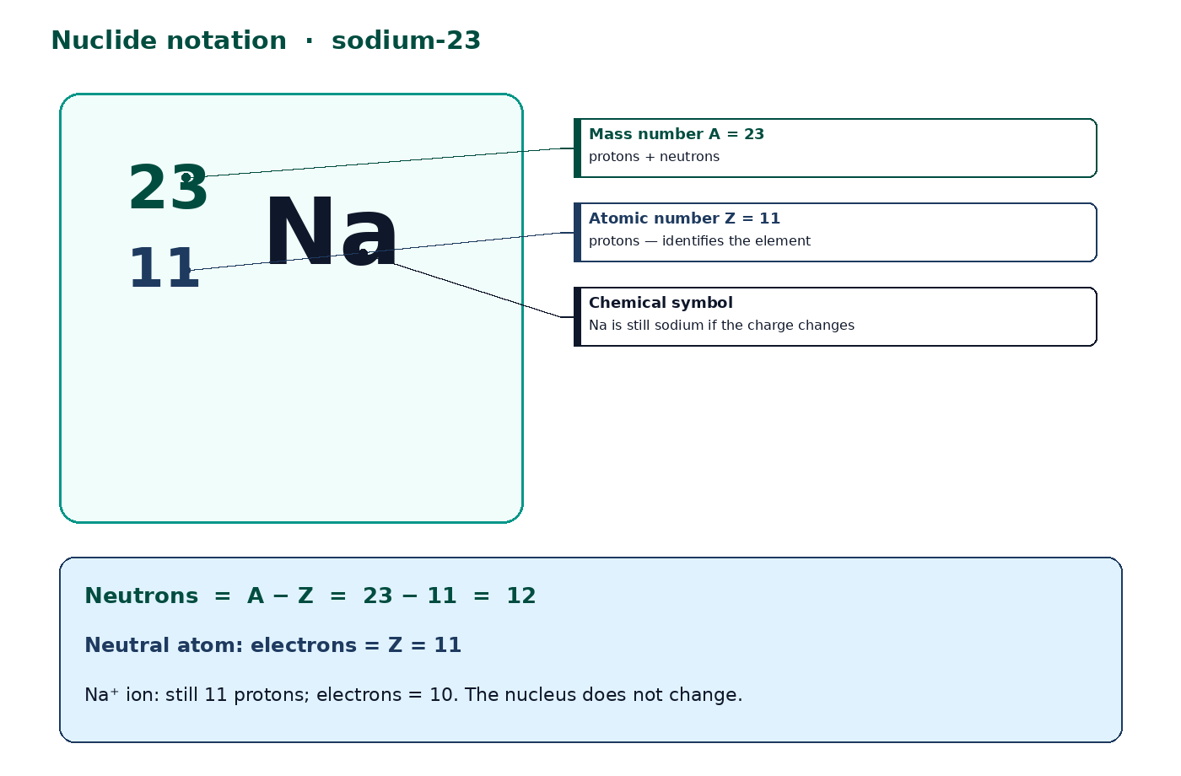
²³₁₁Na
A = protons + neutrons.
Z = protons.
Neutrons = A − Z.
Electrons in a neutral atom = Z.
For an ion, adjust electrons by the charge. The nucleus does not change.
Always write A as a superscript and Z as a subscript — never 23Na as plain text in notes.
jdscience.co.uk
Atomic structure
11 / 35

Slide 12
WORKED EXAMPLE
Sodium-23 atom and ion
Question
For ²³Na, find protons, neutrons and electrons. Then find electrons in Na⁺.
Equation
Substitution
neutrons = A − Z electrons(ion) = Z − charge
A = 23 Z = 11 charge of Na⁺ is +1
Working
Answer + unit
protons = 11 neutrons = 23 − 11 = 12 electrons (atom) = 11
Na⁺ has 10 electrons
The ion is still sodium because Z is still 11.
jdscience.co.uk
Atomic structure
12 / 35

Slide 13
WORKED PRACTICE
Calculate p, n and e
1.
¹²C (neutral atom) [2]
2.
³⁷Cl (neutral atom) [2]
3.
²⁷Al³⁺ [3]
4.
¹⁶O²⁻ [3]
Think first — answers are on the next slide.
jdscience.co.uk
Atomic structure
13 / 35

Slide 14
ANSWERS
Particle-count answers
1
¹²C: 6 p, 6 n, 6 e.
2
³⁷Cl: 17 p, 20 n, 17 e.
3
²⁷Al³⁺: 13 p, 14 n, 10 e (13 − 3).
4
¹⁶O²⁻: 8 p, 8 n, 10 e (8 + 2).
jdscience.co.uk
Atomic structure
14 / 35

Slide 15
Isotopes
Same Z, different neutron number
1 Look for
2 Say in full
3 Level 3 move
Two nuclei with the same proton number and different neutron numbers.
Isotopes are atoms of the same element with different mass numbers.
Chemical properties match because the electron arrangement is the same.
jdscience.co.uk
Atomic structure
15 / 35

Slide 16
Defining isotopes
Same element
Different mass
Isotopes have the same proton number, so they are the same element.
They have different numbers of neutrons and therefore different mass numbers.
Chemistry
Physics
Chemical properties are almost identical because the electron arrangement is the same.
Mass-dependent properties (density, rate of diffusion) can differ. Some isotopes are radioisotopes.
jdscience.co.uk
Atomic structure
16 / 35

Slide 17
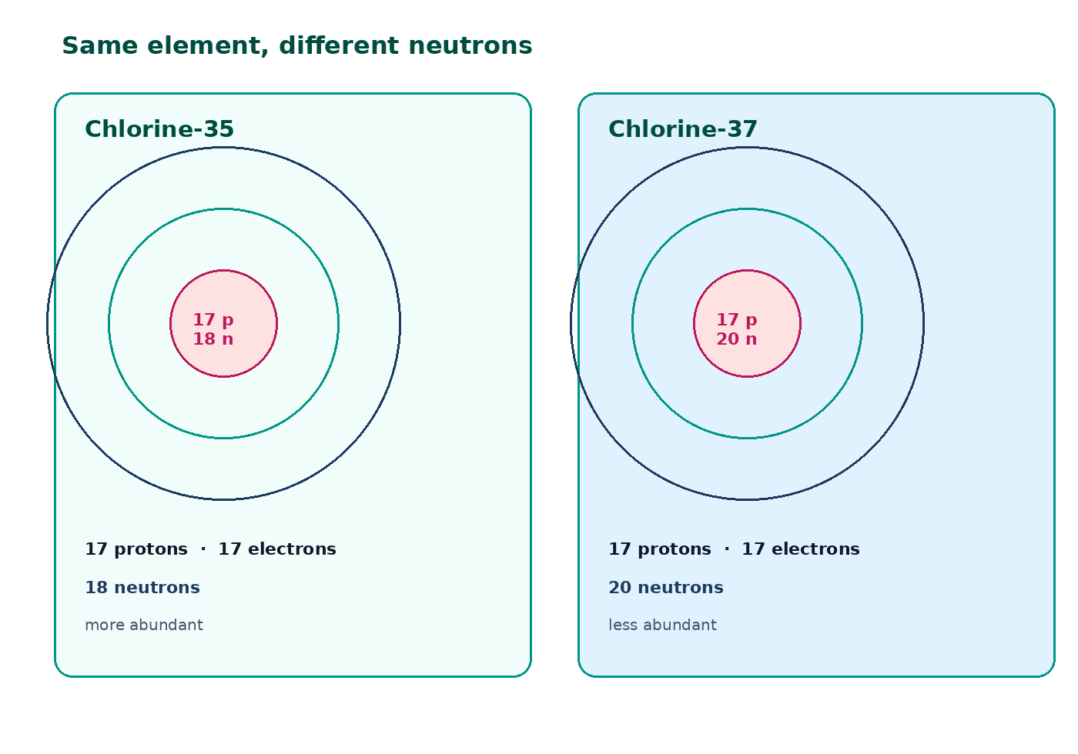
Chlorine-35 and chlorine-37
Both have 17 protons and 17 electrons in the atom.
³⁵Cl has 18 neutrons; ³⁷Cl has 20.
³⁵Cl is more abundant.
They react with sodium in the same way.
Do not say isotopes have different proton numbers.
jdscience.co.uk
Atomic structure
17 / 35

Slide 18
Relative atomic mass
A weighted mean, not a mass number
1 Look for
2 Say in full
3 Level 3 move
A_{r} = (Σ percent × mass number) / 100 — no unit.
Most elements are mixtures of isotopes, so A_{r} is rarely a whole number.
Use the abundances in the question. Compare the result with 1/12 of a ¹²C atom.
jdscience.co.uk
Atomic structure
18 / 35

Slide 19
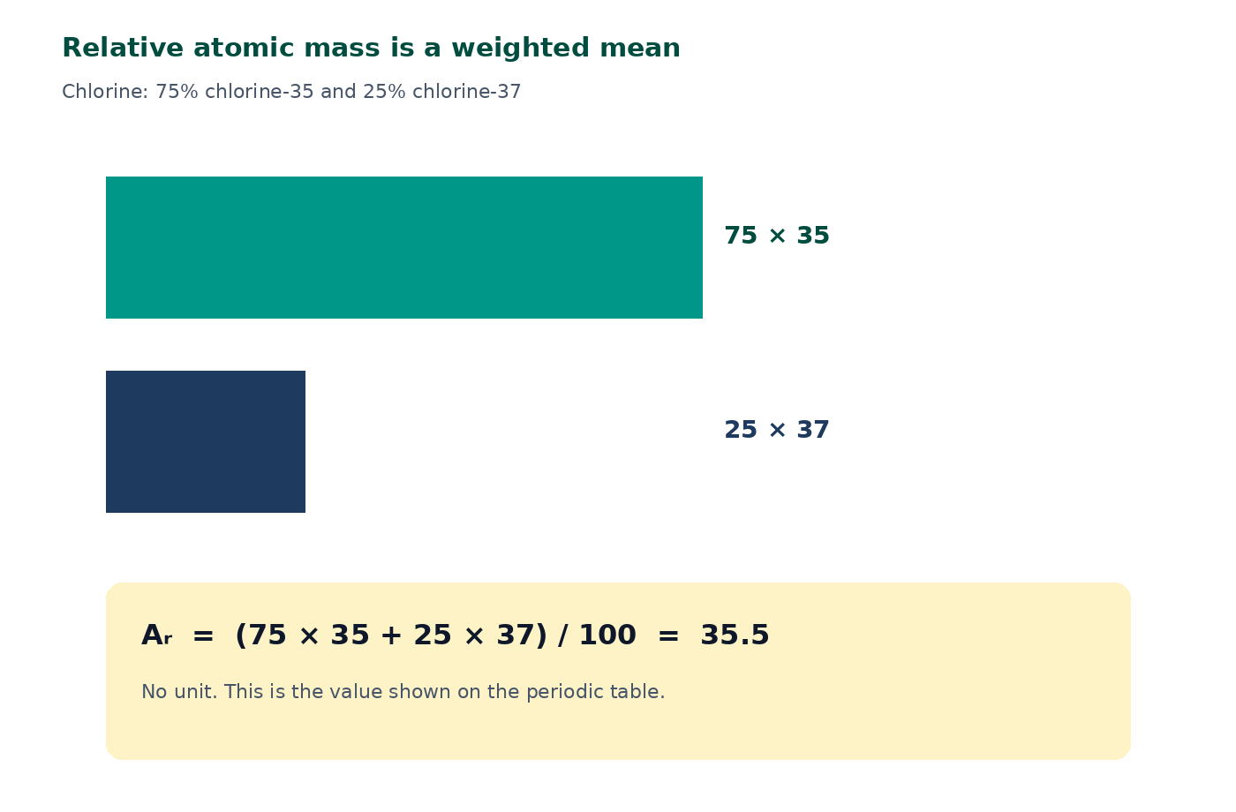
Why A_{r} is not a whole number
Most elements are mixtures of isotopes.
A_{r} is the weighted mean mass compared with 1/12 of the mass of a ¹²C atom.
A_{r} has no unit.
Use the abundances given in the question — do not memorise them.
jdscience.co.uk
Atomic structure
19 / 35

Slide 20
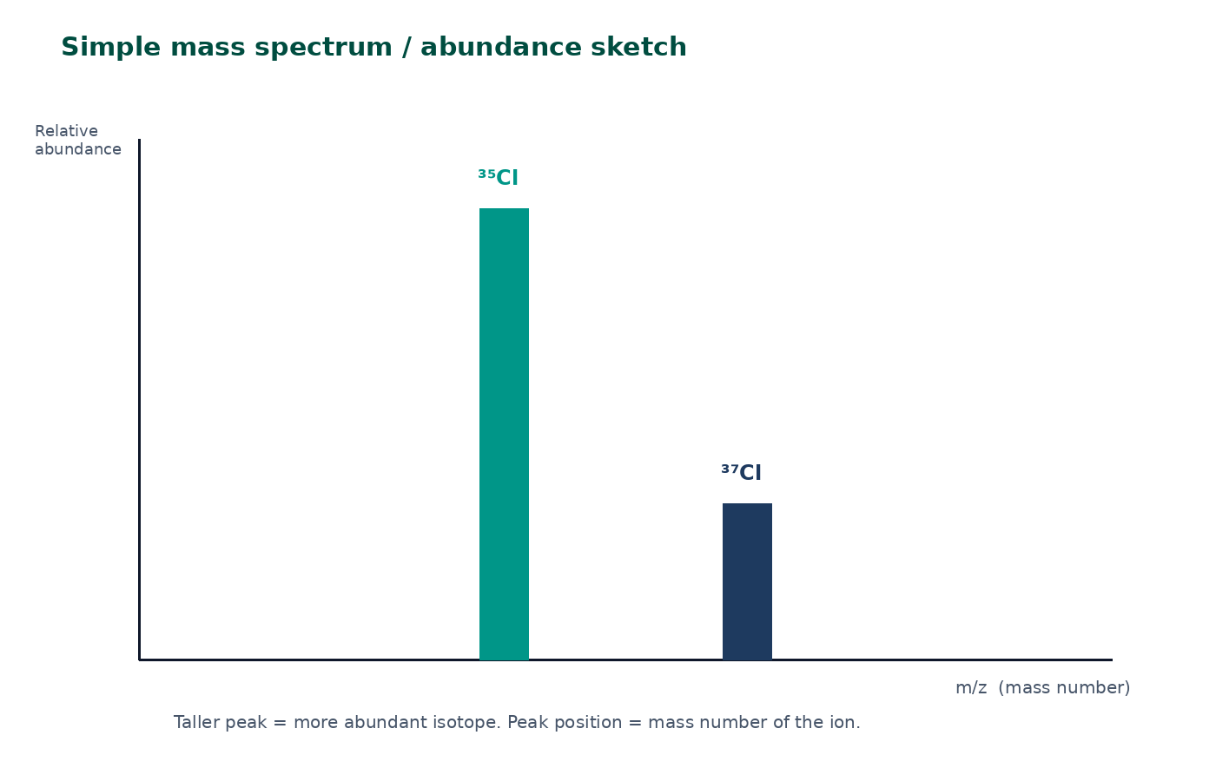
Reading a simple mass spectrum
Peak position is the mass number of that ion.
Peak height is relative abundance.
Use those heights as the percentages in the A_{r} formula.
A tiny peak can often be ignored only after you have checked the 3 s.f. effect.
Teaching sketch — not a copied instrument printout.
jdscience.co.uk
Atomic structure
20 / 35

Slide 21
WORKED EXAMPLE
Chlorine A_{r}
Question
A sample is 75.0% ³⁵Cl and 25.0% ³⁷Cl. Calculate A_{r}.
Equation
Substitution
A_{r} = (Σ percent × mass number) / 100
A_{r} = (75.0 × 35 + 25.0 × 37) / 100
Working
Answer + unit
A_{r} = (2625 + 925) / 100 = 3550 / 100
35.5 no unit
This matches the familiar periodic-table value.
jdscience.co.uk
Atomic structure
21 / 35

Slide 22
Your turn — copper
Given
Find
• 69.0% ⁶³Cu
• 31.0% ⁶⁵Cu
• A_{r} to 1 d.p.
Equation
Substitution
Working
Answer + unit
Write every term. Do not skip the division by 100.
jdscience.co.uk
Atomic structure
22 / 35

Slide 23
CHECK YOUR UNDERSTANDING
Relative atomic mass practice
1
2 marks
2
2 marks
3
2 marks
Boron is 20.0% ¹⁰B and 80.0% ¹¹B. Calculate A_{r}.
Copper is 69.0% ⁶³Cu and 31.0% ⁶⁵Cu. Calculate A_{r} to 1 d.p.
Why is A_{r} for chlorine not a whole number?
Write a full-sentence answer
Write a full-sentence answer
Write a full-sentence answer
Think first — answers are on the next slide.
jdscience.co.uk
Atomic structure
23 / 35

Slide 24
ANSWERS
A_{r} answers
1
2
3
A_{r}(B) = (20×10 + 80×11)/100 = 10.8
A_{r}(Cu) = (69×63 + 31×65)/100 = 63.6
Chlorine is a mixture of ³⁵Cl and ³⁷Cl, so the weighted mean is not an integer.
jdscience.co.uk
Atomic structure
24 / 35

Slide 25
Ions from atoms
Electrons move; protons do not
1 Look for
2 Say in full
3 Level 3 move
Charge = protons − electrons. Na⁺ has 11 p and 10 e.
A cation has lost electrons. An anion has gained electrons.
Z is unchanged, so it is still the same element. Link this to later bonding.
jdscience.co.uk
Atomic structure
25 / 35

Slide 26
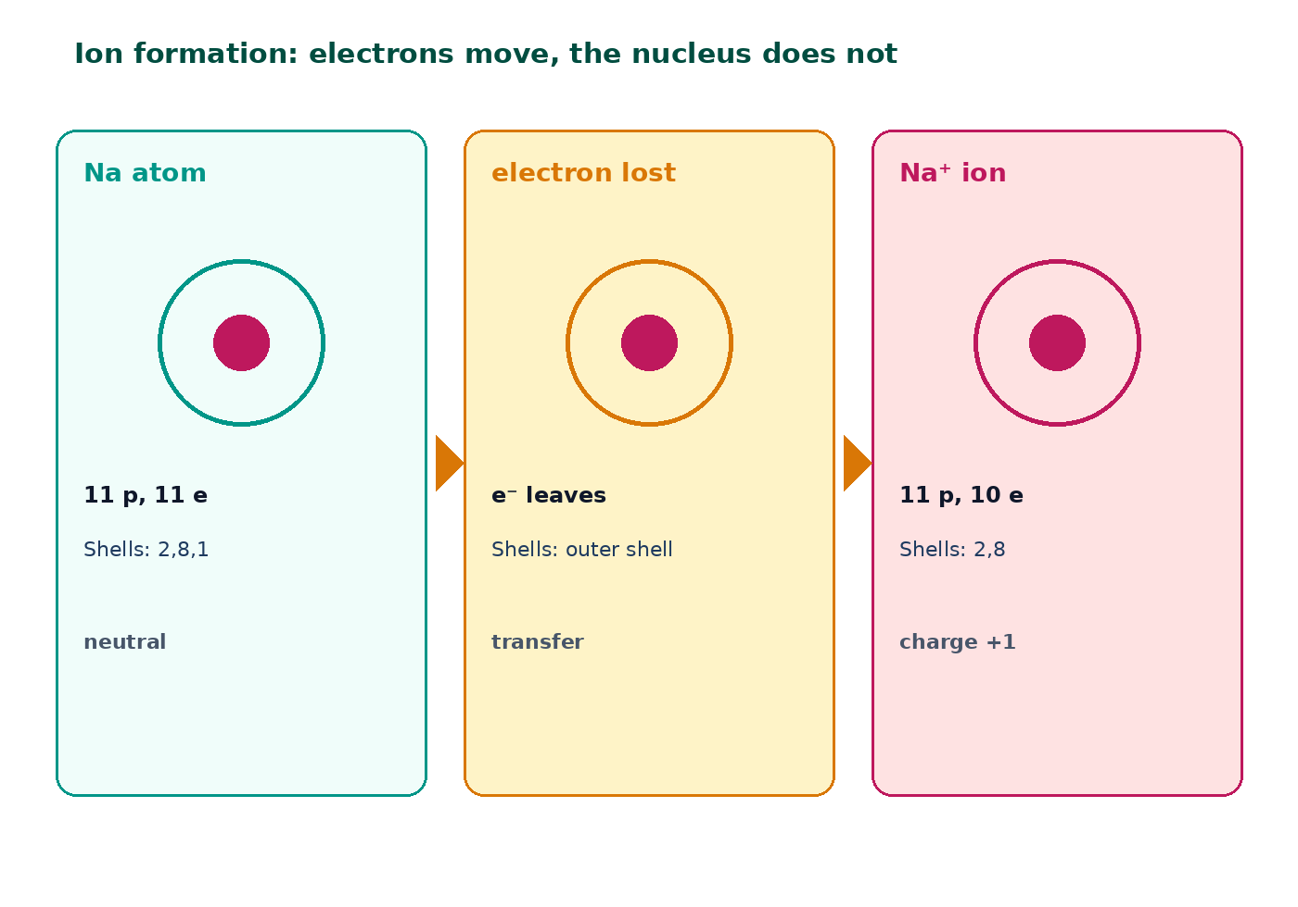
How a sodium ion forms
A cation forms when an atom loses electrons.
An anion forms when an atom gains electrons.
Z is unchanged, so it is still the same element.
Charge number = protons − electrons.
Metals typically form cations; non-metals typically form anions.
jdscience.co.uk
Atomic structure
26 / 35

Slide 27
WORKED EXAMPLE
Aluminium-27 ion
Question
How many protons, neutrons and electrons has ²⁷Al³⁺?
Equation
Substitution
neutrons = A − Z electrons = Z − 3
A = 27 Z = 13 the 3+ means three electrons lost
Working
Answer + unit
protons = 13 neutrons = 14 electrons = 10
13 p, 14 n, 10 e
The ion has the same electron count as neon, but it is still aluminium.
jdscience.co.uk
Atomic structure
27 / 35

Slide 28
Chemical versus nuclear change
Chemical (this unit)
Nuclear (do not confuse)
• Electrons are rearranged
• Proton number stays the same
• Atoms become ions or form bonds
• Identity of the element is unchanged
• The nucleus changes
• Proton number may change
• A different element can form
• Not how Na⁺ is produced in a salt
jdscience.co.uk
Atomic structure
28 / 35

Slide 29
MINI-WHITEBOARD
Four nuclide cards
Draw cards for ²⁴Mg, ²⁴Mg²⁺, ¹⁹F and ¹⁹F⁻. Show A, Z, p, n and e.
²⁴Mg
²⁴Mg²⁺
¹⁹F
¹⁹F⁻
Write, then hold up.
Write, then hold up.
Write, then hold up.
Write, then hold up.
jdscience.co.uk
Atomic structure
29 / 35

Slide 30
Common misconceptions
Not quite
Instead
The mass number is the number of neutrons.
Mass number is protons plus neutrons.
Not quite
Instead
Electrons sit inside the nucleus with the protons.
Electrons occupy shells outside the nucleus.
Not quite
Instead
Isotopes have different numbers of protons.
Isotopes have the same protons and different neutrons.
Not quite
Instead
Ions are formed by changing the number of protons.
Ions form when electrons are lost or gained.
jdscience.co.uk
Atomic structure
30 / 35

Slide 31
MATCHING TASK
Term and meaning
Draw lines to match. Then justify one pair.
Atomic number, Z
— ? —
Weighted mean mass versus 1/12 of ¹²C
Mass number, A
— ? —
Number of protons
Isotope
— ? —
Atom with unequal protons and electrons
Relative atomic mass, A_{r}
— ? —
Protons plus neutrons
Ion
— ? —
Same Z, different neutron number
jdscience.co.uk
Atomic structure
31 / 35

Slide 32
EXAM-STYLE PRACTICE
Exam-style practice
1
2 marks
2
2 marks
3
2 marks
A student writes that ¹⁴C and ¹⁴N are isotopes. Explain why this is incorrect.
An element has two isotopes, ⁶⁹X (60.0%) and ⁷¹X (40.0%). Calculate A_{r}.
Explain why atoms are electrically neutral even though they contain charged particles.
Write a full-sentence answer
Write a full-sentence answer
Write a full-sentence answer
Think first — answers are on the next slide.
jdscience.co.uk
Atomic structure
32 / 35

Slide 33
ANSWERS
Exam-style answers
1
2
3
Isotopes must have the same proton number. ¹⁴C has 6 protons; ¹⁴N has 7, so they are different elements.
A_{r} = (60×69 + 40×71)/100 = 69.8
The number of protons equals the number of electrons, so the charges cancel.
jdscience.co.uk
Atomic structure
33 / 35

Slide 34
Plenary
30–60 seconds each. No notes if you can avoid them.
1
2
3
4
Define Z and A in one sentence each.
Give one pair of isotopes and state what is the same and what is different.
Write the A_{r} formula and one substitution.
Explain in one sentence how a 2− ion forms.
jdscience.co.uk
Atomic structure
34 / 35

Slide 35
Independent practice
1
Complete the Atomic Structure worksheet (writing space is provided).
2
Learn the particle table until you can write it from memory.
3
Calculate p, n and e for five nuclides from a periodic table, including one ion.
Next lesson: electron configuration, including subshells and orbital boxes.
jdscience.co.uk
Atomic structure
35 / 35

