Slide 1
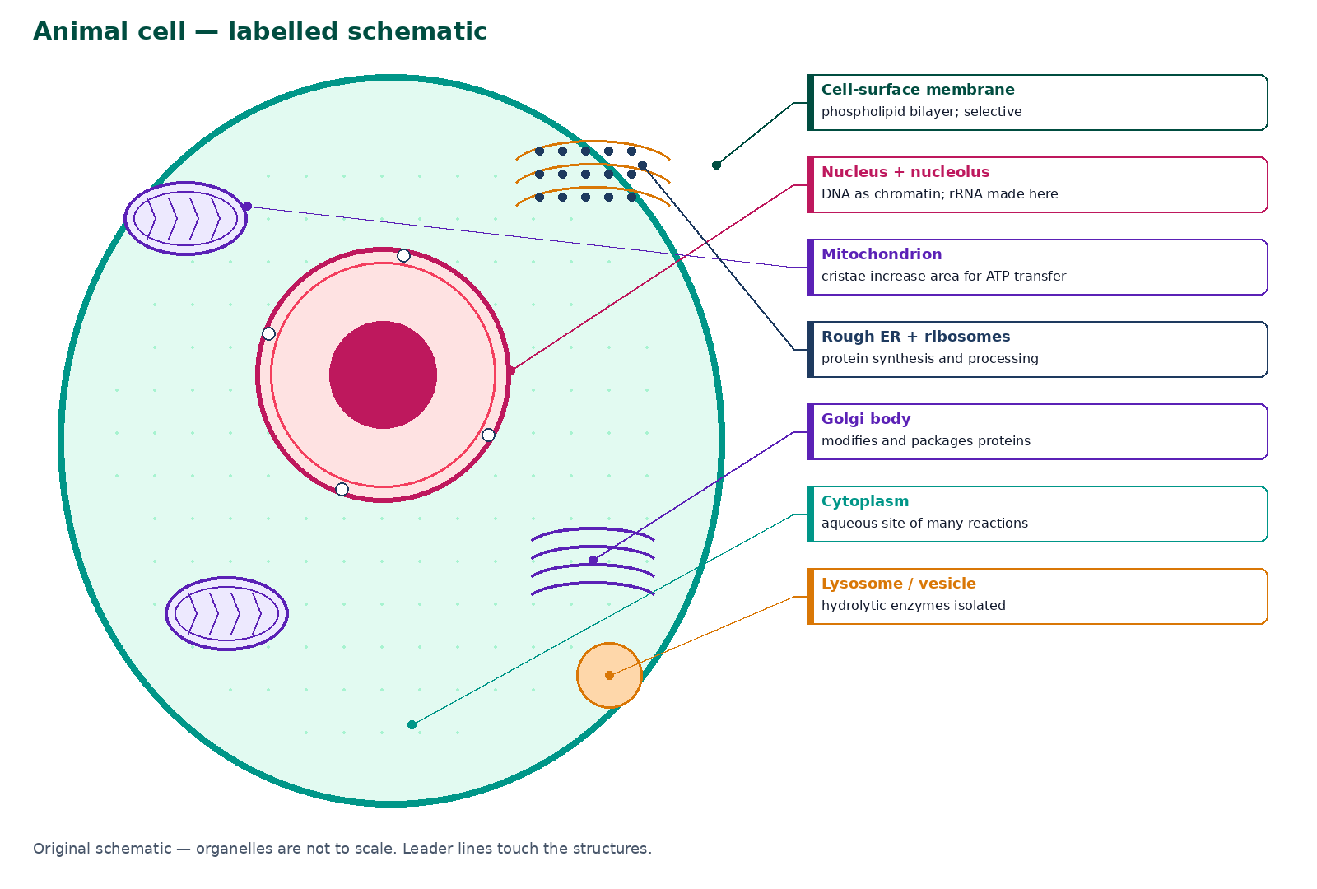

BTEC Level 3 · Applied Science · Unit 1 · Biology
BTEC Unit 1 Biology: Cell Structure
Ultrastructure, membranes, organelle function and structure–function relationships in animal and plant cells.
PowerPoint teaching resource
jdscience.co.uk
Cell structure
1 / 24

Slide 2
Learning objectives
By the end of this lesson you should be able to:
1
Identify the main organelles of animal and plant cells and state their functions.
2
Describe nucleus, mitochondrion, RER–Golgi trafficking and the fluid-mosaic membrane.
3
Compare animal and plant cells using labelled diagrams with leader lines.
4
Link organelle ultrastructure to function using precise vocabulary.
5
Interpret electron-micrograph descriptions without inventing unseen structures.
jdscience.co.uk
Cell structure
2 / 24

Slide 3
LEVEL 3 DEPTH CHECK
Beyond GCSE recall
This lesson must progress past simple recall. Use these Level 3 moves in explanations and answers.
GCSE starting point
Unit 1 progression
Nucleus holds DNA
Envelope, pores, chromatin, nucleolus, mRNA export
Mitochondria make energy
Cristae, matrix, ATP transfer — never ‘make energy’
Plant cells have a wall
Wall is freely permeable; the membrane controls exchange
Cells have parts
Structure–function sentences and specialised-cell adaptations
jdscience.co.uk
Cell structure
3 / 24

Slide 4
DO NOW
Prior knowledge
1.
Name three structures you would expect in a typical animal cell. [2]
2.
Which organelle is associated with aerobic respiration? [1]
3.
What extra structures does a plant cell have compared with an animal cell? [2]
4.
Why do cells need a membrane? [2]
Think first — answers are on the next slide.
jdscience.co.uk
Cell structure
4 / 24

Slide 5
ANSWERS
Retrieval answers
1
Nucleus, cytoplasm and cell-surface membrane (plus mitochondria, ribosomes).
2
The mitochondrion.
3
Cell wall, chloroplasts and a permanent vacuole.
4
To separate the contents from the surroundings and control what enters and leaves.
jdscience.co.uk
Cell structure
5 / 24

Slide 6
The eukaryotic animal cell
Compartments with jobs
1 Look for
2 Say in full
3 Level 3 move
Leader lines to the nucleus, mitochondrion, RER, membrane and cytoplasm.
Each organelle has a structure that matches its function.
Name ultrastructure: envelope, cristae, ribosomes — not just ‘it makes energy’.
jdscience.co.uk
Cell structure
6 / 24

Slide 7
Animal cell — labelled schematic
The nucleus stores DNA as chromatin and controls protein synthesis.
Mitochondria transfer energy to ATP by aerobic respiration.
Ribosomes on RER synthesise proteins for trafficking.
The cell-surface membrane is a phospholipid bilayer with proteins.
Lysosomes isolate hydrolytic enzymes.
Original schematic. Organelles are not to scale. Leader lines touch the structures.
jdscience.co.uk
Cell structure
7 / 24

Slide 8
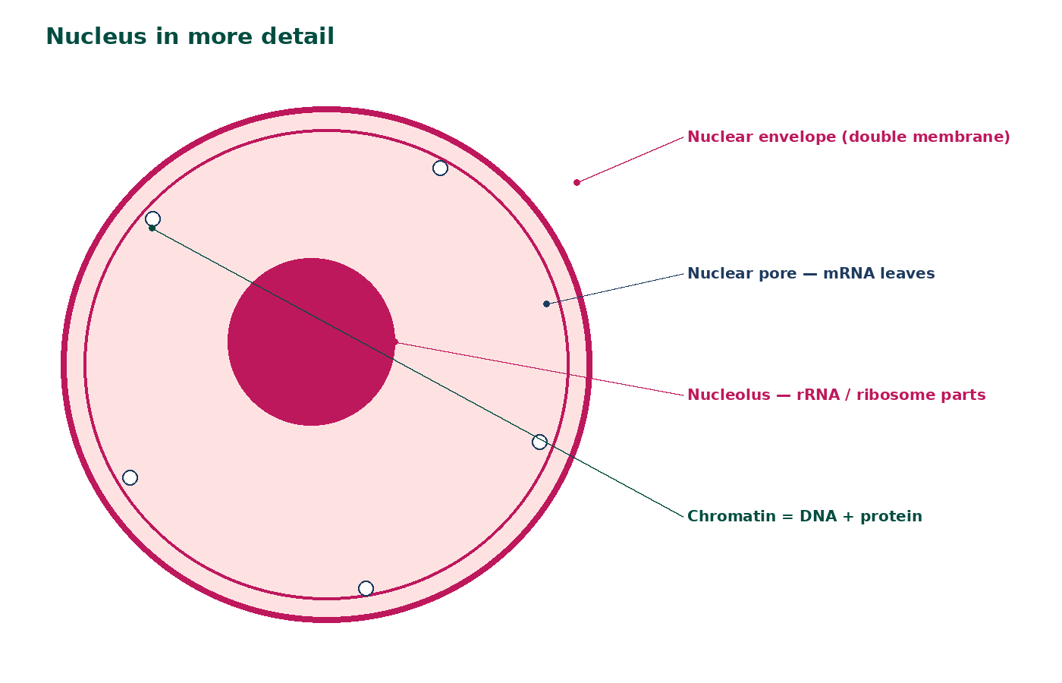
Nucleus in more detail
Double nuclear envelope with pores.
Pores allow mRNA and ribosomal subunits to leave.
Chromatin is DNA plus protein; it condenses to chromosomes for division.
The nucleolus makes rRNA.
Mature mammalian red blood cells have no nucleus.
jdscience.co.uk
Cell structure
8 / 24

Slide 9
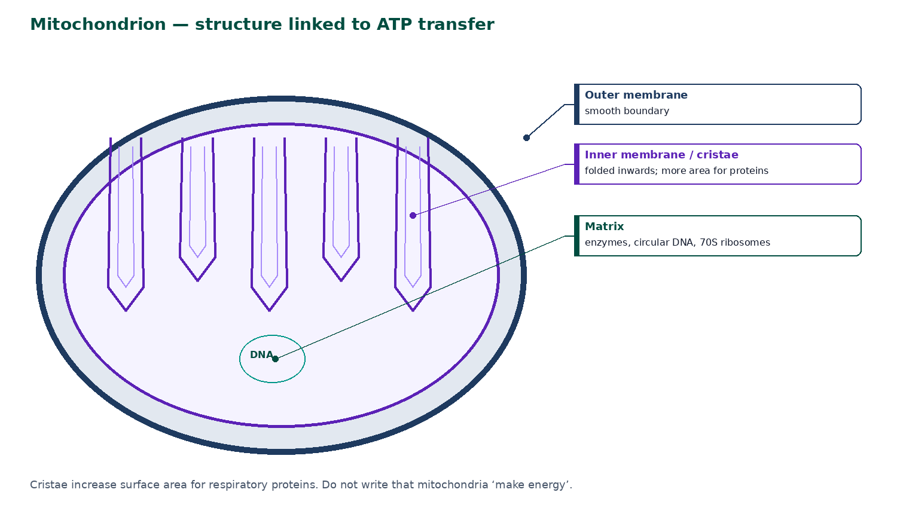
Mitochondrion
Bound by a double membrane.
Inner membrane folds into cristae — more surface area for respiratory proteins.
The matrix contains enzymes, circular DNA and 70S ribosomes.
High-demand cells (muscle, sperm midpiece) have many mitochondria.
Do not write that mitochondria ‘make energy’.
jdscience.co.uk
Cell structure
9 / 24

Slide 10
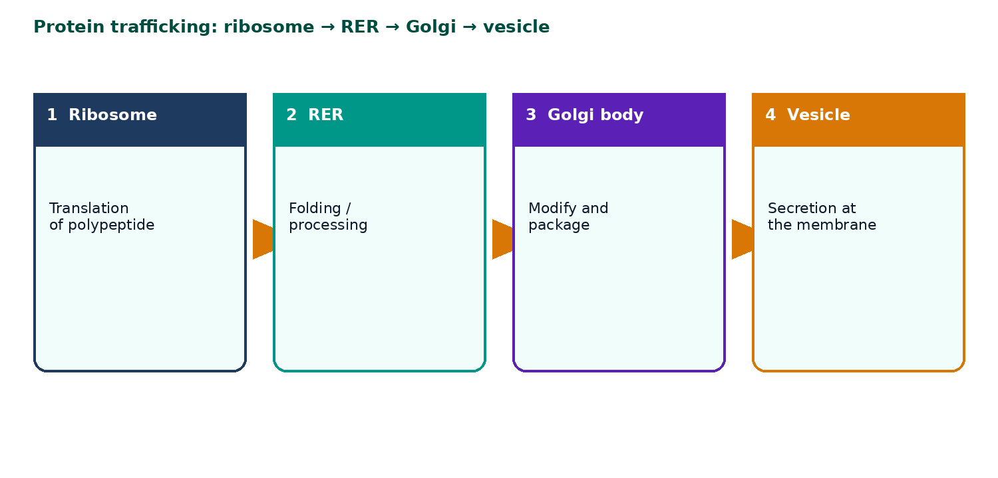
Protein trafficking
Ribosomes are the site of translation.
RER is studded with ribosomes and processes proteins.
The Golgi body modifies proteins and packages them into vesicles.
Vesicles fuse with the membrane for secretion.
Secretory cells have extensive RER and Golgi.
jdscience.co.uk
Cell structure
10 / 24

Slide 11
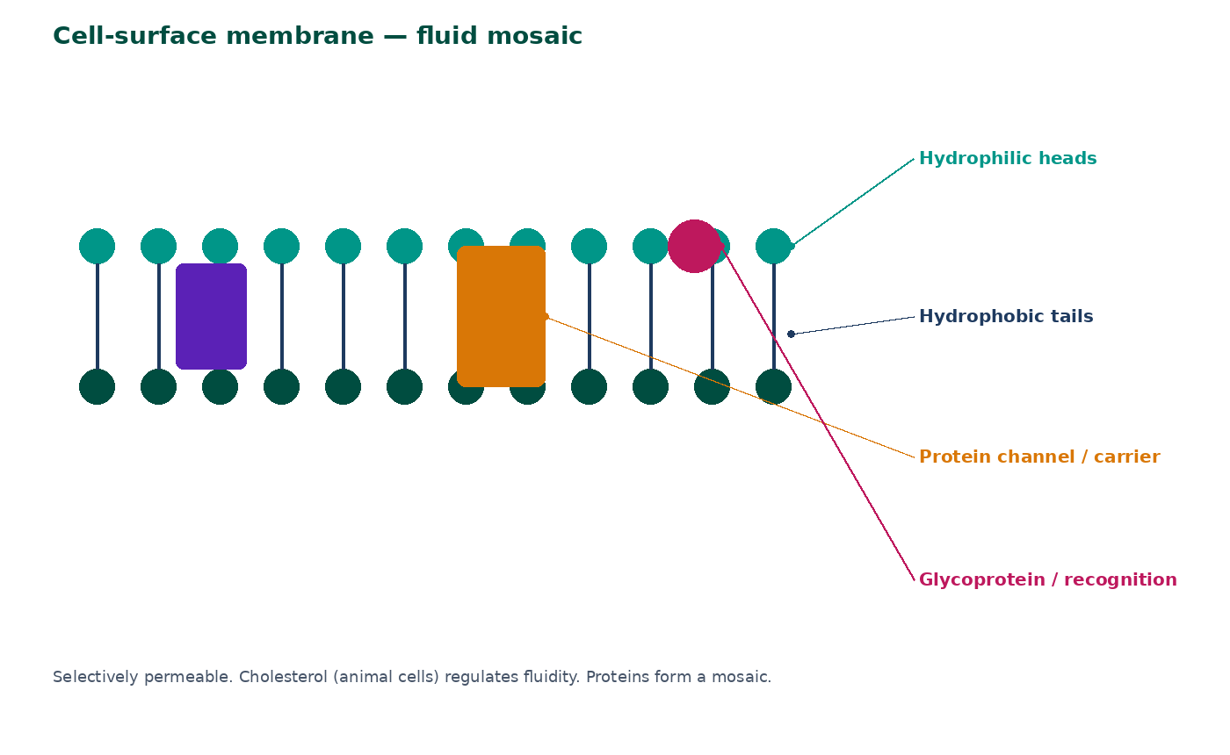
The cell-surface membrane
Phospholipid bilayer: hydrophilic heads face water; hydrophobic tails face inwards.
Proteins form channels, carriers, receptors and enzymes.
It is selectively permeable.
Cholesterol (animal cells) regulates fluidity.
Glycoproteins and glycolipids are used in cell recognition — the fluid mosaic.
jdscience.co.uk
Cell structure
11 / 24

Slide 12
Plant cell extras
Wall, vacuole, chloroplast
1 Look for
2 Say in full
3 Level 3 move
A cellulose wall, a large permanent vacuole and chloroplasts with grana.
The wall is freely permeable; the membrane controls exchange.
Link each extra structure to support, turgidity or photosynthesis.
jdscience.co.uk
Cell structure
12 / 24

Slide 13
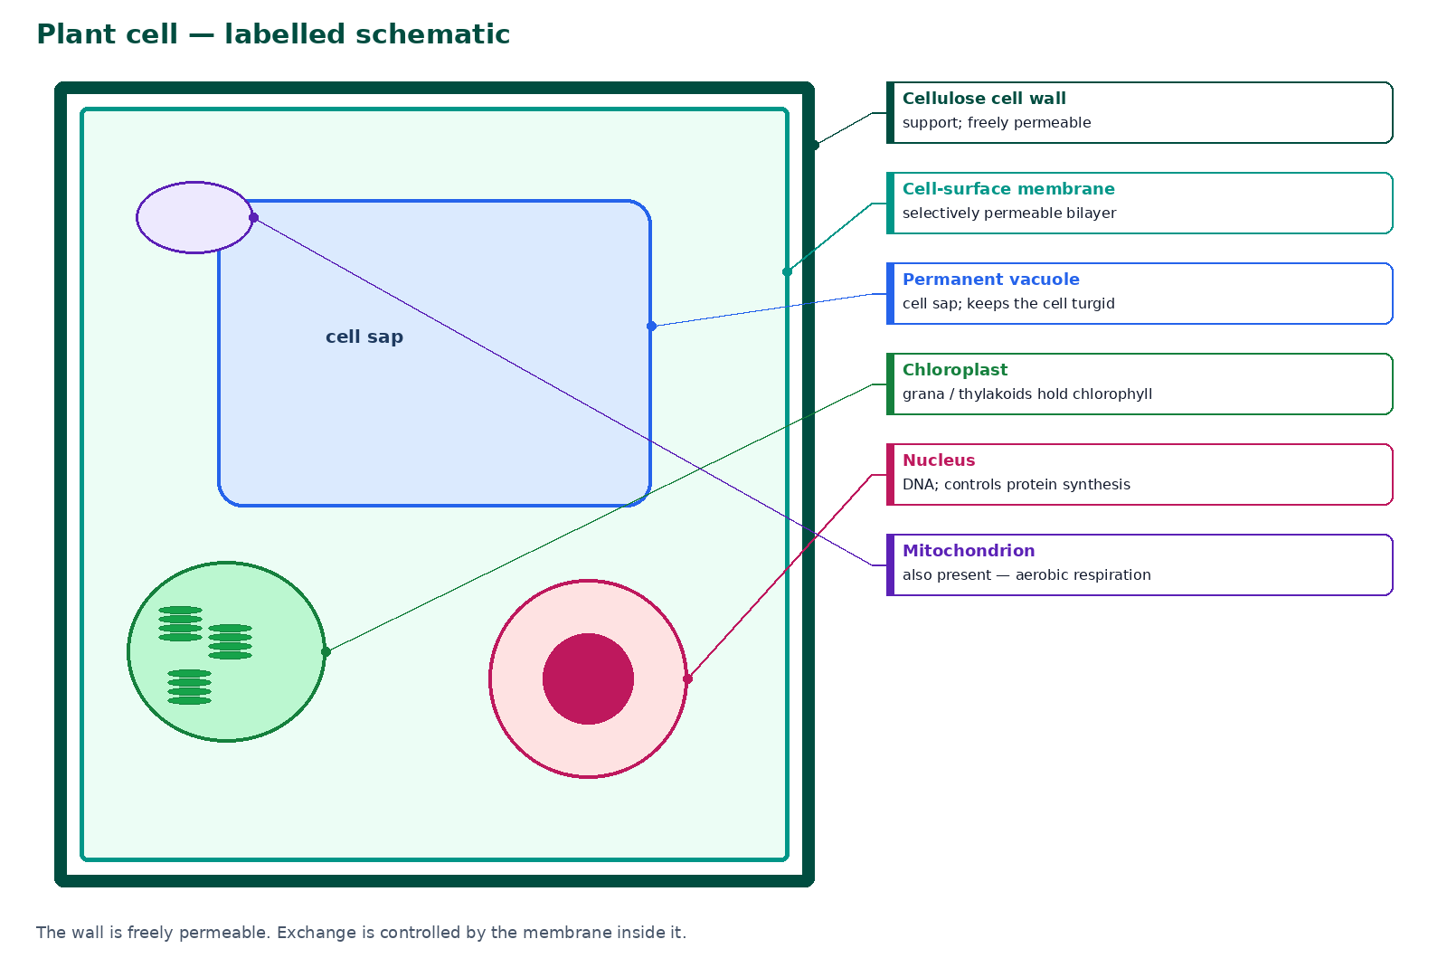
Plant cell — labelled schematic
The cellulose cell wall provides support and prevents osmotic bursting.
The wall is freely permeable to water and most solutes.
The permanent vacuole stores cell sap and helps keep the cell turgid.
Chloroplasts are the site of photosynthesis — grana hold chlorophyll.
Plant cells also have a nucleus, mitochondria and ribosomes.
jdscience.co.uk
Cell structure
13 / 24

Slide 14
Chloroplasts — ultrastructure
Envelope
Grana
Double membrane around the stroma.
Stacks of thylakoids hold chlorophyll and the light-dependent reactions.
Stroma
Not every plant cell
Enzymes for the light-independent reactions, plus DNA and ribosomes.
Root cells typically lack chloroplasts. Chlorophyll is the pigment, not the organelle.
jdscience.co.uk
Cell structure
14 / 24

Slide 15
Animal versus plant cells
Only animal
Only plant
• No cellulose cell wall
• No chloroplasts
• No large permanent vacuole
• Often have centrioles associated with division
• May have cholesterol in the membrane
• Cellulose cell wall
• Chloroplasts in photosynthetic cells
• Large permanent vacuole
• Pits and plasmodesmata connect cytoplasm
• Starch as a storage carbohydrate
jdscience.co.uk
Cell structure
15 / 24

Slide 16
Organelle function summary
Organelle
Main function
Ultrastructure to name
Nucleus
Holds DNA; controls the cell
Envelope / pores / nucleolus
Mitochondrion
Aerobic respiration / ATP
Cristae / matrix
Ribosome / RER
Protein synthesis and processing
Bound ribosomes
Golgi body
Modify and package proteins
Vesicles
Chloroplast
Photosynthesis
Grana / stroma
Cell wall
Support; shape
Cellulose; freely permeable
jdscience.co.uk
Cell structure
16 / 24

Slide 17
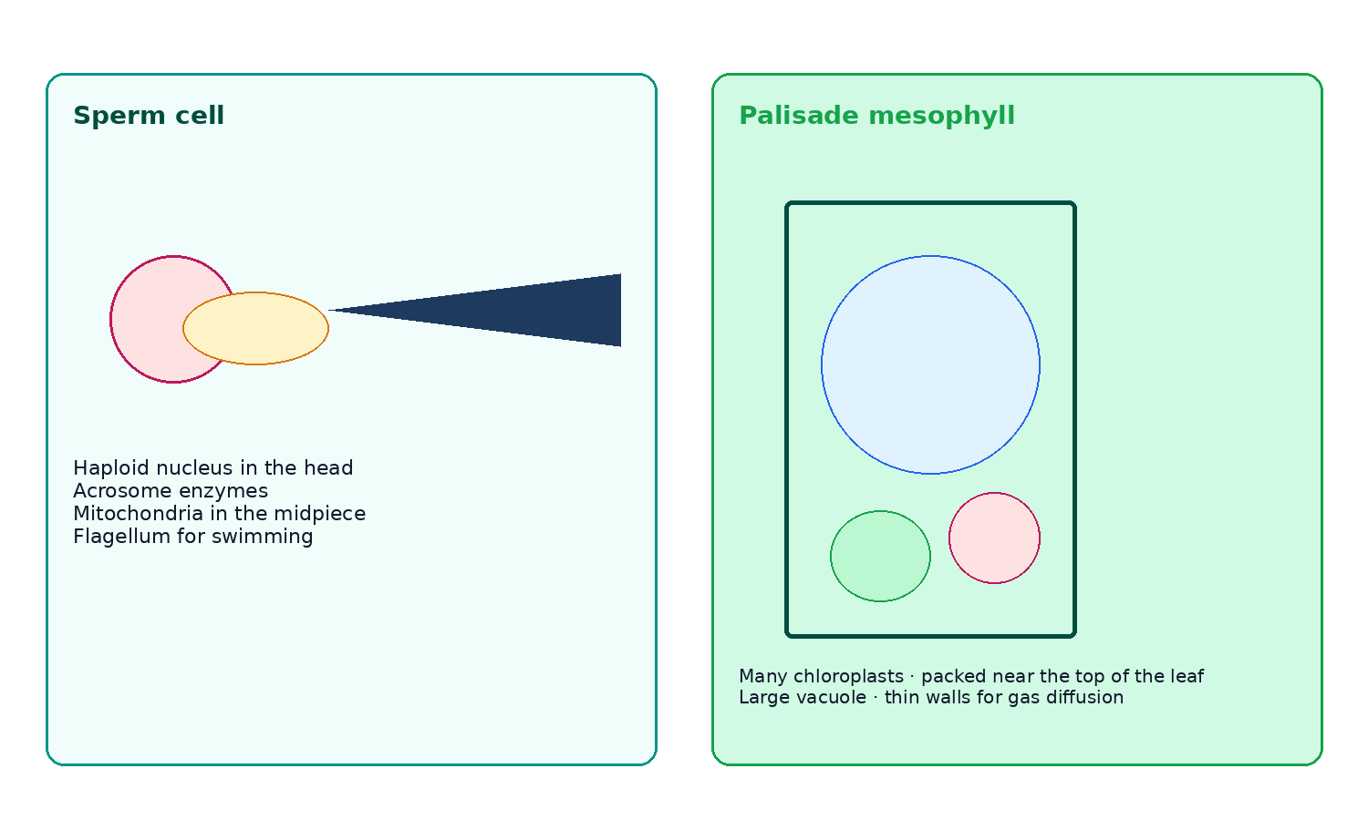
High-demand specialised cells
Sperm: haploid nucleus, acrosome enzymes, mitochondria in the midpiece, flagellum.
Palisade: many chloroplasts, elongated and packed near the top of the leaf.
Large vacuole maintains turgidity so the leaf is held out.
Thin cell walls aid gas diffusion.
Always pair a named adaptation with its function.
jdscience.co.uk
Cell structure
17 / 24

Slide 18
Reading an electron-micrograph description
Cristae
Grana / thylakoids
You are looking at a mitochondrion.
You are looking at a chloroplast.
Double membrane around chromatin
Do not invent labels
You are looking at a nucleus.
Colour is usually added later to EM images.
jdscience.co.uk
Cell structure
18 / 24

Slide 19
STUDENT ACTIVITY
Structure–function cards
10 minutes
1
Write six cards: organelle on one side; function plus one ultrastructure detail on the other.
2
Include nucleus, mitochondrion, ribosome/RER, membrane, chloroplast and vacuole.
3
Test a partner. Reject vague phrases such as ‘helps the cell live’.
jdscience.co.uk
Cell structure
19 / 24

Slide 20
Common misconceptions
Not quite
Instead
The cell wall controls what enters a plant cell.
The membrane controls exchange; the wall is freely permeable.
Not quite
Instead
All plant cells photosynthesise.
Only cells with chloroplasts do.
Not quite
Instead
The nucleus is the ‘brain’ that thinks.
It stores genetic information and controls protein production.
jdscience.co.uk
Cell structure
20 / 24

Slide 21
EXAM-STYLE PRACTICE
Exam-style practice
1
4 marks
2
4 marks
3
3 marks
Describe the function of the nucleus and of mitochondria in an animal cell.
Explain two ways a palisade mesophyll cell is adapted for photosynthesis.
A student says the cell wall and the cell membrane are the same structure. Correct this statement.
Write a full-sentence answer
Write a full-sentence answer
Write a full-sentence answer
Think first — answers are on the next slide.
jdscience.co.uk
Cell structure
21 / 24

Slide 22
ANSWERS
Exam-style answers
1
2
3
Nucleus: contains DNA / chromosomes and controls protein synthesis. Mitochondria: site of aerobic respiration / produce ATP.
Many chloroplasts to absorb light. Positioned near the top of the leaf / elongated shape. Vacuole maintains turgidity. (Any two explained.)
Wall: cellulose, freely permeable, support. Membrane: phospholipid bilayer, selectively permeable, controls exchange.
jdscience.co.uk
Cell structure
22 / 24

Slide 23
Plenary
30–60 seconds each. No notes if you can avoid them.
1
2
3
Point to an organelle and state function plus one ultrastructure detail.
Give one structure found in both cells and one found only in plant cells.
State why red blood cells are an exception to the typical animal cell.
jdscience.co.uk
Cell structure
23 / 24

Slide 24
Independent practice
1
Complete the Cell Structure worksheet, including the labelling page.
2
Learn the organelle table until you can write it from memory.
3
Next lesson: prokaryotic cells compared with these eukaryotic cells.
jdscience.co.uk
Cell structure
24 / 24

