Slide 1
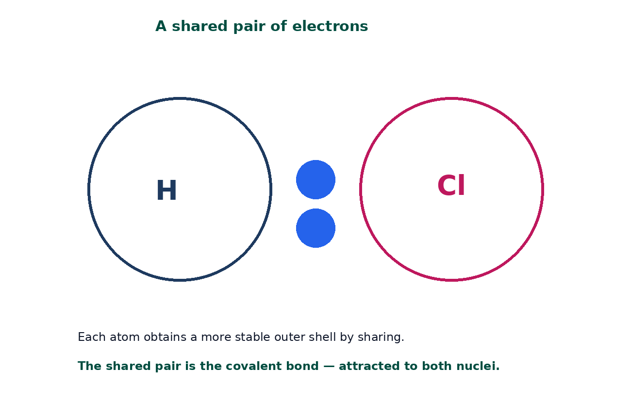

BTEC Level 3 · Applied Science · Unit 1 · Chemistry
BTEC Unit 1 Chemistry: Covalent Bonding
Shared pairs, simple molecules, giant covalent networks and structure–property explanations.
PowerPoint teaching resource
jdscience.co.uk
Covalent bonding
1 / 22

Slide 2
Learning objectives
By the end of this lesson you should be able to:
1
Describe a covalent bond as a shared pair of electrons attracted to both nuclei.
2
Explain why non-metal atoms share rather than transfer.
3
Count shared pairs in H₂, O₂, N₂, CH₄, H₂O and CO₂.
4
Distinguish simple molecular from giant covalent structures.
5
Use structure to explain melting point and electrical conductivity, including graphite.
jdscience.co.uk
Covalent bonding
2 / 22

Slide 3
LEVEL 3 DEPTH CHECK
Beyond GCSE recall
This lesson must progress past simple recall. Use these Level 3 moves in explanations and answers.
GCSE starting point
Unit 1 progression
Covalent = sharing
The shared pair is attracted to both nuclei
Covalent substances melt easily
Only simple molecular ones do; diamond does not
Boiling water breaks O–H bonds
Boiling overcomes intermolecular forces
Graphite is just carbon
Delocalised electrons between layers explain conduction
jdscience.co.uk
Covalent bonding
3 / 22

Slide 4
DO NOW
Prior knowledge
1.
How does ionic bonding differ from sharing electrons? [2]
2.
How many electrons does carbon need for a full outer shell? [1]
3.
Name two elements that exist as diatomic molecules. [1]
4.
What is a full outer shell for Period 2 elements? [1]
Think first — answers are on the next slide.
jdscience.co.uk
Covalent bonding
4 / 22

Slide 5
ANSWERS
Retrieval answers
1
Ionic bonding is electron transfer and attraction between ions; covalent bonding is sharing.
2
Four (carbon is 2,4).
3
Hydrogen, nitrogen, oxygen, fluorine, chlorine, bromine or iodine.
4
Eight electrons (helium is the exception with two).
jdscience.co.uk
Covalent bonding
5 / 22

Slide 6
The covalent bond
A shared pair
1 Look for
2 Say in full
3 Level 3 move
A pair of electrons sitting between two nuclei.
The shared pair is attracted to both nuclei — that attraction is the bond.
Do not say atoms ‘want’ electrons. Name the nuclei and the full outer shells.
jdscience.co.uk
Covalent bonding
6 / 22

Slide 7
A shared pair of electrons
Each atom contributes one electron to the shared pair (unless the bond is dative).
The pair is attracted to both nuclei.
That mutual attraction is the covalent bond.
Both atoms obtain a more stable outer shell.
HCl as an original schematic — not a copied dot-and-cross from another publisher.
jdscience.co.uk
Covalent bonding
7 / 22

Slide 8
Single, double and triple bonds
Single
Double
One shared pair. H–H, Cl–Cl, C–C.
Two shared pairs. O=O, C=O.
Triple
Carbon
Three shared pairs. N≡N.
Regularly forms four covalent bonds in stable molecules.
jdscience.co.uk
Covalent bonding
8 / 22

Slide 9
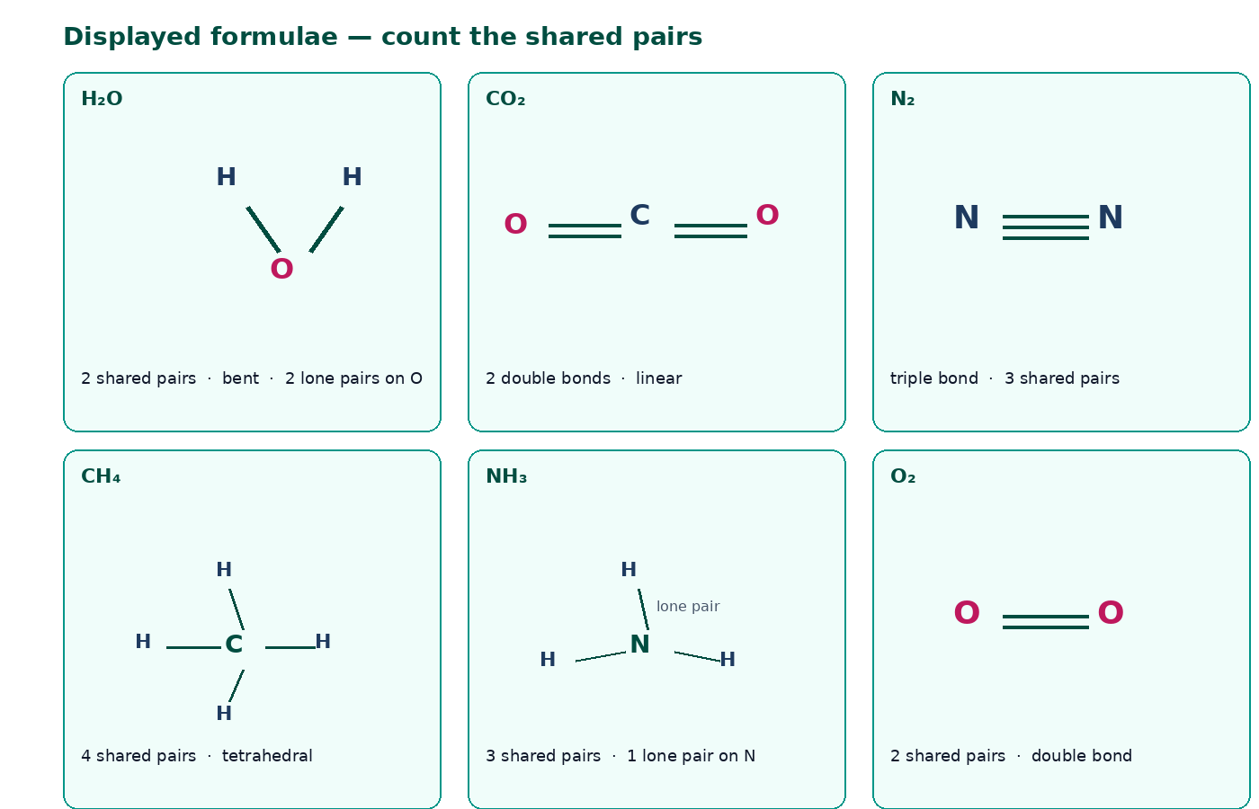
Molecules you must be able to draw
Count the lines: each line is one shared pair.
Water is bent and has two lone pairs on oxygen.
CO₂ is linear: O=C=O.
Ammonia has a lone pair and can form a dative bond to H⁺ to make NH₄⁺.
jdscience.co.uk
Covalent bonding
9 / 22

Slide 10
Why non-metals share
The electron story
Keep the language scientific
• Non-metal atoms attract electrons strongly
• Transferring several electrons is costly
• Sharing lets each atom count the pair
• The pair sits between the nuclei
• Do not say atoms ‘want’ electrons
• Name attraction to both nuclei
• State the full outer shell after sharing
• Do not mention ions in a covalent answer
jdscience.co.uk
Covalent bonding
10 / 22

Slide 11
Two covalent structure types
The structure word wins the mark
1 Look for
2 Say in full
3 Level 3 move
Simple molecular versus giant covalent — two different structures.
Melting iodine overcomes weak forces between I₂ molecules, not I–I bonds.
Graphite conducts because electrons are delocalised between layers.
jdscience.co.uk
Covalent bonding
11 / 22

Slide 12
Structure types
Simple molecular
Giant covalent
• Strong covalent bonds within molecules
• Weak forces between molecules
• Low melting and boiling points
• Usually do not conduct
• Examples: H₂O, CO₂, I₂, CH₄
• Vast network of covalent bonds
• No separate small molecules
• Very high melting points
• Usually do not conduct (graphite is the exception)
• Examples: diamond, graphite, SiO₂
jdscience.co.uk
Covalent bonding
12 / 22

Slide 13
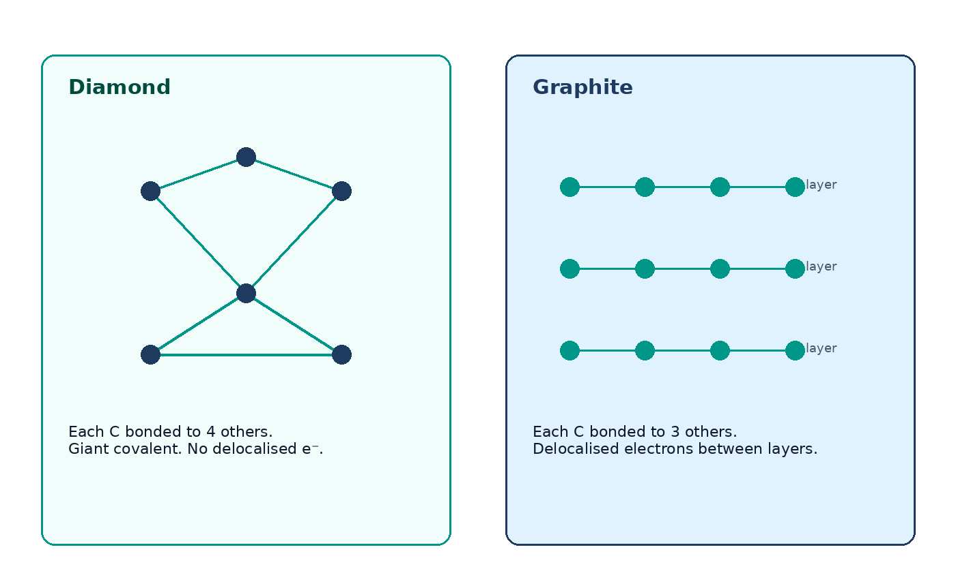
Diamond versus graphite
Diamond: each C bonded to four others — hard, no delocalised electrons.
Graphite: each C bonded to three others in layers.
Spare electrons are delocalised between layers, so graphite conducts.
Layers can slide, so graphite is soft.
jdscience.co.uk
Covalent bonding
13 / 22

Slide 14
Silicon dioxide as a giant covalent example
Bonding
Oxygen
Each Si is covalently bonded to four O atoms.
Each O is bonded to two Si atoms.
Structure
Properties
A 3D network — not SiO₂ molecules.
Very high melting point; does not conduct; hard.
jdscience.co.uk
Covalent bonding
14 / 22

Slide 15
STUDENT ACTIVITY
Bond counts
10 minutes
1
For F₂, O₂, N₂, CH₄ and CO₂, state the number of shared pairs.
2
Identify any lone pairs on the central atom where relevant.
3
Predict whether each substance is a gas at room temperature using structure, not memory alone.
jdscience.co.uk
Covalent bonding
15 / 22

Slide 16
ANSWERS
Bond-count answers
1
2
3
F₂: 1 pair. O₂: 2 pairs. N₂: 3 pairs.
CH₄: 4 pairs; no lone pair on C. CO₂: two double bonds; no lone pair on C.
All are simple molecules, so intermolecular forces are weak and they are gases at room temperature.
jdscience.co.uk
Covalent bonding
16 / 22

Slide 17
A first look at dative bonding
NH₄⁺
After
The fourth N–H bond forms when nitrogen donates its lone pair to H⁺.
Once formed, that bond is identical to the other N–H bonds.
Elsewhere
Limit
Carbon monoxide and some complex ions also contain dative bonds.
Treat it as a special covalent case — not a fourth main bonding type.
jdscience.co.uk
Covalent bonding
17 / 22

Slide 18
Common misconceptions
Not quite
Instead
Breaking covalent bonds is what happens when water boils.
Boiling overcomes intermolecular forces; the O–H bonds remain.
Not quite
Instead
All covalent substances have low melting points.
Giant covalent structures have very high melting points.
Not quite
Instead
Covalent bonds form between a metal and a non-metal.
That pairing usually gives ionic bonding.
jdscience.co.uk
Covalent bonding
18 / 22

Slide 19
EXAM-STYLE PRACTICE
Exam-style practice
1
3 marks
2
4 marks
3
3 marks
Describe how a covalent bond forms in a chlorine molecule.
Explain why iodine melts at a much lower temperature than diamond.
Explain why graphite conducts electricity but diamond does not.
Write a full-sentence answer
Write a full-sentence answer
Write a full-sentence answer
Think first — answers are on the next slide.
jdscience.co.uk
Covalent bonding
19 / 22

Slide 20
ANSWERS
Exam-style answers
1
2
3
Each Cl has 7 outer electrons. They share one pair. Both then have 8. The pair is attracted to both nuclei.
Iodine is simple molecular — melting overcomes weak forces between I₂ molecules. Diamond is giant covalent — many strong C–C bonds must break.
Graphite has delocalised electrons between layers. In diamond every outer electron is held in a C–C bond.
jdscience.co.uk
Covalent bonding
20 / 22

Slide 21
Plenary
30–60 seconds each. No notes if you can avoid them.
1
2
3
Define a covalent bond in one sentence.
Give one simple-molecular and one giant-covalent example.
Name the mobile particle that allows graphite to conduct.
jdscience.co.uk
Covalent bonding
21 / 22

Slide 22
Independent practice
1
Complete the Covalent Bonding worksheet.
2
Draw displayed formulae for H₂O, NH₃, CH₄ and CO₂ from memory.
3
Next lesson: metallic bonding.
jdscience.co.uk
Covalent bonding
22 / 22

