Slide 1
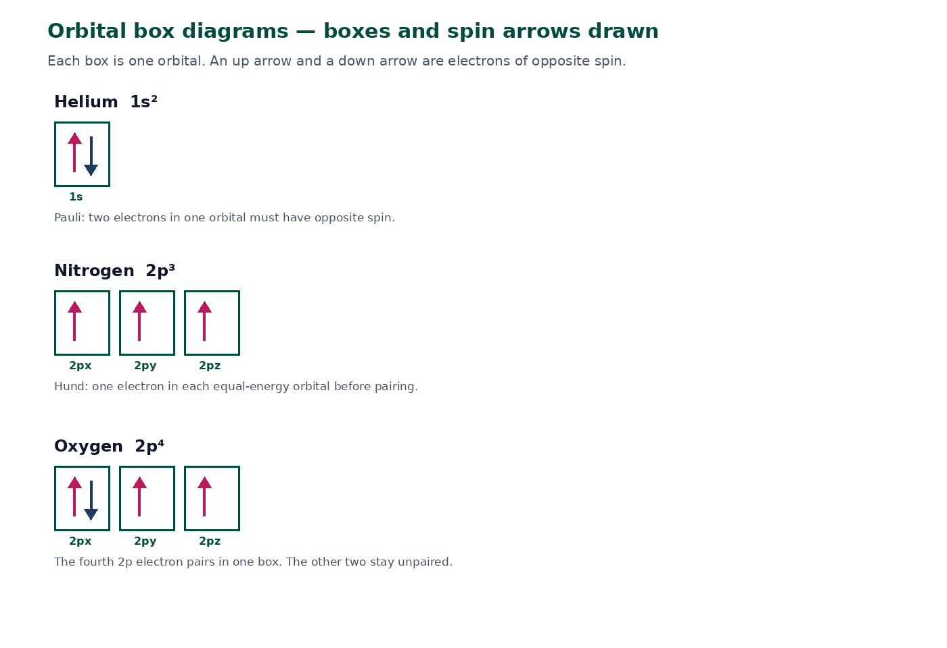

BTEC Level 3 · Applied Science · Unit 1 · Chemistry
BTEC Unit 1 Chemistry: Electron Configuration
Shells for the first 20 elements, then s, p and d subshells, Aufbau, orbital boxes and ions.
PowerPoint teaching resource
jdscience.co.uk
Electron configuration
1 / 25

Slide 2
Learning objectives
By the end of this lesson you should be able to:
1
Write shell configurations (2,8,8,2) for the first 20 elements as a starting model.
2
Describe s, p and d subshells and state their capacities.
3
Write configurations such as 1s² 2s² 2p⁴ using the Aufbau order.
4
Draw orbital box diagrams and apply Hund’s rule.
5
Use configuration to predict simple ion charges and identify s, p or d block.
jdscience.co.uk
Electron configuration
2 / 25

Slide 3
LEVEL 3 DEPTH CHECK
Beyond GCSE recall
This lesson must progress past simple recall. Use these Level 3 moves in explanations and answers.
GCSE starting point
Unit 1 progression
2,8,8 for everything
Keep 2,8,8,2 for Ca, then write 4s² after 3p⁶
Electrons in shells only
Subshells, orbitals, opposite spin, Hund’s rule
Ions ‘want a full shell’
State the electron change and the new configuration
Ignore the periodic table
Link ns¹, ns² and ns² np⁵ to group number
jdscience.co.uk
Electron configuration
3 / 25

Slide 4
DO NOW
Prior knowledge
1.
How many electrons can the first shell hold? [1]
2.
Why do atoms form ions? [2]
3.
What does the group number of sodium tell you? [1]
4.
Which particle is rearranged during bonding? [1]
Think first — answers are on the next slide.
jdscience.co.uk
Electron configuration
4 / 25

Slide 5
ANSWERS
Prior-knowledge answers
1
A maximum of two electrons.
2
To obtain a more stable (often full) outer shell.
3
Sodium is in Group 1, so it has one outer-shell electron.
4
Electrons.
jdscience.co.uk
Electron configuration
5 / 25

Slide 6
Shells first
A useful model for the first 20 elements
1 Look for
2 Say in full
3 Level 3 move
Maximum 2, then 8, then 8, then 2 — calcium is 2,8,8,2.
Electrons occupy the lowest available shell first.
This is the GCSE starting point. Subshells come next.
jdscience.co.uk
Electron configuration
6 / 25

Slide 7
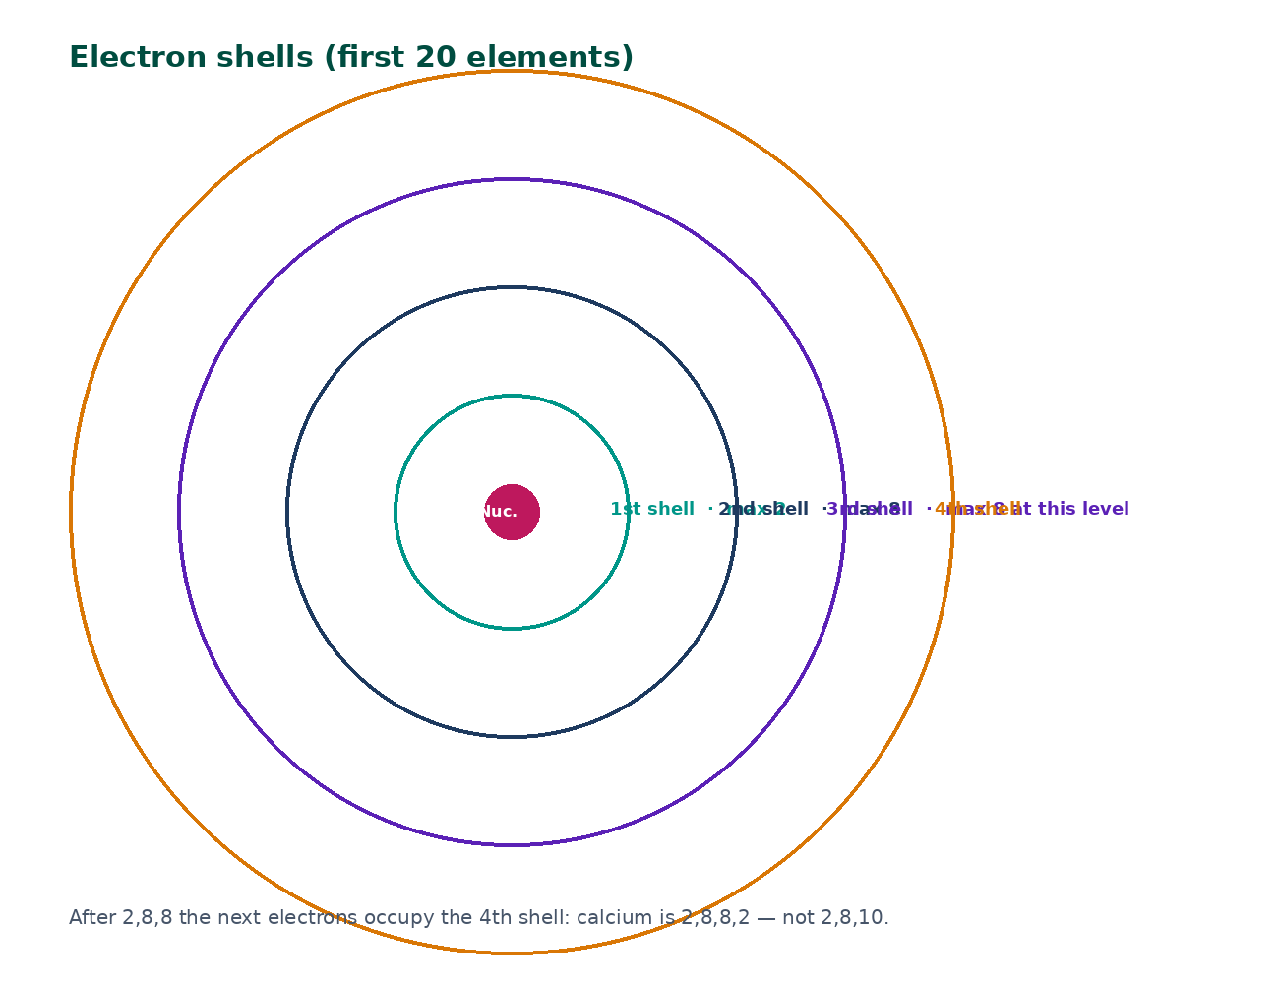
Electron shells
Electrons occupy the lowest available shell first.
For the first 20 elements this course uses 2, 8, 8, then 2.
Calcium is 2,8,8,2 — not 2,8,10.
Period number matches the number of occupied shells for main-group atoms.
This is the GCSE starting point. The lesson now moves to subshells.
jdscience.co.uk
Electron configuration
7 / 25

Slide 8
Selected shell configurations
Element
Z
Shells
Common ion
He
2
2
none (noble gas)
O
8
2,6
O²⁻
Na
11
2,8,1
Na⁺
Cl
17
2,8,7
Cl⁻
Ca
20
2,8,8,2
Ca²⁺
Learn the pattern, then rewrite the same atoms in subshell form.
jdscience.co.uk
Electron configuration
8 / 25

Slide 9
Worked example — chlorine shells
1
2
3
4
5
Count
Fill 1st
Fill 2nd
Write
Ion
Chlorine has 17 electrons.
2 electrons; 15 remain.
8 electrons; 7 remain.
Configuration 2,8,7.
Cl⁻ is 2,8,8.
→
→
→
→
jdscience.co.uk
Electron configuration
9 / 25

Slide 10
CHECK YOUR UNDERSTANDING
Write the shell configurations
1.
Nitrogen (Z = 7) [1]
2.
Magnesium (Z = 12) [1]
3.
Phosphorus (Z = 15) [1]
4.
Potassium (Z = 19) and S²⁻ (Z = 16) [2]
Think first — answers are on the next slide.
jdscience.co.uk
Electron configuration
10 / 25

Slide 11
ANSWERS
Shell-configuration answers
1
N: 2,5
2
Mg: 2,8,2
3
P: 2,8,5
4
K: 2,8,8,1 S²⁻: 2,8,8 (atom is 2,8,6)
jdscience.co.uk
Electron configuration
11 / 25

Slide 12
Subshells and orbitals
Why 2,8,8 is not the whole story
1 Look for
2 Say in full
3 Level 3 move
s, p and d capacities: 2, 6 and 10. Boxes with spin arrows.
Oxygen is 1s² 2s² 2p⁴ — four electrons in 2p, not four p subshells.
Apply Aufbau, Pauli and Hund, then rewrite the ion configuration.
jdscience.co.uk
Electron configuration
12 / 25

Slide 13
Subshell capacities
s
p
1 orbital. Maximum 2 electrons. Example: 1s², 2s², 3s².
3 orbitals. Maximum 6 electrons. Example: 2p⁶, 3p⁵.
d
Orbital
5 orbitals. Maximum 10 electrons. Used when assigning the d-block.
A region that holds two electrons of opposite spin.
jdscience.co.uk
Electron configuration
13 / 25

Slide 14
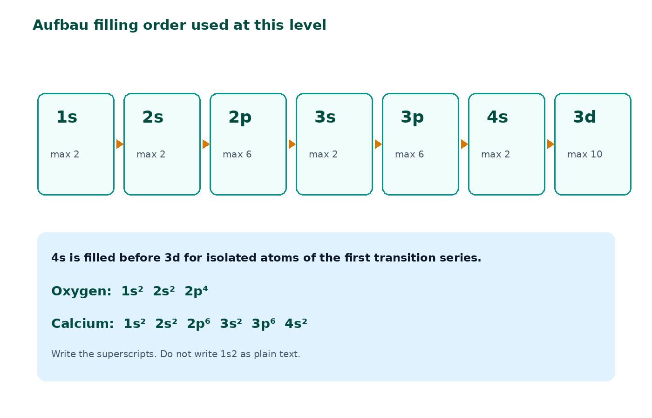
Aufbau order at this level
Fill 1s, 2s, 2p, 3s, 3p, then 4s, then 3d.
4s is filled before 3d for isolated atoms of the first transition series.
Oxygen is 1s² 2s² 2p⁴.
Calcium is 1s² 2s² 2p⁶ 3s² 3p⁶ 4s².
Always write the superscripts.
jdscience.co.uk
Electron configuration
14 / 25

Slide 15
WORKED EXAMPLE
Phosphorus in subshell form
Question
Write the full configuration and the noble-gas shorthand for phosphorus (Z = 15).
Equation
Substitution
Fill lowest subshells first
15 electrons: 1s² 2s² 2p⁶ uses 10; 5 remain
Working
Answer + unit
3s² 3p³ uses the remaining 5
1s² 2s² 2p⁶ 3s² 3p³ [Ne] 3s² 3p³
The 3 shows three electrons in 3p, not three p subshells.
jdscience.co.uk
Electron configuration
15 / 25

Slide 16
Orbital boxes — actually drawn
A box is one orbital.
Arrows are electrons. Opposite arrows = opposite spin (Pauli).
Hund: place one electron in each equal-energy orbital before pairing.
Nitrogen 2p³: three boxes, one up-arrow in each.
Oxygen 2p⁴: the fourth electron pairs in one 2p box.
You do not need boxes for every exam item, but they stop counting errors.
jdscience.co.uk
Electron configuration
16 / 25

Slide 17
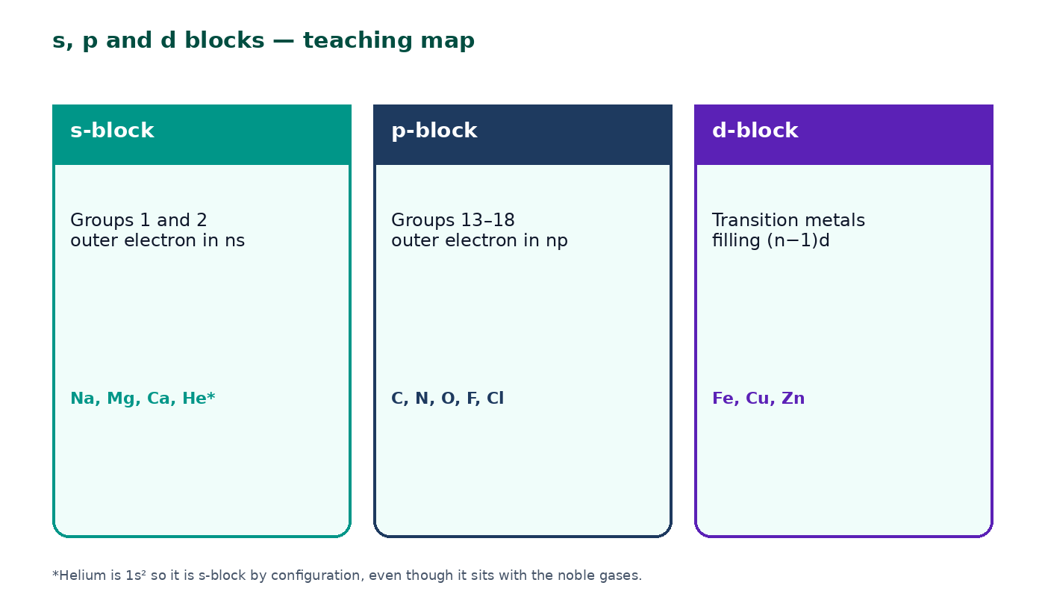
s, p and d blocks
s-block: Groups 1 and 2 — outer electron in an s subshell.
p-block: Groups 13–18 — outer electron in a p subshell.
d-block: transition metals — filling a d subshell.
Helium is 1s² so it is s-block by configuration.
jdscience.co.uk
Electron configuration
17 / 25

Slide 18
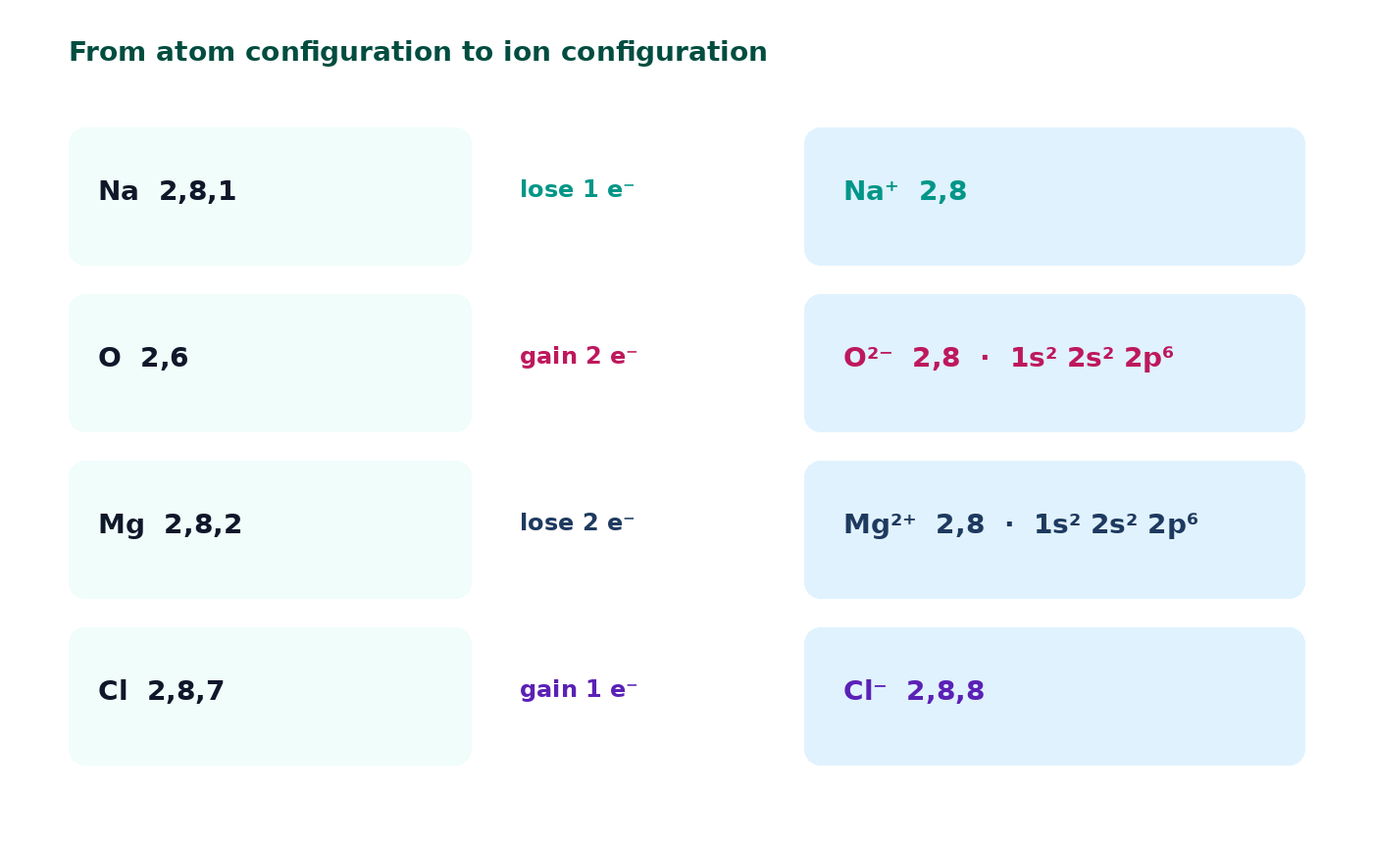
From configuration to ion charge
Start from the atom, then add or remove electrons.
Na 2,8,1 → Na⁺ 2,8.
O 2,6 → O²⁻ 2,8 which is also 1s² 2s² 2p⁶.
Mg²⁺ and Al³⁺ both reach 1s² 2s² 2p⁶.
jdscience.co.uk
Electron configuration
18 / 25

Slide 19
STUDENT ACTIVITY
Build configurations
12 minutes
1
Write full subshell configurations for F, Al, Ar and Ca.
2
Circle the outer-shell electrons.
3
State the most likely ion for F and Al and rewrite the ion configuration.
4
Check a partner’s Ca carefully — 4s comes after 3p.
jdscience.co.uk
Electron configuration
19 / 25

Slide 20
ANSWERS
Activity answers
1
F: 1s² 2s² 2p⁵ → F⁻ is 1s² 2s² 2p⁶
2
Al: 1s² 2s² 2p⁶ 3s² 3p¹ → Al³⁺ is 1s² 2s² 2p⁶
3
Ar: 1s² 2s² 2p⁶ 3s² 3p⁶
4
Ca: 1s² 2s² 2p⁶ 3s² 3p⁶ 4s²
jdscience.co.uk
Electron configuration
20 / 25

Slide 21
Common misconceptions
Not quite
Instead
The third shell always holds 18 electrons in first-20 examples.
For K and Ca this course still uses 2,8,8,1 and 2,8,8,2.
Not quite
Instead
2p⁴ means four p subshells.
It means four electrons in the 2p subshell.
Not quite
Instead
Ions keep the same configuration as the atom.
Ions have lost or gained electrons.
jdscience.co.uk
Electron configuration
21 / 25

Slide 22
EXAM-STYLE PRACTICE
Exam-style practice
1
3 marks
2
2 marks
3
3 marks
Write the electron configuration of Mg²⁺ and explain why this ion is stable.
A student writes chlorine as 2,8,8. Identify the error and give the correct atom configuration.
Explain, using electron configuration, why oxygen typically forms a 2− ion.
Write a full-sentence answer
Write a full-sentence answer
Write a full-sentence answer
Think first — answers are on the next slide.
jdscience.co.uk
Electron configuration
22 / 25

Slide 23
ANSWERS
Exam-style answers
1
2
3
Mg atom is 2,8,2 / 1s² 2s² 2p⁶ 3s². Mg²⁺ is 2,8 / 1s² 2s² 2p⁶. Full outer shell / noble-gas arrangement.
The atom has 17 electrons, not 18. Correct atom configuration is 2,8,7.
Oxygen is 2,6. Gaining two electrons gives 2,8 / 1s² 2s² 2p⁶. A full outer shell is more stable, so O²⁻ forms.
jdscience.co.uk
Electron configuration
23 / 25

Slide 24
Plenary
30–60 seconds each. No notes if you can avoid them.
1
2
3
Whiteboard: element, shells, subshells, likely ion — use Na, O and Ca.
Sketch nitrogen 2p³ boxes from memory.
State one link between group number and outer electrons.
jdscience.co.uk
Electron configuration
24 / 25

Slide 25
Independent practice
1
Complete the Electron Configuration worksheet.
2
Learn configurations for the first 20 elements in both forms.
3
Preview ionic bonding: why Na and Cl form NaCl.
Next lesson: ionic bonding.
jdscience.co.uk
Electron configuration
25 / 25

