Slide 1
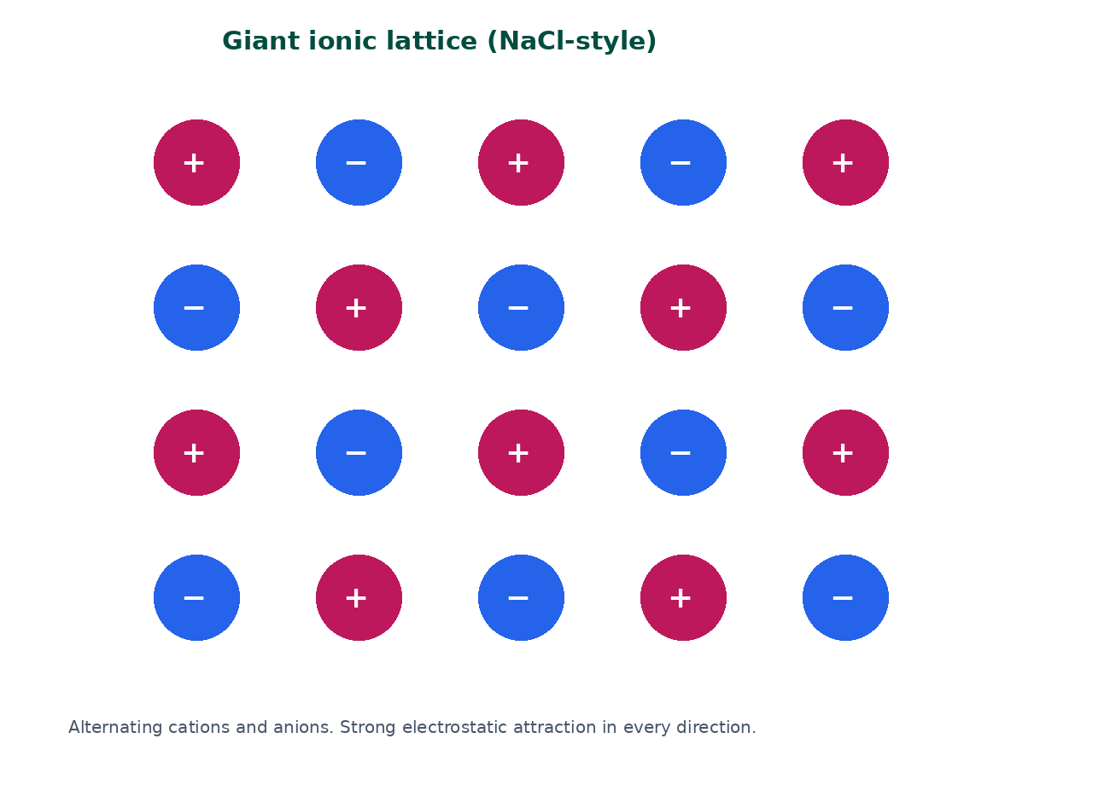

BTEC Level 3 · Applied Science · Unit 1 · Chemistry
BTEC Unit 1 Chemistry: Ionic Bonding
Electron transfer, electrostatic attraction, giant lattices and structure–property links.
PowerPoint teaching resource
jdscience.co.uk
Ionic bonding
1 / 22

Slide 2
Learning objectives
By the end of this lesson you should be able to:
1
Define ionic bonding as electrostatic attraction between oppositely charged ions.
2
Explain ion formation by electron transfer between metals and non-metals.
3
Deduce formulae from ion charges, including polyatomic ions.
4
Use the giant lattice to explain melting point, conductivity, brittleness and solubility.
5
Compare conduction in ionic compounds with metallic conduction.
jdscience.co.uk
Ionic bonding
2 / 22

Slide 3
LEVEL 3 DEPTH CHECK
Beyond GCSE recall
This lesson must progress past simple recall. Use these Level 3 moves in explanations and answers.
GCSE starting point
Unit 1 progression
Metal + non-metal = ionic
Name transfer, ion charges, electrostatic attraction and the lattice
High melting point
Strong attraction throughout a giant lattice needs a lot of energy
Conducts when molten
Mobile ions — not electrons — carry the charge
Guess the formula
Balance charge: Al³⁺ and O²⁻ give Al₂O₃
jdscience.co.uk
Ionic bonding
3 / 22

Slide 4
DO NOW
Prior knowledge
1.
What is the charge on a proton and on an electron? [1]
2.
Write the shell configuration of sodium and of chlorine. [2]
3.
Why do Group 1 metals form 1+ ions? [2]
4.
Name one compound you already know that contains ions. [1]
Think first — answers are on the next slide.
jdscience.co.uk
Ionic bonding
4 / 22

Slide 5
ANSWERS
Retrieval answers
1
Proton +1; electron −1.
2
Na 2,8,1 and Cl 2,8,7.
3
They have one outer electron which is lost to leave a full outer shell.
4
Examples include sodium chloride, copper sulfate or calcium carbonate.
jdscience.co.uk
Ionic bonding
5 / 22

Slide 6
What ionic bonding is
Transfer, then attraction
1 Look for
2 Say in full
3 Level 3 move
A metal losing electrons and a non-metal gaining them.
Ionic bonding is electrostatic attraction between oppositely charged ions.
Name the ions, the transfer and the giant lattice — not just ‘they share’.
jdscience.co.uk
Ionic bonding
6 / 22

Slide 7
A precise definition
The bond
Who bonds
Strong electrostatic attraction between oppositely charged ions.
Typically a metal and a non-metal.
What happens
Where it acts
The metal loses electrons; the non-metal gains electrons.
In all directions throughout a giant lattice.
jdscience.co.uk
Ionic bonding
7 / 22

Slide 8
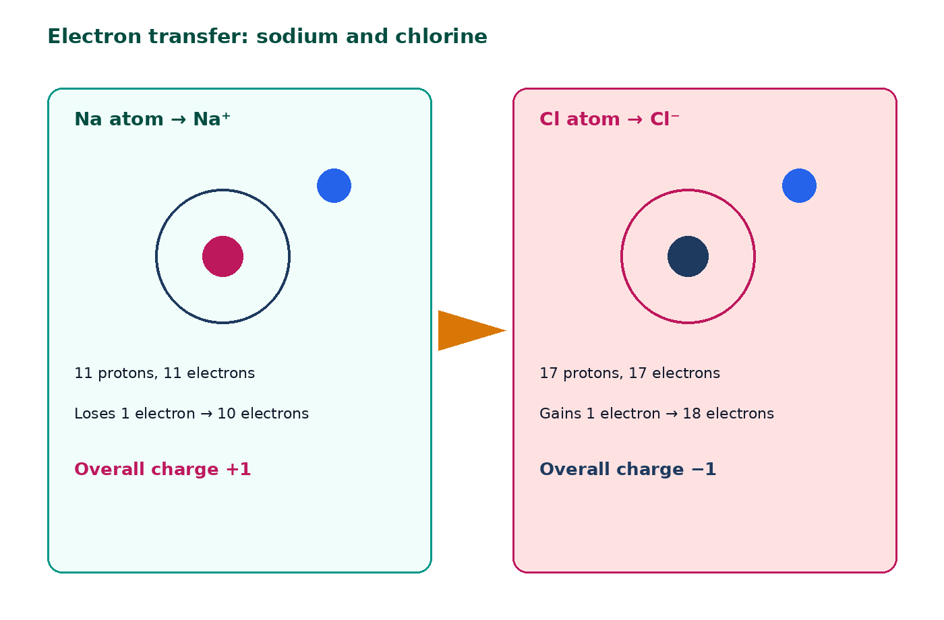
Electron transfer: Na and Cl
Na starts 2,8,1 and becomes Na⁺ 2,8.
Cl starts 2,8,7 and becomes Cl⁻ 2,8,8.
One electron is transferred.
The ions then attract strongly.
The compound is NaCl — there are no NaCl molecules.
jdscience.co.uk
Ionic bonding
8 / 22

Slide 9
Worked example — magnesium oxide
1
2
3
4
5
Mg
O
Ratio
Formula
Lattice
2,8,2 loses 2 e⁻ → Mg²⁺
2,6 gains 2 e⁻ → O²⁻
One Mg supplies both electrons to one O
MgO (charges cancel 1:1)
Giant array of Mg²⁺ and O²⁻
→
→
→
→
jdscience.co.uk
Ionic bonding
9 / 22

Slide 10
Worked example — calcium chloride
1
2
3
4
5
Ca
Cl
Balance
Check
Formula
2,8,8,2 → Ca²⁺
Each Cl is 2,8,7 → Cl⁻
Two Cl atoms for each Ca
+2 balances 2 × −1
CaCl₂
→
→
→
→
jdscience.co.uk
Ionic bonding
10 / 22

Slide 11
Common ions to learn
Name
Formula
Charge
Sodium
Na⁺
+1
Magnesium
Mg²⁺
+2
Aluminium
Al³⁺
+3
Oxide
O²⁻
−2
Chloride
Cl⁻
−1
Sulfate
SO₄²⁻
−2
Hydroxide
OH⁻
−1
Nitrate
NO₃⁻
−1
jdscience.co.uk
Ionic bonding
11 / 22

Slide 12
STUDENT ACTIVITY
Formulae from charges
8 minutes
1
Deduce formulae for Na and O; Al and Cl; Mg and N; K and SO₄²⁻.
2
Show the charge-balance working.
3
Name each compound.
jdscience.co.uk
Ionic bonding
12 / 22

Slide 13
ANSWERS
Formula answers
1
Na₂O — sodium oxide
2
AlCl₃ — aluminium chloride
3
Mg₃N₂ — magnesium nitride
4
K₂SO₄ — potassium sulfate
jdscience.co.uk
Ionic bonding
13 / 22

Slide 14
The giant ionic lattice
Structure explains properties
1 Look for
2 Say in full
3 Level 3 move
Alternating cations and anions in every direction.
Strong attraction throughout the crystal needs a lot of energy to overcome.
Solid: ions fixed, no conduction. Molten/aqueous: mobile ions carry charge.
jdscience.co.uk
Ionic bonding
14 / 22

Slide 15
Giant ionic lattice
Every cation is surrounded by anions, and vice versa.
Attraction is strong and acts throughout the crystal.
A large amount of energy is needed to separate the ions.
That produces high melting and boiling points.
Two-dimensional sketch of a three-dimensional lattice.
jdscience.co.uk
Ionic bonding
15 / 22

Slide 16
Properties of ionic compounds
Typical observations
Explanation from structure
• High melting and boiling points
• Often soluble in water
• Do not conduct when solid
• Do conduct when molten or aqueous
• Often brittle crystals
• Strong attractions throughout the lattice
• Polar water molecules can surround ions
• Ions are fixed, so charge cannot move
• Ions become free to move and carry charge
• A shift lines up like charges, so the crystal splits
jdscience.co.uk
Ionic bonding
16 / 22

Slide 17
Electrical conductivity in more detail
Need
Solid
Conduction requires mobile charged particles.
Ions vibrate but cannot migrate.
Molten / aqueous
Not metallic
Ions move towards electrodes.
Metals conduct using delocalised electrons, not ions.
jdscience.co.uk
Ionic bonding
17 / 22

Slide 18
Common misconceptions
Not quite
Instead
NaCl molecules travel around in salt solution.
There are separate hydrated Na⁺ and Cl⁻ ions.
Not quite
Instead
Ionic solids conduct because electrons jump from ion to ion.
The solid does not conduct; mobile ions are required.
Not quite
Instead
A 2+ ion is formed by gaining two protons.
Charge changes by losing or gaining electrons.
jdscience.co.uk
Ionic bonding
18 / 22

Slide 19
EXAM-STYLE PRACTICE
Exam-style practice
1
4 marks
2
4 marks
3
2 marks
Describe, in terms of electrons, how ionic bonding arises in magnesium oxide.
Explain why sodium chloride has a high melting point but does not conduct as a solid.
Deduce the formula of the compound formed between Al³⁺ and O²⁻. Show the charge balance.
Write a full-sentence answer
Write a full-sentence answer
Write a full-sentence answer
Think first — answers are on the next slide.
jdscience.co.uk
Ionic bonding
19 / 22

Slide 20
ANSWERS
Exam-style answers
1
2
3
Mg loses 2 e⁻ → Mg²⁺. O gains 2 e⁻ → O²⁻. Oppositely charged ions attract. Giant lattice of Mg²⁺ and O²⁻.
Strong electrostatic attraction throughout the lattice → high m.p. Solid ions are not free to move → no conduction.
Two Al³⁺ and three O²⁻ so +6 balances −6. Formula Al₂O₃.
jdscience.co.uk
Ionic bonding
20 / 22

Slide 21
Plenary
30–60 seconds each. No notes if you can avoid them.
1
2
3
Write a 20-word definition of ionic bonding.
Sketch two ions and mark the attraction.
Give one property and its structural explanation.
jdscience.co.uk
Ionic bonding
21 / 22

Slide 22
Independent practice
1
Complete the Ionic Bonding worksheet.
2
Practise formulae until charge balance is automatic.
3
Next lesson: covalent bonding — sharing rather than transfer.
jdscience.co.uk
Ionic bonding
22 / 22

