Slide 1
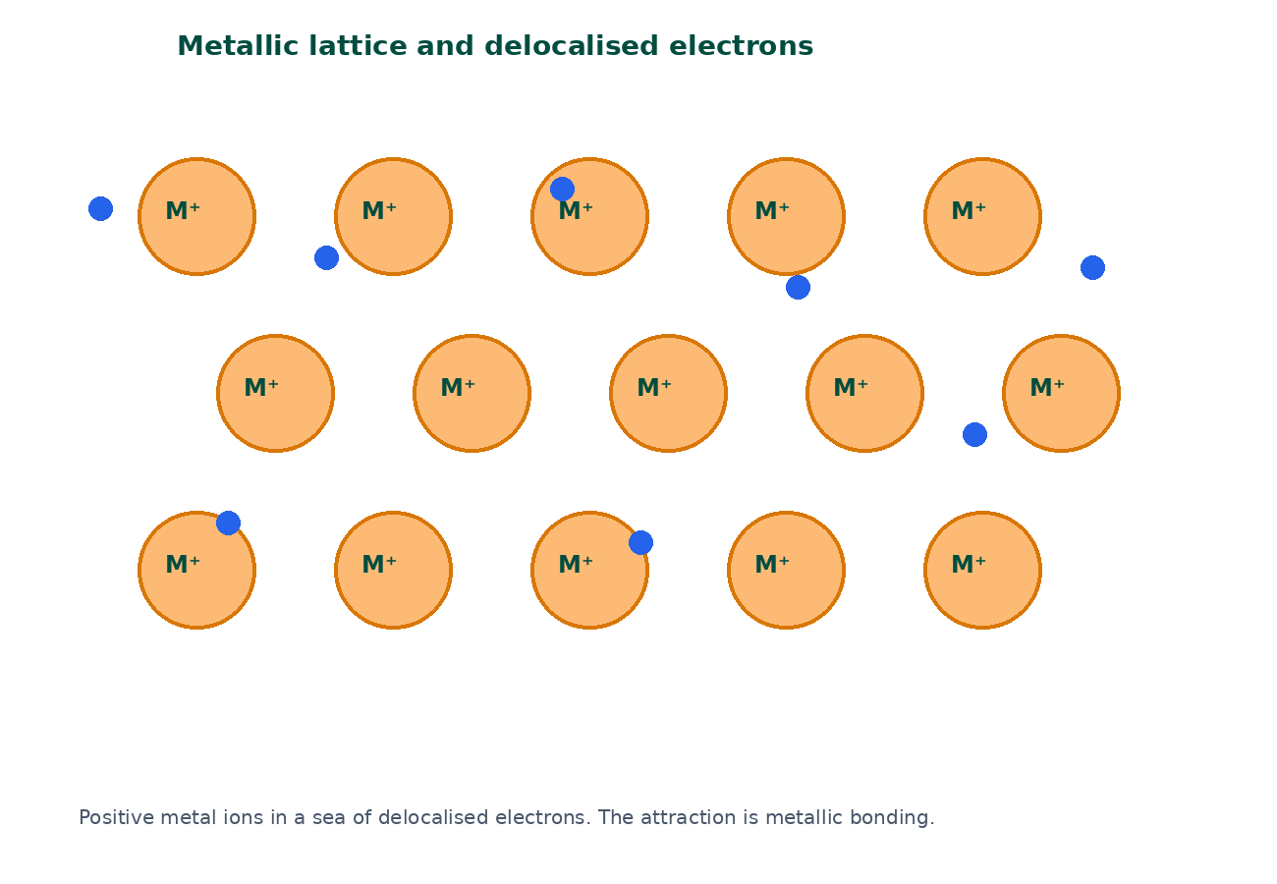

BTEC Level 3 · Applied Science · Unit 1 · Chemistry
BTEC Unit 1 Chemistry: Metallic Bonding
Cations, delocalised electrons and the properties they explain, compared with ionic and covalent solids.
PowerPoint teaching resource
jdscience.co.uk
Metallic bonding
1 / 20

Slide 2
Learning objectives
By the end of this lesson you should be able to:
1
Describe metallic bonding as attraction between positive metal ions and delocalised electrons.
2
Explain electrical and thermal conductivity using mobile electrons.
3
Explain malleability and ductility using sliding layers.
4
Link charge and number of delocalised electrons to melting point and hardness.
5
Compare metallic, ionic and simple-covalent structures.
jdscience.co.uk
Metallic bonding
2 / 20

Slide 3
LEVEL 3 DEPTH CHECK
Beyond GCSE recall
This lesson must progress past simple recall. Use these Level 3 moves in explanations and answers.
GCSE starting point
Unit 1 progression
Sea of electrons
Name cations + delocalised electrons + electrostatic attraction
Metals conduct
Electrons drift; ions stay in the lattice
Metals are bendy
Layers slide; electrons still bind the ions
Alloys are stronger
Different-sized atoms stop layers sliding easily
jdscience.co.uk
Metallic bonding
3 / 20

Slide 4
DO NOW
Prior knowledge
1.
Are metal atoms more likely to lose or gain electrons? [1]
2.
Why does solid sodium chloride not conduct? [2]
3.
Name two physical properties common to most metals. [2]
4.
What does delocalised mean? [1]
Think first — answers are on the next slide.
jdscience.co.uk
Metallic bonding
4 / 20

Slide 5
ANSWERS
Retrieval answers
1
Lose electrons, forming positive ions.
2
Its ions are not free to move.
3
Shiny, conduct heat and electricity, malleable, ductile, high melting points (most).
4
Not fixed to one atom; free to move through the structure.
jdscience.co.uk
Metallic bonding
5 / 20

Slide 6
The metallic lattice
Ions plus a sea of electrons
1 Look for
2 Say in full
3 Level 3 move
Positive metal ions packed closely, with delocalised electrons between them.
Metallic bonding is attraction between cations and the electron sea.
Layers slide but electrons still bind the ions — that is why metals are malleable.
jdscience.co.uk
Metallic bonding
6 / 20

Slide 7
Metallic structure
Metal atoms lose outer electrons into a shared cloud.
The remaining particles are positive ions packed closely.
Delocalised electrons attract every ion and bind the lattice.
The attraction is strong and non-directional.
jdscience.co.uk
Metallic bonding
7 / 20

Slide 8
A careful definition
The bond
Not ionic
Electrostatic attraction between metal cations and delocalised electrons.
There are no anions.
Not covalent
Strength
Electrons are not shared as localised pairs between two atoms.
More delocalised electrons and higher ionic charge generally strengthen the bond.
jdscience.co.uk
Metallic bonding
8 / 20

Slide 9
Explaining metallic properties
Electrical conductivity
Thermal conductivity
• Delocalised electrons are mobile charged particles
• A potential difference makes them drift
• The solid therefore conducts
• Molten metals also conduct
• Electrons transfer kinetic energy rapidly
• Ions also vibrate and pass energy on
• A metal spoon heats quickly in a drink
• Name electrons in a full explanation
jdscience.co.uk
Metallic bonding
9 / 20

Slide 10
Malleability, strength and alloys
Slide
Hold
Layers of positive ions can slide when a force is applied.
Delocalised electrons still attract the ions after the slide.
Words
Alloys
Malleable: sheets. Ductile: wires.
Different-sized atoms distort the layers, so the alloy is harder.
jdscience.co.uk
Metallic bonding
10 / 20

Slide 11
Property, particle, explanation
Property
Mobile particle?
One-sentence explanation
Conducts as a solid
Yes — electrons
Delocalised electrons drift in a p.d.
High melting point (most)
Ions stay packed
Strong attraction throughout the lattice
Malleable
Electrons stay after sliding
Layers of ions slide; electrons still bind them
Group 1 softer
Only one e⁻ per atom
Weaker metallic bonding than many transition metals
jdscience.co.uk
Metallic bonding
11 / 20

Slide 12
Compare three solids
Copper
Sodium chloride
• Cations + delocalised electrons
• Solid conducts
• Malleable
• Used for wires
• Na⁺ and Cl⁻ ions
• Solid does not conduct
• Brittle
• Conducts when molten or dissolved
jdscience.co.uk
Metallic bonding
12 / 20

Slide 13
STUDENT ACTIVITY
Three-structure comparison
12 minutes
1
Draw a three-column table: ionic, simple covalent, metallic.
2
For each, state the particles present, the bonding, melting point (high/low), and whether the solid conducts.
3
Add one example to each column.
4
Write one sentence explaining the conductivity difference between copper and solid sodium chloride.
jdscience.co.uk
Metallic bonding
13 / 20

Slide 14
ANSWERS
Comparison checkpoints
1
Ionic: ions; electrostatic attraction; high m.p.; solid does not conduct.
2
Simple covalent: molecules; covalent inside, weak forces between; low m.p.; does not conduct.
3
Metallic: cations + delocalised electrons; usually high m.p.; solid does conduct.
4
Copper has mobile electrons; solid NaCl does not have mobile ions.
jdscience.co.uk
Metallic bonding
14 / 20

Slide 15
Uses that follow from structure
Wiring
Saucepans
Copper is ductile and a good conductor because electrons can drift.
Metals conduct heat quickly to the food.
Alloys
Mercury
Bridges and frames use stronger metallic bonding plus hardness from mixed atom sizes.
Liquid at room temperature, but it still conducts — metallic bonding can be relatively weak.
jdscience.co.uk
Metallic bonding
15 / 20

Slide 16
Common misconceptions
Not quite
Instead
Metals conduct because positive ions flow through the wire.
The ions stay in the lattice; electrons move.
Not quite
Instead
Metallic bonding is a type of covalent bonding.
Electrons are delocalised, not shared as localised pairs.
Not quite
Instead
All metals have very high melting points.
Mercury is liquid at room temperature; Group 1 metals melt relatively easily.
jdscience.co.uk
Metallic bonding
16 / 20

Slide 17
EXAM-STYLE PRACTICE
Exam-style practice
1
3 marks
2
4 marks
3
3 marks
Describe the bonding in solid magnesium.
Explain why magnesium conducts as a solid but magnesium oxide does not.
Explain why metals can be drawn into wires.
Write a full-sentence answer
Write a full-sentence answer
Write a full-sentence answer
Think first — answers are on the next slide.
jdscience.co.uk
Metallic bonding
17 / 20

Slide 18
ANSWERS
Exam-style answers
1
2
3
Lattice of Mg²⁺ ions. Outer electrons delocalised. Electrostatic attraction is metallic bonding.
Mg has mobile delocalised electrons. MgO is ionic; solid ions are not free to move.
Layers of ions can slide. Delocalised electrons continue to attract the ions, so the metal does not break.
jdscience.co.uk
Metallic bonding
18 / 20

Slide 19
Plenary
30–60 seconds each. No notes if you can avoid them.
1
2
3
Complete: ‘Metallic bonding is the attraction between … and …’
Give one property explained by sliding layers and one by mobile electrons.
State one structural difference between an alloy and a pure metal.
jdscience.co.uk
Metallic bonding
19 / 20

Slide 20
Independent practice
1
Complete the Metallic Bonding worksheet.
2
Revise all three bonding types together.
3
Preview intermolecular forces: why CO₂ is a gas even though it has strong C=O bonds.
jdscience.co.uk
Metallic bonding
20 / 20

