Slide 1
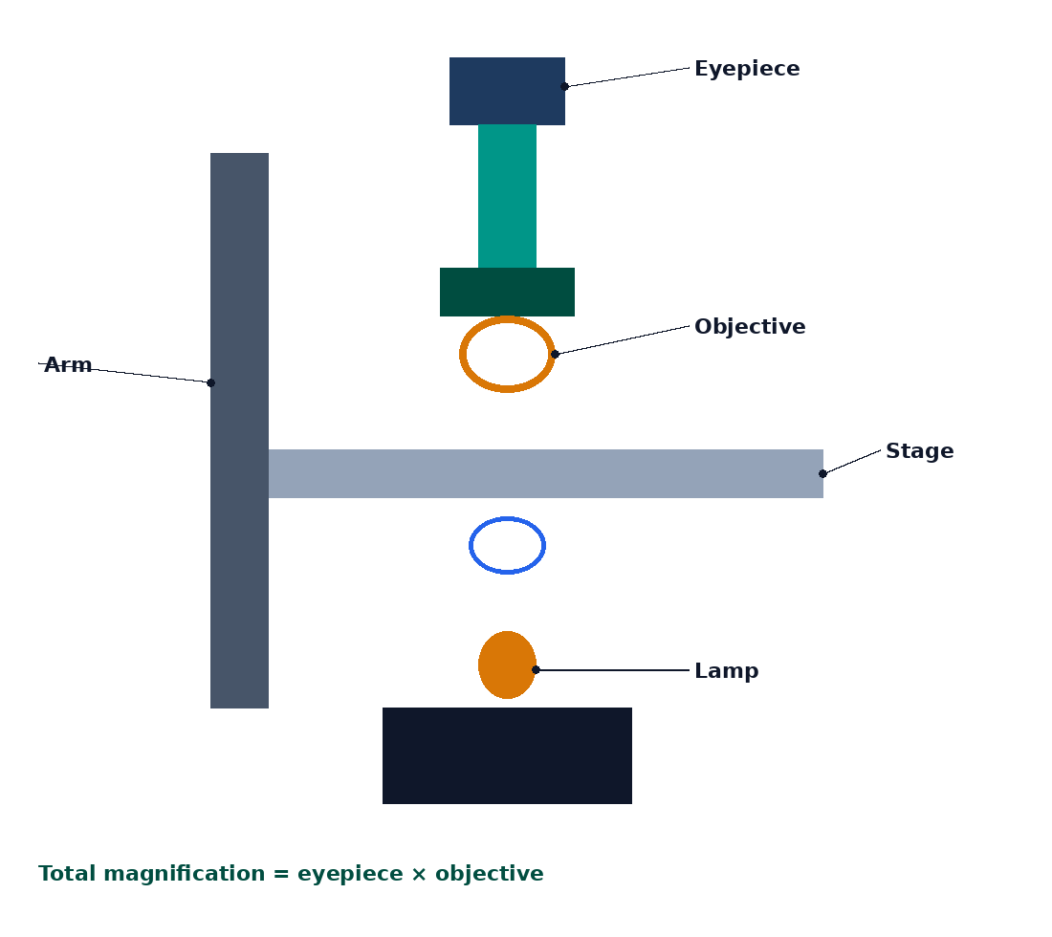

BTEC Level 3 · Applied Science · Unit 1 · Biology
BTEC Unit 1 Biology: Microscopy
Light and electron microscopes, magnification, resolution, unit conversions and instrument choice.
PowerPoint teaching resource
jdscience.co.uk
Microscopy
1 / 24

Slide 2
Learning objectives
By the end of this lesson you should be able to:
1
Describe how a light microscope forms an image and name its main parts.
2
Distinguish magnification from resolution.
3
Calculate magnification, actual size and image size using the standard triangle.
4
Compare light microscopes, TEM and SEM.
5
Choose an appropriate instrument for a stated observation.
jdscience.co.uk
Microscopy
2 / 24

Slide 3
LEVEL 3 DEPTH CHECK
Beyond GCSE recall
This lesson must progress past simple recall. Use these Level 3 moves in explanations and answers.
GCSE starting point
Unit 1 progression
Turn the magnification up
Resolution, not empty magnification, limits useful detail
µm and mm mixed
Convert first: 1 mm = 1000 µm = 1 000 000 nm
EM is always better
Vacuum — living specimens cannot be viewed
Colour EM photos
False colour is added after capture
jdscience.co.uk
Microscopy
3 / 24

Slide 4
DO NOW
Prior knowledge
1.
Which knob do you use first when focusing — coarse or fine? [1]
2.
Why is a stain often used on a slide? [1]
3.
A cell is 25 µm long and the image is 25 mm long. What is M? [2]
4.
Which can see viruses more clearly — a school light microscope or an EM? [1]
Think first — answers are on the next slide.
jdscience.co.uk
Microscopy
4 / 24

Slide 5
ANSWERS
Retrieval answers
1
Coarse focus first with the lowest-power objective, then fine focus.
2
To increase contrast so structures are visible.
3
25 mm = 25 000 µm. M = 25 000 / 25 = ×1000.
4
An electron microscope — viruses are usually below the resolution of a light microscope.
jdscience.co.uk
Microscopy
5 / 24

Slide 6
The light microscope
Rays, lenses and contrast
1 Look for
2 Say in full
3 Level 3 move
Lamp, stage, objective, eyepiece — total magnification = eyepiece × objective.
Magnification enlarges; resolution is the smallest separable distance.
Convert units first. Empty magnification does not add new detail.
jdscience.co.uk
Microscopy
6 / 24

Slide 7
Light microscope schematic
The lamp provides light that passes through the specimen.
The objective produces a magnified real image.
The eyepiece magnifies that image again.
Total magnification = eyepiece × objective.
Start on low power; never use the coarse wheel on high power.
jdscience.co.uk
Microscopy
7 / 24

Slide 8
Magnification versus resolution
Magnification
Resolution
• How many times larger the image is than the real object
• M = image size / actual size
• Can be increased with stronger lenses
• Empty magnification adds no new detail
• Smallest distance at which two points still look separate
• Limited by the wavelength of the radiation used
• Light microscopes: about 0.2 µm
• TEM: about 0.1 nm
jdscience.co.uk
Microscopy
8 / 24

Slide 9
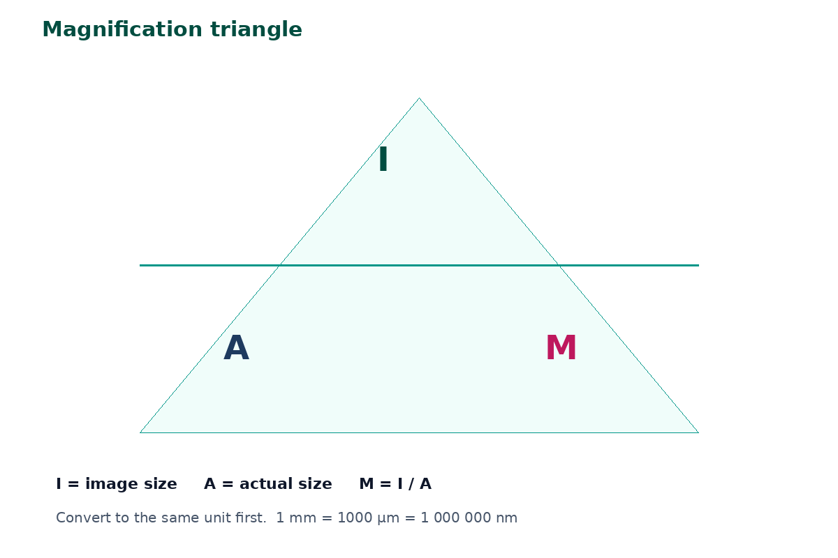
The calculation triangle
Write every quantity in the same unit before dividing.
1 mm = 1000 µm. 1 µm = 1000 nm.
Actual size = image size / magnification.
Show the conversion line — that is where marks are won.
jdscience.co.uk
Microscopy
9 / 24

Slide 10
WORKED EXAMPLE
Actual size of a mitochondrion
Question
A mitochondrion image is 40 mm long. Magnification is ×20 000. Find the actual size in µm.
Equation
Substitution
A = I / M
I = 40 mm = 40 000 µm M = 20 000
Working
Answer + unit
A = 40 000 / 20 000 = 2
2 µm
Check: mitochondria are typically 1–10 µm, so 2 µm is sensible.
jdscience.co.uk
Microscopy
10 / 24

Slide 11
WORKED EXAMPLE
Calculating magnification
Question
A bacterium is 2.0 µm long. The drawing is 80 mm long. Calculate M.
Equation
Substitution
M = I / A
I = 80 mm = 80 000 µm A = 2.0 µm
Working
Answer + unit
M = 80 000 / 2.0 = 40 000
×40 000
Write the ×. Include a scale bar on practical drawings.
jdscience.co.uk
Microscopy
11 / 24

Slide 12
Scaffold — your turn
Given
Find
• Image width = 15 mm
• M = ×400
• Actual size in µm
Equation
Substitution
Working
Answer + unit
Convert 15 mm to µm first.
jdscience.co.uk
Microscopy
12 / 24

Slide 13
CHECK YOUR UNDERSTANDING
Magnification practice
1
2 marks
2
2 marks
3
2 marks
Image = 15 mm, M = ×400. Find actual size in µm.
Actual = 8 µm, image = 4.0 cm. Find M.
A scale bar labelled 5 µm measures 25 mm on the page. What is M?
Write a full-sentence answer
Write a full-sentence answer
Write a full-sentence answer
Think first — answers are on the next slide.
jdscience.co.uk
Microscopy
13 / 24

Slide 14
ANSWERS
Calculation answers
1
2
3
15 mm = 15 000 µm. Actual = 15 000 / 400 = 37.5 µm.
4.0 cm = 40 000 µm. M = 40 000 / 8 = ×5000.
25 mm = 25 000 µm. M = 25 000 / 5 = ×5000.
jdscience.co.uk
Microscopy
14 / 24

Slide 15
Electron microscopy
Shorter wavelength, higher resolution
1 Look for
2 Say in full
3 Level 3 move
TEM for internal detail; SEM for surface; both need a vacuum.
Electrons have a shorter wavelength than light, so resolution is higher.
Living specimens cannot be viewed. Colour on EM images is usually added later.
jdscience.co.uk
Microscopy
15 / 24

Slide 16
TEM and SEM
TEM
SEM
• Electrons pass through a thin specimen
• High internal detail (cristae, thylakoids)
• Requires a vacuum
• Living specimens cannot be used
• Electrons scan the surface
• Good 3D surface appearance
• Also requires a vacuum
• Colour in published images is usually added later
jdscience.co.uk
Microscopy
16 / 24

Slide 17
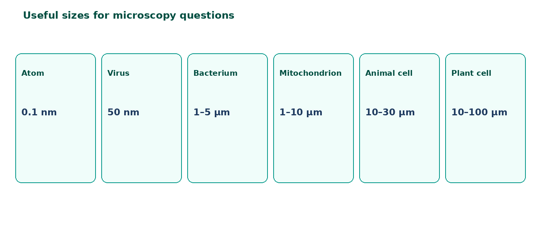
Useful sizes
A plant cell is tens of µm.
A bacterium is a few µm.
A virus is tens of nm.
If two granules are closer than the resolution, extra magnification only enlarges the blur.
jdscience.co.uk
Microscopy
17 / 24

Slide 18
Choosing an instrument
Need to see…
Prefer
Why
Living pond microbes swimming
Light
No vacuum; colour; movement
Cristae inside a mitochondrion
TEM
High internal resolution
Surface of a pollen grain
SEM
Surface topography
Nucleus of an onion cell in class
Light
Large enough; simple prep
jdscience.co.uk
Microscopy
18 / 24

Slide 19
Eyepiece graticule — the idea
What it is
Not fixed
A ruler you see superimposed on the specimen.
The micrometre value of a division changes with the objective.
Calibrate
Then measure
Use a stage micrometer of known length.
Actual size = divisions × µm per division.
jdscience.co.uk
Microscopy
19 / 24

Slide 20
Common misconceptions
Not quite
Instead
Higher magnification always means a clearer image.
Resolution decides useful detail.
Not quite
Instead
Electron microscopes are used in school practicals on living cells.
They need a vacuum; living cells are not used.
Not quite
Instead
µm and nm can be mixed without converting.
Convert to one unit first.
jdscience.co.uk
Microscopy
20 / 24

Slide 21
EXAM-STYLE PRACTICE
Exam-style practice
1
2 marks
2
4 marks
3
2 marks
Calculate the actual width of a cell if the image is 42 mm wide at ×700. Give the answer in µm.
Compare the resolution of a light microscope with that of a TEM and explain the difference.
Give two reasons a scientist might still choose a light microscope rather than an electron microscope.
Write a full-sentence answer
Write a full-sentence answer
Write a full-sentence answer
Think first — answers are on the next slide.
jdscience.co.uk
Microscopy
21 / 24

Slide 22
ANSWERS
Exam-style answers
1
2
3
42 mm = 42 000 µm. Actual = 42 000 / 700 = 60 µm.
Light about 0.2 µm; TEM much smaller (about 0.1 nm) because electrons have a shorter wavelength.
Living specimens / cheaper / colour / easier preparation. (Any two.)
jdscience.co.uk
Microscopy
22 / 24

Slide 23
Plenary
30–60 seconds each. No notes if you can avoid them.
1
2
3
State the magnification formula.
Define resolution in one sentence.
Name one structure you would need an electron microscope to study clearly.
jdscience.co.uk
Microscopy
23 / 24

Slide 24
Independent practice
1
Complete the Microscopy worksheet, including the calculation page.
2
Practise unit conversions until they are automatic.
3
Optional: calibrate an eyepiece graticule if your centre has the slides.
jdscience.co.uk
Microscopy
24 / 24

