Slide 1
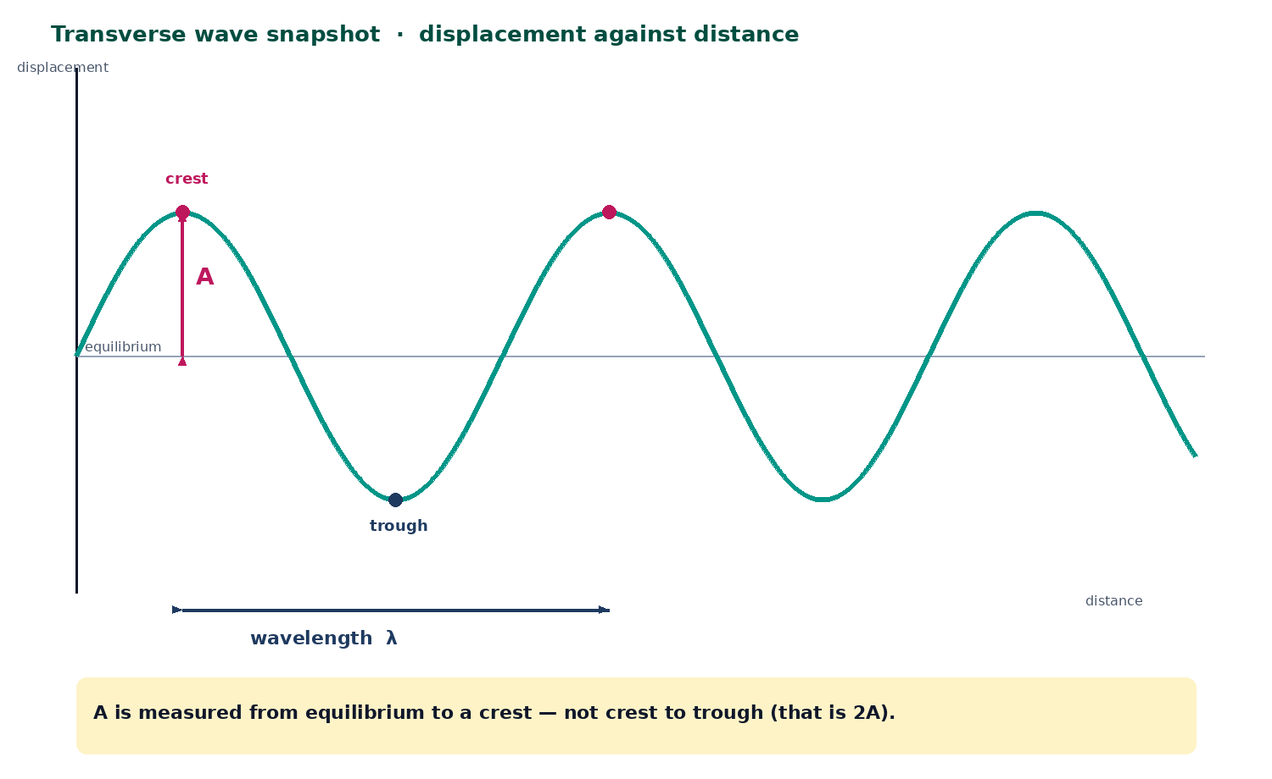

BTEC Level 3 · Applied Science · Unit 1 · Physics
BTEC Unit 1 Physics: Progressive Waves
Displacement, amplitude, wavelength, frequency, period, phase and v = fλ with standard form.
PowerPoint teaching resource
jdscience.co.uk
Progressive waves
1 / 27

Slide 2
Learning objectives
By the end of this lesson you should be able to:
1
Describe a progressive wave as a transfer of energy without a net transfer of matter.
2
Define amplitude, wavelength, frequency, period and wave speed with SI units.
3
Use v = fλ and T = 1/f, including standard-form conversions.
4
Read A and λ from a displacement–distance snapshot and T from a time trace.
5
Explain what stays the same, and what changes, when a wave enters a new medium.
jdscience.co.uk
Progressive waves
2 / 27

Slide 3
LEVEL 3 DEPTH CHECK
Beyond GCSE recall
This lesson must progress past simple recall. Use these Level 3 moves in explanations and answers.
GCSE starting point
Unit 1 progression
Waves move stuff along
Energy transfers; particles oscillate about equilibrium
Amplitude is crest to trough
A is measured from the equilibrium line; crest-to-trough is 2A
v = fλ as a slogan
Derive it: f oscillations each of length λ in one second
Frequency changes in glass
Frequency is fixed by the source; v and λ change
jdscience.co.uk
Progressive waves
3 / 27

Slide 4
DO NOW
Prior knowledge
1.
What does a wave transfer from one place to another? [1]
2.
Give one wave that needs a medium and one that does not. [2]
3.
If 20 crests pass a point in 5.0 s, what is the frequency? [2]
4.
What are the SI units of frequency and of wavelength? [1]
Think first — answers are on the next slide.
jdscience.co.uk
Progressive waves
4 / 27

Slide 5
ANSWERS
Retrieval answers
1
Energy (and information).
2
Needs a medium: sound or water. Does not: electromagnetic waves / light.
3
f = 20 / 5.0 = 4.0 Hz.
4
Frequency: hertz (Hz). Wavelength: metre (m).
jdscience.co.uk
Progressive waves
5 / 27

Slide 6
What a progressive wave is
Energy on the move
1 Look for
2 Say in full
3 Level 3 move
A snapshot with A and λ labelled from the equilibrium line.
A progressive wave transfers energy; particles oscillate about equilibrium.
Crest-to-trough is 2A. Frequency is set by the source, not the medium.
jdscience.co.uk
Progressive waves
6 / 27

Slide 7
A working definition
Transfer
Particles
A progressive wave transfers energy from a source through oscillations of particles or fields.
Oscillations are about an equilibrium position — no net transfer of matter.
Snapshot
Trace
Displacement against distance at one instant gives A and λ.
Displacement against time at one place gives A and T, then f = 1/T.
jdscience.co.uk
Progressive waves
7 / 27

Slide 8
Reading a wave snapshot
Amplitude A is the maximum displacement from equilibrium.
Wavelength λ is the shortest distance between two points in phase.
Neighbouring crests (or troughs) are one wavelength apart.
The equilibrium line is not a trough.
Crest-to-trough height is 2A.
Original displacement–distance sketch.
jdscience.co.uk
Progressive waves
8 / 27

Slide 9
Wave quantities
Quantity
Symbol
SI unit
Meaning
Displacement
s or x
m
Distance from equilibrium at that instant
Amplitude
A
m
Maximum displacement
Wavelength
λ
m
Shortest distance between points in phase
Frequency
f
Hz
Oscillations per second
Period
T
s
Time for one complete oscillation
Wave speed
v
m s⁻¹
Distance the wave profile travels per second
Write the unit of v as m s⁻¹, not just m.
jdscience.co.uk
Progressive waves
9 / 27

Slide 10
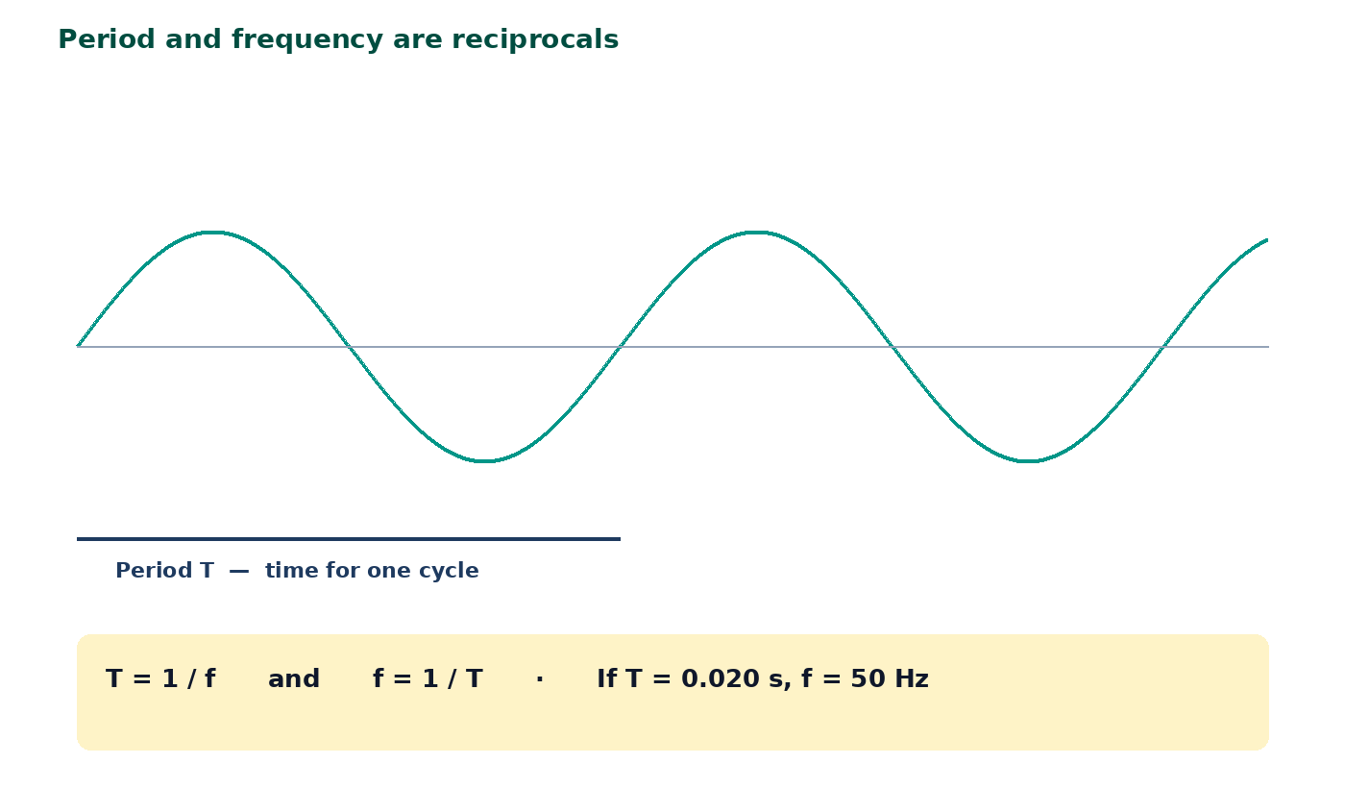
Frequency and period
T = 1 / f and f = 1 / T.
If T = 0.020 s, f = 50 Hz.
If f = 2.5 kHz, convert to 2500 Hz first: T = 4.0 × 10⁻⁴ s.
Frequency is set by the source, not by the medium.
jdscience.co.uk
Progressive waves
10 / 27

Slide 11
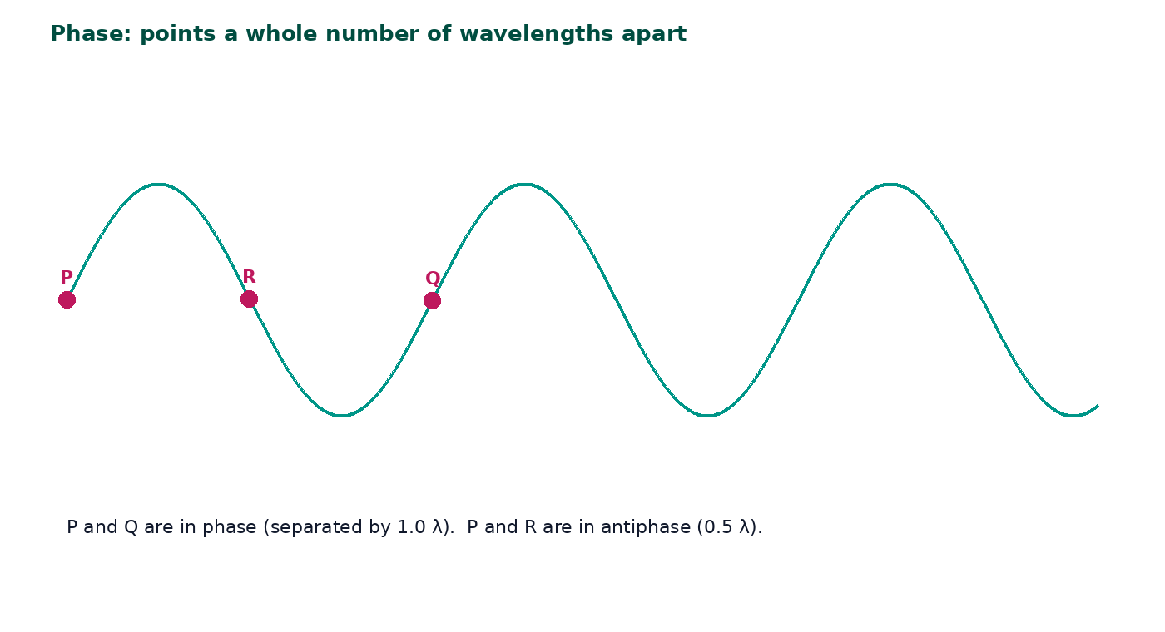
Phase on a snapshot
Points a whole number of wavelengths apart are in phase.
Points 0.5 λ apart are in antiphase.
You cannot read λ from a time graph or T from a distance graph.
Both graphs can look like sine waves — label the axis first.
jdscience.co.uk
Progressive waves
11 / 27

Slide 12
The wave equation
v = fλ
1 Look for
2 Say in full
3 Level 3 move
v = fλ and T = 1/f, with units m s⁻¹, Hz and m.
In one second the source makes f oscillations, each of length λ, so v = fλ.
Convert MHz, nm and standard form before substituting.
jdscience.co.uk
Progressive waves
12 / 27

Slide 13
Why the equation works
1
2
3
4
5
In 1 s
Each one
So
That is v
Rearrange
The source produces f oscillations.
Occupies a length λ.
The profile advances f × λ metres in one second.
v = fλ
f = v / λ λ = v / f
→
→
→
→
jdscience.co.uk
Progressive waves
13 / 27

Slide 14
WORKED EXAMPLE
Sound — tuning fork
Question
A tuning fork of frequency 512 Hz produces sound of wavelength 0.65 m in air. Calculate v.
Equation
Substitution
v = fλ
v = 512 Hz × 0.65 m
Working
Answer + unit
v = 332.8
333 m s⁻¹ (3 s.f.)
This is a sensible speed of sound in air. If the same frequency entered water, v and λ would both increase.
jdscience.co.uk
Progressive waves
14 / 27

Slide 15
WORKED EXAMPLE
Radio wave — standard form
Question
A radio station broadcasts at 100 MHz. Take c = 3.00 × 10⁸ m s⁻¹. Calculate λ.
Equation
Substitution
λ = v / f
f = 100 MHz = 1.00 × 10⁸ Hz v = 3.00 × 10⁸ m s⁻¹
Working
Answer + unit
λ = (3.00 × 10⁸) / (1.00 × 10⁸) = 3.00
3.00 m
Write the powers of ten on a separate line. Electromagnetic waves in air travel at approximately c.
jdscience.co.uk
Progressive waves
15 / 27

Slide 16
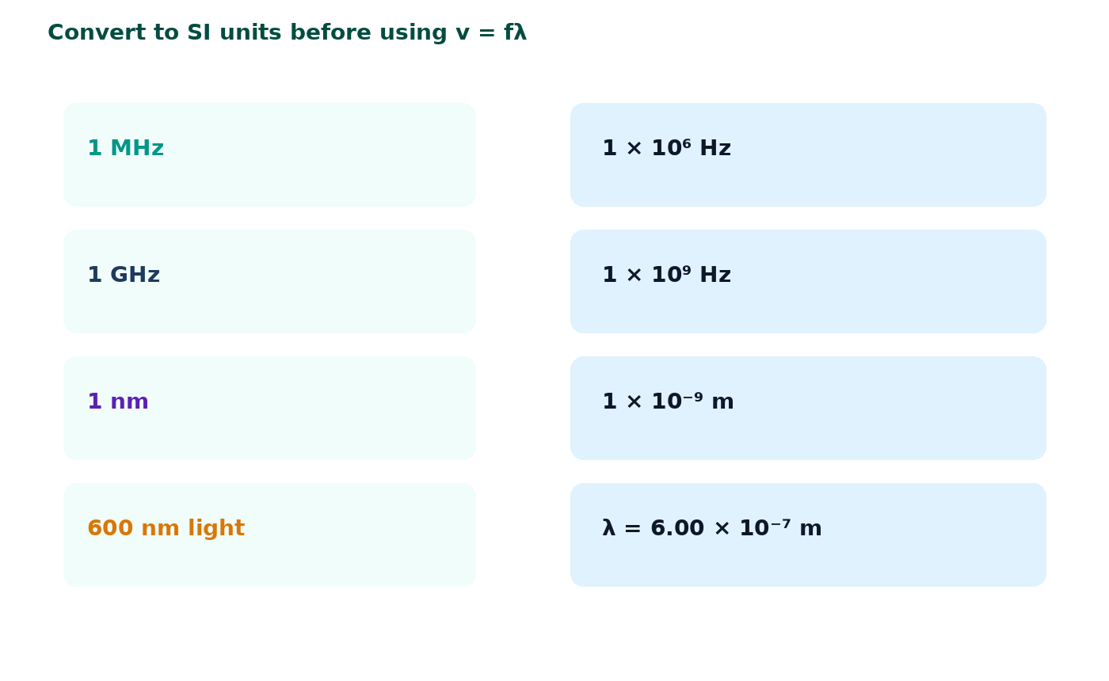
Standard form you must convert
1 MHz = 1 × 10⁶ Hz. 1 GHz = 1 × 10⁹ Hz.
1 nm = 1 × 10⁻⁹ m.
Always convert to Hz and m before using v = fλ.
Worked check: 600 nm light. f = (3.00 × 10⁸) / (6.00 × 10⁻⁷) = 5.00 × 10¹⁴ Hz.
jdscience.co.uk
Progressive waves
16 / 27

Slide 17
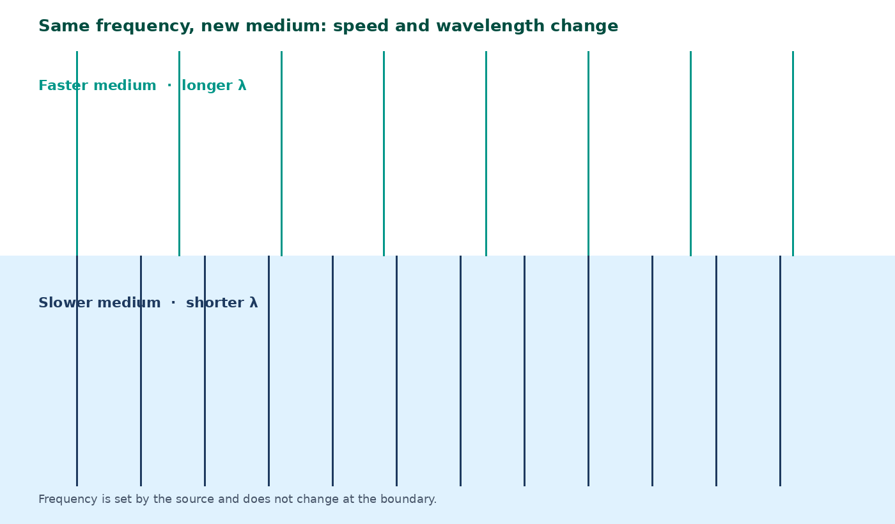
Changing medium — wavefronts
Frequency stays the same at the boundary.
If speed falls, wavelength shortens — the wavefronts crowd together.
If speed rises, wavelength increases.
This is the same logic as light slowing in glass.
jdscience.co.uk
Progressive waves
17 / 27

Slide 18
WORKED EXAMPLE
Water waves entering shallows
Question
Frequency is 2.0 Hz in both regions. Deep-water speed 0.80 m s⁻¹; shallow-water speed 0.50 m s⁻¹. Find both wavelengths.
Equation
Substitution
λ = v / f
f = 2.0 Hz in both regions
Working
Answer + unit
λ_{d}eep = 0.80 / 2.0 = 0.40 m λ_{s}hallow = 0.50 / 2.0 = 0.25 m
0.40 m and 0.25 m
The waves crowd together because speed fell while frequency stayed the same.
jdscience.co.uk
Progressive waves
18 / 27

Slide 19
Calculation scaffold
Given
Find
• 25 cm wavelength
• 4.0 kHz frequency
• v in m s⁻¹
Equation
Substitution
Working
Answer + unit
Convert first: λ = 0.25 m, f = 4000 Hz.
jdscience.co.uk
Progressive waves
19 / 27

Slide 20
CHECK YOUR UNDERSTANDING
Wave-equation practice
1
2 marks
2
3 marks
3
3 marks
Water waves have f = 2.5 Hz and λ = 1.2 m. Find v.
A microwave oven uses f = 2.45 GHz. Taking c = 3.00 × 10⁸ m s⁻¹, find λ.
A wave travels 90 m in 0.30 s. If λ = 1.5 m, find f.
Write a full-sentence answer
Write a full-sentence answer
Write a full-sentence answer
Think first — answers are on the next slide.
jdscience.co.uk
Progressive waves
20 / 27

Slide 21
ANSWERS
Calculation answers
1
2
3
v = 2.5 × 1.2 = 3.0 m s⁻¹.
f = 2.45 × 10⁹ Hz. λ = (3.00 × 10⁸) / (2.45 × 10⁹) = 0.122 m (12.2 cm).
v = 90 / 0.30 = 300 m s⁻¹. f = 300 / 1.5 = 200 Hz.
jdscience.co.uk
Progressive waves
21 / 27

Slide 22
STUDENT ACTIVITY
Graph reading
10 minutes
1
From a displacement–distance graph: measure A and λ (use the scale).
2
From a displacement–time graph of the same wave: measure T and calculate f.
3
Combine f and λ to find v.
4
State which quantity you must not read as amplitude (a random displacement).
jdscience.co.uk
Progressive waves
22 / 27

Slide 23
Common misconceptions
Not quite
Instead
Amplitude is the crest-to-trough height.
That distance is 2A. Amplitude is measured from the equilibrium line.
Not quite
Instead
Wave speed is how fast a particle travels along the wave.
v is the speed of the wave profile / energy transfer.
Not quite
Instead
Frequency changes when a wave enters glass.
Frequency is fixed by the source.
jdscience.co.uk
Progressive waves
23 / 27

Slide 24
EXAM-STYLE PRACTICE
Exam-style practice
1
2 marks
2
2 marks
3
3 marks
Define amplitude and wavelength.
A loudspeaker produces a note of frequency 680 Hz. The speed of sound is 340 m s⁻¹. Calculate the wavelength.
Explain why particles of air do not travel from a singer to a listener even though a sound wave does.
Write a full-sentence answer
Write a full-sentence answer
Write a full-sentence answer
Think first — answers are on the next slide.
jdscience.co.uk
Progressive waves
24 / 27

Slide 25
ANSWERS
Exam-style answers
1
2
3
Amplitude: maximum displacement from equilibrium. Wavelength: shortest distance between two points oscillating in phase.
λ = v / f = 340 / 680 = 0.50 m.
Air particles oscillate about fixed average positions. Energy is passed from particle to particle. There is no net movement of air.
jdscience.co.uk
Progressive waves
25 / 27

Slide 26
Plenary
30–60 seconds each. No notes if you can avoid them.
1
2
3
Write v = fλ and annotate each symbol with a unit.
Sketch one wavelength and mark A and λ.
State what stays the same when a wave crosses into a new medium.
jdscience.co.uk
Progressive waves
26 / 27

Slide 27
Independent practice
1
Complete the Progressive Waves worksheet, including the calculation pages.
2
Practise 1/f and unit conversions (kHz, MHz, GHz, nm, mm).
3
Next lesson: transverse and longitudinal behaviour, phase and superposition.
jdscience.co.uk
Progressive waves
27 / 27

