Slide 1
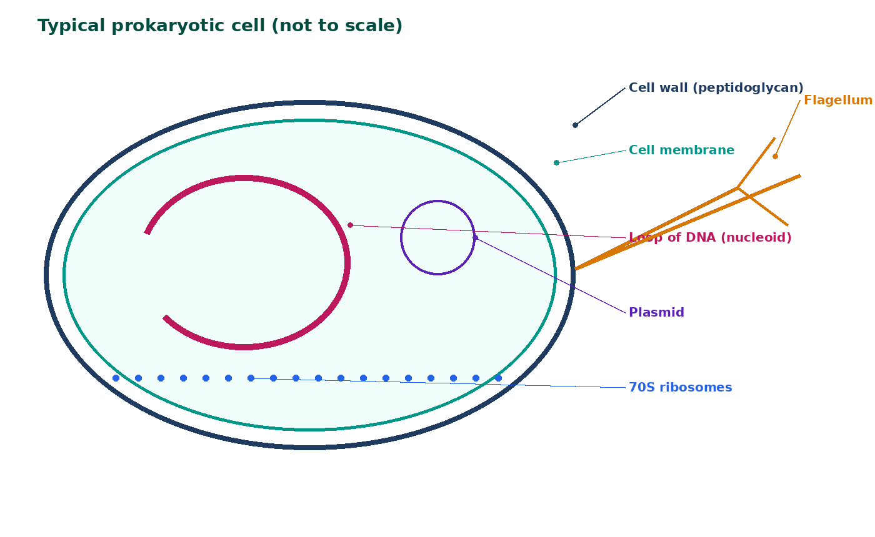

BTEC Level 3 · Applied Science · Unit 1 · Biology
BTEC Unit 1 Biology: Prokaryotic and Eukaryotic Cells
Ultrastructure, DNA organisation, ribosome type, plasmids and why the comparison matters medically.
PowerPoint teaching resource
jdscience.co.uk
Prokaryotic and eukaryotic cells
1 / 21

Slide 2
Learning objectives
By the end of this lesson you should be able to:
1
State the defining features of prokaryotic and eukaryotic cells.
2
Label a bacterial cell, including wall, DNA loop, plasmid, 70S ribosomes and flagellum where present.
3
Compare size, organelles and DNA organisation of the two cell types.
4
Explain antibiotic selectivity and plasmid transfer of resistance.
5
Use paired comparison sentences in extended-response items.
jdscience.co.uk
Prokaryotic and eukaryotic cells
2 / 21

Slide 3
LEVEL 3 DEPTH CHECK
Beyond GCSE recall
This lesson must progress past simple recall. Use these Level 3 moves in explanations and answers.
GCSE starting point
Unit 1 progression
Bacteria have no nucleus
Name nucleoid, circular DNA, plasmids, 70S ribosomes
Bacteria are simple
Name the missing envelope and membrane-bound organelles
Antibiotics kill germs
Targets: peptidoglycan wall or 70S ribosomes, absent in human cells
All bacteria are harmful
Useful roles plus resistance via plasmids
jdscience.co.uk
Prokaryotic and eukaryotic cells
3 / 21

Slide 4
DO NOW
Prior knowledge
1.
Which organelle contains chromosomal DNA in an animal cell? [1]
2.
Do bacteria have a nucleus? [1]
3.
Name one useful and one harmful activity of bacteria. [2]
4.
Which is usually larger, a bacterial cell or an animal cell? [1]
Think first — answers are on the next slide.
jdscience.co.uk
Prokaryotic and eukaryotic cells
4 / 21

Slide 5
ANSWERS
Retrieval answers
1
The nucleus.
2
No — their DNA is not enclosed by a nuclear envelope.
3
Useful: yoghurt / insulin / decomposition. Harmful: infection / food spoilage.
4
An animal cell is typically larger (about 10–30 µm versus about 1–5 µm).
jdscience.co.uk
Prokaryotic and eukaryotic cells
5 / 21

Slide 6
Two fundamental cell types
The nucleus is the key divide
1 Look for
2 Say in full
3 Level 3 move
A nucleus with an envelope versus a DNA loop in the cytoplasm.
Eukaryotes have a nucleus and membrane-bound organelles; prokaryotes do not.
Pair every difference: 70S versus 80S, peptidoglycan versus cellulose, size.
jdscience.co.uk
Prokaryotic and eukaryotic cells
6 / 21

Slide 7
Definitions that earn marks
Eukaryotic
Prokaryotic
Nucleus bounded by a nuclear envelope and membrane-bound organelles.
No nucleus and no membrane-bound organelles.
Who is who
Viruses
Animals, plants, fungi and protoctists are eukaryotic. Bacteria and archaea are prokaryotic.
Acellular — not prokaryotic or eukaryotic.
jdscience.co.uk
Prokaryotic and eukaryotic cells
7 / 21

Slide 8
Bacterial cell schematic
Cell wall (peptidoglycan in many bacteria) gives shape and protection.
The membrane still controls exchange.
DNA is a circular loop in the cytoplasm (nucleoid) — not a nucleus.
Plasmids are small extra DNA circles and may carry resistance genes.
Ribosomes are 70S. Some species have a flagellum or capsule.
Say ‘some bacteria’ for capsule and flagellum.
jdscience.co.uk
Prokaryotic and eukaryotic cells
8 / 21

Slide 9
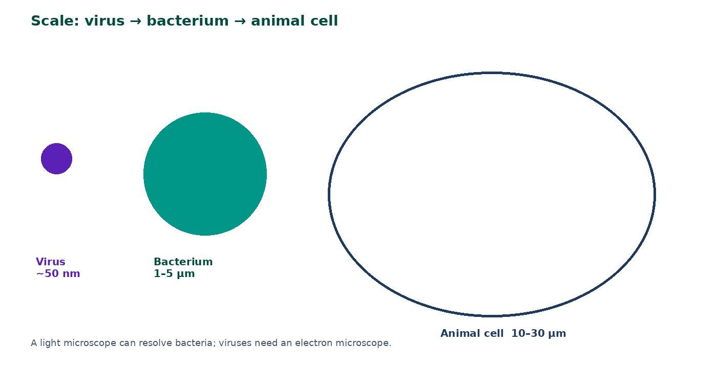
Scale comparison
Bacteria are typically 1–5 µm.
Animal cells are often 10–30 µm.
A small cell has a large surface-area-to-volume ratio, so diffusion can supply it.
Viruses are much smaller still and are not cells.
jdscience.co.uk
Prokaryotic and eukaryotic cells
9 / 21

Slide 10
Prokaryote versus eukaryote
Feature
Prokaryote
Eukaryote
Nucleus
Absent
Present
DNA
Circular loop; plasmids possible
Linear chromosomes in a nucleus
Membrane-bound organelles
Absent
Present
Ribosomes
70S
80S (70S in mitochondria/chloroplasts)
Typical size
1–5 µm
10–100 µm
Cell wall
Peptidoglycan (many bacteria)
Cellulose / chitin / none
Each exam row must contrast the same feature.
jdscience.co.uk
Prokaryotic and eukaryotic cells
10 / 21

Slide 11
DNA organisation
Prokaryotic DNA
Eukaryotic DNA
• Usually one circular chromosome
• Lies free in the cytoplasm (nucleoid)
• May include plasmids that replicate independently
• Not packaged as eukaryotic chromatin with histones in the same way
• Several linear chromosomes
• Associated with histone proteins
• Enclosed by a nuclear envelope
• Mitochondria and chloroplasts also contain circular DNA
jdscience.co.uk
Prokaryotic and eukaryotic cells
11 / 21

Slide 12
Why the comparison matters medically
Wall target
Ribosome target
Some antibiotics block peptidoglycan synthesis.
Some antibiotics bind 70S ribosomes, not 80S.
Selectivity
Resistance
Those targets are absent or different in human cells.
Plasmids can transfer resistance genes by conjugation.
jdscience.co.uk
Prokaryotic and eukaryotic cells
12 / 21

Slide 13
Useful versus harmful bacteria
Useful
Harmful
• Decomposers in nutrient cycles
• Yoghurt and cheese production
• Recombinant insulin and other products
• Gut bacteria that aid digestion
• Pathogens causing infection
• Food spoilage
• Toxin production
• Antibiotic-resistant strains in hospitals
jdscience.co.uk
Prokaryotic and eukaryotic cells
13 / 21

Slide 14
Fungi — a eukaryotic contrast
Nucleus
Wall
Fungi are eukaryotic, so they have nuclei.
Their walls are typically chitin, not cellulose or peptidoglycan.
Form
Point
Yeast is unicellular; mushrooms are multicellular.
Do not dump all walled cells into one group. Viruses remain outside the comparison.
jdscience.co.uk
Prokaryotic and eukaryotic cells
14 / 21

Slide 15
Endosymbiotic hint (Level 3 stretch)
Observation
Idea
Mitochondria and chloroplasts have circular DNA and 70S ribosomes.
These features resemble free-living bacteria.
Theory
Use
The organelles may have originated from engulfed prokaryotes.
A stretch explanation — do not treat it as the whole lesson.
jdscience.co.uk
Prokaryotic and eukaryotic cells
15 / 21

Slide 16
STUDENT ACTIVITY
Venn comparison
10 minutes
1
Draw a two-circle Venn diagram: prokaryote / both / eukaryote.
2
Place: ribosomes, nucleus, cell membrane, plasmids, mitochondria, DNA, cell wall (qualify the chemistry).
3
Write one sentence on a medical application of a difference you placed on one side only.
jdscience.co.uk
Prokaryotic and eukaryotic cells
16 / 21

Slide 17
Common misconceptions
Not quite
Instead
Bacteria have no DNA.
They have DNA; it is not inside a nucleus.
Not quite
Instead
Prokaryotes have no ribosomes.
They have 70S ribosomes.
Not quite
Instead
All bacteria cause disease.
Many are harmless or beneficial.
jdscience.co.uk
Prokaryotic and eukaryotic cells
17 / 21

Slide 18
EXAM-STYLE PRACTICE
Exam-style practice
1
3 marks
2
3 marks
3
2 marks
Give three differences between a bacterial cell and an animal cell.
Explain how a plasmid can be medically important.
A student writes that mitochondria prove a cell is prokaryotic. Explain the error.
Write a full-sentence answer
Write a full-sentence answer
Write a full-sentence answer
Think first — answers are on the next slide.
jdscience.co.uk
Prokaryotic and eukaryotic cells
18 / 21

Slide 19
ANSWERS
Exam-style answers
1
2
3
Bacterium: no nucleus / no mitochondria / peptidoglycan wall / circular DNA / 70S / smaller. Animal cell has the opposite of each stated point.
Plasmids can carry antibiotic-resistance genes, can be transferred, and are used as vectors in genetic engineering.
Mitochondria are membrane-bound organelles found in eukaryotes. Their presence shows the cell is eukaryotic.
jdscience.co.uk
Prokaryotic and eukaryotic cells
19 / 21

Slide 20
Plenary
30–60 seconds each. No notes if you can avoid them.
1
2
3
List four labels for a bacterial cell.
State the single best defining difference between the two cell types.
Give one reason viruses are not placed in either group.
jdscience.co.uk
Prokaryotic and eukaryotic cells
20 / 21

Slide 21
Independent practice
1
Complete the prokaryote/eukaryote worksheet.
2
Practise a six-mark comparison from memory using paired sentences.
3
Next lesson: seeing these cells — microscopy and magnification.
jdscience.co.uk
Prokaryotic and eukaryotic cells
21 / 21

