Slide 1
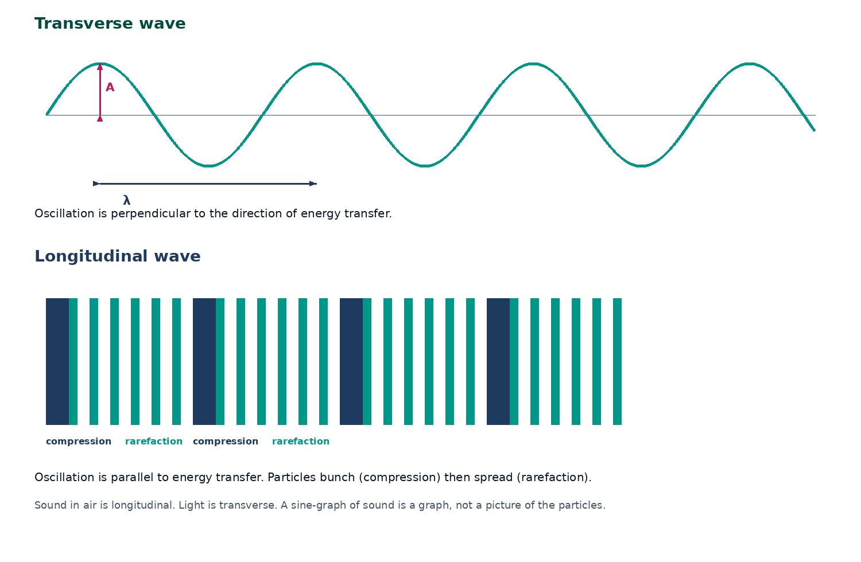

BTEC Level 3 · Applied Science · Unit 1 · Physics
BTEC Unit 1 Physics: Wave Properties
Transverse and longitudinal waves, phase, superposition, polarisation and everyday examples.
PowerPoint teaching resource
jdscience.co.uk
Wave properties
1 / 24

Slide 2
Learning objectives
By the end of this lesson you should be able to:
1
Distinguish transverse and longitudinal waves with examples and diagrams.
2
Describe compressions, rarefactions, crests and troughs.
3
Explain phase, antiphase and path difference.
4
State the principle of superposition and recognise constructive and destructive cases.
5
Use polarisation as evidence that light is transverse and sound is not.
jdscience.co.uk
Wave properties
2 / 24

Slide 3
LEVEL 3 DEPTH CHECK
Beyond GCSE recall
This lesson must progress past simple recall. Use these Level 3 moves in explanations and answers.
GCSE starting point
Unit 1 progression
Sound is a sine wave so it is transverse
The sine curve is a graph; the oscillation is still parallel to travel
Waves destroy each other
Superposition is local; each wave continues
All waves need air
Electromagnetic waves do not need a medium
Polarising sunglasses are a trick
They filter a transverse oscillation plane
jdscience.co.uk
Wave properties
3 / 24

Slide 4
DO NOW
Prior knowledge
1.
Is light transverse or longitudinal? [1]
2.
Is sound in air transverse or longitudinal? [1]
3.
What is transferred by a wave? [1]
4.
Name one piece of evidence that light is a wave. [2]
Think first — answers are on the next slide.
jdscience.co.uk
Wave properties
4 / 24

Slide 5
ANSWERS
Retrieval answers
1
Transverse — oscillations of the electric and magnetic fields are perpendicular to travel.
2
Longitudinal — air particles oscillate parallel to the direction of energy transfer.
3
Energy.
4
Interference / diffraction / polarisation of light.
jdscience.co.uk
Wave properties
5 / 24

Slide 6
Two families of wave
Direction of oscillation
1 Look for
2 Say in full
3 Level 3 move
A transverse snapshot and a compression–rarefaction sketch.
Transverse: oscillation is perpendicular. Longitudinal: it is parallel.
Sound in air cannot be polarised because it is longitudinal.
jdscience.co.uk
Wave properties
6 / 24

Slide 7
Transverse and longitudinal
Transverse: oscillation perpendicular to energy transfer.
Examples: water surface waves, waves on a string, all electromagnetic waves.
Longitudinal: oscillation parallel to energy transfer.
Examples: sound in air, P-waves, compression waves on a slinky.
jdscience.co.uk
Wave properties
7 / 24

Slide 8
Language for each type
Transverse words
Longitudinal words
• Crest — maximum positive displacement
• Trough — maximum negative displacement
• Amplitude — height from equilibrium
• Can be polarised
• Compression — region of higher pressure / closer particles
• Rarefaction — region of lower pressure / more spaced particles
• Wavelength — compression to next compression
• Cannot be polarised
jdscience.co.uk
Wave properties
8 / 24

Slide 9
Electromagnetic waves are transverse
Medium
Speed
They do not need a medium.
They travel at 3.00 × 10⁸ m s⁻¹ in vacuum.
Spectrum
Evidence
From radio waves to gamma rays.
Polarising filters work because the oscillations have a direction. Sound cannot be polarised.
jdscience.co.uk
Wave properties
9 / 24

Slide 10
Phase and superposition
How waves combine
1 Look for
2 Say in full
3 Level 3 move
Points separated by nλ (in phase) or 0.5 λ (antiphase).
The resultant displacement is the sum of the individual displacements.
You cannot read λ from a time graph. Label the axis first.
jdscience.co.uk
Wave properties
10 / 24

Slide 11
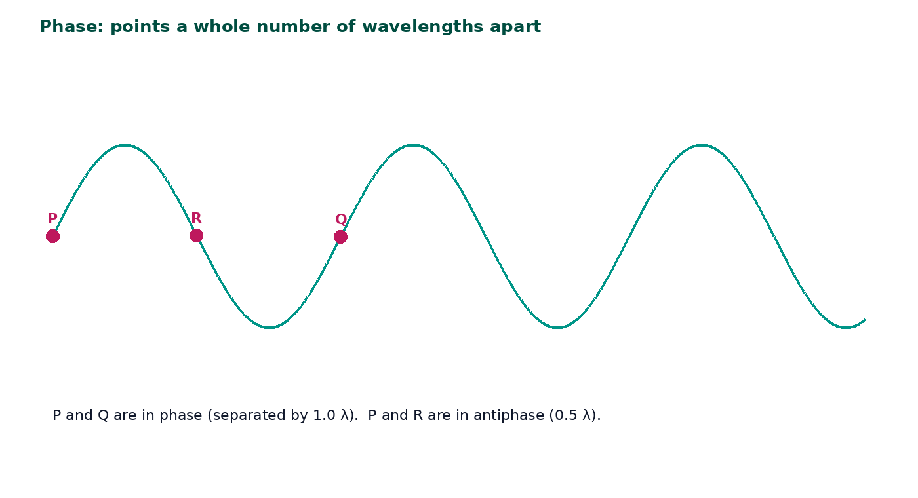
Phase
Two points are in phase if they reach maxima and minima together.
Points separated by a whole number of wavelengths are in phase.
Points separated by an odd number of half-wavelengths are in antiphase.
Path difference is the extra distance one wave travels compared with another.
jdscience.co.uk
Wave properties
11 / 24

Slide 12
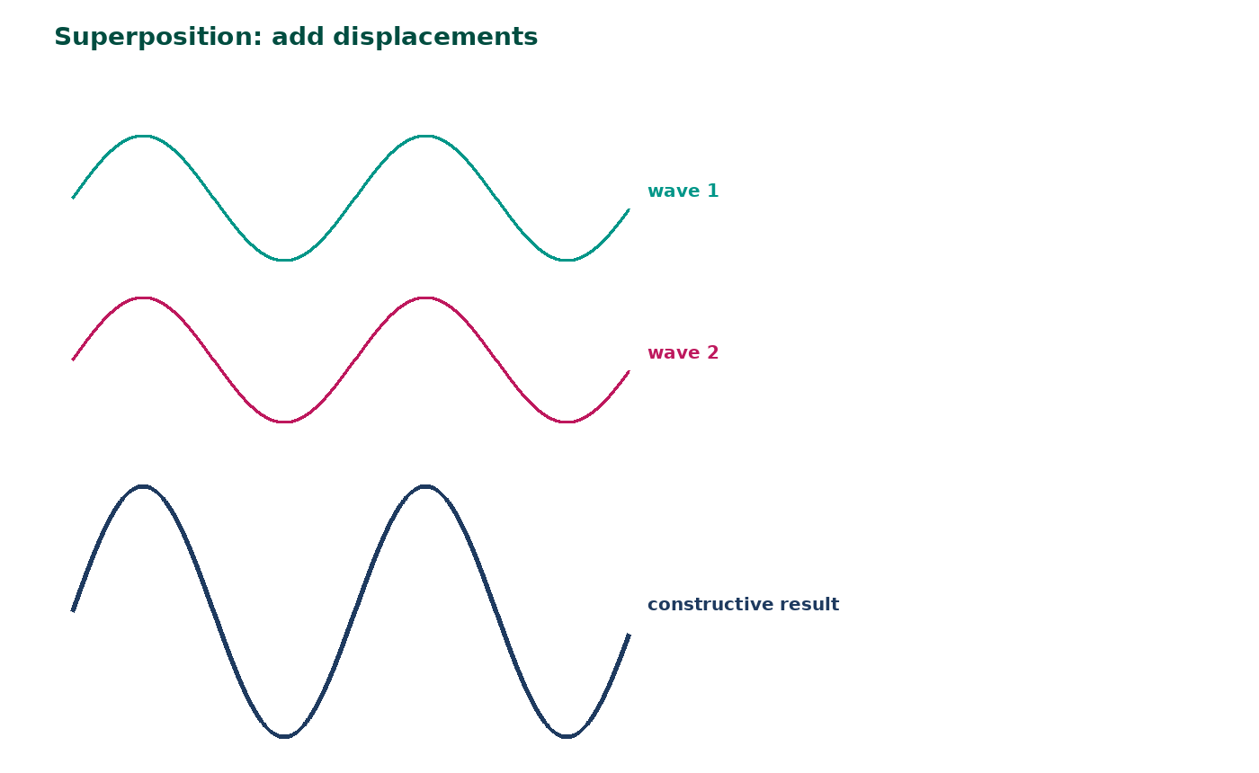
Principle of superposition
When two waves meet, the resultant displacement is the vector sum of the individual displacements.
The waves then continue as if they had not met.
Constructive: displacements in the same direction add.
Destructive: opposite displacements cancel.
This is the basis of interference and of later stationary-wave work.
jdscience.co.uk
Wave properties
12 / 24

Slide 13
WORKED EXAMPLE
Phase from a photograph
Question
Two crests are 3.0 cm apart on a ripple-tank photograph. The wavelength is 1.5 cm. Are they in phase?
Equation
Substitution
separation / λ
3.0 / 1.5 = 2.0
Working
Answer + unit
2.0 is a whole number of wavelengths
in phase
A crest and the neighbouring trough 0.75 cm apart: 0.75 / 1.5 = 0.5, so they are in antiphase.
jdscience.co.uk
Wave properties
13 / 24

Slide 14
Path difference preview
nλ
(n + ½)λ
Constructive interference — the waves arrive in phase.
Destructive interference — the waves arrive in antiphase.
Later
Word
You will use this in Young’s slits and diffraction-grating lessons.
Use displacement, not ‘the waves add energy and vanish’.
jdscience.co.uk
Wave properties
14 / 24

Slide 15
Everyday applications
Longitudinal
Transverse
• Speaking and hearing
• Ultrasound scans
• Sonar
• Earthquake P-waves
• Visible light and radio
• Microwaves in ovens and Wi-Fi
• Polarising sunglasses
• Waves on musical strings
jdscience.co.uk
Wave properties
15 / 24

Slide 16
Media and wave type
Wave
Type
Needs a medium?
Typical speed order
Sound in air
Longitudinal
Yes
10² m s⁻¹
Ripples on water
Transverse (surface)
Yes
10⁰ m s⁻¹
Light in vacuum
Transverse EM
No
3.00 × 10⁸ m s⁻¹
Waves on a string
Transverse
Yes (the string)
depends on tension
jdscience.co.uk
Wave properties
16 / 24

Slide 17
Earthquakes — why the distinction matters
P-waves
S-waves
• Longitudinal
• Travel through solids and liquids
• Faster
• Detected on the far side of the Earth
• Transverse
• Do not travel through the liquid outer core
• Slower
• Do travel through the solid mantle — do not say they ‘cannot travel through the Earth’
jdscience.co.uk
Wave properties
17 / 24

Slide 18
STUDENT ACTIVITY
Classify and justify
8 minutes
1
For each: ultrasound scan, microwave oven, stadium Mexican wave, earthquake P-wave, stadium sound system.
2
State transverse / longitudinal / model only, and name the oscillating particle or field.
3
Identify one that can be polarised and one that cannot.
jdscience.co.uk
Wave properties
18 / 24

Slide 19
ANSWERS
Classification checkpoints
1
Ultrasound: longitudinal pressure wave in tissue.
2
Microwave: transverse electromagnetic wave — can be polarised.
3
Mexican wave: a useful model of a transverse pulse, not a physics wave in a medium — treat carefully.
4
P-wave: longitudinal. Stadium sound: longitudinal. Sound cannot be polarised.
jdscience.co.uk
Wave properties
19 / 24

Slide 20
Common misconceptions
Not quite
Instead
Sound is a transverse wave because we draw it as a sine curve.
The sine curve is a graph of pressure or displacement; the oscillation is still parallel to travel.
Not quite
Instead
Waves that cancel are destroyed forever.
Each wave continues; cancellation is local and temporary.
Not quite
Instead
All waves need air.
Electromagnetic waves do not.
jdscience.co.uk
Wave properties
20 / 24

Slide 21
EXAM-STYLE PRACTICE
Exam-style practice
1
4 marks
2
2 marks
3
2 marks
Describe the difference between a transverse wave and a longitudinal wave. Give one example of each.
State the principle of superposition.
Explain why sound waves from a loudspeaker cannot be polarised.
Write a full-sentence answer
Write a full-sentence answer
Write a full-sentence answer
Think first — answers are on the next slide.
jdscience.co.uk
Wave properties
21 / 24

Slide 22
ANSWERS
Exam-style answers
1
2
3
Transverse: oscillation perpendicular to energy transfer, e.g. light or water waves. Longitudinal: oscillation parallel to energy transfer, e.g. sound in air.
When waves meet, the resultant displacement equals the sum of the individual displacements.
Polarisation requires a transverse oscillation with a direction that can be filtered. Sound is longitudinal, so there is no such direction to filter.
jdscience.co.uk
Wave properties
22 / 24

Slide 23
Plenary
30–60 seconds each. No notes if you can avoid them.
1
2
3
Act: model a longitudinal compression, then a transverse oscillation.
Write one sentence on superposition using the word displacement.
Name one wave that can be polarised and one that cannot.
jdscience.co.uk
Wave properties
23 / 24

Slide 24
Independent practice
1
Complete the Wave Properties worksheet.
2
Revise progressive-wave calculations so the two lessons connect.
3
Later Unit 1 lessons apply these ideas to diffraction, interference and refraction.
jdscience.co.uk
Wave properties
24 / 24

