Slide 1
JD SCIENCE · BIOLOGY
Unit 1 specialise cells
Specialised Cells
How cell structure is adapted to function — palisade mesophyll cells, root hair cells, sperm cells, egg cells, red blood cells and neutrophils. Full diagrams included.
jdscience.co.uk

Slide 2
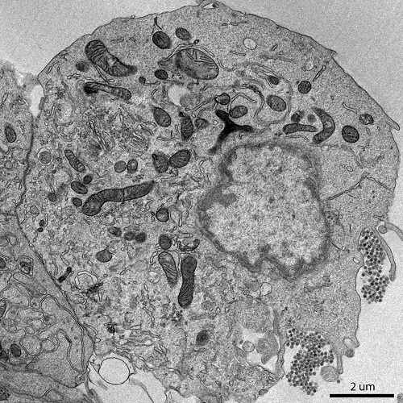
JD SCIENCE
Recap
Eukaryotic cell ultrastructure
Transmission electron micrograph of a eukaryotic cell. Scale bar: 2 μm. Note the nucleus, mitochondria with cristae, and endomembrane system.
jdscience.co.uk · Specialised Cells
2 / 29

Slide 3
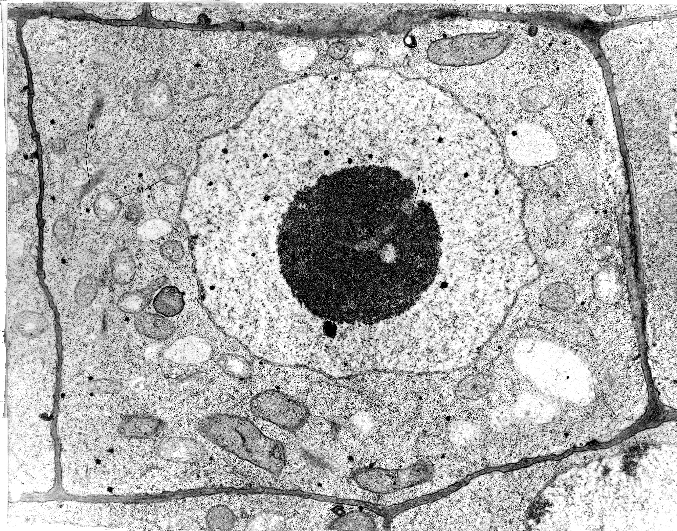
JD SCIENCE
Recap
Recap
Labels on the micrograph: N = nucleus · M = mitochondria
jdscience.co.uk · Specialised Cells
3 / 29

Slide 4
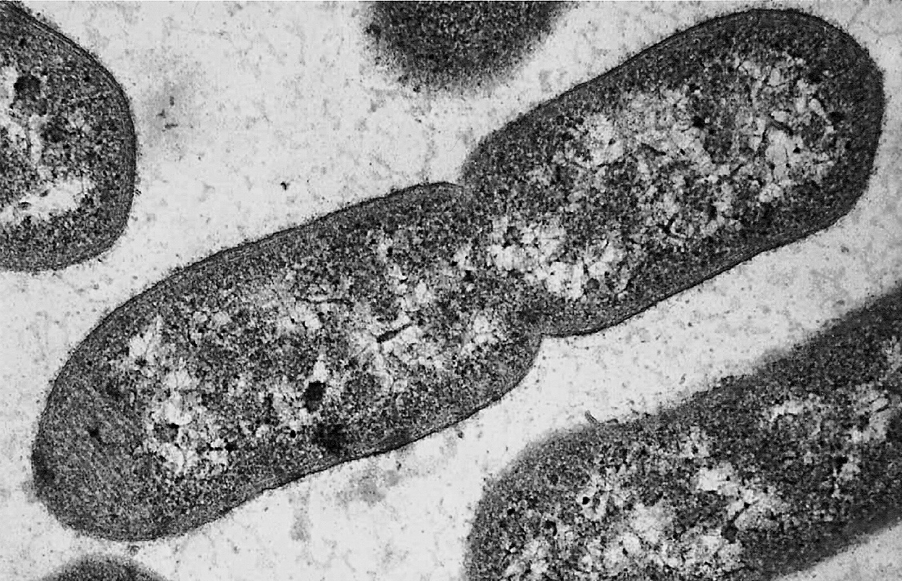
JD SCIENCE
Recap
Recap
Rod-shaped bacteria (prokaryotes). The central cell is undergoing binary fission. No membrane-bound organelles are present.
jdscience.co.uk · Specialised Cells
4 / 29

Slide 5
JD SCIENCE
Starter
What is a specialised cell?
What is a specialised cell?
Do you have any examples?
jdscience.co.uk · Specialised Cells
5 / 29

Slide 6
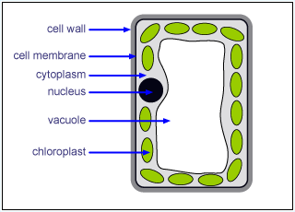
JD SCIENCE
Plant cell
Plant cell — labelled diagram
jdscience.co.uk · Specialised Cells
6 / 29

Slide 7
JD SCIENCE
Palisade mesophyll cell
Palisade Mesophyll Cell
• Palisade mesophyll cells found in leaves
• They are rectangular box-shaped cells that contain chloroplasts
• The chloroplasts can absorb a large amount of light for photosynthesis
jdscience.co.uk · Specialised Cells
7 / 29

Slide 8
JD SCIENCE
Palisade mesophyll cell
Palisade Mesophyll Cell
• They also move around in the cytoplasm to maximise amount of light absorbed
• The cells are closely packed to form a continuous layer in the leaf
• Palisade cells are surrounded by a plasma membrane and a cell wall made of cellulose
• This protects the cell and keeps it rigid
jdscience.co.uk · Specialised Cells
8 / 29

Slide 9
JD SCIENCE
Palisade mesophyll cell
Palisade Mesophyll Cell
• They also have a large vacuole to maintain turgor pressure
• This means the plasma membrane pushes against the cell wall of the plant to maintain its rigid structure
jdscience.co.uk · Specialised Cells
9 / 29

Slide 10
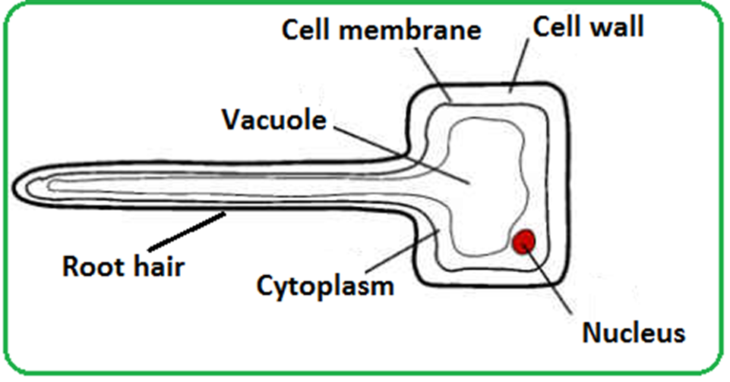
JD SCIENCE
Root hair cell
Root hair cell — labelled diagram
jdscience.co.uk · Specialised Cells
10 / 29

Slide 11
JD SCIENCE
Root hair cell
Root hair cell
• These are found at the plants roots, near the growing tip
• They have long hair-like extensions called root hairs
• The root hairs increase the surface area of the cell to maximise the movement of the water and minerals from the soil into the plant root
jdscience.co.uk · Specialised Cells
11 / 29

Slide 12
JD SCIENCE
Root hair cell
Root hair cell
• The cells have thin cellulose walls and a vacuole containing cell sap with a low water potential
• This encourages movement of water into the cell
jdscience.co.uk · Specialised Cells
12 / 29

Slide 13
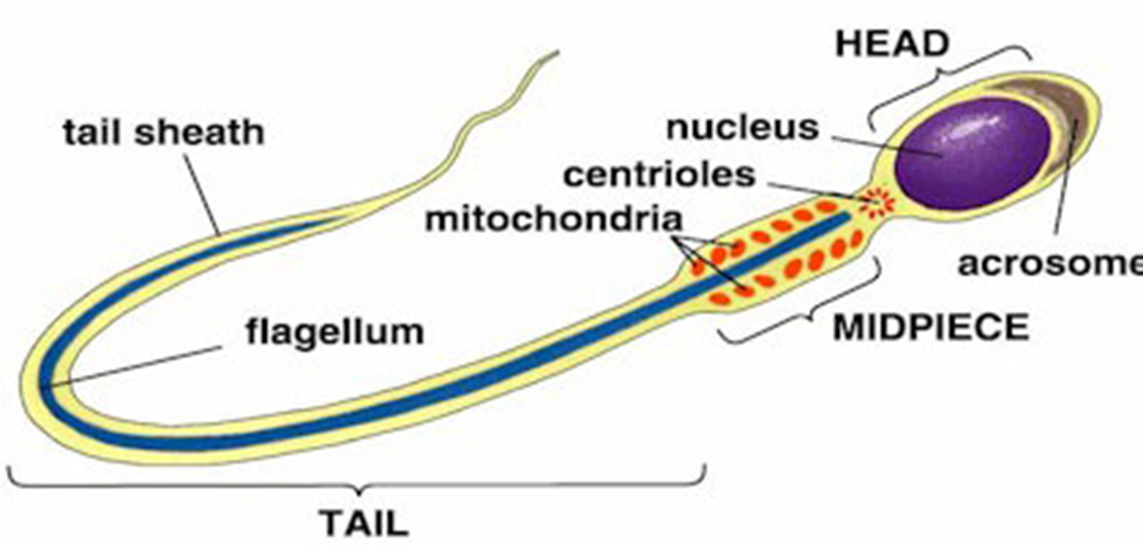
JD SCIENCE
Sperm cell
Sperm cell — labelled diagram
jdscience.co.uk · Specialised Cells
13 / 29

Slide 14
JD SCIENCE
Sperm cell
Sperm cell — key structures
Undulipodium
Plasma membrane
Acrosome
Tail-like structure used for movement
Outer boundary of the cell
Cap containing digestive enzymes
Nucleus
Mitochondria
Contains the haploid genetic information
Supply the energy needed for movement
jdscience.co.uk · Specialised Cells
14 / 29

Slide 15
JD SCIENCE
Sperm cell
Sperm Cell
• These are male gametes
• They have a tail like structure called a undulipodium so they can move
• They also contain many mitochondria to supply the energy needed for this movement
jdscience.co.uk · Specialised Cells
15 / 29

Slide 16
JD SCIENCE
Sperm cell
Sperm Cell
• It is made up of an acrosome which contains digestive enzymes
• These enzymes are released when the sperm meets the egg
• This digests the protective layer and allows the sperm to penetrate
jdscience.co.uk · Specialised Cells
16 / 29

Slide 17
JD SCIENCE
Sperm cell
Sperm Cell
The sperms function is to deliver genetic information to the egg cell or ovum (male gamete).
jdscience.co.uk · Specialised Cells
17 / 29

Slide 18
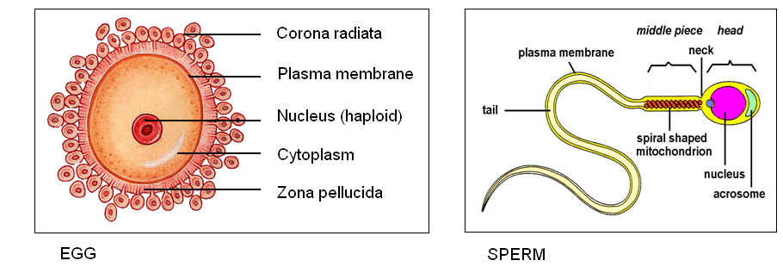
JD SCIENCE
Egg cell and sperm cell
Egg and sperm — comparison diagrams
jdscience.co.uk · Specialised Cells
18 / 29

Slide 19
JD SCIENCE
Egg cell
Egg cell — key structures
Corona radiata
Zona pellucida
Nucleus
Two or three outer layers attached to the zona pellucida. Supplies proteins needed to the fertilised egg.
The outer protective layer/membrane of the egg.
Contains the haploid genetic information.
Cytoplasm
Cell membrane
Contains nutrients and organelles needed after fertilisation.
Plasma membrane immediately around the cytoplasm.
jdscience.co.uk · Specialised Cells
19 / 29

Slide 20
JD SCIENCE
Egg cell
Egg Cell
• Egg cells or ova are the female gametes
• AN egg cell is one of the largest cells in the human body
• It is 0.12mm in diameter
jdscience.co.uk · Specialised Cells
20 / 29

Slide 21
JD SCIENCE
Egg cell
Egg Cell
• It has a nucleus
• A zona pellucida which is the outer protective layer/membrane of the egg
• Attached to this is the corona radiata which consists of two or three layers
• This functions to supply proteins needed to the fertilised egg.
jdscience.co.uk · Specialised Cells
21 / 29

Slide 22
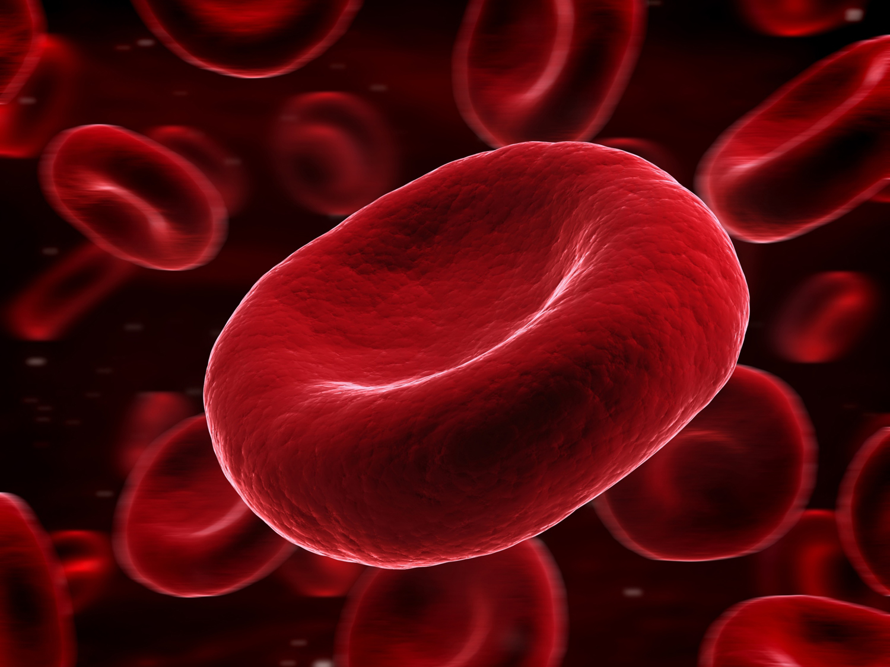
JD SCIENCE
Red blood cell
Red blood cell
jdscience.co.uk · Specialised Cells
22 / 29

Slide 23
JD SCIENCE
Red blood cell
Red blood cell
• Red blood cells or erythrocytes are a biconcave disc
• This increases the surface area o volume ratio of an erythrocyte
• They are flexible so they can squeeze through narrow capillaries
jdscience.co.uk · Specialised Cells
23 / 29

Slide 24
JD SCIENCE
Red blood cell
Red blood cell
• Their function is to transport oxygen around the body
• They do not have a nucleus
• This is to increase space for haemoglobin molecules to attach oxygen
jdscience.co.uk · Specialised Cells
24 / 29

Slide 25
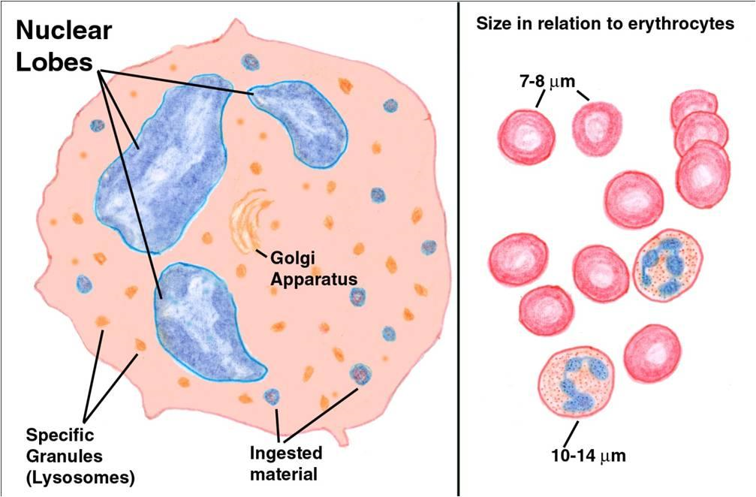
JD SCIENCE
White blood cell
Neutrophil — labelled diagram
jdscience.co.uk · Specialised Cells
25 / 29

Slide 26
JD SCIENCE
White blood cell
White blood cell
• Neutrophils are types of white eblood cells that play an important part in the immune system
• They have multi lobed nuclei, enabling them to squeeze through small gaps when travelling to the site of an infection
jdscience.co.uk · Specialised Cells
26 / 29

Slide 27
JD SCIENCE
White blood cell
White blood cell
• The cytoplasm holds lysosomes that contain enzymes that are used to digest pathogens that are ingested by the neutrophil
jdscience.co.uk · Specialised Cells
27 / 29

Slide 28
JD SCIENCE
Plenary
Who am I?
Describe the key features of different specialised cells – students guess the cell type
jdscience.co.uk · Specialised Cells
28 / 29

Slide 29
JD SCIENCE
Homework
Homework
Revise for exam next week
Review every specialised cell in this pack: palisade mesophyll, root hair, sperm, egg, red blood cell and neutrophil. Learn structure, adaptations and function.
jdscience.co.uk · Specialised Cells
29 / 29

