Slide 1
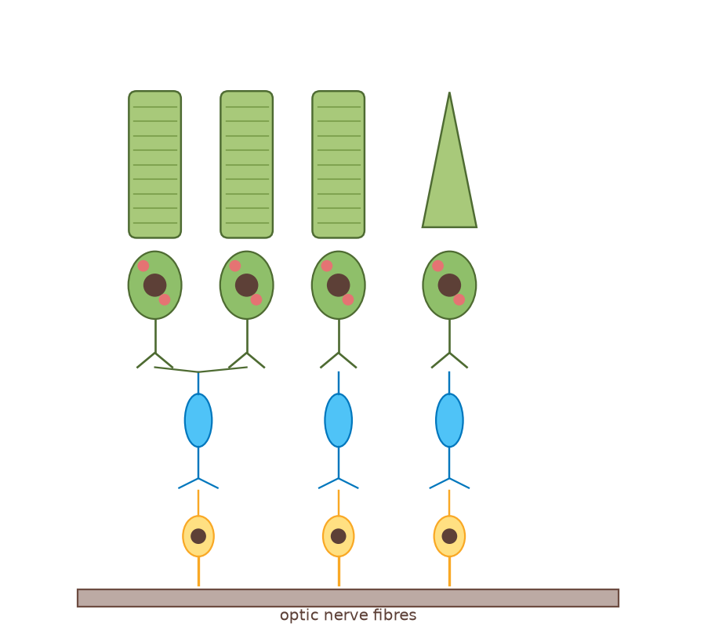
A2 Biology
The Nervous System
Part 1: Organisation
◀
▶
Interactive reconstruction · Flash-free · Original course © Boardworks Ltd 2009
Original course © Boardworks Ltd 2009. Reconstructed interactive resource.
Notes:
Title slide. Click the green arrow on later slides, or press the on-slide buttons. Original Boardworks Flash activities could not be executed; this file rebuilds them with hyperlinks.

Slide 2
How to use this presentation
A2 Biology
This is a reconstructed classroom presentation. Original 2009 Boardworks activities used Adobe Flash, which no longer runs. Every activity below uses native PowerPoint hyperlinks (no macros, no Flash).
Next / Back arrows
Move through the teaching sequence.
Green buttons
Reveal answers, open an activity, or jump to a labelled structure.
Reset
Returns an activity to its starting slide so you can reuse it in the same lesson.
Check / Show answers
Teacher-controlled reveal. Hidden slides are skipped if you just press Space.
Slide Show mode
Start the slide show (F5). Buttons only jump while the show is running.
◀
▶
2 of 19
Original course © Boardworks Ltd 2009. Reconstructed interactive resource.
Notes:
Demonstrate Slide Show mode. Buttons do not jump in Normal (edit) view.

Slide 3
Learning outcomes
A2 Biology
By the end of this lesson you should be able to:
1
Describe the organisation of the human nervous system (CNS and PNS, including somatic and autonomic divisions).
2
Label the main parts of a neurone and state the function of each part.
3
Compare sensory, relay and motor neurones in terms of structure and direction of impulse.
4
Explain how myelination and nodes of Ranvier relate to neurone function.
5
Link organisation of the nervous system to clinical work in neurology.
◀
▶
3 of 19
Original course © Boardworks Ltd 2009. Reconstructed interactive resource.

Slide 4
Contents
A2 Biology
1. the human nervous system
2. organisation explorer (click to reveal)
3. neurone structure – click the labels
4. types of neurone
5. matching activity
6. knowledge check
7. scientist case study
8. plenary
◀
▶
4 of 19
Original course © Boardworks Ltd 2009. Reconstructed interactive resource.
Notes:
Menu for jumping around the lesson. Useful when reusing activities.

Slide 5
The human nervous system
A2 Biology
The nervous system is a highly organized system of nervous tissue that detects, relays and co-ordinates information about an organism’s internal and external environment.
All nervous systems contain nerve cells, called neurones, which convey information in the form of nerve impulses. They can produce a rapid, localized response.
◀
▶
5 of 19
Original course © Boardworks Ltd 2009. Reconstructed interactive resource.
Notes:
Original static teaching slide – scientific wording retained. Diagram is a new 2D reconstruction of retinal circuitry (rods, cones, bipolar and ganglion cells), which appears throughout the series.

Slide 6
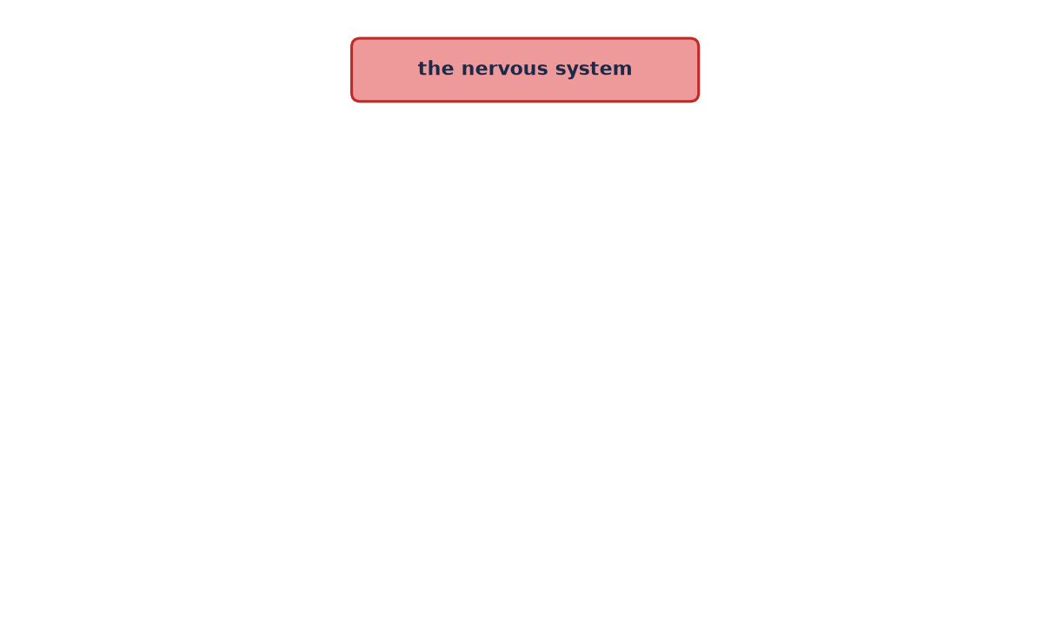
How is the nervous system organized?
A2 Biology
Organization of the nervous system
Each part of the nervous system performs a different function.
Press the red button, then each new button, to reveal how the nervous system is organized.
Reveal CNS and PNS
◀
▶
Reset
Show all
Functions
6 of 19
Original course © Boardworks Ltd 2009. Reconstructed interactive resource.
Notes:
Rebuilt Flash click-to-reveal tree. Each button jumps to the next reveal level. Reset returns to the start.

Slide 7
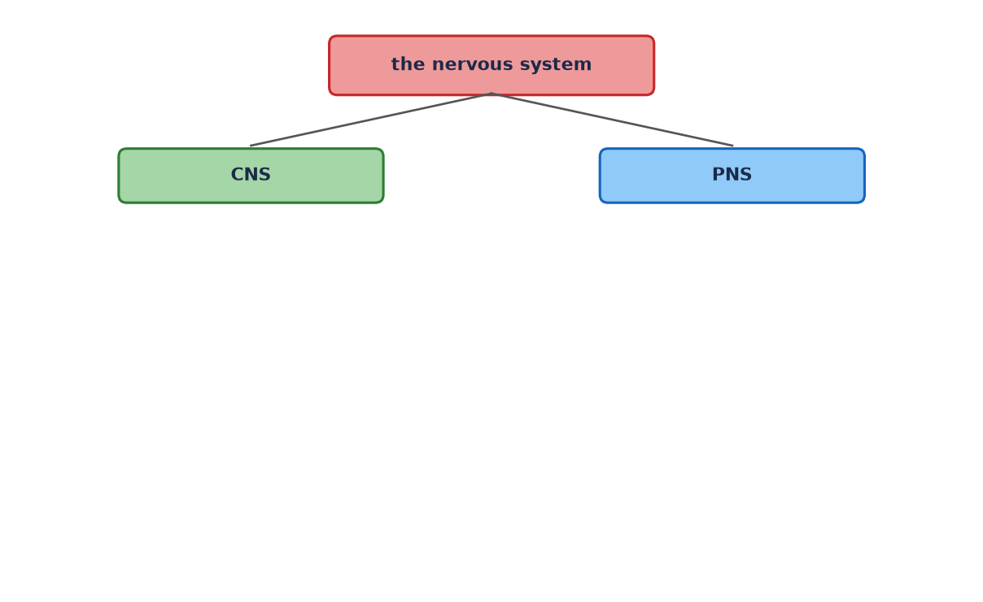
How is the nervous system organized?
A2 Biology
Organization of the nervous system
The nervous system is divided into the CNS and the PNS.
Press CNS and PNS to see what each contains.
Reveal CNS parts
Reveal PNS parts
◀
▶
Reset
Show all
Functions
7 of 19
Original course © Boardworks Ltd 2009. Reconstructed interactive resource.
Notes:
Rebuilt Flash click-to-reveal tree. Each button jumps to the next reveal level. Reset returns to the start.

Slide 8
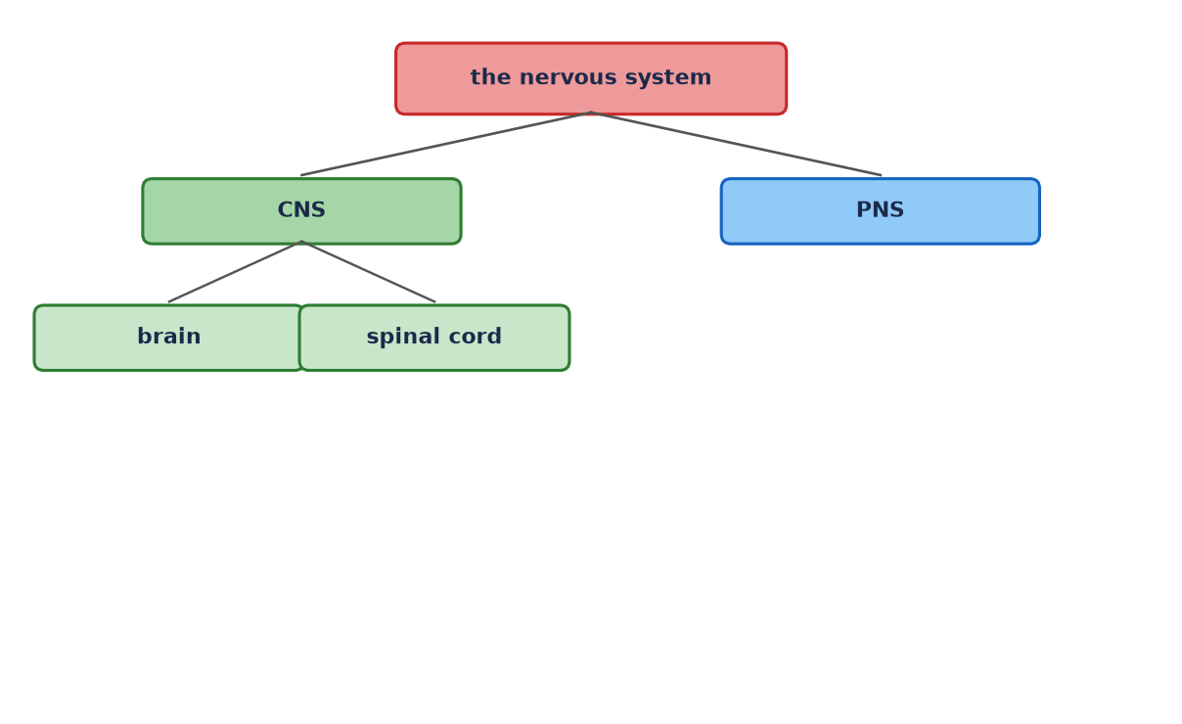
How is the nervous system organized?
A2 Biology
Organization of the nervous system
The CNS is the brain and spinal cord.
Press PNS to see its divisions.
Reveal PNS parts
◀
▶
Reset
Show all
Functions
8 of 19
Original course © Boardworks Ltd 2009. Reconstructed interactive resource.
Notes:
Rebuilt Flash click-to-reveal tree. Each button jumps to the next reveal level. Reset returns to the start.

Slide 9
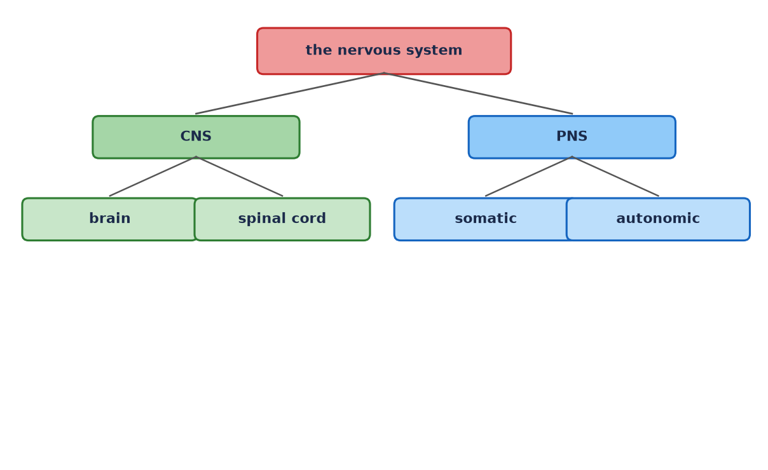
How is the nervous system organized?
A2 Biology
Organization of the nervous system
The PNS is every nerve outside the CNS. It has somatic and autonomic divisions.
Press autonomic to split it further.
Reveal autonomic branches
◀
▶
Reset
Show all
Functions
9 of 19
Original course © Boardworks Ltd 2009. Reconstructed interactive resource.
Notes:
Rebuilt Flash click-to-reveal tree. Each button jumps to the next reveal level. Reset returns to the start.

Slide 10
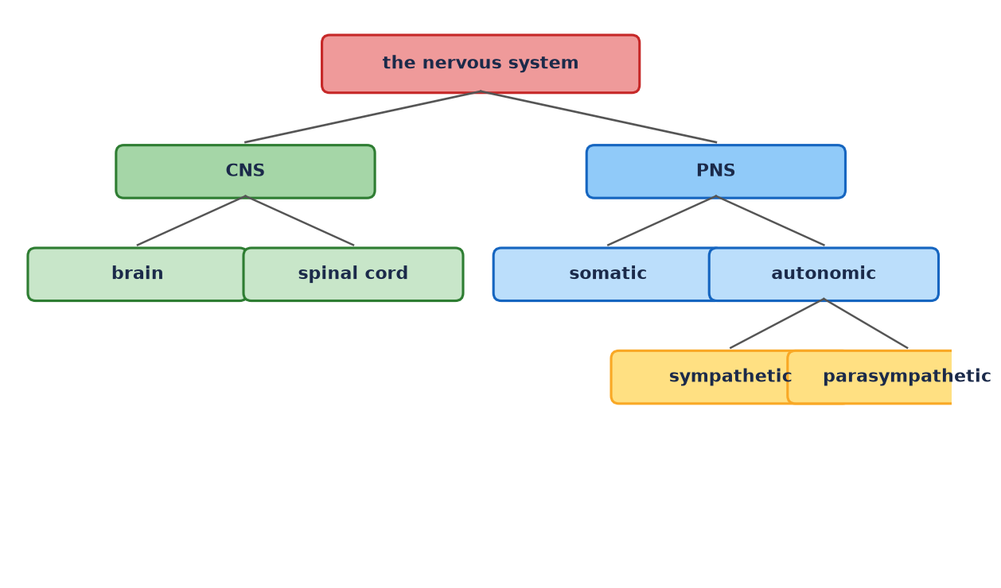
How is the nervous system organized?
A2 Biology
Organization of the nervous system
The autonomic nervous system has sympathetic (‘fight or flight’) and parasympathetic (‘rest and digest’) branches.
◀
▶
Reset
Show all
Functions
10 of 19
Original course © Boardworks Ltd 2009. Reconstructed interactive resource.
Notes:
Rebuilt Flash click-to-reveal tree. Each button jumps to the next reveal level. Reset returns to the start.

Slide 11
Functions of each division
A2 Biology
CNS – brain
Processes sensory information, initiates motor output, higher functions (memory, language, coordination).
CNS – spinal cord
Carries impulses between brain and PNS; is the integrating centre for many reflex arcs.
Somatic PNS
Sensory neurones from skin, muscles and joints; motor neurones to skeletal muscle (mostly voluntary).
Autonomic PNS
Controls glands, smooth muscle and cardiac muscle (involuntary).
Sympathetic
Increases heart rate, dilates bronchioles, diverts blood to muscle – ‘fight or flight’.
Parasympathetic
Slows heart rate, stimulates digestion – ‘rest and digest’. Antagonistic to sympathetic.
Back to explorer
activity
Original course © Boardworks Ltd 2009. Reconstructed interactive resource.

Slide 12
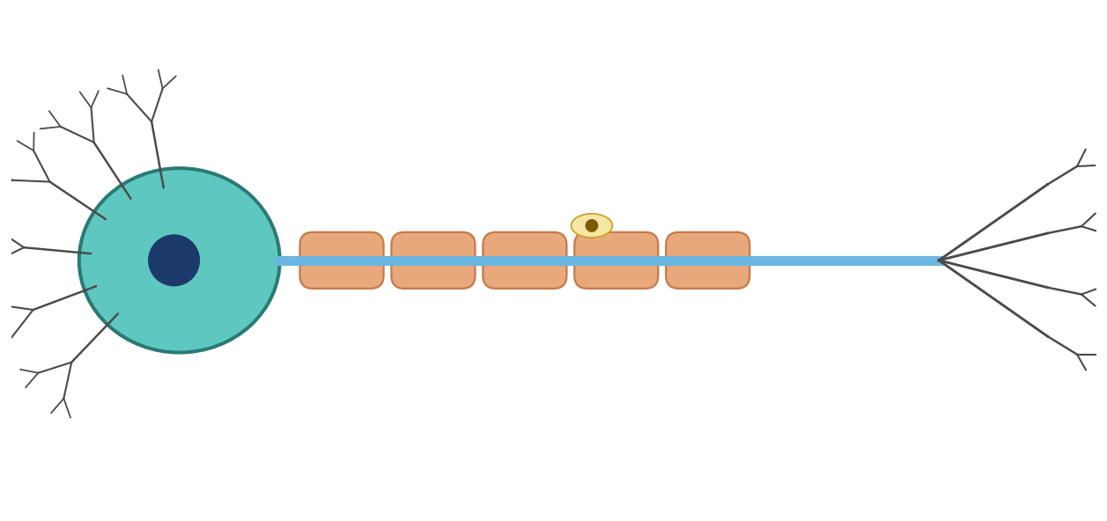
General structure of a neurone
A2 Biology
What is the structure of a neurone?
cell body ▶
axon ▶
node of Ranvier ▶
dendrites ▶
myelin sheath ▶
nucleus of Schwann cell ▶
Neurones are specialized cells that convey information in the form of nerve impulses. Press on the labels to find out more about each part of the neurone.
◀
▶
Reset
11 of 19
Original course © Boardworks Ltd 2009. Reconstructed interactive resource.
Notes:
Rebuilt Flash labelling activity. Each label opens a hidden explanation slide, then Back returns here.

Slide 13
General structure of a neurone
A2 Biology
Cell body
Cell body
The cell body (soma) contains the nucleus and organelles. It is the metabolic centre of the neurone and manufactures proteins and neurotransmitters. In motor neurones it lies in the CNS; in sensory neurones it lies in a ganglion just outside the CNS.
Back to diagram
activity
Original course © Boardworks Ltd 2009. Reconstructed interactive resource.

Slide 14
General structure of a neurone
A2 Biology
Dendrites
Dendrites
Dendrites are highly branched cytoplasmic extensions. They receive impulses from other neurones (or from a receptor) and carry them towards the cell body. More branches mean a larger surface area for synapses.
Back to diagram
activity
Original course © Boardworks Ltd 2009. Reconstructed interactive resource.

Slide 15
General structure of a neurone
A2 Biology
Axon
Axon
The axon is a long, single fibre that carries the nerve impulse away from the cell body towards the synaptic terminals. Motor axons may be more than a metre long. The axoplasm is surrounded by the axon membrane, where the action potential is generated.
Back to diagram
activity
Original course © Boardworks Ltd 2009. Reconstructed interactive resource.

Slide 16
General structure of a neurone
A2 Biology
Myelin sheath
Myelin sheath
A thick insulating layer of fatty material (myelin) wrapped around the axon by Schwann cells in the PNS (oligodendrocytes in the CNS). It prevents ion leakage and greatly increases conduction speed.
Back to diagram
activity
Original course © Boardworks Ltd 2009. Reconstructed interactive resource.

Slide 17
General structure of a neurone
A2 Biology
Node of Ranvier
Node of Ranvier
A gap in the myelin sheath where the axon membrane is exposed. Voltage-gated ion channels are concentrated here. The action potential ‘jumps’ from node to node – saltatory conduction.
Back to diagram
activity
Original course © Boardworks Ltd 2009. Reconstructed interactive resource.

Slide 18
General structure of a neurone
A2 Biology
Schwann cell
Schwann cell
A glial cell that wraps around a PNS axon, forming the myelin sheath. The nucleus of the Schwann cell sits in the outermost layer of the wrap. One Schwann cell myelinates one internodal segment of one axon.
Back to diagram
activity
Original course © Boardworks Ltd 2009. Reconstructed interactive resource.

Slide 19
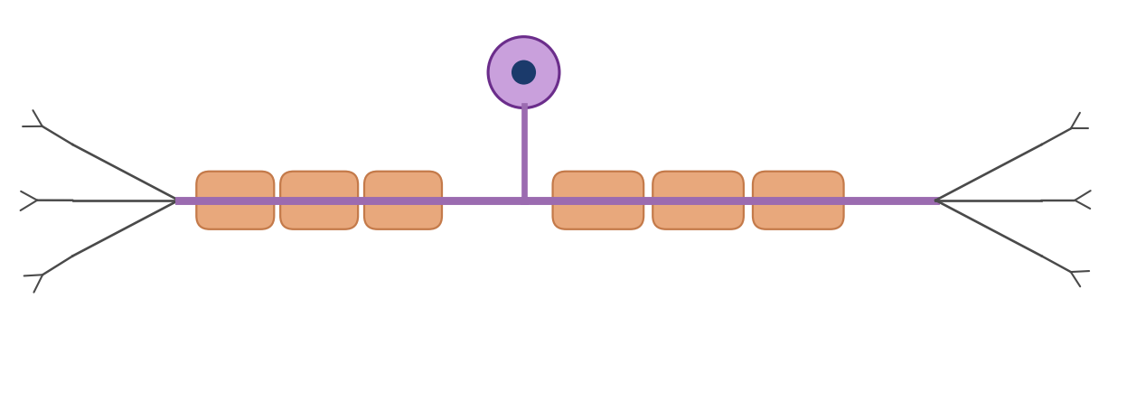
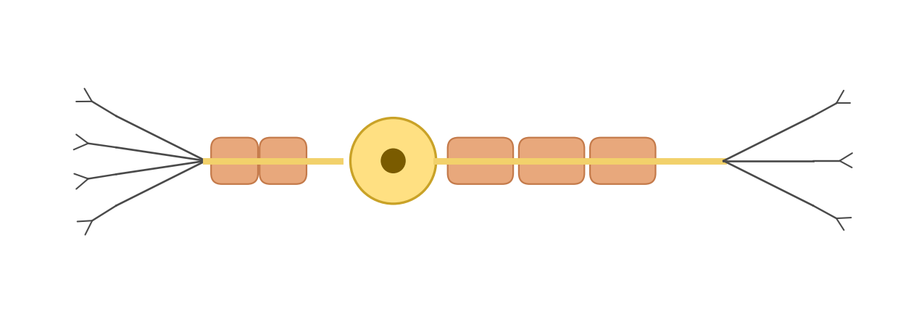
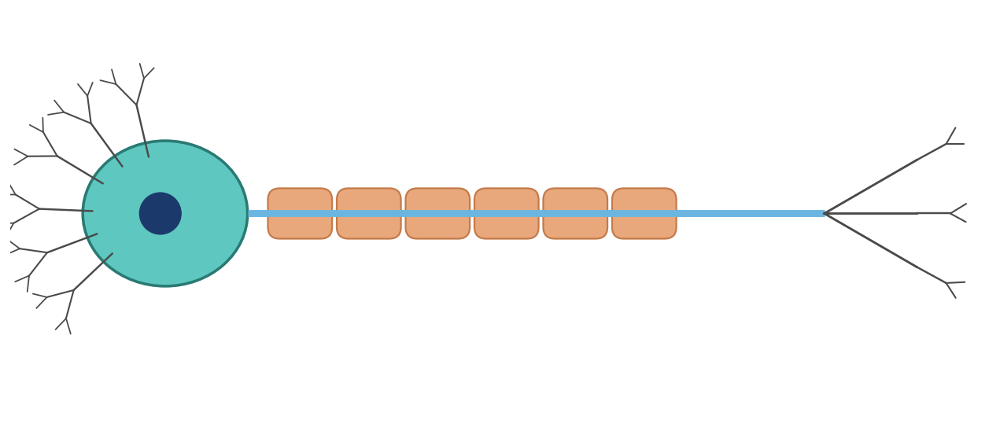
Types of neurone
A2 Biology
There are several different types of neurone:
sensory
neurones:
receptor organs
CNS
info
relay
neurones:
sensory neurones
motor neurones
info
motor
neurones:
CNS
effectors
info
◀
▶
12 of 19
Original course © Boardworks Ltd 2009. Reconstructed interactive resource.
Notes:
Original comparison diagrams rebuilt. Info buttons open function cards.

Slide 20
Types of neurone
A2 Biology
Sensory neurone
Carries impulses from a receptor towards the CNS. The cell body is in a dorsal root ganglion, off to the side of the axon. There is a long dendron and a shorter axon. Many sensory neurones are myelinated.
Back
activity
Original course © Boardworks Ltd 2009. Reconstructed interactive resource.

Slide 21
Types of neurone
A2 Biology
Relay (intermediate) neurone
Found entirely within the CNS. Connects sensory neurones to motor neurones and to other relay neurones, allowing integration and coordination. Typically short, with many synapses. Also called an interneurone.
Back
activity
Original course © Boardworks Ltd 2009. Reconstructed interactive resource.

Slide 22
Types of neurone
A2 Biology
Motor neurone
Carries impulses from the CNS to an effector (muscle or gland). The cell body is in the CNS (grey matter of spinal cord or brain) with many dendrites. A long myelinated axon runs out through the PNS to the effector.
Back
activity
Original course © Boardworks Ltd 2009. Reconstructed interactive resource.

Slide 23
Comparing neurone types
A2 Biology
Click a heading to reveal the comparison. Use Show all before moving on.
Feature
Sensory
Relay
Motor
Show comparison table
◀
▶
13 of 19
Original course © Boardworks Ltd 2009. Reconstructed interactive resource.
Notes:
Reveal table is a hidden slide so Space will skip it during a straight run-through.

Slide 24
Comparing neurone types
A2 Biology
Feature
Sensory
Relay
Motor
Direction of impulse
Receptor → CNS
CNS → CNS
CNS → effector
Cell body position
Dorsal root ganglion
Entirely in CNS
In CNS (grey matter)
Relative axon length
Short axon, long dendron
Short
Long axon
Myelin
Usually myelinated
Often unmyelinated
Usually myelinated
Back
activity
Original course © Boardworks Ltd 2009. Reconstructed interactive resource.

Slide 25
Neurone structure
A2 Biology
Match the parts of the neurone to the definitions
node of Ranvier
a long single fibre that carries nerve impulses
axon
a thick insulating layer around the axon
myelin sheath
gap in the myelin sheath where the axon is exposed
Schwann cell
highly branched fibres that conduct impulses
dendrites
a cell wrapped around the axon, forming the myelin sheath
◀
▶
Check
Reset
14 of 19
Original course © Boardworks Ltd 2009. Reconstructed interactive resource.
Notes:
Rebuilt Flash matching activity. Definitions are shuffled (original order). Click a term to highlight its match, or Check to show the full key. Correct pairs: node of Ranvier = gap in myelin; axon = long single fibre; myelin sheath = insulating layer; Schwann cell = cell wrapped around axon; dendrites = highly branched fibres.

Slide 26
Neurone structure
A2 Biology
Matched pair
node of Ranvier
gap in the myelin sheath where the axon is exposed
Back to matching
activity
Original course © Boardworks Ltd 2009. Reconstructed interactive resource.

Slide 27
Neurone structure
A2 Biology
Matched pair
axon
a long single fibre that carries nerve impulses
Back to matching
activity
Original course © Boardworks Ltd 2009. Reconstructed interactive resource.

Slide 28
Neurone structure
A2 Biology
Matched pair
myelin sheath
a thick insulating layer around the axon
Back to matching
activity
Original course © Boardworks Ltd 2009. Reconstructed interactive resource.

Slide 29
Neurone structure
A2 Biology
Matched pair
Schwann cell
a cell wrapped around the axon, forming the myelin sheath
Back to matching
activity
Original course © Boardworks Ltd 2009. Reconstructed interactive resource.

Slide 30
Neurone structure
A2 Biology
Matched pair
dendrites
highly branched fibres that conduct impulses
Back to matching
activity
Original course © Boardworks Ltd 2009. Reconstructed interactive resource.

Slide 31
Neurone structure – answers
A2 Biology
Answer key
node of Ranvier
gap in the myelin sheath where the axon is exposed
axon
a long single fibre that carries nerve impulses
myelin sheath
a thick insulating layer around the axon
Schwann cell
a cell wrapped around the axon, forming the myelin sheath
dendrites
highly branched fibres that conduct impulses
Back to matching
activity
Original course © Boardworks Ltd 2009. Reconstructed interactive resource.

Slide 32
Knowledge check 1
A2 Biology
Which statement about relay neurones is correct?
A They carry impulses from receptors directly to effectors.
B They are found entirely in the CNS and connect other neurones.
C Their cell bodies always lie in a dorsal root ganglion.
D They are the only myelinated neurones in the nervous system.
◀
▶
15 of 19
Original course © Boardworks Ltd 2009. Reconstructed interactive resource.
Notes:
Correct = B.

Slide 33
Knowledge check 1
A2 Biology
Correct.
Relay (intermediate) neurones lie entirely in the CNS and synapse with sensory and motor neurones, allowing integration.
Continue
activity
Original course © Boardworks Ltd 2009. Reconstructed interactive resource.

Slide 34
Knowledge check 1
A2 Biology
Not quite.
Think about where a relay neurone is found, and what it connects. Try again.
Try again
activity
Original course © Boardworks Ltd 2009. Reconstructed interactive resource.

Slide 35
Knowledge check 1
A2 Biology
Not quite.
Think about where a relay neurone is found, and what it connects. Try again.
Try again
activity
Original course © Boardworks Ltd 2009. Reconstructed interactive resource.

Slide 36
Knowledge check 1
A2 Biology
Not quite.
Think about where a relay neurone is found, and what it connects. Try again.
Try again
activity
Original course © Boardworks Ltd 2009. Reconstructed interactive resource.

Slide 37
Knowledge check 2
A2 Biology
The nodes of Ranvier are:
A the nuclei of Schwann cells
B synapses between sensory and motor neurones
C gaps in the myelin sheath where the axon is exposed
D the cell bodies of sensory neurones
◀
▶
16 of 19
Original course © Boardworks Ltd 2009. Reconstructed interactive resource.

Slide 38
Knowledge check 2
A2 Biology
Correct.
Nodes of Ranvier are unmyelinated gaps. They allow saltatory conduction.
Continue
activity
Original course © Boardworks Ltd 2009. Reconstructed interactive resource.

Slide 39
Knowledge check 2
A2 Biology
Not quite.
Look back at the labelled neurone. Try again.
Try again
activity
Original course © Boardworks Ltd 2009. Reconstructed interactive resource.

Slide 40
Knowledge check 2
A2 Biology
Not quite.
Look back at the labelled neurone. Try again.
Try again
activity
Original course © Boardworks Ltd 2009. Reconstructed interactive resource.

Slide 41
Knowledge check 2
A2 Biology
Not quite.
Look back at the labelled neurone. Try again.
Try again
activity
Original course © Boardworks Ltd 2009. Reconstructed interactive resource.

Slide 42
Scientist case study
A2 Biology
Scientists in the real world: the neurologist
The original Boardworks activity was a Flash interview with Dr Kevin Talbot, then Reader in Clinical Neurology at Oxford University, with a drop-down question menu. The interview recording cannot be recovered from the flattened export. The questions below keep the same classroom purpose: linking organisation of the nervous system to clinical neurology.
What does a neurologist do?
How does motor neurone disease relate to this topic?
Why does organisation of the nervous system matter in diagnosis?
What skills do clinical neurologists use?
◀
▶
17 of 19
Original course © Boardworks Ltd 2009. Reconstructed interactive resource.
Notes:
Original Flash dropdown and photograph were not recoverable and are not copied. Reconstructed Q&A for classroom use.

Slide 43
Scientist case study
A2 Biology
A neurologist is a doctor who diagnoses and treats disorders of the brain, spinal cord and peripheral nerves. They use knowledge of how the nervous system is organised to work out where a lesion is – CNS or PNS, sensory or motor, somatic or autonomic.
Back to questions
activity
Original course © Boardworks Ltd 2009. Reconstructed interactive resource.

Slide 44
Scientist case study
A2 Biology
Motor neurone disease (MND / ALS) destroys motor neurones in the CNS. Signals no longer reach skeletal muscle, so muscles weaken and waste. Sensory neurones are typically spared, which is why the organisation into sensory, relay and motor pathways is clinically important.
Back to questions
activity
Original course © Boardworks Ltd 2009. Reconstructed interactive resource.

Slide 45
Scientist case study
A2 Biology
Symptoms follow the wiring. A problem in a spinal motor neurone affects effectors supplied by that segment. A brain lesion may affect many pathways. Distinguishing upper from lower motor neurone signs, and CNS from PNS, depends on this map of organisation.
Back to questions
activity
Original course © Boardworks Ltd 2009. Reconstructed interactive resource.

Slide 46
Scientist case study
A2 Biology
History taking, neurological examination (tone, power, reflexes, sensation, coordination), and linking signs to named pathways. Research neurologists also study how neurones live, die and might be protected – building on the cell biology of the neurone you have just labelled.
Back to questions
activity
Original course © Boardworks Ltd 2009. Reconstructed interactive resource.

Slide 47
Plenary
A2 Biology
True or false? Click a statement, then decide.
Sensory neurones carry impulses from the CNS to effectors.
The sympathetic and parasympathetic systems are both autonomic.
Myelin is produced by Schwann cells in the PNS.
Relay neurones have their cell bodies in the dorsal root ganglion.
Show all answers
◀
▶
18 of 19
Original course © Boardworks Ltd 2009. Reconstructed interactive resource.

Slide 48
Plenary
A2 Biology
False
Sensory neurones carry impulses from receptors to the CNS. Motor neurones run from the CNS to effectors.
Back
activity
Original course © Boardworks Ltd 2009. Reconstructed interactive resource.

Slide 49
Plenary
A2 Biology
True
Both are divisions of the autonomic (involuntary) nervous system and usually act antagonistically.
Back
activity
Original course © Boardworks Ltd 2009. Reconstructed interactive resource.

Slide 50
Plenary
A2 Biology
True
In the PNS, Schwann cells wrap the axon. In the CNS the equivalent cells are oligodendrocytes.
Back
activity
Original course © Boardworks Ltd 2009. Reconstructed interactive resource.

Slide 51
Plenary
A2 Biology
False
Dorsal root ganglia contain sensory neurone cell bodies. Relay neurone cell bodies are in the CNS.
Back
activity
Original course © Boardworks Ltd 2009. Reconstructed interactive resource.

Slide 52
Plenary – answers
A2 Biology
False. Sensory neurones carry impulses from the CNS to effectors. Sensory neurones carry impulses from receptors to the CNS. Motor neurones run from the CNS to effectors.
True. The sympathetic and parasympathetic systems are both autonomic. Both are divisions of the autonomic (involuntary) nervous system and usually act antagonistically.
True. Myelin is produced by Schwann cells in the PNS. In the PNS, Schwann cells wrap the axon. In the CNS the equivalent cells are oligodendrocytes.
False. Relay neurones have their cell bodies in the dorsal root ganglion. Dorsal root ganglia contain sensory neurone cell bodies. Relay neurone cell bodies are in the CNS.
Back
activity
Original course © Boardworks Ltd 2009. Reconstructed interactive resource.

Slide 53
End of Part 1
A2 Biology
Next: Part 2 – The nerve impulse
You can replay any activity from the Contents slide. Reset always returns an activity to its first screen so it can be used again with another group or a second pass.
Back to contents
◀
▶
19 of 19
Original course © Boardworks Ltd 2009. Reconstructed interactive resource.

