Slide 1
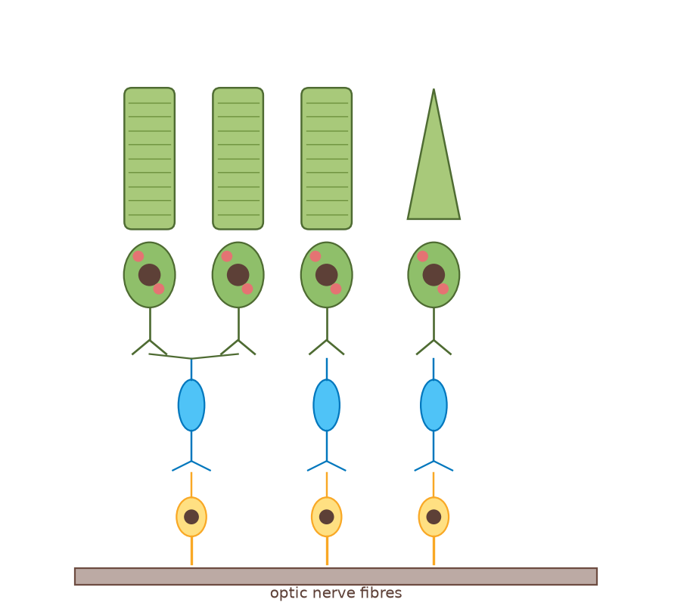
A2 Biology
The Nervous System
Part 2: The nerve impulse
◀
▶
Interactive reconstruction · Flash-free · Original course © Boardworks Ltd 2009
Original course © Boardworks Ltd 2009. Reconstructed interactive resource.

Slide 2
Contents
A2 Biology
1. what is a nerve impulse?
2. resting potential animation
3. resting potential questions
4. action potential animation
5. ion channels table
6. action potential graph
7. all-or-nothing and stimulus strength
8. refractory period
9. saltatory conduction
10. true or false plenary
◀
▶
2 of 29
Original course © Boardworks Ltd 2009. Reconstructed interactive resource.

Slide 3
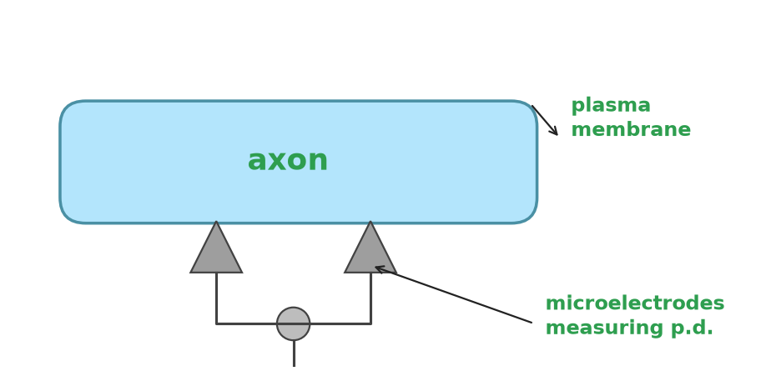
What is a nerve impulse?
A2 Biology
All cells have a difference in electrical charge across the plasma membrane. This is called the potential difference (p.d.). It is measured in millivolts (mV).
The normal, resting state of an axon is called the resting potential. In this state the p.d. across the axon is –70 mV. The membrane is said to be polarized.
A nerve impulse, or action potential, occurs when the p.d. across an axon is temporarily reversed. The p.d. changes to around +35 mV. The membrane is said to be depolarized.
◀
▶
3 of 29
Original course © Boardworks Ltd 2009. Reconstructed interactive resource.
Notes:
Original static teaching slide. Wording retained. Diagram rebuilt.

Slide 4
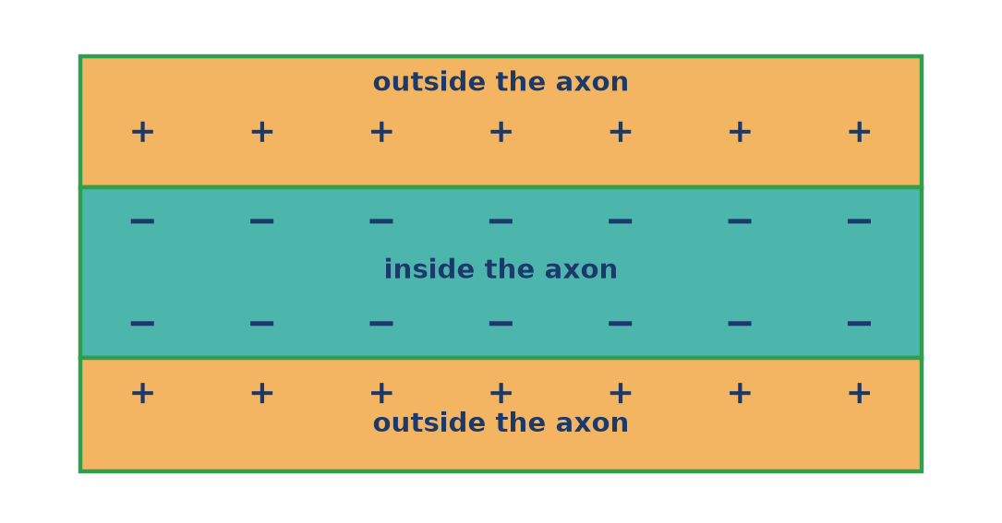
What happens during the resting state?
A2 Biology
Step 1 of 4: Charge difference
An axon is at resting potential when no impulse is present. The inside is negative compared with the outside (about –70 mV). Click Next step to see how this state is maintained.
◀
▶
Reset
Next step
4 of 29
Original course © Boardworks Ltd 2009. Reconstructed interactive resource.
Notes:
Rebuilt Flash play-bar animation as a teacher-paced step sequence with Reset.

Slide 5
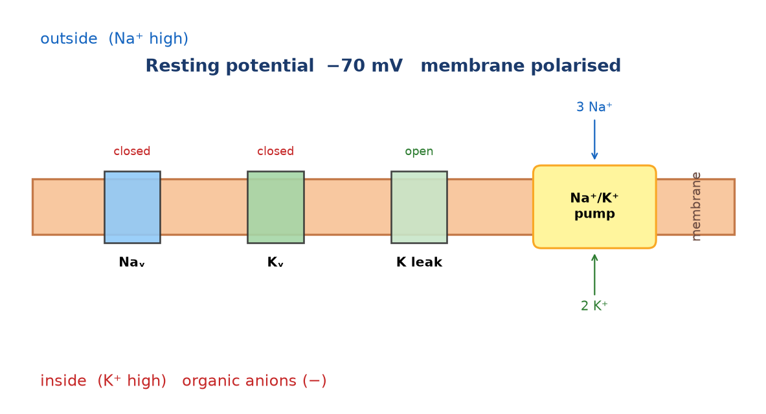
What happens during the resting state?
A2 Biology
Step 2 of 4: Sodium–potassium pump
The Na⁺/K⁺ pump uses ATP to move 3 Na⁺ out for every 2 K⁺ in. This is active transport. The unequal exchange makes the inside more negative.
◀
▶
Previous
Reset
Next step
5 of 29
Original course © Boardworks Ltd 2009. Reconstructed interactive resource.
Notes:
Rebuilt Flash play-bar animation as a teacher-paced step sequence with Reset.

Slide 6
What happens during the resting state?
A2 Biology
Step 3 of 4: Membrane permeability
The resting membrane is much more permeable to K⁺ than to Na⁺ because of open potassium leak channels. K⁺ diffuses out, leaving behind negatively charged organic ions (proteins) that cannot leave.
◀
▶
Previous
Reset
Next step
6 of 29
Original course © Boardworks Ltd 2009. Reconstructed interactive resource.
Notes:
Rebuilt Flash play-bar animation as a teacher-paced step sequence with Reset.

Slide 7
What happens during the resting state?
A2 Biology
Step 4 of 4: Putting it together
Pump (3 Na⁺ out, 2 K⁺ in) + K⁺ leak + trapped organic anions = polarised membrane at about –70 mV. Voltage-gated Na⁺ and K⁺ channels are closed.
◀
▶
Previous
Reset
Continue
7 of 29
Original course © Boardworks Ltd 2009. Reconstructed interactive resource.
Notes:
Rebuilt Flash play-bar animation as a teacher-paced step sequence with Reset.

Slide 8
Understanding resting potential
A2 Biology
What happens during resting potential? Choose the correct ending for each sentence.
The potential difference across the axon is …
During this state the axon is …
The inside of the axon is …
The sodium–potassium pump moves …
The axon membrane is more permeable to …
Show all answers
◀
▶
8 of 29
Original course © Boardworks Ltd 2009. Reconstructed interactive resource.
Notes:
Rebuilt Flash drop-down cloze. Original S/C (show/check) buttons become Show all answers.

Slide 9
Understanding resting potential
A2 Biology
The potential difference across the axon is …
-70 mV
0 mV
+35 mV
activity
Original course © Boardworks Ltd 2009. Reconstructed interactive resource.

Slide 10
Understanding resting potential
A2 Biology
During this state the axon is …
polarised
depolarised
at threshold
activity
Original course © Boardworks Ltd 2009. Reconstructed interactive resource.

Slide 11
Understanding resting potential
A2 Biology
The inside of the axon is …
negative compared with the outside
positive compared with the outside
at the same charge as the outside
activity
Original course © Boardworks Ltd 2009. Reconstructed interactive resource.

Slide 12
Understanding resting potential
A2 Biology
The sodium–potassium pump moves …
an unequal number of ions (3 Na⁺ out, 2 K⁺ in)
equal numbers of Na⁺ and K⁺
only sodium ions
activity
Original course © Boardworks Ltd 2009. Reconstructed interactive resource.

Slide 13
Understanding resting potential
A2 Biology
The axon membrane is more permeable to …
potassium ions than sodium ions
sodium ions than potassium ions
calcium ions than potassium ions
activity
Original course © Boardworks Ltd 2009. Reconstructed interactive resource.

Slide 14
Understanding resting potential
A2 Biology
Correct.
Resting potential is about –70 mV (some texts use –65 to –70 mV).
Back
activity
Original course © Boardworks Ltd 2009. Reconstructed interactive resource.

Slide 15
Understanding resting potential
A2 Biology
Not quite.
Look back at the resting-potential animation and try again.
Try again
activity
Original course © Boardworks Ltd 2009. Reconstructed interactive resource.

Slide 16
Understanding resting potential
A2 Biology
Not quite.
Look back at the resting-potential animation and try again.
Try again
activity
Original course © Boardworks Ltd 2009. Reconstructed interactive resource.

Slide 17
Understanding resting potential
A2 Biology
Correct.
The membrane has a charge difference, so it is polarised.
Back
activity
Original course © Boardworks Ltd 2009. Reconstructed interactive resource.

Slide 18
Understanding resting potential
A2 Biology
Not quite.
Look back at the resting-potential animation and try again.
Try again
activity
Original course © Boardworks Ltd 2009. Reconstructed interactive resource.

Slide 19
Understanding resting potential
A2 Biology
Not quite.
Look back at the resting-potential animation and try again.
Try again
activity
Original course © Boardworks Ltd 2009. Reconstructed interactive resource.

Slide 20
Understanding resting potential
A2 Biology
Correct.
Organic anions and net ion movement keep the inside negative.
Back
activity
Original course © Boardworks Ltd 2009. Reconstructed interactive resource.

Slide 21
Understanding resting potential
A2 Biology
Not quite.
Look back at the resting-potential animation and try again.
Try again
activity
Original course © Boardworks Ltd 2009. Reconstructed interactive resource.

Slide 22
Understanding resting potential
A2 Biology
Not quite.
Look back at the resting-potential animation and try again.
Try again
activity
Original course © Boardworks Ltd 2009. Reconstructed interactive resource.

Slide 23
Understanding resting potential
A2 Biology
Correct.
The 3:2 ratio helps generate the resting potential.
Back
activity
Original course © Boardworks Ltd 2009. Reconstructed interactive resource.

Slide 24
Understanding resting potential
A2 Biology
Not quite.
Look back at the resting-potential animation and try again.
Try again
activity
Original course © Boardworks Ltd 2009. Reconstructed interactive resource.

Slide 25
Understanding resting potential
A2 Biology
Not quite.
Look back at the resting-potential animation and try again.
Try again
activity
Original course © Boardworks Ltd 2009. Reconstructed interactive resource.

Slide 26
Understanding resting potential
A2 Biology
Correct.
K⁺ leak channels are open at rest; voltage-gated Na⁺ channels are closed.
Back
activity
Original course © Boardworks Ltd 2009. Reconstructed interactive resource.

Slide 27
Understanding resting potential
A2 Biology
Not quite.
Look back at the resting-potential animation and try again.
Try again
activity
Original course © Boardworks Ltd 2009. Reconstructed interactive resource.

Slide 28
Understanding resting potential
A2 Biology
Not quite.
Look back at the resting-potential animation and try again.
Try again
activity
Original course © Boardworks Ltd 2009. Reconstructed interactive resource.

Slide 29
Resting potential – answers
A2 Biology
Answer key
• p.d. = –70 mV
• the axon is polarised
• inside is negative compared with the outside
• the pump moves 3 Na⁺ out and 2 K⁺ in (unequal numbers)
• the membrane is more permeable to K⁺ than to Na⁺
Back
activity
Original course © Boardworks Ltd 2009. Reconstructed interactive resource.

Slide 30
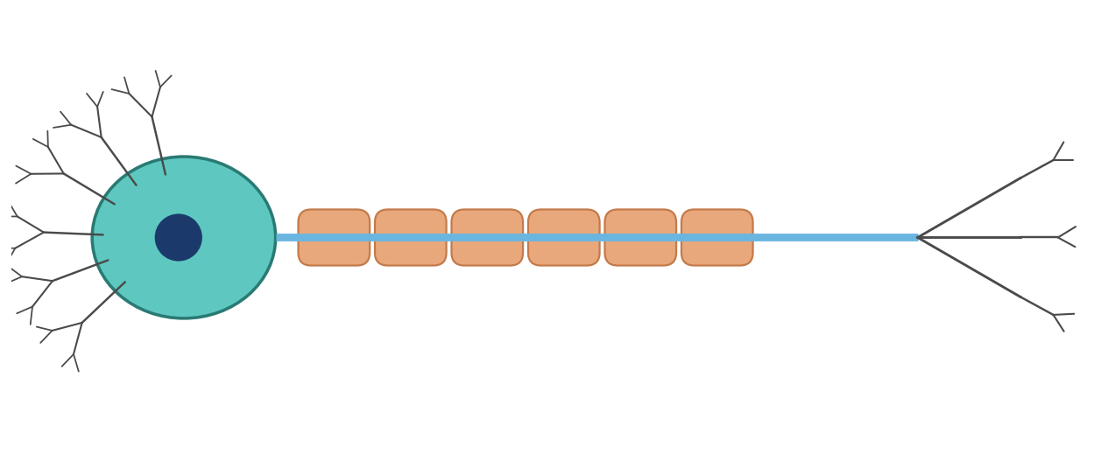
Action potential
A2 Biology
A temporary reversal of the potential difference in the axon is caused by a change in the distribution of ions.
Press play on the next screens to see how this change propagates a nerve impulse.
Play sequence
◀
▶
9 of 29
Original course © Boardworks Ltd 2009. Reconstructed interactive resource.

Slide 31
What happens during an action potential?
A2 Biology
Step 1 of 4: Resting – channels closed
Voltage-gated Na⁺ and K⁺ channels are closed. The membrane is polarised at about –70 mV.
◀
▶
Reset
Next step
10 of 29
Original course © Boardworks Ltd 2009. Reconstructed interactive resource.
Notes:
Rebuilt Flash play animation of ion movement during an action potential.

Slide 32
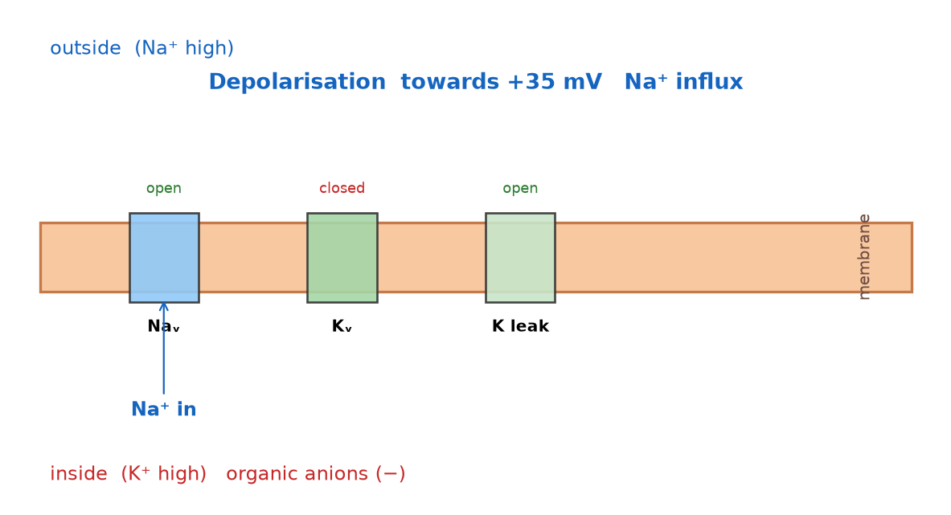
What happens during an action potential?
A2 Biology
Step 2 of 4: Depolarisation – Na⁺ in
A stimulus opens voltage-gated sodium channels. Na⁺ rushes in down its electrochemical gradient. The inside becomes positive (about +35 mV). This is depolarisation.
◀
▶
Previous
Reset
Next step
11 of 29
Original course © Boardworks Ltd 2009. Reconstructed interactive resource.
Notes:
Rebuilt Flash play animation of ion movement during an action potential.

Slide 33
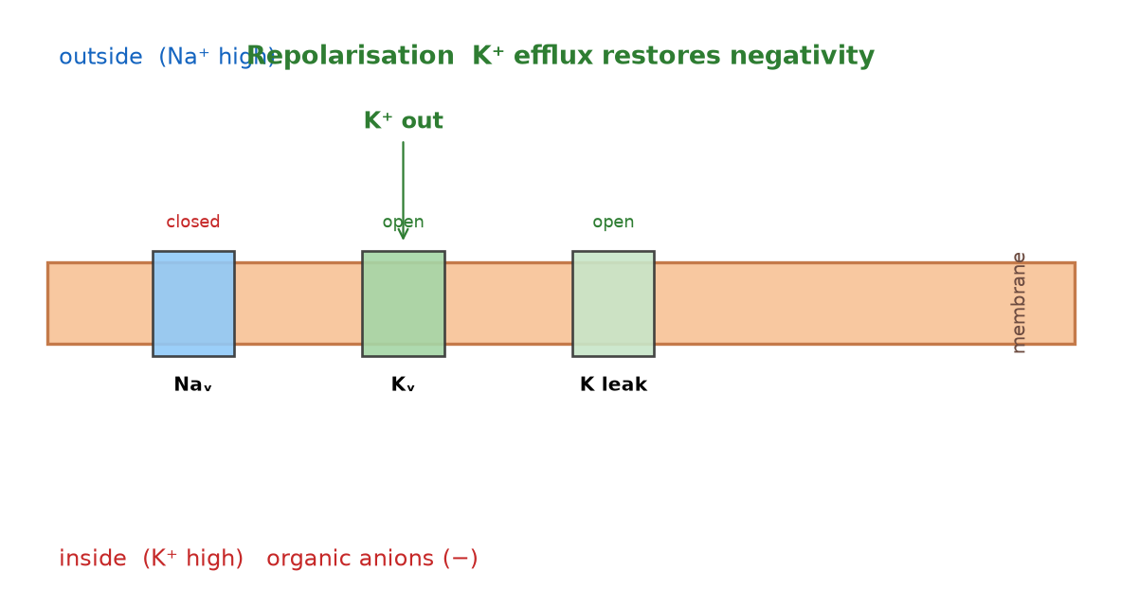
What happens during an action potential?
A2 Biology
Step 3 of 4: Repolarisation – K⁺ out
Na⁺ channels inactivate. Voltage-gated K⁺ channels open. K⁺ leaves the axon and the inside becomes negative again. This is repolarisation.
◀
▶
Previous
Reset
Next step
12 of 29
Original course © Boardworks Ltd 2009. Reconstructed interactive resource.
Notes:
Rebuilt Flash play animation of ion movement during an action potential.

Slide 34
What happens during an action potential?
A2 Biology
Step 4 of 4: Return to rest
There is a brief hyperpolarisation (more negative than rest). The Na⁺/K⁺ pump and leak channels restore the resting ion distribution. Local currents then depolarise the next patch of membrane.
◀
▶
Previous
Reset
Continue
13 of 29
Original course © Boardworks Ltd 2009. Reconstructed interactive resource.
Notes:
Rebuilt Flash play animation of ion movement during an action potential.

Slide 35
What happens during an action potential?
A2 Biology
Which voltage-gated ion channels are open during each stage?
voltage-gated potassium
voltage-gated sodium
resting potential
click to reveal
click to reveal
depolarisation
click to reveal
click to reveal
repolarisation
click to reveal
click to reveal
◀
▶
Check
Reset
14 of 29
Original course © Boardworks Ltd 2009. Reconstructed interactive resource.
Notes:
Rebuilt Flash open/closed drag table. Click Check for the key.

Slide 36
Ion channels – answers
A2 Biology
Answer key
K⁺ voltage-gated
Na⁺ voltage-gated
resting potential
closed
closed
depolarisation
closed
open
repolarisation
open
closed
Note: potassium leak channels stay open at rest. This table is about voltage-gated channels only, matching the original Boardworks activity.
Back
activity
Original course © Boardworks Ltd 2009. Reconstructed interactive resource.

Slide 37
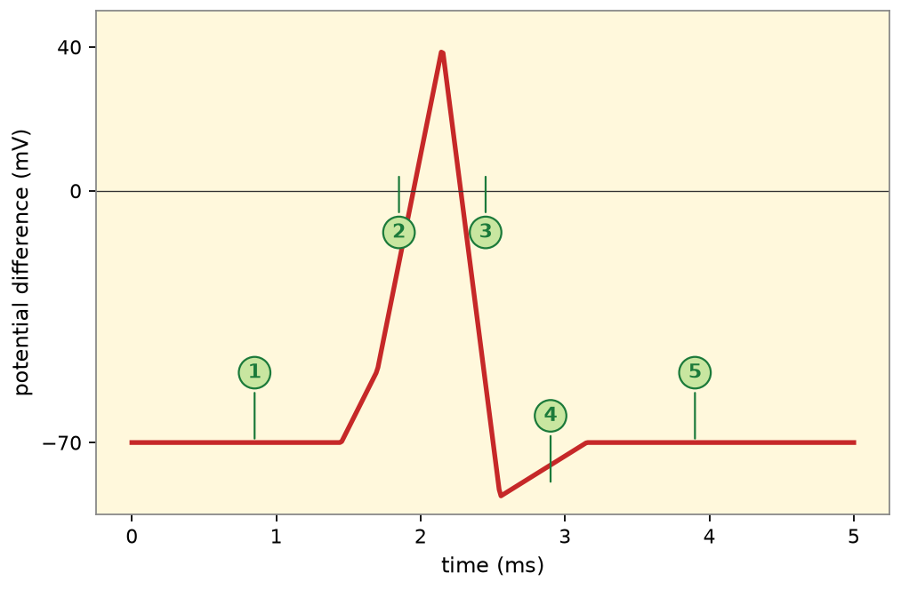
Changes during an action potential
A2 Biology
How does the potential difference change?
Press on the numbered graph labels to view a summary of the events during each stage of an action potential.
1 rest
2 depolarisation
3 repolarisation
4 hyperpolarisation
5 return to rest
◀
▶
15 of 29
Original course © Boardworks Ltd 2009. Reconstructed interactive resource.
Notes:
Rebuilt Flash click-on-graph. Stages 1–5 match the original numbered labels.

Slide 38
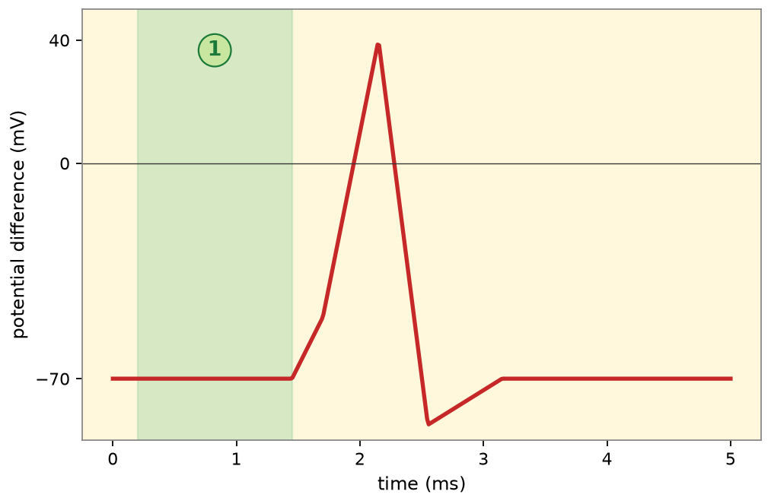
Changes during an action potential
A2 Biology
1 Resting potential
Voltage-gated channels closed. p.d. ≈ –70 mV. Membrane polarised. Na⁺/K⁺ pump and K⁺ leak maintain the gradient.
Back to graph
activity
Original course © Boardworks Ltd 2009. Reconstructed interactive resource.

Slide 39
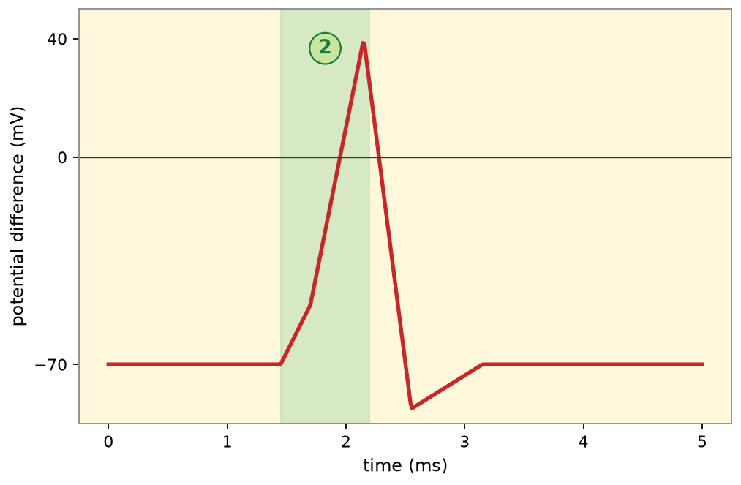
Changes during an action potential
A2 Biology
2 Depolarisation
Threshold reached. Voltage-gated Na⁺ channels open. Na⁺ influx reverses the p.d. towards +35 mV. The membrane is depolarised.
Back to graph
activity
Original course © Boardworks Ltd 2009. Reconstructed interactive resource.

Slide 40
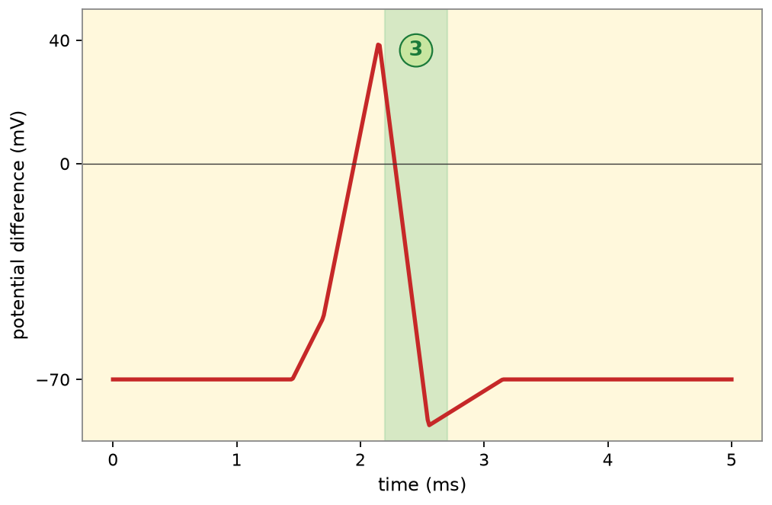
Changes during an action potential
A2 Biology
3 Repolarisation
Na⁺ channels inactivate. Voltage-gated K⁺ channels open. K⁺ efflux restores negativity inside the axon.
Back to graph
activity
Original course © Boardworks Ltd 2009. Reconstructed interactive resource.

Slide 41
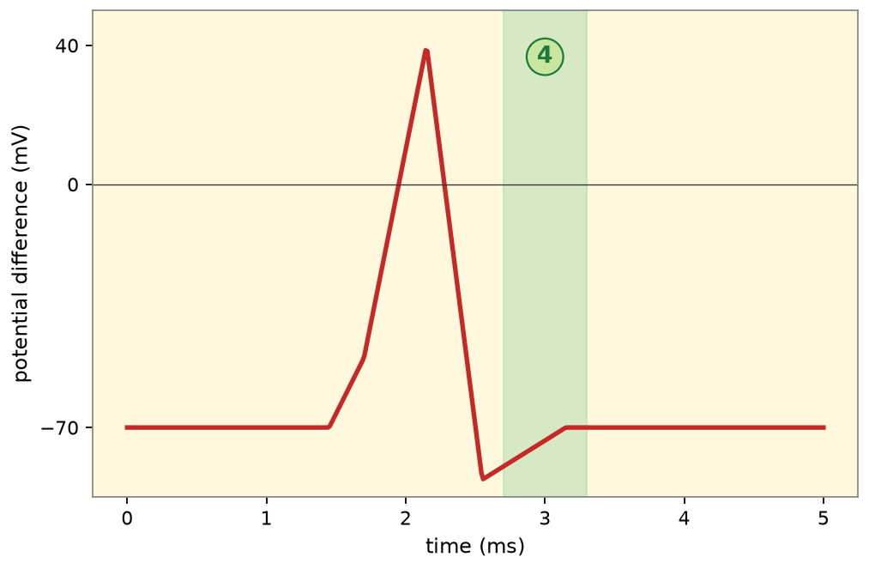
Changes during an action potential
A2 Biology
4 Hyperpolarisation
K⁺ channels are slow to close, so the p.d. briefly becomes more negative than rest (undershoot).
Back to graph
activity
Original course © Boardworks Ltd 2009. Reconstructed interactive resource.

Slide 42
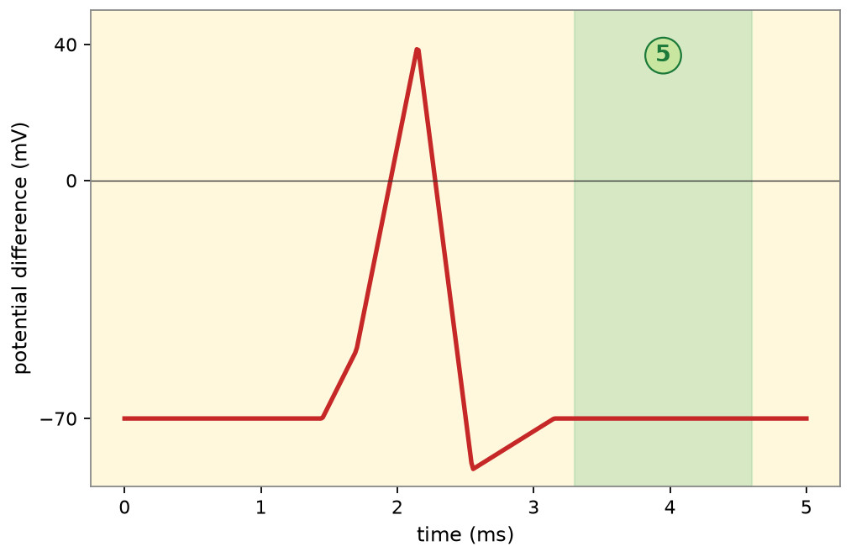
Changes during an action potential
A2 Biology
5 Return to resting potential
Ion channels reset. The pump restores Na⁺ and K⁺ concentrations. The axon is ready for another impulse once the refractory period ends.
Back to graph
activity
Original course © Boardworks Ltd 2009. Reconstructed interactive resource.

Slide 43
How does the axon change?
A2 Biology
Changes within the axon are essential for the propagation of an action potential.
Answer these questions about the properties of depolarisation, repolarisation and resting potential.
Press start to begin.
start
◀
▶
16 of 29
Original course © Boardworks Ltd 2009. Reconstructed interactive resource.
Notes:
Rebuilt Flash start-quiz. Three MCQs follow.

Slide 44
How does the axon change?
A2 Biology
During depolarisation, which ions move where?
A Na⁺ ions move into the axon
B K⁺ ions move into the axon
C Na⁺ ions move out of the axon
D Organic anions leave the axon
◀
▶
17 of 29
Original course © Boardworks Ltd 2009. Reconstructed interactive resource.
Notes:
Correct = A. Voltage-gated sodium channels open and Na⁺ floods in, making the inside positive.

Slide 45
How does the axon change?
A2 Biology
Correct.
Voltage-gated sodium channels open and Na⁺ floods in, making the inside positive.
Continue
activity
Original course © Boardworks Ltd 2009. Reconstructed interactive resource.

Slide 46
How does the axon change?
A2 Biology
Not quite.
Think about which channels open first when threshold is reached.
Try again
activity
Original course © Boardworks Ltd 2009. Reconstructed interactive resource.

Slide 47
How does the axon change?
A2 Biology
Not quite.
Think about which channels open first when threshold is reached.
Try again
activity
Original course © Boardworks Ltd 2009. Reconstructed interactive resource.

Slide 48
How does the axon change?
A2 Biology
Not quite.
Think about which channels open first when threshold is reached.
Try again
activity
Original course © Boardworks Ltd 2009. Reconstructed interactive resource.

Slide 49
How does the axon change?
A2 Biology
During repolarisation, the inside of the axon becomes negative again because:
A Na⁺ continues to enter
B K⁺ ions leave the axon
C The membrane becomes impermeable to all ions
D Chloride ions enter in large amounts
◀
▶
18 of 29
Original course © Boardworks Ltd 2009. Reconstructed interactive resource.
Notes:
Correct = B. Voltage-gated potassium channels open and K⁺ efflux restores the negative inside.

Slide 50
How does the axon change?
A2 Biology
Correct.
Voltage-gated potassium channels open and K⁺ efflux restores the negative inside.
Continue
activity
Original course © Boardworks Ltd 2009. Reconstructed interactive resource.

Slide 51
How does the axon change?
A2 Biology
Not quite.
Repolarisation is caused by potassium leaving, not by sodium still entering.
Try again
activity
Original course © Boardworks Ltd 2009. Reconstructed interactive resource.

Slide 52
How does the axon change?
A2 Biology
Not quite.
Repolarisation is caused by potassium leaving, not by sodium still entering.
Try again
activity
Original course © Boardworks Ltd 2009. Reconstructed interactive resource.

Slide 53
How does the axon change?
A2 Biology
Not quite.
Repolarisation is caused by potassium leaving, not by sodium still entering.
Try again
activity
Original course © Boardworks Ltd 2009. Reconstructed interactive resource.

Slide 54
How does the axon change?
A2 Biology
Why does a local circuit cause the next region of membrane to depolarise?
A The pump reverses direction
B Positive charge inside spreads to the adjacent region, opening Na⁺ channels there
C Myelin pumps sodium
D The synapse releases calcium along the axon
◀
▶
19 of 29
Original course © Boardworks Ltd 2009. Reconstructed interactive resource.
Notes:
Correct = B. Inward Na⁺ makes that patch positive. Nearby resting membrane is depolarised to threshold and a new action potential is generated – the impulse propagates.

Slide 55
How does the axon change?
A2 Biology
Correct.
Inward Na⁺ makes that patch positive. Nearby resting membrane is depolarised to threshold and a new action potential is generated – the impulse propagates.
Continue
activity
Original course © Boardworks Ltd 2009. Reconstructed interactive resource.

Slide 56
How does the axon change?
A2 Biology
Not quite.
Local currents (local circuits) are the link between one depolarised patch and the next.
Try again
activity
Original course © Boardworks Ltd 2009. Reconstructed interactive resource.

Slide 57
How does the axon change?
A2 Biology
Not quite.
Local currents (local circuits) are the link between one depolarised patch and the next.
Try again
activity
Original course © Boardworks Ltd 2009. Reconstructed interactive resource.

Slide 58
How does the axon change?
A2 Biology
Not quite.
Local currents (local circuits) are the link between one depolarised patch and the next.
Try again
activity
Original course © Boardworks Ltd 2009. Reconstructed interactive resource.

Slide 59
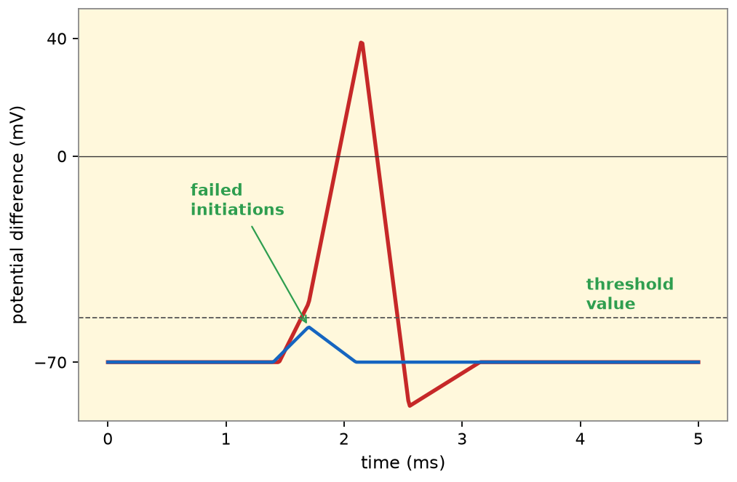
The all or nothing principle
A2 Biology
For an action potential to be generated, the stimulus must be greater than the threshold value.
A stimulus will be below the threshold value if insufficient numbers of sodium channels open, preventing full depolarization of the axon.
Once the threshold value is reached, the action potential generated is always the same size regardless of the strength of the stimulus. It is an ‘all or nothing’ response.
◀
▶
20 of 29
Original course © Boardworks Ltd 2009. Reconstructed interactive resource.
Notes:
Original static teaching slide. Graph rebuilt.

Slide 60
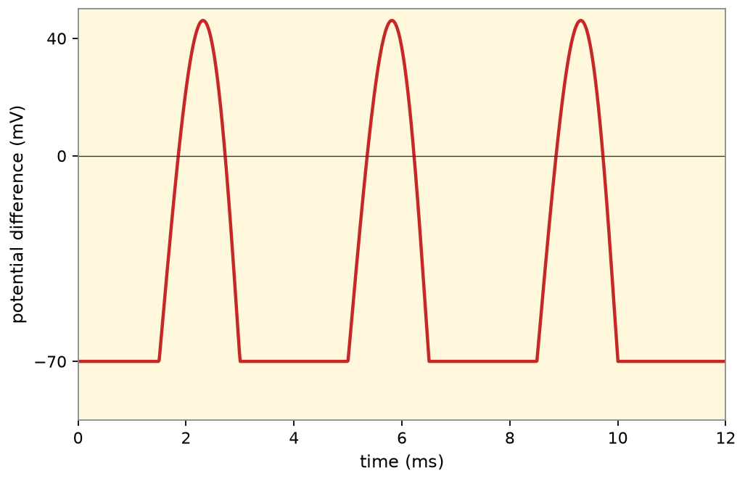
Different strengths of stimuli
A2 Biology
Changing the strength of the stimulus
Adjust the strength of the stimulus to see how this affects the frequency of an action potential.
weak
medium
strong
A stronger stimulus does not make a bigger action potential. It increases the frequency of action potentials.
◀
▶
21 of 29
Original course © Boardworks Ltd 2009. Reconstructed interactive resource.
Notes:
Rebuilt Flash slider. Weak/medium/strong buttons show different AP frequencies.

Slide 61
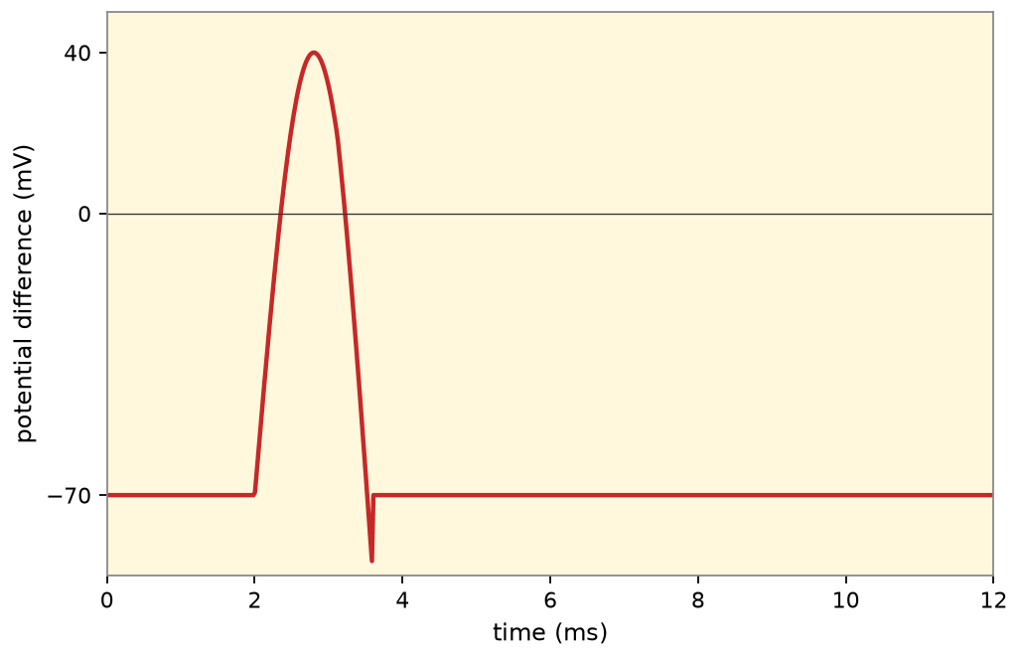
Different strengths of stimuli
A2 Biology
Weak (just above threshold): low frequency of action potentials.
Back
activity
Original course © Boardworks Ltd 2009. Reconstructed interactive resource.

Slide 62
Different strengths of stimuli
A2 Biology
Medium: higher frequency. Amplitude of each action potential is unchanged.
Back
activity
Original course © Boardworks Ltd 2009. Reconstructed interactive resource.

Slide 63
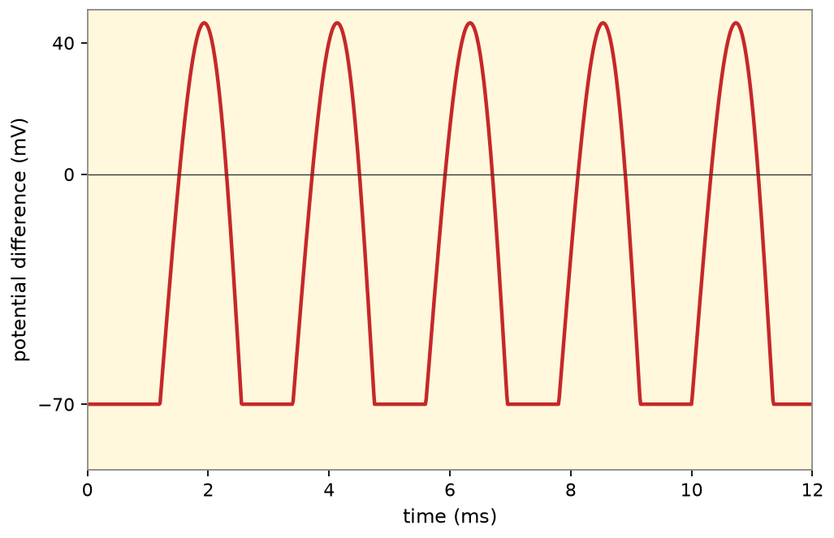
Different strengths of stimuli
A2 Biology
Strong: highest frequency. Still the same amplitude – all or nothing.
Back
activity
Original course © Boardworks Ltd 2009. Reconstructed interactive resource.

Slide 64
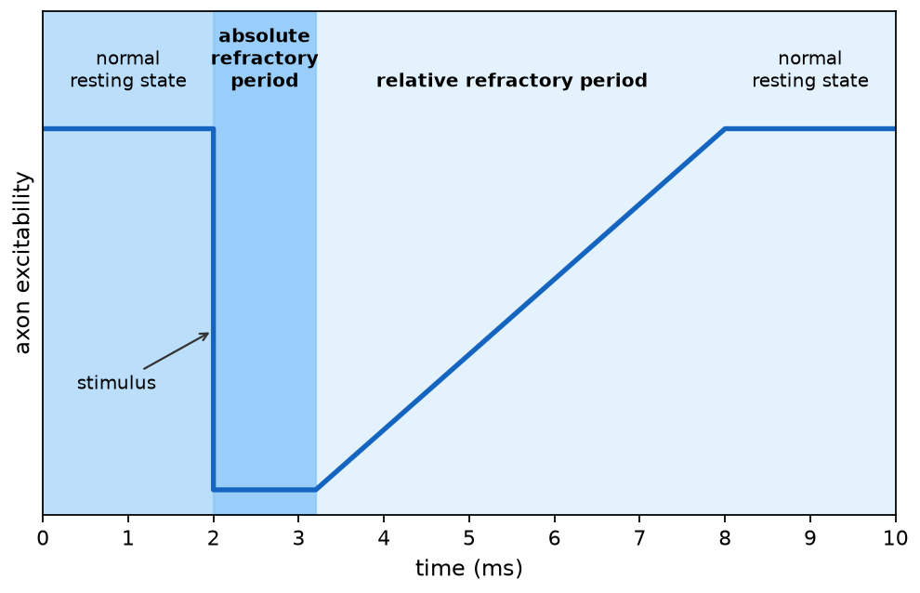
The axon after an action potential
A2 Biology
What is the refractory period?
Once an action potential has passed, the axon becomes inexcitable for a short period of time. Press on each area of the graph to learn more about how the axon excitability changes.
absolute refractory
relative refractory
◀
▶
22 of 29
Original course © Boardworks Ltd 2009. Reconstructed interactive resource.
Notes:
Rebuilt Flash click-on-graph for refractory periods.

Slide 65
The axon after an action potential
A2 Biology
Absolute refractory period
No new action potential can be generated, however strong the stimulus. Voltage-gated Na⁺ channels are inactivated and must reset. This also forces unidirectional propagation – the region behind the impulse cannot fire again yet.
Back
activity
Original course © Boardworks Ltd 2009. Reconstructed interactive resource.

Slide 66
The axon after an action potential
A2 Biology
Relative refractory period
A larger-than-normal stimulus can generate an action potential because some Na⁺ channels have recovered but the membrane is still hyperpolarised. Excitability rises back to normal as the resting potential is restored.
Back
activity
Original course © Boardworks Ltd 2009. Reconstructed interactive resource.

Slide 67
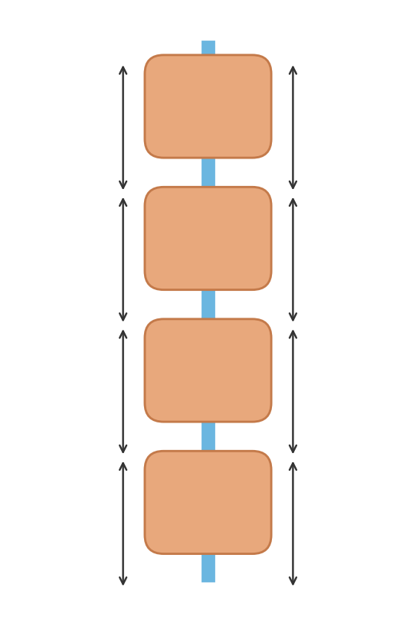
What affects the speed of an impulse?
A2 Biology
Step 1 of 4: Myelin and nodes
An action potential moves faster along myelinated neurones than those without a myelin sheath.
Ion channels at the nodes of Ranvier allow Na⁺ and K⁺ to cross. It is only at these points that an action potential is generated in a myelinated neurone.
◀
▶
Reset
Next step
23 of 29
Original course © Boardworks Ltd 2009. Reconstructed interactive resource.
Notes:
Rebuilt saltatory conduction animation plus the original speed-factor teaching points.

Slide 68
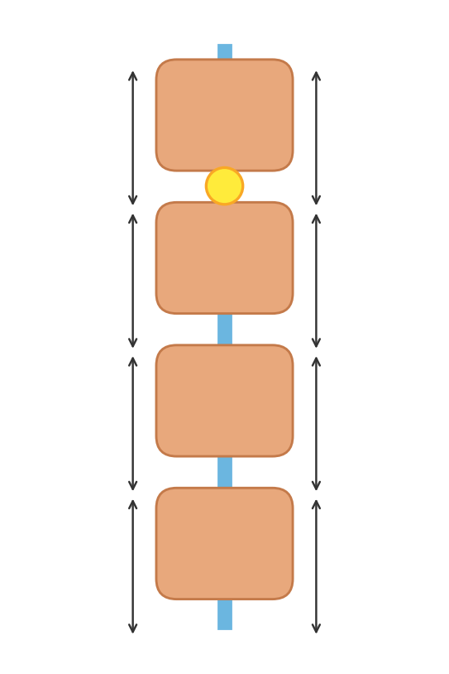
What affects the speed of an impulse?
A2 Biology
Step 2 of 4: Jumping from node to node
The action potential appears at a node. Local currents depolarise the next node. This jumping is saltatory conduction and is much quicker than step-by-step conduction in a non-myelinated axon.
◀
▶
Previous
Reset
Next step
24 of 29
Original course © Boardworks Ltd 2009. Reconstructed interactive resource.
Notes:
Rebuilt saltatory conduction animation plus the original speed-factor teaching points.

Slide 69
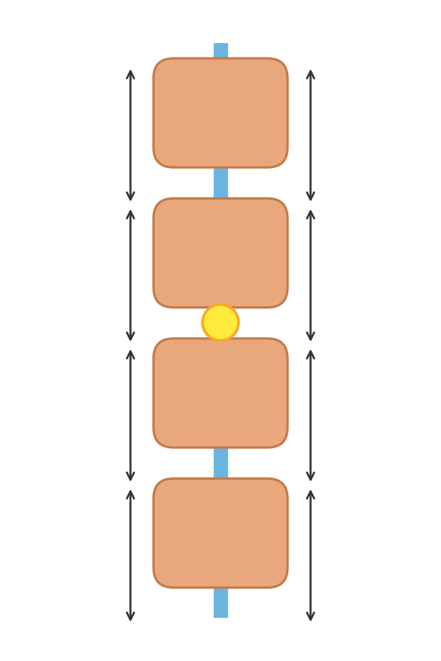
What affects the speed of an impulse?
A2 Biology
Step 3 of 4: Next node fires
The impulse ‘jumps’ to the next exposed node. Myelin prevents ion leakage in the internodes, so the local current remains strong enough to bring the distant node to threshold.
◀
▶
Previous
Reset
Next step
25 of 29
Original course © Boardworks Ltd 2009. Reconstructed interactive resource.
Notes:
Rebuilt saltatory conduction animation plus the original speed-factor teaching points.

Slide 70
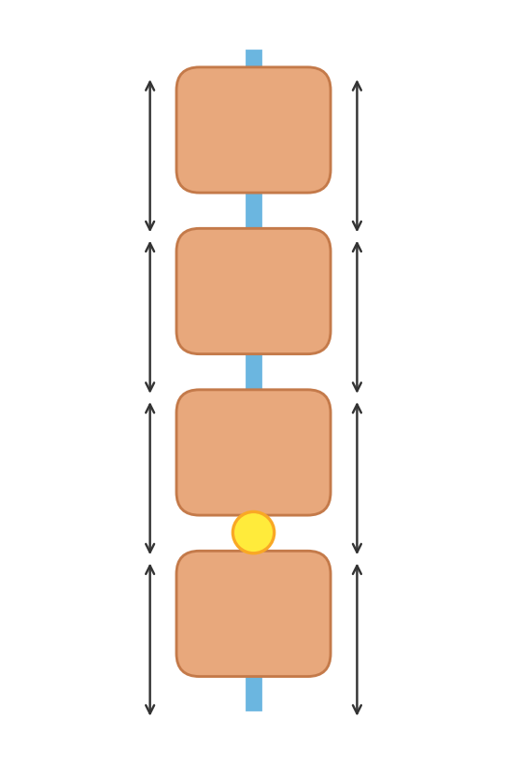
What affects the speed of an impulse?
A2 Biology
Step 4 of 4: Axon diameter and temperature
Greater axon diameter → faster impulse (smaller surface area to volume ratio, less ion leak).
Higher temperature → faster impulse (faster ion diffusion), until proteins denature. This is why local cooling slows nerves.
◀
▶
Previous
Reset
Continue
26 of 29
Original course © Boardworks Ltd 2009. Reconstructed interactive resource.
Notes:
Rebuilt saltatory conduction animation plus the original speed-factor teaching points.

Slide 71
What affects the speed of an impulse?
A2 Biology
The speed of a nerve impulse is also affected by:
Axon diameter – The greater the diameter of the axon the faster the impulse travels.
Axons with a small diameter have a larger surface area to volume ratio than axons with a large diameter. This causes a larger amount of ions to leak out of the axon, making it more difficult for an action potential to propagate.
Temperature – The higher the temperature, the faster the speed of the impulse. Temperature affects the rate of diffusion of ions across the axon.
◀
▶
27 of 29
Original course © Boardworks Ltd 2009. Reconstructed interactive resource.
Notes:
Original wording retained.

Slide 72
True or false?
A2 Biology
Are these statements about action potentials true or false?
1. Every stimulus detected by the sensory receptors causes an action potential to be generated.
true
false
2. An action potential is always the same size regardless of the strength of stimuli.
true
false
3. The amplitude of the action potential increases when the stimulus is stronger.
true
false
4. In an unmyelinated neurone an action potential will travel by saltatory conduction.
true
false
5. It is impossible for an action potential to be generated during the absolute refractory period.
true
false
◀
▶
Show all
Reset
28 of 29
Original course © Boardworks Ltd 2009. Reconstructed interactive resource.
Notes:
Click true or false for each statement. Show all reveals the key.

Slide 73
True or false?
A2 Biology
Incorrect. The statement is FALSE.
Every stimulus detected by the sensory receptors causes an action potential to be generated.
The generator potential must reach threshold. Subthreshold stimuli fail to trigger an action potential.
Back to quiz
activity
Original course © Boardworks Ltd 2009. Reconstructed interactive resource.

Slide 74
True or false?
A2 Biology
Correct. The statement is FALSE.
Every stimulus detected by the sensory receptors causes an action potential to be generated.
The generator potential must reach threshold. Subthreshold stimuli fail to trigger an action potential.
Back to quiz
activity
Original course © Boardworks Ltd 2009. Reconstructed interactive resource.

Slide 75
True or false?
A2 Biology
Correct. The statement is TRUE.
An action potential is always the same size regardless of the strength of stimuli.
All-or-nothing: once threshold is reached, amplitude is constant. Strength is coded by frequency.
Back to quiz
activity
Original course © Boardworks Ltd 2009. Reconstructed interactive resource.

Slide 76
True or false?
A2 Biology
Incorrect. The statement is TRUE.
An action potential is always the same size regardless of the strength of stimuli.
All-or-nothing: once threshold is reached, amplitude is constant. Strength is coded by frequency.
Back to quiz
activity
Original course © Boardworks Ltd 2009. Reconstructed interactive resource.

Slide 77
True or false?
A2 Biology
Incorrect. The statement is FALSE.
The amplitude of the action potential increases when the stimulus is stronger.
Amplitude stays the same. Frequency increases.
Back to quiz
activity
Original course © Boardworks Ltd 2009. Reconstructed interactive resource.

Slide 78
True or false?
A2 Biology
Correct. The statement is FALSE.
The amplitude of the action potential increases when the stimulus is stronger.
Amplitude stays the same. Frequency increases.
Back to quiz
activity
Original course © Boardworks Ltd 2009. Reconstructed interactive resource.

Slide 79
True or false?
A2 Biology
Incorrect. The statement is FALSE.
In an unmyelinated neurone an action potential will travel by saltatory conduction.
Saltatory conduction requires myelin and nodes of Ranvier. Unmyelinated axons use continuous conduction.
Back to quiz
activity
Original course © Boardworks Ltd 2009. Reconstructed interactive resource.

Slide 80
True or false?
A2 Biology
Correct. The statement is FALSE.
In an unmyelinated neurone an action potential will travel by saltatory conduction.
Saltatory conduction requires myelin and nodes of Ranvier. Unmyelinated axons use continuous conduction.
Back to quiz
activity
Original course © Boardworks Ltd 2009. Reconstructed interactive resource.

Slide 81
True or false?
A2 Biology
Correct. The statement is TRUE.
It is impossible for an action potential to be generated during the absolute refractory period.
Na⁺ channels are inactivated. No stimulus, however strong, can open enough of them.
Back to quiz
activity
Original course © Boardworks Ltd 2009. Reconstructed interactive resource.

Slide 82
True or false?
A2 Biology
Incorrect. The statement is TRUE.
It is impossible for an action potential to be generated during the absolute refractory period.
Na⁺ channels are inactivated. No stimulus, however strong, can open enough of them.
Back to quiz
activity
Original course © Boardworks Ltd 2009. Reconstructed interactive resource.

Slide 83
True or false? – answers
A2 Biology
1. FALSE. Every stimulus detected by the sensory receptors causes an action potential to be generated. The generator potential must reach threshold. Subthreshold stimuli fail to trigger an action potential.
2. TRUE. An action potential is always the same size regardless of the strength of stimuli. All-or-nothing: once threshold is reached, amplitude is constant. Strength is coded by frequency.
3. FALSE. The amplitude of the action potential increases when the stimulus is stronger. Amplitude stays the same. Frequency increases.
4. FALSE. In an unmyelinated neurone an action potential will travel by saltatory conduction. Saltatory conduction requires myelin and nodes of Ranvier. Unmyelinated axons use continuous conduction.
5. TRUE. It is impossible for an action potential to be generated during the absolute refractory period. Na⁺ channels are inactivated. No stimulus, however strong, can open enough of them.
Back to quiz
Continue
activity
Original course © Boardworks Ltd 2009. Reconstructed interactive resource.

Slide 84
End of Part 2
A2 Biology
Next: Part 3 – Sensory receptors
Back to contents
◀
▶
29 of 29
Original course © Boardworks Ltd 2009. Reconstructed interactive resource.

