Slide 1
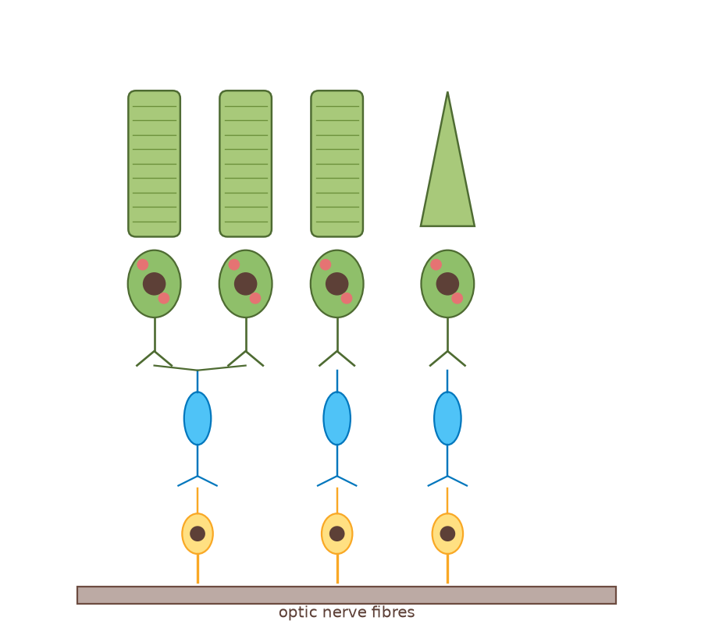
A2 Biology
The Nervous System
Part 3: Sensory receptors
◀
▶
Interactive reconstruction · Flash-free · Original course © Boardworks Ltd 2009
Original course © Boardworks Ltd 2009. Reconstructed interactive resource.

Slide 2
Contents
A2 Biology
1. the sensory nervous system
2. Pacinian corpuscle animation
3. photoreceptors in the retina
4. rod cells and rhodopsin
5. cone cells and iodopsin
6. rods vs cones sorting
7. knowledge check
◀
▶
2 of 14
Original course © Boardworks Ltd 2009. Reconstructed interactive resource.

Slide 3
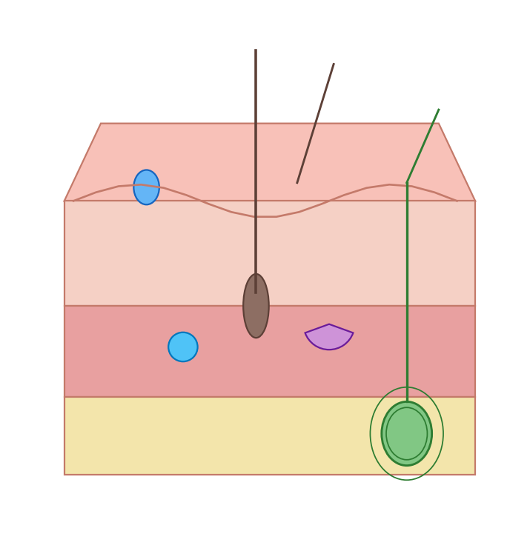
The sensory nervous system
A2 Biology
Receptors are specialized cells that can detect changes in the body’s internal and external environment. Most receptor cells are only sensitive to one type of stimulus.
Receptors convert the energy of the stimulus into the start of a nerve impulse known as a generator potential.
For example, mechanoreceptors detect changes in mechanical energy, such as pressure.
◀
mechanoreceptor in the skin
▶
3 of 14
Original course © Boardworks Ltd 2009. Reconstructed interactive resource.
Notes:
Original wording retained. Skin-block diagram rebuilt (Pacinian corpuscle highlighted in later slides).

Slide 4
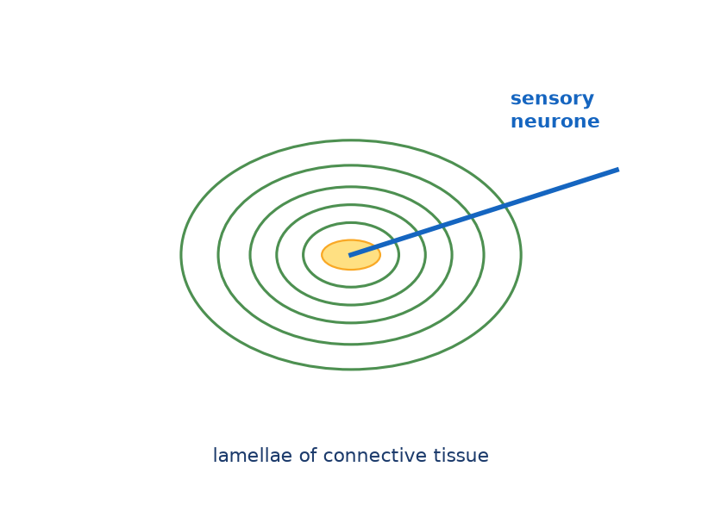
Mechanoreceptors in the skin
A2 Biology
Step 1 of 4: Pacinian corpuscle at rest
Mechanoreceptors within the skin can detect pressure. The Pacinian corpuscle is a pressure receptor in the dermis/hypodermis. It has concentric lamellae of connective tissue around a sensory neurone ending.
◀
▶
Reset
Next step
4 of 14
Original course © Boardworks Ltd 2009. Reconstructed interactive resource.
Notes:
Rebuilt Flash play animation of pressure transduction in a Pacinian corpuscle.

Slide 5
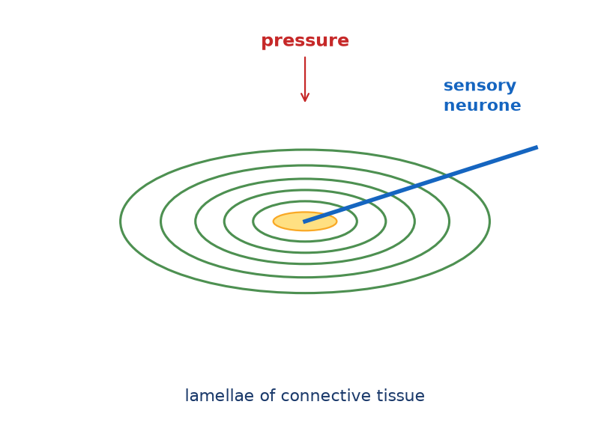
Mechanoreceptors in the skin
A2 Biology
Step 2 of 4: Pressure deforms the lamellae
Pressure deforms the lamellae and stretches the neurone ending in the centre. Stretch-mediated sodium channels in the membrane open.
◀
▶
Previous
Reset
Next step
5 of 14
Original course © Boardworks Ltd 2009. Reconstructed interactive resource.
Notes:
Rebuilt Flash play animation of pressure transduction in a Pacinian corpuscle.

Slide 6
Mechanoreceptors in the skin
A2 Biology
Step 3 of 4: Generator potential
Na⁺ enters and the membrane depolarises – a generator potential. The greater the pressure, the greater the deformation and the larger the generator potential (it is graded).
◀
▶
Previous
Reset
Next step
6 of 14
Original course © Boardworks Ltd 2009. Reconstructed interactive resource.
Notes:
Rebuilt Flash play animation of pressure transduction in a Pacinian corpuscle.

Slide 7
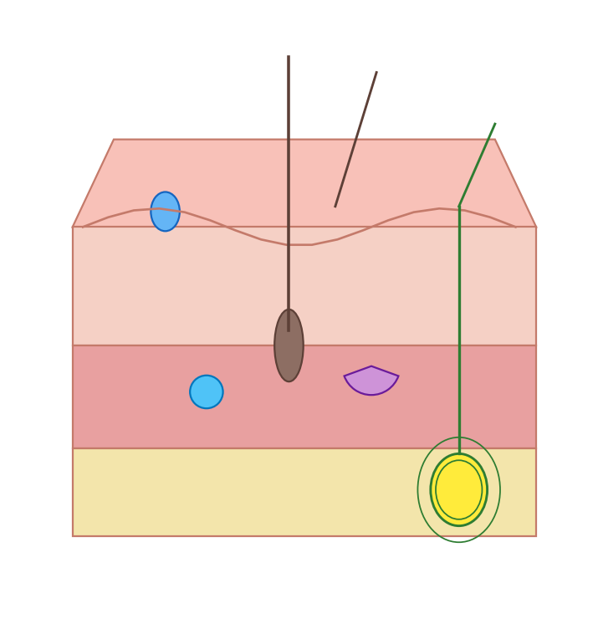
Mechanoreceptors in the skin
A2 Biology
Step 4 of 4: If threshold is reached
If the generator potential reaches threshold, voltage-gated Na⁺ channels open and an action potential fires along the sensory neurone towards the CNS. This is how mechanical energy is transduced into electrical energy.
◀
▶
Previous
Reset
Continue
7 of 14
Original course © Boardworks Ltd 2009. Reconstructed interactive resource.
Notes:
Rebuilt Flash play animation of pressure transduction in a Pacinian corpuscle.

Slide 8
Photoreceptors in the retina
A2 Biology
What cells are found in the retina?
The retina is a photosensitive layer at the back of the eye. It contains two types of photoreceptors called rods and cones, which respond to different light intensities.
Press on each label to find out more about the cells of the retina.
cone cell ▶
rod cell ▶
bipolar cell ▶
ganglion cell ▶
optic nerve ▶
◀
▶
Reset
8 of 14
Original course © Boardworks Ltd 2009. Reconstructed interactive resource.
Notes:
Rebuilt Flash click-label retina activity.

Slide 9
Photoreceptors in the retina
A2 Biology
Cone cell
Photoreceptor for high light intensity and colour. Outer segment is conical. Concentrated in the fovea. Contains iodopsin. Usually a 1:1 link to a bipolar cell – high visual acuity.
Back
activity
Original course © Boardworks Ltd 2009. Reconstructed interactive resource.

Slide 10
Photoreceptors in the retina
A2 Biology
Rod cell
Photoreceptor for dim light (scotopic vision). Outer segment is rod-shaped with many rhodopsin discs. Many rods synapse with one bipolar cell (retinal convergence) – high sensitivity, lower acuity. Absent from the fovea.
Back
activity
Original course © Boardworks Ltd 2009. Reconstructed interactive resource.

Slide 11
Photoreceptors in the retina
A2 Biology
Bipolar cell
Connects photoreceptors to ganglion cells. In rod pathways, several rods share a bipolar cell (summation of generator potentials). In cone pathways at the fovea, the link is often one-to-one.
Back
activity
Original course © Boardworks Ltd 2009. Reconstructed interactive resource.

Slide 12
Photoreceptors in the retina
A2 Biology
Ganglion cell
Its axon forms part of the optic nerve. An action potential is generated in the ganglion cell, not in the rod or cone themselves. The optic disc (blind spot) is where these axons leave the eye.
Back
activity
Original course © Boardworks Ltd 2009. Reconstructed interactive resource.

Slide 13
Photoreceptors in the retina
A2 Biology
Optic nerve
Bundle of ganglion-cell axons leaving at the blind spot. There are no photoreceptors here, so an image falling on the optic disc is not seen.
Back
activity
Original course © Boardworks Ltd 2009. Reconstructed interactive resource.

Slide 14
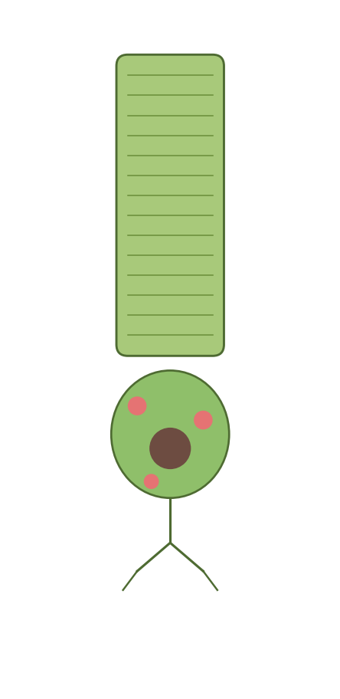
How do rod cells produce impulses?
A2 Biology
Rod cells allow vision in dim light due to the presence of a pigment called rhodopsin, which is found in membrane-bound vesicles.
When rhodopsin absorbs light it splits into its constituent parts, opsin and retinal. This is called bleaching. Low intensity light is sufficient to cause this breakdown.
The presence of opsin causes a change in the permeability of the rod cell to sodium, which initiates a generator potential. Rhodopsin can reform in the absence of further light stimulation.
vesicles containing rhodopsin
◀
▶
9 of 14
Original course © Boardworks Ltd 2009. Reconstructed interactive resource.
Notes:
Original wording retained. At A-level, bleaching of rhodopsin → opsin + retinal → generator potential is the required sequence. (More advanced courses note that light actually closes Na⁺ channels in rods; the Boardworks 2009 wording is kept here as in the source course.)

Slide 15
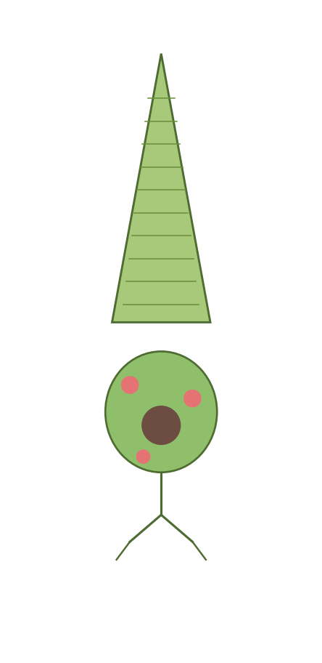
How do cone cells produce impulses?
A2 Biology
Cone cells are sensitive to high light intensities due to the presence of the pigment iodopsin.
In bright light, iodopsin is broken down into its constituent parts, generating an action potential in the ganglion cell.
There are three different types of cone cell, each containing a different form of iodopsin. Each form of iodopsin absorbs a different wavelength of light – green, blue or red.
The colour seen depends on the relative degree of stimulation of the three different types of cone cell.
vesicles containing iodopsin
◀
▶
10 of 14
Original course © Boardworks Ltd 2009. Reconstructed interactive resource.
Notes:
Original wording retained. Trichromatic theory: three iodopsin forms, colour from relative stimulation.

Slide 16
Photoreceptors
A2 Biology
Do these statements apply to rods or cones?
Click a statement, then place it.
mostly used for night vision
contain rhodopsin
contain iodopsin
concentrated in the fovea
high sensitivity, lower acuity
three types detect colour
many share one bipolar cell
work in bright light
◀
▶
Check
Reset
11 of 14
Original course © Boardworks Ltd 2009. Reconstructed interactive resource.
Notes:
Rebuilt Flash rods/cones sort. Original first card was ‘mostly used for night vision’ (rods).

Slide 17
Photoreceptors
A2 Biology
mostly used for night vision
Does this describe rods or cones?
rods
cones
activity
Original course © Boardworks Ltd 2009. Reconstructed interactive resource.

Slide 18
Photoreceptors
A2 Biology
Correct – rods.
mostly used for night vision
Back to sort
activity
Original course © Boardworks Ltd 2009. Reconstructed interactive resource.

Slide 19
Photoreceptors
A2 Biology
Not quite.
‘mostly used for night vision’ describes rods, not cones.
Back to sort
activity
Original course © Boardworks Ltd 2009. Reconstructed interactive resource.

Slide 20
Photoreceptors
A2 Biology
contain rhodopsin
Does this describe rods or cones?
rods
cones
activity
Original course © Boardworks Ltd 2009. Reconstructed interactive resource.

Slide 21
Photoreceptors
A2 Biology
Correct – rods.
contain rhodopsin
Back to sort
activity
Original course © Boardworks Ltd 2009. Reconstructed interactive resource.

Slide 22
Photoreceptors
A2 Biology
Not quite.
‘contain rhodopsin’ describes rods, not cones.
Back to sort
activity
Original course © Boardworks Ltd 2009. Reconstructed interactive resource.

Slide 23
Photoreceptors
A2 Biology
contain iodopsin
Does this describe rods or cones?
rods
cones
activity
Original course © Boardworks Ltd 2009. Reconstructed interactive resource.

Slide 24
Photoreceptors
A2 Biology
Not quite.
‘contain iodopsin’ describes cones, not rods.
Back to sort
activity
Original course © Boardworks Ltd 2009. Reconstructed interactive resource.

Slide 25
Photoreceptors
A2 Biology
Correct – cones.
contain iodopsin
Back to sort
activity
Original course © Boardworks Ltd 2009. Reconstructed interactive resource.

Slide 26
Photoreceptors
A2 Biology
concentrated in the fovea
Does this describe rods or cones?
rods
cones
activity
Original course © Boardworks Ltd 2009. Reconstructed interactive resource.

Slide 27
Photoreceptors
A2 Biology
Not quite.
‘concentrated in the fovea’ describes cones, not rods.
Back to sort
activity
Original course © Boardworks Ltd 2009. Reconstructed interactive resource.

Slide 28
Photoreceptors
A2 Biology
Correct – cones.
concentrated in the fovea
Back to sort
activity
Original course © Boardworks Ltd 2009. Reconstructed interactive resource.

Slide 29
Photoreceptors
A2 Biology
high sensitivity, lower acuity
Does this describe rods or cones?
rods
cones
activity
Original course © Boardworks Ltd 2009. Reconstructed interactive resource.

Slide 30
Photoreceptors
A2 Biology
Correct – rods.
high sensitivity, lower acuity
Back to sort
activity
Original course © Boardworks Ltd 2009. Reconstructed interactive resource.

Slide 31
Photoreceptors
A2 Biology
Not quite.
‘high sensitivity, lower acuity’ describes rods, not cones.
Back to sort
activity
Original course © Boardworks Ltd 2009. Reconstructed interactive resource.

Slide 32
Photoreceptors
A2 Biology
three types detect colour
Does this describe rods or cones?
rods
cones
activity
Original course © Boardworks Ltd 2009. Reconstructed interactive resource.

Slide 33
Photoreceptors
A2 Biology
Not quite.
‘three types detect colour’ describes cones, not rods.
Back to sort
activity
Original course © Boardworks Ltd 2009. Reconstructed interactive resource.

Slide 34
Photoreceptors
A2 Biology
Correct – cones.
three types detect colour
Back to sort
activity
Original course © Boardworks Ltd 2009. Reconstructed interactive resource.

Slide 35
Photoreceptors
A2 Biology
many share one bipolar cell
Does this describe rods or cones?
rods
cones
activity
Original course © Boardworks Ltd 2009. Reconstructed interactive resource.

Slide 36
Photoreceptors
A2 Biology
Correct – rods.
many share one bipolar cell
Back to sort
activity
Original course © Boardworks Ltd 2009. Reconstructed interactive resource.

Slide 37
Photoreceptors
A2 Biology
Not quite.
‘many share one bipolar cell’ describes rods, not cones.
Back to sort
activity
Original course © Boardworks Ltd 2009. Reconstructed interactive resource.

Slide 38
Photoreceptors
A2 Biology
work in bright light
Does this describe rods or cones?
rods
cones
activity
Original course © Boardworks Ltd 2009. Reconstructed interactive resource.

Slide 39
Photoreceptors
A2 Biology
Not quite.
‘work in bright light’ describes cones, not rods.
Back to sort
activity
Original course © Boardworks Ltd 2009. Reconstructed interactive resource.

Slide 40
Photoreceptors
A2 Biology
Correct – cones.
work in bright light
Back to sort
activity
Original course © Boardworks Ltd 2009. Reconstructed interactive resource.

Slide 41
Photoreceptors – answers
A2 Biology
RODS
• mostly used for night vision
• contain rhodopsin
• high sensitivity, lower acuity
• many share one bipolar cell
CONES
• contain iodopsin
• concentrated in the fovea
• three types detect colour
• work in bright light
Back
activity
Original course © Boardworks Ltd 2009. Reconstructed interactive resource.

Slide 42
Knowledge check
A2 Biology
A Pacinian corpuscle produces a generator potential when:
A stretch-mediated sodium channels open and Na⁺ enters
B iodopsin is bleached by dim light
C voltage-gated potassium channels close permanently
D acetylcholine is released from the lamellae
◀
▶
12 of 14
Original course © Boardworks Ltd 2009. Reconstructed interactive resource.
Notes:
Correct = A. Pressure deforms the ending, stretch-mediated Na⁺ channels open, Na⁺ influx creates a graded generator potential.

Slide 43
Knowledge check
A2 Biology
Correct.
Pressure deforms the ending, stretch-mediated Na⁺ channels open, Na⁺ influx creates a graded generator potential.
Continue
activity
Original course © Boardworks Ltd 2009. Reconstructed interactive resource.

Slide 44
Knowledge check
A2 Biology
Not quite.
Think about transduction of mechanical energy in the Pacinian corpuscle.
Try again
activity
Original course © Boardworks Ltd 2009. Reconstructed interactive resource.

Slide 45
Knowledge check
A2 Biology
Not quite.
Think about transduction of mechanical energy in the Pacinian corpuscle.
Try again
activity
Original course © Boardworks Ltd 2009. Reconstructed interactive resource.

Slide 46
Knowledge check
A2 Biology
Not quite.
Think about transduction of mechanical energy in the Pacinian corpuscle.
Try again
activity
Original course © Boardworks Ltd 2009. Reconstructed interactive resource.

Slide 47
Knowledge check
A2 Biology
Which statement about rods is correct?
A They contain iodopsin and give high visual acuity
B They contain rhodopsin and are used in dim light
C They are concentrated in the fovea
D Each rod has a 1:1 connection to a ganglion cell at the fovea
◀
▶
13 of 14
Original course © Boardworks Ltd 2009. Reconstructed interactive resource.
Notes:
Correct = B. Rods use rhodopsin, operate in dim light, show convergence, and are absent from the fovea.

Slide 48
Knowledge check
A2 Biology
Correct.
Rods use rhodopsin, operate in dim light, show convergence, and are absent from the fovea.
Continue
activity
Original course © Boardworks Ltd 2009. Reconstructed interactive resource.

Slide 49
Knowledge check
A2 Biology
Not quite.
Compare pigment, location and connectivity of rods and cones.
Try again
activity
Original course © Boardworks Ltd 2009. Reconstructed interactive resource.

Slide 50
Knowledge check
A2 Biology
Not quite.
Compare pigment, location and connectivity of rods and cones.
Try again
activity
Original course © Boardworks Ltd 2009. Reconstructed interactive resource.

Slide 51
Knowledge check
A2 Biology
Not quite.
Compare pigment, location and connectivity of rods and cones.
Try again
activity
Original course © Boardworks Ltd 2009. Reconstructed interactive resource.

Slide 52
End of Part 3
A2 Biology
Next: Part 4 – The synapse
Back to contents
◀
▶
14 of 14
Original course © Boardworks Ltd 2009. Reconstructed interactive resource.

