Slide 1
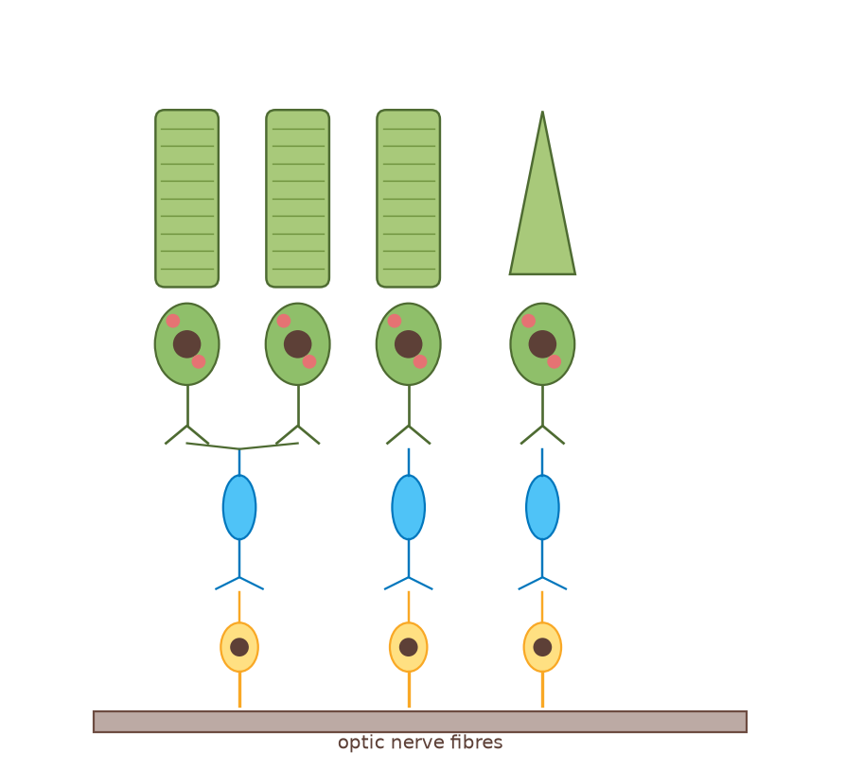
A2 Biology
The Nervous System
Part 4: The synapse
◀
▶
Interactive reconstruction · Flash-free · Original course © Boardworks Ltd 2009
Original course © Boardworks Ltd 2009. Reconstructed interactive resource.

Slide 2
Contents
A2 Biology
1. what happens at a synapse? (animation)
2. features of a synapse
3. transmission sequence
4. structure – labelling
5. knowledge check
◀
▶
2 of 16
Original course © Boardworks Ltd 2009. Reconstructed interactive resource.

Slide 3
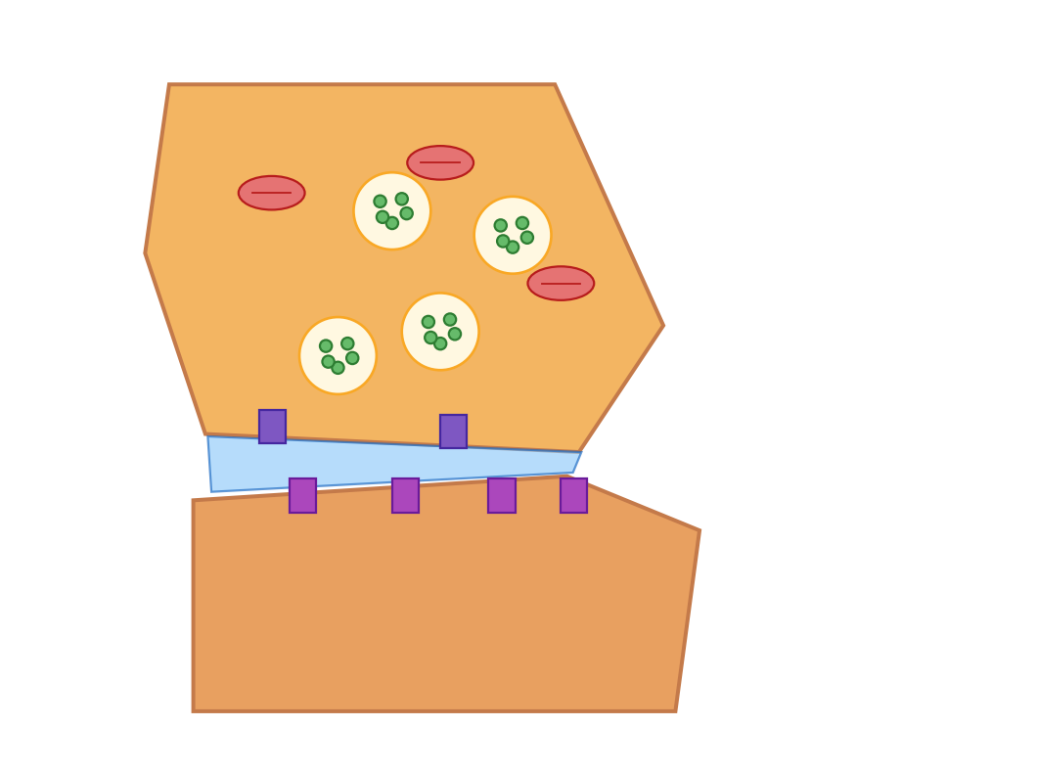
What happens at a synapse?
A2 Biology
Step 1 of 8: The junction
Nervous impulses can be transmitted from one neurone to another. This transfer occurs at a junction called the synapse. Press Next step to watch neurotransmitter release, diffusion, binding and the postsynaptic response.
◀
▶
Reset
Next step
3 of 16
Original course © Boardworks Ltd 2009. Reconstructed interactive resource.
Notes:
Rebuilt Flash synapse animation as an 8-step sequence covering AP arrival, Ca²⁺ entry, vesicle fusion, ACh diffusion, receptor binding and postsynaptic depolarisation.

Slide 4
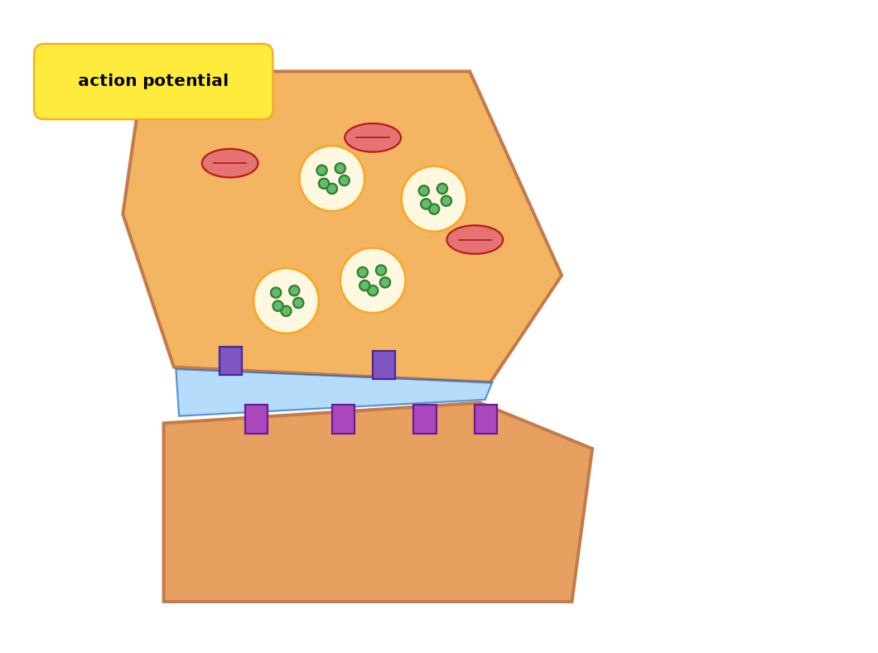
What happens at a synapse?
A2 Biology
Step 2 of 8: Action potential arrives
An action potential reaches the synaptic knob of the presynaptic neurone. The membrane depolarises.
◀
▶
Previous
Reset
Next step
4 of 16
Original course © Boardworks Ltd 2009. Reconstructed interactive resource.
Notes:
Rebuilt Flash synapse animation as an 8-step sequence covering AP arrival, Ca²⁺ entry, vesicle fusion, ACh diffusion, receptor binding and postsynaptic depolarisation.

Slide 5

What happens at a synapse?
A2 Biology
Step 3 of 8: Calcium ions enter
Voltage-gated calcium channels open. Ca²⁺ diffuses into the synaptic knob down its concentration gradient.
◀
▶
Previous
Reset
Next step
5 of 16
Original course © Boardworks Ltd 2009. Reconstructed interactive resource.
Notes:
Rebuilt Flash synapse animation as an 8-step sequence covering AP arrival, Ca²⁺ entry, vesicle fusion, ACh diffusion, receptor binding and postsynaptic depolarisation.

Slide 6
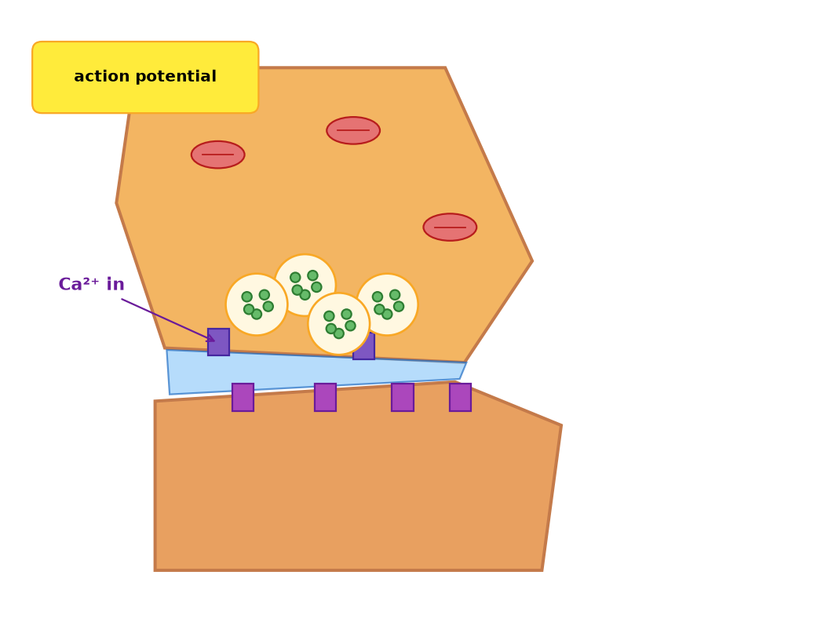
What happens at a synapse?
A2 Biology
Step 4 of 8: Vesicles move
Ca²⁺ causes synaptic vesicles to move to and fuse with the presynaptic membrane.
◀
▶
Previous
Reset
Next step
6 of 16
Original course © Boardworks Ltd 2009. Reconstructed interactive resource.
Notes:
Rebuilt Flash synapse animation as an 8-step sequence covering AP arrival, Ca²⁺ entry, vesicle fusion, ACh diffusion, receptor binding and postsynaptic depolarisation.

Slide 7
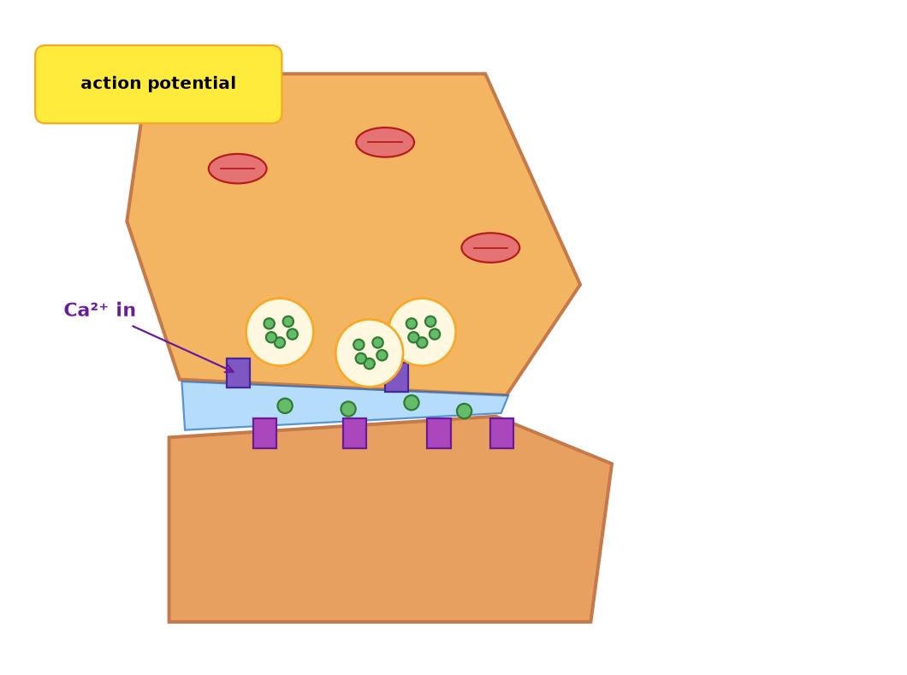
What happens at a synapse?
A2 Biology
Step 5 of 8: Acetylcholine released
Vesicles release acetylcholine (ACh) into the synaptic cleft by exocytosis.
◀
▶
Previous
Reset
Next step
7 of 16
Original course © Boardworks Ltd 2009. Reconstructed interactive resource.
Notes:
Rebuilt Flash synapse animation as an 8-step sequence covering AP arrival, Ca²⁺ entry, vesicle fusion, ACh diffusion, receptor binding and postsynaptic depolarisation.

Slide 8
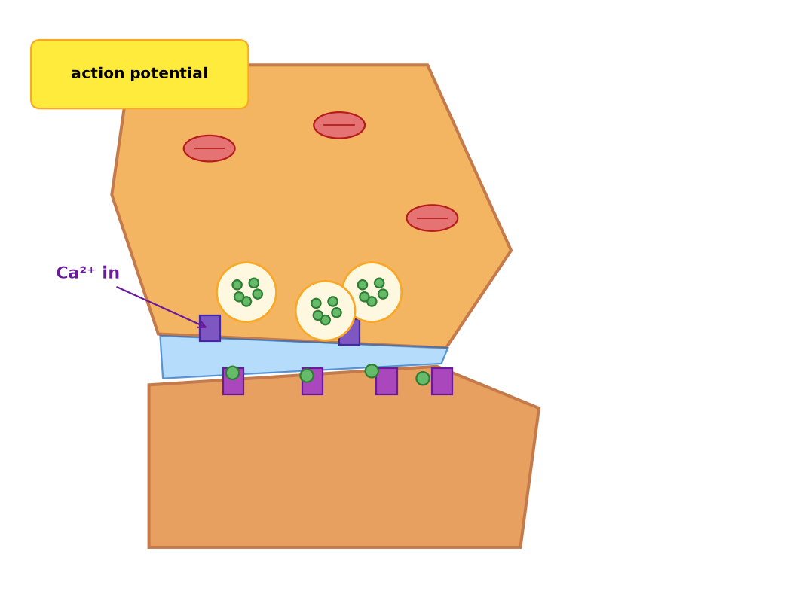
What happens at a synapse?
A2 Biology
Step 6 of 8: Diffusion across the cleft
ACh diffuses across the synaptic cleft (about 20–30 nm). This is the reason synaptic transmission is slower than electrical conduction along an axon.
◀
▶
Previous
Reset
Next step
8 of 16
Original course © Boardworks Ltd 2009. Reconstructed interactive resource.
Notes:
Rebuilt Flash synapse animation as an 8-step sequence covering AP arrival, Ca²⁺ entry, vesicle fusion, ACh diffusion, receptor binding and postsynaptic depolarisation.

Slide 9
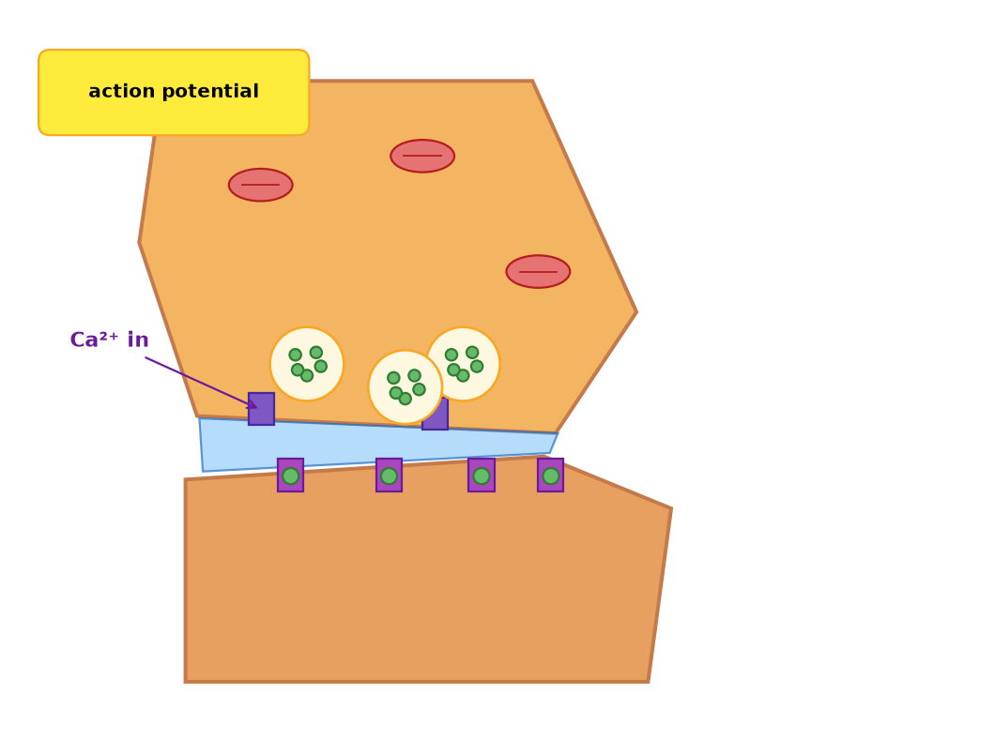
What happens at a synapse?
A2 Biology
Step 7 of 8: Receptor binding
ACh binds to complementary receptors on the postsynaptic membrane. This opens ligand-gated sodium channels.
◀
▶
Previous
Reset
Next step
9 of 16
Original course © Boardworks Ltd 2009. Reconstructed interactive resource.
Notes:
Rebuilt Flash synapse animation as an 8-step sequence covering AP arrival, Ca²⁺ entry, vesicle fusion, ACh diffusion, receptor binding and postsynaptic depolarisation.

Slide 10
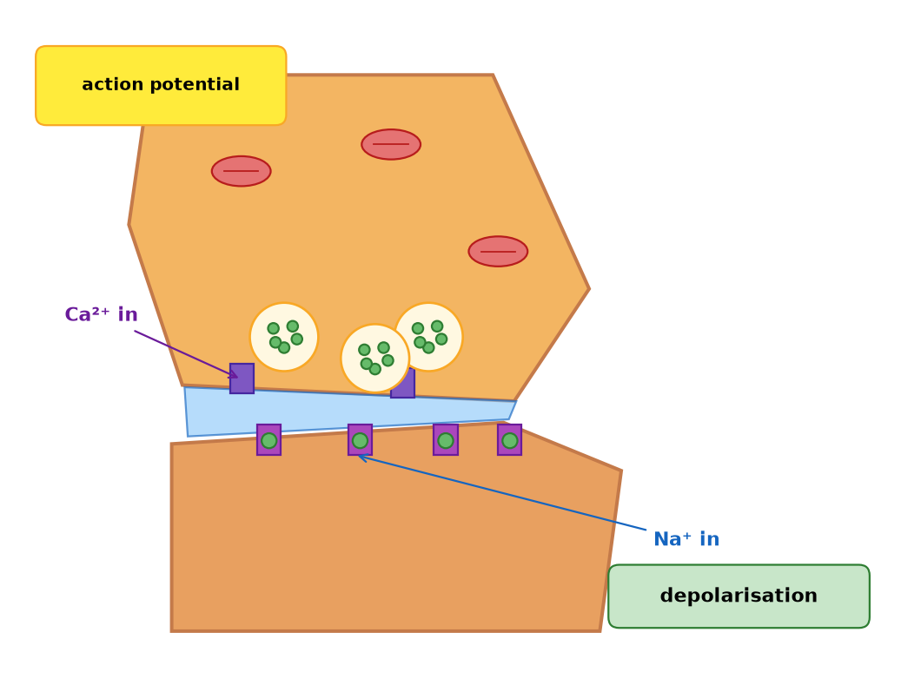
What happens at a synapse?
A2 Biology
Step 8 of 8: Postsynaptic response
Na⁺ enters the postsynaptic neurone. If the excitatory postsynaptic potential reaches threshold, an action potential is generated. ACh is then hydrolysed by acetylcholinesterase so the membrane can repolarise.
◀
▶
Previous
Reset
Continue
10 of 16
Original course © Boardworks Ltd 2009. Reconstructed interactive resource.
Notes:
Rebuilt Flash synapse animation as an 8-step sequence covering AP arrival, Ca²⁺ entry, vesicle fusion, ACh diffusion, receptor binding and postsynaptic depolarisation.

Slide 11
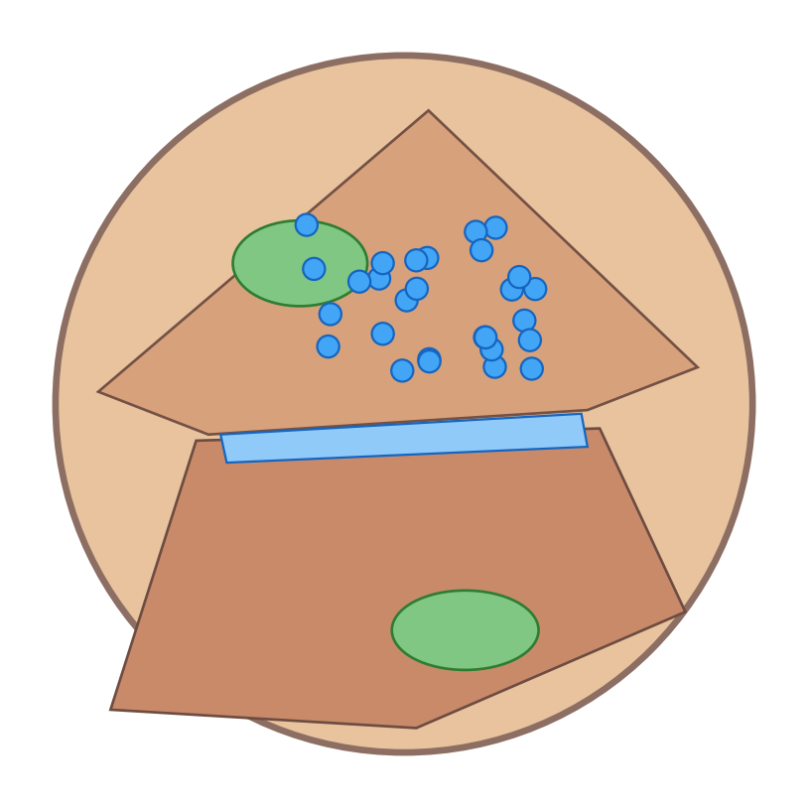
What are the main features?
A2 Biology
The features of a synapse
Which structures can you identify?
Which cell is the presynaptic neurone?
show diagram
identify structures
which is presynaptic?
◀
▶
11 of 16
Original course © Boardworks Ltd 2009. Reconstructed interactive resource.
Notes:
Original Flash toggle (micrograph / diagram) rebuilt. The electron-micrograph lookalike is an original illustration, not the copyrighted TEM image.

Slide 12
What are the main features?
A2 Biology
2D diagram of a cholinergic synapse.
Orange: presynaptic knob (vesicles, mitochondria, Ca²⁺ channels).
Blue band: synaptic cleft.
Lower cell: postsynaptic membrane with receptors.
Back
activity
Original course © Boardworks Ltd 2009. Reconstructed interactive resource.

Slide 13
What are the main features?
A2 Biology
Synaptic vesicles (contain neurotransmitter)
Mitochondria (ATP for exocytosis and pumps)
Presynaptic membrane with voltage-gated Ca²⁺ channels
Synaptic cleft (diffusion pathway)
Postsynaptic receptors / ligand-gated Na⁺ channels
Postsynaptic neurone
Back
activity
Original course © Boardworks Ltd 2009. Reconstructed interactive resource.

Slide 14
What are the main features?
A2 Biology
The presynaptic neurone is the one that contains the synaptic vesicles (the upper cell in the diagram).
It is the cell that arrives with the action potential and releases neurotransmitter. The postsynaptic cell has the receptors and, if threshold is reached, fires the next action potential.
Synapses are unidirectional because vesicles are only in the presynaptic knob and receptors only on the postsynaptic membrane.
Back
activity
Original course © Boardworks Ltd 2009. Reconstructed interactive resource.

Slide 15
Transmission across a synapse
A2 Biology
What is the sequence in events across a synapse?
The statements are jumbled (as in the original). Click Check to see the correct order.
1
Calcium channels in the membrane open and ions move in.
2
An action potential is generated in the postsynaptic neurone.
3
Synaptic vesicles move towards the presynaptic membrane.
4
An action potential arrives at the presynaptic neurone.
5
Vesicles fuse with the membrane, releasing acetylcholine.
6
Acetylcholine binds to receptors on the postsynaptic cell.
7
Sodium channels on the postsynaptic membrane open.
8
Sodium ions move into the cell, causing it to depolarize.
◀
▶
Check
Reset
12 of 16
Original course © Boardworks Ltd 2009. Reconstructed interactive resource.
Notes:
Original Flash sequencing activity. Shuffled order retained from the source slide. Correct order: 4, 1, 3, 5, 6, 7, 8, 2 of the numbered source list (AP arrives → Ca²⁺ in → vesicles move → ACh released → bind → Na⁺ channels open → Na⁺ in / depolarise → postsynaptic AP).

Slide 16
Transmission – correct order
A2 Biology
Correct sequence
1
An action potential arrives at the presynaptic neurone.
2
Calcium channels in the membrane open and ions move in.
3
Synaptic vesicles move towards the presynaptic membrane.
4
Vesicles fuse with the membrane, releasing acetylcholine.
5
Acetylcholine binds to receptors on the postsynaptic cell.
6
Sodium channels on the postsynaptic membrane open.
7
Sodium ions move into the cell, causing it to depolarize.
8
An action potential is generated in the postsynaptic neurone.
Back
activity
Original course © Boardworks Ltd 2009. Reconstructed interactive resource.

Slide 17
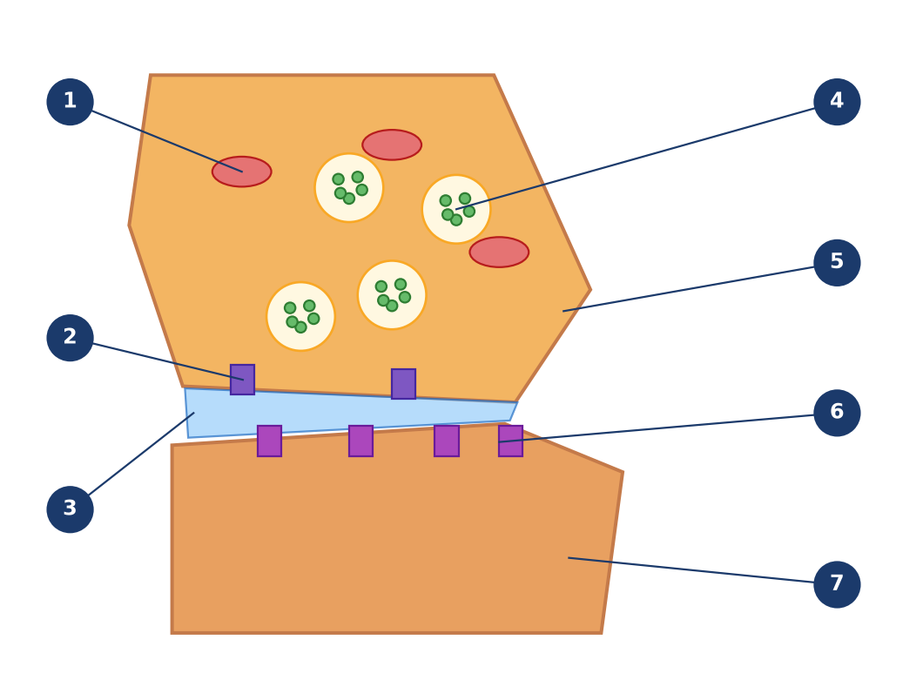
The structure of the synapse
A2 Biology
What are the main features of a synapse?
1
4
5
2
6
3
7
Click a numbered hotspot, then choose the correct label from the list.
◀
▶
Check
Reset
13 of 16
Original course © Boardworks Ltd 2009. Reconstructed interactive resource.
Notes:
Rebuilt Flash drop-down labelling. Seven structures around the synaptic knob and cleft.

Slide 18
The structure of the synapse
A2 Biology
Choose the correct label
mitochondrion
voltage-gated Ca²⁺ channel
synaptic cleft
synaptic vesicle
presynaptic membrane
receptor (ligand-gated Na⁺ channel)
postsynaptic membrane
activity
Original course © Boardworks Ltd 2009. Reconstructed interactive resource.

Slide 19
The structure of the synapse
A2 Biology
Correct – 1 Mitochondrion
Provides ATP for active transport (Na⁺/K⁺ pump, Ca²⁺ removal) and for vesicle recycling / exocytosis.
Back to diagram
activity
Original course © Boardworks Ltd 2009. Reconstructed interactive resource.

Slide 20
The structure of the synapse
A2 Biology
Not that one.
Look at the position of the leader line and try again.
Try again
activity
Original course © Boardworks Ltd 2009. Reconstructed interactive resource.

Slide 21
The structure of the synapse
A2 Biology
Choose the correct label
mitochondrion
voltage-gated Ca²⁺ channel
synaptic cleft
synaptic vesicle
presynaptic membrane
receptor (ligand-gated Na⁺ channel)
postsynaptic membrane
activity
Original course © Boardworks Ltd 2009. Reconstructed interactive resource.

Slide 22
The structure of the synapse
A2 Biology
Correct – 2 Voltage-gated Ca²⁺ channel
Opens when the action potential depolarises the presynaptic membrane, allowing Ca²⁺ in.
Back to diagram
activity
Original course © Boardworks Ltd 2009. Reconstructed interactive resource.

Slide 23
The structure of the synapse
A2 Biology
Not that one.
Look at the position of the leader line and try again.
Try again
activity
Original course © Boardworks Ltd 2009. Reconstructed interactive resource.

Slide 24
The structure of the synapse
A2 Biology
Choose the correct label
mitochondrion
voltage-gated Ca²⁺ channel
synaptic cleft
synaptic vesicle
presynaptic membrane
receptor (ligand-gated Na⁺ channel)
postsynaptic membrane
activity
Original course © Boardworks Ltd 2009. Reconstructed interactive resource.

Slide 25
The structure of the synapse
A2 Biology
Correct – 3 Synaptic cleft
Narrow gap between the two neurones. Neurotransmitter diffuses across it. It also ensures the impulse cannot jump electrically, keeping the synapse unidirectional and integrable.
Back to diagram
activity
Original course © Boardworks Ltd 2009. Reconstructed interactive resource.

Slide 26
The structure of the synapse
A2 Biology
Not that one.
Look at the position of the leader line and try again.
Try again
activity
Original course © Boardworks Ltd 2009. Reconstructed interactive resource.

Slide 27
The structure of the synapse
A2 Biology
Choose the correct label
mitochondrion
voltage-gated Ca²⁺ channel
synaptic cleft
synaptic vesicle
presynaptic membrane
receptor (ligand-gated Na⁺ channel)
postsynaptic membrane
activity
Original course © Boardworks Ltd 2009. Reconstructed interactive resource.

Slide 28
The structure of the synapse
A2 Biology
Correct – 4 Synaptic vesicle
Contains acetylcholine (in this cholinergic example). Fuses with the presynaptic membrane during exocytosis.
Back to diagram
activity
Original course © Boardworks Ltd 2009. Reconstructed interactive resource.

Slide 29
The structure of the synapse
A2 Biology
Not that one.
Look at the position of the leader line and try again.
Try again
activity
Original course © Boardworks Ltd 2009. Reconstructed interactive resource.

Slide 30
The structure of the synapse
A2 Biology
Choose the correct label
mitochondrion
voltage-gated Ca²⁺ channel
synaptic cleft
synaptic vesicle
presynaptic membrane
receptor (ligand-gated Na⁺ channel)
postsynaptic membrane
activity
Original course © Boardworks Ltd 2009. Reconstructed interactive resource.

Slide 31
The structure of the synapse
A2 Biology
Correct – 5 Presynaptic membrane
Membrane of the synaptic knob. Site of vesicle fusion and Ca²⁺ channels.
Back to diagram
activity
Original course © Boardworks Ltd 2009. Reconstructed interactive resource.

Slide 32
The structure of the synapse
A2 Biology
Not that one.
Look at the position of the leader line and try again.
Try again
activity
Original course © Boardworks Ltd 2009. Reconstructed interactive resource.

Slide 33
The structure of the synapse
A2 Biology
Choose the correct label
mitochondrion
voltage-gated Ca²⁺ channel
synaptic cleft
synaptic vesicle
presynaptic membrane
receptor (ligand-gated Na⁺ channel)
postsynaptic membrane
activity
Original course © Boardworks Ltd 2009. Reconstructed interactive resource.

Slide 34
The structure of the synapse
A2 Biology
Correct – 6 Receptor / ligand-gated Na⁺ channel
On the postsynaptic membrane. ACh binding opens the channel so Na⁺ can enter.
Back to diagram
activity
Original course © Boardworks Ltd 2009. Reconstructed interactive resource.

Slide 35
The structure of the synapse
A2 Biology
Not that one.
Look at the position of the leader line and try again.
Try again
activity
Original course © Boardworks Ltd 2009. Reconstructed interactive resource.

Slide 36
The structure of the synapse
A2 Biology
Choose the correct label
mitochondrion
voltage-gated Ca²⁺ channel
synaptic cleft
synaptic vesicle
presynaptic membrane
receptor (ligand-gated Na⁺ channel)
postsynaptic membrane
activity
Original course © Boardworks Ltd 2009. Reconstructed interactive resource.

Slide 37
The structure of the synapse
A2 Biology
Correct – 7 Postsynaptic membrane
Membrane of the next neurone (or effector). Generates an excitatory (or inhibitory) postsynaptic potential.
Back to diagram
activity
Original course © Boardworks Ltd 2009. Reconstructed interactive resource.

Slide 38
The structure of the synapse
A2 Biology
Not that one.
Look at the position of the leader line and try again.
Try again
activity
Original course © Boardworks Ltd 2009. Reconstructed interactive resource.

Slide 39
Synapse structure – answers
A2 Biology
1 Mitochondrion – Provides ATP for active transport (Na⁺/K⁺ pump, Ca²⁺ removal) and for vesicle recycling / exocytosis.
2 Voltage-gated Ca²⁺ channel – Opens when the action potential depolarises the presynaptic membrane, allowing Ca²⁺ in.
3 Synaptic cleft – Narrow gap between the two neurones. Neurotransmitter diffuses across it. It also ensures the impulse cannot jump electrically, keeping the synapse unidirectional and integrable.
4 Synaptic vesicle – Contains acetylcholine (in this cholinergic example). Fuses with the presynaptic membrane during exocytosis.
5 Presynaptic membrane – Membrane of the synaptic knob. Site of vesicle fusion and Ca²⁺ channels.
6 Receptor / ligand-gated Na⁺ channel – On the postsynaptic membrane. ACh binding opens the channel so Na⁺ can enter.
7 Postsynaptic membrane – Membrane of the next neurone (or effector). Generates an excitatory (or inhibitory) postsynaptic potential.
Back
activity
Original course © Boardworks Ltd 2009. Reconstructed interactive resource.

Slide 40
Knowledge check
A2 Biology
What is the immediate effect of Ca²⁺ entering the synaptic knob?
A Acetylcholinesterase is activated
B Synaptic vesicles move to and fuse with the presynaptic membrane
C Sodium ions leave the postsynaptic neurone
D The synaptic cleft becomes wider
◀
▶
14 of 16
Original course © Boardworks Ltd 2009. Reconstructed interactive resource.
Notes:
Correct = B. Ca²⁺ is the trigger for vesicle exocytosis of acetylcholine.

Slide 41
Knowledge check
A2 Biology
Correct.
Ca²⁺ is the trigger for vesicle exocytosis of acetylcholine.
Continue
activity
Original course © Boardworks Ltd 2009. Reconstructed interactive resource.

Slide 42
Knowledge check
A2 Biology
Not quite.
Calcium entry is the step that links the action potential to neurotransmitter release.
Try again
activity
Original course © Boardworks Ltd 2009. Reconstructed interactive resource.

Slide 43
Knowledge check
A2 Biology
Not quite.
Calcium entry is the step that links the action potential to neurotransmitter release.
Try again
activity
Original course © Boardworks Ltd 2009. Reconstructed interactive resource.

Slide 44
Knowledge check
A2 Biology
Not quite.
Calcium entry is the step that links the action potential to neurotransmitter release.
Try again
activity
Original course © Boardworks Ltd 2009. Reconstructed interactive resource.

Slide 45
Knowledge check
A2 Biology
Why is transmission at a cholinergic synapse unidirectional?
A Myelin is only on the postsynaptic side
B Vesicles are only presynaptic and receptors are only postsynaptic
C Sodium ions can only diffuse one way
D The cleft contains mitochondria that pump ACh backwards
◀
▶
15 of 16
Original course © Boardworks Ltd 2009. Reconstructed interactive resource.
Notes:
Correct = B. Neurotransmitter is released from one side only; receptors sit only on the other. The impulse cannot reverse.

Slide 46
Knowledge check
A2 Biology
Correct.
Neurotransmitter is released from one side only; receptors sit only on the other. The impulse cannot reverse.
Continue
activity
Original course © Boardworks Ltd 2009. Reconstructed interactive resource.

Slide 47
Knowledge check
A2 Biology
Not quite.
Think about where the vesicles are, and where the receptors are.
Try again
activity
Original course © Boardworks Ltd 2009. Reconstructed interactive resource.

Slide 48
Knowledge check
A2 Biology
Not quite.
Think about where the vesicles are, and where the receptors are.
Try again
activity
Original course © Boardworks Ltd 2009. Reconstructed interactive resource.

Slide 49
Knowledge check
A2 Biology
Not quite.
Think about where the vesicles are, and where the receptors are.
Try again
activity
Original course © Boardworks Ltd 2009. Reconstructed interactive resource.

Slide 50
End of Part 4
A2 Biology
End of the nervous system series
Replay any activity from Contents. Reset returns each activity to its first screen so you can use it again in the same lesson.
Back to contents
◀
▶
16 of 16
Original course © Boardworks Ltd 2009. Reconstructed interactive resource.

