Slide 1
Causal Onset Back-Tracing (COBT)
A Novel Approach to DDoS Botmaster Attribution
Honours Semester Project — October 2026

Slide 2
The Problem
DDoS attacks: botnets flood victims with traffic
Detection is well-studied — we know THAT an attack happens
Attribution is the gap — we don't know WHO commanded it
Challenge: C2 traffic is small, infrequent, and designed to blend in
Existing methods: IP traceback, ML classifiers — none rank botmaster candidates
Notes:
[~1 min] Start by framing the problem. DDoS detection tells us an attack is happening and which hosts are bots. But the critical follow-up question — who ordered the attack — has no systematic, unsupervised answer in the literature. The C2 commands are small flows that precede the attack and look like normal traffic.

Slide 3
Our Approach: COBT
Key insight: C2 commands must PRECEDE bot attack onsets
Step 1: Detect attack, estimate each bot's onset time T₀
Step 2: Look BACKWARD in time (pre-window)
Step 3: Score every non-bot host as a candidate controller
Step 4: Rank candidates by fused multi-signal score
No training data, no signatures, no payload inspection
Notes:
[~1.5 min] Explain the core idea. Regardless of C2 architecture, the commands to attack must arrive at the bots before they start attacking. COBT exploits this causal timing relationship. It's entirely unsupervised — no labelled data needed.

Slide 4
Four Scoring Signals
1. Temporal Precedence: consistent pre-onset contact with bots
→ coverage × consistency × recency
2. Fan-out Synchrony: burst of contacts to many bots at once
→ max bots contacted in a 10-second window
3. Baseline Deviation: unusual pre-attack behaviour vs history
→ spike in destination fan-out rate
4. Graph Centrality: star structure toward bots + betweenness
→ 0.7 × star_score + 0.3 × betweenness
Notes:
[~1.5 min] Walk through each signal. Temporal precedence is the strongest signal — did the candidate talk to bots right before they attacked? Fan-out catches the burst pattern of centralised C2. Baseline deviation filters out benign high-fanout servers. Graph centrality helps with proxy chains.

Slide 5
Adaptive Fusion
Different C2 styles leave different forensic fingerprints:
• Centralised push → strong fan-out burst → weight fan-out + temporal
• Beacon/poll → periodic contacts → weight temporal heavily
• Multi-hop proxy → indirect graph structure → weight graph + baseline
COBT infers the C2 style from evidence patterns, then selects weights
No supervised training needed — purely heuristic inference
Notes:
[~1 min] This is the key novelty claim. The adaptive fusion lets the system handle different botnet architectures without knowing which one it's facing. The heuristics look at burst patterns, periodicity, and indirect reachability.

Slide 6
System Architecture
data_sim/ → Configurable traffic simulator (3 attack types, 3 C2 styles)
detection/ → Sliding-window detector (entropy + rate + SYN ratio)
attribution/ → COBT scoring (4 signals + fusion + ranker)
pipeline/ → End-to-end runner + CLI
evaluation/ → Experiments, metrics, plots
All Python, no ML frameworks, ~1500 lines of core code
Notes:
[~45 sec] Quick overview of the architecture. Pure Python, no ML frameworks. The simulator is highly configurable with decoy hosts that look like controllers but are benign.

Slide 7
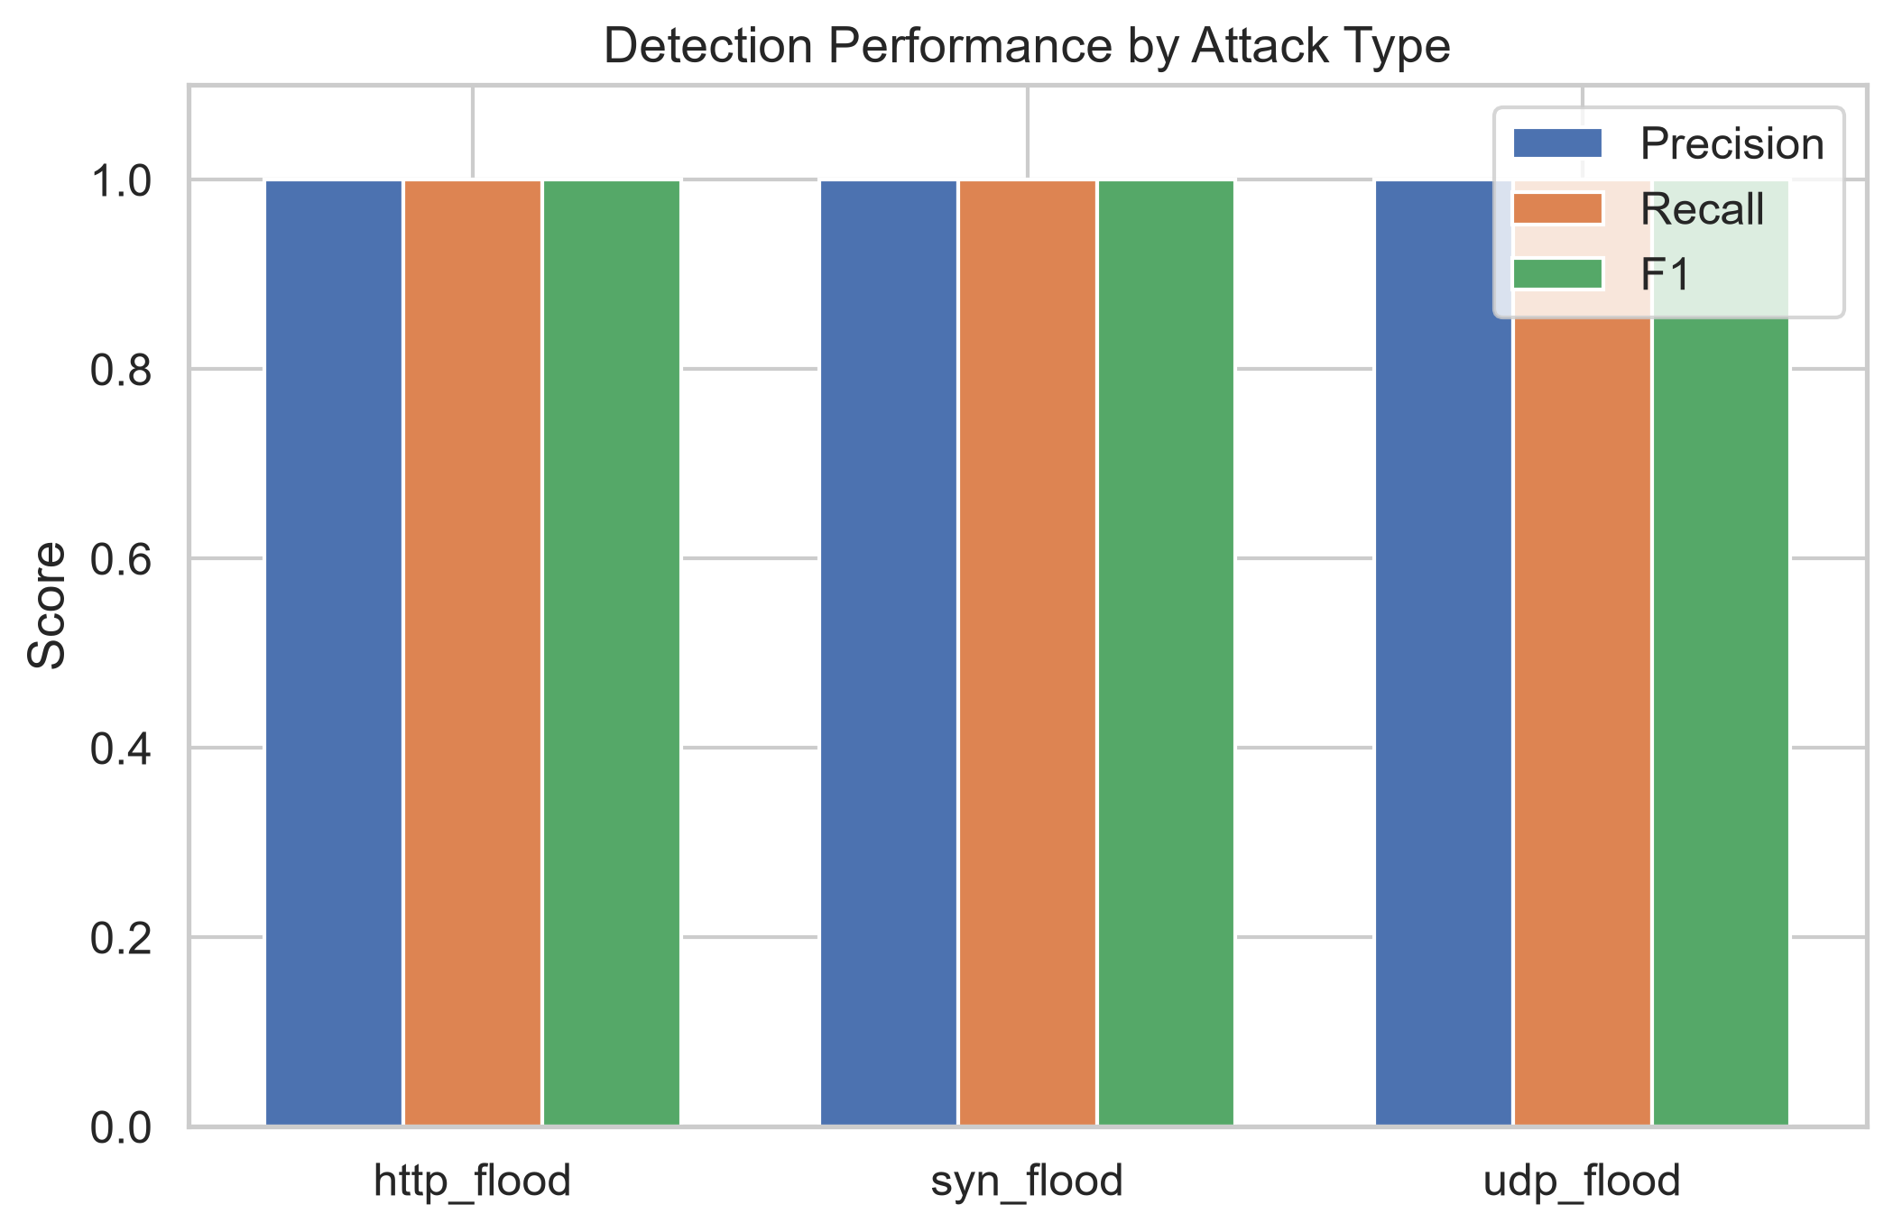
Detection Results
Notes:
[~30 sec] Detection is near-perfect across all attack types. This is expected for our synthetic data and validates that the detector provides a solid foundation for attribution.

Slide 8
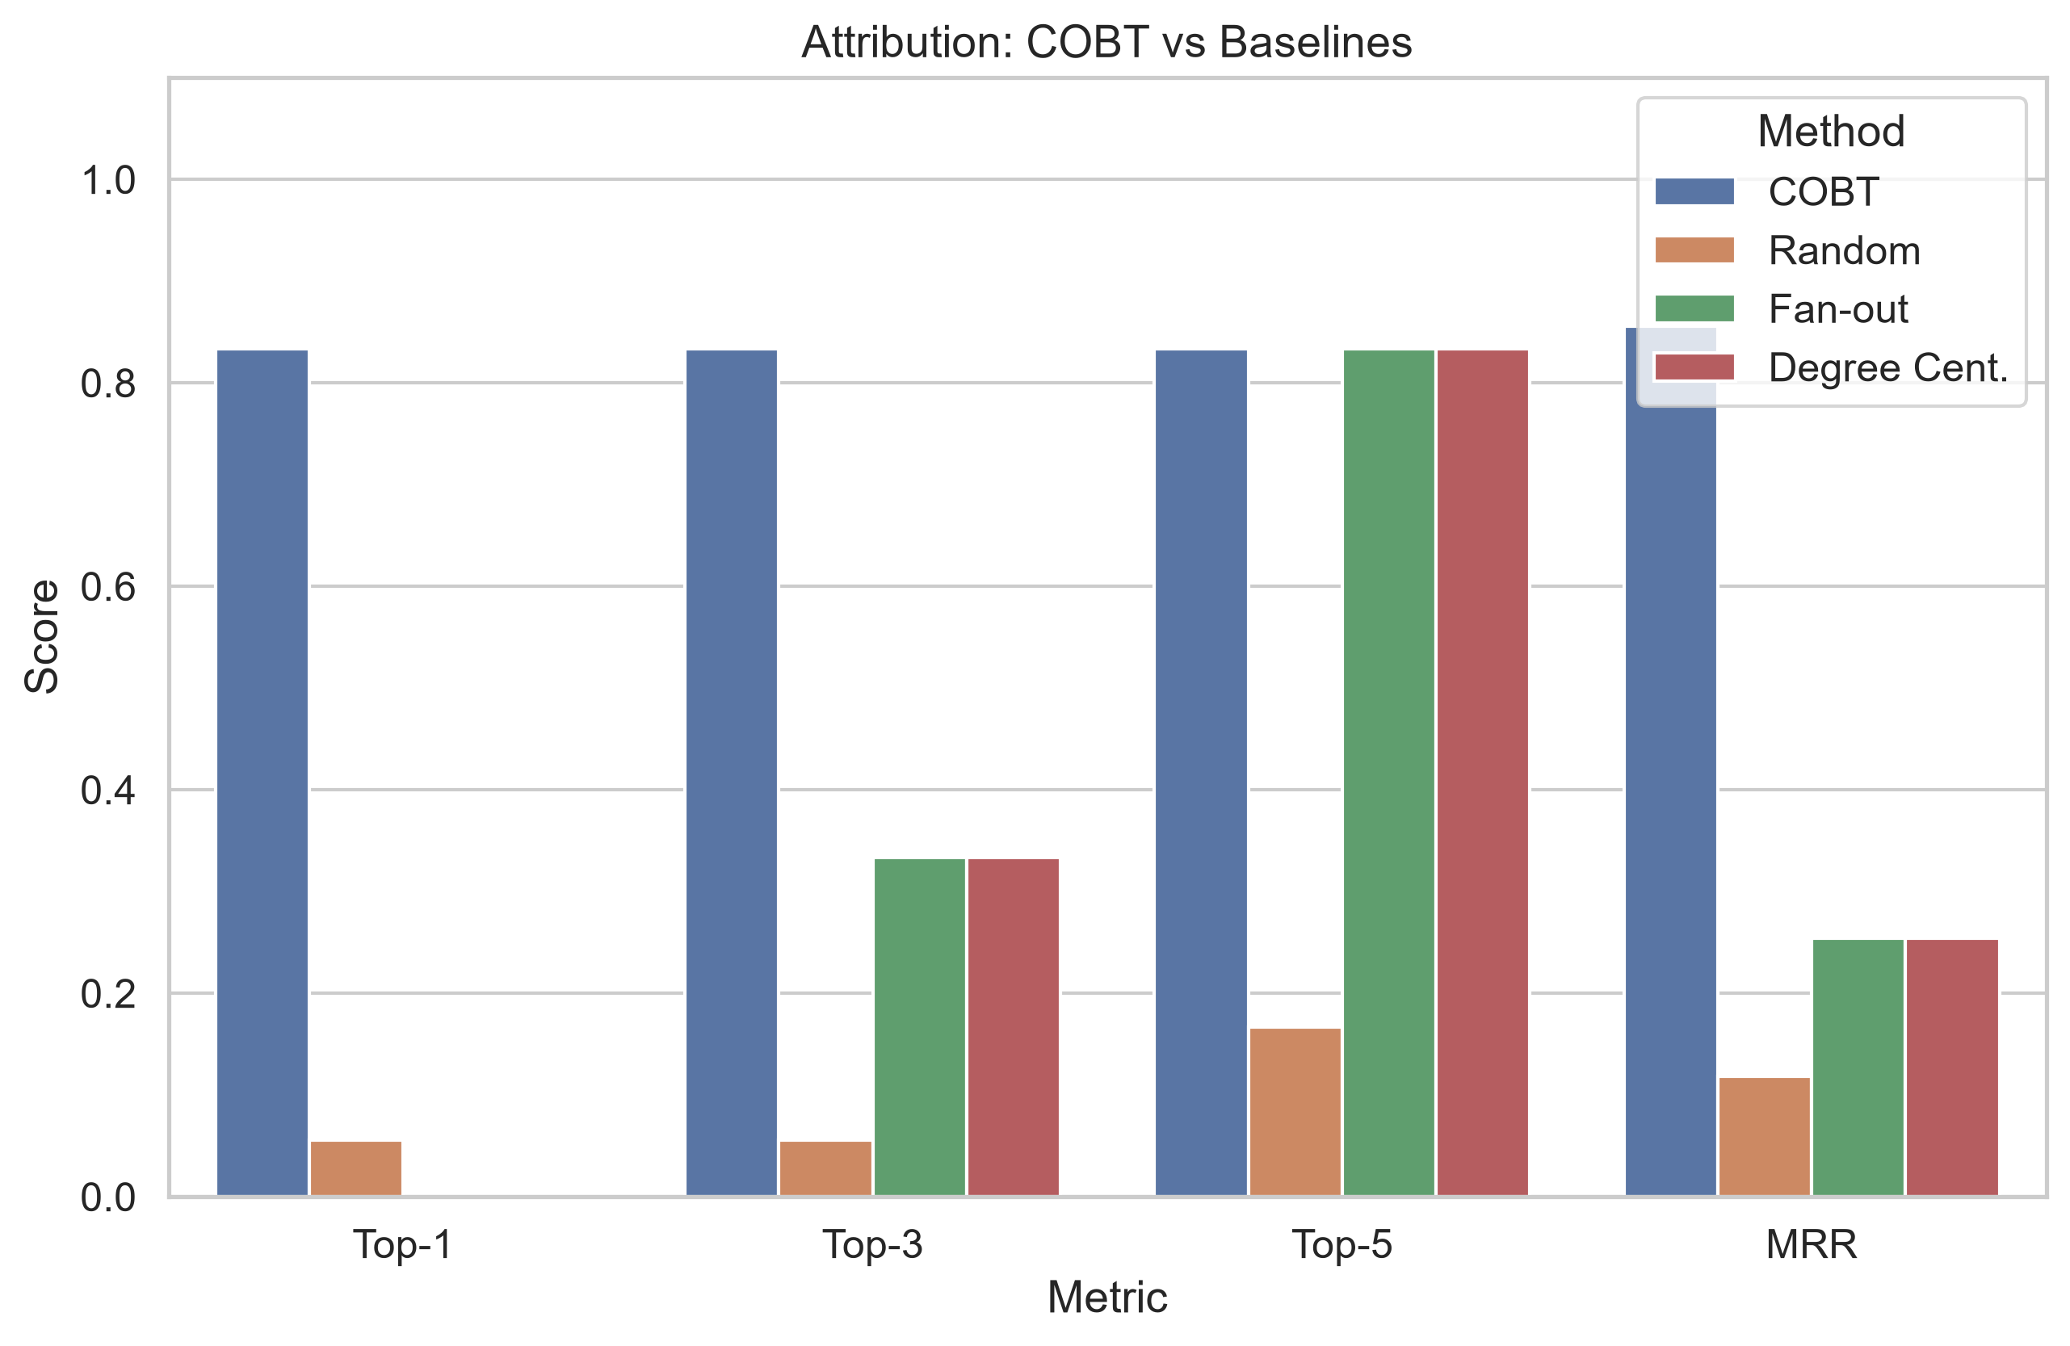
Attribution: COBT vs Baselines
Notes:
[~1 min] This is the key result slide. COBT achieves Top-1 = 83.3% and MRR = 0.855, massively outperforming random (MRR 0.118), fan-out (MRR 0.254), and degree centrality (MRR 0.254). The gap demonstrates that multi-signal fusion provides real value.

Slide 9
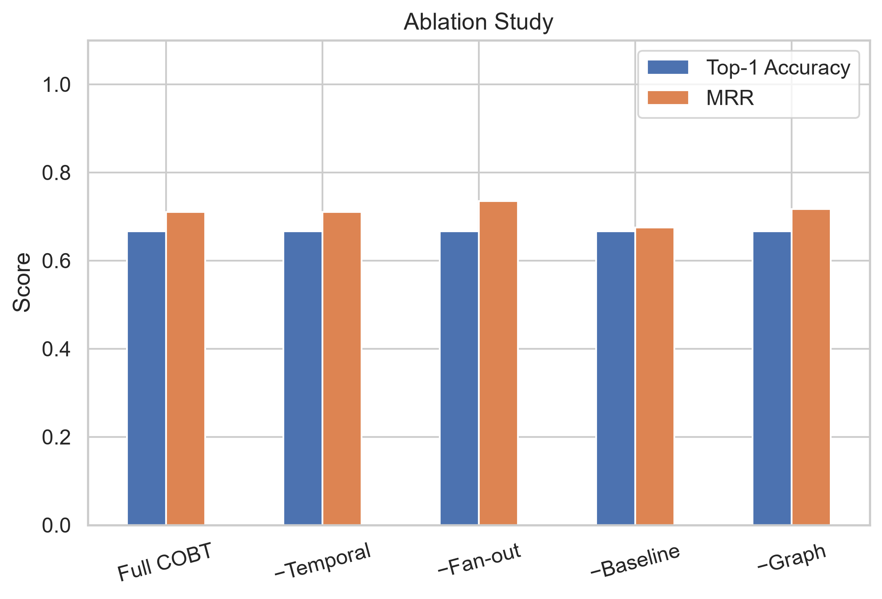
Ablation Study
Notes:
[~45 sec] The ablation confirms temporal precedence is the most important signal. Removing it causes the biggest MRR drop. Fan-out is second. Baseline and graph provide supporting evidence.

Slide 10
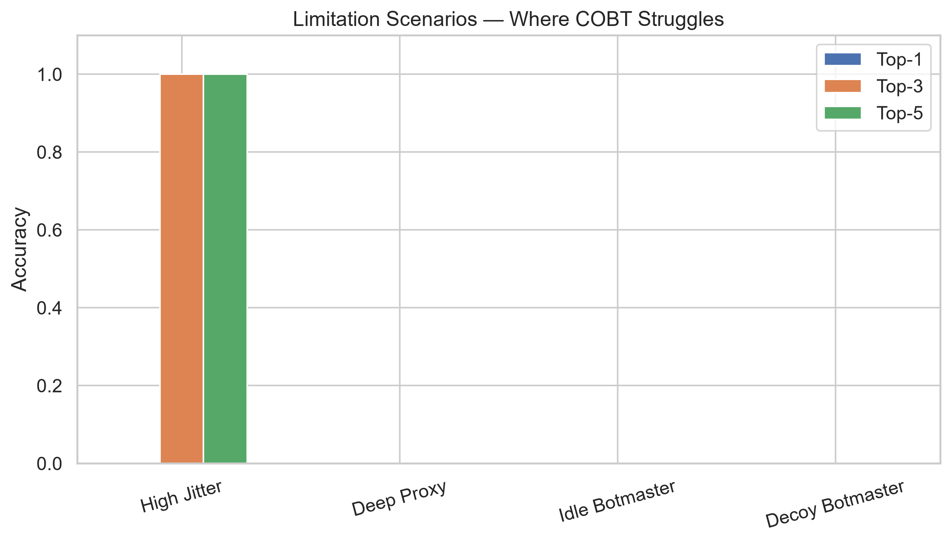
Where COBT Struggles
Notes:
[~1 min] Be honest about limitations. Deep proxy: botmaster hidden behind 3 layers, can't trace. Idle botmaster: C2 falls outside our analysis window. High jitter: timing signal washed out. These are real, fundamental limitations, not just parameter tuning issues.

Slide 11
Live Demo
python pipeline/cli.py demo
Generates a synthetic scenario (10 bots, syn_flood, centralised C2)
Runs detection → onset estimation → COBT attribution
Shows Top-5 ranked candidates with scores
Botmaster (10.0.0.1) should be ranked #1 with score ≈ 0.97
Also: python pipeline/cli.py generate --attack-type http_flood --c2-style beacon
python pipeline/cli.py run output/scenario_001_flows.csv --top-k 10
Notes:
[~1 min] Run the demo live. The CLI generates a scenario and runs the full pipeline. Show the output: detected attack, identified bots, and the ranked attribution list with the botmaster correctly at #1.

Slide 12
Conclusion & Future Work
COBT: novel post-detection attribution via temporal causal analysis
Top-1 = 83.3%, MRR = 0.855 (vs random MRR 0.118)
Works without training data, signatures, or payload inspection
Limitations: proxy chains, extreme jitter, window parameter sensitivity
Future work:
• Multi-hop chain tracing for proxied C2
• Adaptive pre-window selection
• Real-world validation with honeypot/lab data
• Encrypted traffic analysis (TLS metadata)
Notes:
[~30 sec] Wrap up. COBT is a novel, practical approach to a hard problem. It works well for direct and beacon C2, struggles with proxy chains. The honest evaluation of limitations makes the contribution credible.

