Slide 1
MoleSignal
INVESTOR DECK · NOV 2026
Observability meets
incident response
Open source. Self-hosted. Your choice of AI model.
Raising $750,000 for a 24-month plan
Zongsheng Xu · Founder | From product delivery to customer validation
Pre-launch refinement · No external users or paying customers · Company not yet incorporated
01 / 14
Notes:
MoleSignal is an open-source, fully self-hostable observability and incident-response platform. It aims to keep investigation context, team response and model control in one environment. Founder Zongsheng Xu is seeking $750,000 for a 24-month plan to move from independent product delivery to early customer validation. The product is in pre-launch refinement, with no external users or paying customers, and the company has not yet been incorporated. The raise, horizon and stage are founder-provided facts.

Slide 2
01 / CUSTOMER PAIN
More tools. Still too much operational work.
Fragmented context
Complex total cost
More control needs
Logs, metrics, traces and
incidents span workflows.
Engineers repeatedly align
time, services, ownership
and response progress.
SaaS bills grow across
multiple usage dimensions.
Self-hosting shifts work to
component operations,
storage and engineering.
Telemetry can be sensitive.
AI adds model access,
tool permissions and
approvals to the same
governance boundary.
Cost: investigation and handoffs
Cost: budget and platform effort
Cost: governance and deployment
Our hypothesis: teams want signals, response and control in one product.
Target-customer hypotheses, pending interviews and pilots; not claims about every tool or team.
02 / 14
Notes:
The target problem has three parts: fragmented investigation context, difficult total-cost management, and control over sensitive telemetry and AI access. Switching among signals and incident workflows can create investigation and handoff work. SaaS usage charges and self-hosted component operations create different cost structures. These are target-customer hypotheses, not findings from completed interviews or universal criticisms of every vendor. Early discovery must establish frequency, urgency and willingness to pay.

Slide 3
02 / PRODUCT APPROACH
Investigate and respond in one environment
Unified telemetry
Incident response
Logs, metrics, traces and cross-signal context.
SQL / PromQL for investigation.
Alerts, on-call, escalation and status updates.
Carry findings into response and review.
Mole Agent
Self-managed deployment
Gather evidence within platform permissions.
Choose models; approve high-risk actions.
Rust binary, PostgreSQL metadata,
local or object storage; standard protocols.
Start with existing alerts. Migrate telemetry when the team is ready.
Based on current code and documentation. Pre-launch; no external production validation yet.
03 / 14
Notes:
Current code and documentation cover telemetry, incident response, Mole Agent and self-managed deployment. SQL, PromQL and cross-signal context support investigations across logs, metrics and traces. Alerts feed on-call, escalation, status updates and review. Mole Agent uses platform permissions, selectable models and approval for high-risk actions. Deployment uses a Rust binary, PostgreSQL metadata and local or object storage. Teams can begin with existing alerts and migrate telemetry later. These implementations have not yet been validated by external production customers. Evidence: project README and current route implementations, reviewed Nov 2, 2026.

Slide 4
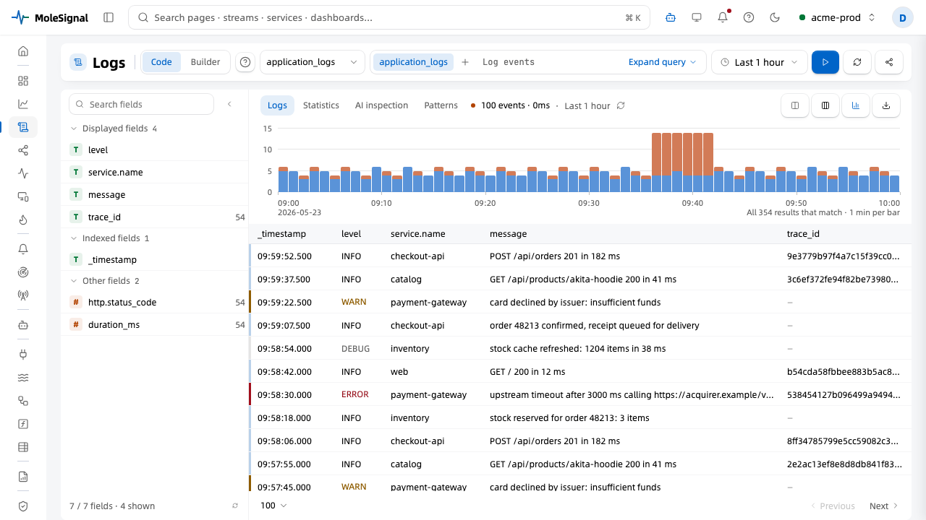
02 / PRODUCT VIEW · LOGS
Find the events behind a time-window spike
Log explorer
SQL and filters
Time and severity
Service / trace_id
Keep query context
inside the investigation
Actual product frontend · Test-fixture demo data, not customer data
04 / 14
Notes:
This is an actual frontend screenshot from the repository log explorer, with fields, time distribution, severity, service and trace identifiers. It uses Playwright fixture data, not customer telemetry. The visible counts and services are not evidence of production performance or commercial adoption. The product intent is to preserve query and time context for further investigation. Image source: web/playwright/tests/05-visual.spec.ts-snapshots/logs-light-comfortable-chromium-darwin.png. The corresponding test explicitly uses a mocked backend.

Slide 5
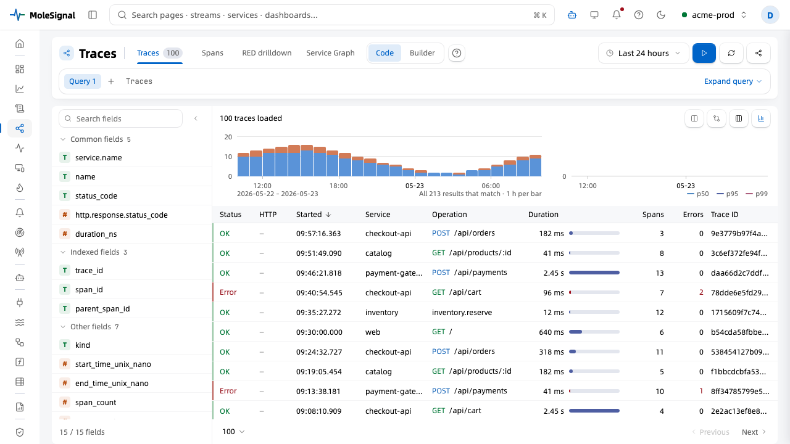
02 / PRODUCT VIEW · TRACES
Investigate latency and errors by request
Trace explorer
Service and status
Duration and errors
Spans / RED views
Connect requests
with log context
Actual product frontend · Test-fixture demo data · Investigation efficiency gains not yet measured
05 / 14
Notes:
The trace explorer organizes service, status, duration, errors and trace identifiers around individual requests, with entry points for spans, RED and service views. Together with logs it supports cross-signal investigation. All counts, latencies and service names shown are demonstration fixtures. No customer investigation-time improvement has been measured. Image source: web/playwright/tests/05-visual.spec.ts-snapshots/traces-light-comfortable-chromium-darwin.png; 05-visual.spec.ts explicitly uses a mocked backend.

Slide 6
02 / INCIDENT RESPONSE & MOLE AGENT
Carry investigation into team response
For the on-call team
For controlled AI investigation
Receive, group and route incoming alerts.
Define ownership with on-call and escalation.
Record progress and publish status updates.
Turn incident reviews into follow-up work.
Record hypotheses and supporting evidence.
Respect platform identity and permissions.
Choose models, including internal endpoints.
Require approval for high-risk actions.
Proposed value: fewer tool handoffs. Reliability and outcomes still need pilot validation.
Current implementation and documentation; no guarantee of correct root cause or unapproved remediation.
06 / 14
Notes:
Incident response includes alert intake, grouping, routing, on-call, escalation, status updates and review follow-ups. Mole Agent records hypotheses and evidence; it does not guarantee a correct root cause. Teams can select internal model endpoints, and tool execution uses platform identity and permissions, with high-risk operations subject to approval. Fewer handoffs is a proposed value, while reliability, time savings and investigation quality require pilot validation. Evidence: current README sections on incident response and Mole Agent.

Slide 7
03 / TARGET CUSTOMERS
Start with teams short on platform capacity
Users
Initial customer hypothesis
SREs, platform and backend engineers
and on-call responders
Uses Prometheus, Grafana or cloud tools.
Needs on-call without a large platform team.
Wants less upkeep and control over data.
Start with SaaS and internet-service teams.
Buyers
CTOs, engineering and platform leaders
Buying managed operations and time savings
Acquire through open source, founder outreach and design partners; start with alert response.
Customer profile and acquisition channels are hypotheses. Design-partner pipeline remains unvalidated.
07 / 14
Notes:
Users are SREs, platform and backend engineers, and on-call responders. Buyers are expected to be CTOs and engineering or platform budget owners. The initial hypothesis is SaaS and internet-service teams that already have monitoring but limited platform capacity. Payment should be justified by managed operations and saved effort, not feature counts alone. Planned acquisition begins with open source, founder outreach and design partners, using alert response as the first use case. This profile and partner pipeline remain unvalidated.

Slide 8
04 / COMPETITIVE LANDSCAPE
Customers already have strong alternatives
Datadog
Grafana
OpenObserve
Broad SaaS platform for
observability, response and AI.
Multiple product and
usage-based pricing units.
Loki, Mimir and Tempo;
Cloud IRM with AI investigation.
Composable projects and
managed cloud options.
Unified telemetry, self-hosting
and Cloud; incidents and AI.
AGPL core; Cloud primarily
priced per GB ingested.
Fits teams prioritizing breadth
and accepting that pricing model.
Fits teams valuing flexibility
and existing ecosystem investment.
Significant technical overlap;
workflow fit must earn the choice.
AI, a single binary and object storage are not exclusive moats.
Official descriptions checked Nov 2, 2026. Fit assessments are judgments, not benchmark results. Sources in notes.
08 / 14
Notes:
Datadog combines observability, incident response and AI investigation, with multiple product and usage pricing dimensions. Grafana offers the Loki, Mimir and Tempo ecosystem, alongside Cloud IRM with on-call and AI investigation. OpenObserve offers unified telemetry, single-binary self-hosting and Cloud, as well as incidents, workflows and AI SRE. Its open-source core is AGPL and Cloud is primarily priced by GB ingested. Fit assessments are our interpretation of official descriptions, not hands-on competitor benchmarks. AI, Rust, object storage and a single binary are not exclusive advantages. Official sources checked Nov 2, 2026: https://www.datadoghq.com/product/incident-response/ ; https://www.datadoghq.com/product/ai/bits-investigation/ ; https://www.datadoghq.com/pricing/ ; https://grafana.com/oss/ ; https://grafana.com/products/cloud/irm/ ; https://openobserve.ai/platform/ ; https://openobserve.ai/pricing/ .

Slide 9
04 / WHY MOLESIGNAL
For teams prioritizing control and response
Openness and control
One response experience
Apache 2.0, self-hosted data and model choice.
A fit when deployment control is essential.
Investigation, on-call, status and approvals.
Aim to reduce assembly and handoff effort.
Incremental adoption
Advantages to prove
Accept existing alerts and standard telemetry.
Test one use case before broader migration.
Prove setup, response efficiency and retention.
TCO and performance gains remain unproven.
Differentiation rests on workflow fit and execution. A durable moat must develop through real adoption.
09 / 14
Notes:
The reason to consider MoleSignal is the combined fit of Apache 2.0, self-hosting, model choice, a unified response experience and incremental adoption. These are selection hypotheses, not proven superior outcomes. We must validate setup success, response efficiency, retention, total cost and performance under comparable conditions. OpenObserve in particular has substantial technical overlap. Existing Datadog or Grafana customers need a clear migration benefit. Evidence: MoleSignal LICENSE and README, plus the official competitor sources on the preceding slide.

Slide 10
05 / BUSINESS MODEL
Open-source adoption. Cloud subscriptions.
Open-source self-hosting
Cloud subscriptions
Free · Apache 2.0
Planned · Pricing TBD
Customers run their infrastructure and data.
Build trust through code, docs and deployment.
Learn from actual needs and product feedback.
Proposed: usage allowance plus overages.
Hosting, upgrades, backups and support.
Test willingness to pay before setting tiers.
Measure conversion, retention, and unit costs for storage, queries, models and support.
Cloud has not launched. Subscription structure is a proposal, not published pricing or a margin commitment.
10 / 14
Notes:
The business model uses open-source self-hosting to build adoption and trust, and Cloud subscriptions to monetize managed operations. The source is Apache 2.0. Cloud is still on a waitlist and has not launched. A subscription with an included allowance and usage overages is a proposed structure, not published pricing. Hosting, upgrades, backups and support are planned service value. We must measure conversion, retention and the costs of storage, queries, models and support before claiming revenue or margins. Evidence: project LICENSE and website Cloud/pricing copy; the subscription structure is a planning proposal.

Slide 11
06 / CURRENT STAGE
Product built. Customer validation ahead.
Pre-launch
Delivered so far
Backend, frontend, deployment and user docs.
Telemetry, response and Agent implementation.
0 external users
0 paying customers
Next validation
Company not yet incorporated
Cloud has not launched
External installs, workloads and recovery.
Repeat use, willingness to pay, support effort.
Founder-provided stage as of Nov 2, 2026. Implemented features are not customer validation or commercial traction.
11 / 14
Notes:
The product has a backend, frontend, deployment and user documentation, and implementations spanning telemetry, response and the Agent. This demonstrates product delivery, not customer validation or traction. The founder confirms zero external users and zero paying customers, pre-launch refinement, and no incorporated company yet. Cloud has not launched. Next priorities are external installs, real workloads, recovery, continued use, willingness to pay and support burden. Stage supplied by the founder on Nov 2, 2026; implementation evidence is the current repository and README.

Slide 12
07 / FOUNDER
Zongsheng Xu | Founder, MoleSignal
Production-systems experience
End-to-end product delivery
Years in backend / infrastructure; Rust and Go.
Cloud-native platforms and financial trading.
Designed and built matching, liquidation,
clearing and settlement systems.
Selected work: a decentralized-exchange
matching engine; a clearing/settlement rewrite.
Independently led MoleSignal product definition,
architecture, technology choices and full-stack
development, assisted by AI coding tools.
Low latency · State machines · Raft · WAL / Snapshot
Failure recovery · Consistency of financial balances
Founder fit: translating failure, recovery and consistency requirements into a usable product.
Founder-provided background. No employer names, exact tenure or unverified scale claims included.
12 / 14
Notes:
Zongsheng Xu has years of backend and infrastructure experience, primarily using Rust and Go, across cloud-native platforms and financial trading systems. His responsibilities include matching, liquidation, clearing and settlement design and development, covering low latency, state machines, Raft availability, WAL and snapshots, recovery and consistency of financial balances. Selected deliveries include a decentralized-exchange matching engine and a clearing/settlement rewrite. He independently leads MoleSignal product definition, architecture, technology choices and full-stack development, assisted by AI coding tools. This is founder-provided background; no employer, exact tenure or unverified scale has been added.

Slide 13
08 / FUNDING PLAN
$750,000 for 24 months of validation
$750,000
Proposed allocation · Subject to detailed budgeting
55% · $412,500 Core product and R&D
24-month planning horizon
20% · $150,000 Cloud infrastructure and operations
Average budget: $31,250/month,
including contingency. Actual spend
depends on hiring and cloud usage.
15% · $112,500 Customer validation and marketing
10% · $75,000 Incorporation, legal and contingency
Priorities: reliability, operable Cloud, real demand and initial willingness to pay.
Raise and horizon supplied by founder; allocation is proposed, not current burn. Valuation and instrument not specified here.
13 / 14
Notes:
The founder plans to raise $750,000 for 24 months. The suggested allocation is 55%, or $412,500, to core product and R&D; 20%, or $150,000, to cloud infrastructure and operations; 15%, or $112,500, to customer validation and early marketing; and 10%, or $75,000, to incorporation, legal and contingency. This totals $750,000 and averages $31,250 monthly, including contingency; it is not current burn. Allocation remains a proposal and depends on staffing, location and cloud consumption. The investment entity and financing structure need to be established before execution. No valuation or instrument is specified in this deck.

Slide 14
08 / 24-MONTH VALIDATION PLAN
Prove value through adoption and payment
Months 0–6
Months 7–12
Months 13–24
Release and incorporate
Target 3–5 design partners
Validate setup and recovery
Launch invite-only Cloud pilot
Target 3 paying teams
Test tiers and support cost
Target 10 paying teams
Observe usage and renewals
Test unit costs and acquisition
Gate: successful installs
and continued use
Gate: demonstrated
willingness to pay
Gate: retention and
repeatable delivery
MoleSignal · Let's walk through the product and technical diligence
molesignal.com / github.com/molesignal/molesignal
Proposed targets, not achieved results or commitments. Timeline starts when funding is received.
14 / 14
Notes:
The proposed clock begins when funding is received. In months zero to six, release the product, incorporate and target three to five design partners while validating installation and recovery. In months seven to twelve, launch an invite-only Cloud pilot and target three paying teams while testing tiers and support costs. In months thirteen to twenty-four, target ten paying teams and observe continued use, renewals, unit costs and acquisition. These are proposed targets, not achieved outcomes or commitments. If validation fails, refine the use case before expanding spending. We invite a product walkthrough and technical diligence. Product and source: https://molesignal.com ; https://github.com/molesignal/molesignal .

