Slide 1
Alignment Lab
Mole 2025

Slide 2
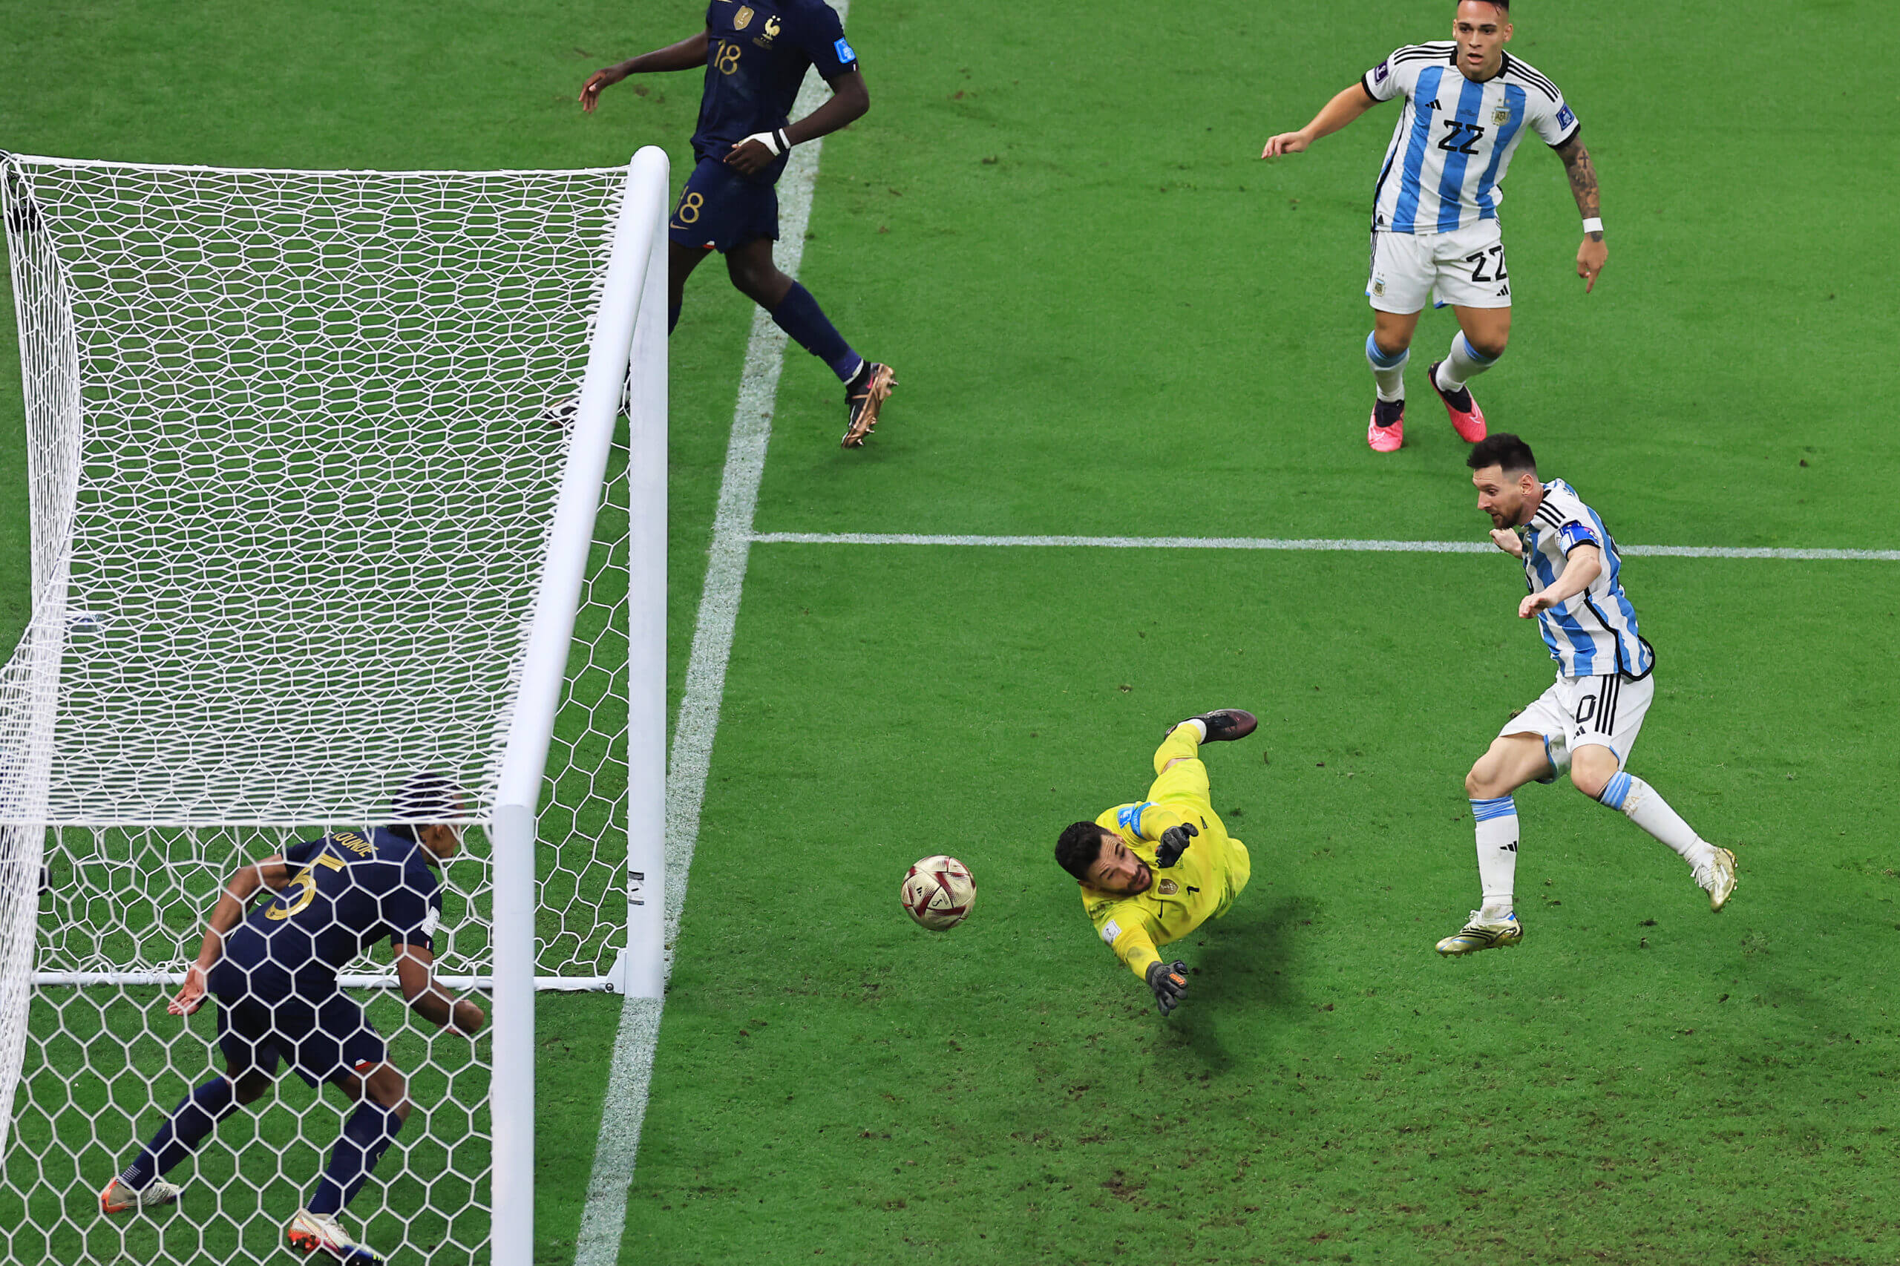
Expected Outcomes
Become familiar with the features of multiple sequence alignment and alignment visualization programs
Run analyses on your remote Jetstream compute node
Move files to and from the remote computer and your local machine

Slide 3
Background

Slide 4
General Background
Multiple sequence alignment (MSA) is important for phylogenetic estimation or model-based inference of evolutionary processes
The goal of MSA is to introduce gaps into sequences so that columns of an aligned matrix contain character states that are homologous
Homology cannot be directly observed but can be inferred

Slide 5
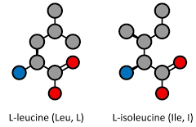
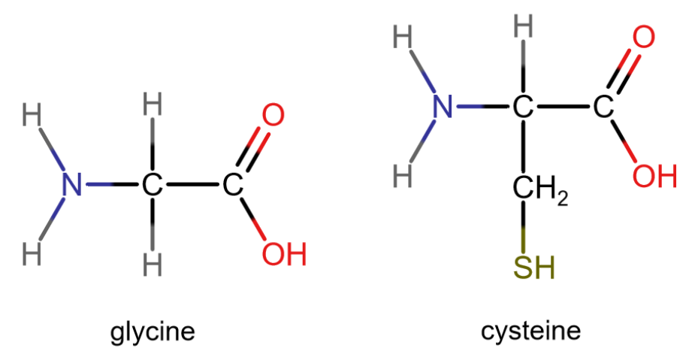
Inferring Homology
MSA algorithm attempts to produce homologous alignments by scoring many plausible alignments and choosing one with the best score
Aligning two positions that display the same nucleotide improves the score
Aligning two positions that are not the same decrease the score

Slide 6
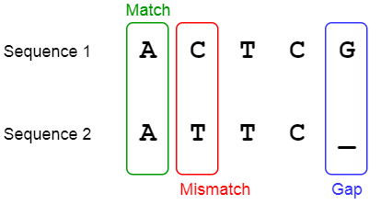
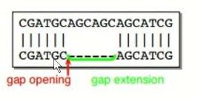
Inferring Homology
Placing gaps in a sequence is penalized too
Introducing a new gap usually has a higher cost than extending an existing gap

Slide 7
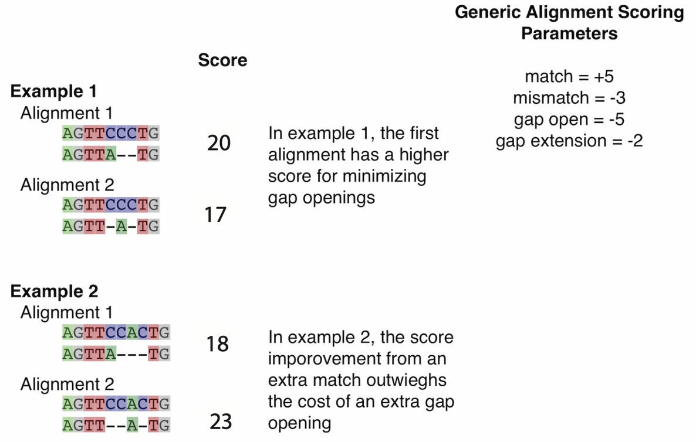
In example 2, the score improvement from an extra match outweighs the cost of an extra gap opening

Slide 8
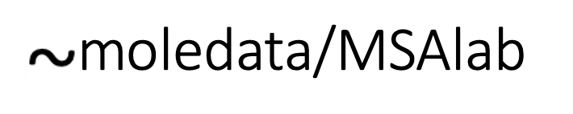
The data for the exercise is in this folder
Alignment will be done using MAFFT and MUSCLE, both are available on the Jetstream node
Alignment visualization will be done by SeaView and MEGA (AliView is also a good option!)
~/moledata/MSAlab

Slide 9

Let’s get to work!

Slide 10
Exercise 1: Basic Functions in SeaView and MEGA
Copy the 1ped.fasta file from your remote machine to your laptop
The 1ped.fasta file contains alcohol dehydrogenase nucleotide sequences from a variety of organisms
Open in SeaView or MEGA

Slide 11
Exercise 2: Comparison of two different alignment programs

Slide 12
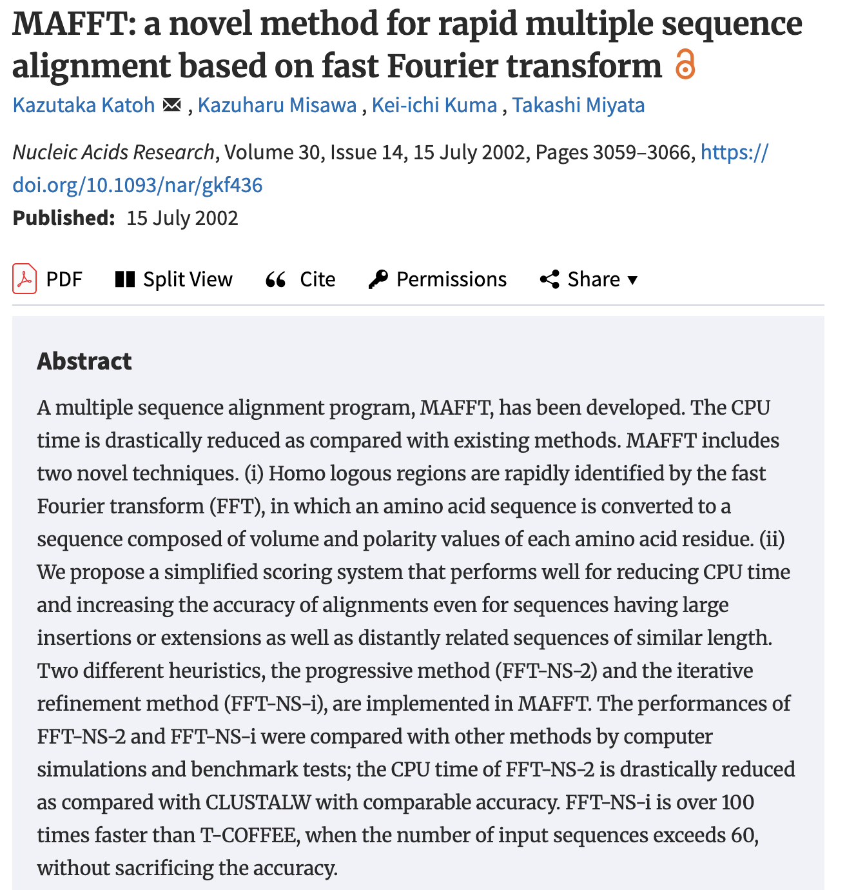
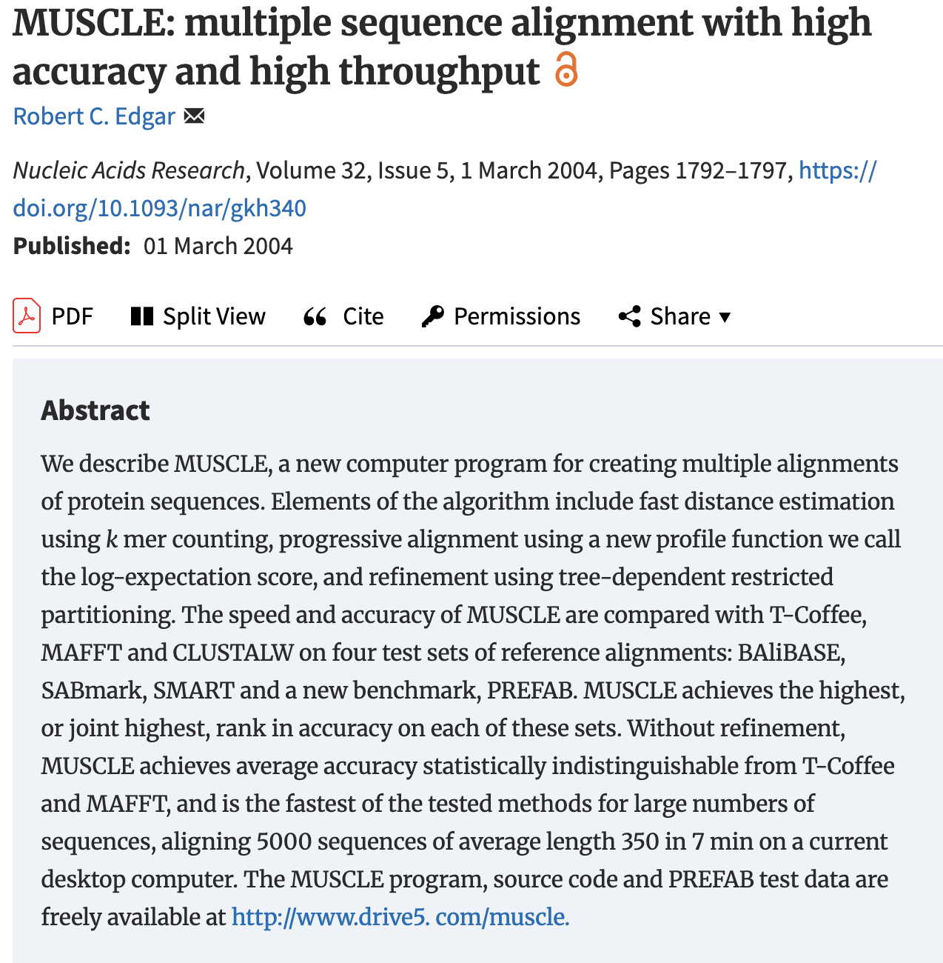

Slide 13
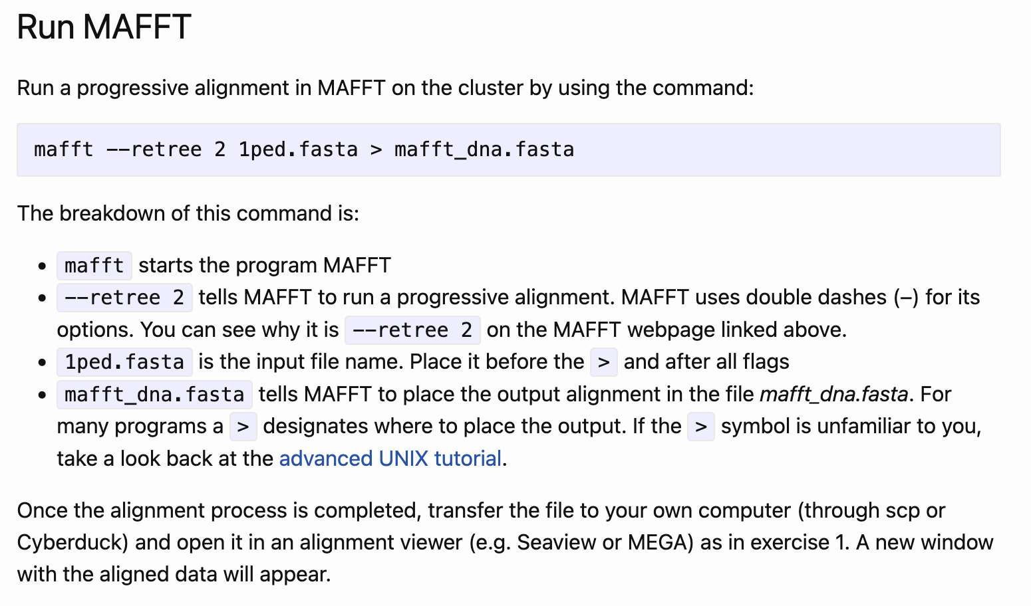
MAFFT

Slide 14
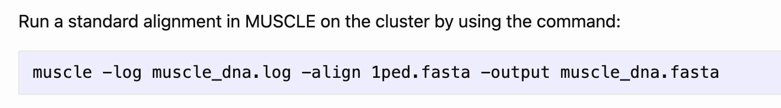
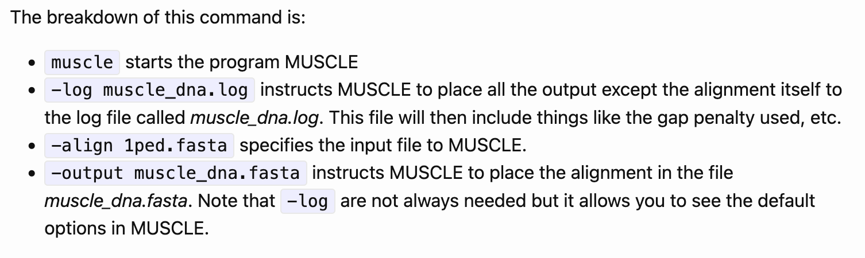
MUSCLE

Slide 15
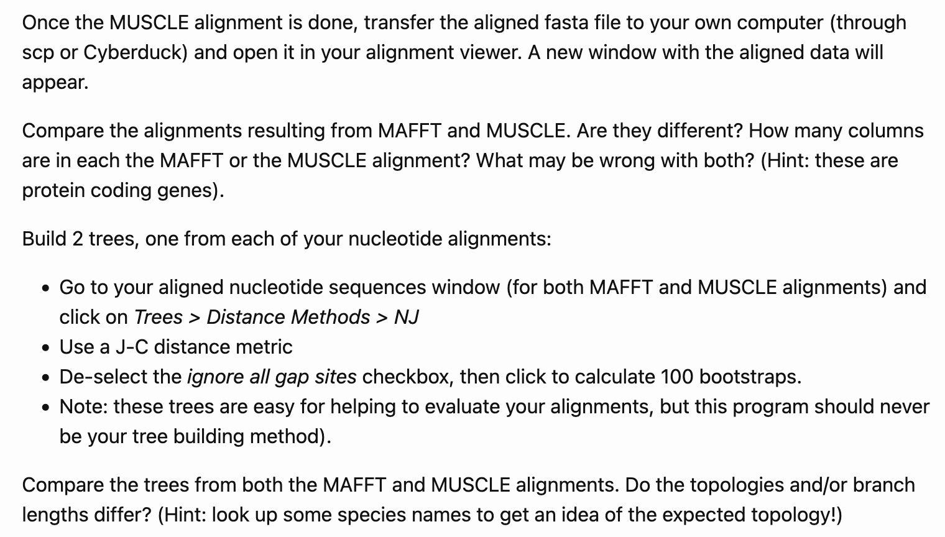
Alignment Comparison

Slide 16
Exercise 3: Comparison of two different alignment approaches in MAFFT using protein sequences

Slide 17
First Steps…
Return to the alignment viewer window with the unaligned 1ped.fasta sequences
Click Props > View as proteins (SeaView) or select Translated Protein Sequences in the main alignment window (MEGA)
Click File > Save prot alignment (SeaView) or Data > Export alignment (MEGA) and save the file as 1ped_aa.fasta with Fasta as the file format
Transfer this file to the MSAlab folder on the virtual machine

Slide 18
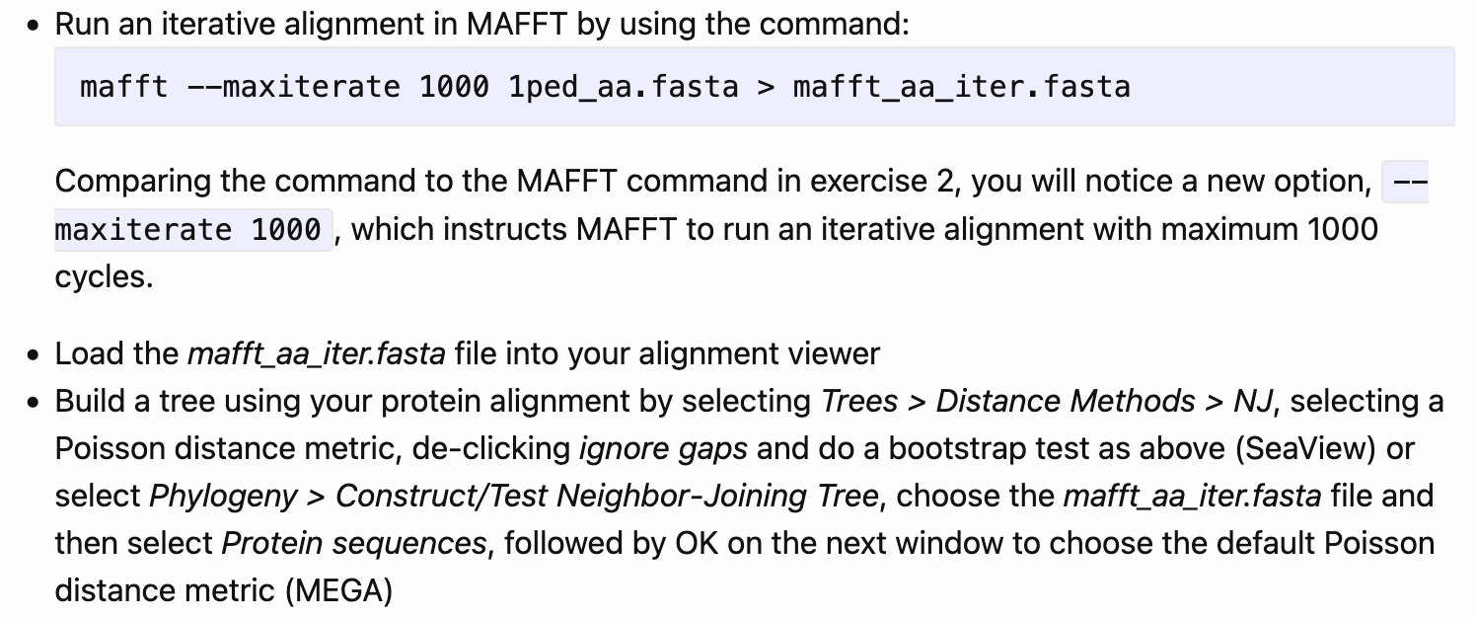
Iterative Alignment Method

Slide 19
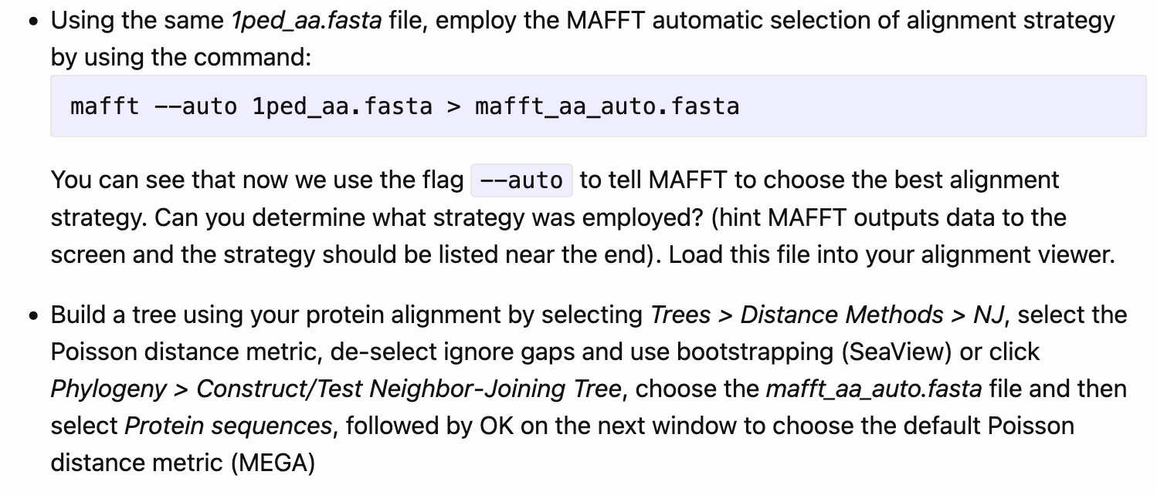
Auto Alignment Method

Slide 20
Questions
Compare the amino acid alignments and trees
Which do you prefer?
Should protein-coding sequence alignment be made with protein translation or nucleotide sequences?

