Slide 1

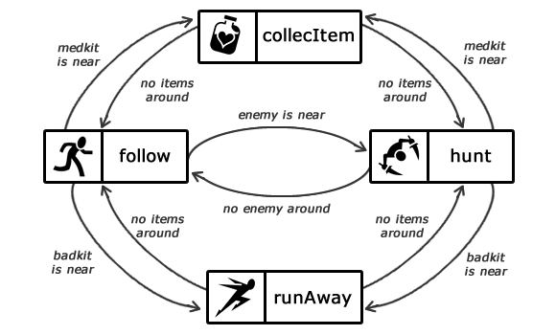
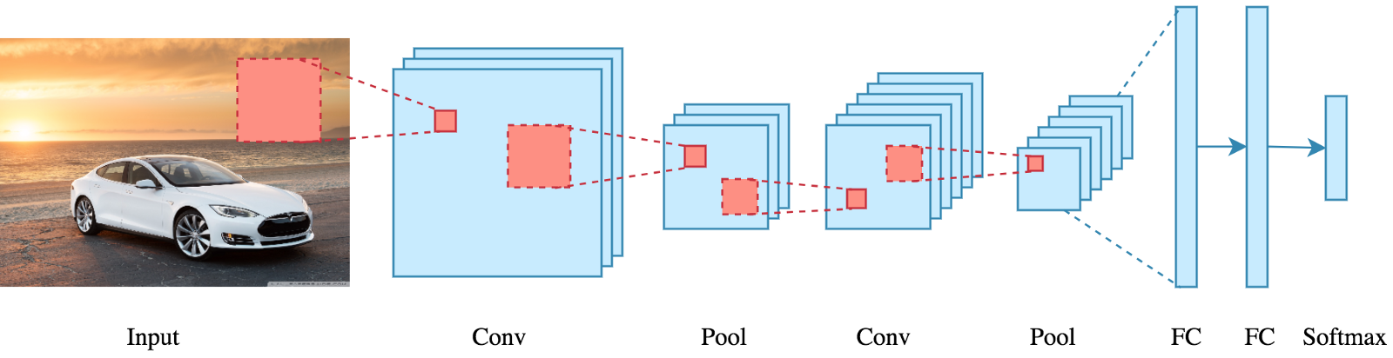

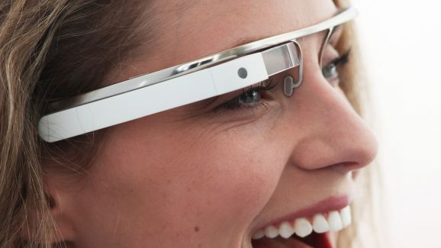
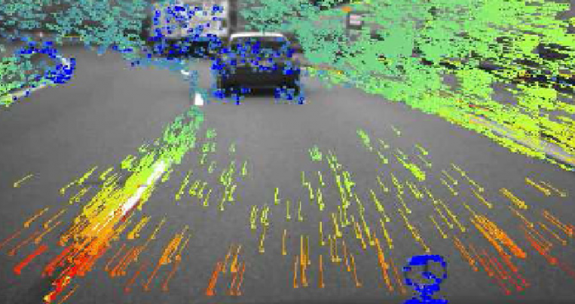

Edge Node
Wireless
first hop
Objects
Client Device
Sensor streams
Video/Audio/Others
Deep Neural Networks
Actions
Optical Flow
User Context
Low Level Features
Semantic Concepts
Application Task Model F{S,E}

