Slide 1

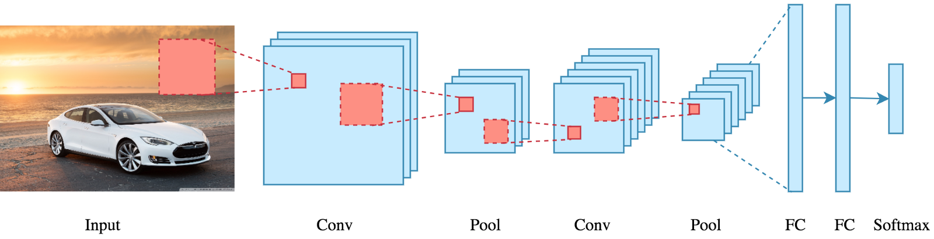
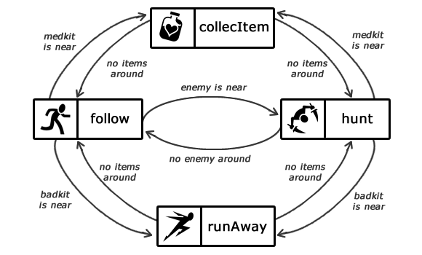

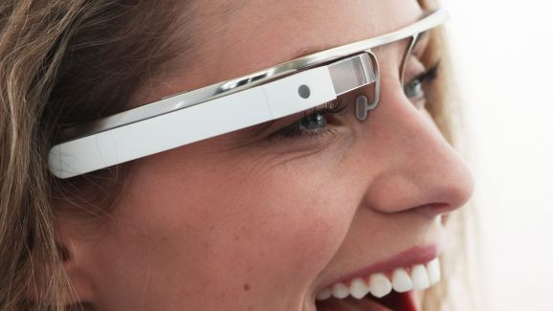
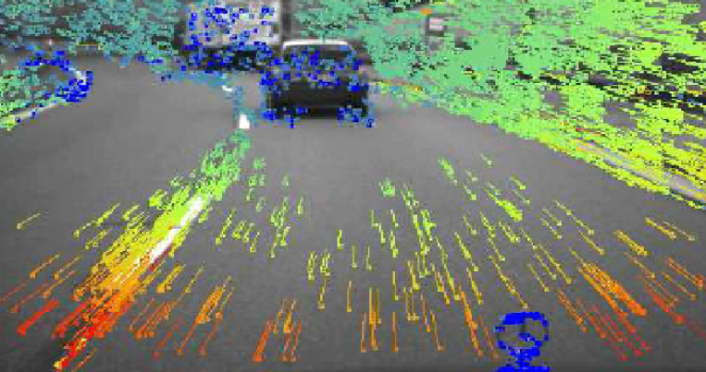

Edge Node
Wireless first hop
Objects
Client device
Sensor streams
Video/Audio/Others
Deep Neural Networks
Actions
Application Task Model
Optical Flow
Low Level Features
User Context
Semantic Concepts
Feedbacks

