Slide 1
PMSM Fault Diagnosis — Wavelet Scalogram + CNN

Slide 2
PMSM Fault Diagnosis using Wavelet Scalograms + CNN
Aleppo University — Faculty of Electrical & Electronic Engineering · Department of Mechatronics Engineering
Students: Mulham Fetna · Mohammad Zein Qabbani
Supervisor: Eng. Saad Almoustafa · Year: Fourth Year
Research seminar — CNN classification of PMSM operating states from time–frequency images

Slide 3
1. The problem
PMSM motors run EVs, robots, industrial servos, aircraft actuators.
The most common stator fault — an inter-turn short circuit — can escalate to total winding failure within minutes.
Goal: detect faults automatically and early from the motor’s own signals.
Classical methods (e.g. current spectrum analysis) need an expert to know which frequency to watch and break down when speed/load vary.

Slide 4
2. Our idea
Turn a signal problem into an image problem.
signal ─► segment ─► CWT ─► scalogram image ─► CNN ─► fault class (current/ (Morlet) (224×224) Healthy / InterTurn vibration) (+ Demag / Overload)
The CNN learns the fault signatures itself — no hand-designed features.
Two signal channels studied: stator current and vibration.

Slide 5
3. System pipeline
Sources: real KAIST dataset (current + vibration), a synthetic generator, and MATLAB FOC/Simscape simulation.
One config + one manifest drive everything (signal → scalogram → label → split): fully reproducible.
Implemented in Python (TensorFlow/Keras, PyWavelets), MATLAB-free, 38 unit tests + CI.

Slide 6
4. PMSM & its faults
PMSM: permanent-magnet rotor locks onto the stator’s rotating field → rotates synchronously, no slip → high efficiency.
Driven by Field-Oriented Control (FOC) — current sensors are already present.
Faults studied:
Inter-turn short (primary, real data)
Demagnetization, Overload (synthetic)

Slide 7
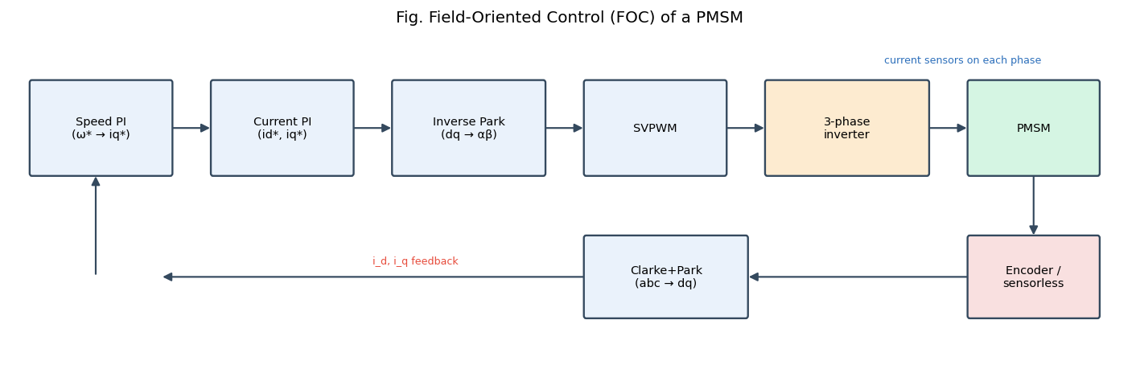
Motor & control system

Slide 8
Stator (3-phase winding) + PM rotor; driven by an inverter under FOC.
The current loop rejects disturbances → it masks the fault in the current.
That is why vibration detects inter-turn faults far better (our key result).

Slide 9
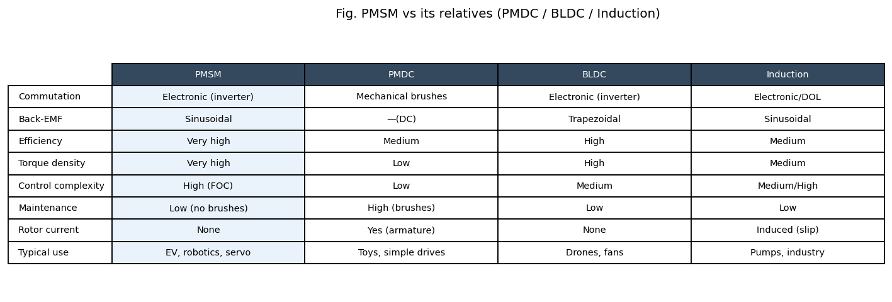
PMSM vs its relatives

Slide 10
vs PMDC: same easy torque control, but no brushes → less maintenance.
vs BLDC: sinusoidal back-EMF + FOC → smoother torque, higher efficiency.
vs Induction: no rotor current/slip → higher efficiency & torque density.

Slide 11
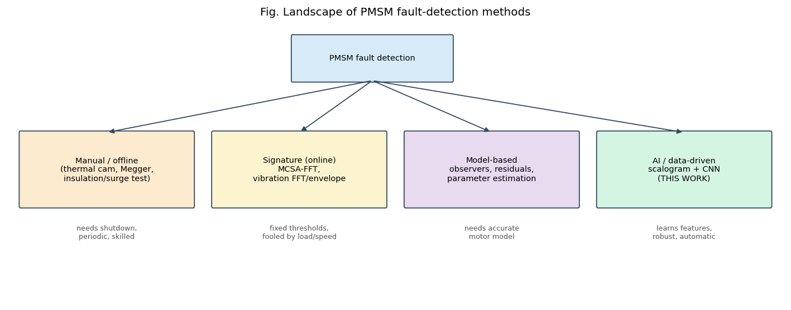
Detecting the fault — today vs this work

Slide 12
Manual/offline (thermal, Megger, surge) → need shutdown, periodic.
Online MCSA/vibration FFT → fixed thresholds, fooled by load/speed.
CWT scalogram + CNN → learns features, robust, detects earlier.

Slide 13
5. Why wavelets, not Fourier
Fourier is blind to time — it can’t say when a frequency occurs.
Motor fault signals are non-stationary (transient, load-dependent).
Uncertainty principle: Δt · Δf ≥ const — can’t have perfect time and frequency resolution.
Wavelets = short, localised waves → frequency-dependent resolution, ideal for transients.

Slide 14
6. The CWT & scalogram
Scale the Morlet wavelet (frequency knob) and slide it (time knob).
Each coefficient = similarity of the signal to that wave at that time.
Scalogram = colour image of energy vs. time (x) and frequency (y).
Bright bands & side-bands = fault signatures the CNN can see.

Slide 15
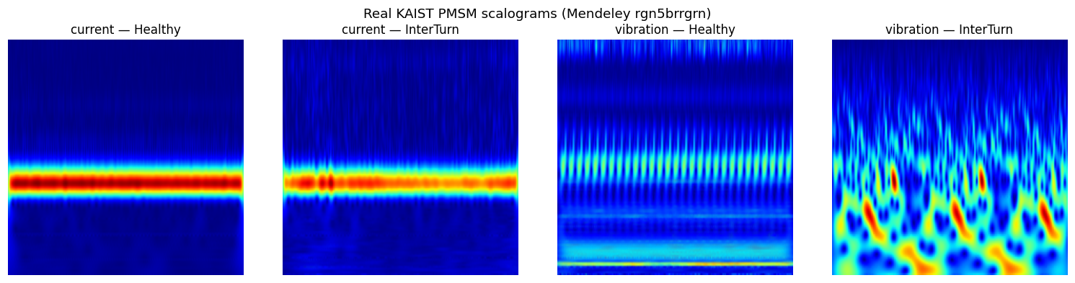
7. Example scalograms (real KAIST data)

Slide 16
Inter-turn fault visibly enriches the vibration time–frequency content.

Slide 17
Channel | Healthy | InterTurn
current | 200 (4 rec.) | 1350 (27 rec.)
vibration | 200 (4 rec.) | 1400 (28 rec.)
8. The dataset
KAIST PMSM stator-fault dataset (Mendeley rgn5brrgrn, CC-BY-4.0).
Current @ 100 kHz, vibration @ 25.6 kHz → decimated to 10 kHz.
3,150 scalogram segments (0.5 s windows, 50 % overlap).

Slide 18
9. Leakage-free split
Split by recording, not by segment → no correlated windows across train/test (no data leakage).
Stratified by class, per channel, 70 / 15 / 15.
Special care: only 4 healthy recordings → force ≥1 into each split so every class is evaluable.

Slide 19
10. Class imbalance — the key issue
Only 4 healthy vs ~60 fault recordings.
Naïve training → model predicts “faulty” for everything: 80 % “accuracy” but 0 % healthy detection.
Fix: undersample the majority in train/val, keep test natural.
Report balanced accuracy & macro-F1, not raw accuracy.

Slide 20
11. CNN architecture
224×224×3 → Conv32 → Pool → Conv64 → Pool → Conv128 → Pool → Flatten → Dropout(0.5) → Dense128 → Softmax
Adam, sparse cross-entropy, early stopping, data augmentation.
Fusion model: two branches (current + vibration) → global avg pool → concatenate → dense.

Slide 21
Channel | Balanced acc | Macro-F1 | Healthy rec. | InterTurn rec.
Vibration | 1.00 | 1.00 | 1.00 | 1.00
Fusion (cur.+vib.) | 0.88 | 0.76 | 1.00 | 0.75
Current | 0.69 | 0.49 | 1.00 | 0.37
12. Results — real data

Slide 22
Held-out recordings, Healthy vs Inter-turn.

Slide 23
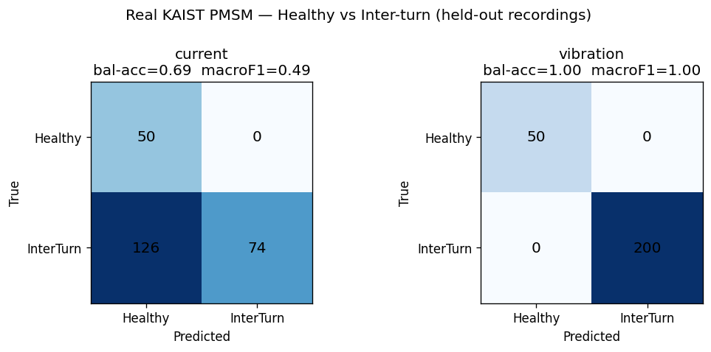
13. Confusion matrices

Slide 24
Vibration is perfect; current misses most faults; fusion is in between.

Slide 25
14. Analysis
Vibration ≫ current for inter-turn detection — physically expected (vibration responds directly; FOC suppresses current signatures).
Fusion beats current but not vibration alone on this small data.
Right metric matters: balanced accuracy exposed the majority-class collapse that raw accuracy hid.

Slide 26
15. Improvement experiments
Balancing removes the majority-class collapse (current healthy recall 0.00 → 1.00).
Image size & training-set size studied (see docs/experiments.md).
Overfitting controlled by dropout, global average pooling, augmentation and early stopping.

Slide 27
16. Limitations
Only 4 distinct healthy recordings → perfect vibration score can’t yet exclude a recording-identity shortcut.
Demagnetization / Overload only synthetic.
Fusion comparison indicative, not strictly controlled.

Slide 28
17. Conclusions & future work
A reproducible scalogram + CNN pipeline detects inter-turn PMSM faults; vibration reaches balanced accuracy 1.00 on held-out recordings.
Future: more independent recordings; paired multi-channel fusion; severity-aware targets; explainability (Grad-CAM); on-line deployment in the drive.

Slide 29
Thank you
Questions?
Code, data instructions and full report: github.com/molhamfetnah/pmsm-fault-diagnosis-cnn-scalogram

