Slide 1

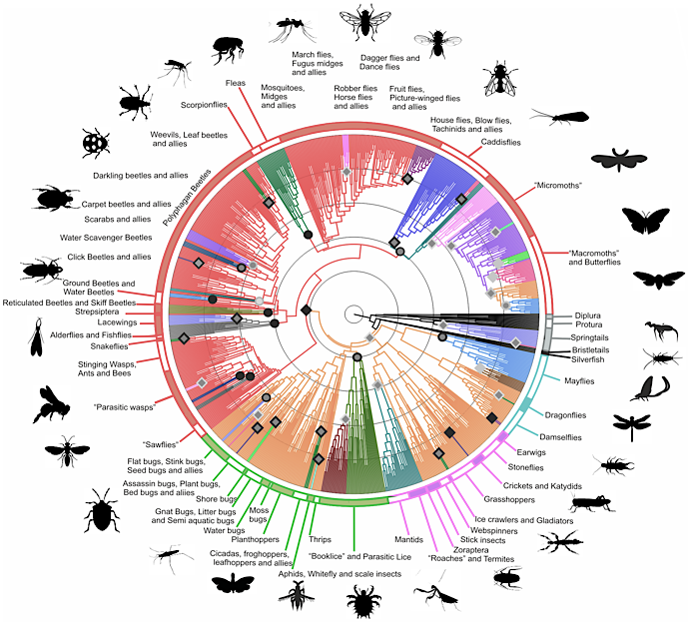
Data Mining for the Prioritization of American Insecta Genomes
David Molik • Stephen Richards • Michael Pfrender

Slide 2
What Genomes Do We Have?

Slide 3
Which Species Do We Study?

Slide 4
Which (Arthropod) Species Do We Prioritize?

Slide 5
What is the Quality of Current Genomes?

