Slide 1

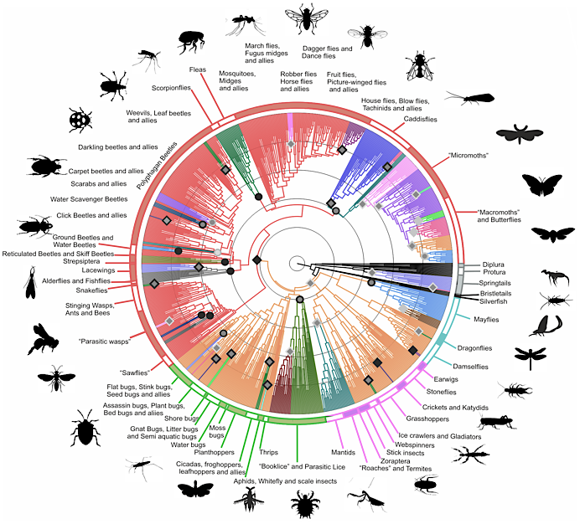
Data Mining for the Prioritization of American Insecta Genomes
David Molik • Stephen Richards • Michael Pfrender

Slide 2

Background

Slide 3
Preparing to sequence (make Genome assemblies) all Life.
We need to figure out which things to sequence first.

Slide 4



Selecting Data. Species Lists

Slide 5




Selecting Data. Genomes/Work

Slide 6
Which Species Do We Study?

Slide 7
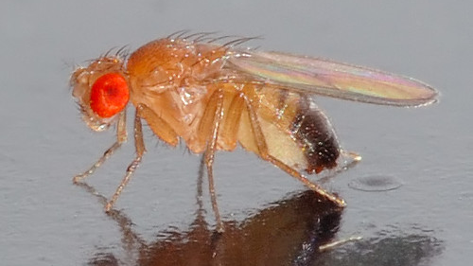

Slide 8
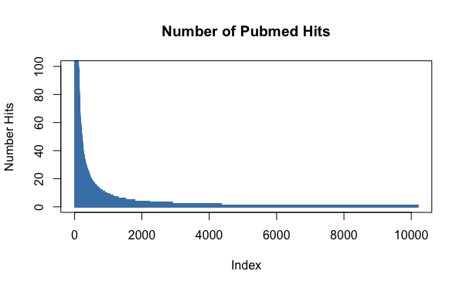
Which Species Do We Study?

Slide 9
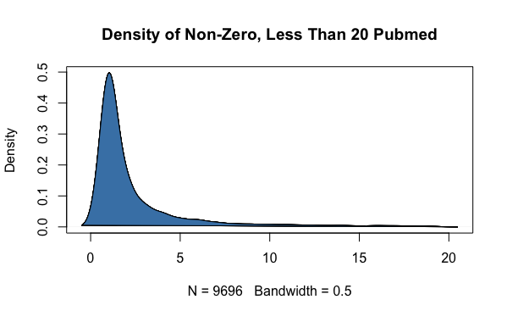
Which Species Do We Study?

Slide 10
Which Species Do We Study?
Drosophila melanogaster 22144
Aedes aegypti 4597
Apis mellifera 2924
Bombyx mori 2899
Anopheles gambiae 2152
Aedes albopictus 1996
Culex quinquefasciatus 1390
Pemphigus vulgaris 1379
Culex pipiens 1148
Galleria mellonella 1094
Helicoverpa armigera 1052
Tribolium castaneum 968
Bemisia tabaci 959
Spodoptera frugiperda 882
Manduca sexta 798
D. melanogaster accounts for %20 of all Insect publications from 2008-2018
Top 13 hits account for %50 of all publications

Slide 11
Which Genomes Do We Have?

Slide 12
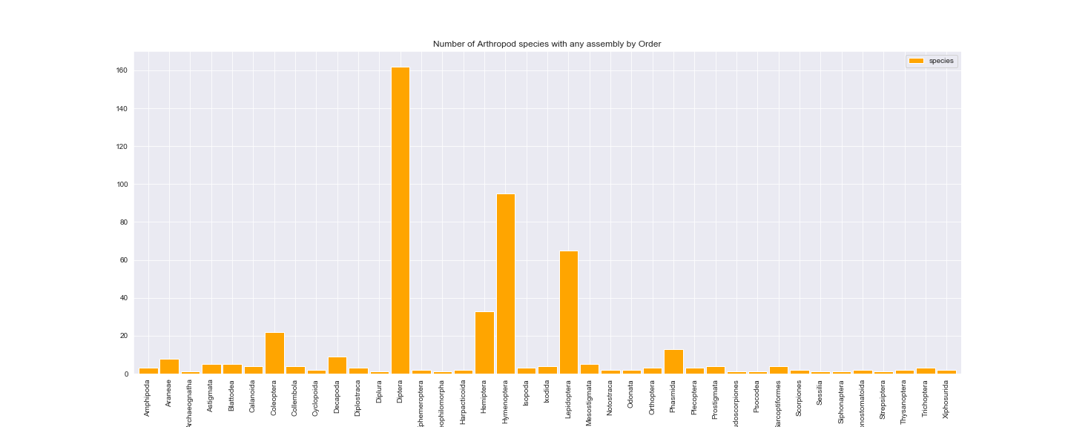
Which Genomes/Assemblies Do We Have?

Slide 13
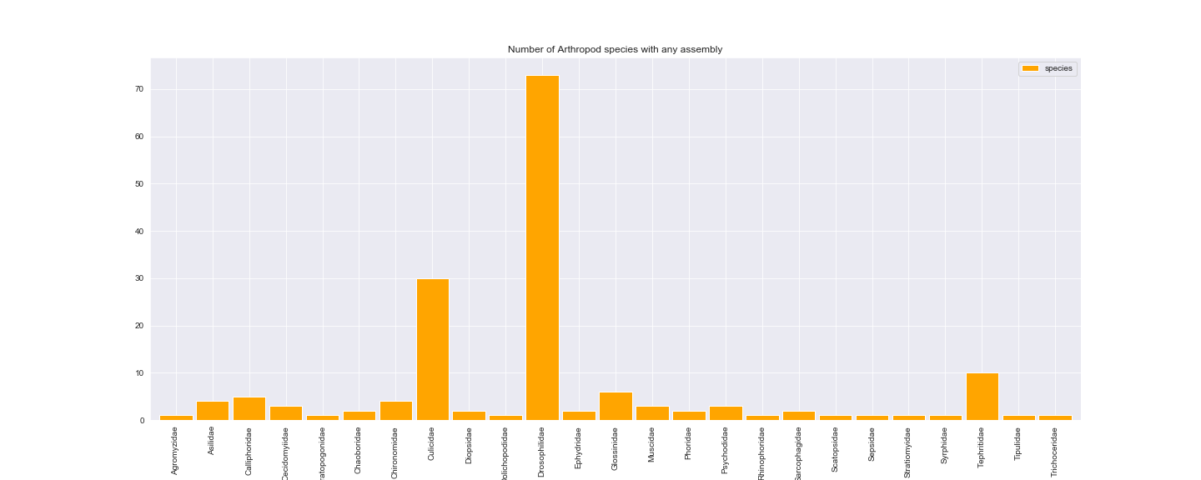
Which Genomes Do We Have? (Just Diptera)

Slide 14
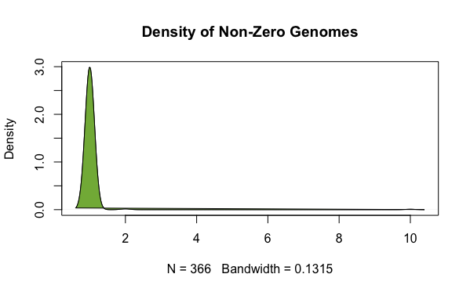
Which Genomes Do We Have?

Slide 15
Which (Arthropod) Species Do We Prioritize?

Slide 16
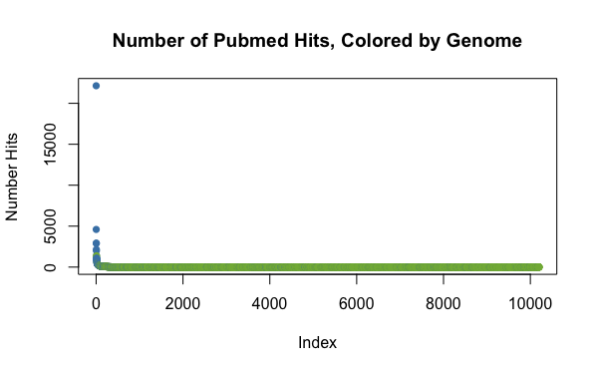
Which (Arthropod) Species Do We Prioritize?

Slide 17
Which (Arthropod) Species Do We Prioritize?
That being said, putting the caveat of type of work being done on arthropod…

Slide 18
What is the Quality of Current Genomes?

Slide 19
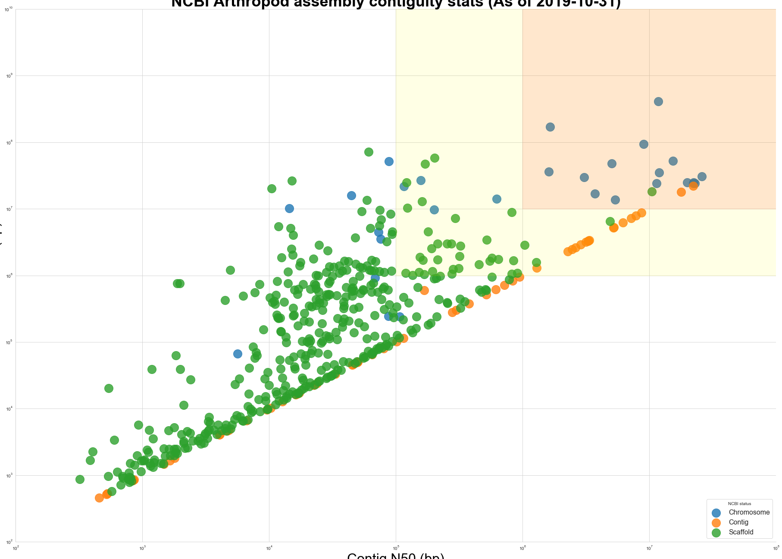
What is the Quality of Current Genomes?
NCBI Arthropod Assembly Stats (including 2019)
Scaffold n50
Contig n50

Slide 20
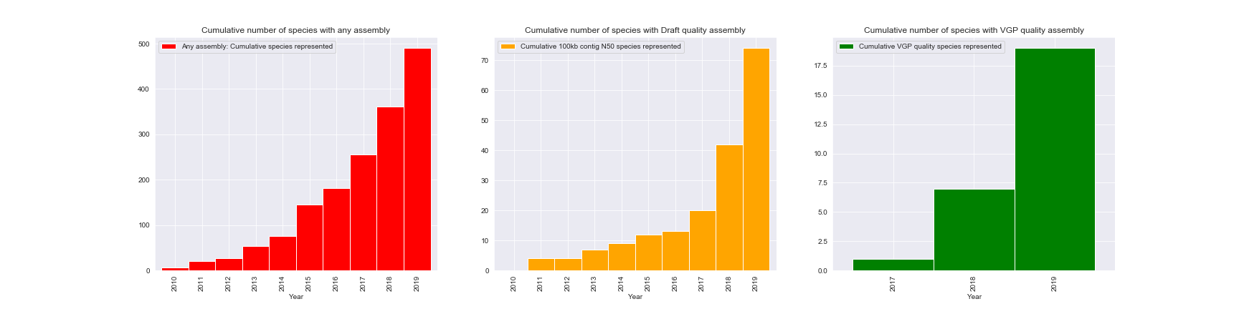
What is the Quality of Current Genomes?
Scaffold n50

