Slide 1
A Proposal for Computer-Assisted Assessment with Item Classification for Programming Skills
C. González-Sacristán, P. Molins-Ruano, F. Díez, P. Rodriguez and G. M. Sacha
@uam

Slide 2
Outline
INTRODUCTION
ASSESSMENT MODELS FOR PROGRAMING SKILLS
  Defining the item categories
  Model Description
  Numerical Simulations
COMPLETION TYPE TESTS IN PROGRAMMING SKILLS EVALUATION
  Description of the subject “Computer Methods”
  Completion type tests development
CONCLUSION AND FUTURE WORK

Slide 3
Introduction
Computer-assisted method to improve the quality of the assessment process for subjects related to basic programming.
Improvement of the objectiveness, taking into account the relevance of the subject contents.

Slide 4
Assessment for programing skills:
Item categories
Examples of basic programming questions ordered in three (significance, not difficulty)categories:
Level | Question
1 | - What does “compile” mean? - What is an algorithm?
2 | - How many bytes uses an array defined as char a[4]; in ANSI C? - What is the meaning of “segmentation fault”?
3 | - What is the objective of the Runge-Kutta Method? - What is the main characteristic of a recursive function?

Slide 5
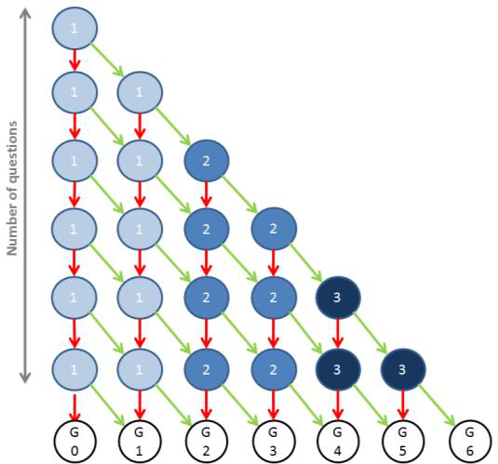
Assessment models for programing skills:
Model I description

Slide 6
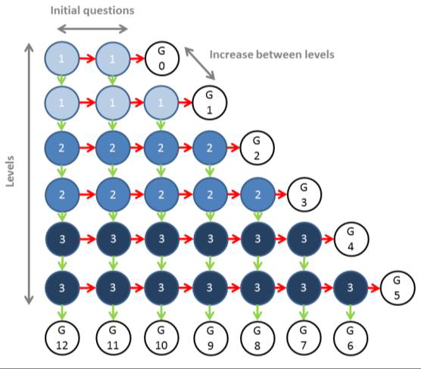
Assessment models for programing skills:
Model II description

Slide 7
Assessment models for programing skills:
Defining student profiles
Student | Test type | Level 1 | Level 2 | Level 3
Good | Completion | 90% | 80% | 70%
 | Multiple choice | 95% | 95% | 95%
Bad | Completion | 20% | 20% | 20%
 | Multiple choice | 33% | 33% | 33%
Direct | Completion | 90% | 50% | 10%
 | Multiple choice | 90% | 70% | 45%
Inverse | Completion | 10% | 50% | 90%
 | Multiple choice | 45% | 70% | 90%

Slide 8
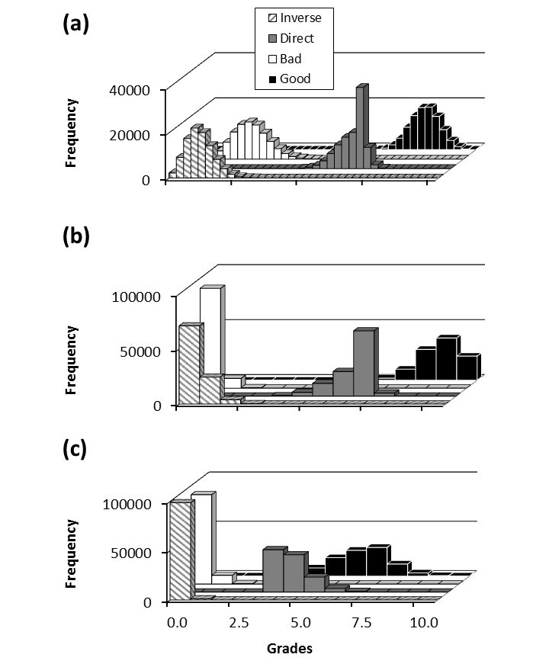
Assessment models for programing skills:
Numerical simulations (CT-MI: 10⁵ st)
Model 1,completion tests.
36 levels with 1 question per node.
12 levels with 2/3 correct answers per node.
12 levels with 3/3 correct answers per node.

Slide 9
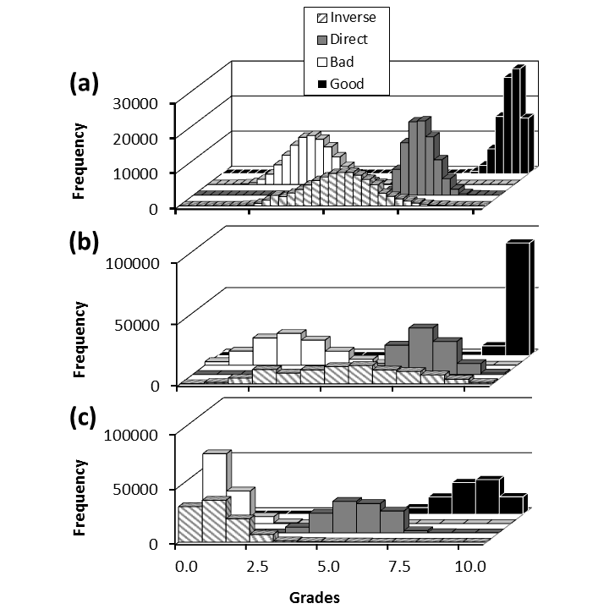
Assessment models for programing skills:
Numerical simulations (MCT- MI: 10⁵ st)
Model 1, multiple choice tests.
36 levels with 1 question per node.
12 levels with 2/3 correct answers per node.
12 levels with 3/3 correct answers per node.

Slide 10
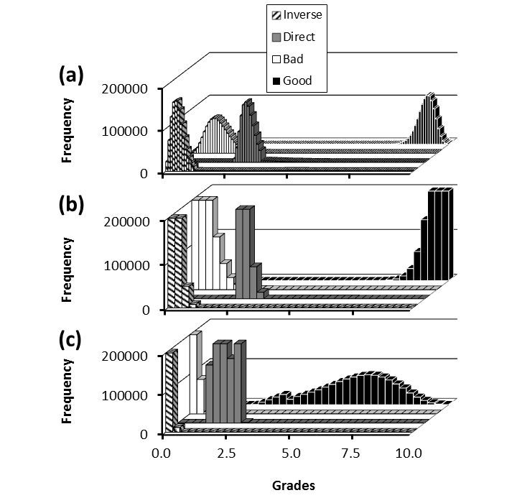
Assessment models for programing skills:
Numerical simulations (CT- MII: 10⁶ st)
Model 2,completion tests.
36 levels with 1 question per node.
12 levels with 2/3 correct answers per node.
12 levels with 3/3 correct answers per node.

Slide 11
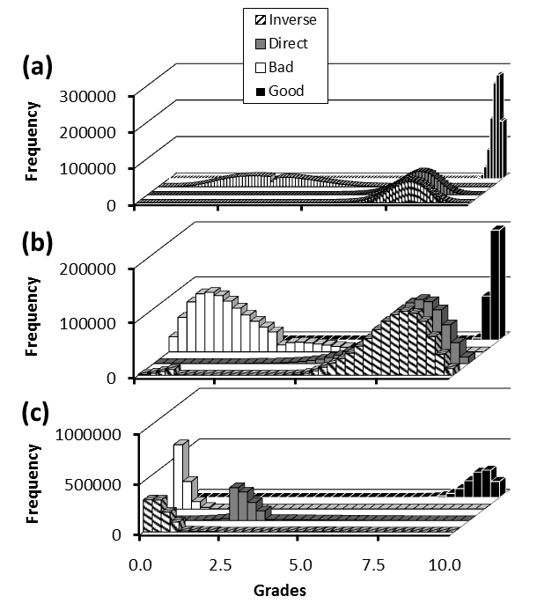
Assessment models for programing skills:
Numerical simulations (MCT- MII: 10⁶ st)
Model 2, multiple choice tests.
36 levels with 1 question per node.
12 levels with 2/3 correct answers per node.
12 levels with 3/3 correct answers per node.

Slide 12
Completion Tests in Programming Skills:
“Computer Methods”
Compulsory course in the 1st year of Chemical Engineering Bachelor Degree.
About 100 students took this course in the 2012/2013 academic year.
Mainly related to fundamentals of Computer Science and Computer Programming in Matlab language.
Taught through theoretical and practical lessons.

Slide 13
Completion Tests in Programming Skills:
Completion type tests development
Example of a question used in completion type tests:
“The following code calculates the definite integral of the function f(x)=cos(x) between -1 and 1, in 0.01 increments.
ini=-1;
fin=1;
inc=0.01;
inte=0;
for x=ini:inc:fin
inte=inte+cos(x+inc/2);
end
inte=inte*inc;
disp(inte)
This algorithm must be modified so as to use the function f(x)=x² between 10 and 11, in 0.5 increments.
Answer:______”

Slide 14
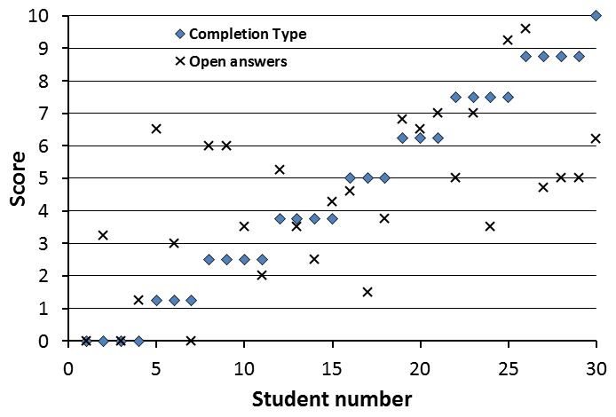
COMPLETION TYPE TESTS IN PROGRAMMING SKILLS EVALUATION
Completion type tests development
PONER NUMEROS PARA CORRELACION

Slide 15
CONCLUSION AND FUTURE WORK
Results from this work can be directly used in computer-assisted tests for different subjects and disciplines.
Some self-evaluation tools can be developed to be used by the students with the objective of correcting their deficiencies in the learning process

