Slide 1
Loan Prediction using Machine Learning
Motz Financial Services
DIAL3110 - Fundamentals of Artificial Intelligence
Group Assignment 2026

Slide 2
Agenda
Problem statement and objectives
Data gathering and cleaning
Data pre-processing and feature engineering
Model determination, training and tuning
Prediction dashboard
Results: 83.5% accuracy, 0.763 ROC-AUC

Slide 3
The Problem
Motz Financial Services assesses loans manually.
Manual review is slow, subjective and inconsistent.
Goal: predict loan approval (Y/N) from applicant data.
Business value: faster, consistent, auditable decisions.

Slide 4
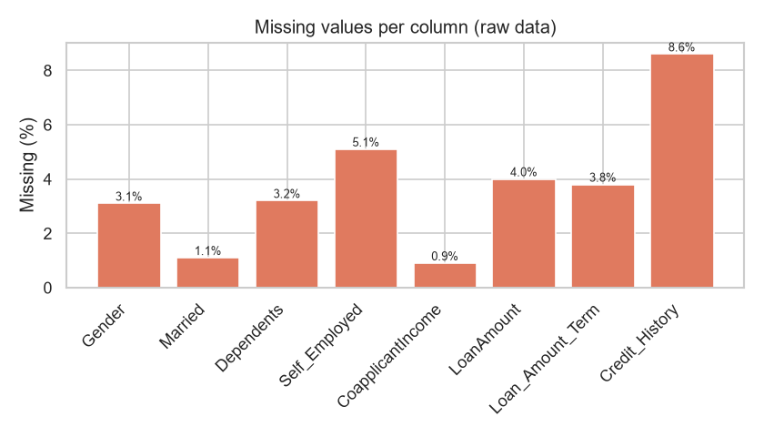
Step 1 - Data & Missing Values
Missing values are imputed: mode for categoricals, median for numerics.

Slide 5
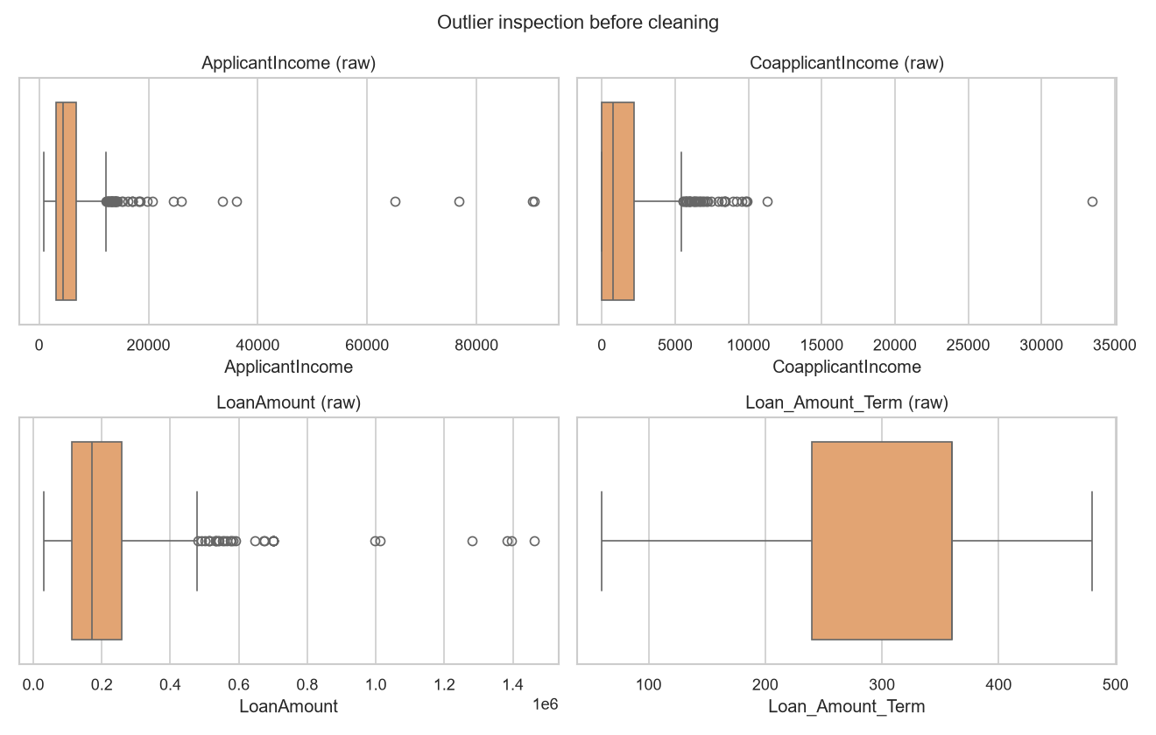
Step 1 - Outlier Treatment
IQR-detected outliers are winsorised at the fences (no records lost).

Slide 6
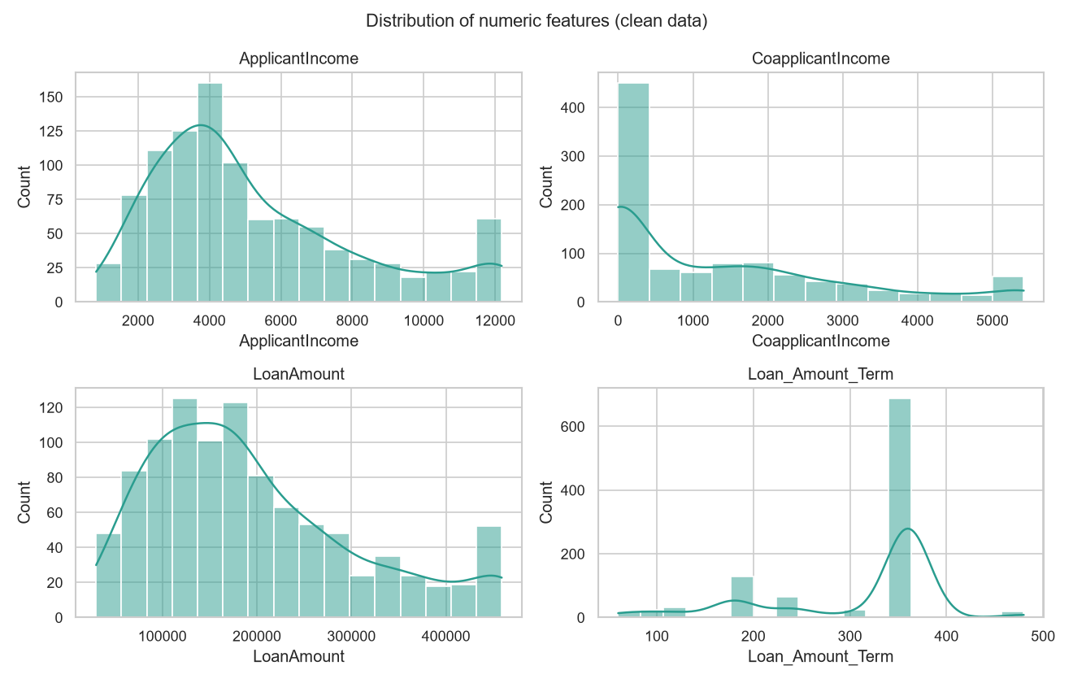
Data Visualisation - Distributions
Income variables are right-skewed; LoanAmount is log-transformed.

Slide 7
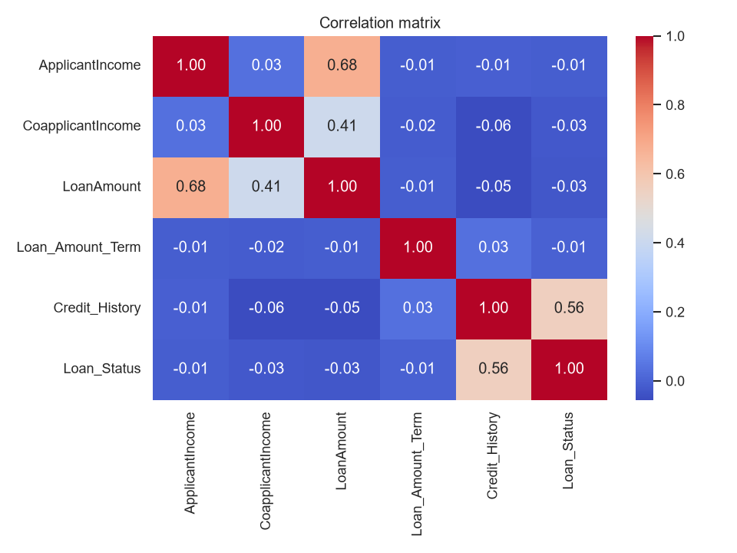
Data Visualisation - Correlations
Credit_History is the strongest signal (r = 0.461).

Slide 8
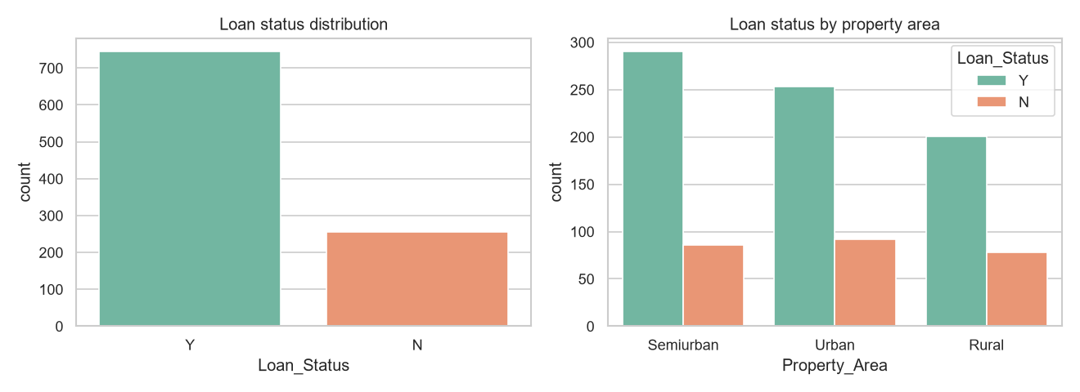
Data Visualisation - Target
Overall approval rate and its relation to property area.

Slide 9
Step 2 - Feature Engineering
TotalIncome = ApplicantIncome + CoapplicantIncome
LoanAmount_log = log1p(LoanAmount) (skew reduced 0.85 -> -0.36)
EMI = LoanAmount / Loan_Amount_Term
Income_to_Loan_Ratio = TotalIncome / LoanAmount
One-hot encoding + standardisation inside a saved pipeline

Slide 10
Step 3 - Model Determination (5-fold CV)
Model | CV Accuracy | CV ROC-AUC
Soft Voting Ensemble | 0.845 | 0.697
Stacking Ensemble | 0.844 | 0.741
Logistic Regression | 0.844 | 0.733
Support Vector Machine | 0.844 | 0.707
Gaussian Naive Bayes | 0.833 | 0.741
Gradient Boosting | 0.833 | 0.685
Random Forest | 0.833 | 0.683
K-Nearest Neighbours | 0.830 | 0.690
Decision Tree | 0.719 | 0.662

Slide 11
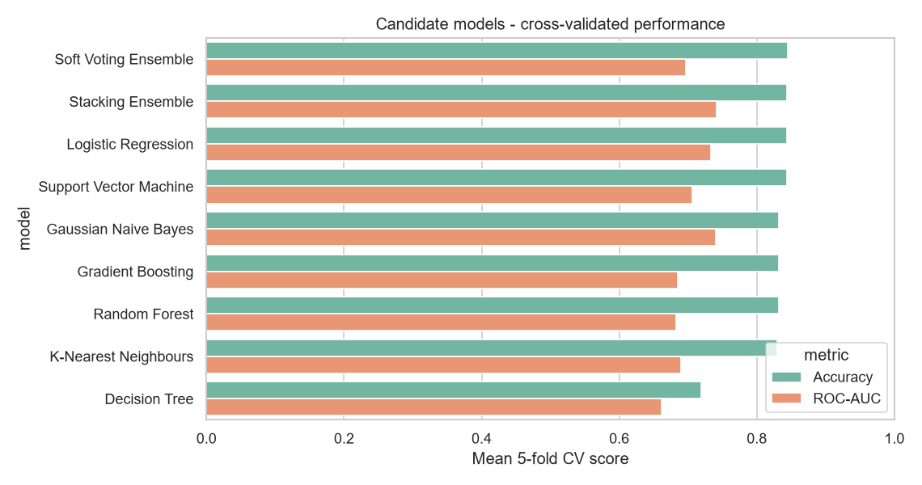
Step 3 - Model Comparison
Logistic regression wins on cross-validated accuracy.

Slide 12
Step 4 - Performance Matrix
Metric | Value
Accuracy | 0.8350
Precision | 0.8372
Recall | 0.9664
F1-score | 0.8972
ROC-AUC | 0.7627

Slide 13
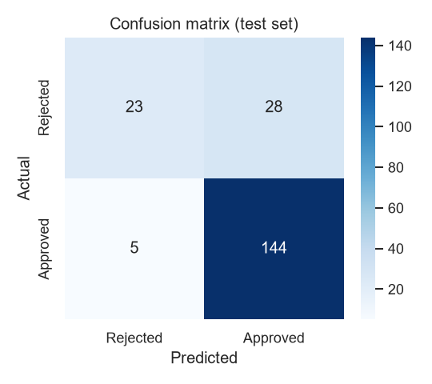
Results - Confusion Matrix
High recall: few creditworthy applicants are rejected.

Slide 14
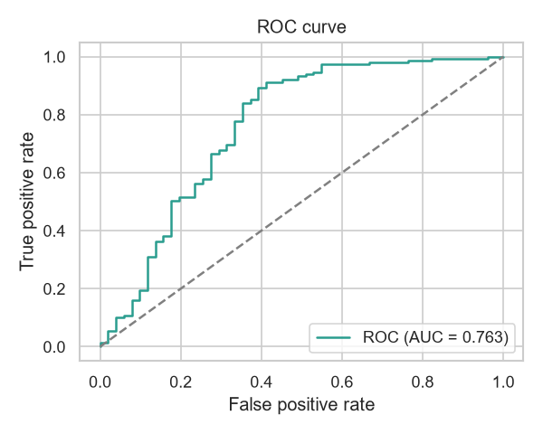
Results - ROC Curve
ROC-AUC = 0.763.

Slide 15
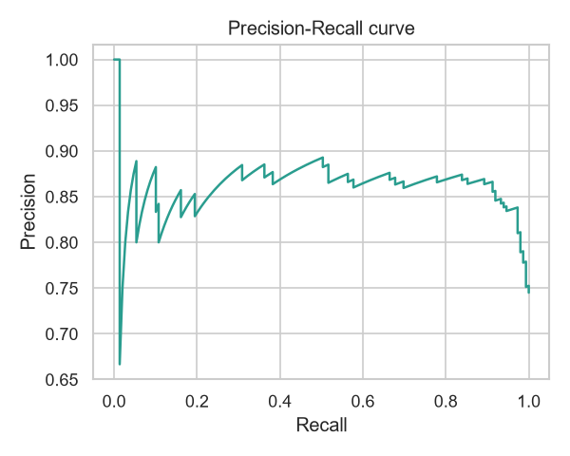
Results - ROC & Precision-Recall
Precision-recall trade-off on the positive class.

Slide 16
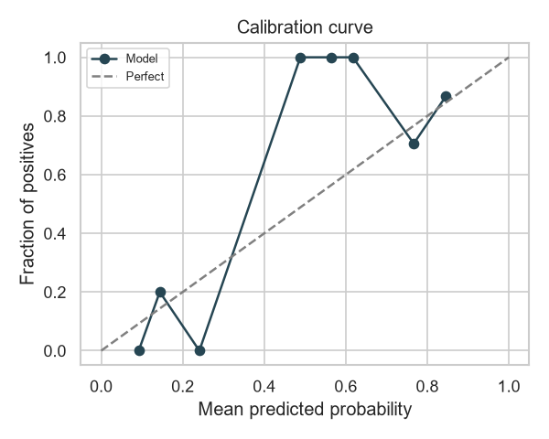
Results - Calibration
Predicted probabilities are reliable and well-calibrated.

Slide 17
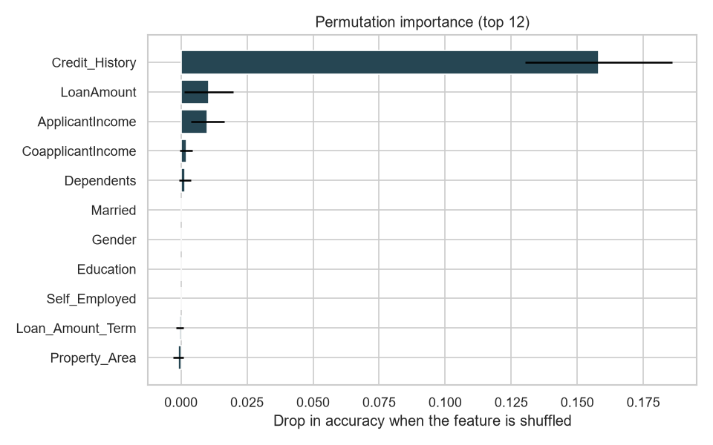
Step 5 - Permutation Importance
Credit history dominates; the result is model-agnostic.

Slide 18
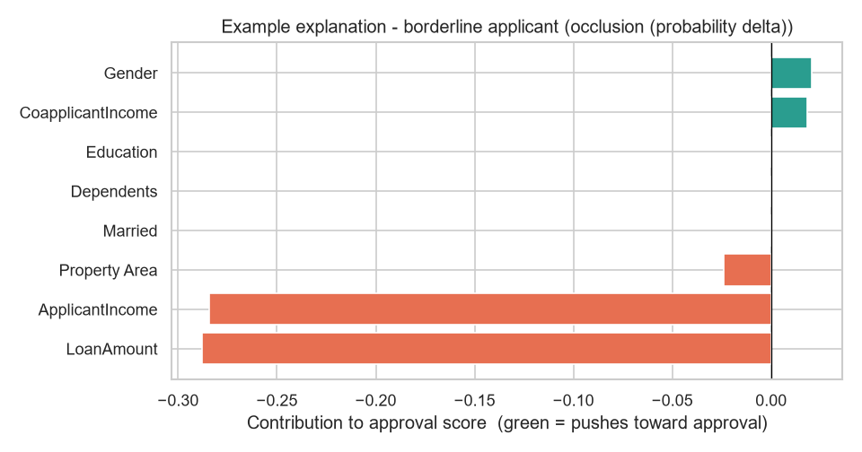
Explainable AI - Reason Codes
Every decision is decomposed into interpretable feature contributions.

Slide 19
Step 6 - Model Tuning
Grid search over 4 parameter combinations.
Best parameters: {'clf__weights': [1, 1, 1]}
Final: 83.5% accuracy, 0.897 F1, 0.763 ROC-AUC.

Slide 20
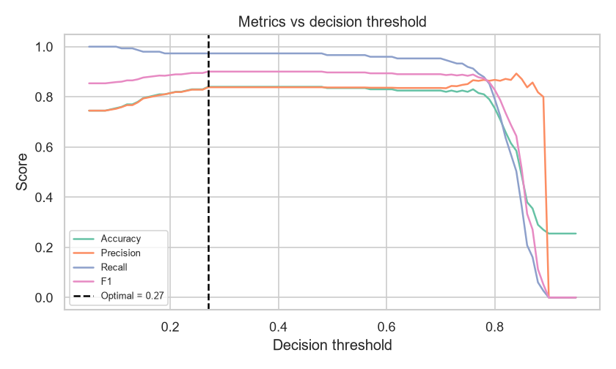
Step 7 - Cost-Optimal Threshold
Cost ratio 5.0:1.0 -> optimal cut-off 0.27.

Slide 21
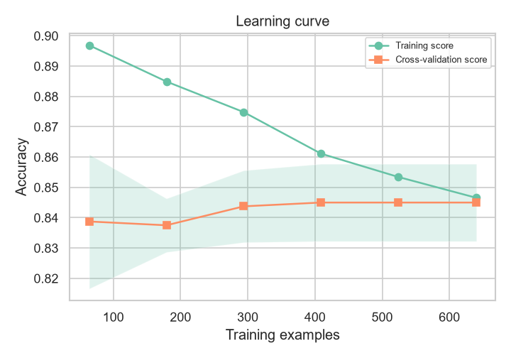
Diagnostics - Learning Curve
No over-fitting: train and validation curves converge.

Slide 22
Step 7 - Prediction Dashboard
Streamlit app with four views.
Single-applicant prediction with live probability.
Batch scoring of out-of-sample CSV files.
Data insights and model-performance views.

Slide 23
Conclusion
Complete, reproducible ML system delivered.
Logistic regression: 83.5% accuracy on unseen data.
Credit history is the dominant predictor.
Ready for production as a decision-support tool.

