Slide 1

JIRA Recommending System based on NLP
Nov 22, 2022
Kumar Zhang

Slide 2
Introduction
Solution:
The similarity method that will be used to calculate the similarities between the embeddings. -- Cosine Similarity
The algorithm that will be used to transform the text into an embedding, which is a form to represent the text in a vector space. -- Doc2Vec
Pros:
1. Hyper parameters tuned to get better performance.
2. Feedback collection & consideration to improve the accuracy.
3. Easily deployed.
4. Easily adapt to other JIRA projects

Slide 3
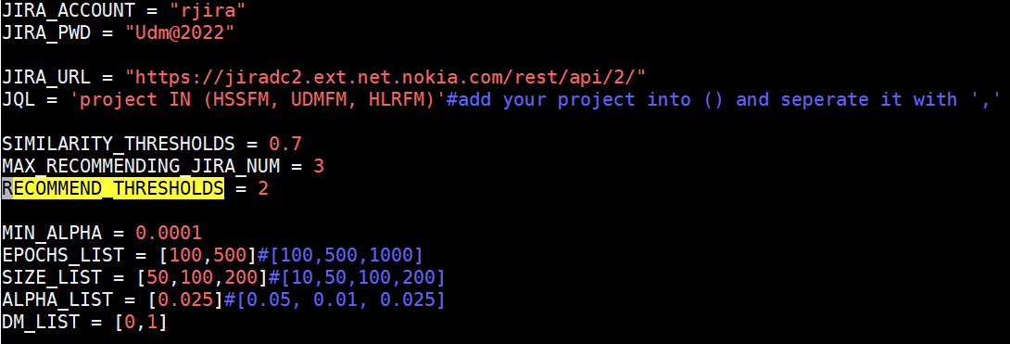
Configuration Settings

Slide 4
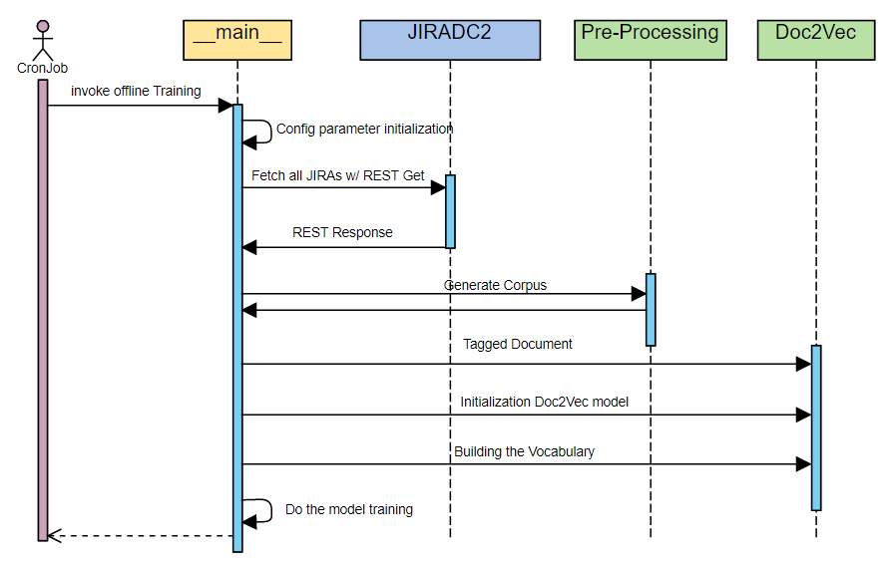
Flow of model training

Slide 5
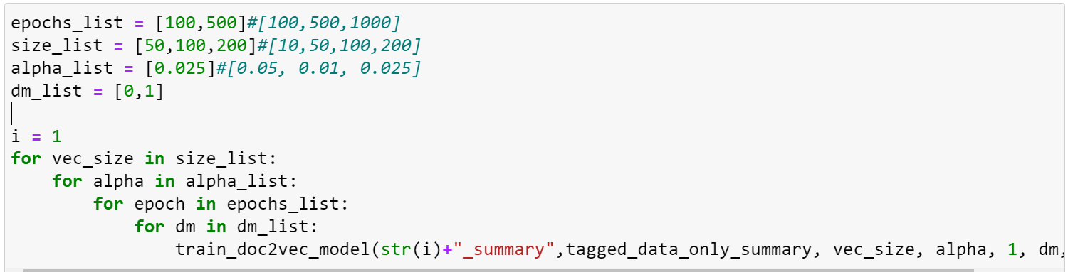
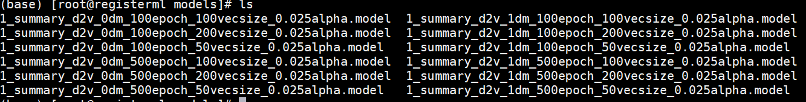
Hyper Parameters tuning

Slide 6
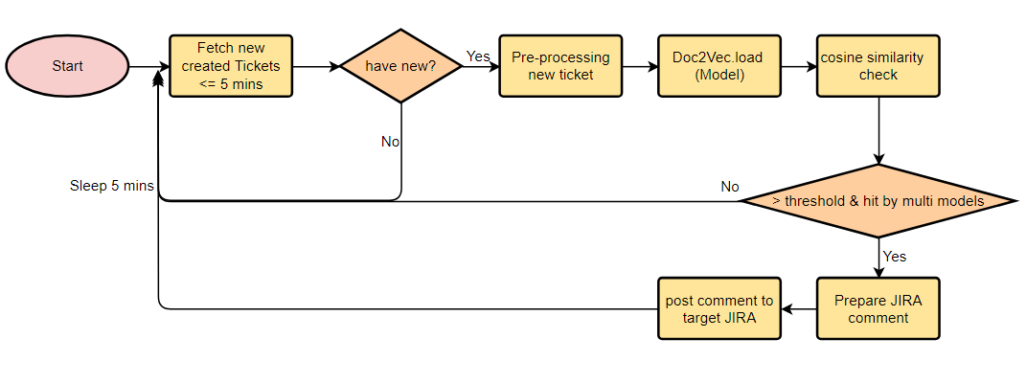
Tickets Recommending Procedure

Slide 7
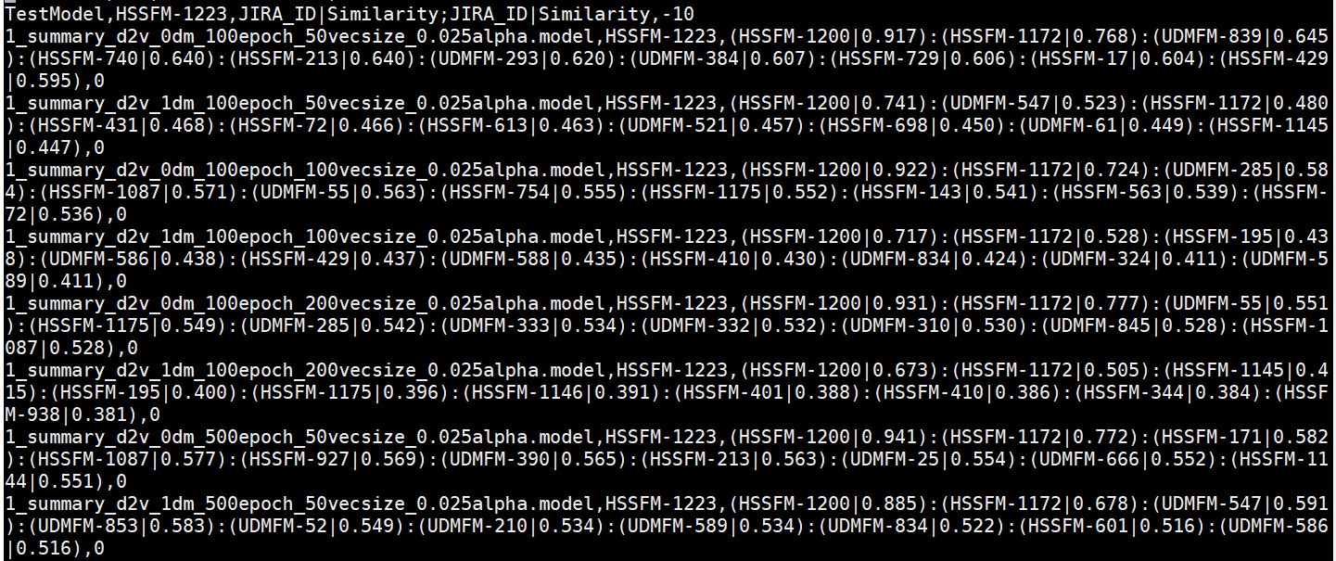
Tickets recommending

Slide 8
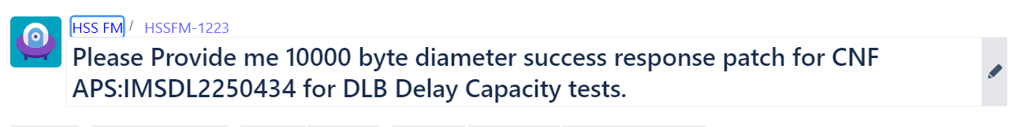
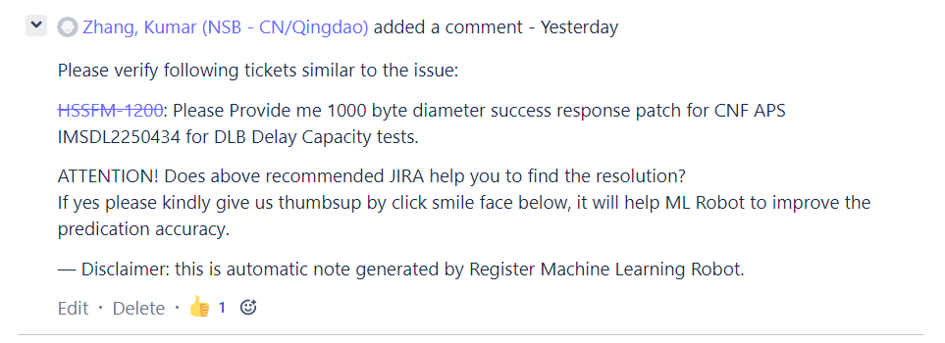
Tickets recommending

Slide 9
Demo

Slide 10
Next step --
How to improve accuracy?
Continuously collect user’s feedback and tune the hyper parameters
Introducing expert system as supplement to define keyword vocabulary to help the similarity calculate

Slide 11
Backup

Slide 12
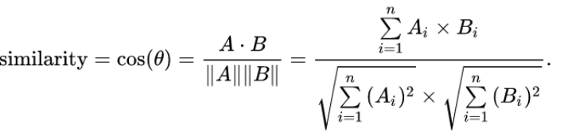
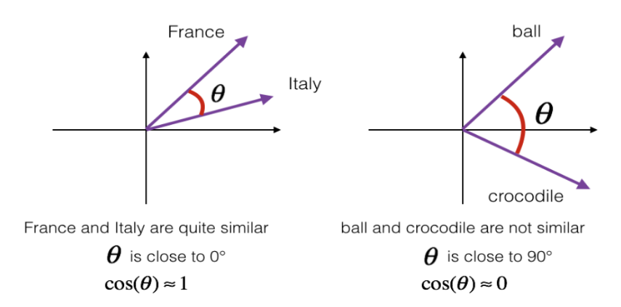
Cosine Similarity

Slide 13
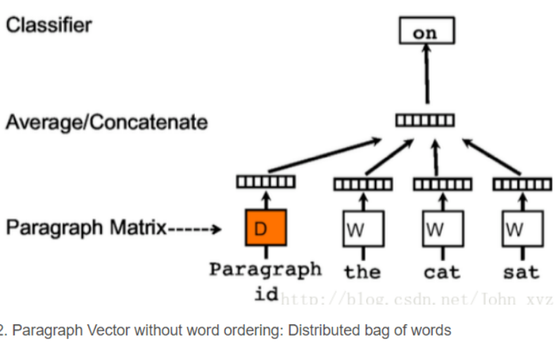
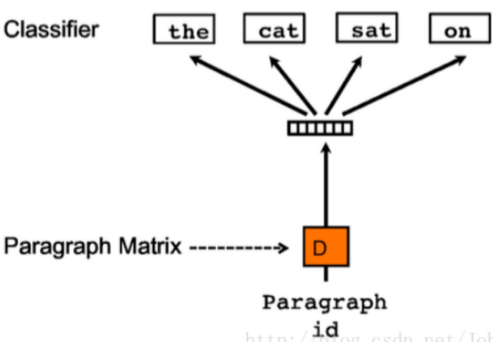
Doc2Vec

