Slide 1



Philadelphia Eagles Organization Database
By Matthew Olivo

Slide 2
What is my Database
A full catalog of all available historical personnel and players records
Ability to use all CRUD operations on database
Simple Python with a Mysql backend

Slide 3
Why I picked this topic
I love the Philadelphia Eagles
I love the NFL
I love looking at the history of the NFL

Slide 4
Problem
There are a lot of databases out there that track players stats and team history.
Far fewer that look at history of team executives and owner ship
Tracking all the coaches that pass through an organization is almost never done.

Slide 5
Why my Database is the solution
While not perfect, my database has completeness of comprehensive online opensource databases
Mixed with the ability to look at advanced views and the added functionality of adding and deleting custom records

Slide 6
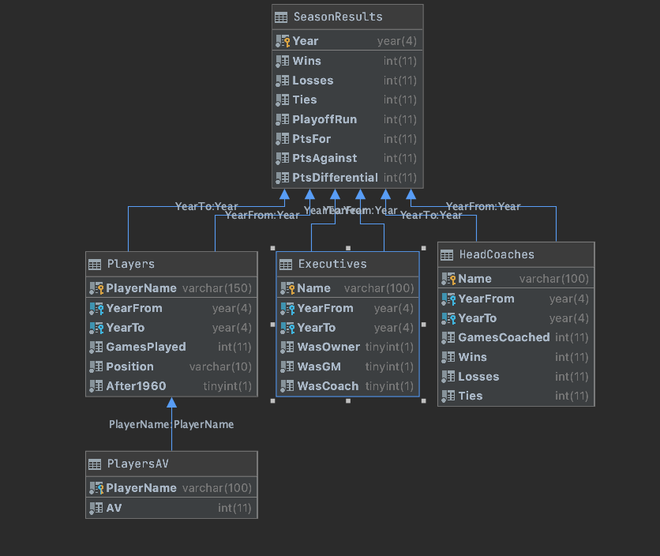
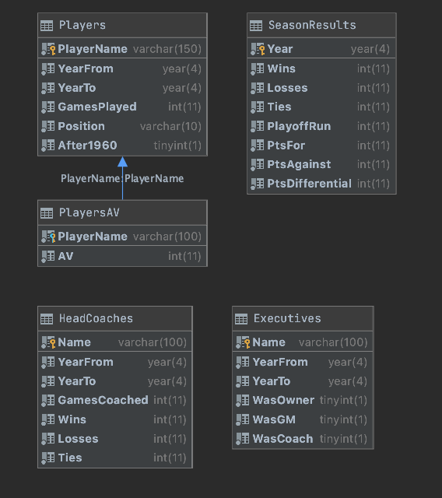

Schema(s)
z

Slide 7
Demo

