Slide 1
ASP.NET Today and Tomorrow
Scott Hunter
Principal Group Program Manager, App Plat
@coolcsh

Slide 2
dotnetConf
Virtual conference Microsoft/Community driven
July 25-26: Microsoft
TBD 2014:
.NET Core (Compilers, Languages, Runtime)
.NET Client / Device
.NET Server / Cloud
Community and Product Teams

Slide 3
History of ASP (18 years)
1996 - Active Server Pages (ASP)
2002 – ASP.NET
2008 – ASP.NET MVC
2010 – ASP.NET Web Pages
2012 – ASP.NET Web API, SignalR
2014 – ASP.NET vNext

Slide 4
What is Modern Web?
Web Frameworks:
Mobile / Tablet First
Responsive Design
Client Frameworks
Cloud Ready
Cross Platform
Web Tooling
Standards Based
Tooling in Browser
Open Tooling
Grunt / Bower

Slide 5


ASP.NET vNext and the Modern Web
Totally Modular
Faster Development Cycle
Seamless transition from on-premises to cloud
Choose your Editors
and Tools
Open Source with Contributions
OSS
Cross-Platform
Fast

Slide 6

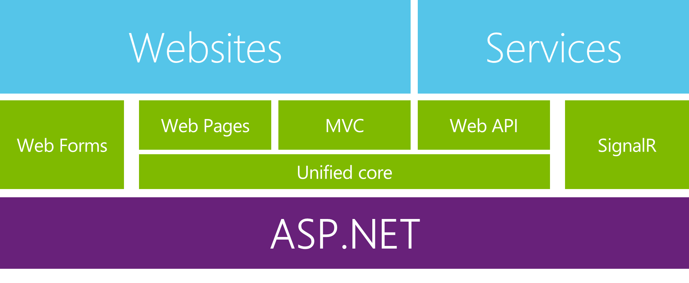
Enabling the Modern Web and Cloud
Extending Application Types
Enterprise LOB on Web
Enterprise LOB desktop apps with web backend
Modern Web applications
Common Improvements
Consistency
Modularization
Tracing & Diagnostics
Dependency Injection
Familiar frameworks
Notes:
MVC + Web API
Bootstrap + Angular.js

Slide 7
Modern Web – Agility
Faster Development Cycle
Features are shipped as packages
Framework ships as part of the application
More Control
Zero day security bugs patched by Microsoft
Same code runs in development and production
Developer opts into new versions, allowing breaking changes

Slide 8
Modern Web - Fast
Runtime Performance
Faster startup times
Lower memory / higher density (> 90% reduction)
Modular, opt into just features needed
Use a raw socket, framework or both
Development productivity and low friction
Edit code and refresh browser
Flexibility of dynamic environment with the power of .NET
Develop with Visual Studio, third party and cloud editors

Slide 9
Modern Web – Cloud
Seamless transition from on-premises to cloud
Cloud ready
Configuration
Session
Cache
Diagnostics
Run/Debug in Cloud
Tracing/Logging without re-deploy

Slide 10
Modern Web – Cross Platform
Runtime
Windows, Mac, Linux
Editors
Visual Studio, Text, Cloud editors
No editors (command line)
OSS
Open Source with Contributions
Notes:
Browser Link

Slide 11
ASP.NET vNext - Summary
MVC, Web API, Web Pages 6, SignalR 3, EF 7
Feature | .NET vNext | .NET vNext (Cloud Optimized)
Cloud Ready | * | *
Modular Design | * | *
Dependency Injection | * | *
Consistent Tracing / Debugging | * | *
Faster Development (No Build Step) | * | *
Open Source | * | *
Full Side by Side (framework deployed inside application) |  | *
Fast startup, Low memory / High throughput (best of class) |  | *

Slide 12
ASP.NET vNext - Compatibility
Web Forms, MVC 5, Web API 2, Web Pages 3, SignalR 2, EF 6
Fully supported on .NET vNext
MVC, Web API, Web Pages 6, SignalR 3, EF 7
Breaking changes:
New project system
New configuration system
MVC / Web API / Web Pages merge
No System.Web, new lightweight HttpContext (not System.Net.Http)
.NET vNext (Cloud Optimized)
Subset of the .NET vNext Framework
Things you depend on might not be available yet (images, etc)

Slide 13

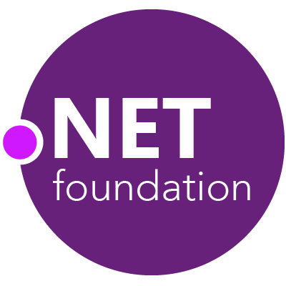
Future of .NET
.NETvNext
Openness
Client apps
Web and services
Windows Store, WPF, Windows Forms,
Console apps and related libraries.
ASP.NET vNext: Web Forms, MVC, Web Pages, Web API, SignalR
WCF
Multi-purpose
Device optimized
Native compilation
Small footprint, side-by-side
Cross-device enabled
Cloud optimized
High throughput
Small footprint, side-by-side
Cross-platform enabled
Specialized
Common
Runtime
Compilers
Libraries
Next gen JIT (“RyuJIT”)
SIMD (Data Parallelization)
.NET Compiler Platform (“Roslyn”)
Languages innovation
BCL and PCL
Entity Framework
Notes:
[3 min]
No time for ROSLYN/RUNTIME slides/demos
Mention that we focused on that at //BUILD.
But focus on the Common .NET subjects as talking points
Finalize with Openness and the .NET foundation

Slide 14



Summary
Providing the best end-to-end development experience…
…on your terms
Platform
Framework
Tools
…or bring your own
…or bring your own
…or bring your own
Notes:
(30 sec)
[3 minutes until this slide, including it]
This slide must be used to reinforce the role of .NET in our platform, which is open for developers to bring their preferred frameworks and tools but also provides the best end-to-end experience with .NET, Visual Studio, Azure and Windows.
Talking points:
Microsoft provides the best end to end development experience based on our Cloud and operating systems (Microsoft Azure and Windows), our mainstream development platform (.NET) and the best development tooling in the planet (Visual Studio).
But, we recognize that we live in a world with a heterogeneous technology context, so our platforms and tools are open and ready to be integrated with your own devices (like based on iOS and Android), other development platforms (like Java, Objective C, Node.JS) and their related tooling (Eclipse, Xcode, etc.).
But, we want to reinforce the strategic position of the .NET ecosystem, including .NET partners, as part of the Microsoft end to end development experience.
Let me tell you what is the current status of .NET (go to next slide)…

Slide 15
dotnetConf Day 2 - Web
9:30 – 10: ASP.NET Web Forms
10:00 – 11:00: ASP.NET MVC 6
11:00 – 12:00: Entity Framework
12:00 – 1:00: Azure Web Sites
1:00 – 2:00: ASP.NET Publishing
2:00 – 3:00: Identity
3:00 – 4:00: Dependency Injection
4:00 – 4:30: SignalR
4:30 – 5:00: ASP.NET vNext

