Slide 1

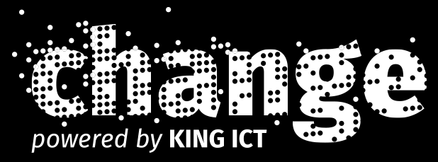
Waaaay to short intro to Xamarin
Miljenko Cvjetko (mel, moljac)

Slide 3
Thank you for the invite!

