Slide 1
CompressPro

Slide 2
Prepared By
Md. Nasim Molla
MUH2025024M
Year-03, Term – 01
Supervised By
MD. Eusha Kadir
Lecturer
Institute of Information Technology
Noakhali Science and Technology University
15/06/2023 CompressPro 02

Slide 3
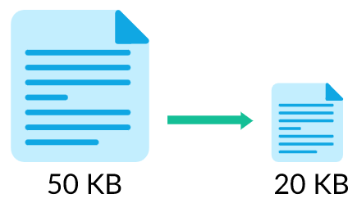
INTRODUCTION
CompressPro is the software project that’s aim to reducing the size of a file by encoding its data in a more efficient way, without losing any of the original data. The compressed file takes up less space than the original file, which can be useful for storing, transmitting, or archiving large files. The process of restoring the compressed file to its original size and format is called decompression. This is the another aim of CompressPro.
File compression is achieved by using compression algorithms.
15/05/2022 CompressPro 3

Slide 4
Objective
Implement 4 compression and decompression algorithm. Like:-
Provide facility to choose efficient algorithm for compressing and decompressing different type of file.
Solve extra memory issue
Transmit data more faster without losing the original quality of data
Huffman coding
Lzw
LZ77
Gzip
15/06/2022 CompressPro 4

Slide 5
Problem Statement
File Format Handling: PDF, text, Word documents, and various image formats JPEG, PNG, or GIF.
Compression Algorithms: Research and select appropriate compression algorithms based on the file formats being handled.
Compression Ratio and Speed: Strive to achieve a high compression ratio, i.e., a significant reduction in file size, while balancing the computational resources required and the speed of compression.
Performance and Scalability: Consider the performance and scalability aspects of the project.
15/06/2022 CompressPro 5

Slide 6
Project Scope
Project objectives: Clearly stated goals and objectives that the project aims to achieve.
Deliverables: The tangible outcomes or results that will be produced by the project.
Boundaries: The limits or boundaries of the project, specifying what is included and excluded.
Assumptions: Key assumptions made about the project, including any constraints or dependencies.
Constraints: Limitations or restrictions that may impact the project, such as budget, time, or resources.
15/06/2022 CompressPro 6

Slide 7
Stake Holders
Project Supervisor, Data Scientist / Algorithm Developers, Data Analyst. Software Engineers/Developers Quality Assurance/Testers: Students. Computer / Internet user
25/06/2022 CompressPro 7

Slide 8
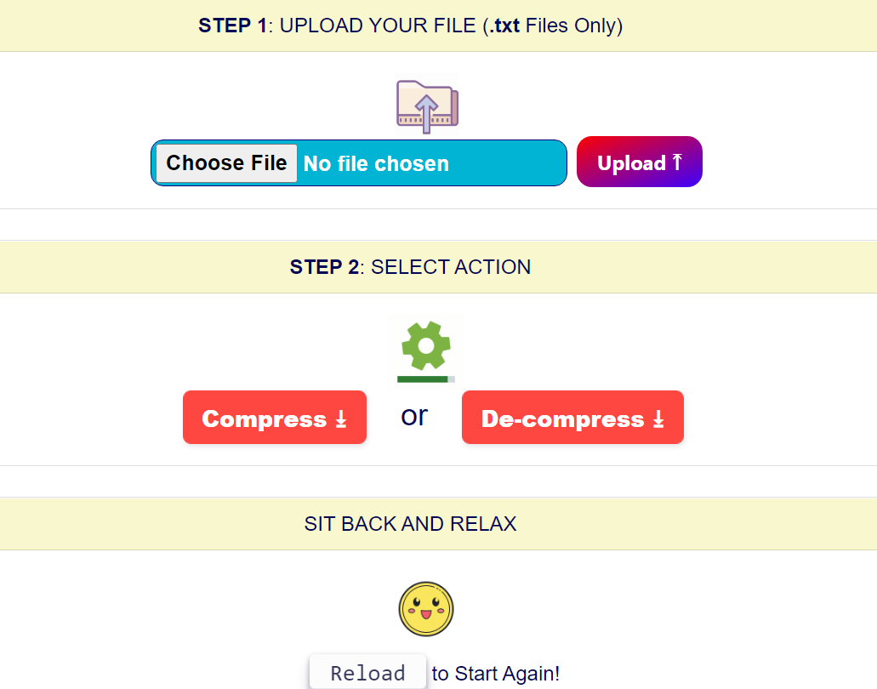
System Design
15/06/2022 CompressPro 8

Slide 9

15/06/2022 CompressPro 9

Slide 10


